Slide 2
http://mediamatters.org/blog/2012/08/09/today-in-dishonest-fox-charts-government-aid-ed/189223

Slide 3
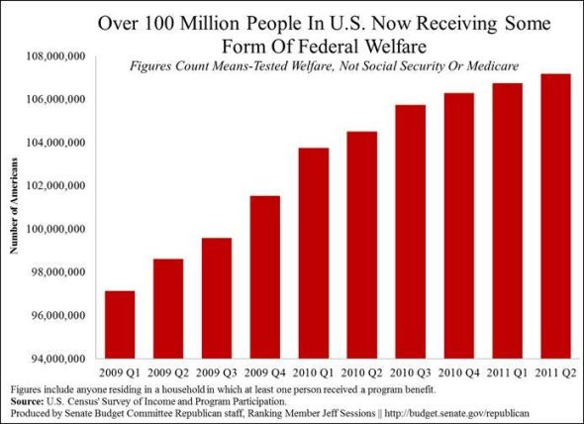
http://simplystatistics.org/2012/11/26/the-statisticians-at-fox-news-use-classic-and-novel-graphical-techniques-to-lead-with-data/

Slide 4
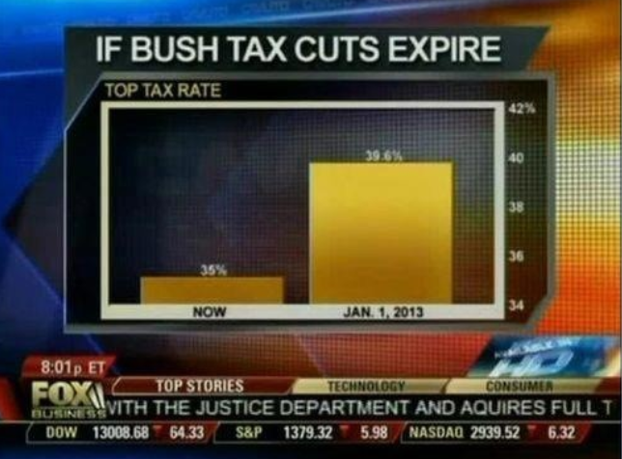

Slide 5
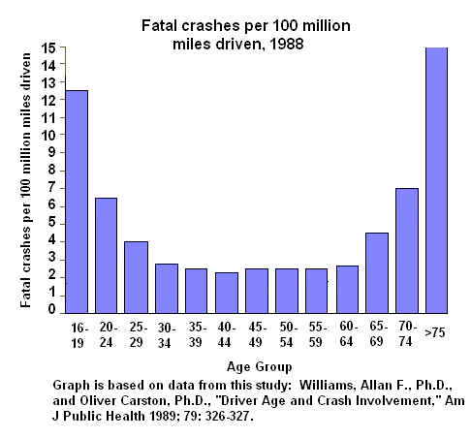
http://www.econoclass.com/misleadingstats.html

Slide 6
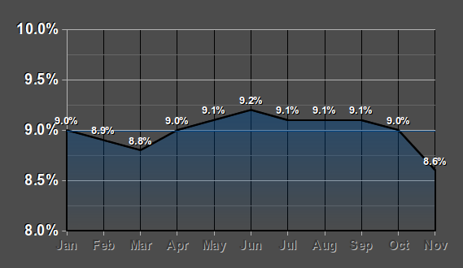

Slide 7
