Slide 1
Global Media Industries
Week 2

Slide 2
Globalization & Media Industries
https://www.youtube.com/watch?v=3i4IWfuxw-U

Slide 3
INDUSTRIES
Modern Western Civilization
Science. Massification. Quantification
Industrial Revolution
Technologies & Mass Production
Mass Consumption: Standardization

Slide 4
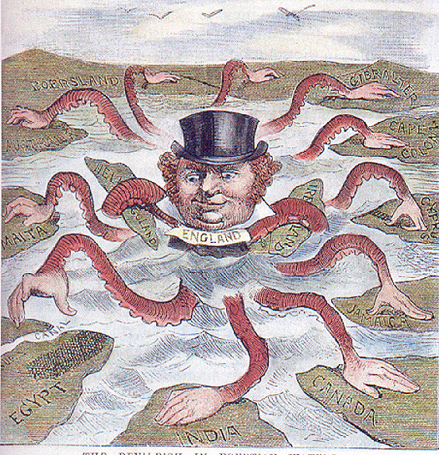
Globalized Western Civilization
Rapid economic development in Europe and the US
They began to see colonies as:
Markets for goods
Sources for raw materials
Movement from mercantilism to imperialism
Cultural Impacts
Christianity was introduced
Linguistic Hegemony: English, French..
Mass education: Western science
Family structure: Small, Division of labor, Individualism
Nationalism: Central Politics, Territoriality, Public Communication

Slide 5
Global Industrialization
Mass Circulation: Electronic media and Mechanical Reproduction
Conflicts in a global scale
Multi-Channel Media & Educated Public & the end of Cause and Effect
Globalization & Network Society
Conglomeration & Market Expansion

Slide 6
INDUSTRIES
Media is as an early indicator of how industries adopting changes in industry structure and consumer behavior resulting from new technologies
Mail-Order -> TV Home Shopping → Online Shopping ⬄ Retail industries & Logistics
Computer & Smartphone ⬄ Print products, Coffee consumptions, Tourism

Slide 7
Production
Content Creation: Original Developments
Production: Producing end-products
Whose investment: Global Conglomeration – Warner, Disney, Sony & Regional Conglomeration
Global Division of Labor
Japanese Animation: Japanese Creators+ Chinese Animators + American Distributors
Global outsourcing structure
Creative class = Freelancing labor => Flexible labor => Precarious class
Promotion: Reaching Consumers

Slide 8
Distribution
Technological Integration
Vertical-Horizontal Monopoly: I distribute what I produce. You consume.
From Multiplex to Netflix -> Disney vs Apple vs Google
Amazon: Buy and Watch
Public TV in the age of Internet: BBC online for free? Battle over VPN
News Curation: Who sets the agenda?

Slide 9
CONSUMPTION
Production-Distribution-CONSUMPTION
Symbolic Capital & Cultural Taste
Smart Phones, High-end Headphones, OLED TVs, Smart Watches, Electronic Cars, VR
Demand generated by supply (backed by low income workers)
& Digital Wastes go into the third world
Global Polarization

Slide 10
MEDIA INDUSTRIES
Media Conglomeration: Horizontal – Vertical Integration
Corporate Voice
Avoid “Serious” Controversies
Promote “Soft” Controversies
(In)Direct Voice
Public Sphere & Information Capital
Public Decision & Necessary Information & Information Dependence
New Media: Utopia vs Dystopia
Public vs Private
Free Press vs Regulation

