Slide 1
World Media Systems
Week 3

Slide 2
What does globalization mean to you?
Do you think people, countries, and regions of the world are growing closer together or moving further apart? In what ways?
What factors are causing the world to come closer together or to move further apart?
What is the role of travel, communication technology, media companies, and audience media use in bringing the world closer together or moving it farther apart?
What groups of people from which countries or regions might be dissatisfied with or concerned about the way in which media affect the world coming closer together or moving farther apart? What do you think their concerns are?

Slide 3
Globalization
A modern and old phenomenon
A kind of worldwide climate in which people industries, governments and countries across the world are being propelled into closer political, economic, and cultural unions
- Leading impetus is corporate profit-making initiative
  - Has fostered the creation of an acting supranational governance network (UN, WTO, IMF, ITU, etc.)

Slide 4
Four Factors Stimulating Globalization
International Travel
  Increases knowledge and interaction
  Stimulates industries and options
Communication Technologies
  Facilitates communication across boundaries and borders
  Stimulates corporate growth globally
Global Media Conglomerates
  A giant parent corporation (i.e. a very complex organization) that maintains an extended reach (i.e. operating transnationally) and presides over an amalgamation of subsidiaries with decentralized value system.
  Challenging conceptions of nationality as it pertains to self-identity
    ‘Country’ still important as unit for understanding media and its usage
Audience Curiosity (regarding other parts of the world)
  Engaging foreign media content means acquiring the will, taste, skills, and sensitivity to do so

Slide 5
Criticisms of Globalization
Homogenization of Media
Unfairness in Global Information Flow
Spread of Cultural Imperialism

Slide 6
What does the term system mean to you?
What qualifies something as a system?
What is a particular system that affects your life? What are the basic elements of that system?
How do the elements of the system relate to each other? How do the elements help the system to function?

Slide 7
Elements of a Media System
Cultural Characteristics
Philosophies for Media Systems
Regulation of Media
Financing of Media
Accessibility of Media
Media Content
News Reporting
Media Imports and Exports
Media Audiences

Slide 8
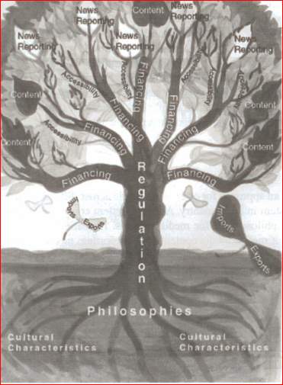

Slide 9
The Changing Media
Merging Technologies/Merging Industries
  digital, interactive, asynchronous, quality, convergence, etc.
Evolving regulation, evolving lifestyles
  Narrowcasting, produsers (participative features of social media)
Technological Determinism vs. Cultural Determinism
Political Economy and Cultural Studies

Slide 10
Theory of relationship between communication practices, symbols, and technologies
Mass media communication = selective production of information
Fields of Selection = Frames for selecting information
  News
  Advertising
  Entertainment
    Overlap in style/substance across three fields (towards commercial ends)
Social Function of Mass Media
“Reality” needs a communication medium to manifest itself

