Slide 1
How media and news savvy are you?
“savvy”: having practical knowledge and experience

Slide 2
Question 1: choose a., b., or c.
For context, as of April 2018, total worldwide population is _________.
5.6 billion
6.6 billion
7.6 billion

Slide 3
Question 2: choose a., b., or c.
The internet has _______ users.
4.2 billion
5.2 billion
6.2 billion

Slide 4
Question 3: choose a., b., or c.
On average, people have ______ social media accounts.
1.54
3.54
5.54

Slide 5
Question 4: choose a., b., or c.
The average daily time spent on social media is __________ a day.
16 minutes
60 minutes
116 minutes

Slide 6
Question 5: choose a., b., or c.
_________ of all internet searches are carried out by Google.
86.47%
91.47%
96.47%

Slide 7
Question 6: put in the order from the most to the fewest users
Youtube
Instagram
Twitter
Facebook
WhatsApp
LinkedIn
Pinterest
Reddit
__________
__________
__________
__________
__________
__________
__________
__________

Slide 8
Question 7: Fill in the gap
Simply put, a ____________ is an easy way for people to categorize, find and join conversations on a particular topic. It is used to highlight keywords or topics within a Tweet, and can be placed anywhere within a post.

Slide 9
Question 8: choose a., b., or c.
A landmark report issued on Oct. 8 from the United Nations’ scientific panel on climate change paints a far more dire picture of the immediate consequences of climate change than previously thought. It describes a world of worsening food shortages and wildfires, and a mass die-off of coral reefs as soon as ________.
2040
2060
2080

Slide 10
Question 9: choose a., b., or c.
Nadia Murad, a survivor of sexual violence by the Islamic State, and Dr. Denis Mukwege, a gynecological surgeon who founded a hospital in the Democratic Republic of Congo, were awarded the 2018 Nobel Peace Prize for their ______.
campaigns against the use of rape as a weapon of war
contributions to finding a cure for AIDS
struggle for women’s rights in the Middle East and Africa

Slide 11
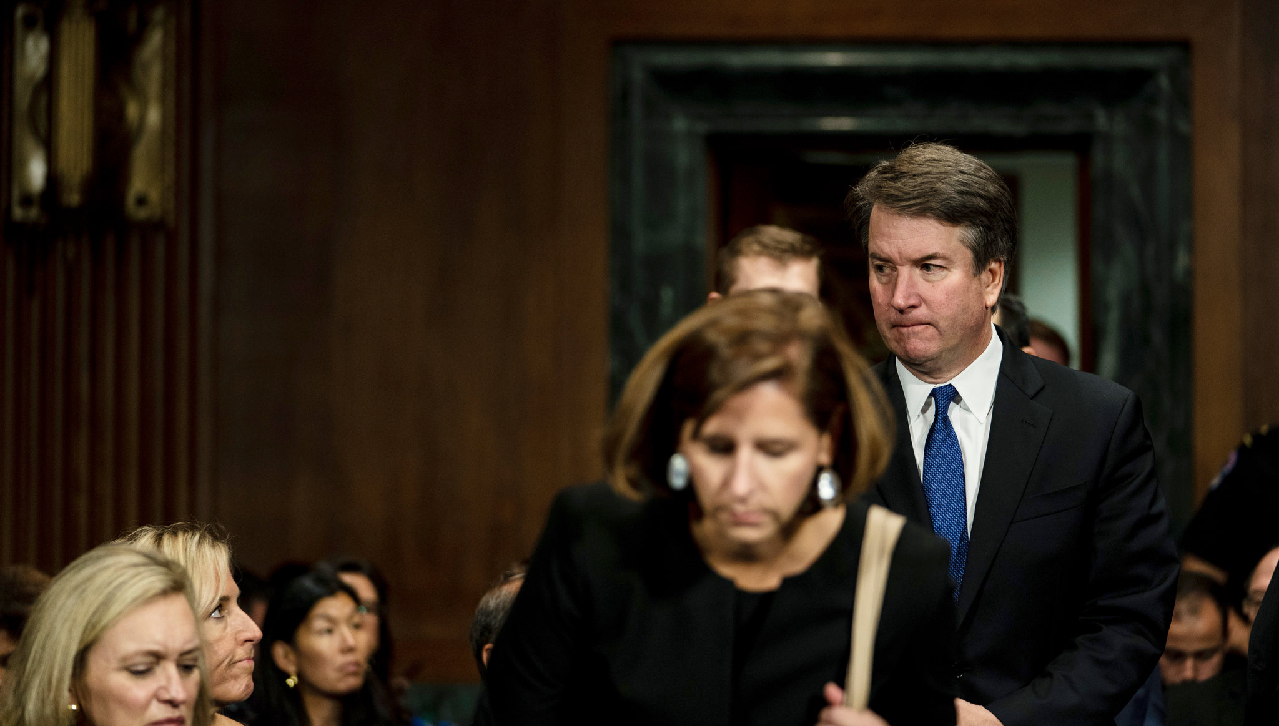
Question 10: What does this picture refer to?
Judge Brett M. Kavanaugh, facing allegations of _________ and growing doubts over his confirmation to the US Supreme Court.
fraud
lying under oath
sexual impropriety

Slide 12
Question 11: What does TBT/Throwback Thursday mean? Write your answers.

Slide 13
Question 1: choose a., b., or c.
For context, as of April 2018, total worldwide population is 7.6 billion.
5.6 billion
6.6 billion
7.6 billion

Slide 14
Question 2: choose a., b., or c.
The internet has 4.2 billion users.
4.2 billion
5.2 billion
6.2 billion

Slide 15
Question 3: choose a., b., or c.
On average, people have 5.54 social media accounts.
1.54
3.54
5.54

Slide 16
Question 4: choose a., b., or c.
The average daily time spent on social media is 116 minutes a day.
16 minutes
60 minutes
116 minutes

Slide 17
Question 5: choose a., b., or c.
91.47% of all internet searches are carried out by Google.
86.47%
91.47%
96.47%

Slide 18
Question 6: put in the order from the most to the fewest users
Youtube
Instagram
Twitter
Facebook
WhatsApp
LinkedIn
Pinterest
Reddit
Facebook
Youtube
WhatsApp
Instagram
LinkedIn
Twitter
Reddit
Pinterest

Slide 19
Question 7: Fill in the gap
Simply put, a hashtag is an easy way for people to categorize, find and join conversations on a particular topic. It is used to highlight keywords or topics within a Tweet, and can be placed anywhere within a post.

Slide 20
Question 8: choose a., b., or c.
A landmark report issued on Oct. 8 from the United Nations’ scientific panel on climate change paints a far more dire picture of the immediate consequences of climate change than previously thought. It describes a world of worsening food shortages and wildfires, and a mass die-off of coral reefs as soon as 2040.
2040
2060
2080

Slide 21
Question 9: choose a., b., or c.
Nadia Murad, a survivor of sexual violence by the Islamic State, and Dr. Denis Mukwege, a gynecological surgeon who founded a hospital in the Democratic Republic of Congo, were awarded the 2018 Nobel Peace Prize for their campaigns against the use of rape as a weapon of war.
campaigns against the use of rape as a weapon of war
contributions to finding a cure for AIDS
struggle for women’s rights in the Middle East and Africa

Slide 22
Question 10: What does this picture refer to?
Judge Brett M. Kavanaugh, facing allegations of sexual impropriety and growing doubts over his confirmation to the US Supreme Court.
fraud
lying under oath
sexual impropriety

Slide 23
Question 11: What does TBT/Throwback Thursday mean?
It is the name of a weekly social media posting trend and hashtag game that people from all over the world use online to share and look back fondly on some of their favorite memories.
On Thursdays, anyone can participate in the Throwback Thursday trend by posting content on social networking sites like Instagram, Twitter, Tumblr or Facebook to reminisce about a past event. Posts can include content (usually photos) from years ago or from just a few days ago.

Slide 24
Sources
New York Times: Weekly News Quiz for Students
https://www.nytimes.com
Brandwatch: 121 Amazing Social Media Statistics and Facts
https://www.brandwatch.com
Lifewire: Tech Untangled
Https://www.lifewire.com

