Slide 1
Democratic Competition and Political Representation
CPDD
Fall 2019
Doc. Marek Rybář, PhD.

Slide 2
Linkages between parties and voters
programmatic
clientelistic
charismatic

Slide 3
Programmatic Linkage
Normatively a precondition of a well-functioning democratic regime
Such linkage is conditional and performance-dependent (how well do parties keep their manifesto pledges?)
Scrutinized throughout the electoral cycle: party manifesto → elections → performance in government → elections → etc.

Slide 4
Programmatic Linkage
Linkage between party/candidate and voters is never fully programmatic, always a mixture of motivations :
Leaders: policy and office
Party activists: collective and selective incentives
Voters: rational and affective components of party choice

Slide 5
Programmatic Linkage
Formally can be analysed as a chain of delegation: Principal-agent relationship
voter—parliamentarian—government—minister—(civil servant)
Parties have a say in all the “pairs”, even though legitimacy of their interference varies
agency drift: what are the possible solutions?

Slide 6
Clientelistic Linkage
A form of personalised bilateral exchange, asymmetric relationship, a sense of duty
“Old” clientelism: a hierarchical relationship between patron and client in traditional communities
Patron offers basic resources to his clients, who in turn repay by providing services or economic goods (rent, labour, etc.)

Slide 7
Clientelistic Linkage
A strong sense of responsibility (patron) and duty (client)
This traditional interaction can take up modern forms:
Patron (or their associates) run in elections
Clients supply votes, patron supplies or promises goods)

Slide 8
Clientelistic Linkage
“New” clientelism: less personalised, a key role played by networks and brokers:
A pyramid: patron is on top (politician, party), clients-voters are at the bottom
They are connected through a network of local officials, local entrepreneurs, party organizational structures etc.
It remains a bilateral relationship (important broker, important broker—less important broker, less important broker—client/voter)

Slide 9
Why is clientelism a problem?
Voters disregard a broader context of their party choice
Politicians do not have a mandate (motivation) to pursue public interests
Clientelistic linkage is rigid, in conflict with the role of elections as a feedback-providing mechanism

Slide 10
Why is clientelism a problem?
It is not voters who control politicians//Rather, politicians control voters
Transactions typically do not take place simultaneously, trust is needed for the system to work (a growing number of exchanges tends to strengthen the linkage)

Slide 11
Clientelism: explained by political culture?
Putnam (1993): differentiated performance of Italy’s regions explained by existence in the north of deep-seated patterns of behaviour:
Representative institutions (guilds etc.) of the medieval era → self-organizing behaviour → understanding for public/collective interest→ policies in search of common good
Absence of such patterns in the south: low trust in parties—problems with collective action—rent-seeking = clientelism, nepotism

Slide 12
Clientelism: explained by strategic interactions?
Shefter (1994): timing of democratisation and state-building
If parties and party competition emerged BEFORE autonomous state apparatus was established = public resources are exploited for distribution of private benefits
Autonomous state bureaucracy BEFOTE party-based mobilisation = a strong barrier preventing widespread clientelistic exchange

Slide 13
Charismatic linkage
Considered a pre-modern form of political authority in political theory (M. Weber)
“Charisma” traditionally studied by social psychology
Pappas (2009): charisma is primarily a political phenomenon, a specific type of political leadership

Slide 14
Charismatic personalism (Pappas)
1. nearly absolute and centralised control by the leader over “his” party
(division of powers and labour depend on leader’s decisions, formal rules are not observed)
2. a strong and unmediated emotional link between the leader and followers

Slide 15
Charismatic personalism (Pappas)
3. delegative and missionary relationship between the leader and his followers
(delegation in the sense of missing horizontal accountability)
It may exist in democratic regimes
A plan of radical (but not necessarily authoritarian) transformation of institutional architecture of the state

Slide 16
What shapes party systems
1. a political sociology approach: politics mirrors society (Lipset and Rokkan)
2. strategic choices of political elites (what themes to politicize)
3. formal institutions, especially the electoral system and executive-legislative relations

Slide 17
How do electoral rules shape party systems?
Duverger law: the simple majority single-ballot system favors the two-party system
Example: United Kingdom
Duverger’s hypothesis: simple majority system with second ballot, and proportional representation favor multipartism
Examples: France, Spain etc.
However, in structuring party systems, electoral systems are “supplemented” by the structure of societies (cleavages)

Slide 18
A decline in importance of political parties
An ongoing social and political modernisation = a decline in importance of parties
Rise of educational levels → no need to rely on parties to provide a link to the state (institutions)
Independent mass media
Alternative channels of political mobilisation (social movements, organized interests)

Slide 19
The Consequences of dealignment
A drop in voter turnout (voters who identified with parties had traditionally voted more often than those without party identification)
On average, some 10 percentage points drop over the last 50 years
Increased volatility levels: entry of new parties and the rise of the number of relevant parties
Individual level: split ticket voting and divided government

Slide 20
The Consequences of dealignment
Timing of decisions about who to vote for in elections
An increased trend of identification with a politician (and not with their party)
Decrease in active participation at election campaigns
Less voters with „party predispositions“

Slide 21
What is a party system?
A stable, valued and recurring pattern of interactions between its components (parties)
“Systemness” - Interactions among parties that go beyond their individual characteristics

Slide 22
Party „systemness“
Results from competition among parties:
Number of parties (how to count them?)
Relative size and strength (how to assess it?)
Dimensions of party competition
Distance between parties (polarization)
Propensity to govern together

Slide 23
Number of parties
Nearly all classifications take into account the number of parties
All that compete in elections?
All that gain parliamentary seats
All that have a say in who governs

Slide 24
The 2005 UK Elections
Candidates of 14 parties competed in the parliamentary elections
Candidates of 14 parties gained seats in the Parliament
Three parties gained an overwhelming majority of seats (Lab 35,2%=356, Con 32,3=197, LibDem 22%=62 mandates)
Other parties tend to gain votes in specific regions

Slide 25
Duverger (1954)
Number of parties alone shapes the dynamics among them
One party system, two party system, multipartism
Bipartism is natural and normatively superior, multipartism leads to instability

Slide 26
Relative size of parties
Blondel (1968): an empirical classification of democratic party systems
1945-1966: UK, USA, NZE, AUS, AUT (two parties combined >89%
CAN, GER, IRE: (two parties combined gain 75-80%, a third relevant party exists, important for government formation

Slide 27
Dimensions of party competition Sartori (1976)
We only need to take into account the relevant parties (i.e. parties with a coalition potential or with a blackmail potential)
The more relevant parties in the system, the greater the ideological distance among them
Polarised pluralism: anti-system parties at both ends of the ideological spectrum
However, very few cases of polarised multipartism after 1989

Slide 28
Tendency of parties to govern together
Governing is at the core of contemporary parties
Structures of competition can be seen to be either closed (and predictable) or open (and unpredictable) depending on:
the patterns of alternation in government,
the degree of innovation or persistence in processes of government formation, and
the range of parties gaining access to government

Slide 29
Party system institutionalization (PSI)
Conceptually different from party institutionalisation (PI)
Crucial for democratic consolidation and survival
Casal-Bertoa: PSI as sufficient (not necessary) condition of democratic survival
No link between PI and democratic breakdown

Slide 30
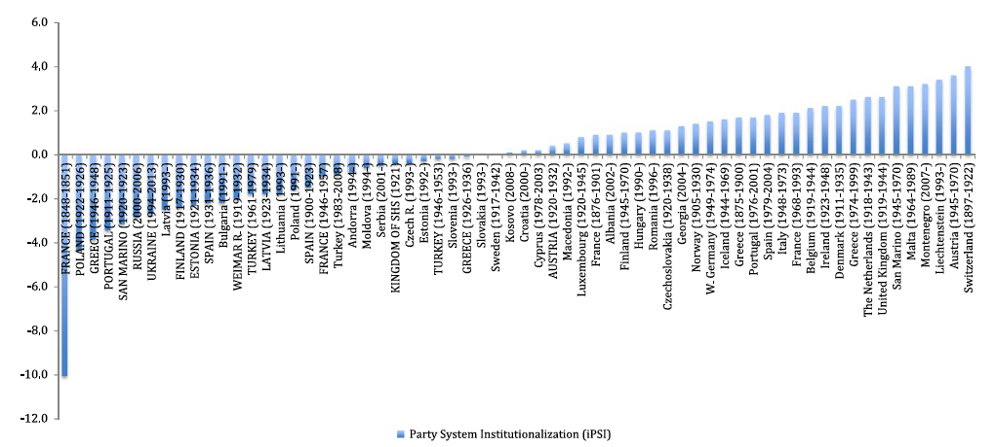
PSI and democratic collapse (FCB, 2016)

Slide 31
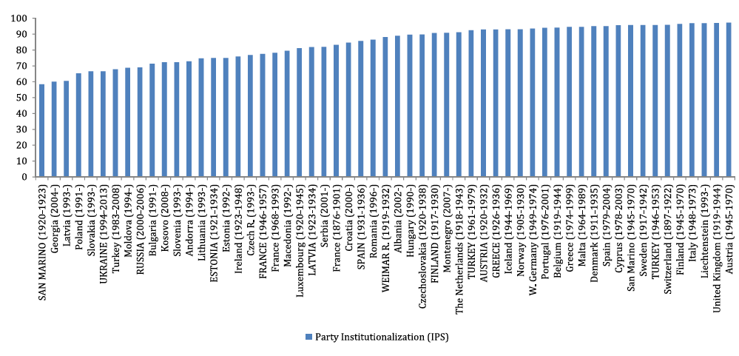
PI and democratic collapse (FCB, 2016)

