Slide 1
Ethnicity & Nation/alism
Comparative Perspectives on Democracy and Development
Fall 2020
Doc. Marek Rybář, PhD.

Slide 2
From modern states to nation-states
The once revolutionary template of political legitimacy— self-rule in the name of a nation of equal citizens—is now almost universally adopted
Empires have dissolved, theocracies have been dethroned, and only a handful of countries, mostly in the Middle East, are still governed as absolutist monarchies
Why did modern states—once they emerged out of the dynamics of war-making, bureaucratic centralization, and increasing taxation—become nation-states?

Slide 3
Nationalism as the tool of state legitimacy
E. Gellner: nationalism is a doctrine that claims that national and state units should be congruent
there are many theories attempting to explain the rise of nations and nationalism
it is a matter of empirical investigation what theory explains the rise of modern nation-states and thus has an explanatory power beyond the European context

Slide 4
E. Gellner (1983)
nationalism and the nation-state is a direct consequence of the shift from an agricultural to an industrial society
the new economic system requires a mobile and flexible workforce
a rationalized standardized education in a common language provides workers with the skills to shift from job to job and communicate effectively with others
the educational apparatus of a nation-state eventually provides the new, standardized, and homogenized culture

Slide 5
E. Gellner (1983)
For an advanced, industrialized economy to work, the population must have shared skills to work as bureaucrats, as administrators, as clerks etc.
Shared culture is required for the state to function effectively
Therefore, educational system heavily involved in the process of cultural homogenization
And linguistic too where necessary e.g. Eugen Weber Peasants into Frenchmen (1976)

Slide 6
E. Gellner (1983)
however, modernization and industrialization is an uneven process, affecting each region differently
rural inhabitants move to industrialized centers, where their prospects remain limited if their language and culture do not correspond to the center’s high culture
resentment fed into nationalism lead to an alternative project of high culture and possibly to creation of the new nation-states (separatism)
a similar process unfolded in the colonial world, where skin color was associated with unequal power, paving the way for anti-colonial nationalisms

Slide 7
B. Anderson (1991)
A nation is a community: socially constructed and imagined
An imagined political community that is both limited and sovereign
Imagined: members cannot all know each other
Limited: no nation encompasses all of mankind
Sovereign: nations emerged during Enlightenment and strive for freedom
Community: people are connected with brotherhood

Slide 8
B. Anderson (1991)
the rise of “print capitalism” enabled literacy in vernacular languages
the emerging reading public shared a narrative cosmos and imagined itself as a national community of common origin and future political destiny
newspapers and novels in a near full literacy context lead to imagined communities
Low-level colonial administrators recruited from the local population could not aspire to positions above the provincial levels:
confined to the provincial bureaucratic space laid the groundwork for imagining the nation along provincial (rather than linguistic) lines

Slide 9
B. Anderson (1991)
because the nation cannot be remembered, “it must be narrated” (p. 204)
this becomes one of the important functions of education and of schools, the rendering of a particular narration as valid, as reasonable, as true
combined with other narrators (religion, popular media), schools are a discursive site where the public is “continuously reassured that the imagined world is visibly rooted in everyday life” (p. 35-36)
the nation then emerges as something reified, and schools play a large roles in this reification

Slide 10
L. Greenfeld (1992)
it is not deep-seated socioeconomic factors, but rather dynamic variables, that play the key role in spreading the nation-state as a universal norm of state form
adoption of nationalist ideologies is the result of an imitation process through which a variety of political movements across the world copy from each other
the imitation process proceeds along established networks of political and cultural relations
TUR and JAP (GER), AFR (FRA a BRIT), Kurds a Arabs (TUR) etc.

Slide 11
Michael Billig: Banal (Everyday) Nationalism
When we study nationalism, we tend to think in terms of independence struggles for new states or extremism
Nationalism is presented as “an extraordinary, emotional mood striking at extraordinary times”
in established western democracies (1995) nationalism was thought to exist on the margins of political life
For Billig, this overlooks the nationalism of the western nation-states
Billig claims that nations are reproduced daily:

Slide 12
Michael Billig: Banal (Everyday) Nationalism
national identity in established nations is remembered because it is embedded in routines of life, which constantly remind, or “flag”, nationhood...these are so numerous and they are such familiar part of the social environment that they operate mindlessly” (p. 38)
these flags “are given hardly a second glance from day to day; they are unwaved, unsaluted, unnoticed”
this is not a conscious activity: it differs from the collective remembering of a commemoration
the remembering is mindless, occurring as other activities are being consciously engaged in

Slide 13
Michael Billig: Banal (Everyday) Nationalism
Nationalism, far from being an intermittent mood in established nations, is the endemic condition
banality is not synonymous with harmlessness
irrationality and violence of nationalism is often projected onto others
“we” live in a reasonable world where none of that matters, “they” are the ones infected by that fiery mindless nationalism
once a nation is established, it depends for its continuous existence upon a collective amnesia: if we think all the time about the exclusion and violence involved in the nation-making, could the nation ever function as a moral community?

Slide 14
Empirical tests
Wimmer and Feinstein (2010): most theories have only a limited reach
no to Gellner: no general association between industrialization and nation-state formation ( early nation-states in Latin America were created in a preindustrial environment, while the highly industrialized Soviet and Yugoslav provinces had to wait to accomplish nation-statehood)
no to Anderson: Territories that correspond to the boundaries of provinces or states are not more likely to become nation-states AND more literate societies are less likely to become nation-states

Slide 15
Wimmer and Feinstein (2010)
nationalists will be more successful if the center is weakened by wars
imperial states that are powerful players in the international arena can more easily co-opt, control, or suppress nationalist movements and prevent the establishment of nation-states
nation-states are created wherever a power shift allows nationalists to overthrow or absorb the established regime,
this happens quite independently of whether domestic modernization processes have readied a society for nation-building

Slide 16
Wimmer and Feinstein (2010)
such a power shift is more likely when nationalists have had ample time to mobilize the population and delegitimize the old regime or when the established regime is weakened by wars
nationalists who struggle against an imperial center are at a disadvantage when the empire has considerable global military and economic power
all this indicates the importance of elite interactions and configurations as well as the importance of imitation processes

Slide 17
Identity
(Hale 2004) it is the set of points of personal reference on which people rely to navigate the social world they inhabit
to make sense of social relationships that they encounter
to discern their place in these constellations
and to understand the opportunities for action in this context

Slide 18
Ethnicity and its origins
primordialism: there are clear-cut and enduring boundaries between groups;
each has its particular constitutive features that do not change (cultures, traditions, histories, physical traits, language repertoires, religion, etc.);
kinship relations are the critical element that holds each group together
constructivism: F. Barth: defining feature of an ethnic group is not the particular elements of culture or kinship but the mere fact that boundaries are perceived and persist

Slide 19
Ethnicity and its origins
mere assignment to a group is enough, under controlled conditions, to induce group-oriented behavior
ethnicity is an important identity because it
(1) involves barriers to communication (language)
(2) (sometimes) involves physical differences
(3) 1. a 2. tend to be territorially concentrated
(4) symbols of ethnicity are shared by the whole community
(5) however, identity changes, and the meanings and identifications can be manipulated by elites and individual subjects

Slide 20
Ethnicity and its origins
ethnicity is one of the most frequently used concepts of political analysis
Chandra a Wilkinson (2008): ethnic identity as a category in which descent-based attributes are necessary for membership
a difference between ethnic structure and ethnic practice

Slide 21
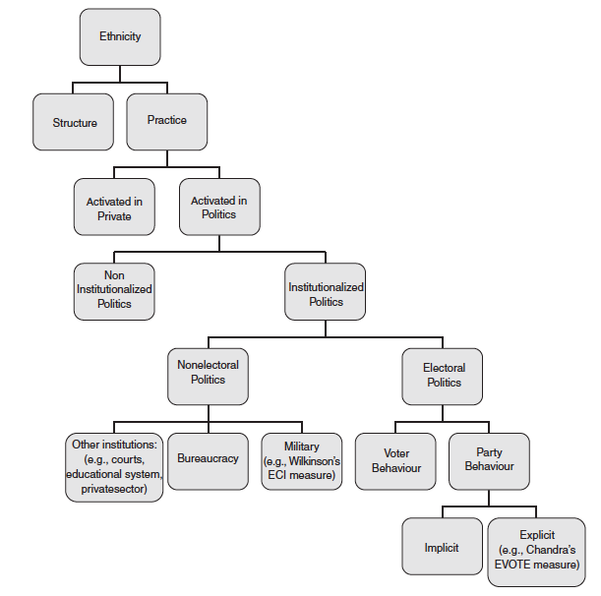
structure – static attributes linked to common descent, (e.g. language)
practice – dynamic attributes, the act of using one or more identities embedded in this structure to guide behavior
ethnic structure of a population is difficult to change in a short time but may change over time, since ethnic practice is based on the activated categories
political institutions, job opportunities, social interactions etc. may trigger the process of change

Slide 22
Consider, for instance, a woman living in New York with attributes such
as dark skin, birth in Trinidad, and descent from parents of African origin. In the short term, we can take these attributes as being fixed. If she has dark skin now, she is likely to have dark skin 10 years from now. Because these attributes are fixed in the short term, so is her nominal repertoire of descent-based categories.
This repertoire includes the categories West Indian, Black, Trinidadian, and so on, but it does not include the categories Asian or German, for which she
does not have the requisite descent-based attributes.
But the categories that she activates from this fixed set can change, often quite rapidly. She may well switch back and forth between the identities Black, West Indian, Trinidadian, and others, depending on the incentives that she faces without any change in her underlying set of attributes.
Chandra & Wilkinson, p. 521

Slide 23
Consequences of National Identity
three empirical patterns in modern democracies:
1. national identification is more common among the poor than among the rich
2, national identification tends to reduce support for redistribution
3. across democracies there is a strong negative relationship between the prevalence of national identification and the level of redistribution
! individual economic preferences are shaped by collective identities!

Slide 24
M. Shayo: Identity at Work
to identify with different groups means to have different preferences over outcomes
preferences involve two components:
1. the status of the various groups that exist in society
2. the perceived similarity between an individual and the other members of the group
The perceived distance from a group is a weighted distance between the individual and the prototype of that group
(the weights reflects the relative salience of the various dimensions)

Slide 25
Shayo: Identification with groups
1. people are more likely to categorize themselves as members of a group the more “similar” they are to the other members of that group
2. people tend to identify more with high-status groups than with low status groups
these factors are the same two factors that affect individual behavior under identification

Slide 26
Shayo: Ethnic and Class Identities
two types of equilibria may emerge:
1. the members of the lower class, who always constitute a majority, identify with their class (and vote for a relatively high level of redistribution)
2. members of the lower class think of themselves more as members of the nation as a whole than as members of a low-status part of it (they are less concerned with income redistribution and vote for a lower level of redistribution than they would under class identity)
since these are equilibria they change only under externa pressures (RatChoice)

Slide 27
Shayo: Ethnic and Class Identities
a threat to national security may lead to conviction that we all are threatened – both the rich and the poor – less attention is paid to class belonging and less support there is for taxation and redistribution
conversely, in situations of natural disasters, due to which lower classes are disproportionally suffering, lower-class people people may more identify with these people and with their demands for more redistribution

Slide 28
Shayo: Ethnic and Class Identities
model explains the situation in the US where lower classes tend to identify more with the nation and less support redistribution
it also explains well why many voters of Social Democracy in Western Europe shifted they support to radical anti-immigrant right :
Immigration of foreign workers affects primarily the composition of the poorer segments of society
consequently, identifying oneself as part of the working class is not as self-evident for the native workers as it used to be (support for general interest redistribution declines)

