Slide 1
Development I
Comparative Perspectives
Marek Rybář, PhD.

Slide 2
Research Problem
How can we explain enormous political, economic, and social differences among countries of the contemporary world?

Slide 3
Geographical factors
Hall and Jones (1999): There is a strong positive correlation between a country’s distance from the Earth’s equator and the quality of its institutions

Slide 4
Geographical factors
What exactly do we mean when we speak of geography?
What exactly does geography influence?
What are the exact mechanisms of such an influence/impact?

Slide 5
Geographical factors
climate
topography
geology
biogeography

Slide 6
Climate
Conditions on Earth’s surface:
temperature, precipitation, sunlight, humidity and streams
What matters is not just average numbers but also the absence of extremes (heat waves, heavy downpours and droughts)

Slide 7
Climate
Montesquieu: The Spirit of the Laws (1748): temperature
People are brave, more trusting, more determined and more disciplined in colder climate
In warmer climate they are lazier, the powerful ones will force weaker people to work for them (slavery): climate → human activities→ institutions

Slide 8
Climate
Ellsworth Huntington (1915): temperature and humidity directly influence human institutions
Ideal climate in the winter is between +3 and +18 (London, New Zealand, North California) because people are more honest, determined, and show more initiative

Slide 9
Climate
D. Landes (1998): discomfort caused by warm weather is greater than discomfort caused by cold climate
White persons (Caucasians) would not get used to work at plantations → slavery
precipitation: favorable streams and precipitation endowed Europe with favorable climate

Slide 10
Topography
General nonbiological conditions on Earth’s surface
mountains, oceans, islands, length of rivers, their navigability and volatility during the seasons of the year

Slide 11
Topography
K. Wittfogel (1957): rivers can be relatively easily controlled and regulated
Civilizations near rivers developed a sophisticated division of labor: a narrow ruling class controlled the mass workforce
the forced labor was later used for other development projects: building roads, canals, irrigation systems, monuments etc.
The rise of “the oriental despotism”:
topography → technology → institutions

Slide 12
Topography
However, a different situation had existed in Europe (Jones a Landes 1998):
High mountains, rivers without deltas, large forests, an irregular shape of the continent, plus many islands all prevented the rise of a single civilization
No dependence on a despotic ruler because “farmers” had access to different source of water (rains)

Slide 13
Topography
Oceanic Currents: Europe in 1500 was not richer then China, India and the Arab world
A relative proximity of rich America (silver and gold) and favorable oceanic streams gave advantage to European sailors/kings who gained resources that later helped financing the Industrial revolution
However, there is no clear-cut explanation for the emergence of institutions in this line of explanations

Slide 14
Topography
Acemoglu et al (2002): Europe after 1500 got richer thanks to its trade with America, India and East Asia
Only countries with access to the sea would benefit
There is a link between international trade and good institutions:
Trade strengthened the position of traders (not the traditionally privileged gentry), who sought guarantees for their newly acquired property --> strengthening of property rights
topography → rise of a new social group → good institutions

Slide 15
Geology
Nonbiological conditions under Earth’s surface:
character of soil, quality and quantity of natural resources, active volcanos, earthquakes etc.

Slide 16
Geology
Quality of soil differed in North and South America (Engerman and Sokoloff 2002):
Soil in the South (Central) America suitable for production of tradeable commodities (sugar, tobacco)
Slave labor widely used → vast social and political inequalities → the emergence of institutions that protected privileges of the powerful and prevented effective political inclusion and participation for many years

Slide 17
Geology
Natural resources: oil, gas, gold, diamonds, copper
Too much natural resources was hypothesized to lead to “resource curse”:
From the 1970s: countries with an abundance of natural resources tend to have less economic growth, less democracy, and worse development outcomes than countries with fewer natural resources

Slide 18
Geology
direct economic effect?
Revenue volatility: High volatility in the prices of natural resources leads to abrupt changes to social programs, erosion of the rule of law and decline in popular support for governments (Nigeria, Venezuela, and oil prices)
Lack of investments: Companies export their profits from the country, no investments into local development

Slide 19
Geology
Political explanations?
“Fast cash”: lack of long-term economic policies
Income from natural resources is used to subsidy the underperforming sectors of the economy -> high political costs of structural changes
Violence: ethno-political groups are more likely to resort to rebellion (rather than using non-violent means) in resource-rich countries

Slide 20
Geology
The rentier state: governments do not collect taxes → are thus less accountable, do not strengthen property rights, and the general state capacities are rather low
The relationship between oil and authoritarianism holds after the Cold War: without US or Soviet support, resource-poor authoritarian regimes democratized, while resource-rich ones managed to resist domestic pressures to democratize

Slide 21
Biogeography
“geography” of living organisms (NOT humans!)
Abundance and character of fauna and flora, type of vegetation, microorganisms (bacteria, viruses)

Slide 22
Biogeography
J. Diamond: differences in biogeographical resources during Neolithic times fully developed after 1500 in different developmental trajectories of the continents
Favorable conditions: animals suitable for domestication AND access to highly nutritious (and storable) plants/grains
Eurasian continent (East-West orientation) favorable to easy transfer of modern technologies from the Middle East (“the Fertile Crescent) to Europe
Technologies of South American civilizations of the time did not “travel” (South-North orientation of the Americas less favorable)

Slide 23
Biogeography
Eurasia: Early departure from picking and hunting to agriculture
resulted in a sophisticated division of labor, trade, urbanization and strong political development
Followed by rapid technological development and,
after 1500, gave Europeans the ability to dominate the New World (Spain vs. the Aztecs and the Incas), and not the other way round

Slide 24
Biogeography and institutions
Diamond cannot explain the persistence of institutions after 1500 nor why subsequent technological changes were not used on other continents to bridge the developmental gap
Acemoglu, Johnson a Robinson (2001):
differences in European mortality rates to estimate the effect of institutions on economic performance, i.e.:
The link between micro/biogeographical conditions and the quality of governance

Slide 25
Biogeography and institutions
the great majority of European deaths in the colonies were caused by malaria and yellow fever
malaria and yellow fever → extractive institutions → weak protection of the rule of law, personal freedom, and property → weak subsequent economic and political development
Favorable micro/biogeographical conditions → permanent settlements → good institutions → stabile economic and political development

Slide 26
Institutional explanations
Good institutions favor self-realization, innovations, freedom of expression, equality before the law, and protect political and economic competition
North America: English colonizers first tried the strategies first used by Spaniards in South America but the local conditions were not conducive to their strategy
Representative institutions were introduced only as a “plan B”

Slide 27
Institutional explanations
Acemoglu a Robinson Why Nations Fail (2012):
short video AKA 500 pages in 5 minutes:
https://www.youtube.com/watch?v=2z5RAZlv2UQ

Slide 28
Questions
HOW PRECISELY do decisions in the past influence today’s political and social reality?
“classical geography”: fixed geographical factors (ecology, climate, resources) have the same impact today as in the past – directly on the people
More sophisticated explanations emphasize the mediating role of institutions
Acemoglu et al work with broadly conceived sets of institutions, however, a precise mechanism of their influence is unclear (how and why do institutions persist)

Slide 29
Inequality as a direct consequence of the past
the importance of Africa’s slave trades in shaping subsequent economic development:
a robust negative relationship between the number of slaves taken from a country and its subsequent economic development
the slave trades impeded the formation of broader ethnic groups, leading to ethnic fractionalization, and the slave trades resulted in a weakening and underdevelopment of political structures: colonial origins of trust?

Slide 30
Human capital/education
Woodberry (2012): a positive relationship between activities of protestant missionaries and subsequent structural changes in the colonies:
In India, the missionaries founded most of the educational institutions, invented the print version for local vernaculars, printed first books and newspapers
(they also destroyed traditional communities, promoted racist policies etc.)

Slide 31
Woodberry (2012)
They developed civil society, both directly and in response to their missionary efforts
they fostered rule of law, by mobilizing white colonial settlers: The more independent the missionaries from colonial states, the more they could speak out against injustices and demand reform
Education, spurred social mobility, opportunities for women, and long-term health improvements

Slide 32
Transport as Development
Global South: poorly maintained infrastructure, unreliable, labor-intensive and high-cost transport,
A majority of population lives in spatially circumscribed local socio-economic systems where poverty and immobility are linked

Slide 33
Transport as Development
Hilling (1996):
“revolution in transport” in the developed world:
Cheap mass air travel
High and rising levels of personal mobility
Internationalization in industry and commerce → “Global village”
situations, when development followed after transport infrastructure: new railroads paved the way for increases in production and export

Slide 34
Transport as Development
Transport infrastructure in Amazonia ➔ expansion of agriculture, forestry and mining industry
Transport and infrastructure often link to non-economic factors: military, ideological and political considerations (control over territory)
Consequences of new transport infrastructure:
For users (reduced costs, reliability, …)
For non-users (cheaper products, greater selection, changing land values, )
For wider regions (shifts from non-monetary to monetary economy, from isolation to incorporation, from rural to urban etc. )

Slide 35
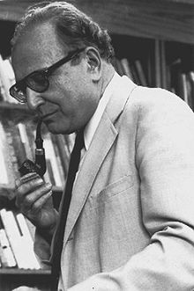
Modernization
Economic factors lead to modernity, to economic and political progress
S.M. Lipset (1959): GDP per capita fosters democratization and strengthens democracy
Income is strongly linked to other phenomena that influence democratization

Slide 36
Modernization
the literature on modernization and democracy has offered three explanations of the emergence of democracy
1) a functional match between democracy and social modernization
2) extension of pluralistic values associated with economic development
3) transformation of economic and social structures

Slide 37
A functional match between democracy and modernization
a market economy is sustained by a free flow of information,
markets can prosper only when embedded in a political framework characterized by the recognition of political rights and constitutional liberties
there is a lack of causal direction in this line of argument, consequently, a second explanation has been put forward:

Slide 38
Extension of values associated with economic development 1/2
rising education levels AND an autonomous labor force generate a public opinion tolerating multiplicity of values and opinions, thus paving the way for accepting liberal democracy as the mechanism to settle disagreements
however, what makes the practice of toleration relatively easier and less costly?

Slide 39
Extension of values associated with economic development 2/2
either a shift in religious and cultural values OR a change in the structure of material or economic relations
however, the link between religious practices and democratization seems to be weak (many countries democratize before a widespread process of secularization)

Slide 40
Transformation of economic and social structures
modernization results in a reduction of the level of inequality which is a source of political conflict AND the growth of a middle class who acts as a moderating force
the causal mechanisms linking economic development and democracy are underspecified - what is missing is the role of political agency

Slide 41
Przeworski et al (2000) Democracy and Development 1/2
Economic growth does not explain the occurrence of democracy, only whether it will survive once it appears
In poor countries, neither type of regime can produce growth more effectively than the other, while in wealthier countries, democracies grow faster
Dictatorships have higher fertility rates and lower life expectancies, why?

Slide 42
Przeworski et al (2000) Democracy and Development 2/2
since democracies find it easier to credibly commit to taking care of you, parents are less concerned about having lots of children
democracies can credibly commit to assist the elderly, dictatorships cannot
even if the economy is good this year and you're getting your pension, the dictator may cut your benefits off if the economy falls

Slide 43
Boix and Stokes (2003)
when the Przeworski et al dataset is divided by time periods, economic development is an extremely important predictor of transition prior to 1950, but has only a small (though statistically significant) effect in the post-1950 period
Selection bias: Przeworski focuses on the cases after WWII, if cases from the earlier periods are added, a link between economic development and democracy is stronger

Slide 44
Boix a Stokes (2003)
Why is it that rich countries were already democratic and poor countries were dictatorships after 1950?
democratization in 1850-1940: strong link between GDP per capita and democracy
Development CAUSES democracy but the link is less visible after 1950 because rich countries are already democratic at that time

Slide 45
Boix (2003)
the core assumption is that democratization is driven by conflict between the rich and the poor
increasing levels of economic equality bolster the chances of democracy: redistributive pressures from the poorest social strata on the rich diminish
since the tax rich would pay under democracy becomes smaller than the costs of repression, they accept the introduction of democracy

Slide 46
Boix (2003)
the importance of capital mobility: as it increases (i.e. owners can transfer it abroad), tax rates also decline;
similarly, when capital can be hidden from the state or can be used only by the owner, the temptation to confiscate it also declines
e.g. in South Africa opposition to democracy was high among the Afrikaner farmers, it barely existed among financial and industrial elites (who could move their capital abroad)

Slide 47
Why does development underpin democracy?
Inglehart (2000): material conditions influence how individuals perceive social and economic reality
Development influences our subjectively perceived well-being which in turn shapes the legitimacy of democratic institution
high level of well-being supports democracy, a strong link between the type of regime and subjective well-being
(despite anecdotic evidence suggesting the opposite, people in rich countries are more satisfied with their lives)

Slide 48
Modernization and demography 1
Dyson:
Demographic transition has been central to the creation of the modern world – independently of economic aspects of modernization
Sustained mortality decline causes both urbanization and fertility decline

Slide 49
Modernization and demography 2
Urbanization leads to an increased division of labor, dependence upon monetary exchange, and the wider distribution of political power (“organized democracy is the product of urban life”)
Fertility and mortality decline contribute to reduced gender differentiation (“women become more like men”)
Population ageing probably contributes to the rise of modern democracy

Slide 50
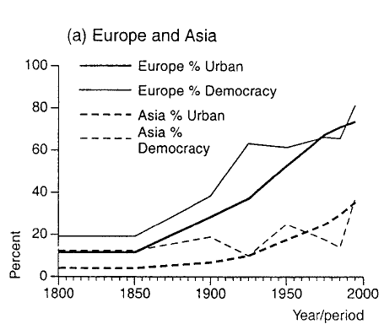
Urbanization and Democracy 1

Slide 51
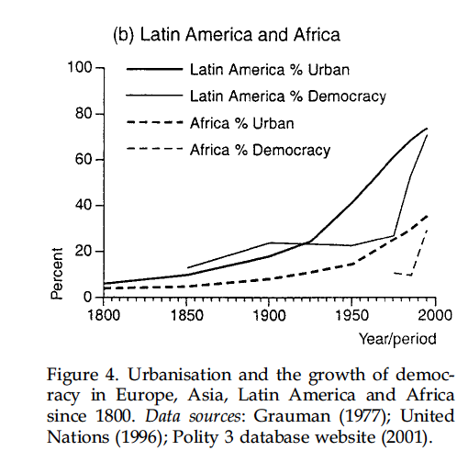
Urbanization and Democracy 2

Slide 52
Other Institutions and Economic Growth
Weber: bureaucracy as one of the institutional foundations of capitalist growth
public administrative organizations characterized by meritocratic recruitment and predictable, long-term career rewards will be more effective at facilitating growth than other forms of state organization

Slide 53
Professional Bureaucracy and Economic Growth
Evans and Rauch: a strong and significant correlation between score on the “Weberianness” Scale and total growth of real GDP per capita during the 1970-1990 period (r = .67; p < .001)
Because the data refer primarily to core economic agencies, the implication is not that the entire bureaucratic apparatus must be structured in this way to have positive effects on growth

