Slide 1
ING vs INF

Slide 2
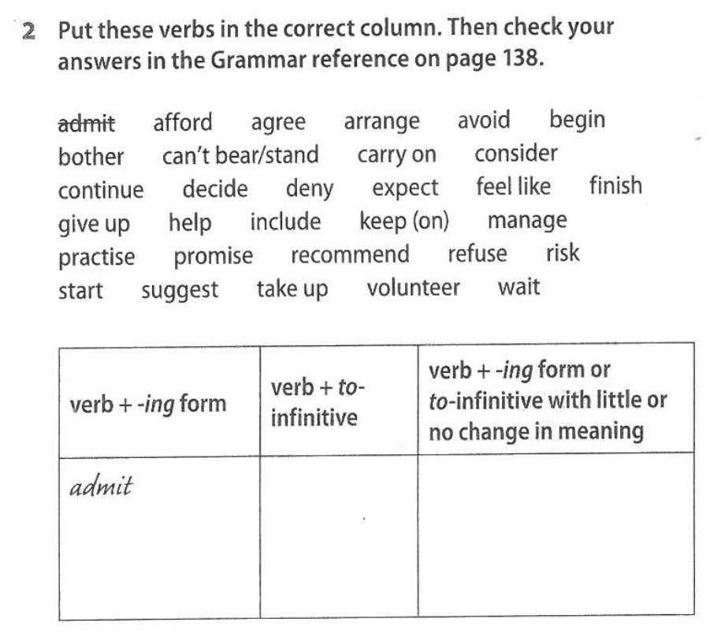

Slide 3
Words that change meaning
Stop
Remember
Forget
Like
Try
Mean
Go on

Slide 4
Stop
I was walking home and I stopped to buy some bread.
I stopped smoking.

Slide 5
Remember
I remembered to do my homework yesterday.
I remembered doing my homework yesterday.

Slide 6
Forget
I forgot to do my homework yesterday.
I forgot doing my homework yesterday.

Slide 7
Like
I like cycling to school.
I like to cycle to school.

Slide 8
Try
I tried playing a guitar last year.
I tried to play a guitar last year.

Slide 9
Mean
I did not mean to hurt you.
This does not mean hurting you.

Slide 10
Go on
He was watching TV and went on to play chess.
He went on watching TV after I left

