Slide 1
Green Growth Debunked Martin Černý Katedra environmentálních studií FSS MU Research and Degrowth

Slide 2
Green Growth
Beneficial for the environment?
Feasible, or squaring the circle?

Slide 3
Economic Growth and the Environment… …from the mainstream point of view
1990s: economists analysed the relationship between economic growth and selected environmental pressures and found out that these two were negatively correlated: the higher economic growth, the lesser environmental pressure
According to them, environmental damage would first grow and then decline in an inverted U-shaped relationship, the so-called Environmental Kuznets Curve
Strong policy implications: an economy can ‚grow out‘ of environmental problems
(Parrique et al., 2019, p. 19)

Slide 4
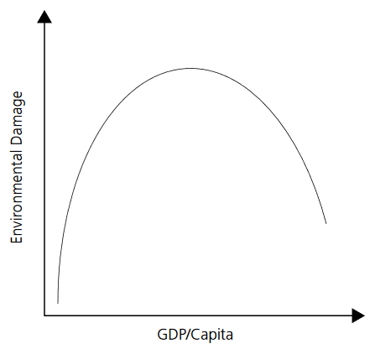
Economic Growth and the Environment… …from the mainstream point of view
Environmental Kuznets Curve (inverted U-shaped relationship between economic output (GDP) per capita and environmental damage)
Source: Everett et al., 2010

Slide 5
Environmental Kuznets Curve (EKC)
Assumptions/factors (Everett et al., 2010):
Beyond a certain point, consumers prefer improvements in the environment over further consumption
Technological improvements – cleaner technologies (renewable energy, electromobility, etc.) + shift of the economy from ‚dirty‘ industries to cleaner industries and from industry to services in general
Policy implications:
Foster economic growth in order to improve the environment

Slide 6
…nevertheless, there are couple of problems:
EKC works for a limited set of environmental indicators only:
Mostly (air, soil and water) pollutants with significant local impact
Does NOT work for:
Carbon and other greenhouse gases
Energy use
The costs of fixing the environmental damage can be drastically higher than the costs of mitigation
(Everett et al., 2010)

Slide 7
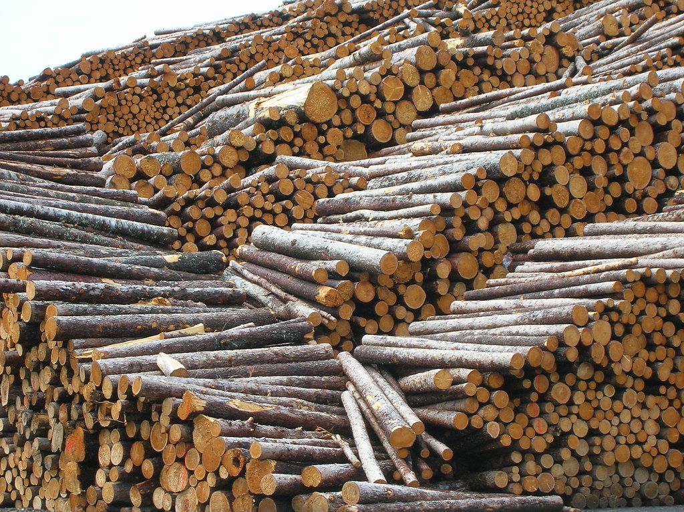
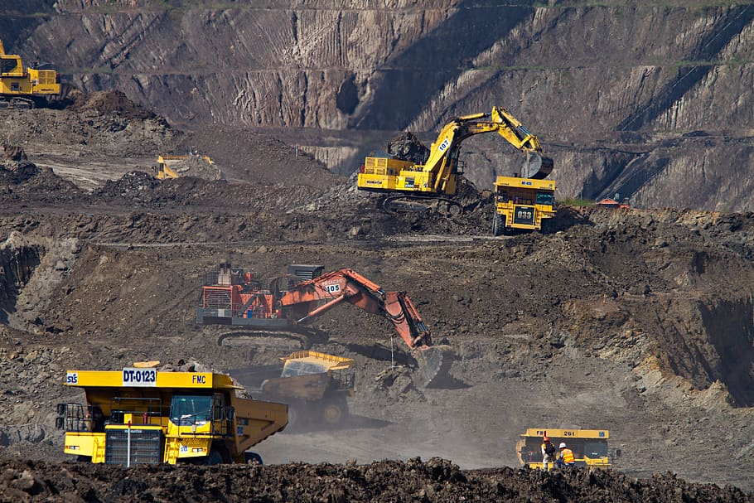
Production factors
To produce goods and services, the economy needs a set of inputs (a „recipe“ for a technology of each product/industry), including usually work, various types of capital and something from the nature – „natural resources“, „natural capital“ or „natural assets“
ANY economy, even the one with the greatest resource efficiency in the universe, will still have some minimal requirements for material inputs

Slide 8
Production factors
Except for the desired output, the economic activity also has ‚undesired‘ outcomes („externalities“): waste, greenhouse gas emmissions…
„There is usually a link between resource use and environmental impacts; for example, extracting and using more fossil fuels (resource) generates CO2 emissions contributing to climate change (impact).“ (Parrique et al., 2019, p. 13)

Slide 9
GDP and environmental pressures
According to Parrique et al. (2019), „[m]ost studies decomposing the effects of different variables on CO2 emissions (energy consumption, energy intensity, carbon intensity, GDP) conclude that GDP is one of the biggest drivers of CO2 emissions“ (Cansino and Moreno, 2018; Chen et al., 2018; Jiang et al., 2016; Madaleno and Moutinho, 2018; Roinioti and Koroneos, 2017)

Slide 10
Green Growth
„[The notion that] continued economic expansion is compatible with our planet’s ecology, as technological change and substitution will allow us to absolutely decouple GDP growth from resource use and carbon emissions.“ (Hickel and Kallis, 2020)
Sustainable Developments Goals (UN) + UNEP, The European Green Deal (EU), OECD, The World Bank, …
Assumptions of green growth (Hickel and Kallis, 2020):
Absolute decoupling of GDP growth from resource use and carbon emissions is feasible (advocated by Sollow, 1973)
…at a rate sufficient enough to prevent further acceleration of the climate change and other environmental degradation
Efficient use of natural resources (and therefore decoupling) can be reached by technological change towards clean technologies

Slide 11
The European Green Deal
„The European Green Deal is a response to these challenges. It is a new growth strategy that aims to transform the EU into a fair and prosperous society, with a modern, resource-efficient and competitive economy where there are no net emissions of greenhouse gases in 2050 and where economic growth is decoupled from resource use.“
(European Commission, 2019)

Slide 12
Decoupling
Relative or absolute
Relative: GDP grows faster than material throughput
Absolute: GDP grows while material throuput reduces
Global or local
Territorial- (calculated with doemstic material consumption /DMC/) or footprint- (calculated with material footprint /MF/ accounting) based
Temporary or permanent
Continuous economic growth requires a permanent absolute decoupling between GDP and environmental pressures (to prevent recoupling later on – N-shaped curve)
(Parrique et al., 2019; Hickel and Kallis, 2020)

Slide 13
Decoupling and resource use
Resources: Energy, water, materials
„Is absolute decoupling possible, and, if so, is it possible at a rate sufficient for returning to and staying within planetary boundaries?“ (Hickel and Kallis, 2020, p. 471)
A proposed threshold for the reduction of the global material footprint is 50 billion tons per year in order to stay within the planetary boundaries (e.g. Hoekstra and Wiedmann 2014) by 2050 (Bringezu 2015)
‚Resource efficiency‘ of an economy: GDP/DMC; GDP/MF
DMC as an indicator misses imported goods. This is highly problematic, because many rich countries ‚outsource‘ their production to the poor ones. This is clearly visible, if one calculates decoupling with the material footprint approach (Wiedmann et al., 2015):
Source: Wiedmann et al., 2015

Slide 14
Decoupling and resource use
Unlike stated in the OECD (2017) Green Growth Indicators report, the EU OECD states have therefore not achieved absolute decoupling
Wiedmann et al. (2015): only relative decoupling has been happening and only for China, India and South Africa
On a global scale, there has been a steady rise in the resource use (Giljum et al., 2014): between 1980 and 2009, global material consumption grew by 93,4%, at an average rate of 2,4% per year, accelerating between 2000 and 2009 to 3,4% per year, which matches the average yearly GDP growth
Before 2000, at least relative decoupling on a global scale was achieved; after 2000, no decoupling at all occurring at a global scale in 21st century
No historical evidence of absolute decoupling, rather re-coupling in the past 20 years
http://www.materialflows.net/

Slide 15
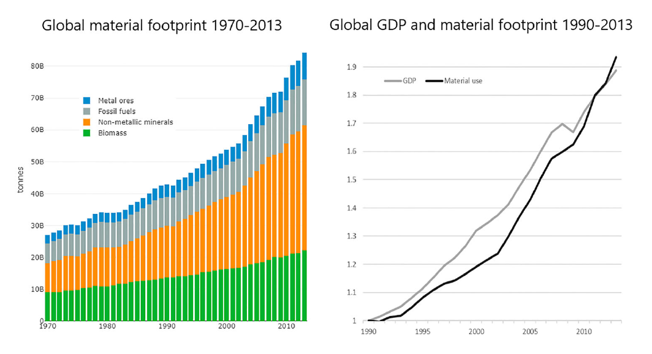
Source: Hickel and Kallis, 2020, retrieved from Materialflows.net/World Bank

Slide 16
Decoupling and resource use
This was the past. Lack of effort only? What are the future prospects?
Services-based economy?
No empirical evidence; services still require substantial indirect material inputs (embodied resource use), that easily ‚hide‘ in imports, which are not always taken into account in decoupling studies and models (Hickel and Kallis, 2020)
Technological improvements? (greater efficiency, cleaner technologies)
To achieve this, even in the most optimistic scenario, material efficiency would need to rise by 4,5% per year – again, there is no empirical evidence from the past for such a pace
Rebound effect cancels out some efficiency gains (reduced costs leading to spending and thus increased material demand)
Circular economy?
Efficiency in material use fostered by increased recycling rates cannot last forever and at some point reaches physical limits – minimum required inputs (especially non-substitutable resources such as land, water, raw materials and energy) (Ward et al., 2016)
All estimates, however, depend on the rate of GDP growth. The models usually work with GDP growth observed in the past, i.e. 2-3% per year. If the pace of growth is lower, the situation improves.

Slide 17
Decoupling and resource use: Conclusions
„The empirical data suggest that absolute decoupling of GDP from resource use
(a) may be possible in the short term in some rich nations with strong abatement policy, but only assuming theoretical efficiency gains that may be impossible to achieve in reality;
(b) is not feasible on a global scale, even under best-case scenario policy conditions;
(c) is physically impossible to maintain in the longer term
In light of this data, we can conclude that green growth theory – in terms of resource use – lacks empirical support. We are not aware of any credible empirical models that contradict this conclusion.“
(Hickel and Kallis, 2020, p. 475)

Slide 18
Decoupling and carbon emissions
Long-term trend towards relative decoupling of GDP and carbon emissions; absolute decoupling seems possible, albeit only local and time-constrained cases (Parrique etl al., 2019, pp. 24-27)
Nonetheless, in the context of climate change, the question is not only if we can reach absolute decoupling, but if we can reduce emissions sufficiently enough to stay within the ‚safe‘ boundaries of 1,5° or 2°C
Climate change is caused by cumulative, absolute impacts. „[I]t is the magnitude and timing of […] decoupling which is at stake more than its mere statistical existence.“ (Parrique et al., 2019, p. 15)
Again, even though absolute decoupling in emissions has been observed historically, in the 21st century not even relative decoupling has been reached so far (Hickel and Kallis, 2020)

Slide 19
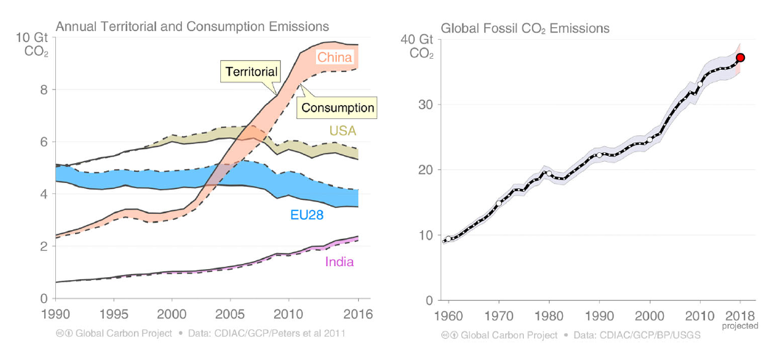
Source: Le Quéré et al., 2018

Slide 20
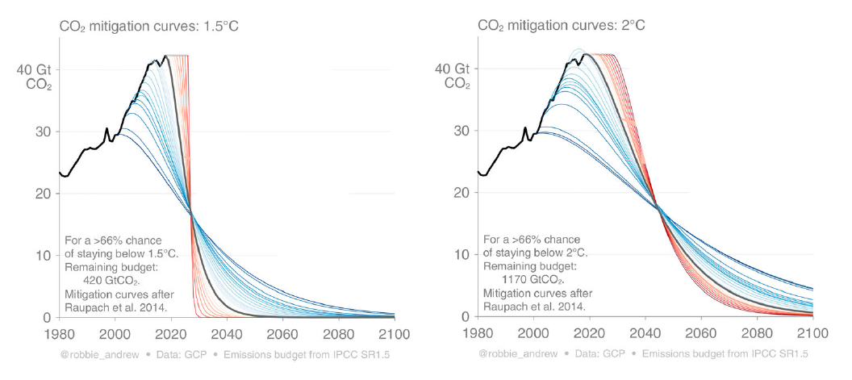
Decoupling and carbon emissions
Current trends are incompatible with the Paris Agreement targets: BAU to lead to 2,5°C – 5,5°C of warming (Hickel and Kallis, 2020, p. 477)
Existing ‚growth‘ scenarios that project staying within the carbon budget are based on an assumption of large-scale carbon capture and storage and sequestration in combination with high bioenergy potential (a speculative technology – land demands, etc.), allowing to emit approx. twice as much carbon emissions
Without CCS, the world would need to go carbon neutral by 2050 (2075) to remain within 1,5°C (2°C):
Source: Le Quéré et al., 2018

Slide 21
Decoupling and carbon emissions
Scenarios without CCS assume ‚full optimal‘ technology efficiency improvements (the most efficient technologies applied on a wide scale in all sectors), mass aforestation, and has high mitigation costs:
E.g.: renewable energy – 2,3 to 4,6 times faster installation rate than so far, energy intensity af the economy falling by 2/3, lowering energy demand under 2015 level (Jacobson and Delucchi, 2011). Even this would only make 90% of the necessary efforts.
If GDP grows globally by 2,1% per year (PWC prediciton), decoupling of carbon emissions must occur at 9,6% to reach 1,5°C, or at 6,4% to reach 2°C (Hickel and Kallis, 2020)
Vs.
Schandl et al. (2016): decoupling can occur at 3% annualy max. under optimistic assumptions
Equity considerations: Burden higher for rich nations (historical responsibility)

Slide 22
Decoupling and carbon emissions: Conclusions
„[W]hile absolute decoupling of GDP from emissions is possible and is already happening in some regions, it is unlikely to happen fast enough to respect the carbon budgets for 1.5°C and 2°C against a background of continued economic growth. Growth increases energy demand, making the transition to renewable energy more difficult, and increases emissions from land use change and industrial processes.“
(Hickel and Kallis, 2020, p. 480)
Green growth within the planetary boundaries relies heavily on the assumption of deploying carbon negative technologies (CCS). Their applicability at wider scale is being questioned.
Even a global 0% GDP growth scenario under other optimistic assumptions requires decoupling of carbon emissions at a rate of 6,8% per year to reach 1,5°C and 4% per year to stay within 2°C

Slide 23
Decoupling in general*: 7 reasons to worry
Rising energy expenditures
Cheaper substitutes to existing sources usually preferred
Rebound effects
Efficiency improvements often partly or fully compensated by a reallocation of saved resources and money to more consumption
Problem shifting
Technological solutions to one environmental problem can create new ones
The underestimated impact of services
The service economy can only exist on the top of the material economy, not instead of it
Limited potential of recycling
Insufficient and inappropriate technological change
Not all technological improvements are driven by environmental considerations, and many are rather harmful; tend to be more intensive in the use of natural resources than labour and capital
Cost shifting
Externalisation of environmental impact from high-consumption to low-consumption countries through international trade (DMC vs. MF accounting)
(Parrique et al., 2019, pp. 4-5)
*Note that there are other ‚decouplings‘ for other environmental indicators than discussed here: land use, pollutants, biodiversity loss…)

Slide 24
Decoupling in general: Conclusions
„The conclusion is both overwhelmingly clear and sobering: not only is there no empirical evidence supporting the existence of a decoupling of economic growth from environmental pressures on anywhere near the scale needed to deal with environmental breakdown, but also, and perhaps more importantly, such decoupling appears unlikely to happen in the future.“
(Parrique et al., 2019, p. 3)

Slide 25
Source: Facebook Justin Arjoon (https://www.facebook.com/photo.php?fbid=10106654433933132&set=a.10100637297028722&type=3&theater)

Slide 26
Decoupling Debunked for download at:
https://eeb.org/library/decoupling-debunked/

Slide 27
Why does the current economy ‚need‘ to grow?
Capital accumulation („[The] dynamic that motivates the pursuit of profit, involving the investment of money or any financial asset with the goal of increasing the initial monetary value of said asset as a financial return“ – “Capital accumulation,” 2020)
Monetary system based on debt money (multiple expansion of deposits)

Slide 28
References
Bringezu, S., 2015. Possible Target Corridor for Sustainable Use of Global Material Resources. Resources 4, 25–54. https://doi.org/10.3390/resources4010025
Capital accumulation, 2020. . Wikipedia.
Dasgupta, S., Laplante, B., Wang, H., Wheeler, D., 2002. Confronting the Environmental Kuznets Curve. Journal of Economic Perspectives 16, 147–168. https://doi.org/10.1257/0895330027157
European Commission, 2020. Green growth and circular economy - Environment - European Commission [WWW Document]. URL https://ec.europa.eu/environment/green-growth/index_en.htm (accessed 6.15.20).
European Commission, 2019. COMMUNICATION FROM THE COMMISSION TO THE EUROPEAN PARLIAMENT, THE EUROPEAN COUNCIL, THE COUNCIL, THE EUROPEAN ECONOMIC AND SOCIAL COMMITTEE AND THE COMMITTEE OF THE REGIONS The European Green Deal.
Everett, T., Ishwaran, M., Ansaloni, G.P., Rubin, A., 2010. Economic growth and the environment 52.
Giljum, S., Dittrich, M., Lieber, M., Lutter, S., 2014. Global Patterns of Material Flows and their Socio-Economic and Environmental Implications: A MFA Study on All Countries World-Wide from 1980 to 2009. Resources 3, 319–339. https://doi.org/10.3390/resources3010319
Hickel, J., Kallis, G., 2020. Is Green Growth Possible? New Political Economy 25, 469–486. https://doi.org/10.1080/13563467.2019.1598964
Hoekstra, A.Y., Wiedmann, T.O., 2014. Humanity’s unsustainable environmental footprint. Science 344, 1114–1117. https://doi.org/10.1126/science.1248365
Jacobson, M.Z., Delucchi, M.A., 2011. Providing all global energy with wind, water, and solar power, Part I: Technologies, energy resources, quantities and areas of infrastructure, and materials. Energy Policy 39, 1154–1169. https://doi.org/10.1016/j.enpol.2010.11.040
Le Quéré, C., Andrew, R.M., Friedlingstein, P., Sitch, S., Hauck, J., Pongratz, J., Pickers, P.A., Korsbakken, J.I., Peters, G.P., Canadell, J.G., Arneth, A., Arora, V.K., Barbero, L., Bastos, A., Bopp, L., Chevallier, F., Chini, L.P., Ciais, P., Doney, S.C., Gkritzalis, T., Goll, D.S., Harris, I., Haverd, V., Hoffman, F.M., Hoppema, M., Houghton, R.A., Hurtt, G., Ilyina, T., Jain, A.K., Johannessen, T., Jones, C.D., Kato, E., Keeling, R.F., Goldewijk, K.K., Landschützer, P., Lefèvre, N., Lienert, S., Liu, Z., Lombardozzi, D., Metzl, N., Munro, D.R., Nabel, J.E.M.S., Nakaoka, S., Neill, C., Olsen, A., Ono, T., Patra, P., Peregon, A., Peters, W., Peylin, P., Pfeil, B., Pierrot, D., Poulter, B., Rehder, G., Resplandy, L., Robertson, E., Rocher, M., Rödenbeck, C., Schuster, U., Schwinger, J., Séférian, R., Skjelvan, I., Steinhoff, T., Sutton, A., Tans, P.P., Tian, H., Tilbrook, B., Tubiello, F.N., van der Laan-Luijkx, I.T., van der Werf, G.R., Viovy, N., Walker, A.P., Wiltshire, A.J., Wright, R., Zaehle, S., Zheng, B., 2018. Global Carbon Budget 2018. Earth System Science Data 10, 2141–2194. https://doi.org/10.5194/essd-10-2141-2018
OECD, 2017. Green Growth Indicators.
OECD, 2011. Towards Green Growth.
Parrique, T., Barth, J., Briens, F., Kerschner, C., Kraus-Polk, A., Kuokkanen, A., Spangenberg, J.H., 2019. Decoupling debunked. Evidence and arguments against green growth as a sole strategy for sustainability. A study edited by the European Environment Bureau EEB.
Schandl, H., Hatfield-Dodds, S., Wiedmann, T., Geschke, A., Cai, Y., West, J., Newth, D., Baynes, T., Lenzen, M., Owen, A., 2016. Decoupling global environmental pressure and economic growth: scenarios for energy use, materials use and carbon emissions. Journal of Cleaner Production, Absolute Reductions in Material Throughput, Energy Use and Emissions 132, 45–56. https://doi.org/10.1016/j.jclepro.2015.06.100
Solow, R.M., 1973. Is the End of the World at Hand? Challenge 16, 39–50. https://doi.org/10.1080/05775132.1973.11469961
Ward, J.D., Sutton, P.C., Werner, A.D., Costanza, R., Mohr, S.H., Simmons, C.T., 2016. Is Decoupling GDP Growth from Environmental Impact Possible? PLoS One 11. https://doi.org/10.1371/journal.pone.0164733
Wiedmann, T.O., Schandl, H., Lenzen, M., Moran, D., Suh, S., West, J., Kanemoto, K., 2015. The material footprint of nations. PNAS 112, 6271–6276. https://doi.org/10.1073/pnas.1220362110

