Slide 1
IRE 111
Week 10: Project workshop
Colin Kimbrell

Slide 2
Research fundamentals revisited
4 phases of research:
preliminary, preparatory, analysis, reporting
First step is to build background knowledge
Extensive reading (aka - reviewing the literature) is the means
Doing so will inspire your research…
& help you to situate your research in the field –
  e.g. the CARS model

Slide 3
Research fundamentals & the final project
4 phases of research:
preliminary, (preparatory), analysis, reporting
Building background knowledge through…
Extensive reading (aka - reviewing the literature)
Hopefully you will gain inspiration for your future research…
As well as useful output to be used therein

Slide 4
What output?
Primary: a literature review
  Definition of literature
    a: writings in prose or verse
      especially: writings having excellence of form or expression and expressing ideas of permanent or universal interest
    b: the body of writings on a particular subject
Secondary: a research “proposal”

Slide 5

What output?

Slide 6
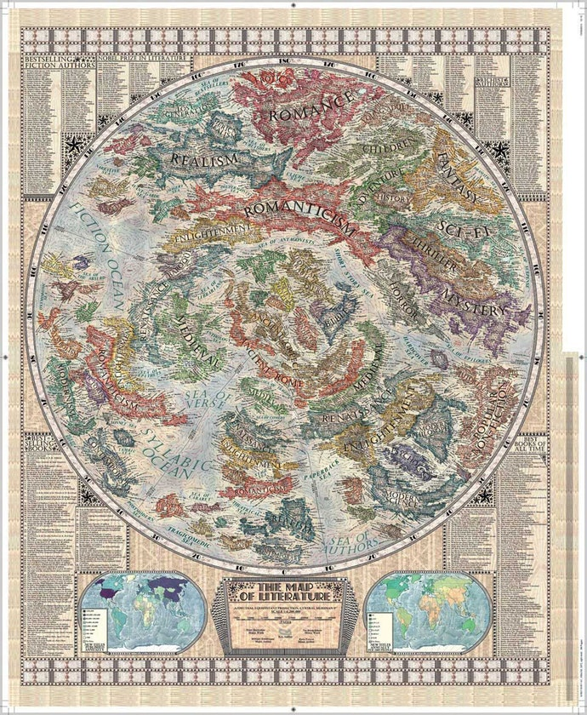

Slide 7
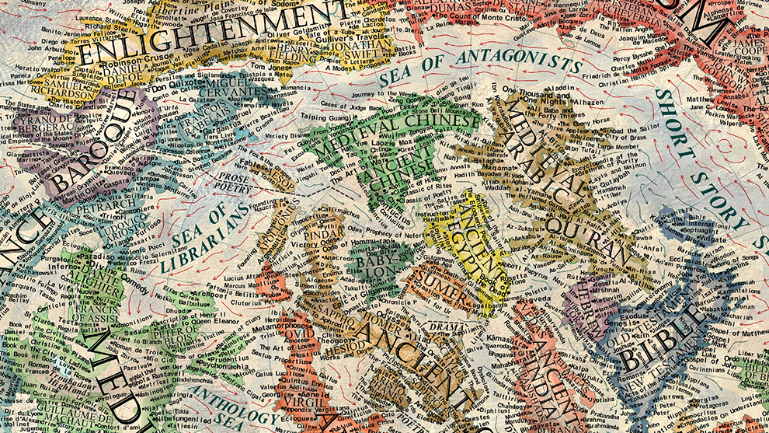

Slide 8
Common mistakes in previous years
Weak justification of the topics relevance to IR/PoliSci + not supported with sources
Lit review focuses on particular research question/case
No discussion of operationalization
Limited range of literature is covered
Proposed application is insufficiently explained:
  Justification of case selection/research question
  Connection with particular conceptualization + operationalization is unclear
  Data sources are not discussed
  Other particular aspects are unclear, e.g. time period

Slide 9
Conceptualization & operationalization
AKA definition & measurement
How would you define “democracy”?
Based on that definition, how can we measure “democracy”?
Is Russia a democracy?

Slide 10
Your final projects & your bachelor studies/ thesis
4 phases of research:
preliminary, preparatory, analysis, reporting
Building background knowledge through…
Extensive reading (aka - reviewing the literature)
Inspiration & useful outputs for your future research
Skills development
Remember, this is a continuous process.

Slide 11
Your bachelor studies & future you
Skills development
Extensive background knowledge
In-depth knowledge of a particular topic
And (hopefully) inspiration and useful output
Remember, continuous processes.

Slide 12
Some books
Kristin Luker, Salsa Dancing into the Social Sciences: Research in an Age of Info-glut
James Hayton, PhD: An uncommon guide to research, writing & PhD life
Cal Newport, So Good They Can’t Ignore You: Why Skills Trump Passion in the Quest for Work You Love

Slide 13
Questions?

