Slide 1
Scientific study of politics
Research Methods and Tools
2020

Slide 2
Scientific approach
Students are interested in politics, not in methods…;
Aim: to explain, why it is scientific approach to politics, what is more valuable, than knowledge generated on empirical facts only…
Science: proceeding from causal theories to scientific knowledge;
The key is thinking about the world in the language of models, where the subject of interest is defined by variables - which are causally interconnected - framed by theory;
Even if we take this course just as a means of gaining qualifications ... - it is still a beneficial way of thinking about a world that will apply at any time…;
What is the scientific way of thinking about the problem good for:
  Helps to use research findings for the needs of other courses;
  It helps to be a better recipient of information;
  It is the first step on the way to become a producer of scientific knowledge.
"Just the Facts" approach: the world is changing, the facts are getting old, theories allow us for a better understanding of the interactions - why changes occur and what the probable direction and impacts will be;
Questions: What? How? Why? (to describe; to understand; to explain).

Slide 3
Looking for causal explanation
Critical thinking: (how we know?)
  We are always willing to take new evidence into account, change what we think - what we know is "true";
  Balanced by vigilance and critical appraisal of new evidence;
Like other scientists - political scientists are developing and testing theories;
  Theory: a testable presumption about the cause of the phenomenon we are examining;
  when the theory was created, we can translate it into one or more testable hypotheses;
The hypothesis is claim derived from the theory, about the relationship we expect to observe;
  Null hypothesis: also on theory-based… - what we expect to observe if our theory is incorrect;
Testing a hypothesis is a process in which a scientist systematically collects evidence to decide whether the evidence supports a hypothesis or a null hypothesis;
  if the hypothesis survives testing, we begin to gain confidence in theory…

Slide 4
…causal theory–>
–> hypothesis–>
–> empirical test –>
–> evaluation of hypothesis–>
–> evaluation of causal theory–>
–> scientific knowledge …

Slide 5
Science
The core of the scientific process is skepticism (attack on theory, finding a new test that would question the theory, null hypothesis favored);
  Vs. „advocate" approach - the objective of producing the desired result - ignoring or discrediting evidence against him, supporting and highlighting the evidence for him;
  Political sciences – a problem of normative bias;
When is theory established – scientists builds on that foundations…
Paradigm (Kuhn) – scientific disciplines go through knowledge accumulation cycles based on a set of shared assumptions and universally accepted theories of how the world works;
  When the paradigm is accepted - more specific questions arising from previous research are formulated - so-called normal science;
  When a major problem is discovered -> revolutionary period (Earth as the center of the Universe) -> the increasing amount of evidence outweighs the consensus - new assumptions and theories -> new paradigms -> a new period of normal science (liberalism vs. nationalism; ISI – ELG).

Slide 6
Language of variables and causal relations
Variable: label+ value;
  Example: „incumbent president (US) has a better chance of re-election if the economy is doing well";
  Economy is independent variable (the cause) – election result is dependent variable (consequence);
  Value of dependent var. depends (is changing with a change) on value of independent var.; IV -> DV
Theory (practically): it is the assumption of the causes of the phenomenon we are examining;
  i.e. that the independent variable is causally linked to the dependent variable ... the change in independent var. causes the change of the dependent var.;
  higher (lower) IV is the cause of a higher (lower) DV (positive direction / negative direction + the change is the key);
Causal explanation: it corresponds (practically) to the question "why do you think DV is causally linked to the IV"?
  if the answer is meaningful, it's worth it ... if it's (also) original it's great!
Example: the president is responsible for the state of the economy, he has EP tools; voters have an intense interest in a well functioning economy (wellbeing) ... will appreciate the president for the proper use of EP tools, ... therefore the state of the economy is functionally linked (affects it.. causes the difference) with the election result – e.g. higher GDP growth is associated with higher vote gains;
Concept of IV (state of economy) –> causal theory –> concept of DV (probability of being reelected)
operationalization phase
Measurable IV (GDP growth in%) -> hypothesis -> Measurable DV (election result - number of votes).

Slide 7
Hypothesis testing
We need testable hypotheses - from a general statement to a more specific statement about facts that we find in the real world;
  E.g. inflation, unemployment, growth, trade balance (ECONOMY) / election result in percents of votes for candidate (ELECTION);
  ... in some elections there is no incumbent president running (do we apply the same for president's party?); there can be strong third candidate (do we split the votes?);
Example: We put each elections into graph:
  X axis: -5 to +5 percent GDP growth; Y axis: 0 to 100% percent votes;
  There will be a positive slope (higher -> higher); if we use e.g. ???, there will be a negative slope (higher -> lower) – this is determined by the operationalization;
We can thus collect data from the world and see how they are compatible with our theory ... but we are far from being able to state causality - i.e. GDP growth is the cause of the result;
  no social phenomenon can be explained by a single variable - if we come with another, we begin to think like scientists…;
  we will make a graph for another and find out whether there is the same (stronger) correlation; then we examine the relationship between the two…
  ... foreign policy intervention (war); extraordinary state of the global economy (crisis); big domestic affair; affiliation to particular political party; divided government (US)…

Slide 8
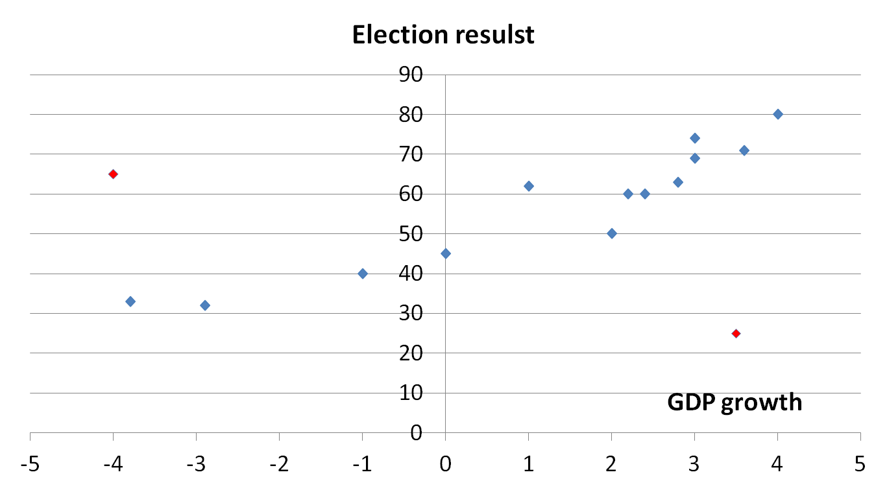
Impact of US economic condition on elections

Slide 9
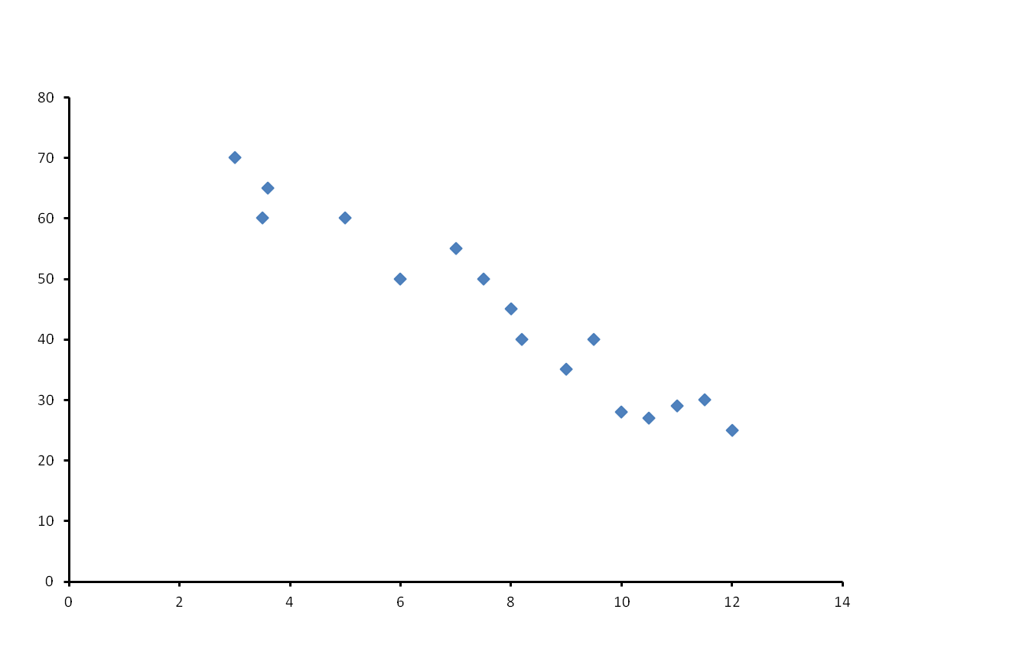
Election result depending on…..???
Election result in percents
……………???

Slide 10
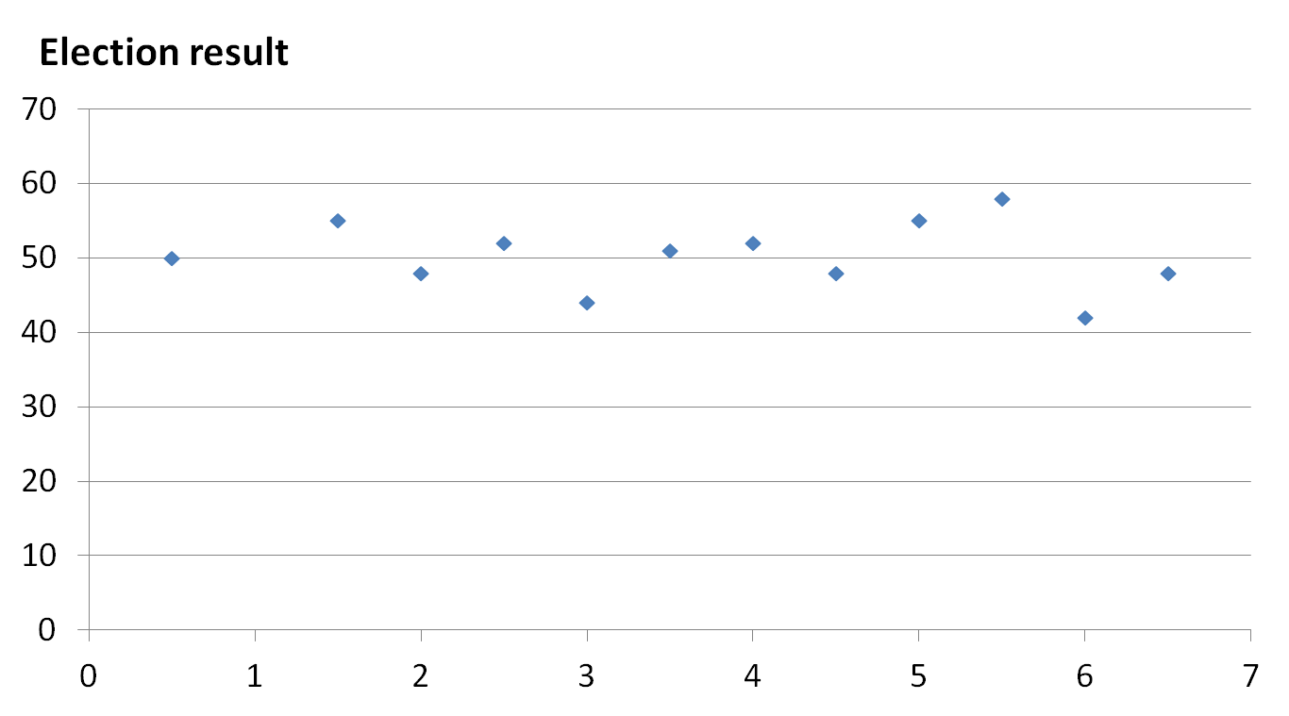

Slide 11
How to construct a model
Model - when we think about phenomena in terms of dependent variables and create theories about the independent variables that are influencing them, then we construct theoretical models;
  It's the "unrealistic" character of model that makes it practical ... models are simplification … vs.
  Excessive reduction makes them irrelevant for understanding of the real world ...
Hints:
  Models we try always to build as causal (vs. correlation);
  We should not be led by the data itself (testing the theories on the dates that led to their creation is problematic);
  Evidence must be firmly based on empirical reality of the real world (vs. rationalist exercises);
  To avoid normativness (vs. neutrality);
  Look for both: universality and simplicity;

Slide 12
Building a theory
Identification of interesting variation;
  Cross-sectional: same time, different place (cases);
  Time-series: the same case, different time;
Use of our knowledge of the problem - shift from a specific case to a more general theory:
  September 11 -> change in support of the US President (what would make a smaller scale attack; what would do other types of incidents; would this happen in another country?); 1970 Mueller: presidential popularity and international conflict…;
Know local, think global;
  Natural scientists doesn't have theory that can only be applied to France ...
Explore previous research:
  Which other causes are not included?
  Can the theory be applied elsewhere?
  What are the other implications?
  How can theory work at another level of aggregation (micro-macro)?
How do I know I have a good theory?
  Is it causal? Can I test it on data I have not yet examined? Is it generalizing? Is it simple? Is it new? Is it non-banal?

