Slide 1
Energy and Society
Jan Osička

Slide 2
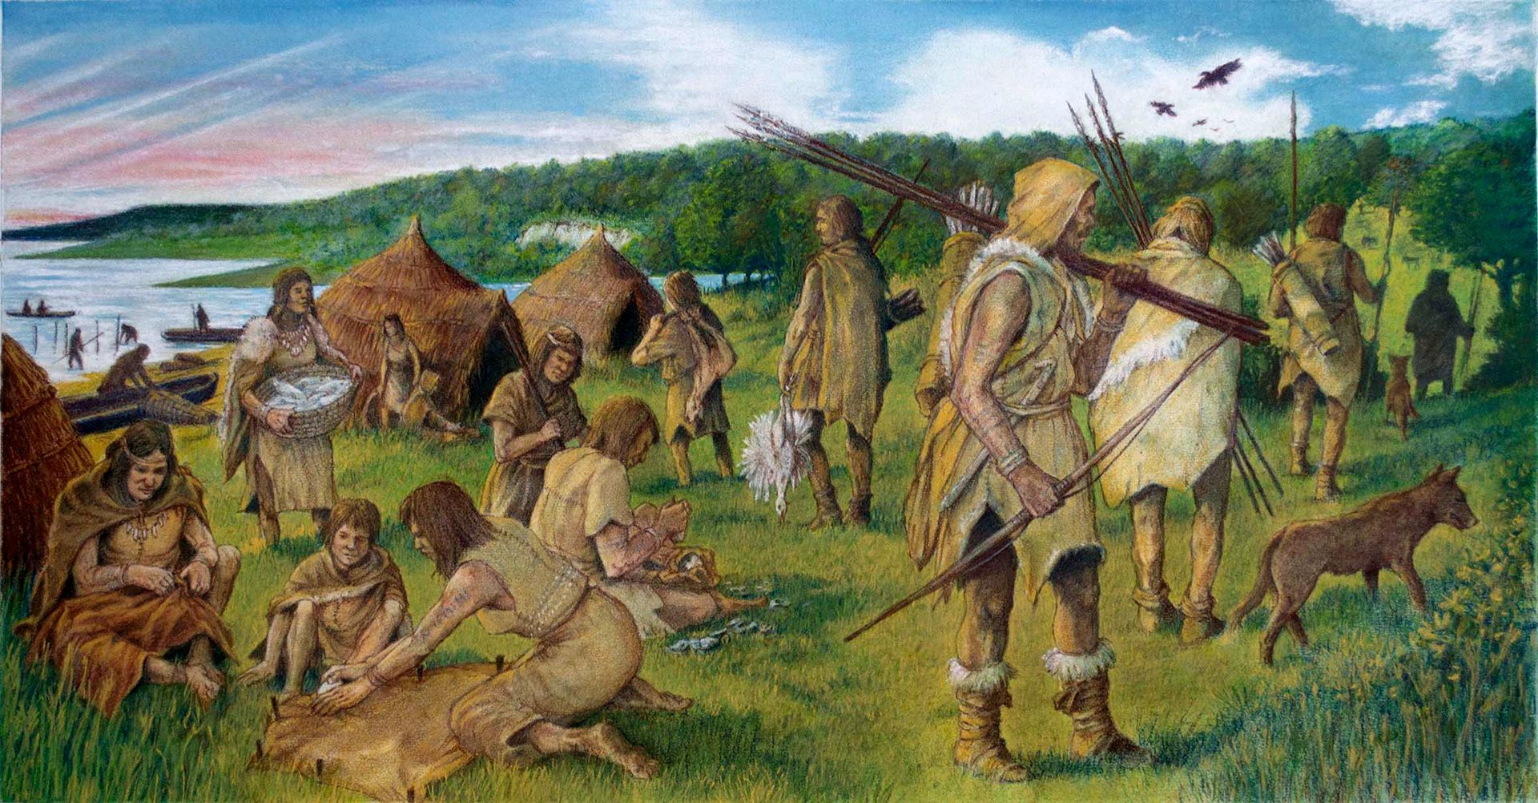
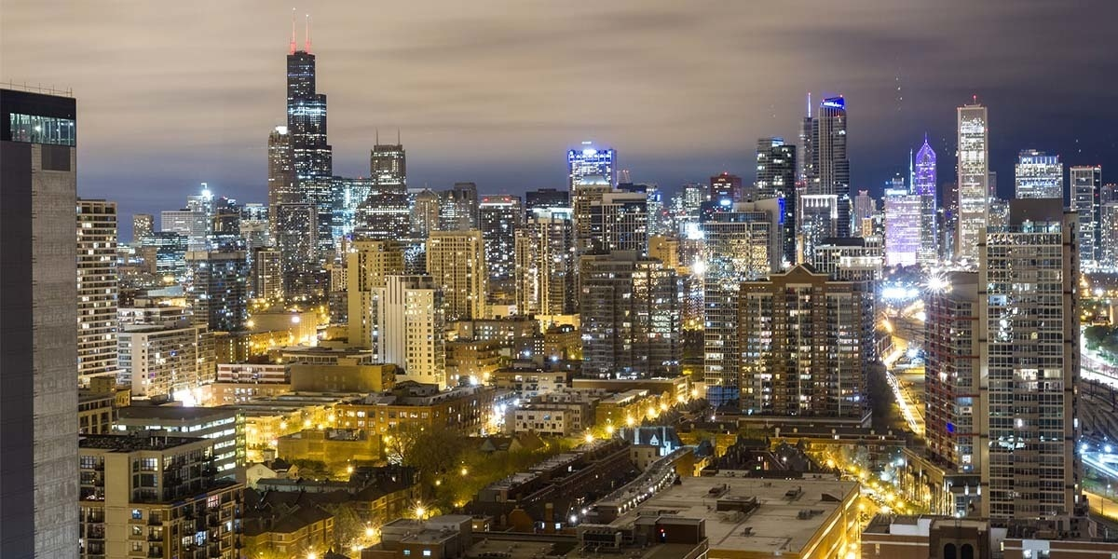
Energy-intensive society: how did we get there?

Slide 3
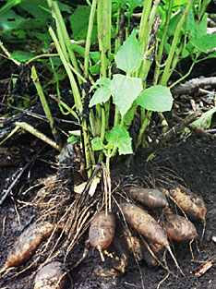
Foraging society
Human body and exosomatic sources of power - fire, body extensions (bows)
Energy return on investment (EROI) up to 40, usually around 3, often around 1.
Very low population density (0,1 person/sq. km)

Slide 4
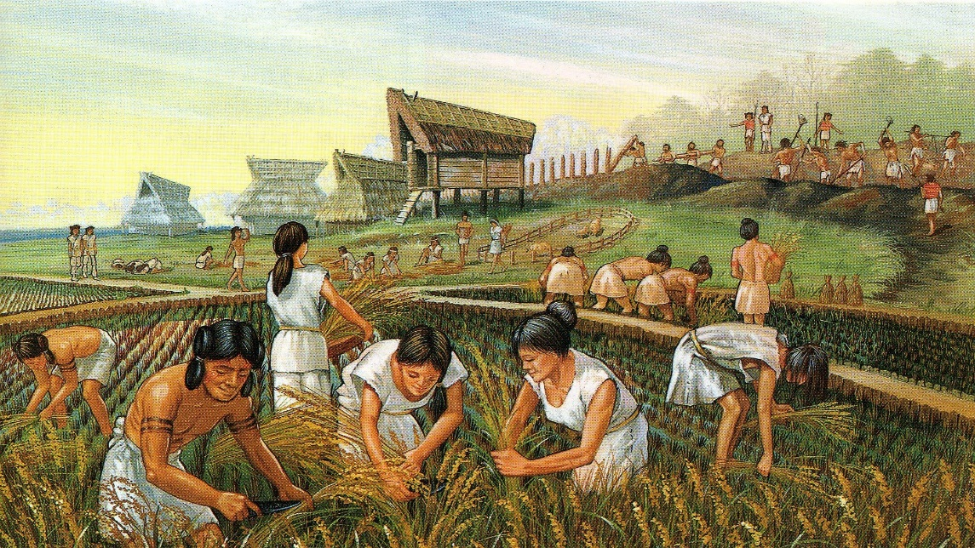
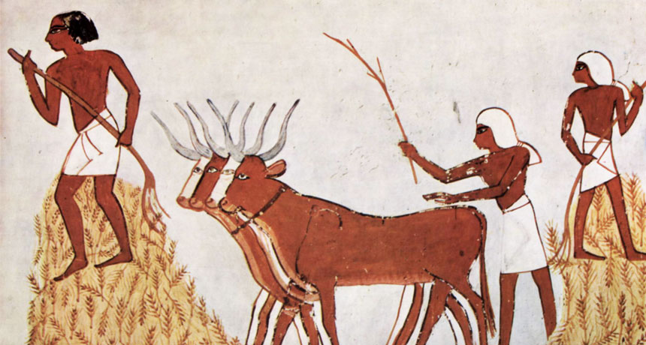
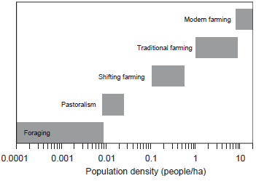
Agricultural society
Greater population density (20-30 persons/sq. km)
First exosomatic sources of power:
Oxes (200-500 W)
Charcoal (29 MJ/kg, no smoke)
Metallurgy: low efficiency, high energy intensity (until 1750)

Slide 5
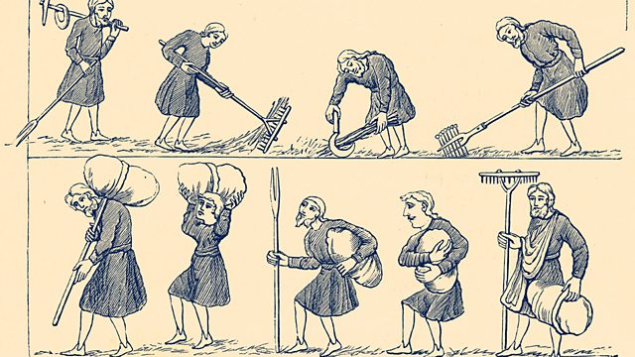
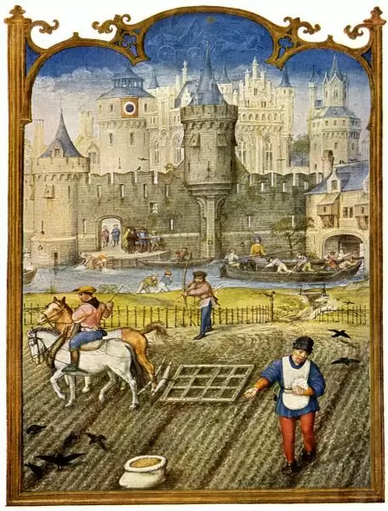
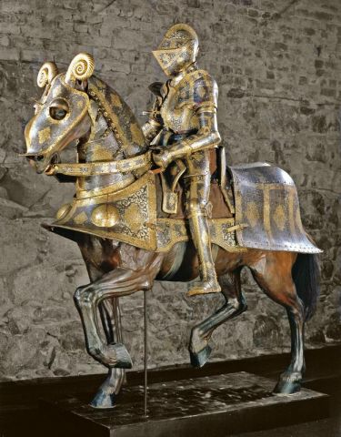
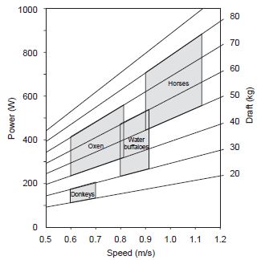
Progress in the Middle Ages: prime movers
Organic prime movers still dominant
Increased efficiency in energy transformation (treadwheels, horseshoes, fodder, breeding)
Non-organic prime movers
Watermills (England, 11th century)
Wind power: sails (+ compass, heavy cannons, rear stear = colonization)

Slide 6
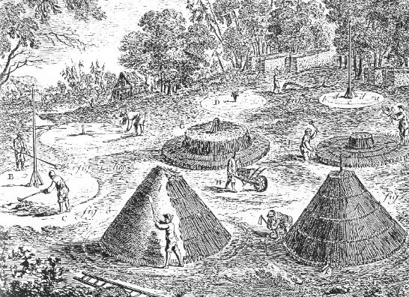
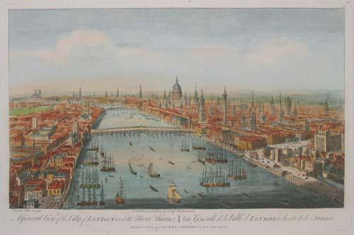
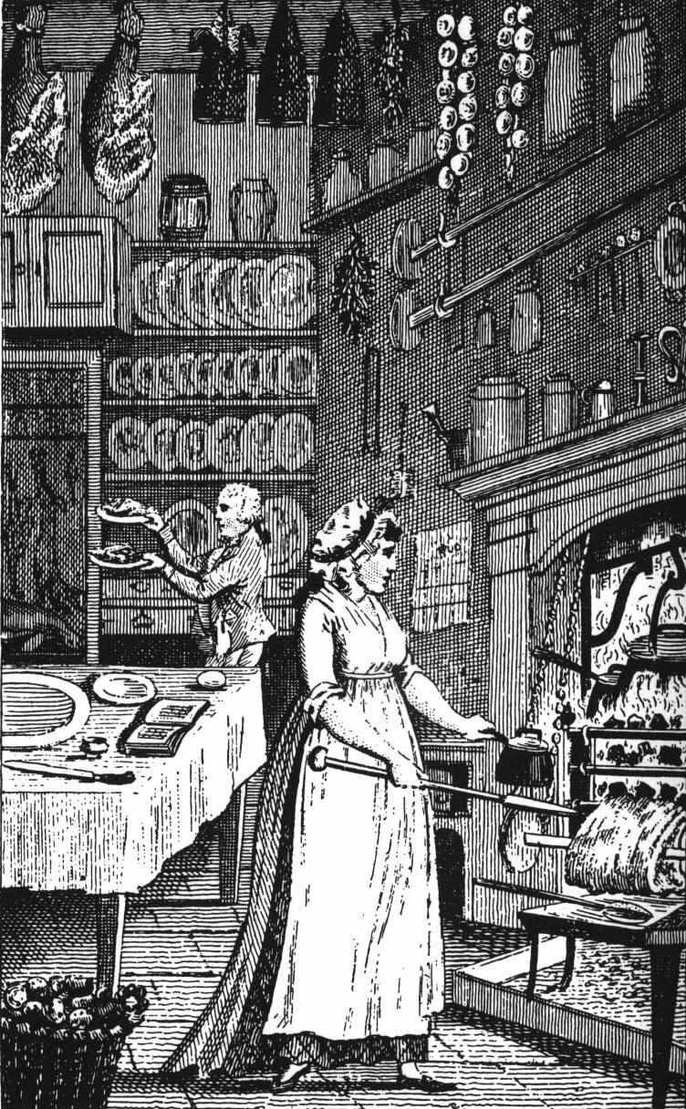
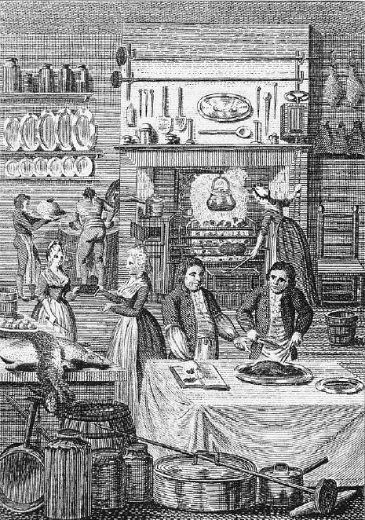
Progress in the Middle Ages: fuel scarcity
Early 18th century England
Average furnace
300 tons of iron per year
12,000 tons of wood
20 square km of forest
Total production: 20,000 tons of iron (1,100 km² of forest)
Total production in early 19th century: 1,000,000 tons of iron

Slide 7
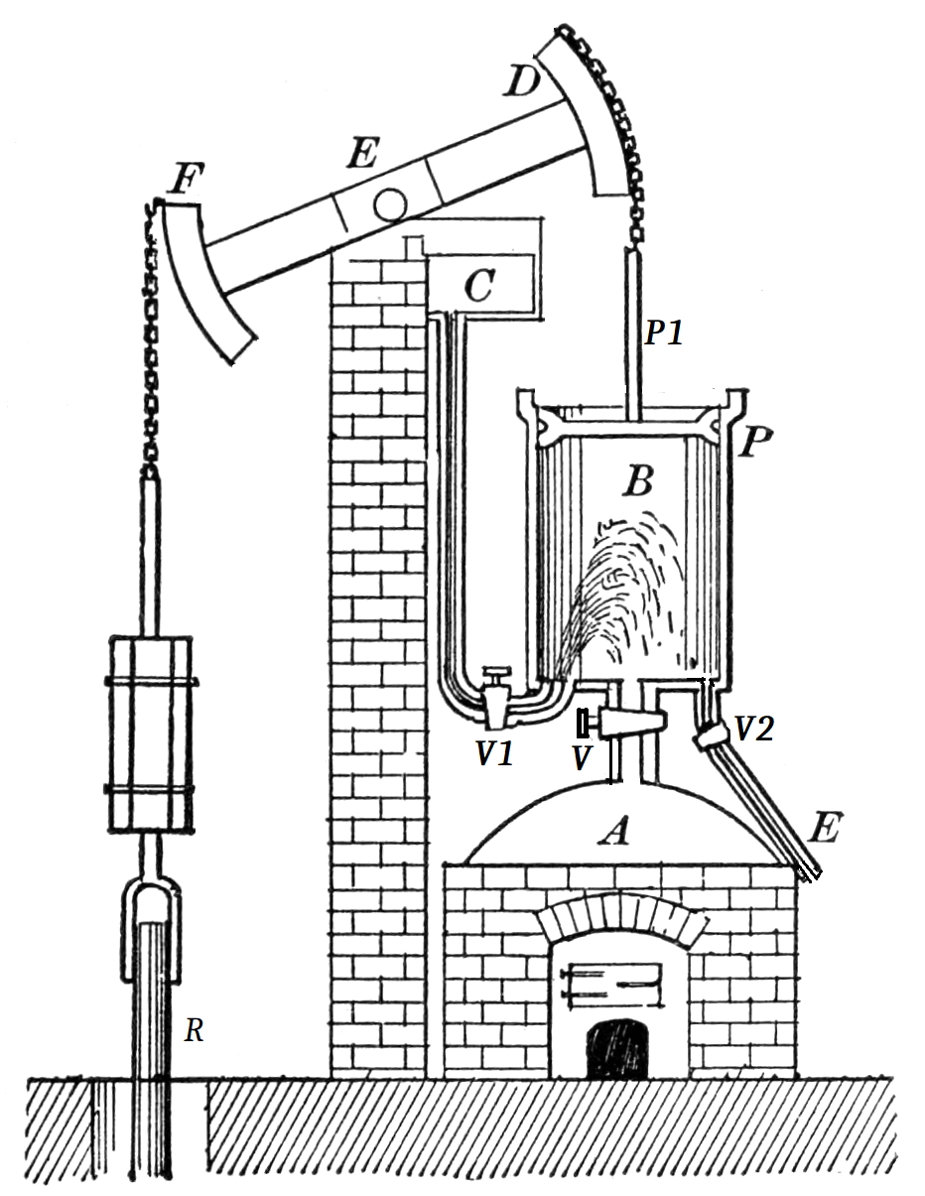
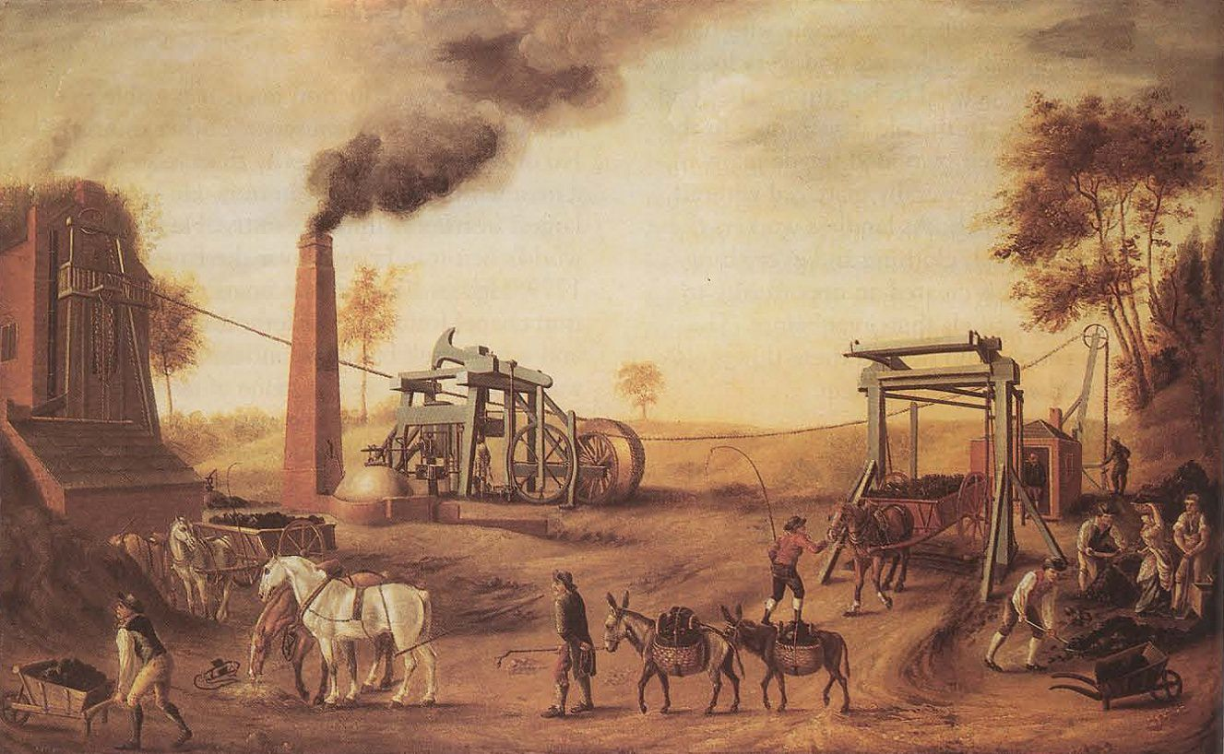
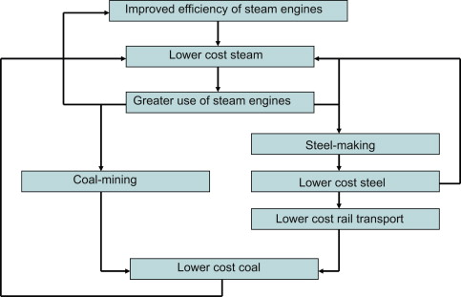
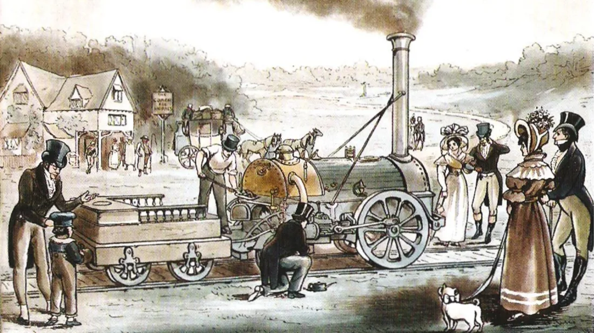
Towards modernity: steam engine
Early steam engine (Newcomen): 20 kW, efficiency 5%
Coal – steam – steel positive feedback
Later (19th century): inland transport revolution

Slide 8
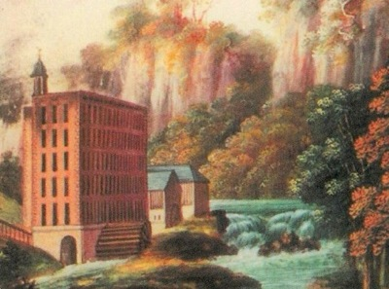
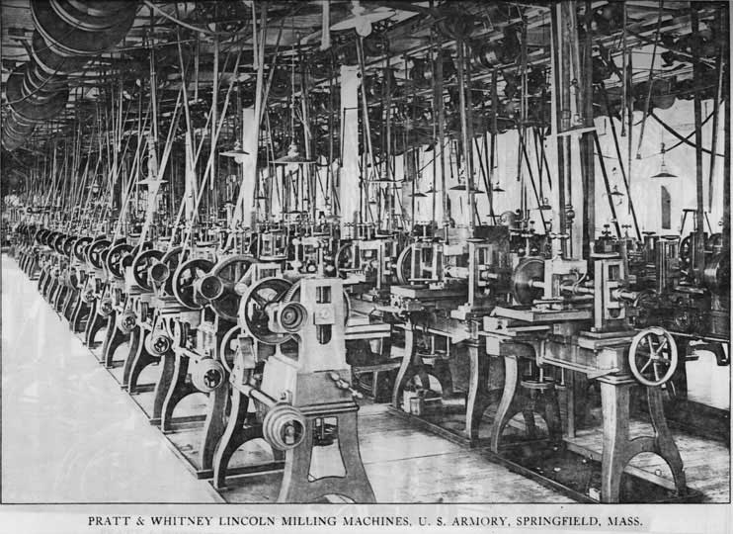
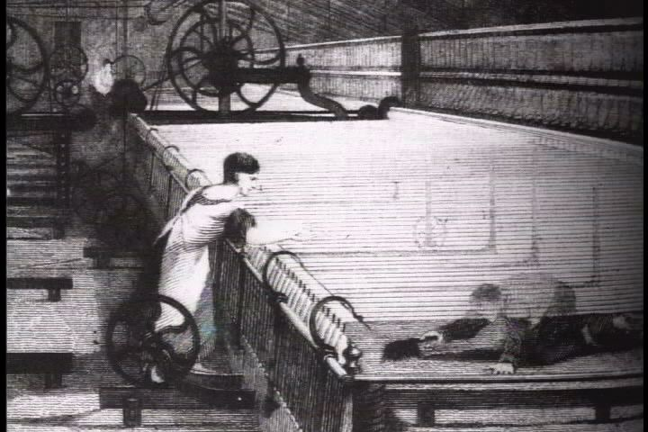
Towards modernity: industrial revolution
Powered by watermills and later steam
Europe 1800-1950: Five distinct prime movers: humans, animals, watermills/turbines, windmills, steam engines
USA 1870: mechanical power outweighs organic power
North Sea 1900: installed capacity in windmills: 100 MW

Slide 9
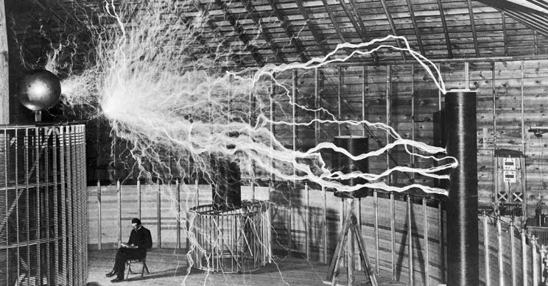
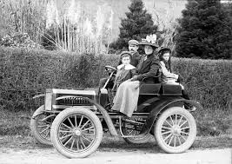
Towards modernity: 1880-1900
T. A. Edison: the basics of electricity production and use
G. Westinghouse and N. Tesla: alternating current
Ch. Parsons: steam turbine
W. Stanley: transformer
N. Tesla: electric motor
USA 1930s: 80% of all mechanical power electrified
Profound change in work and personal life
G. Daimler: spark ignition engine
W. Maybach: carburator
K. Benz: electrical ignition
R. Diesel: compression ignition engine
Three waves of automobile dissemination
Aviation: 1904: the Wright brothers, 1969 Boeing 747, 1969: Apollo 11

Slide 10
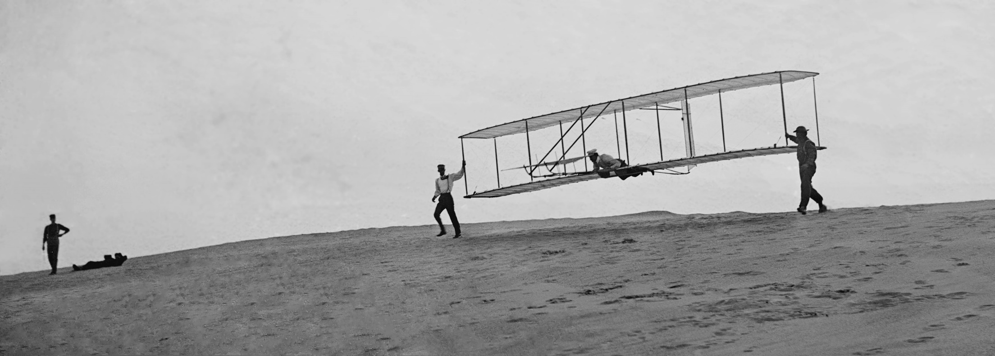
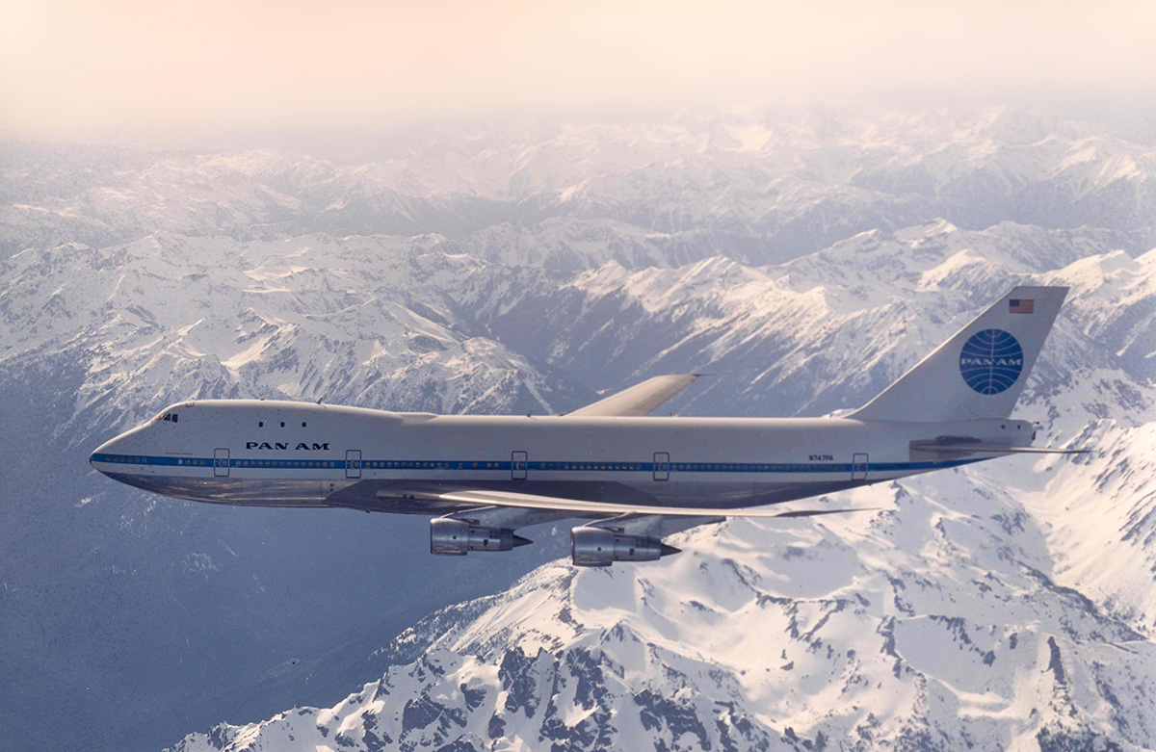
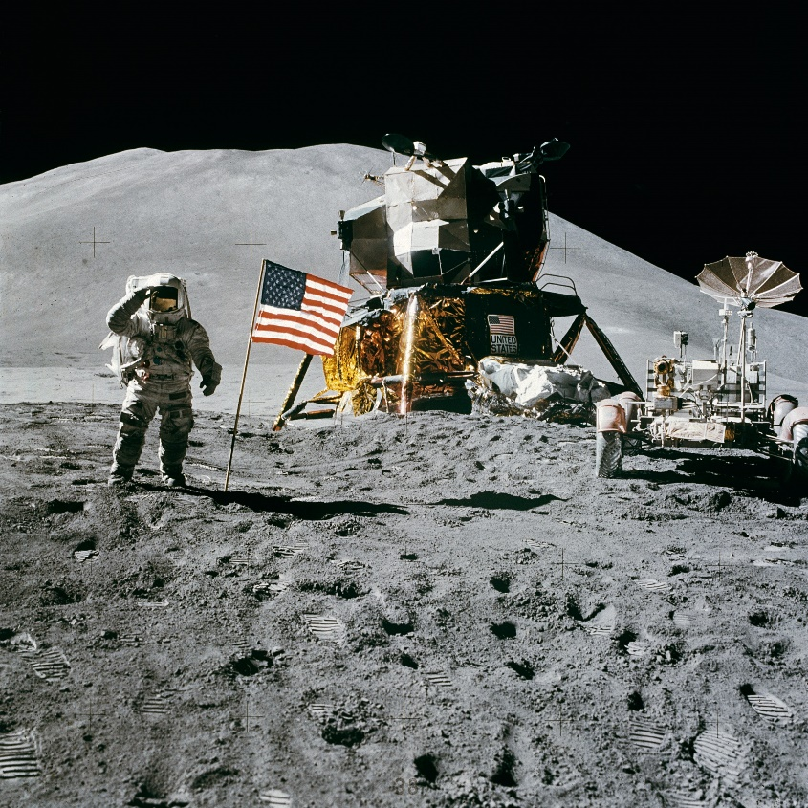

Slide 11
Energy-intensive society

Slide 12
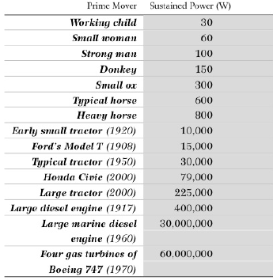
Energy-intensive society
Mechanization of agriculture and industry
Last 10,000 years:
Maximum power of the prime movers has increased 15,000,000x
99% of this change occurred in 20th century

Slide 13
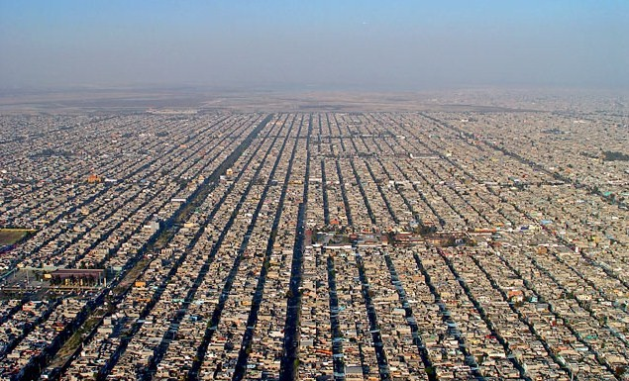
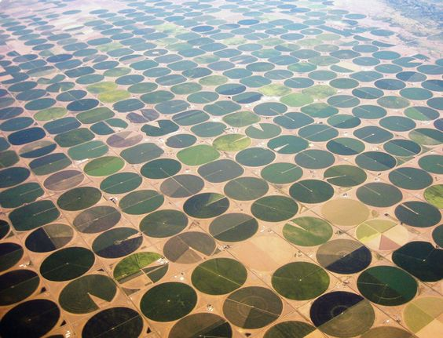
Energy-intensive society
Increased quality of life
Increased inequality
10% consumes 40% of all primary energy
50% consumes 10% of all primary energy
Anthropocene

Slide 14
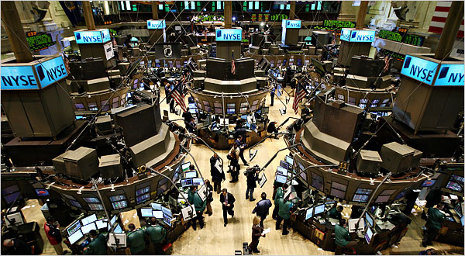
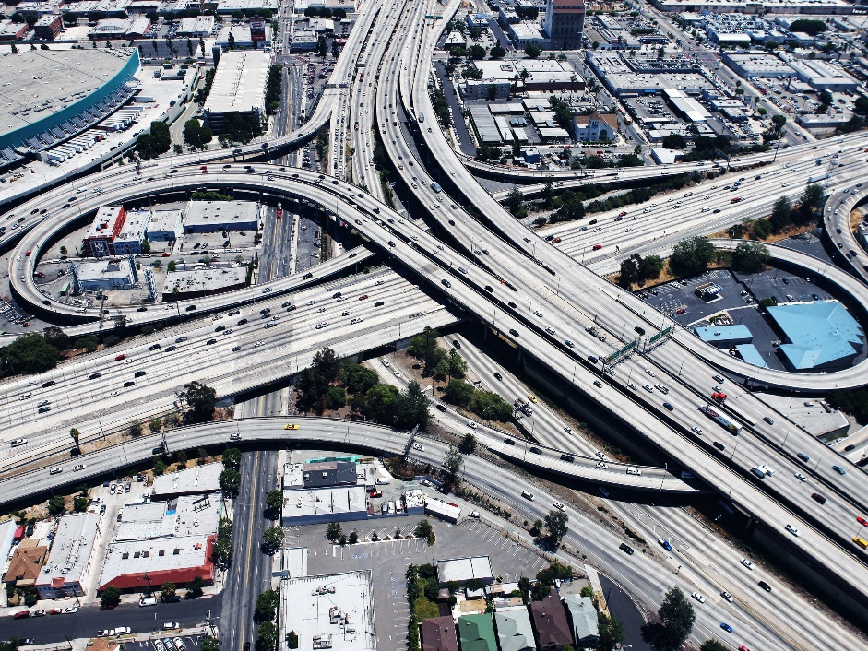
Conclusions
Development stages reflect the power, efficiency, and flexibility of employed prime movers
Harnessing more energy leads to greater complexity of society
Maintaining the level of complexity requires energy

Slide 15
Now, about the course..

Slide 16
What will we be doing here?
Study and discuss the development of the World energy system since 1945.
Learn about the roots of the contemporary energy policies.
Identify and analyze the most influential trends in the past and present energy system.
Discuss the future of energy.

Slide 17
Who will be guiding you through the course?
Jan Osička
Filip Černoch
2009 Istanbul Bilgi University
Energy markets
Renewable energy
Cross-border effects of energy policies
2016 Deutsche Gesellschaft für Auswärtige Politik
2016 Energy advisor to PM Sobotka
Energy policy in the EU
Energy transitions
The regulation behind Energiewende

Slide 18
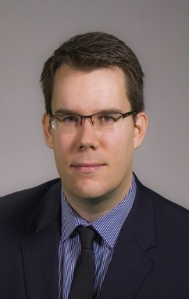
Masaryk University Center for Energy Studies
Founded by Břetislav Dančák in 2009
Dpt. of International Relations and European Studies: 8 full-time researchers
Multidisciplinary research platform dealing with energy
Social dimension of energy transactions (public participation, local opposition, energy poverty)
Energy geopolitics (Russia, pipelines, power)
Energy transition (renewable energy, decarbonization)

Slide 19
www.energy.fss.muni.cz

