Slide 1
Modern energy system: the case of nuclear energy

Slide 2
The afterwar period - changes introduced during/after the war
Regimes, institutions and economy
War economy – nationalization of resources and supply chains (US/UK)
US turns net energy importer – further pressure on relations with producing countries
Technological advancement
ICT – radar, remote control, guiding systems, electrical computation, network communication
Transportation – ICS-based mobility, jet engine-based aviation
Rocket science – space program
Chemical engineering – plastics (substitutes for rubber and glass)
Piping/welding – oil and gas transfers
Nuclear energy

Slide 3
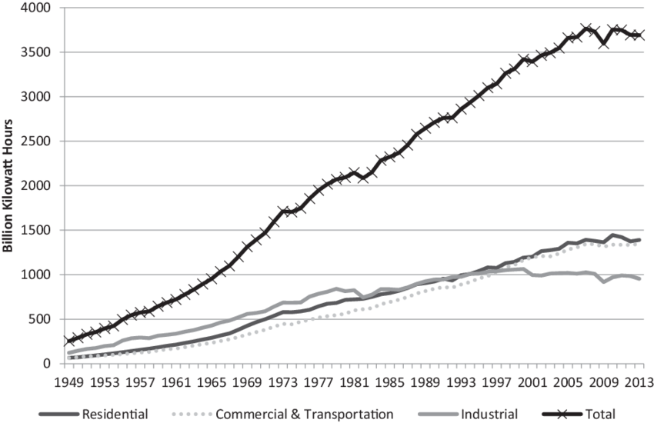
The afterwar period
Electricity consumption in the U.S.

Slide 4
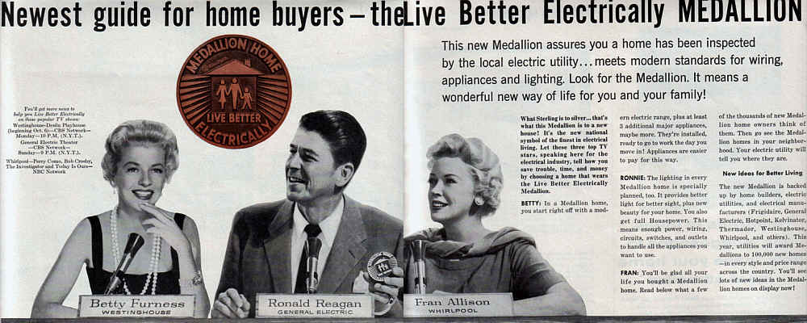
Consolidating the power industry: the business model
The “Grow and build“ strategy
(technological progress + cost/price decline)
Promote electricity usage
Build bigger and more efficient plants
Bring down the costs and sell more electricity
Promote further electricity usage
…
Year | Rated power (MW) | Thermal efficiency (%) | Price (USD1992/kWh)
1892 |  | 2.5 | 4.00
1907 | 12 |  | 1.56
1927 | 110 | 20 | 0.55
1947 |  |  | 0.19
1967 | 1,000 | 40 | 0.09

Slide 5
The consolidation of nuclear industry in the U. S.
“The energy produced by breaking down the atom is a very poor kind of thing. Anyone who expects a source of power from the transformations of these atoms is talking moonshine.”
Lord Ernest Rutherford, 1933.
“It is not too much to expect that our children will enjoy in their homes [nuclear generated] electrical energy too cheap to meter.”
Lewis Strauss, Chairman, US Atomic Energy Commission, 1954.
„The failure of the U.S. nuclear power program ranks as the largest managerial disaster in business history, a disaster on a monumental scale … only the blind, or the biased, can now think that the money has been well spent. It is a defeat for the U.S. consumer and for the competitiveness of U.S. industry, for the utilities that undertook the program and for the private enterprise system that made it possible.“
Forbes cover story “Nuclear Follies“, February 11, 1985

Slide 6
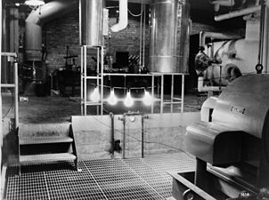
The origins
The Manhattan project (1942-1946)
The experimental breeder reactor (1951)
Atoms for Peace (1953)
Atomic Energy Act of 1954
Regulatory oversight over nuclear energy assigned to the Atomic Energy Commission (AEC)

Slide 7
Commercialization of nuclear energy
AEC‘s role: „To ensure public health and safety from the hazards of nuclear power without imposing excessive requirements that would inhibit the growth of the industry“ (NRC 2017)
Insufficiently rigorous regulations in several important areas, including radiation protection standards, reactor safety, plant siting, and environmental protection

Slide 8
Commercialization of nuclear energy
Rapid increase in power output
1953-1962: below 300 MW
1965: average 660 MW
1970: average above 1,000 MW
Upscaling perhaps too fast to facilitate learning
Multiple manufacturers (Westinghouse, Argonne National Laboratory, General Electrics, BWXT,…) => multiple reactor designs and sub-designs (each unit a prototype)
=> Economy of scale has not been achieved

Slide 9
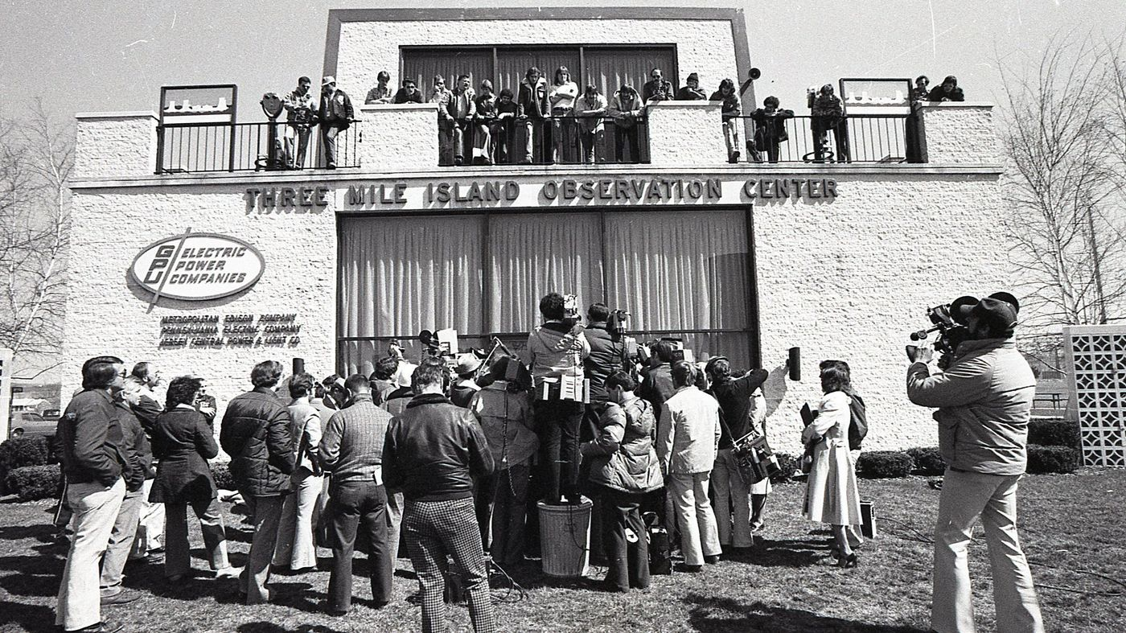
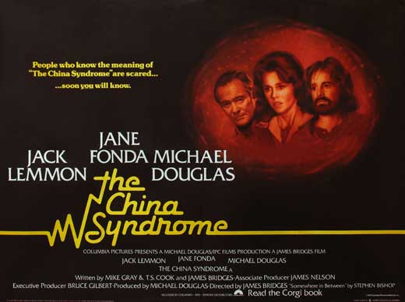
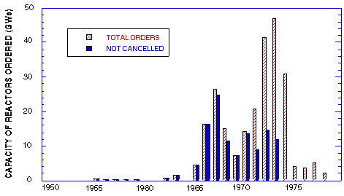
1970s: industry in crisis
Electricity demand increases with a slower pace
Costs of nuclear power increase
Political and local opposition towards nuclear

Slide 10
Shoreham NPP (Long Island, USA)
Announced in 1965 by Long Island Light Company (LILCO)
Expected to come on line by 1973 at $65 - $75 million
1968 LILCO decides to increase the unit‘s size from 540 to 820 MW
Cost overrun
Construction delay => more time for anti-nuclear movement to spread across Long Island
1979 Public opposition intensifies after the Three Mile Island accident => 1983 the county legislature does not approve the plant‘s evacuation plans
Costs reach $2 bn (low productivity and design changes ordered by federal regulators)
1984 The plant is completed, but does not receive operation license due to the unapproved evacuation plans
1994: The plant is fully decommissioned, the total costs reach $6 billion (covered by the LI consumers)
Notes:
The Chinese Syndrome: 16. 3. 1979
TMI accident: 22. 3. 1979
http://www.nytimes.com/1979/03/18/archives/nuclear-experts-debate-the-china-syndrome-but-does-it-satisfy-the.html?_r=0
https://www.youtube.com/watch?v=D8W5hq5dsZ4

Slide 11
Discussion: path dependencies and critical junctures
David, P. A., 1985, Clio and the Economics of QWERTY, The American Economic Review 75 (2).
Collier, R. B., Collier, D, 1991, Shaping the political arena: critical junctures, the labor movement, and regime dynamics in Latin America, Princeton University Press.

