Slide 1
Populism in the Balkans
Populism and political parties POL 133
Věra Stojarová

Slide 2
Populism
Hostility towards representative politics
Heartland and the people
Lack of core values, negativism
Sense of extreme crisis
Non-political nature of populist movements and charistmatic leader
Chameleonic nature

Slide 3
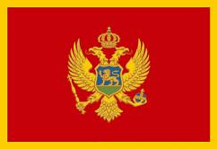
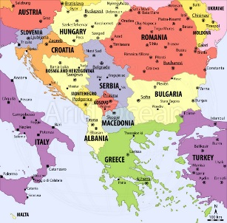
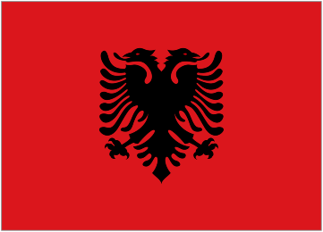
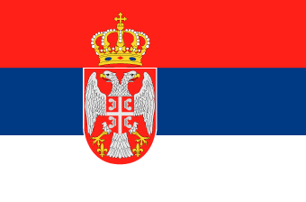
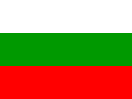
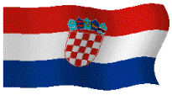
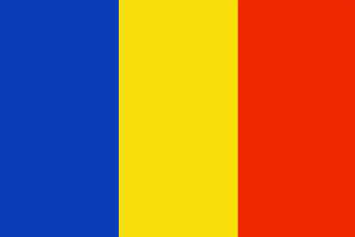
Main features of Slovenia and the Western/Eastern Balkan states
What is Balkan? Western Balkan, southern, eastern??
Dates: (395, 1054, end of 14, century, 1453)
Dissolution of yugoslavia into what??
Nations, ethnics, religions, language, script, lliteracy, life standard

Slide 4
Timeline
1991 Slovenia
1991-95 Croatia
1992-95 BiH
1997 Anarchy in Albania
1998-99 Kosovo
2000 Presevo valley
2001 Macedonia
2003 Belgrade agreement
2006 Montenegro
2008 Kosovo

Slide 5
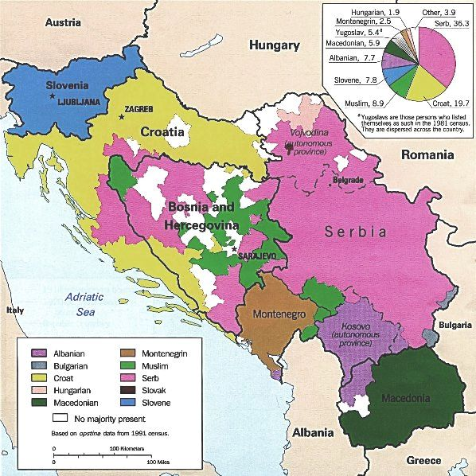
Populism in the Balkans
Croatia: Croatian Democratic Union HDZ
Bosnia and Herzegovina: parties based on ethnicity
Serbia: Serbian Radical Party, Serbian Progressive Party strong nationalist bzw. populist parties
Montenegro: one man show
Macedonia: VMRO-DPMNE
Kosovo: Vetevendosje
Albania: polarisation of Democrats and Socialists
Romania: PP-DD (nationalist PRM)
Bulgaria: GERB, NDSV, RZS (nationalist: VMRO and Ataka)

Slide 6
Populism in the Balkans
Democratic backsliding
Illiberal democracies or authoritarian regimes

Slide 7
In the name of the people or in the name of the nation??
Post-Yugoslavian states – nationalism tied with populism, not really good example of populism, extreme sense of crisis during the wars
Romania, Bulgaria – social populism in Bulgarian GERB, NDSV, RZS and Romanian PP-DD, nationalist populism in the case of Bulgarian Ataka and VMRO and Romanian PRM

Slide 8
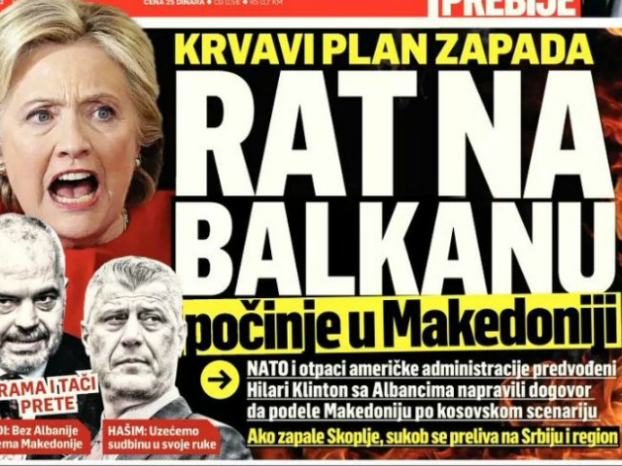
Post-Yugoslavian states
Enemy: USA, other nation, ethnic, globalism, NATO, ICTY, political representation
Heartland
Lack of core values – nationalism as the ideology
Sense of extreme crisis – Balkan wars, simplicity, emotions, straightness
Charismatic leader – Balkan parties as one man show
Chameleonic nature

Slide 9
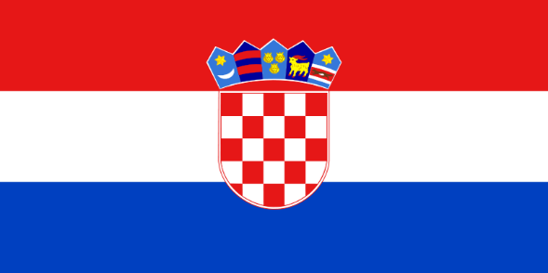
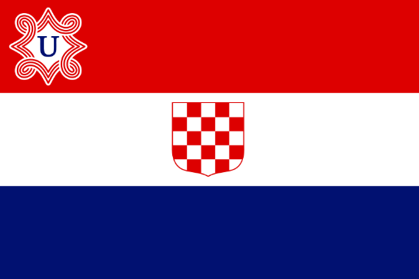
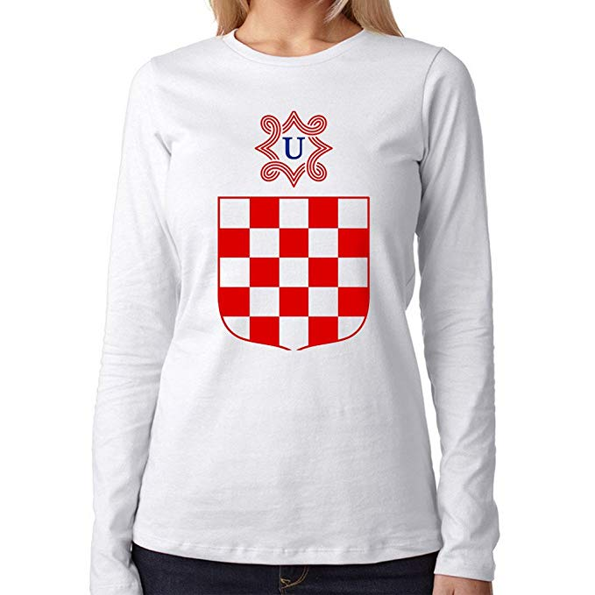
Populism in Croatia
Polarisation
Nativist populism HDZ
Veteran organisations, Church
Za dom spremni, Chessboard, Kuna, Jasenovac, Street names, Homeland war, Victory Day,Thompson
HSP
Živi zid – squating, lower taxes, monetary system not fair, legalisation of marihuana,

Slide 10
Populism in Serbia
Serbia engaged in wars (Croatia, BiH, Kosovo)
Enemies – Croats, Muslims, Albanians, USA, EU, NATO, „international community“, ICTY, globalism, internal dimension for/against SPS/“democrats“
Heartland : Srbija do Tokija, Srbija is like a Nokia, its getting smaller and smaller
In the name of the people = in the name of the nation
Charismatic leader : parties as one man shows – Slobodan Milošević, Vojislav Šešelj, Vuk Drašković,
Chameleonic nature – SRS with Socialists or against them?

Slide 11
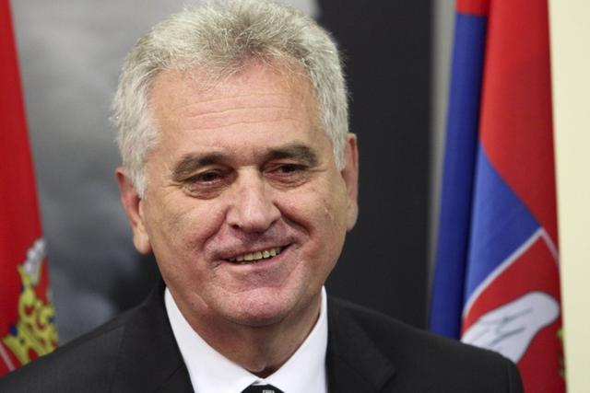
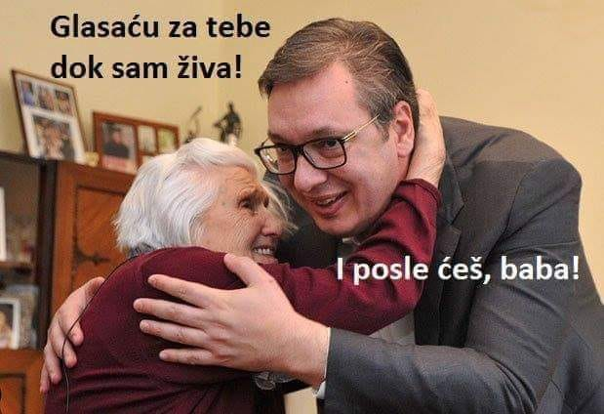
Current populism in Serbia - SNS
Serbian Progressive Party (Srpska napredna stranka, SNS)
Tomislav Nikolic/Alexandar Vucic
nationalism, traditionalism, anti-modernism, anti-westernisation,
Serbian Orthodox Church, traditional society, football hoooligans
Anniversaries of NATO „air campaign“, ICTY decisions, omnipotent Kosovo case

Slide 12
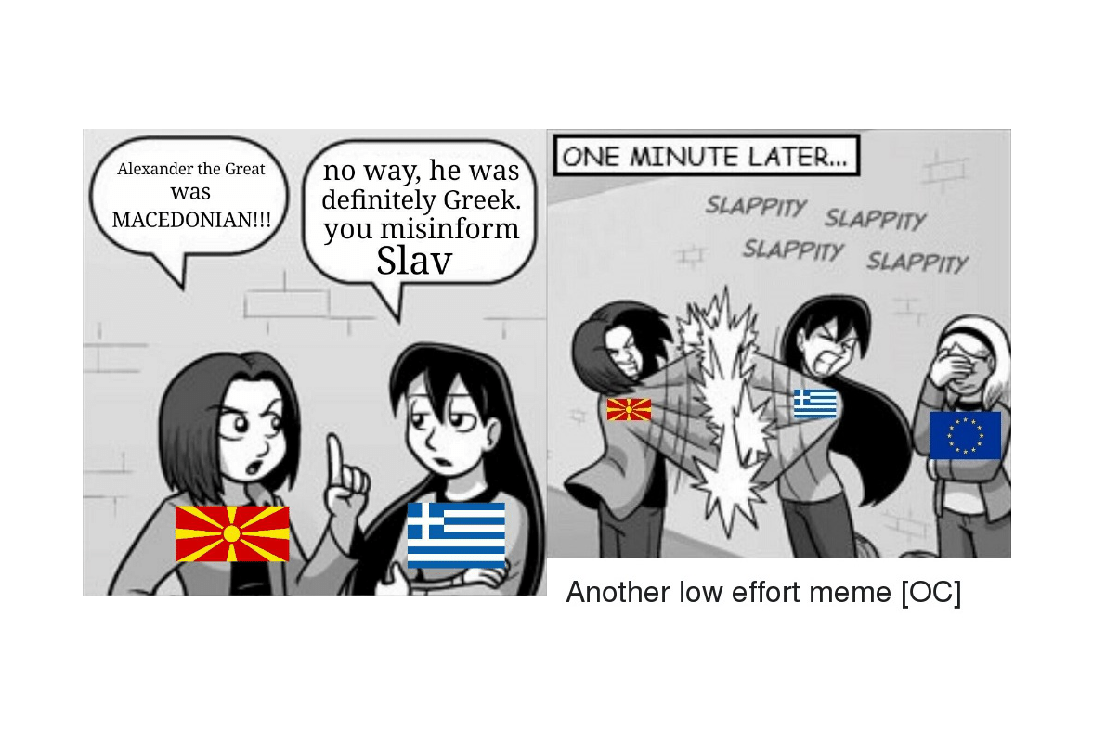
Populism in North Macedonia
Greece, Bulgaria, Albanians, Serbian orthodox church
VMRO-DPMNE
Alexaander the Great, airport, highway, Skopje
Antiquisation
Nationalism

Slide 13
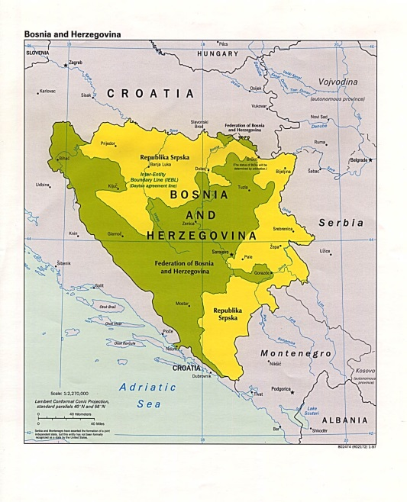
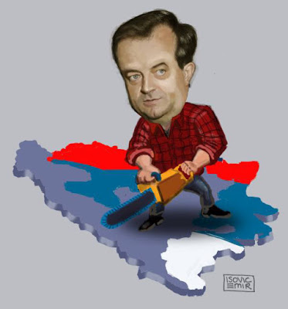
Populism in BiH
Parties based on ethnicity
Authoritarian régime in RS – Dodik
In the name of the nation

Slide 14
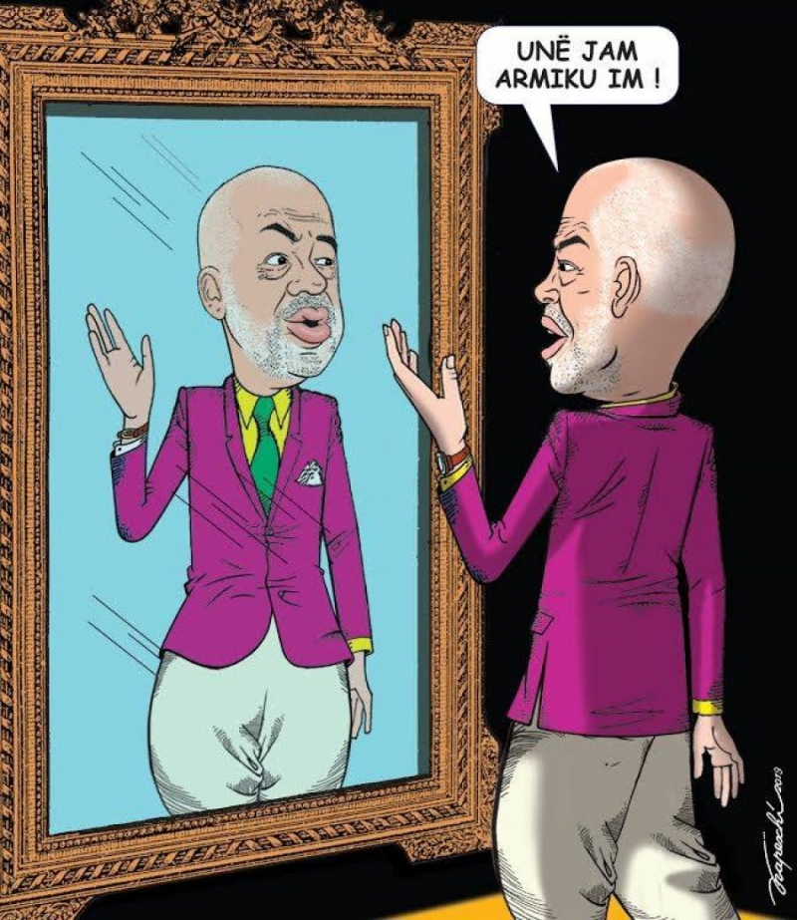
Populism in Albania ??
Democratic party vs. Socialist party
Polarisation
Illiberal practices

Slide 15
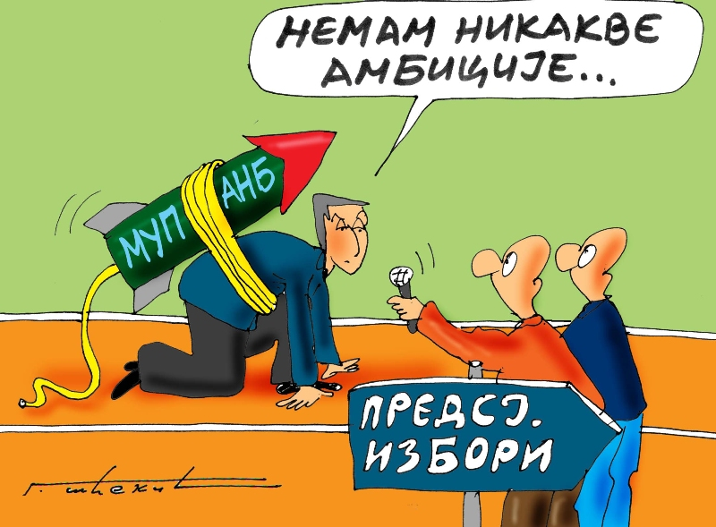
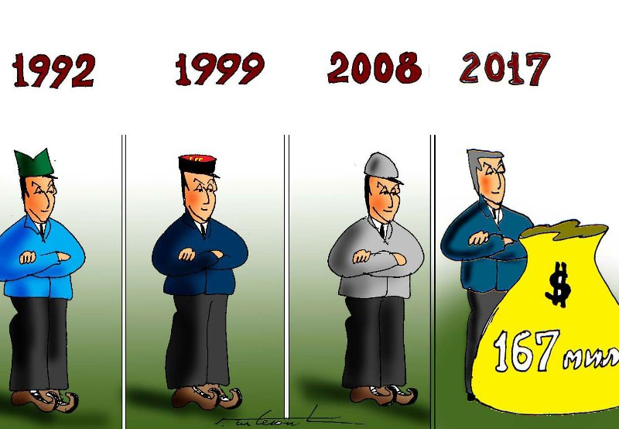
Populism in Montenegro ???
Milo Djukanovic forever
In the name of the nation
Towards the EU and NATO
Together with Russia??

Slide 16
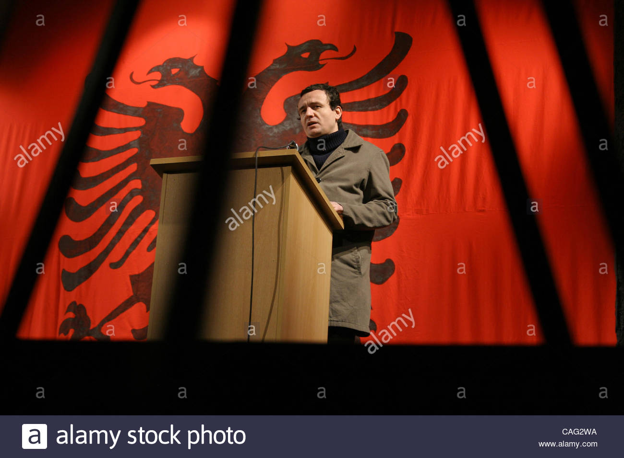
Populism in Kosovo
Vetevendosje
Albin Kurti
Self-determination – referendum
Clan parties
Against the established parties (PDK,AAK,LDK)

Slide 17
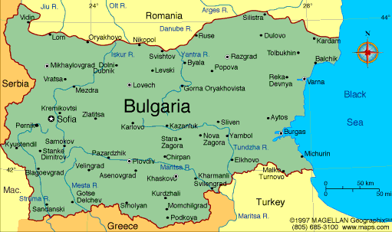
Populism in Bulgaria
NDSV – National Movement for Stability and Progress
GERB
Ataka
RZS – Order, Law and Justice

Slide 18
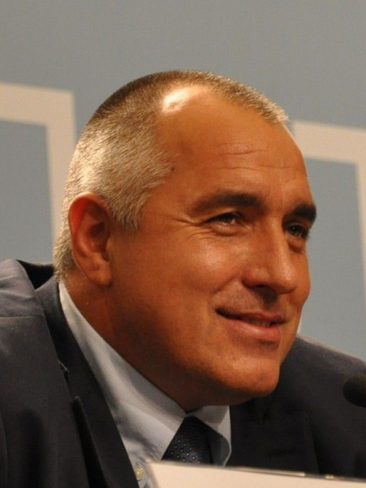
Bulgaria: GERB – Citizens for European development of Bulgaria
heraldic sign or coat of arms in Bulgarian as acronym
personal bodyguard of King Simeon II. Boyko Borissov.
2009 to date
discourse against the ruling elite and the mafia
an image of a person trying to solve everyday problems and going to many cities in Bulgaria
“I proved I can satisfy people’s needs- while the others were talking, I was working and solving problems”.
“us” versus “them”
to finish once and for all with the mafia and the former agents of the communist secret services in Bulgaria
always present in the media
close to the people, “one of them”, always being present and “speaking their language”. His direct contact with people certainly distinguished him also from the “aristocratic” style of King Simeon II

Slide 19
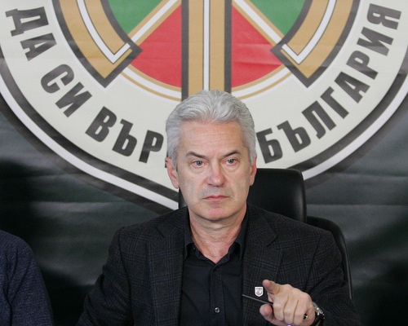
Bulgaria: Ataka
Volen Siderov
Anti-establishment, anti-NATO and anti-EU discourse as well as his hostile attitude the Turkish and Roma minorities in Bulgaria.
the world conspiracy theories and the anti-Bulgarian policies
scored 8% on the national elections, thus becoming the fourth largest party in Bulgarian Parliament
discourse of “Us” vs “Them” : “they are corrupt and will ruin the future of our country”, “they work with the mafia and steal our money”, “they are all enemies of Bulgaria”.
It criticises the organization of the political system:
direct democracy, a “greater control on the politicians and judiciary monitoring of their actions”.
also mobilized its supporters while going on the streets and organizing public meetings

Slide 20
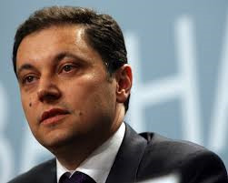
Bulgaria: Order, Law and Justice -RZS
directed against Bulgarian political elite’s corruption, the fight against the mafia and the politicians related with organized crime circles.
Its leader Yane Yanev
stayed marginal
The discourse “the corrupt elite” vs. “the honest people”
Protest party

Slide 21
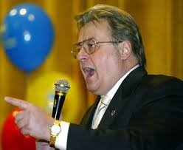
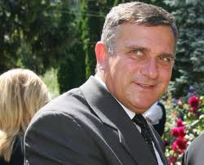
Romania: Greater Romania Party, PRM
its inspiration from the communist regime, i.e., the regime of Nicolae Ceauşescu.
the preservation of national values, traditions, the defence of the national interest, culture and religion.
incorporation of Moldova and part of Ukraine into Romania at the beginning of the 1990s.
anti-Semitic and xenophobic postures, targeting Jews, Hungarians and Romas,
a fight against corruption, nepotism, discrimination and economic crime – and promotes a strong state

Slide 23
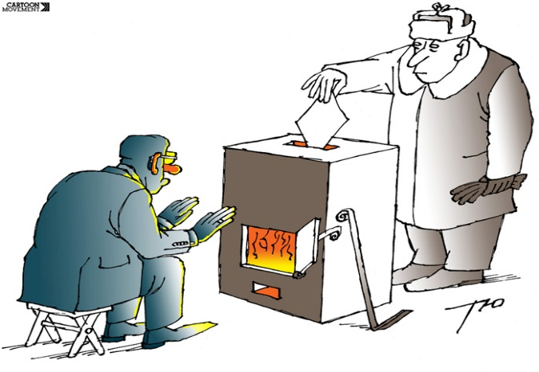
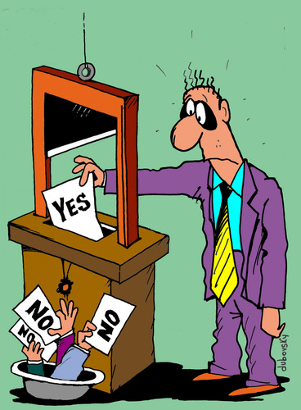
Free and Fair elections
inaccuracy of the voters’ register (multiple voting, voting of dead and those who emigrated)
politicised electoral commissions
vote buying, party employment, intimidation of voters, job loss threats
blurring of state and party activities, control of the media

Slide 24
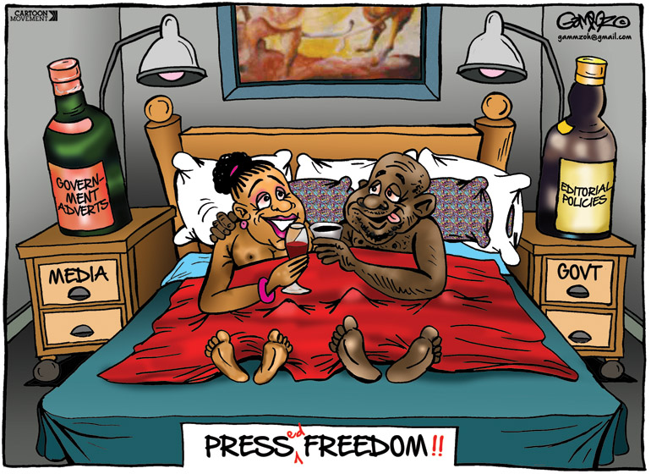
Media freedom
media under direct influence of the ruling party or owned by the proxys of ruling elite leading to extensive coverage of ruling party and minimum coverage of oppositional parties
direct verbal/physical attacks on journalist supported by politicians shaping so the public discourse that media are enemies
arrests of investigative journalists
regulatory bodies close to the ruling parties
defamation, insult, incitement to hatred and other open ended concepts leading to self-censorship
over-regulation leading to charges against media outlets

Slide 25
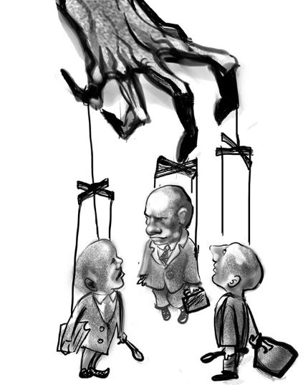
Privileged access to public resources and misuese of power
secret contracts
non-transparent budgets
economic subsidies to the loyal ones without proper oversight
party patronage in public as well as private sector
manipulised public tenders
appointing only party loyals to the top positions in public companies

Slide 26
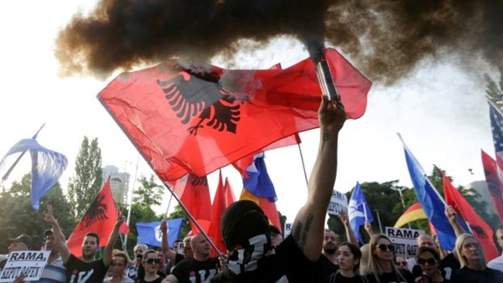
Civil society and other independent institutions
Ombudsman
Civil society
Other independent institutions with oversight function

Slide 27
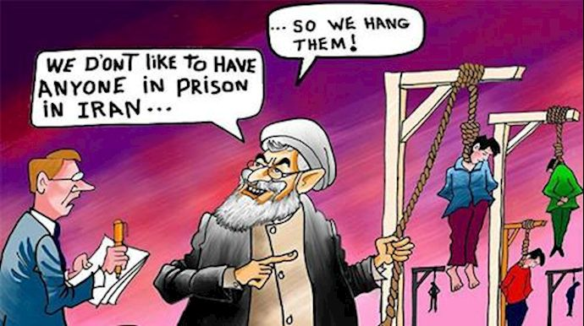
Illiberal Democracy and Populism/Nationalism

