Slide 1
Political authoritarianism
Political psychology and intergroup conflict
Michal Mužík
29. 10. 2020

Slide 2
Authoritarianism
Personality characteristic
Notes:
Fromm, E. (1941). Escape from Freedom. New York, NY: Farrar & Rinehart.
Adorno, T. W., Frenkel-Brunswik, E., Levinson, D. J., Sanford, R. N. (1950). The Authoritarian Personality. New York, NY: Harper.

Slide 3
Authoritarianism
Personality characteristic
OR
Cluster of social attitudes
Notes:
Altemeyer, R.A. (1981). Right-Wing Authoritarianism. Winnipeg: University of Manitoba Press.

Slide 4
Authoritarianism
Personality characteristic
OR
Cluster of social attitudes
OR
Value dimension
Notes:
Duckitt, J. (2001). A dual-process cognitive-motivational theory of ideology and prejudice. In Zanna, M. P. (Ed.), Advances in Experimental Social Psychology, vol. 33 (pp. 41-113). San Diego, CA: Academic Press.

Slide 5
Authoritarianism
Personality characteristic
OR
Cluster of social attitudes
OR
Value dimension

Slide 6
Authoritarianism
Two main dimensions of authoritarianism:
Right-wing authoritarianism (RWA; Altemeyer, 1981)
Social dominance orientation (SDO; Pratto et al., 1994)
Out-group
In-group
Out-group
Group
Group
Group
Notes:
Right-wing in RWA represents preference for status quo and established social hierarchy, and resistance to change.
Left-wing in LWA should represent preference for societal change and opposition to established social hierarchy.

Slide 7
Dimensions of authoritarianism
(Altemeyer, 1996)
Authoritarian submission

Slide 8
Dimensions of authoritarianism
(Altemeyer, 1996)
Authoritarian submission
Authoritarian aggression

Slide 9
Dimensions of authoritarianism
(Altemeyer, 1996)
Authoritarian submission
Authoritarian aggression
Conventionalism

Slide 10
Authoritarianism
Order
Uniformity
Traditions
In-group solidarity
World as a dangerous place
Distrust of others
Resistance to change

Slide 11
Authoritarianism
Prejudice
Political intolerance
Fundamentalism
Intergroup conflict
Notes:
For more on political tolerance, see Sullivan & Transue (1999)

Slide 12
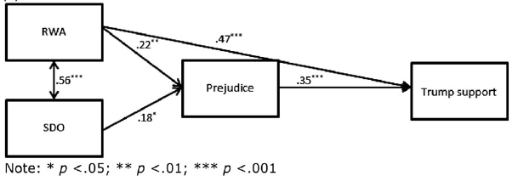
Van Assche, Dhont, & Pettigrew (2019)
Notes:
Support for Donald Trump („I support the program and/or ideas of Donald Trump“) was used to measure far-right support in the United States.

Slide 13
Conway & McFarland (2019)
Correlations between authoritarianism and candidate support.
2008 | RWA
Obama Support | -0.24
McCain Support | 0.29
2016
Clinton Support | -0.44
Trump Support | 0.50
Notes:
Correlations between left-wing authoritarianism (LWA) and candidate support: r=0.44 for Obama support; r=-0.24 for McCain support; r=0.35 for Clinton support; r=-0.40 for Trump support.
For more information on controversy of LWA scale, see Nilsson & Jost (2020).

Slide 14
Authoritarianism
Perceived
threat
Prejudice
Political intolerance
Fundamentalism
Intergroup conflict

Slide 15
Perceived threat and authoritarianism
External, social or intergroup threat

Slide 16
Perceived threat and authoritarianism
External, social or intergroup threat
Intolerance = authoritarianism X threat
(Stenner, 2005)
Notes:
The authoritarian dynamic (Stenner, 2005)

Slide 17
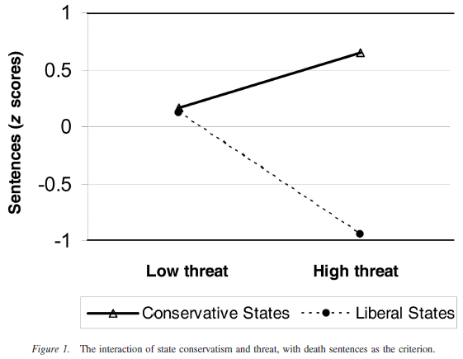
McCann (2008)
Notes:
„Because of the strong correspondence between conservatism and authoritarianism in America, one should assume that jurors in murder trials are more likely to be authoritarian in conservative states than in liberal states.“ (McCann, 2008, p. 915)
Interaction between state conservatism and threat leads to higher number of death sentences in that particular state.

Slide 18
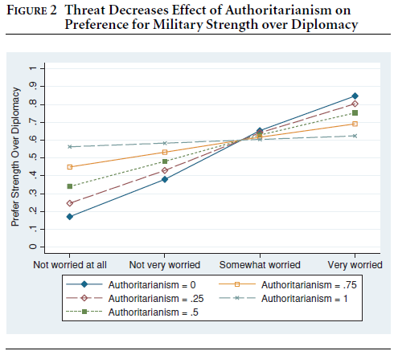
Hetherington & Suhay (2011)
Notes:
High authoritarians do not become more supportive of military strength in response to perceived threat from terrorism.
Non-authoritarians are susceptible to “authoritarian thinking” when they perceive a grave threat.

Slide 19
Authoritarianism
Perceived
threat
Prejudice
Political intolerance
Fundamentalism
Intergroup conflict

Slide 20
Authoritarianism
Perceived Fear/anxiety
threat
Prejudice
Political intolerance
Fundamentalism
Intergroup conflict
Notes:
Fear and anxiety are usually used interchangeably in political psychology.

Slide 21
Authoritarianism
Perceived Fear/anxiety
threat Anger
Prejudice
Political intolerance
Fundamentalism
Intergroup conflict
Notes:
In political psychology, emotions are often used as an emotional categories that cluster similar affective states.

Slide 22
Emotions and authoritarianism
Threat
Fear/anxiety
Anger
Authoritarianism
Prejudice, intolerance

Slide 23
Emotions and perceived threat (Theory of affective intelligence)
Threat
Notes:
Marcus, G. E., Neuman, W. R., & MacKuen, M. (2000). Affective intelligence and political judgment. Chicago: The University of Chicago Press.

Slide 24
Emotions and perceived threat (Theory of affective intelligence)
Uncertainty
Threat
Notes:
Novel threats – new or unusual situations filled with uncertainty

Slide 25
Emotions and perceived threat (Theory of affective intelligence)
Uncertainty
Fear/anxiety
Threat

Slide 26
Emotions and perceived threat (Theory of affective intelligence)
Uncertainty
Fear/anxiety
Threat
Normative violation
Notes:
Familiar threats – situations that are familiar and noxious, and are interpreted as a violation of norms

Slide 27
Emotions and perceived threat (Theory of affective intelligence)
Uncertainty
Fear/anxiety
Threat
Normative violation
Anger

Slide 28
Emotions and authoritarianism
Threat
?
?
Fear/anxiety
Anger
-
+
Authoritarianism
Prejudice, intolerance

Slide 29
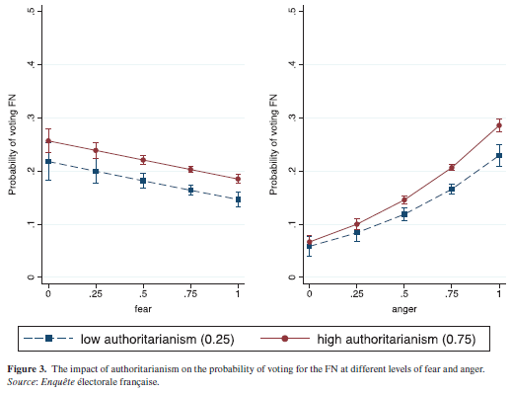
Vasilopoulos et al. (2019)
Notes:
„While both anger and fear appeals are common in far-right discourse, our results show that anger evoked by the terrorist attacks has the far stronger and positive impact on support for the far right, while anxiety weakens support for far-right voting. Further, our results also show that these two affective reactions each interact with dispositional traits but in different ways. Anger strengthens the role of the convictions that align with far-right voting. Anxiety, however, weakens the influence of the dispositional convictions that encourage voting for the far right. “ (Vasiloupoulos et al., 2019, p. 14)

Slide 30
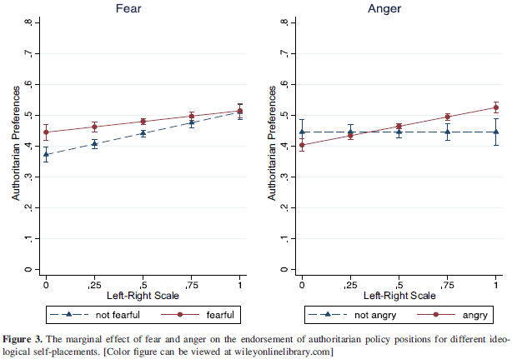
Vasilopoulos, Marcus, & Foucault (2018)
Notes:
Despite differences between conservatism and authoritarianism, right-wing political orientation (aka conservatism) is considered to be a disposition to authoritarianism, because conservatives usually tend to be more intolerant and supportive of authoritarian policies.
„These findings support the claim that anxiety causes the abandonment of habitual routines and increases the reliance on contemporary assessments. On the other hand, anger increases reliance on extant ideological and partisan convictions, making respondents less likely to change political attitudes.“ (Vasilopoulos, Marcus, & Foucault, 2018, p. 11)

Slide 31
Emotions and authoritarianism
„Hence, it would be more apt to say that we are observing the impact of xenocholera, Islamocholera, or homocholera, hatred of others, hatred of Muslims, and hatred of gay people.“ (Marcus et al., 2019)

Slide 32
Summary
Authoritarianism leads to prejudice and intolerance
Authoritarianism is associated with the perception of threat
The effect of perception of threat varies contextually
Anger strengthens the effect of authoritarianism

Slide 33
References
Adorno, T. W., Frenkel-Brunswik, E., Levinson, D. J., Sanford, R. N. (1950). The Authoritarian Personality. New York, NY: Harper.
Altemeyer, R.A. (1981). Right-Wing Authoritarianism. Winnipeg: University of Manitoba Press.
Altemeyer, B. (1996). The Authoritarian Specter. Cambridge, MA: Harvard University Press.
Conway, L. G., & McFarland, J. D. (2019). Do right-wing and left-wing authoritarianism predict election outcomes?: Support for Obama and Trump across two United States presidential elections. Personality And Individual Differences, 138, 84-87.
Duckitt, J. (2001). A dual-process cognitive-motivational theory of ideology and prejudice. In Zanna, M. P. (Ed.), Advances in Experimental Social Psychology, vol. 33 (pp. 41-113). San Diego, CA: Academic Press.
Fromm, E. (1941). Escape from Freedom. New York, NY: Farrar & Rinehart.
Hetherington, M. J., & Suhay, E. (2011). Authoritarianism, Threat, and Americans’ Support for the War on Terror. American Journal Of Political Science, 55(3), 546-560.
Marcus, G. E., Neuman, W. R., & MacKuen, M. (2000). Affective intelligence and political judgment. Chicago: The University of Chicago Press.
Marcus, G. E., Valentino, N. A., Vasilopoulos, P., & Foucault, M. (2019). Applying the theory of affective intelligence to support for authoritarian policies and parties. Advances In Political Psychology, 40(Suppl. 1), 109-139.
McCann, S.J. (2008). Societal threat, authoritarianism, conservatism, and US state death penalty sentencing (1977–2004). Journal of Personality and Social Psychology, 94, 913–923.
Nilsson, A., & Jost, J. T. (2020). The authoritarian-conservatism nexus. Current Opinion In Behavioral Sciences, 34, 148-154.
Pratto, F., Sidanius, J., Stallworth, L.M., Malle, B.F. (1994). Social dominance orientation: a personality variable predicting social and political attitudes. Journal of Personality and Social Psychology, 67 (4), 741–763.
Stenner, K. (2005). The Authoritarian Dynamic. Cambridge, UK: Cambridge University Press.
Sullivan, J. L., & Transue, J. E. (1999). The psychological underpinnings of democracy: A selective review of research on political tolerance, interpersonal trust, and social capital. Annual Review Of Psychology, 50(1), 625-650.
Van Assche, J., Dhont, K., & Pettigrew, T. F. (2019). The social‐psychological bases of far‐right support in Europe and the United States. Journal of Community & Applied Social Psychology, 29(5), 385-401.
Vasilopoulos, P., Marcus, G. E., & Foucault, M. (2018). Emotional responses to the Charlie Hebdo attacks: Addressing the authoritarianism puzzle. Political Psychology, 39(3), 557-575.
Vasilopoulos, P., Marcus, G. E., Valentino, N. A., & Foucault, M. (2019). Fear, Anger, and Voting for the Far Right: Evidence From the November 13, 2015 Paris Terror Attacks. Political Psychology, 40(4): 679-704.

