Slide 1
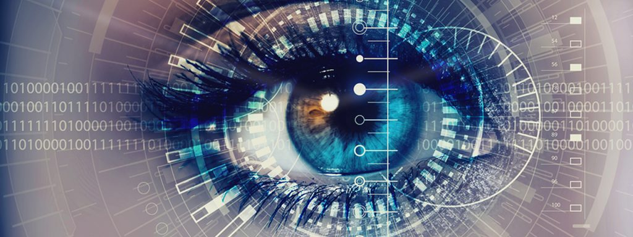
Culture and socialization determines what we notice, what we see and what we perceive as important

Slide 2
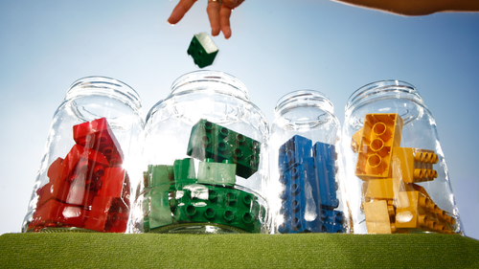
People live their life through classification. Most often ME/US and THEM

Slide 3
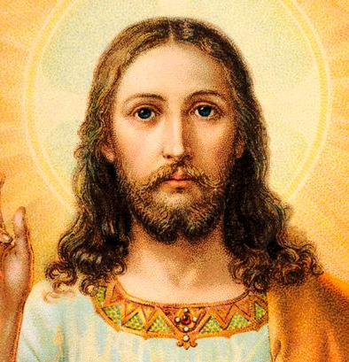
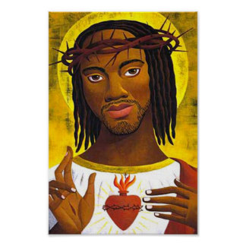
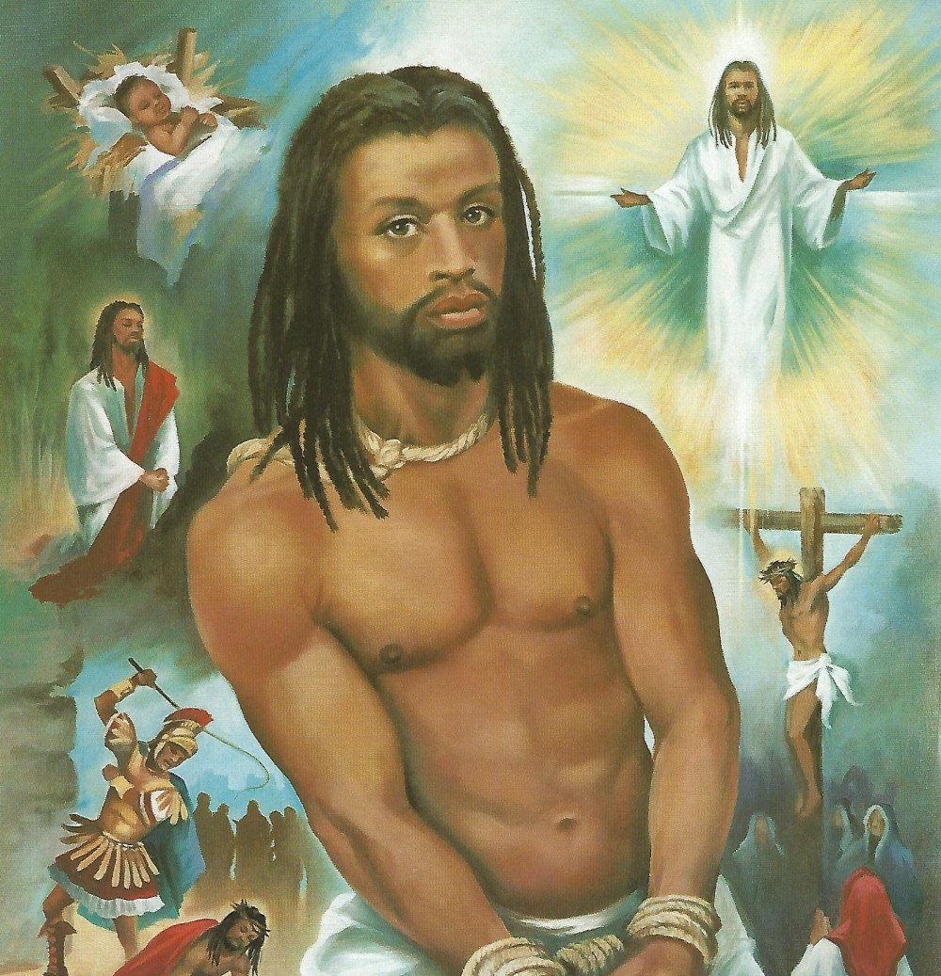
Men and God alike: We all have our ´own´ Jesus

Slide 4
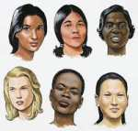
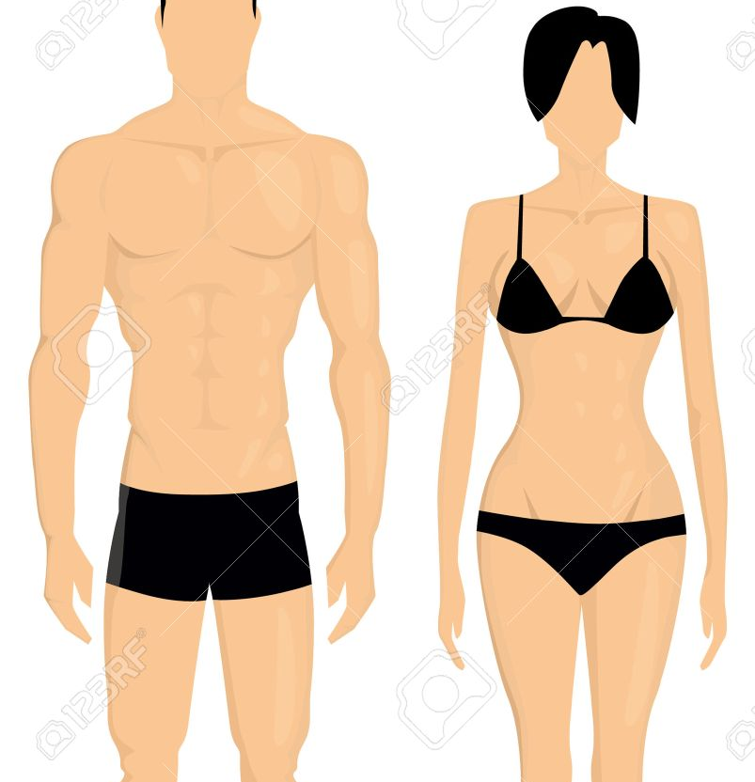
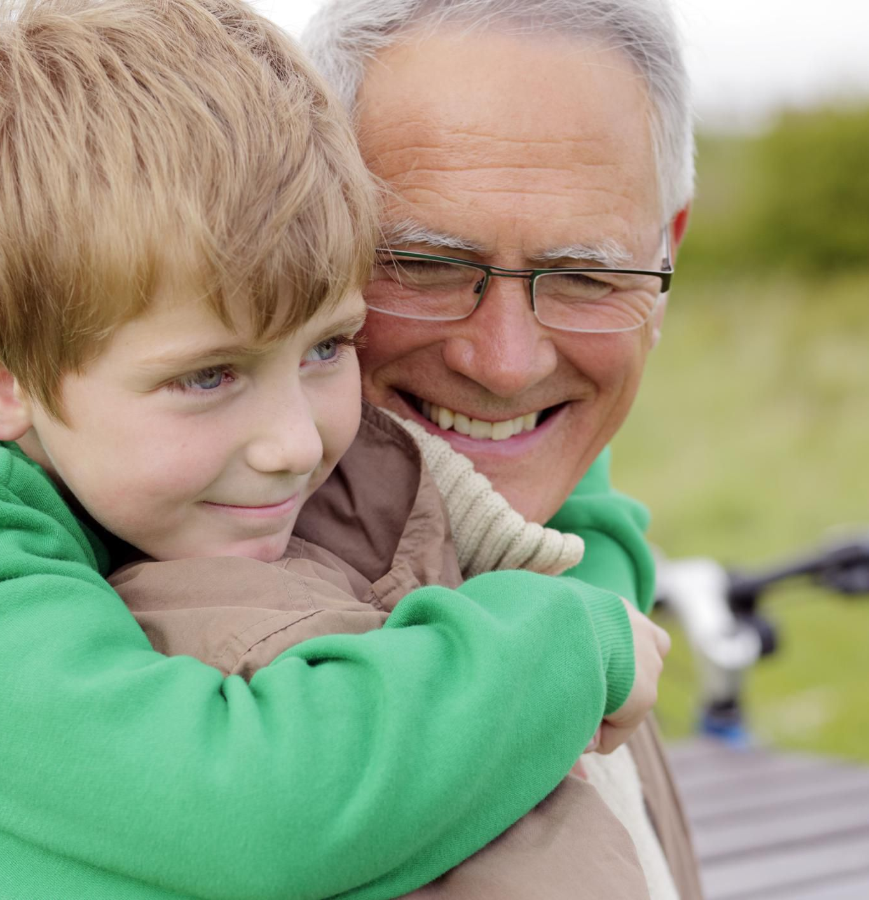
Difference at birth: colour of skin, strength, sex, age etc.

Slide 5
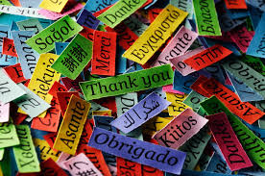
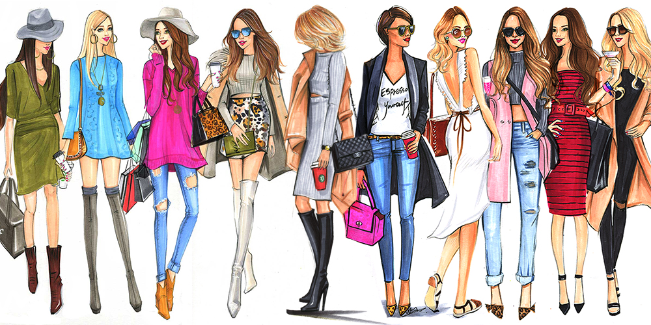
Differences learned through culture

Slide 6
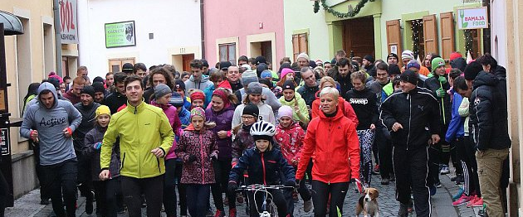
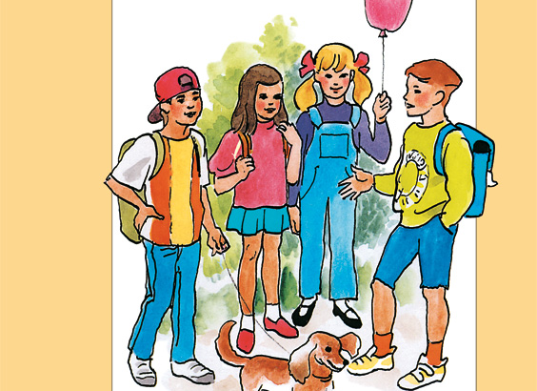
Spot the difference?

Slide 7
Artificial category of RACE (colonial invention: 24 races in 1871 CENSUS, instrument of control: race/nationality/cast confusion) Aylmer sisters

Slide 8
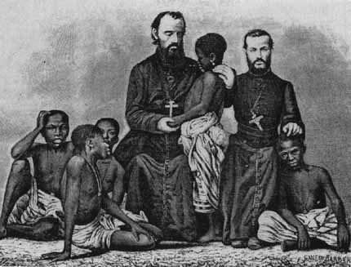
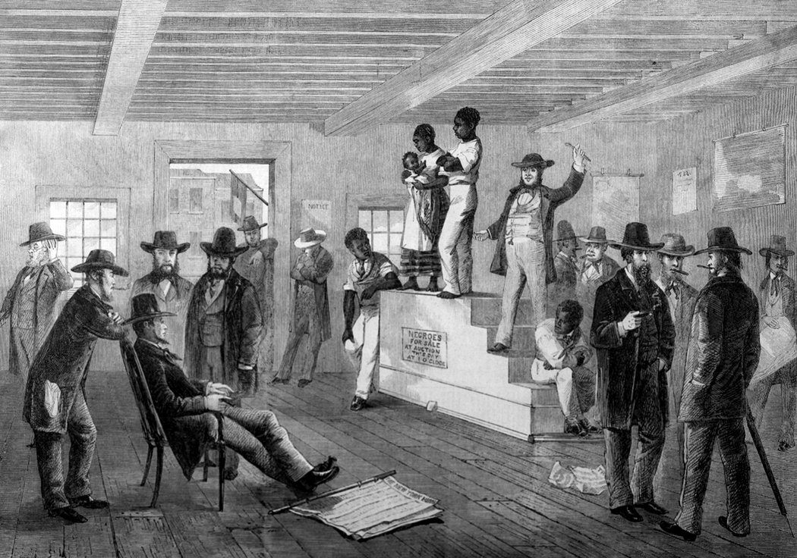
Colonial heritage: White race is beautiful, powerful, rich, educated, successful, cultural, civilised, on the right spiritual track.

Slide 9
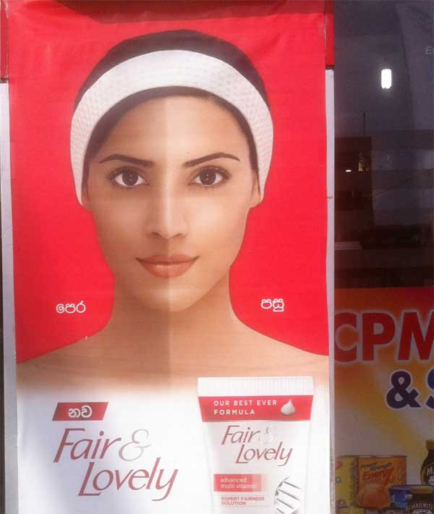
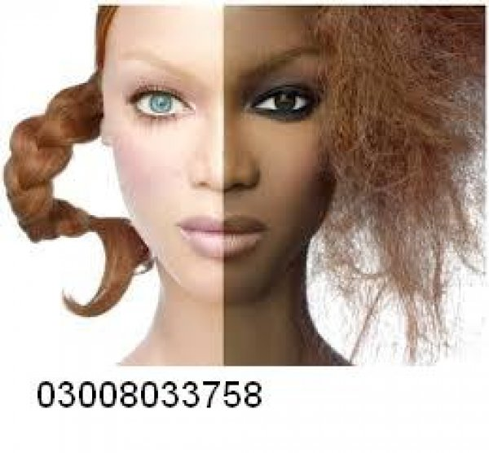
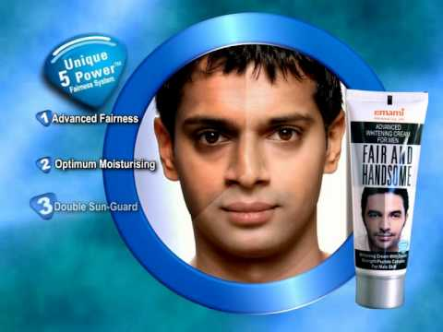
Beauty: Fair complexion desired Skin whitening and beauty

Slide 10
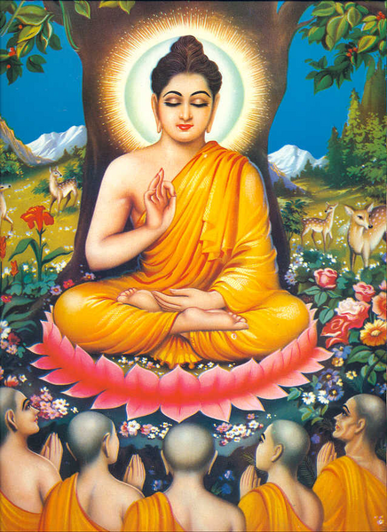
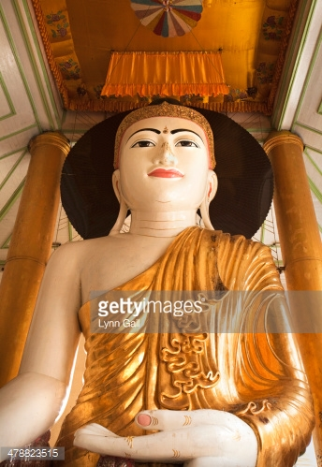
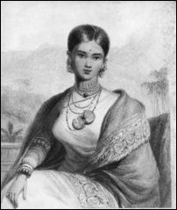
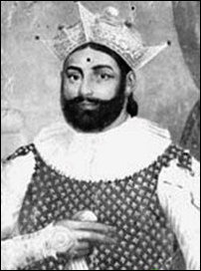
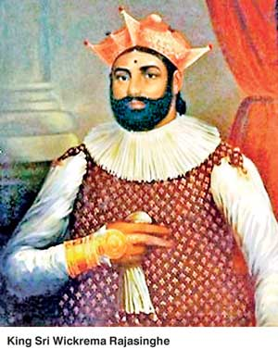
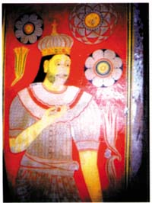
Fair complexion: Whiteness associated with Buddhism – spirituality (Buddha, white colour temples/clothes) and Kandyan nobility/kings

Slide 11
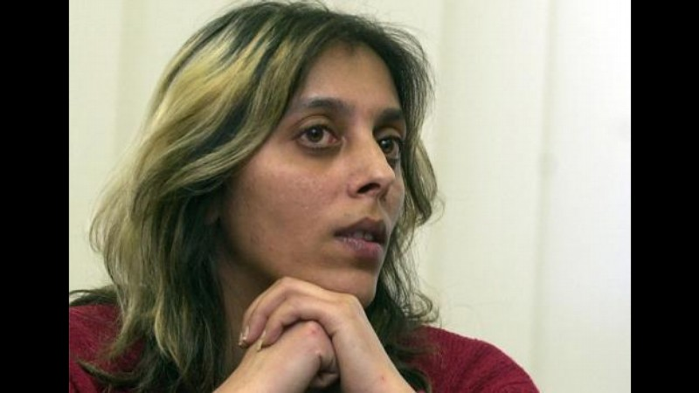
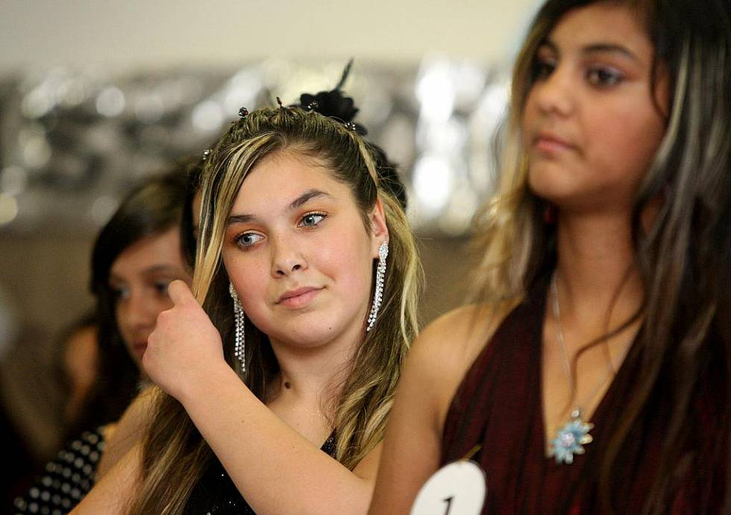
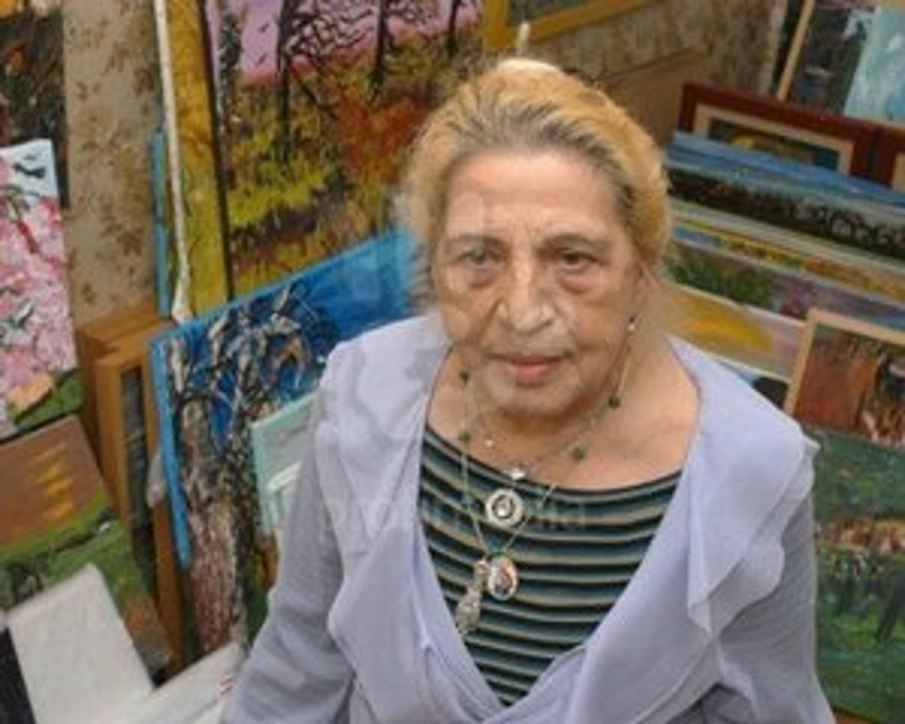
Manipulating body: hair colour

Slide 12
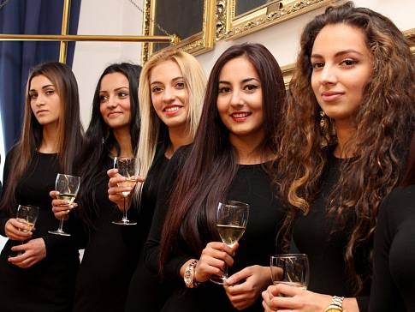
Rewarding Complexion

Slide 13
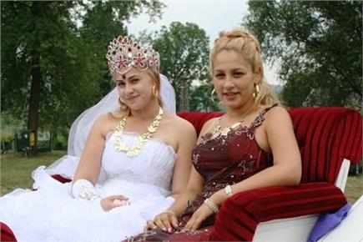
Fair complexion == higher bride price (Olach Roma)

Slide 14
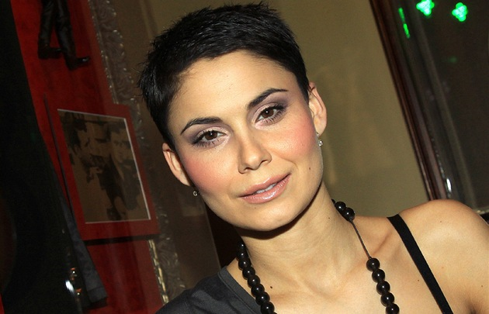
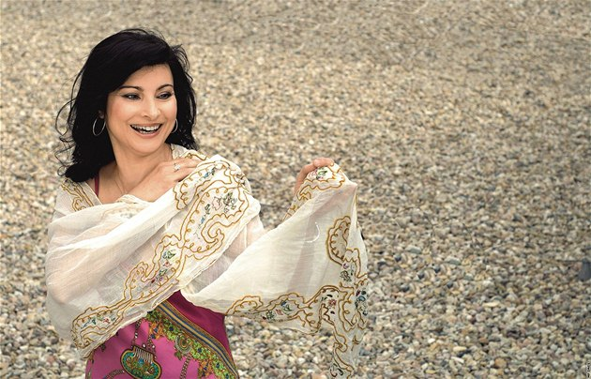
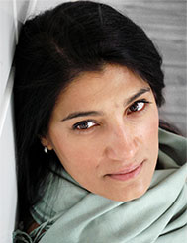
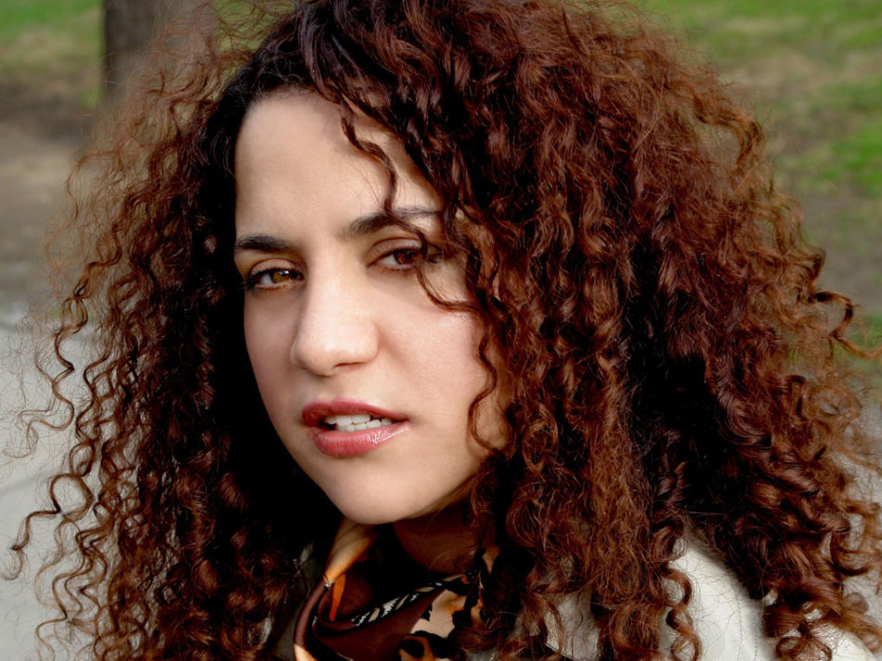
Professionals – role models

Slide 15
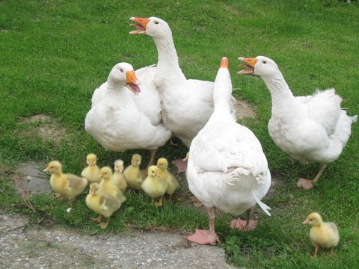
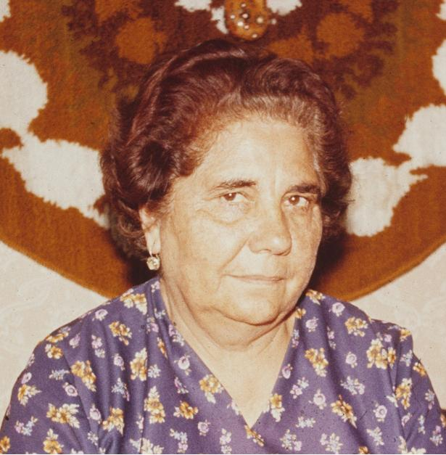
Colour symbolism as part of values system intrinsic to language: Romaness: Papiňori----Goose ---- Beauty

Slide 16
Message
Whiteness brings advantage (internally and externally)
Fair complexion raises the possibility to manipulate Gypsiness/body to certain extend (physically and socially) and become accepted by the majority population
Context matters (places of unexpected encounter – affluence) – dissociation from stereotypes of inferiority
Education brings about cultural acceptance
Out of expected context - constant minority reminder – questions of fear, stability, home, quality of cohabitation
.

Slide 17
Race as category is artificially constructed vs.
Power of racism in everyday life

Slide 18
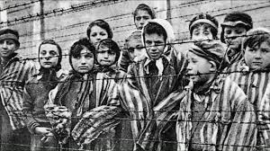
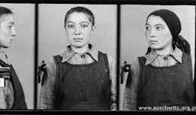

Slide 19
What is racism?
When category I/us (skin colour) has other possibilities, rights and opportunities than
Them

Slide 20
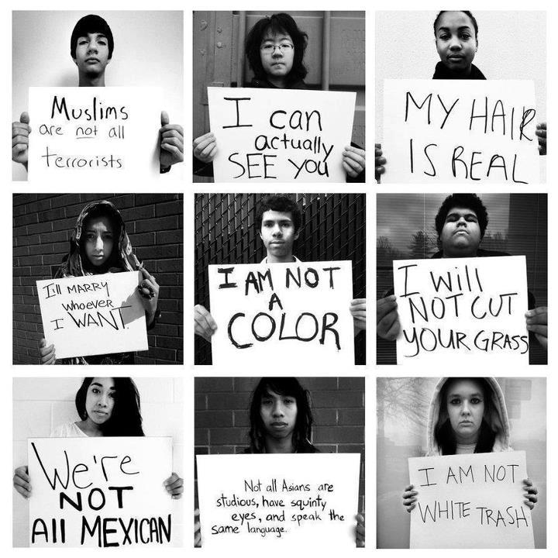
Racism: idea of superiority penetrates deep into culture
BIRTH
I
I
family-skin colour
I
I
lineage-cast/occupation
I
I
culture – the way things are done and thought through
CULTURAL PATHOLOGY

Slide 21
Racism brings along power Power leads to inequalities Inequalities create conflicts Conflict brings about poor quality of life Possible solution?

Slide 22
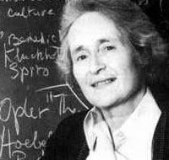
Mary Douglas: Purity and danger
Anomaly is labelled according to cultural rules (good/bad) and it is approached accordingly.
Anomaly is physically removed (ghettos, reservations, concentration camps, special hospitals, asylums etc.)
Anomaly is labelled TABO (e.g. Forbidden marriage, contact etc.)
Anomaly is labelled dangerous and there is a war/fight against it.
Anomaly gains higher spiritual status, it is praised and feared.
Nothing works long term!

Slide 23
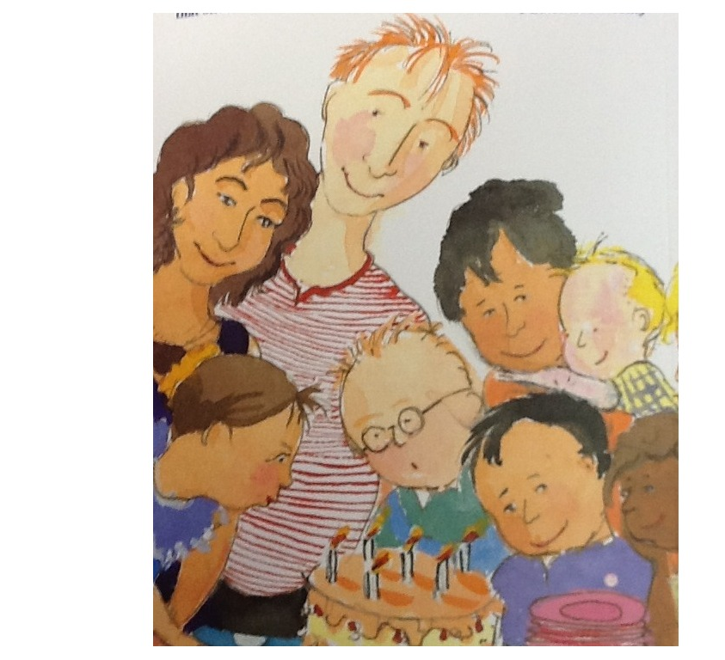
For change to happen we must change the system in which we THINK, re-thing anomaly as NORMAL and accept it as a part of the system.

Slide 24
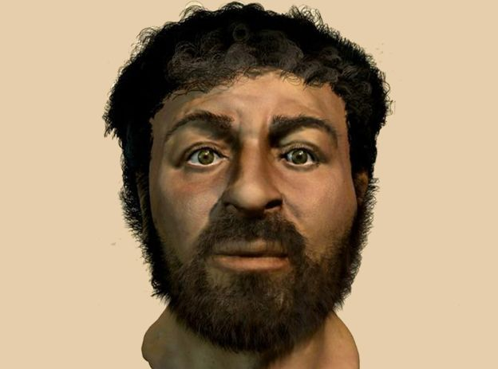
A guy you all know: Who am I?

Slide 25
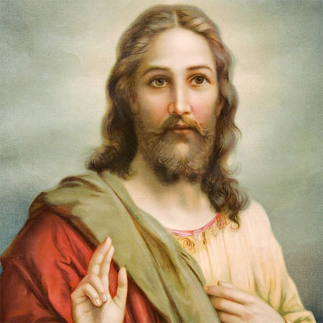

Slide 26
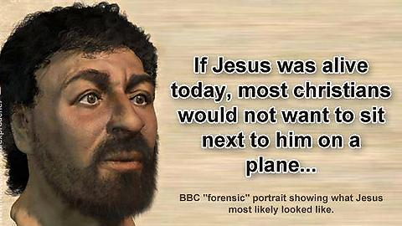

Slide 27
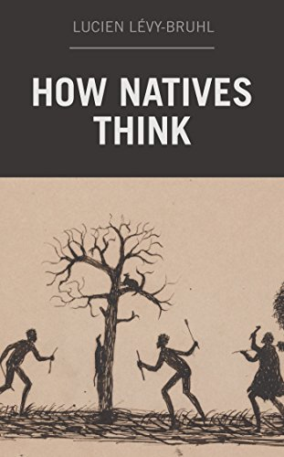
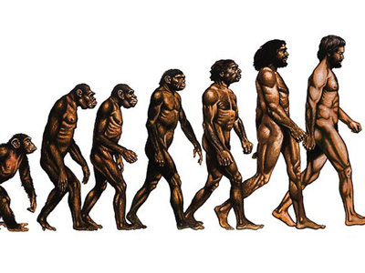
Theory of natural selection include the way of thinking!!

Slide 28
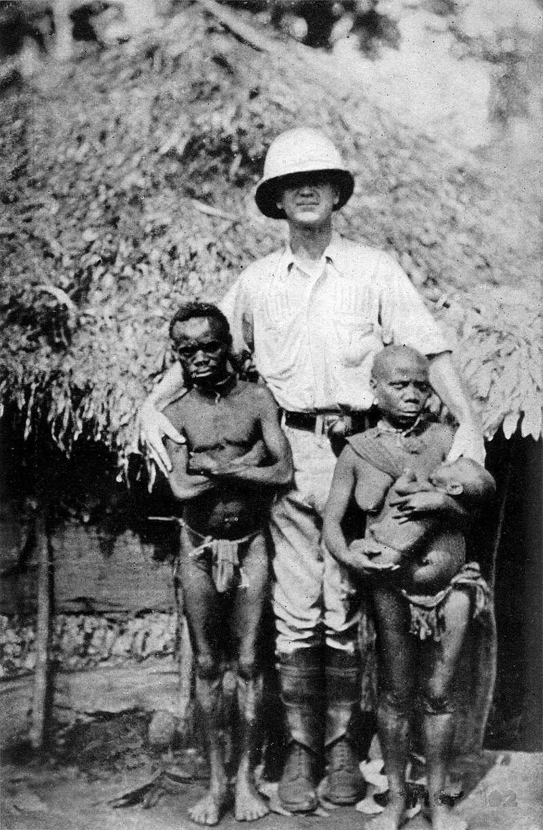
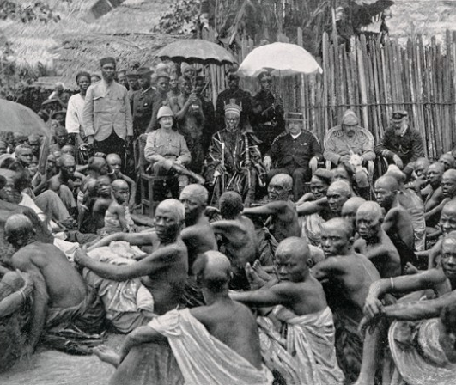
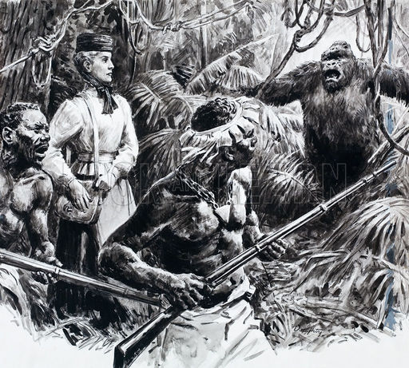
Science, power, religion

Slide 29
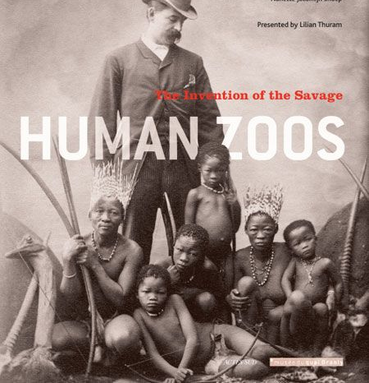
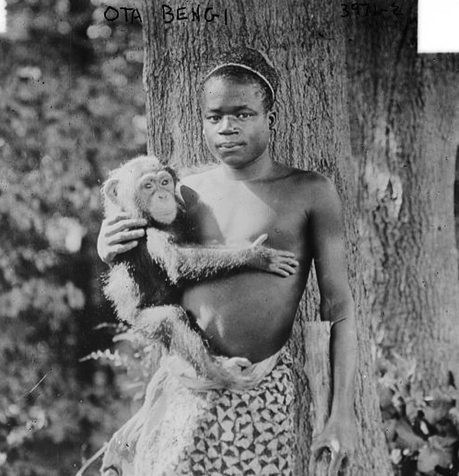
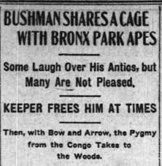
Lost step of evolution: human zoo

Slide 30
Hotentot Venus Saartje Baartman

Slide 31
Scientific points: physical differences are greated inside the same race than in beween the races. i.e. race theories rest upon unobjective presumptions. Race is disfunctional and blured cattegory.

Slide 32
Tallest and shortest people of the world

Slide 35
Feeling through.. research method. Eva Lukešová
Já, imigrantka - Byla vytvořena v roce 2015, kdy byla dle agentury MediaTenor právě migrace nejvíce medializovaným tématem. Z médií jsem vnímala imigranty jako velkou masu anonymních lidí, jejichž identitou je pouze role imigranta. Postrádala jsem informace o individualitách s vlastní minulostí, zkušenostmi a motivacemi. A proti této dehumanizaci, jsem se chtěla vymezit, a proto se ústředním bodem mé práce stala metoda "vcítění se". „ … Weber ukazuje, že můžeme porozumět motivaci chování druhých lidí. Můžeme se vcítit do jejich jednání a navíc můžeme ve svých představách znovu prožít jejich zkušenosti. Velká část těchto empatických rekonstrukcí jednání ostatních lidí, jež může zahrnovat i jednání historických aktérů, je zřejmá …“ (Whimster 2004:303). Tuto empatickou rekonstrukci jsem zhmotnila a to tak, že jsem vytvořila sochu sebe sama v dětském věku a poté, co jsem se s ní identifikovala jako s mým dětským já, jsem ji začala měnit do podoby africké holčičky, ale stále jakožto mě s vlastními touhami, motivacemi a zkušenostmi. V představách jsem umístila toto mé já do situací, které by mohly být součástí života dětské imigrantky, abych dala konkrétní tvář a identitu jednomu ze z medializované masy imigrantů. Weber, M., S. Whimster (ed.). 2004. The essential Weber: a reader. New York, NY: Routledge.
https://www.youtube.com/watch?v=W06agBN7oMg

Slide 36
We will always use classification. How deffinite do have to be the boarders? POWER is the concept behind classification. Racism is longing for power and control, that tried to hide behind science.

Slide 37
You are about to embark on a train from Istanbul to London. Journey takes four days and nights. There are four bank beds in your train compartment. Whom will you pick as companion?
1) giggling teenager
2) mother with a baby
3) a man, who just got out of Istanbul jail
4) middle aged homosexual
5) very active elderly salesman
6) Arabic speaking young man
7) professional magician
8) old Roma woman
9) USA war veteran
10) a Jew
11) middle aged woman, alcoholic
12) a heavy smoker

