Slide 1
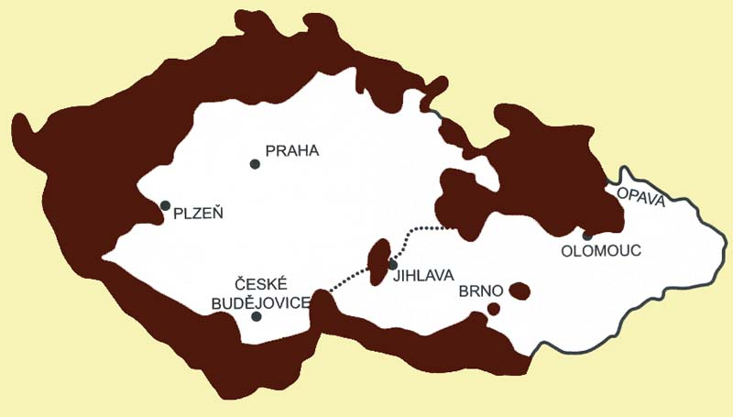
Sudeten 1910 (census) – 1947 (German speaking majority)

Slide 2
Eva Davidová Foto
https://www.google.com/search?q=star%C3%A1+romsk%C3%A1+osada&source=lnms&tbm=isch&sa=X&ved=0ahUKEwi4nqbR0PngAhVzt3EKHaZRDikQ_AUIDigB&biw=1334&bih=640#imgrc=iFKAz32aReYx4M:

Slide 3
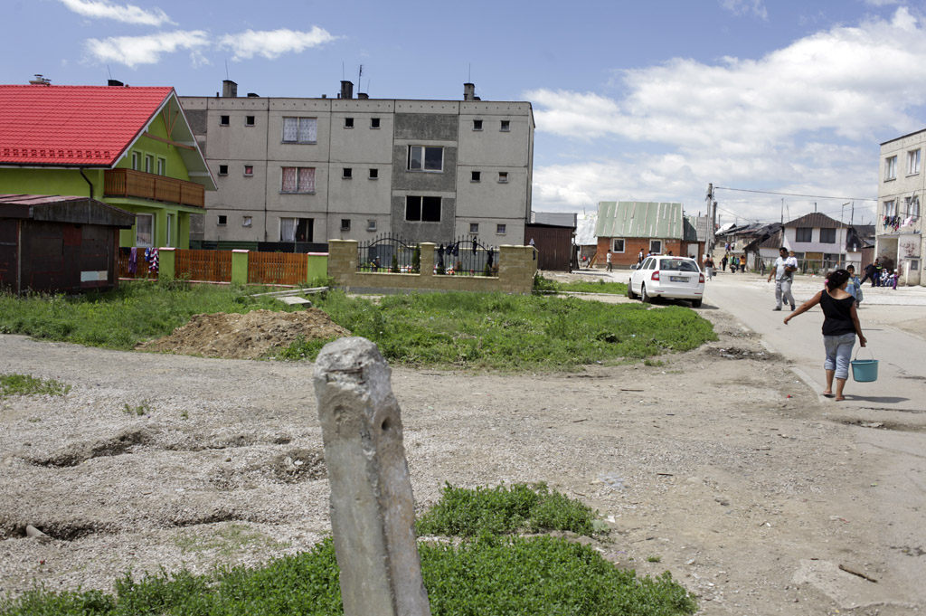
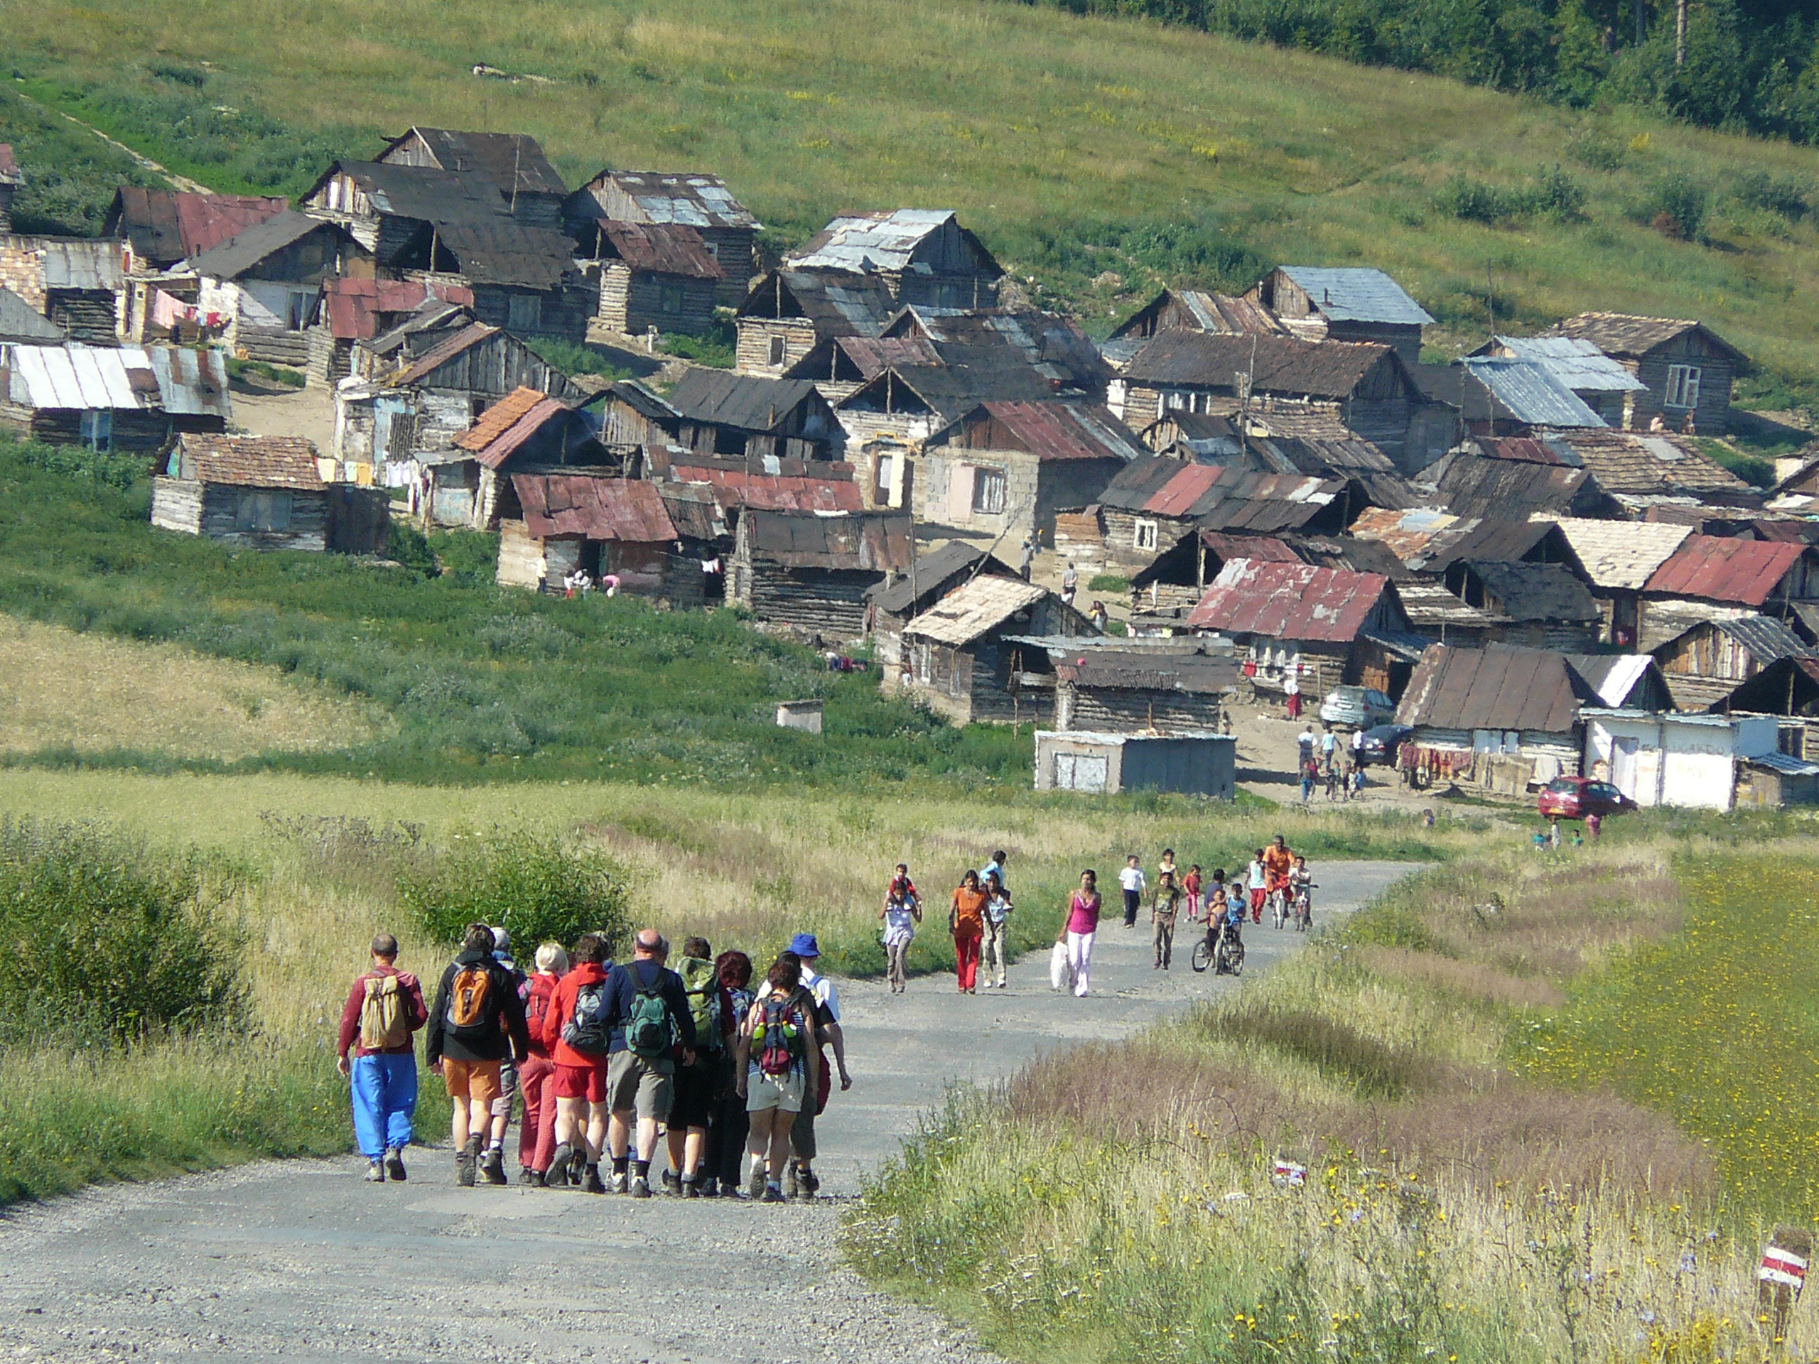
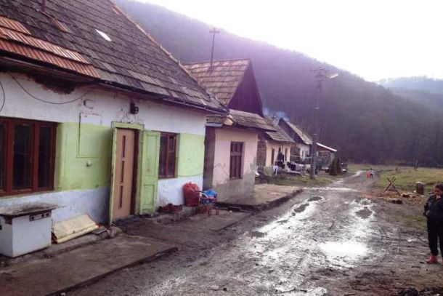
Roma villages in Slovakia

Slide 4
Village family network

Slide 5
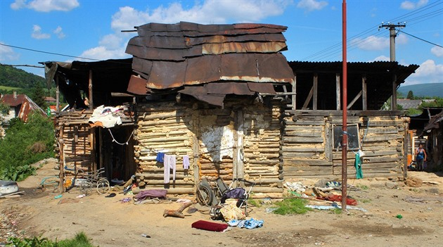

Slide 6
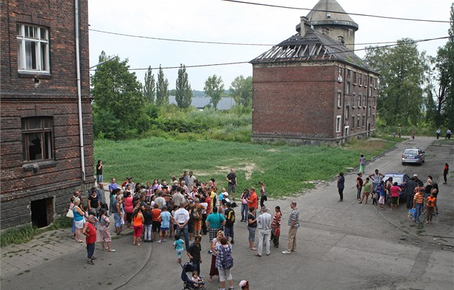
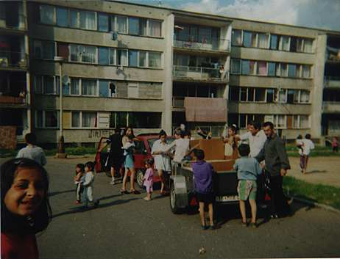
Town

Slide 7
Video villages and towns today
https://video.aktualne.cz/objektivem-jana-sibika/des-a-hruza-v-nejvetsim-romskem-ghette-v-evrope/r~f91e89ba86f911e5bd0a002590604f2e/ (luník)
https://www.youtube.com/watch?v=hZXA8daDHa0 (osada Malcov)
https://www.youtube.com/watch?v=MapG0JB7gp4 (anglická zkušenost)

Slide 8
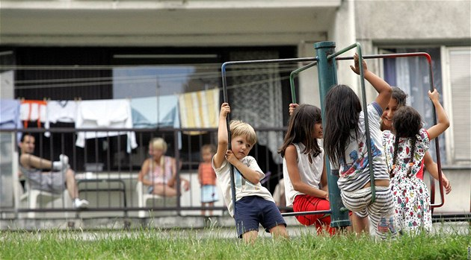
Integration vs. loneliness

Slide 9
Larks on the string
https://www.youtube.com/watch?v=x1eR-iwABIc minuta 22 a dál

Slide 10
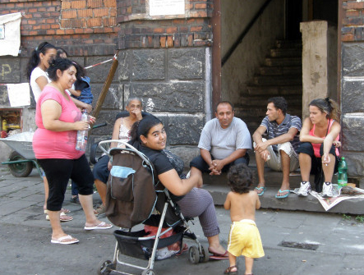
Re-creating the network in the city

Slide 11
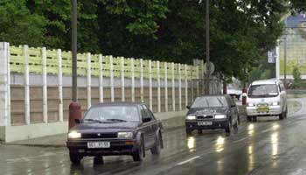
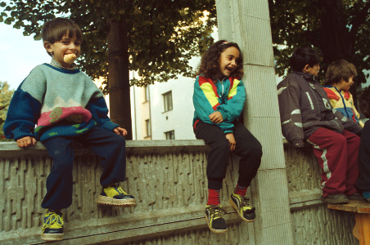
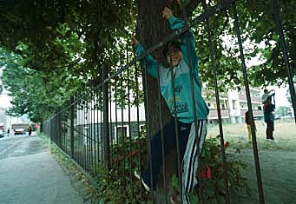
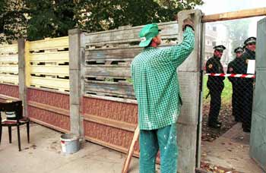
Ústí nad Labem, Matiční street

Slide 12
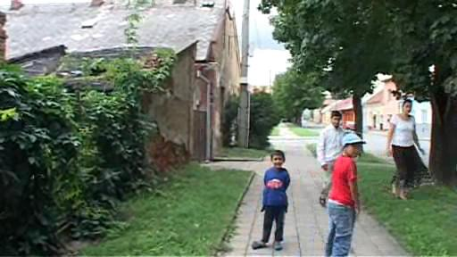
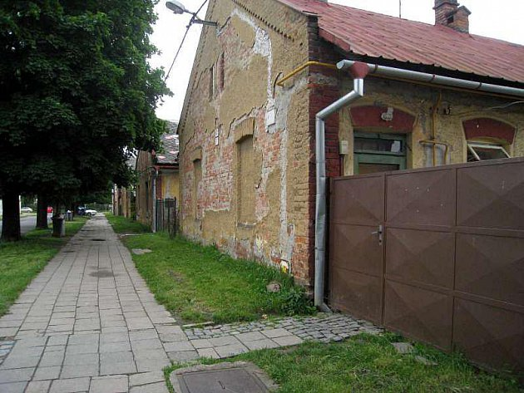
Holešov, Školní street

Slide 13
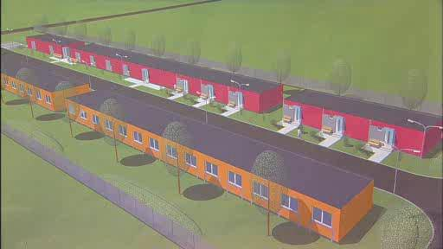
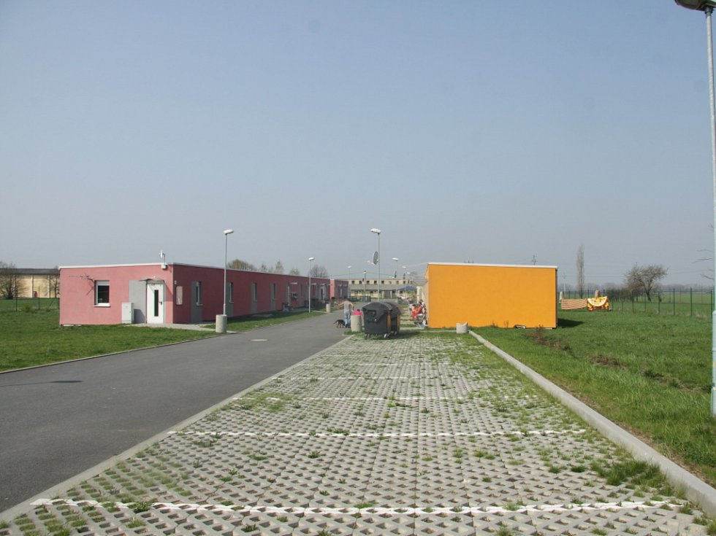
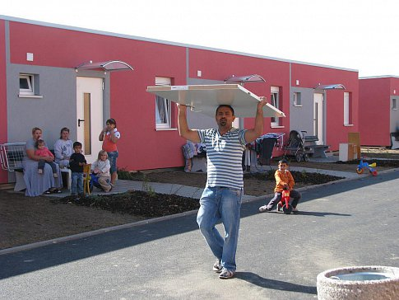
Holešov

Slide 14
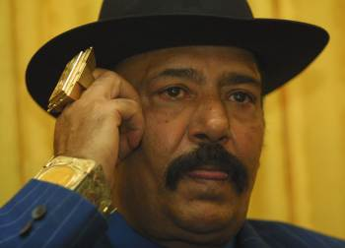
Vajda vs. Roma deputy

Slide 15
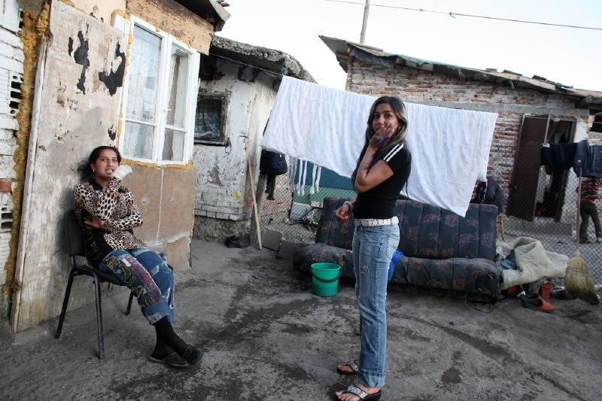
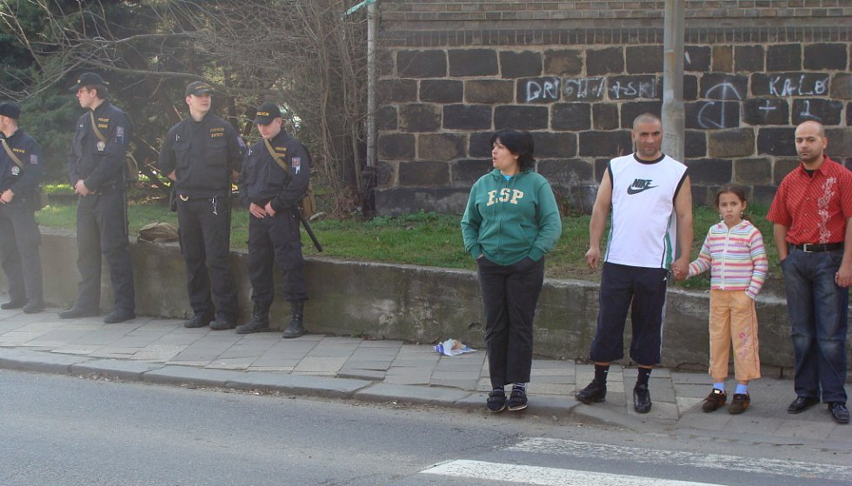
Moral: gossip vs. law

Slide 16
The main threat od spatial exclusion
Not criminality
But
finding your own values and value system, which is different from mainstream.

Slide 17
a man is not able to be alone…
Exclusion sets incentive to search for own identity; possibility to keep distance on the basis of new values.
Integration process against exclusion
Multikulturalism vs. partikularism

Slide 18
Multikulturalisms
1957 Switzerland
60. s in Canada (French and English speaking population united), state ideology
70. s – Europe a Gastarbeiters – asimilation becomes mainstream
American melting pott possible only for individuals. Hispanics broken this model.
Europe since 1989: ambition to educate towards inter-cultural tolerance and knowledge (cultural relativism) – Holland and Scandinavia leading trends vs. discriminatory/assimilatory politics (German speaking world)

