Slide 1
DATOVÁ ŽURNALISTIKA: OD CHOLERY PO SCROLLYTELLING

Slide 2
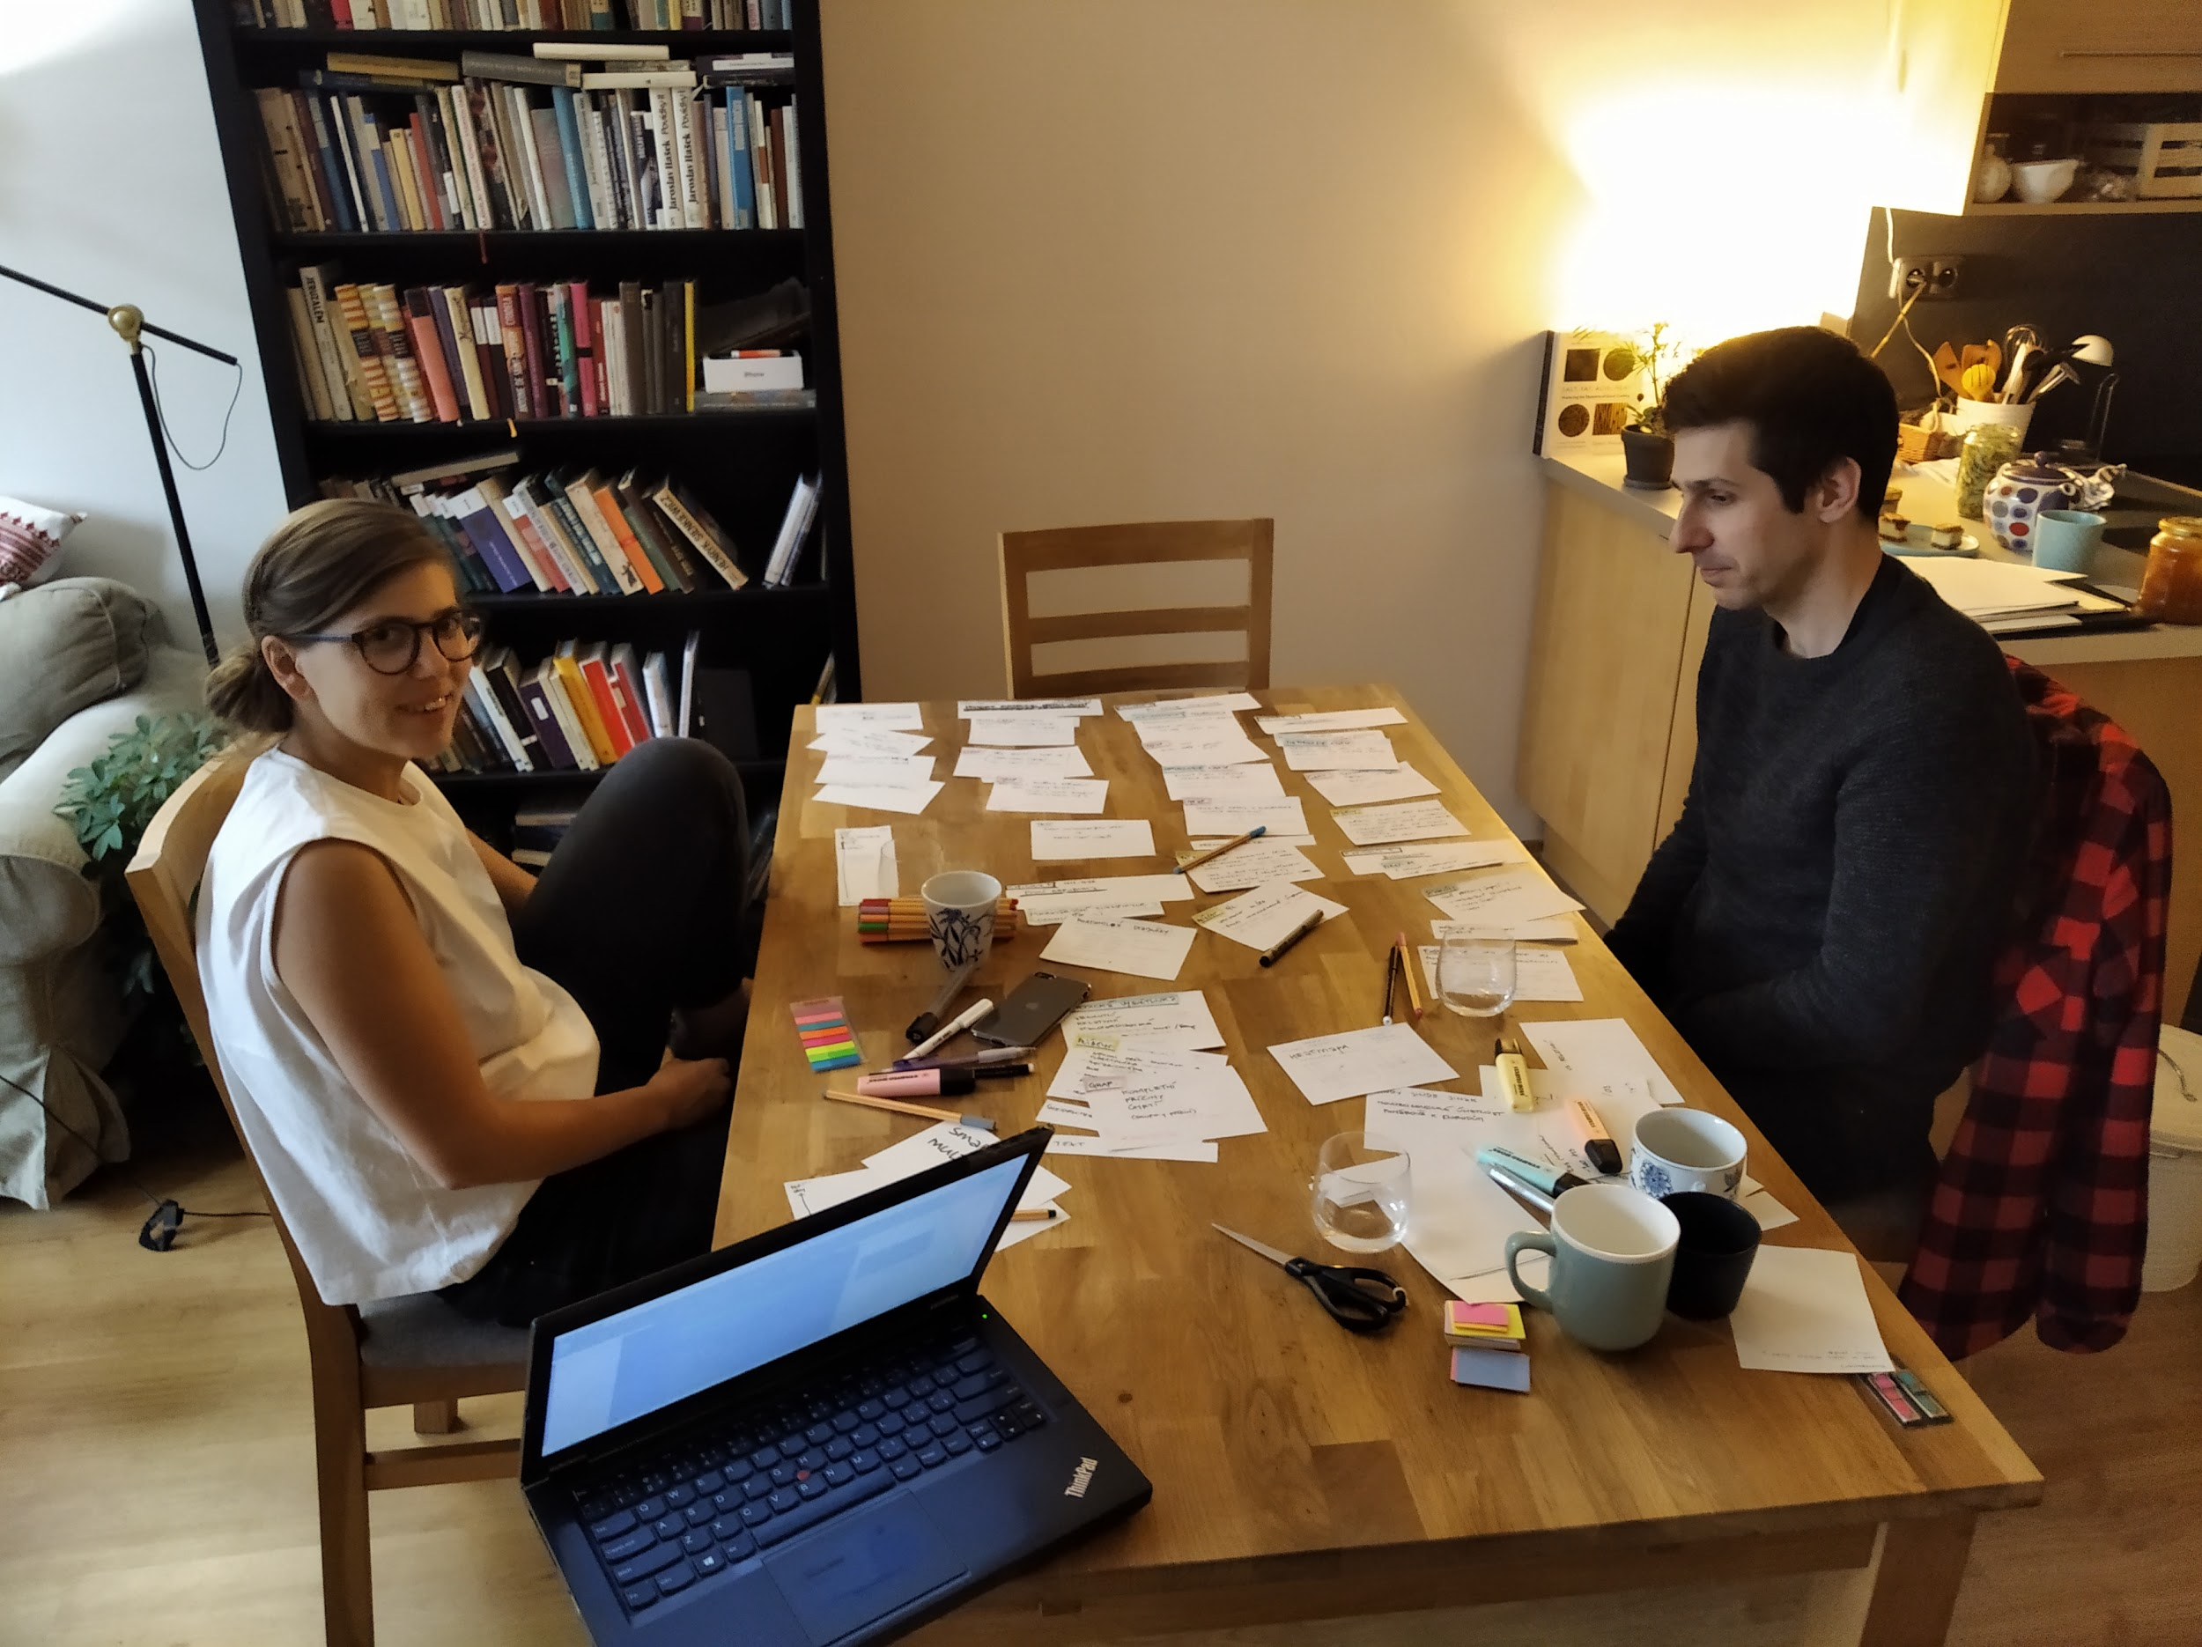

Slide 3
HISTORIE

Slide 4
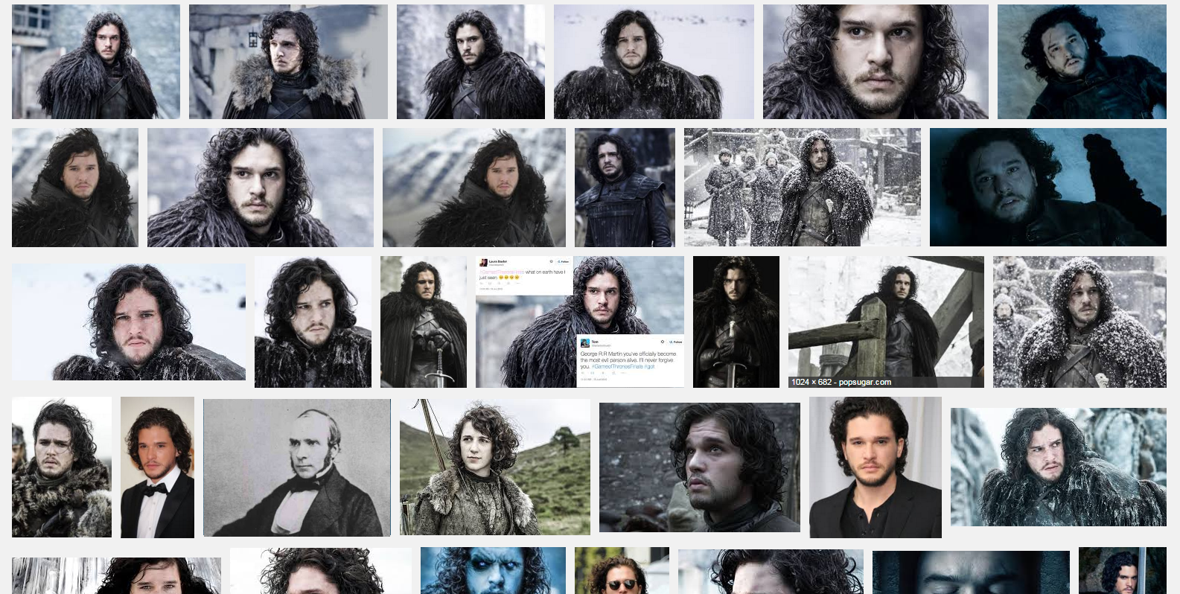

Slide 6
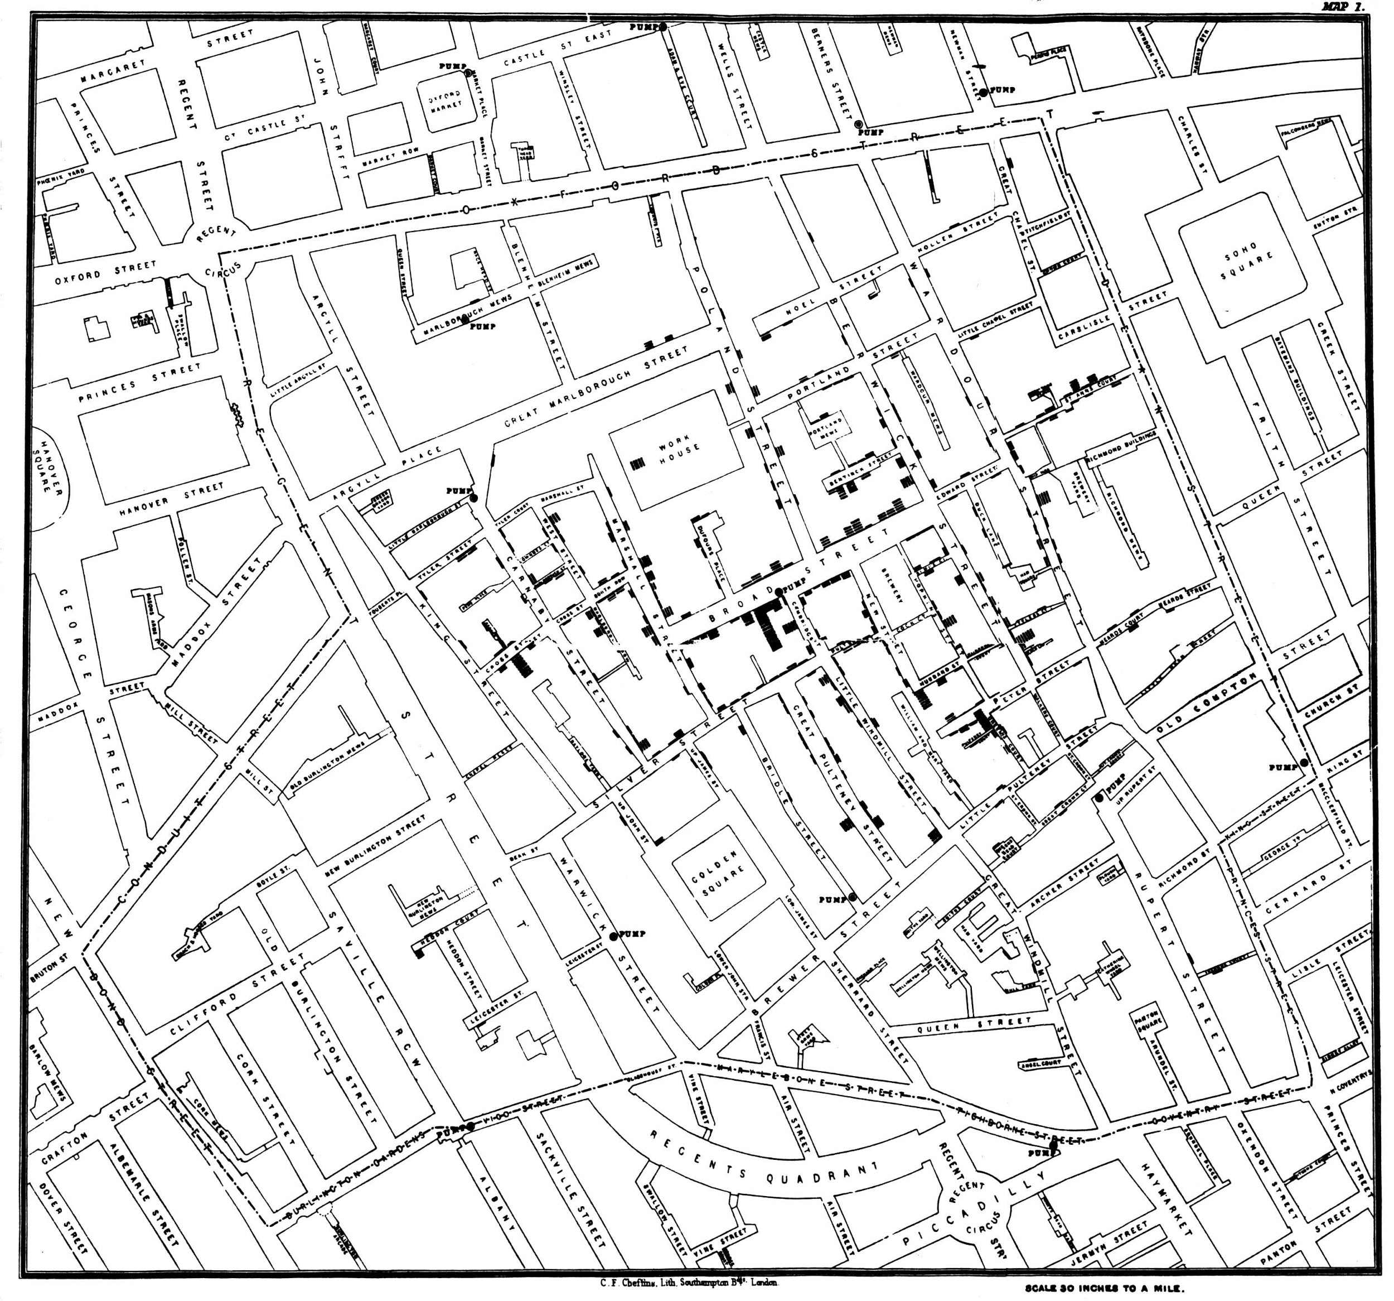
JOHN SNOW, 1854
Notes:
https://simonrogers.net/2013/03/15/john-snow-data-journalist/

Slide 7
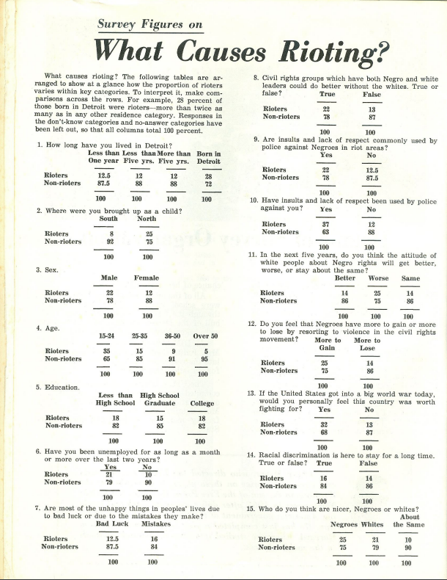
PHILIP MEYER, 1967
Notes:
https://s3.amazonaws.com/s3.documentcloud.org/documents/2070181/detroit1967.pdf

Slide 8
2010s
Notes:
https://datajournalism.stanford.edu/index.html

Slide 9
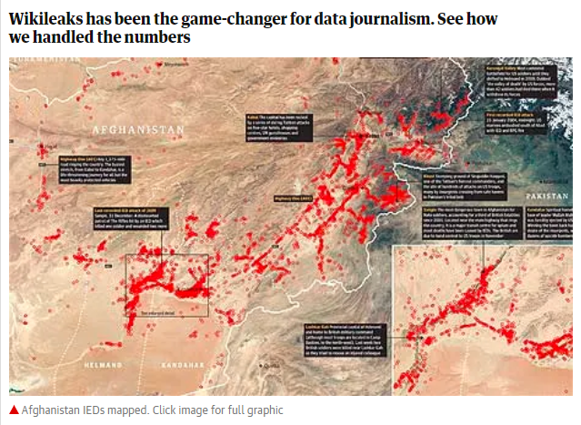
Notes:
https://wardiaries.wikileaks.org/ https://www.theguardian.com/news/datablog+media/wikileaks

Slide 10
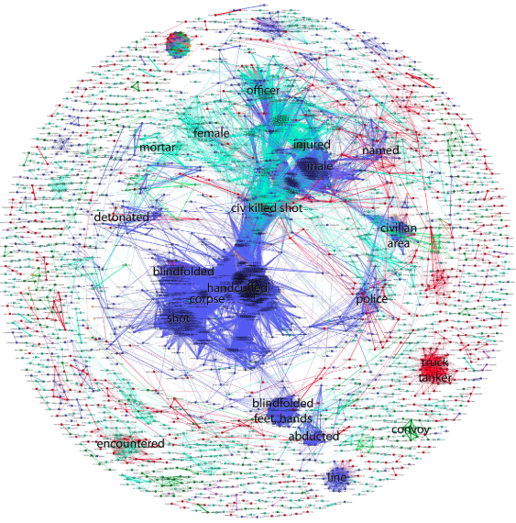
Notes:
http://jonathanstray.com/wp-content/uploads/2010/12/SIGACTS-dec-2006-hi-res2.jpg

Slide 11
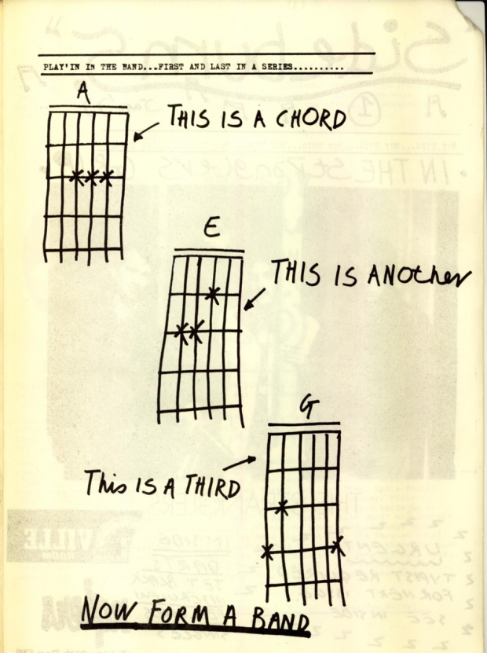
“ANYONE CAN DO IT. DATA JOURNALISM IS THE NEW PUNK”
THE GUARDIAN, 2012
Notes:
https://www.theguardian.com/news/datablog/2012/may/24/data-journalism-punk

Slide 12
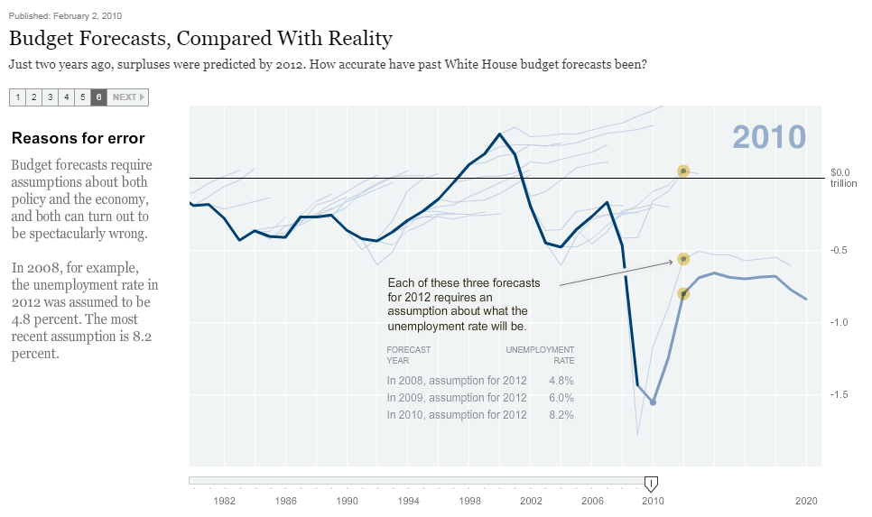
Notes:
https://archive.nytimes.com/www.nytimes.com/interactive/2010/02/02/us/politics/20100201-budget-porcupine-graphic.html
https://ihned.cz/c3-58291130-000000_d-58291130-prognozy-hdp-kdo-je-nejpresnejsi

Slide 13
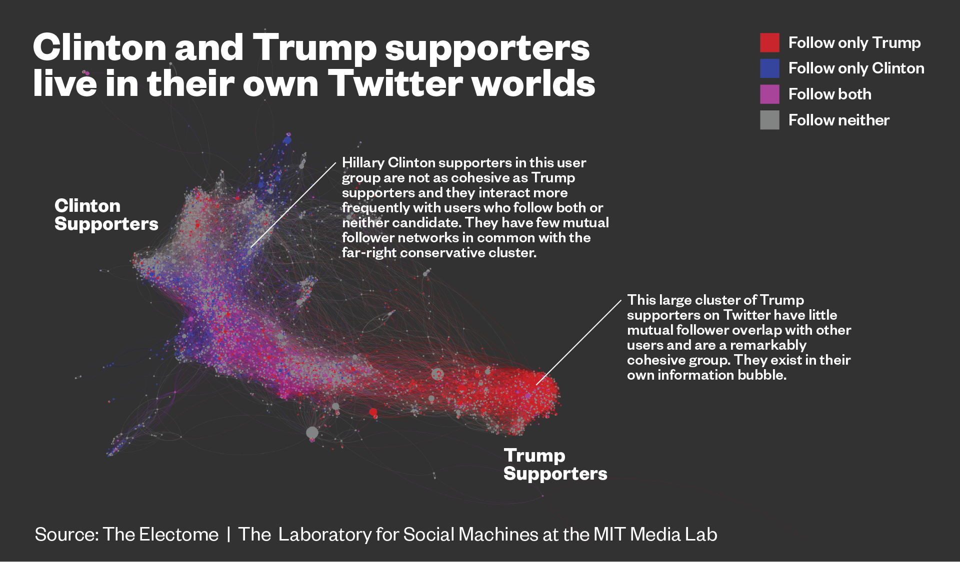
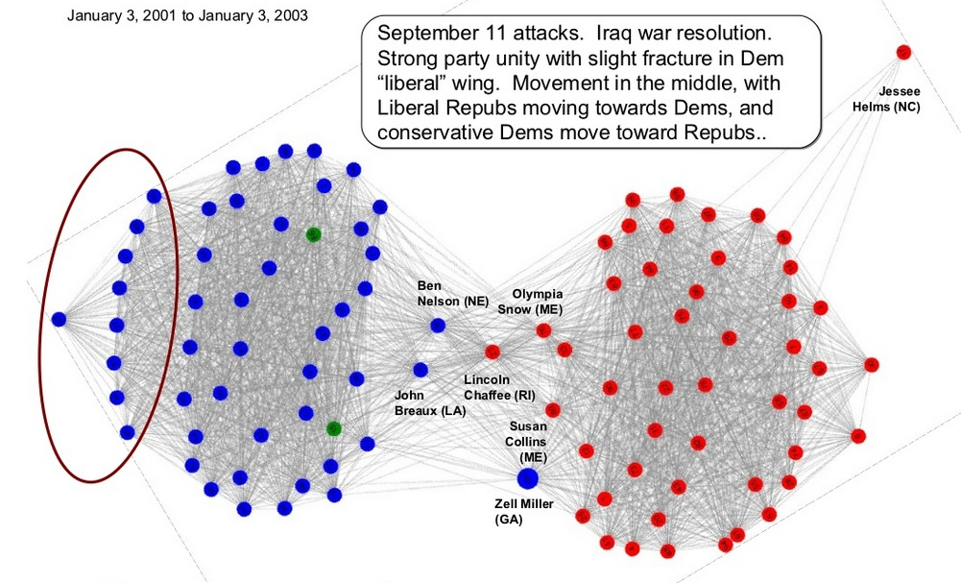
Notes:
https://news.vice.com/story/journalists-and-trump-voters-live-in-separate-online-bubbles-mit-analysis-shows
https://www.lidovky.cz/bubliny.aspx

Slide 14
2020

Slide 15
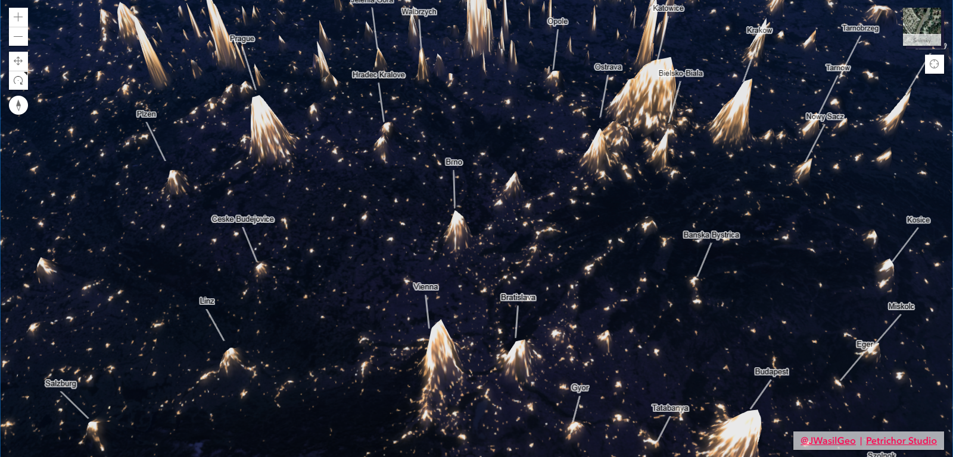
Notes:
https://datajournalism.com/awards
http://dev.datajournalismawards.org/2018-winners/
https://www.informationisbeautifulawards.com/awards/2019

Slide 16
PŘÍSTUPY

Slide 17
EXPLAINERY
Notes:
https://www.nytimes.com/projects/2012/snow-fall/index.html#/?part=tunnel-creek
https://highline.huffingtonpost.com/articles/en/poor-millennials/
https://www.nytimes.com/interactive/2020/08/11/opinion/us-coronavirus-black-mortality.html

Slide 18
EXPLAINERY
INVESTIGACE
Notes:
https://www.bellingcat.com/app/uploads/2014/11/Origin-of-the-Separatists-Buk-A-Bellingcat-Investigation1.pdf
https://www.investigace.cz/fincen-files-cesko/

Slide 19
EXPLAINERY
INVESTIGACE
MODELOVÁNÍ/PREDIKCE
Notes:
https://projects.fivethirtyeight.com/2020-election-forecast/
https://www.huffpost.com/entry/pollster-predictive-perfo_b_2087862

Slide 20
EXPLAINERY
INVESTIGACE
MODELOVÁNÍ/PREDIKCE
FACT-CHECKING
Notes:
https://demagog.cz/vypis-recniku

Slide 21
EXPLAINERY
INVESTIGACE
MODELOVÁNÍ/PREDIKCE
FACT-CHECKING SENSOR JOURNALISM
Notes:
http://www.washingtonpost.com/wp-srv/special/local/dc-shot-spotter/
https://plus.rozhlas.cz/unikatni-mereni-co-se-deje-v-tele-pri-maratonu-6525665

Slide 22
EXPLAINERY
INVESTIGACE
MODELOVÁNÍ/PREDIKCE
FACT-CHECKING SENSOR JOURNALISM
DAILY CHART
Notes:
https://www.economist.com/

Slide 23
EXPLAINERY
INVESTIGACE
MODELOVÁNÍ/PREDIKCE
FACT-CHECKING SENSOR JOURNALISM
DAILY CHART
NEWSGAMES
Notes:
https://www.google.com/search?q=filosofighters&safe=off&sxsrf=ALeKk01YLEOaCB20aRv2-aZVOla0psa13A:1602660348305&source=lnms&tbm=isch&sa=X&ved=2ahUKEwj7h4aGx7PsAhVzqHEKHYAbD_4Q_AUoAXoECAsQAw&biw=1600&bih=789
https://ig.ft.com/uber-game/

Slide 24
EXPLAINERY
INVESTIGACE
MODELOVÁNÍ/PREDIKCE
FACT-CHECKING SENSOR JOURNALISM
DAILY CHART
NEWSGAMES
DATA ART
Notes:
https://www.google.com/search?q=nuage+vert&safe=off&sxsrf=ALeKk02nZq90EWxqSoICX0I9YYJLZN_9Hw:1602660725738&source=lnms&tbm=isch&sa=X&ved=2ahUKEwjh34K6yLPsAhX_DmMBHagyCe0Q_AUoAXoECB8QAw&biw=1600&bih=789
https://www.google.com/search?q=they+rule&safe=off&sxsrf=ALeKk00FaFcs47jQf5ZQeFu5cIq_Zo5x0Q:1602660843666&source=lnms&tbm=isch&sa=X&ved=2ahUKEwjExKDyyLPsAhVl7eAKHfLqBfsQ_AUoAXoECAsQAw&biw=1600&bih=789
https://www.google.com/search?q=lubo%C5%A1+pln%C3%BD+pup%C3%ADkov%C3%BD+den%C3%ADk&safe=off&sxsrf=ALeKk02vKmtms8BXXsPrm1EiRVeCUbTMQw:1602660937463&source=lnms&tbm=isch&sa=X&ved=2ahUKEwj0sf2eybPsAhVB2-AKHXRJAK0Q_AUoAXoECAwQAw&biw=1600&bih=789

Slide 25
— Vox
„What makes it data journalism isn’t the form, it’s the starting point in a data. The result can take many forms: it might be a text article, or a data visualization, or a video, or something else entirely.“

Slide 26
PROCES

Slide 27
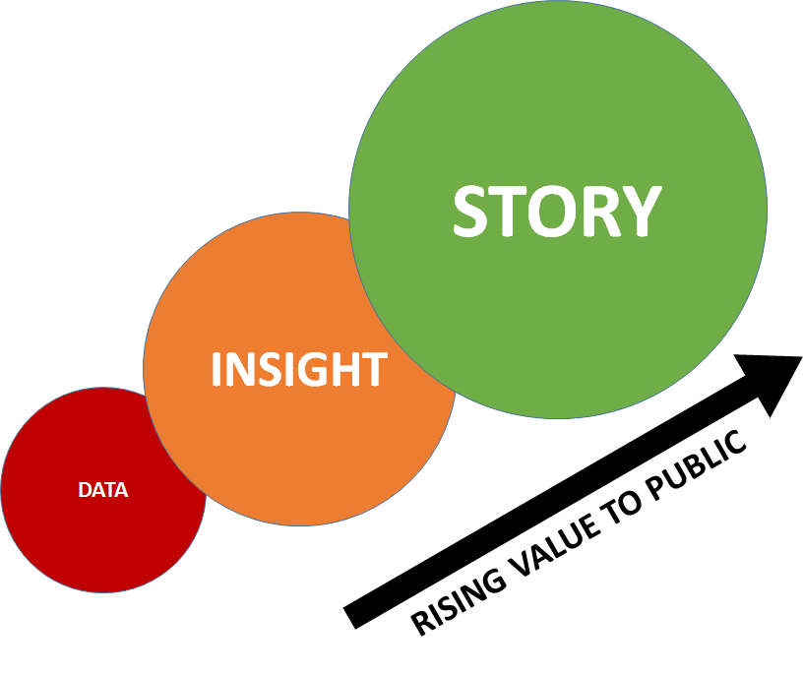

Slide 28
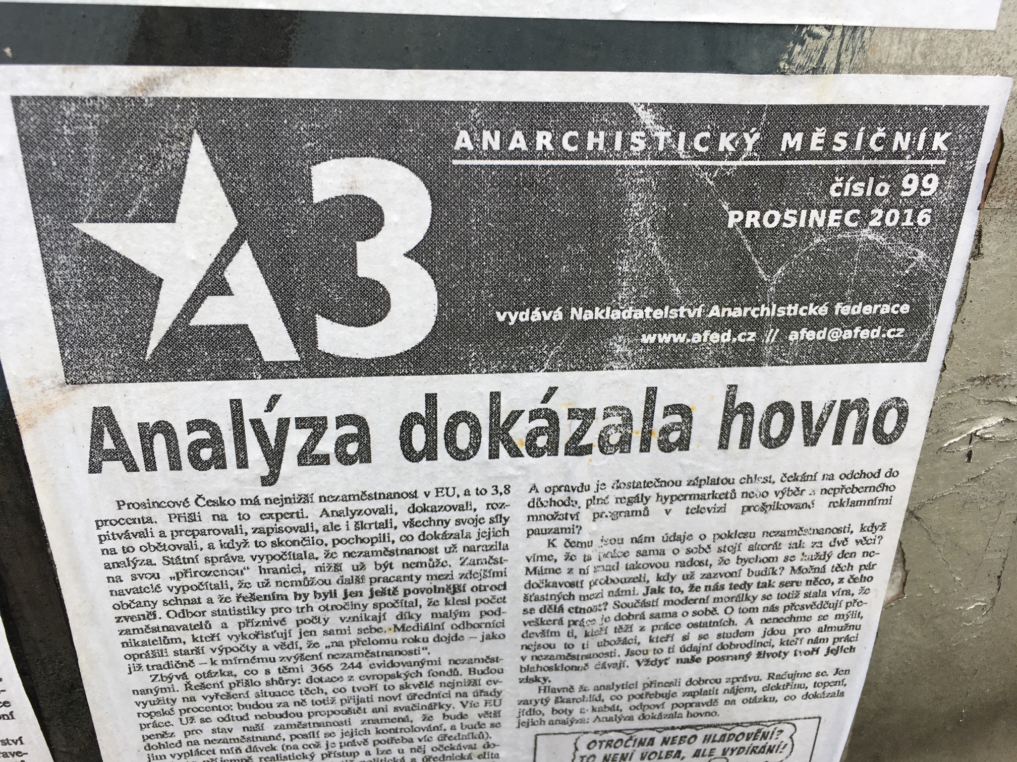

Slide 29
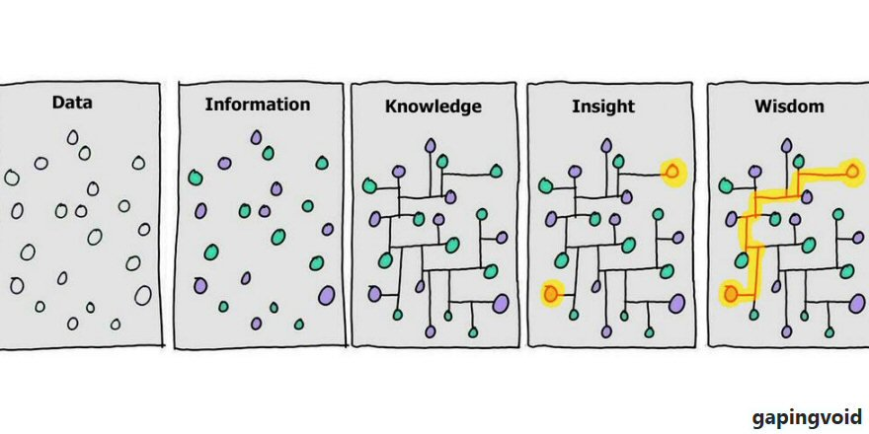

Slide 31
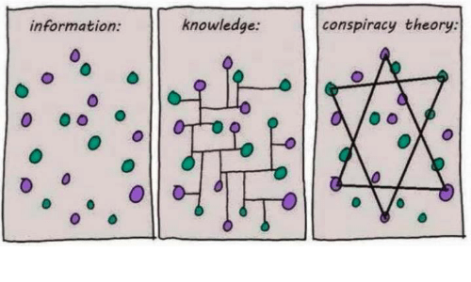

Slide 32
Notes:
https://www.irozhlas.cz/veda-technologie/technologie/data-rozhlas-podcast-marcel-sulek_1810120813_cib

