Slide 1
Modern technologies and conflict
Energy, climate, resources
Jakub Drmola

Slide 2
Climate change
Extinction is the norm
99% of all spieces
Mostly due to climate change
Mostly triggered by volcanism
Planet will survive, life will survive, humans will survive too
Geopolitical consequences
Lack of water and food
Poor adaptation
Migration and conflicts
All countries impacted
“lifeboat” countries?

Slide 3
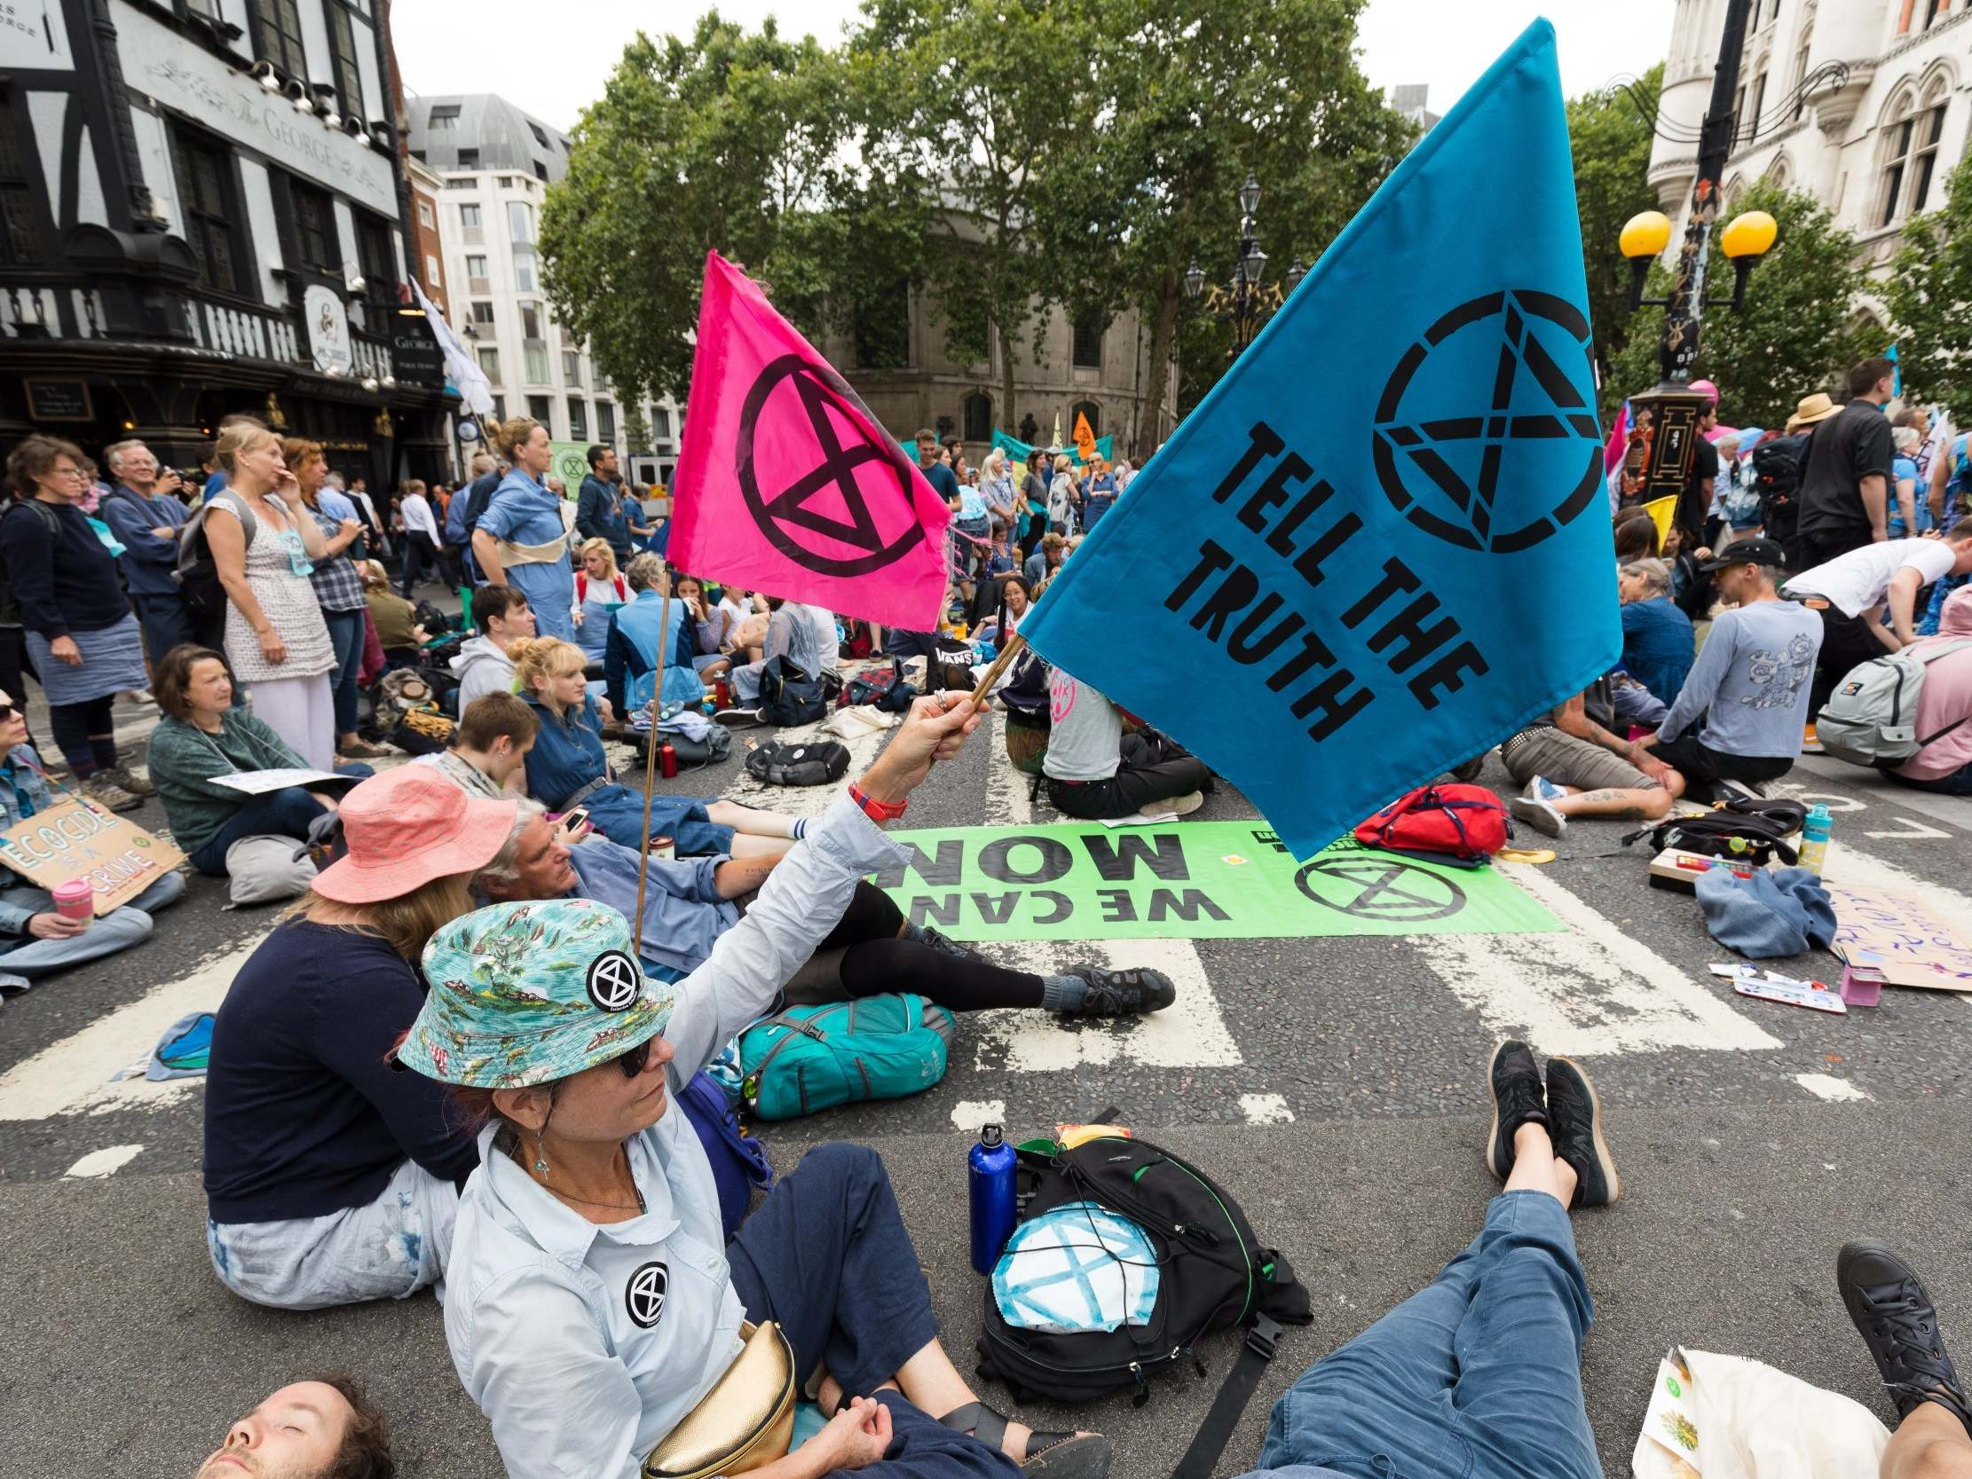
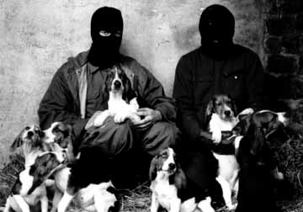
Climate change and conflicts
Social conflict
Organized violence
Armed conflicts

Slide 4
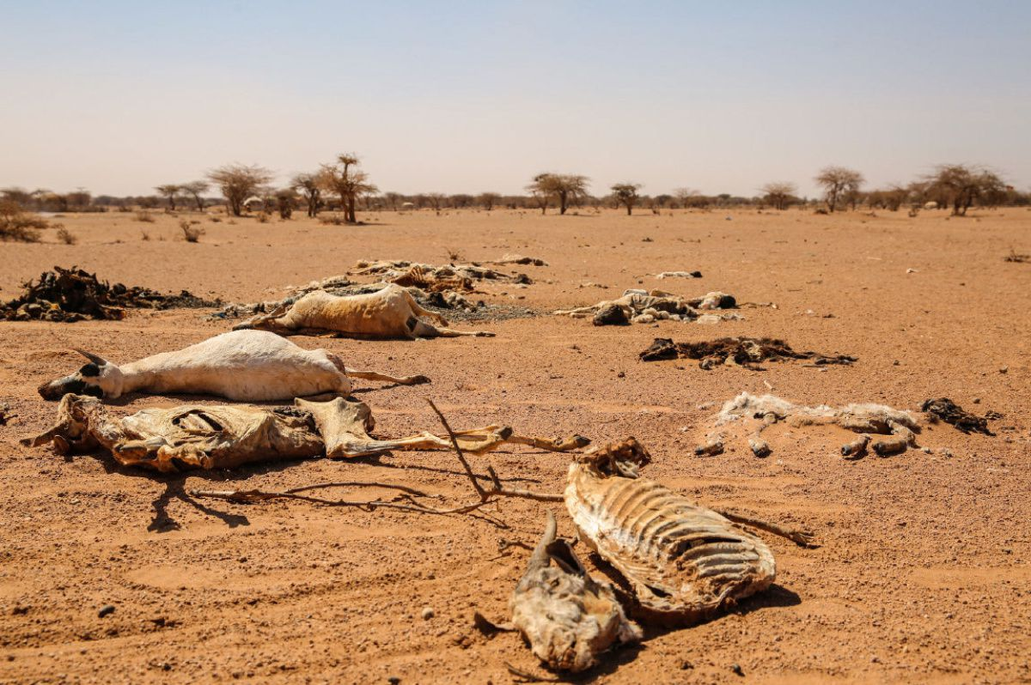

Slide 5
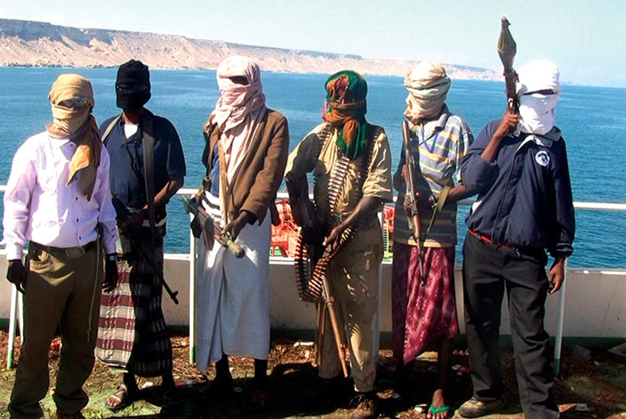

Slide 6
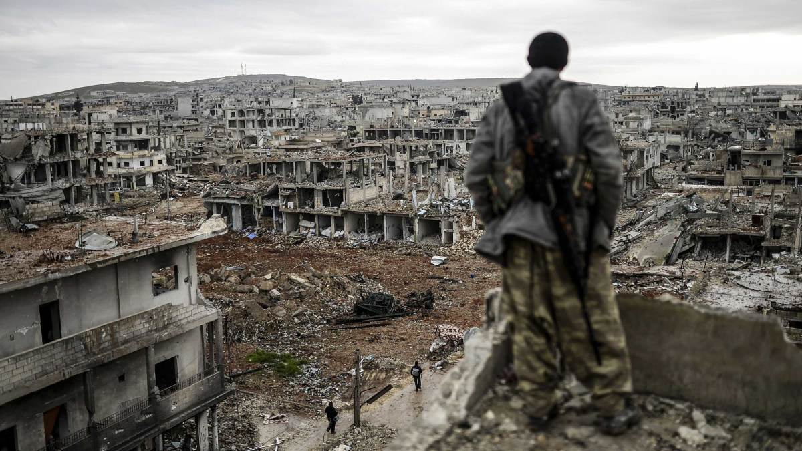

Slide 7
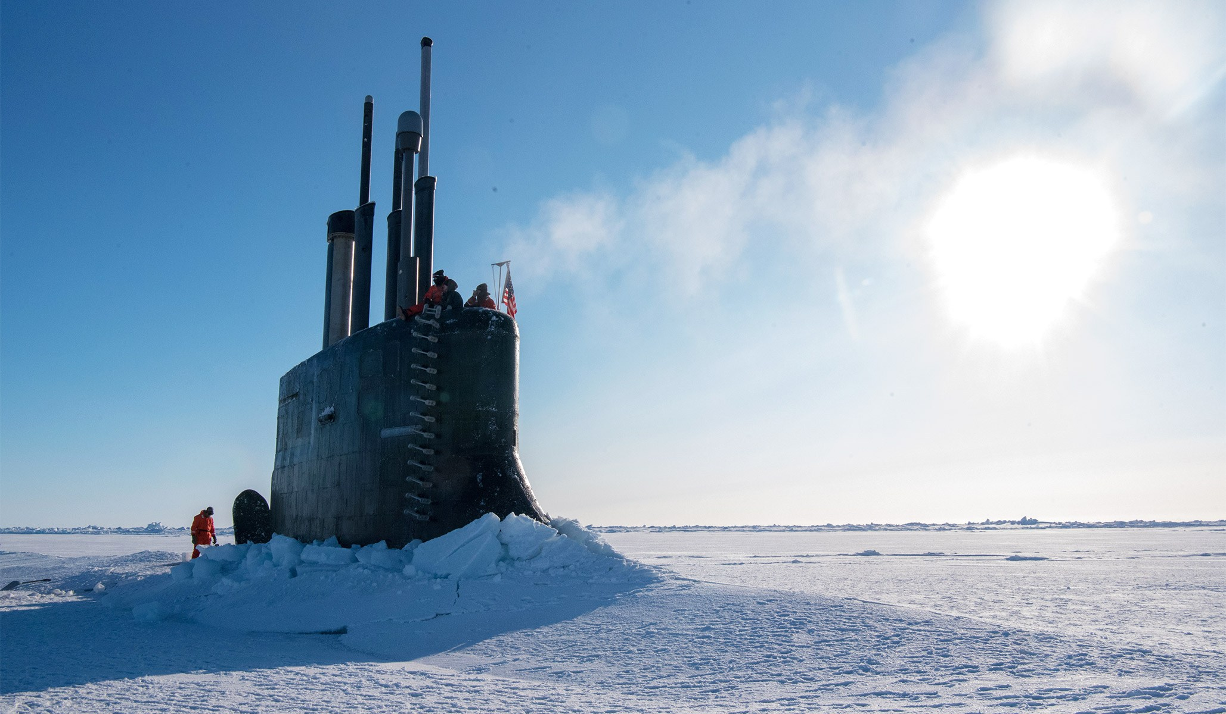

Slide 8
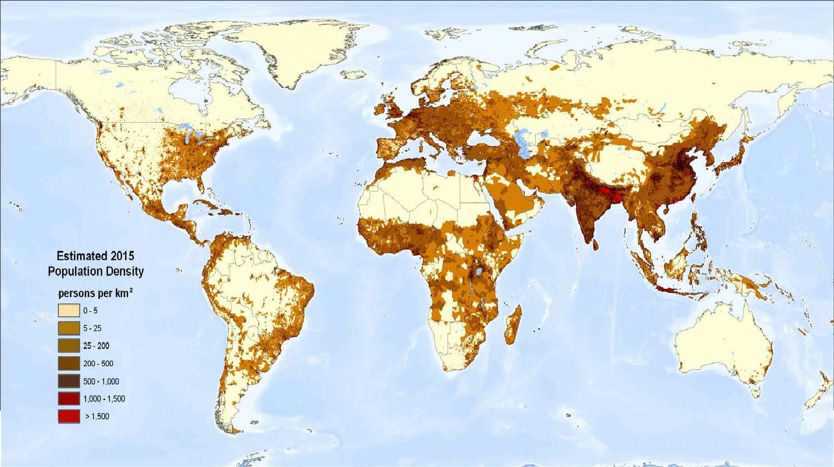

Slide 9
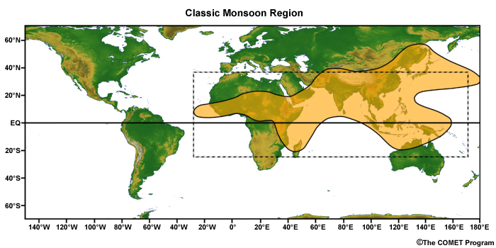

Slide 10
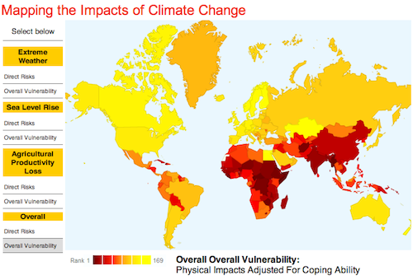

Slide 11
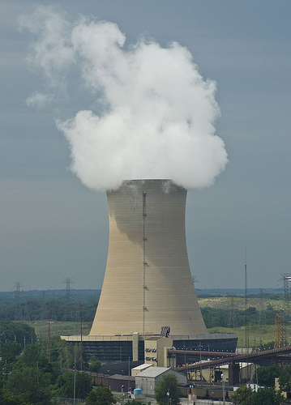
Energy sources
Burning buried sunshine (80%)
Burning fresh sunshine (10%)
Heat from sunshine (7%)
geothermal + nuclear energy (3%)
Issue of energy storage
Energy consumption is growing and will continue to grow
Nuclear fusion?
ITER, 2030?, $20 000 000 000

Slide 12
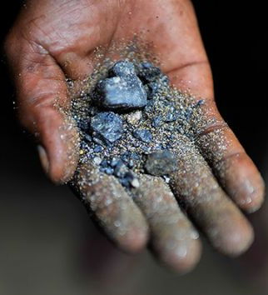
Coltan
Mined for tantalum and niobium, used in electronics (condensators)
All phones, computers, TVs…
circa 60% from DRC
https://www.youtube.com/watch?v=fPIB17PE2vM
“resource curse”
(re)source of conflict
Slavery and civil war
Environmental impact

Slide 13
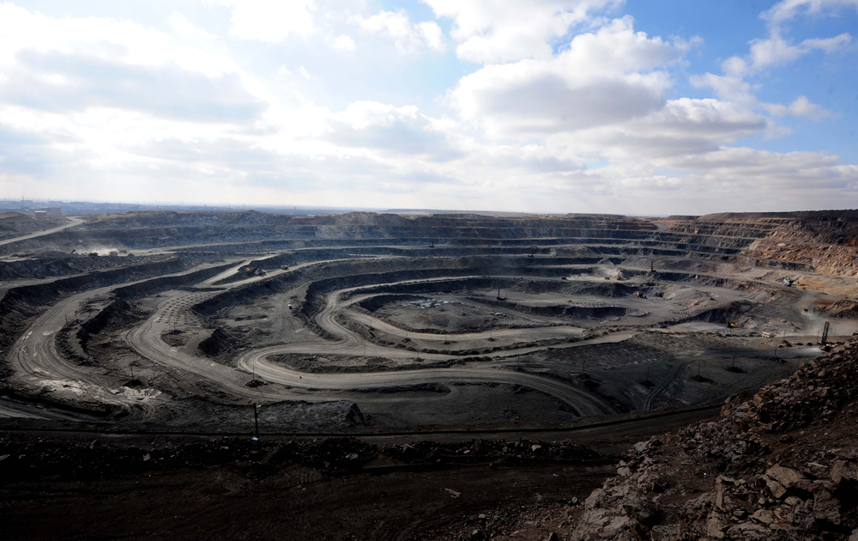
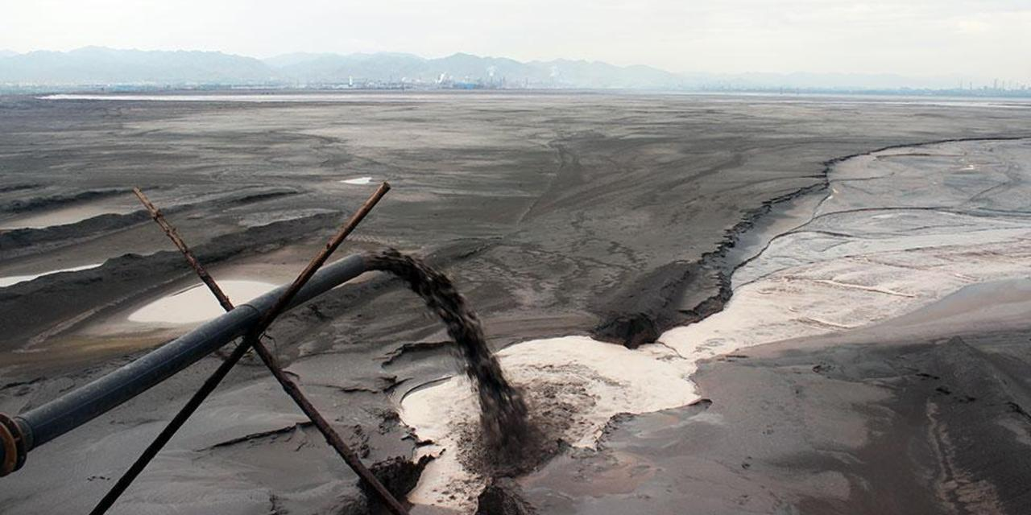
REE mining
90% of global production from mines in Baotou, northern China
cerium, neodymium, yttrium, terbium, scandium, lanthan, dysprosium, …
Massive ecological impact
Geopolitical tool
Other deposits: DPRK and Afghanistan

Slide 14
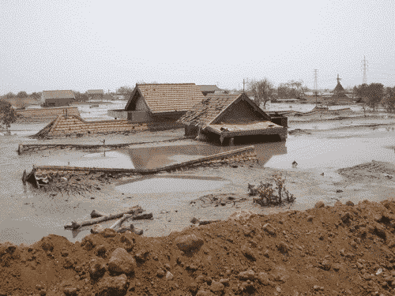
2006, Indonesia, East Java, Sidoarjo
Natural gas drilling turned into mud volcano
180 000 m³/day -> 10 000 m³/day
Area 10 km²

Slide 15
Geo-engineering
umělé a cílené ovlivňování klimatu
+ nevědomé brždění změn znečištěním
snaha zbrzdit oteplování a získat čas
obvykle skrze zvyšování albeda (odrazivost)
SRM - Solar Radiation Management
rozprašování látek v atmosféře, stavební úpravy
riziko závislost a jednostranných akcí
nebo “carbon capture”
technický/organický

