Slide 1
Formation of the modern states
Comparative Perspectives on Democracy and Development
Conflict and Democracy Studies Program
Marek Rybář, PhD

Slide 2
Why study the state?
state weakness undermines government performance, which can easily fuel public discontent
if essential services (public security, education, healthcare, infrastructure, etc.) are underprovided or distributed unevenly, there arises a broad perception of government ineffectiveness, corruption, unfairness, and neglect
in democracies, poor governmental performance erodes public trust in politicians, parties, and, eventually, democratic institutions themselves

Slide 3
Where does the state come from?
The historical rise of the state matters as a way of understanding both how our contemporary polities are organized and how they function
fundamental to our understanding of economic growth, good governance, regime stability, and democratic success
Two related answers: war between rival rulers and contracts between rulers and the ruled

Slide 4
The European prototype?
why did the state, particularly European states, become the most important political center of power over the last four hundred years?
Tilly: all European states went through the transition towards bureaucratization and absolutism due to the pressure of warfare
the state is like an outsized mafia that runs a protection racket, it needs money to protect itself from other similar organizations (competing states)

Slide 5
The European prototype?
modern states are a technological and logistical byproduct of war-making effort
war --> extraction of resources --> repression --> state formation
building and sustaining a modern army required a permanent bureaucratic infrastructure capable of extracting resources from the society, that in turn led to bureaucratic centralization

Slide 6
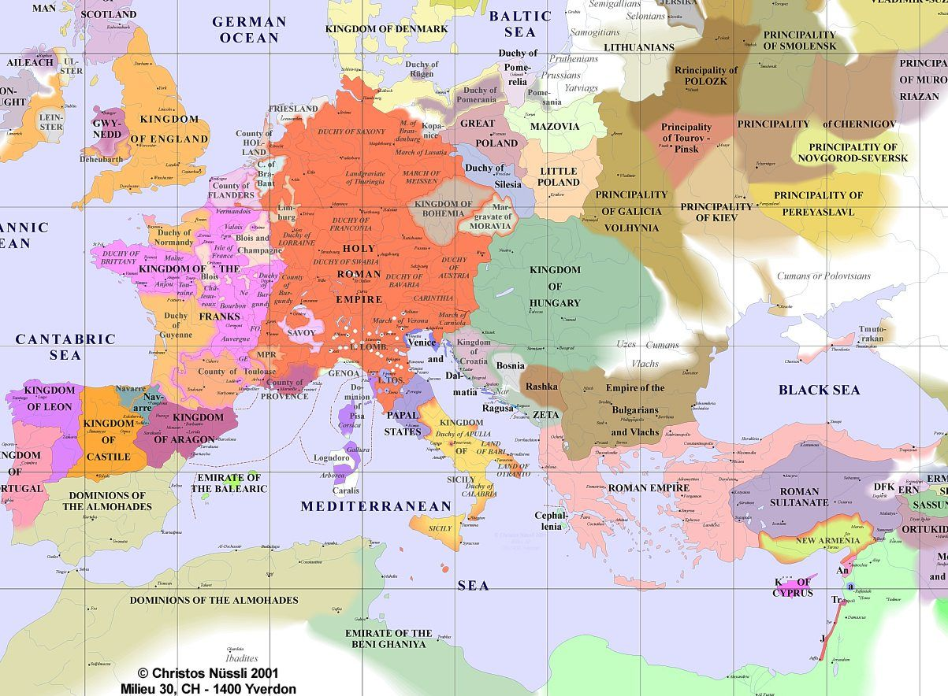

Slide 7
Multiplicity of state types in Europe
How to explain various forms of states found in Europe that over the last thousand years (empires, city-states, nation-states)?
the war-makes-states relationship is general, while Tilly’s theory of coercion and capital is specifically European
in highly commercialized countries with readily taxable resources (ENG & NETH) the drive towards bureaucratization and absolutism was weaker than in less modernized contexts (FRA, Prussia, Eastern Europe)

Slide 8
paths of state formation
1) coercion-intensive: often empires such as Russia plus Sweden and all Eastern Europe
2) capital-intensive: Italian, German, and Swiss city states and the Netherlands
3) capitalized coercion: territorial states or nation-states, particularly France, Great Britain, Spain and Prussia
eventually, all had to follow the third track which was militarily superior, particularly in its ability to organize and sustain a standing army

Slide 9
paths of state formation
coercion and capital vary across the European space
coercion is best understood from a top-down perspective as consolidation of the state from above,
while capital requires a bottom-up perspective on the groups in society and their resources
coercion vs. capital -----> timing of certain forms of states (empire, city-state, nation-state)
(preparation for war and bargaining over taxes as the mechanism)

Slide 10
The importance of capital/cities
even after the convergence to nation-state, the states retained characteristics from previous paths, such as the character of the representative institutions
No monarch could obtain assets without the compliance of at least some of the wealthy (and armed) elites: kings entered into explicit agreements with nobles, merchants, and clergy
representative assemblies limited the discretion of rulers in exchange for the income to fight wars, build states, and thus promote growth and state development.

Slide 11
How well does the model travel?
from the Middle Ages, Europe constituted an international system in which the threat of war was ubiquitous
state-builders had to strengthen the center to survive ruthless competition
Outside Europe, the situation looks quite different, especially after the World War II: geopolitical pressures were considerably less important
many states are ineffective, plagued with corruption, and the absence of public services; some are even failed states

Slide 12
a few exceptions
Japan, and South Korea, Taiwan and later China have developed powerful states
Southeast Asia also provides several examples of strong states such as Singapore, Malaysia, Thailand and to some extent Indonesia
individual success stories across South America and Africa, including Botswana, Chile and Uruguay - all developed relatively effective states while they were still poor

Slide 13
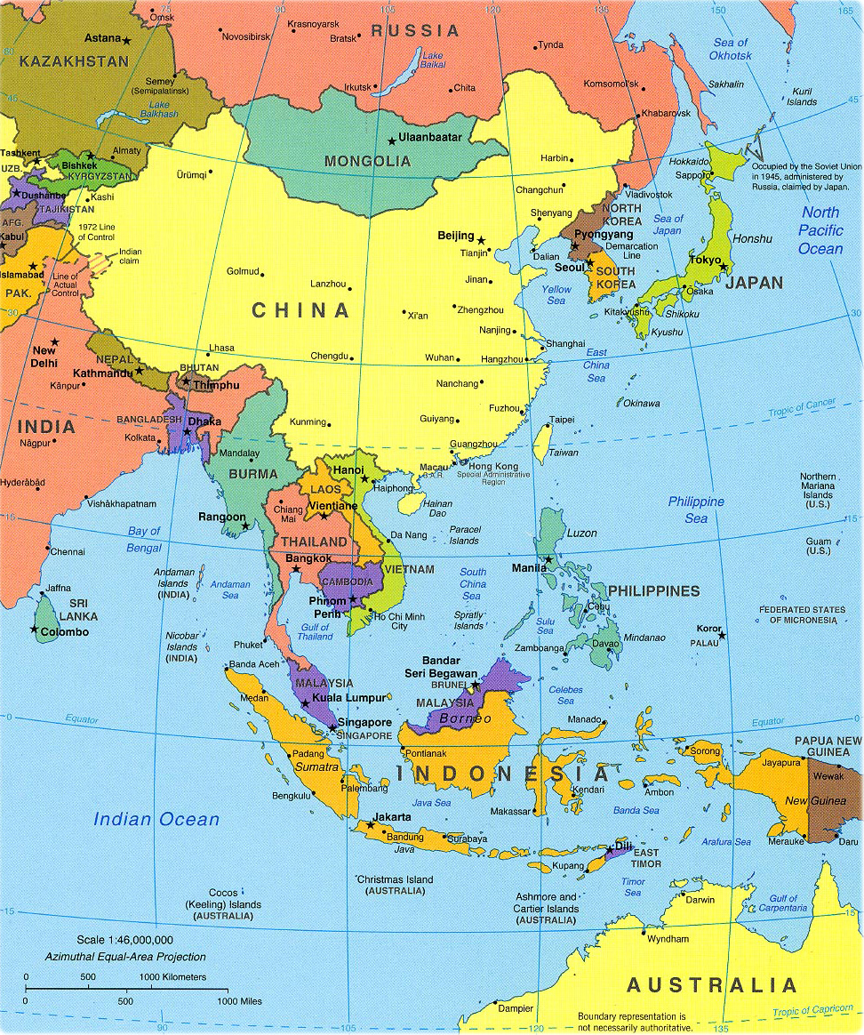

Slide 14
Theoretical challenges
The need to understand the consequences of different conditions outside Europe, and to explain why effective states have nevertheless been established in some places
East Asia is the major exception after 1945 in that geopolitical pressures were strong: located between Japan/US and China, they were forced to enlist their own citizens in state-building project
unable to maintain a credible defence without a flow of tax revenue

Slide 15
Sub-Saharan Africa
most African states are unable to complete even basic tasks like enforcing laws, building roads, and giving population universal access to education
state apparatus is riddled with corruption and nepotism, the state is absent in rural areas, and is unable to tax their residents systematically
it finances its operation via indirect taxes on trade and via development aid (plus income from natural resources)

Slide 16
Sub-Saharan Africa
compared to Western Europe, population density in Africa has always been very low
just a hundred years ago there were no cities and no transport infrastructure
war was aimed at capturing people (enslave them and trade them) rather than conquering territory
a secondary goal was to make neighboring tribes to pay tribute, preferably in the form of slaves

Slide 17
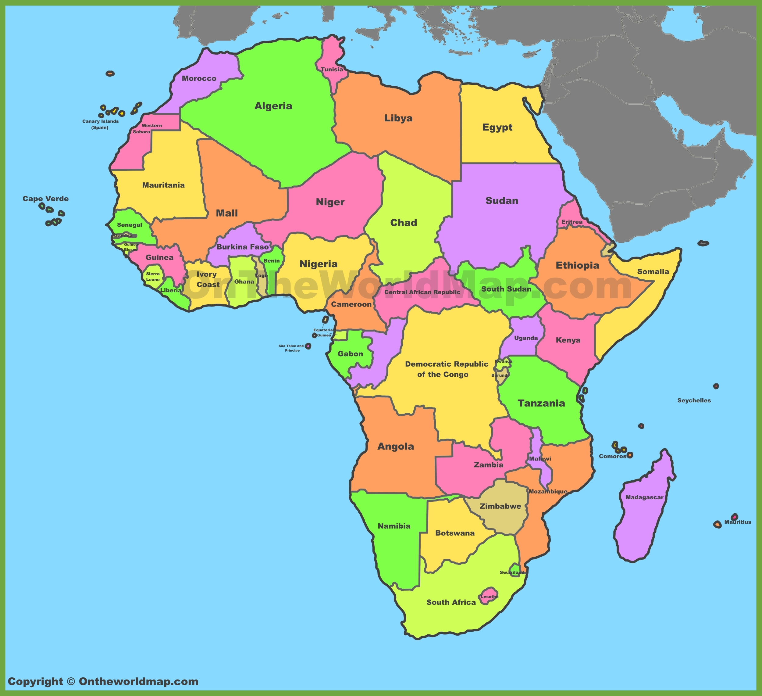

Slide 18
Herbst’s (2000) argument about Africa
the power in Africa was non-territorial
Europeans were long reluctant to become engaged in Africa: they merely established coastal strongholds from which they could purchase slaves and precious goods such as metal and ivory
Only in the 1880s, at the Berlin Conference, European powers drew lines on the map of Africa and divided among themselves the new colonies

Slide 19
Herbst’s (2000) argument about Africa
Europeans were not interested in waging wars over rather worthless African territory: their peaceful colonial coexistence was secured through treaties and agreements
French, British, Portuguese, Belgians and Germans were able to conquer very large territories without major effort to control them
concentrated on building a capital where they were present, while rural areas were ruled indirectly, often through cooperation with tribal chiefs

Slide 20
Herbst’s (2000) argument about Africa
without the need to protect the population against external enemies, the African states have struggled to be recognized internally
the lack of external pressure has undermined two of the most important state functions, namely, to create legitimacy and to collect taxes
nevertheless, state capacity among African states vary

Slide 21
Herbst’s (2000) argument about Africa
geography: the least favorable is the situation of large countries with population centers separated by great distances (Sudan, Nigeria, Democratic Republic of Congo,
the most favorable situation is in countries of a manageable size with a single population center (Botswana, Eritrea),
states with favorable geography, also have better citizenship policies and protection of property rights

Slide 22
Latin America
mostly composed of states that never won institutional autonomy for themselves: low legitimacy and a limited institutional capacity
a remarkably peaceful place with respect to inter-state conflicts: generally brief, involved limited number of troops, caused minor changes to national borders (the borders of 1840 roughly correspond to the borders of today)
why have Latin American states been so weak and why has the continent been so peaceful?

Slide 23
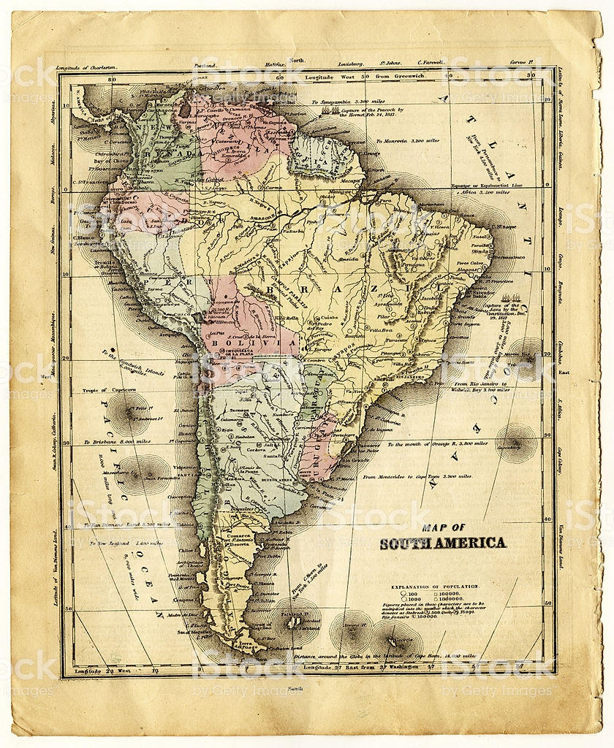
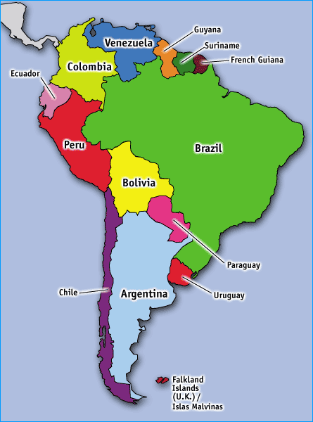

Slide 24
Centeno’s (2003) argument about Latin America
The states too weak to wage war and therefore are also weak to maintain law and order
the military too often occupied with fighting domestic rather than foreign enemies - civil wars more common than inter-state wars
with a single exception, most wars during the last two hundred years were limited, in contrast to Europe's total wars (as well as the US civil war)

Slide 25
Centeno’s (2003) argument about Latin America
limited wars have not fostered a broader and more efficient taxation of the population, but were financed by printing money (an inflation tax), via taxes on international trade, and by borrowing (in Europe)
war sparks taxation only under specific conditions, notably strong political institutions which can be realized only if the elites agree on boosting the state capacity
the first real states in Latin America emerged later, in early 20th century, and their creation coincided with the sustained period of peace

Slide 26
Why was Latin America different?
The states were internally divided, and both masses and elites were unable to find common ground
regional fragmentation, portions of the county controlled by local bosses, racial segregation, and ideological conservative-liberal division within the elite
wars did not contribute to national sentiment: the elites not interested in creating a sense of inclusive nationalism which would lead to granting indigenous underclass citizenship rights

Slide 27
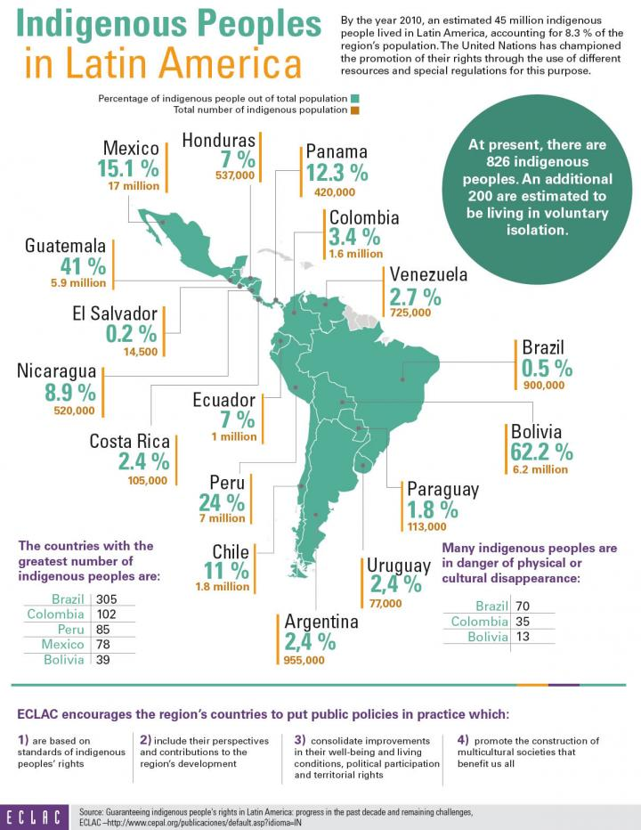

Slide 28
Latin American exceptions
the total War of the Triple Alliance (1864-1870) where a thoroughly mobilized Paraguay lost half of its population in conflict with Argentina and Brazil
Paraguay emerged victorious from one of the few other serious wars (against Bolivia in 1932-1935)
the clearest exception is Chile, with an early emergence of an efficient state and with a consensus between the elites and the masses - war facilitated both

Slide 29
Latin American exceptions
Argentina, Brazil, Uruguay and Mexico have similarly undergone periods in which warfare had favorable effects on state building, fostering a sense of national unity
the original war-makes-states relationship is based on a number of scope conditions:
an administrative core exists before the geopolitical pressures, at least part of the elite sees the development of state capacity as being in its interest, and that there is a general agreement as to who is included in the nation

Slide 30
Definitional and Methodological Questions
the most important is the distinction between minimalist and maximalist definitions of the state
the minimalist definition makes it possible to trace the first states six thousand years back in time: the state is any organization of society that is more sophisticated than a tribe

Slide 31
Tilly vs. weber
Tilly defined states as "coercion-wielding organizations that are distinct from households and kinship groups and exercise priority in some respect over all other organizations within substantial territories"
Weber offered a more maximalist definition of the state as an entity that possesses a monopoly on the legitimate use of force within a specific territory
the legitimate monopoly on force implies modern organs such as the military, the bureaucracy, the courts and the police

Slide 32
Legitimacy as a modern phenomenon
legitimacy means that the citizenry normally follows the state’s rules, partly because they are embedded in a rule-of-law mind-set and partly due to the presence of a common political community
this kind of apparatus has not existed in most of the states that fit the minimalist definition
its internal power monopoly is couched in international competition with other states

Slide 33
Legitimacy as an indispensable condition
minimalist post-Weberian definitions of the state avoid the concepts of legitimacy and monopoly, because they do not understand them as constants:
not all (modern) states are legitimate, and many do not have a monopoly of (legitimate) violence on their territory
however, if we do not include "legitimacy" into understanding modern states, the concept of the state becomes too materialist

Slide 34
Legitimacy as an indispensable condition
Without legitimacy, the state is reduced to military power and bureaucracy that enforce material order
no state is based solely on a physical and material bases: ideas, values and norms play a wider role than producing physical coercion, they legitimate the state power
the state best understood as an object of analysis that exists simultaneously as material force and as a non-materialistic construct

Slide 35
What is state capacity
some definitional disagreements but consensus that it has to do with the ability of the state to execute policies
Additionally, some scholars see the ability of the state to
penetrate society, provide public goods, extract revenues, deliver well-being, and control economic resources
Some add impartiality, efficiency and absence of corruption as fundamental features of state capacity

Slide 36
How to measure state capacity?
A numer of comparative indeces, both subjective and objective data:
Quality of Government Index (Quality of Government Institute, https://www.gu.se/en/quality-government)
Government Effectiveness Index (World Bank, www.worldbank.org)
Failed States Index (https://fragilestatesindex.org/)
Corruption Perceptions Index (Transparency International, www.transparency.org)
the composite indices are based on a combination of several sub-indicators

