Slide 1
Introduction to Statistics and SPSS
Methodology of Conflict and Democracy Studies
November 22

Slide 2
Aim of this lecture
Variables and their categories
Population and sample
Hypotheses and null hypotheses
Statistical significance
Introduction to SPSS
How to make your own variables

Slide 3
Logic of Statistics
Deductive logic of research
What we do:
  Derive hypotheses from the theory
  Define variables and operationalize our concepts
  Collect the data
  Test the hypotheses using statistical models
  Provide interpretation and decide whether our hypotheses hold or not
This all requires more than just few cases

Slide 4
Variables
Measurable items that change their values
Number of cars on highways, maximum daily temperature, local turnout in elections
Independent (predictor) and dependent (outcome) variables
Main tool for testing hypotheses

Slide 5
Levels of Measurement
Completely different categorization of variables than IV and DV
Categorical:
  Nominal
  Ordinal
Continuous:
  Interval
  Ratio

Slide 6
Nominal Variables
Their values cannot be ordered in a logical way
Names of towns, names of streets, telephone numbers, colors, species of animals, numbers of players
Binary variables – nominal variables with just two values
  Someone is employed or he/she is not employed
  Citizen either voted in election or did not vote
  You either attend this lecture or you do not

Slide 7
Ordinal Variables
Their values can be ranked in a logical way however we cannot tell the exact differences between the values
School grades, Olympic medals, military ranks, age groups
Ordinal variables tell us more than nominal variables (ordering values) but less than interval and ratio variables

Slide 8
Interval and Ratio Variables
Interval:
  We can order the values and we know the differences
  Equal intervals on a scale represent equal differences
  Temperature in Celsius
Ratio:
  Same as interval but ratios of values are meaningful
  They have to contain a true zero
  Distance in kilometers, time in seconds
In SPSS interval and ratio variables are under the same label (scale)

Slide 9
Continuous or Discrete?
Scale (interval, ratio) variables can be either:
  Continuous
  Discrete
Depends on whether the values can take any values on a scale
Success rate in a test (in %)
Number of kids in families

Slide 10
 | Nominal | Ordinal | Scale (interval, ratio)
Can we logically order the values? | No | No | Yes
Do we know differences between the values? | No | Yes | Yes
Continuous or discrete | Discrete | Discrete | Continuous / discrete

Slide 11
Population and Sample
Population:
  Includes all possible subjects of a dataset
  All towns of a country, all university students
Sample:
  Includes only part of the cases and it is a subset of the population
  Important feature – representativeness
  1,000 people in a survey
  Many ways of selection – random and non-random

Slide 12
Population and Sample
Working with population data:
  You have data for the whole population
  Your findings apply to the whole population
Working with sample data:
  You have data for the sample only
  Your aim is to apply the findings to the whole population
Nobody cares if 53 per cent of 1,000 survey respondents support Brexit but whether 53 per cent of UK population has this opinion

Slide 13
Hypotheses
Logical conjecture about the nature of relationships between two or more variables expressed in the form of a testable statement (O’Leary 2004)
“Higher unemployment leads to higher frustration of the society”
Null hypothesis:
  Statement about absence of any relationship between independent and dependent variable
  Every hypothesis has its null hypothesis
In statistics, all operations test the null hypotheses
After testing the null hypotheses either hold or they are dismissed (what gives support to our hypotheses)

Slide 14
Statistical Significance
Working with samples is always connected with some sampling error
Statistical significance allows to estimate whether the found effects are not only random and so they can be applied to the whole population
Levels of significance: 95 %, 99 %, 99.9 %
Significance and hypotheses testing:
  If a result is significant, we reject the null hypothesis and we gain confidence in our own hypothesis
  If a result is not significant, we hold the null hypothesis and we thus we have no support for our own hypothesis

Slide 15
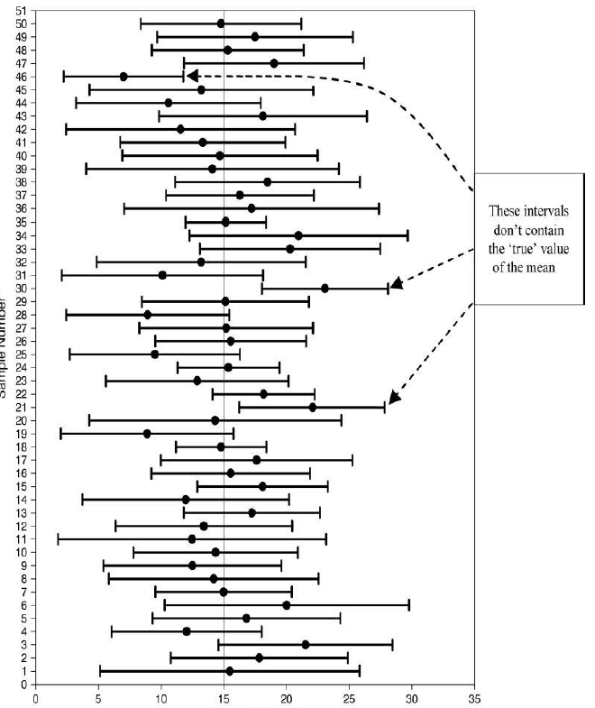

Slide 16
Statistical Significance
A statistically significant effect does not necessarily mean that it is also important and meaningful
A finding that a new medicine reduces body temperature of the patient by 0.01 °C (significant at 99.9 %)
A finding that a new medicine reduces body temperature of the patient by 1 °C (significant at 99.9 %)

