Slide 1
International security - ireb1007
Fall 2021
Security terms and theories
dr. Martin Chovančík

Slide 2
Starting discussion
Is security survival?
Is security absolute or relational?
Is state/national security paramount?
How do we know we’re (not) secure? Who decides? (think individual but also collective)
Who improves or damages security (which actors)?

Slide 3
Short Group work
Make a group of 4
Pick exactly ONE country – any country (if more of you or some of you are from that country all the better)
Come up with a list of top 5 security issues the population of said country is facing
This is a priority list
What is lower on the list might not be addressed – enjoy the same resources
So what makes us most insecure? (WMD, or climate, or race, or conflict?)

Slide 4
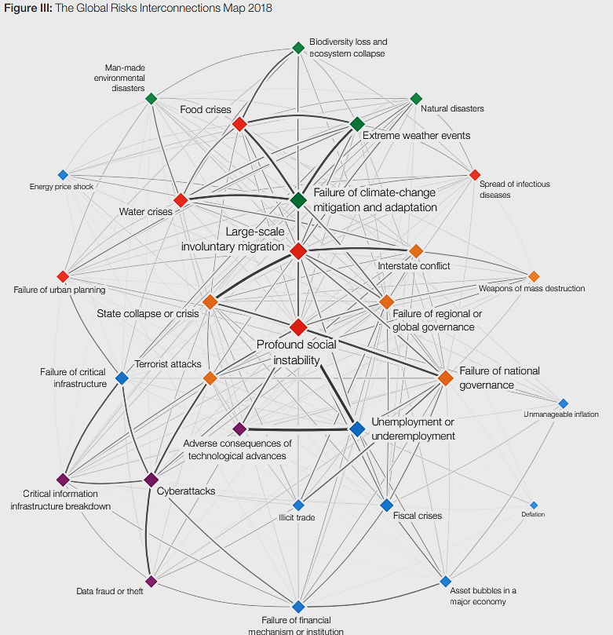
Global risks
World Economic Forum
The Global Risks Report 2019 14th Edition
https://www.weforum.org/reports/the-global-risks-report-2019

Slide 6
security
security is survival plus
while survival is easier to define the plus is not
depending on the level of analysis (read Singer) survival will consist of:
a degree of sovereignty, independence, and territorial integrity
the prevention/mitigation of threats to values
freedom from (persecution)
and freedom to (pursue happiness)
Global
International
National
Individual

Slide 7
threat
Cold War
dual threat to state security – physical and ideological
dual as source – internal and external
oriented at military
Collective defense
Current
societal and environmental threats
previous are present, but less important
Collective security
primary phenomenon endangering values
severity corresponds to how core the value is
national security threat as an action or sequence of events that (Ullman 1983):
1) threatens drastically and over a relatively brief span of time to degrade the quality of life for the inhabitants of a state; or
2) threatens significantly to narrow the range of policy choices available to the government of a state or to private non-governmental entities (persons, groups, corporations) within the state
ever broadening list with varying weights of impact

Slide 8
Security challenge
In Collective Security, threat is not known in advance
In Collective Defence, threat is known in advance
In Collective Security enemy is not known in advance
In Collective Defence enemy is known in advance
Collective Security is global in nature
Collective Defence is regional and continental
Is it just a threat?
technically a synonym, but used to underline collective security and increase the standing of remote but shared threats
often “soft security”:
i.e.: contagions, environmental degradation, migration, antibiotic resistance, drought, ageing populations, and many others growing in importance due to globalization
does not have to name an adversary

Slide 9
vulnerability
the level AND area-specific weakness/exposure to threats
susceptibility to threat, being exposed, or sensitive to STRESSORS in a particular area and at a particular level
follows the logic of security challenges and discourse is guided away from military and national security vulnerabilities, to more societal and environmental definitions
How would you conduct a structural vulnerability assessment?
What is resilience?
from physical exposure: presence and density of the people, habitat, networks, goods and services in risk zones, physical military or civilian infrastructure
to concepts of resilience: societal capacity to retain values and recover from attacks negative influence

Slide 10
Risk
Is a risk negative or positive?
likelihood of occurrence
“Uncertainty arises when the future is unknown but no actual probabilities (objective or subjective) are attached to alternative outcomes. Risk arises when specific numerical probabilities are attached to alternative outcomes”(Llewllyn 1996:744)
probability of a loss coupled with our evaluation of its size and significance
What is a risk appetite?
Risk management
just weigh the risk of climate change against the risk of economic downturn if policies are applied
How aggressively?
How “risky” is it to stall?
Broadest equation:
Impact
Threat
Vulnerability
RISK

Slide 11
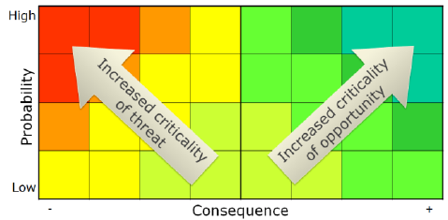
Risk assessment matrix

Slide 12
referent
referent or referent object
entity whose security is to be assured
national security – state
human security – individual
broadening category – regions, communities, minorities, institutions, etc.
all require actorness: i.e. the ability to take decisions as a social actor

Slide 13
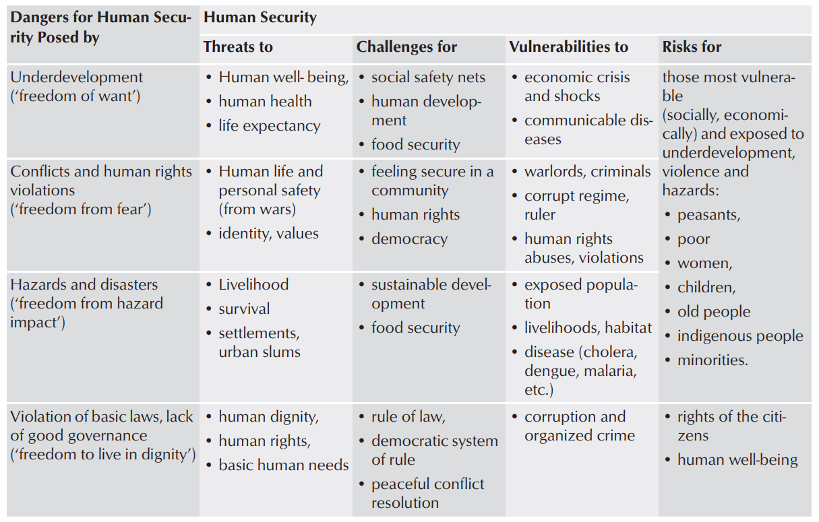
threat
Brauch 2011: 101
Concepts of Security Threats, Challenges, Vulnerabilities and Risks

