Slide 1
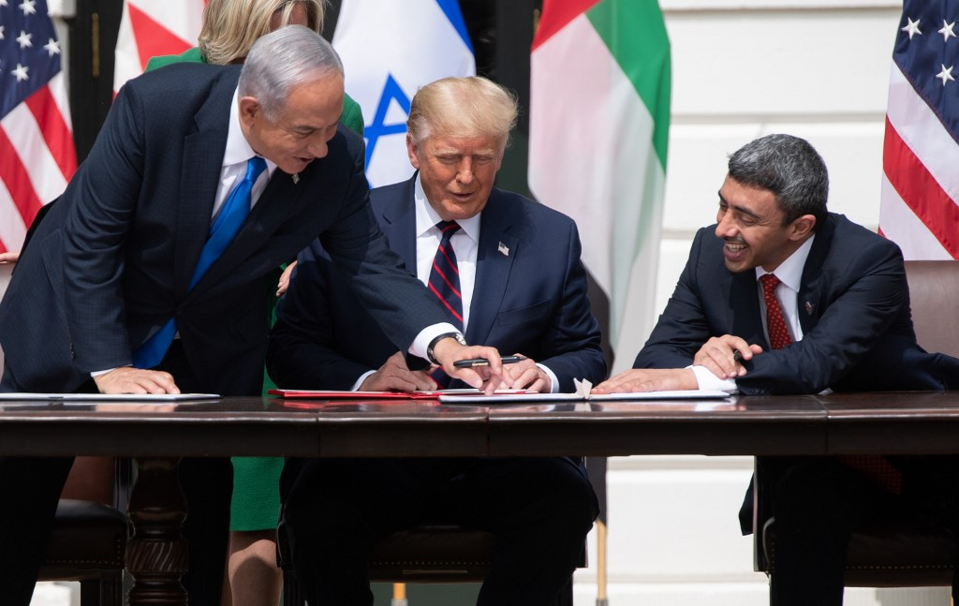
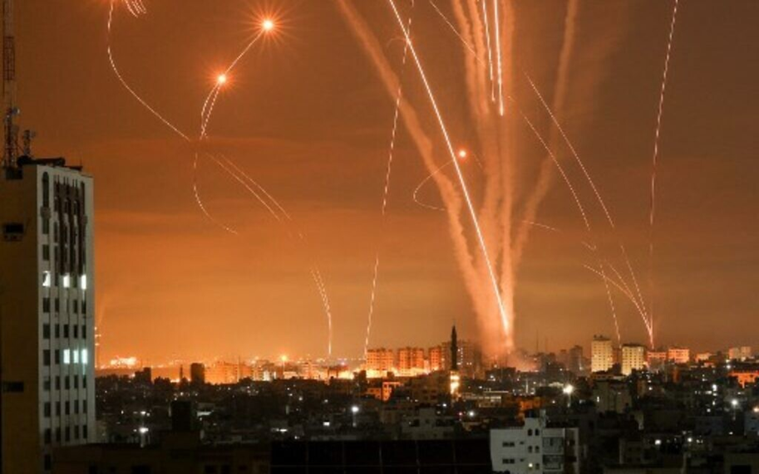
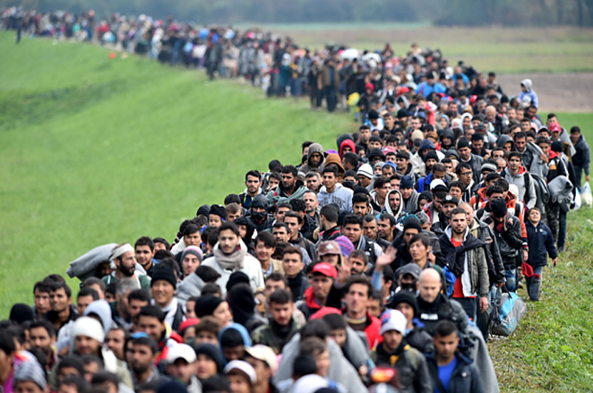
CURRENT EVENTS IN THE MIDDLE EAST
Mgr. Eva Taterová, M.A., Ph.D.
Politics and Society in the Middle East

Slide 2
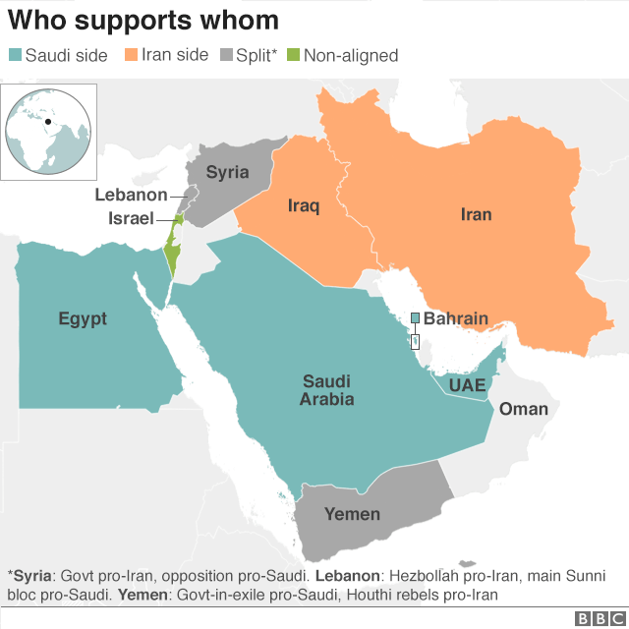
NEW COLD WAR IN THE MIDDLE EAST?
1. "Saudi" - inaccurately "Sunni" bloc
maintaining the conservative regimes of the Middle East (mainly Saudis, UAE + Bahrain, Egypt) + Israel
2. "Iranian" - inaccurately "Shiite" bloc
Iran, Syria, Lebanese Hezbollah, largely the government in Iraq
3. Qatar and Turkey
Proxy Wars - Iraq, Syria, Yemen, etc.

Slide 3
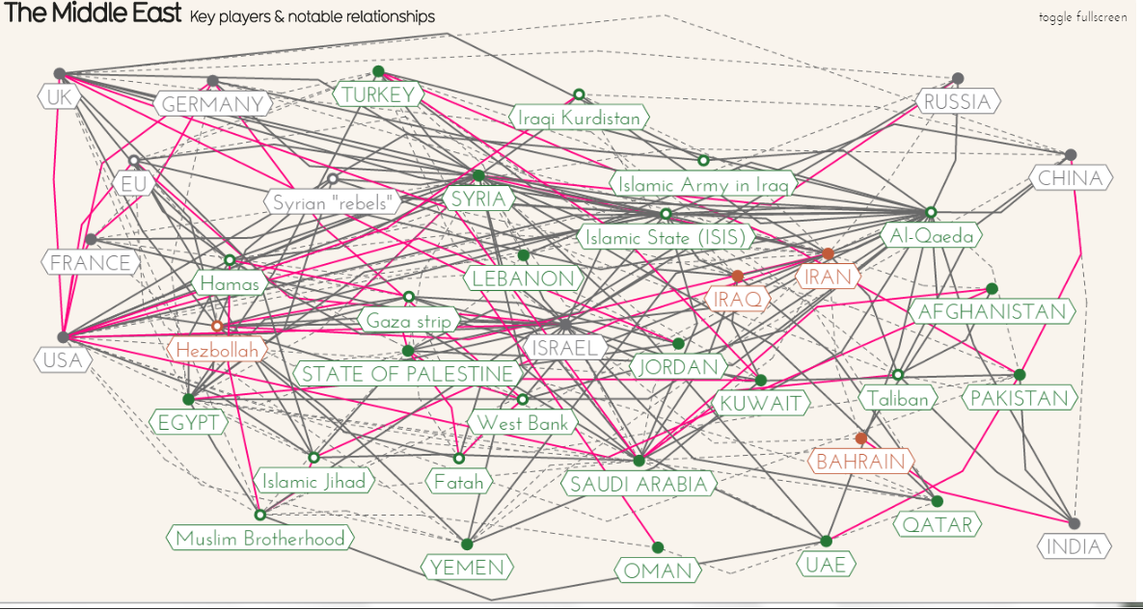

Slide 4
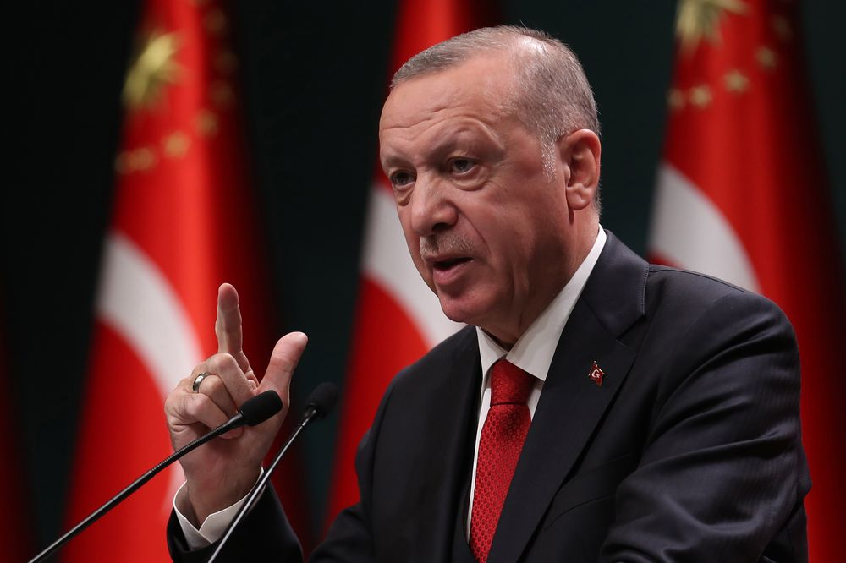
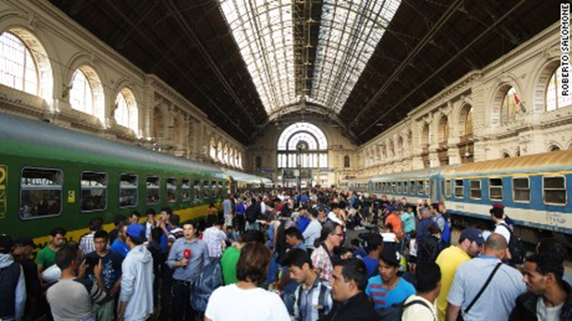
Turkey as a new key player
Member of NATO (2nd strongest army).
Fighting Kurds (YPG / PKK).
It benefits from the problems of Syria.
An important role in the context of the migration crisis.
Increasing domestic and foreign influence of President Erdogan.
Business partner of the United States.

Slide 5

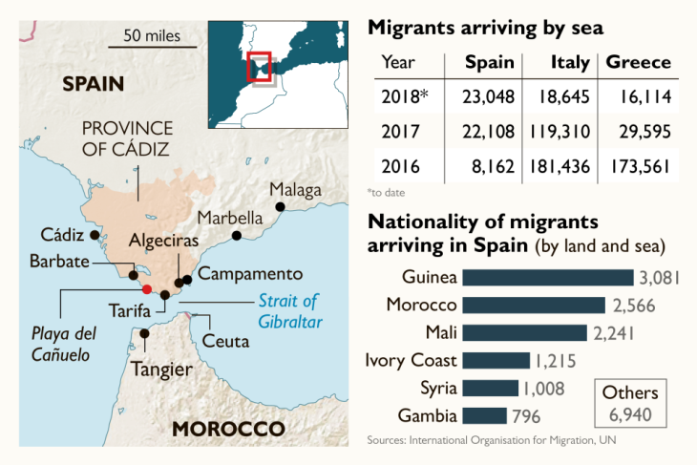
EU AND MIGRATION CRISIS
Start in 2015 – sharp increase in the number of migrants – over a million people came.
EU response was quite slow.
Cooperation of neighbouring countries is crucial for tackling illegal migration.
Most problematic border is Turkey-Greece – FRONTEX action needed – Treaty with Turkey.
Currently most people come through Spain, but the numbers are much smaller.

Slide 6
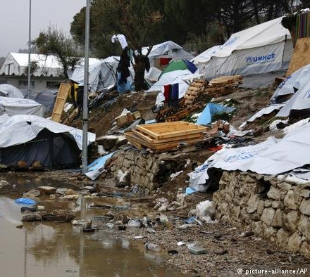
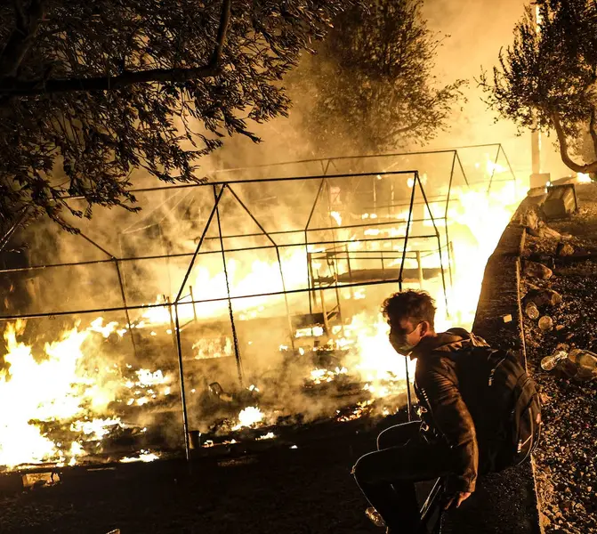
MORIA CAMP, GREECE

Slide 7
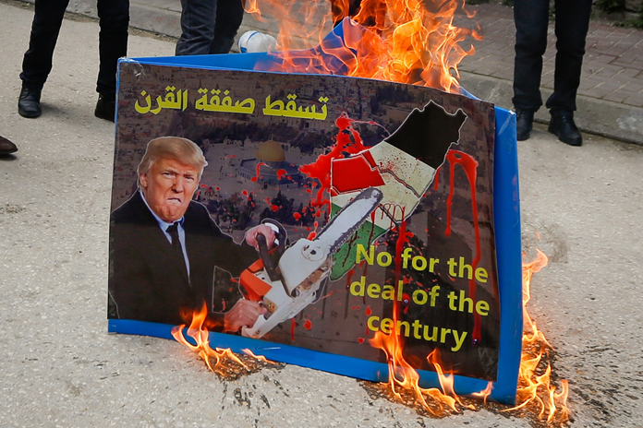
CHANGE OF ISRAELI POSITION
Move of the US embassy from Tel Aviv to Jerusalem in 2018.
Normalization of the diplomatic relations with selected Muslim countries in 2020:
  United Arab Emirates.
  Bahrain.
  Sudan.
  Morocco.
  Intensifying cooperation between Israel and the Sunni countries of the region.
Arab-Israeli conflict is no longer the dividing line of the region – Has the world forgotten the Palestinians?

Slide 8

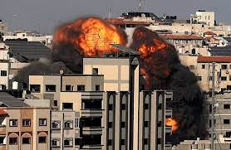
CURRENT CRISIS ISRAEL vs. HAMAS

Slide 9
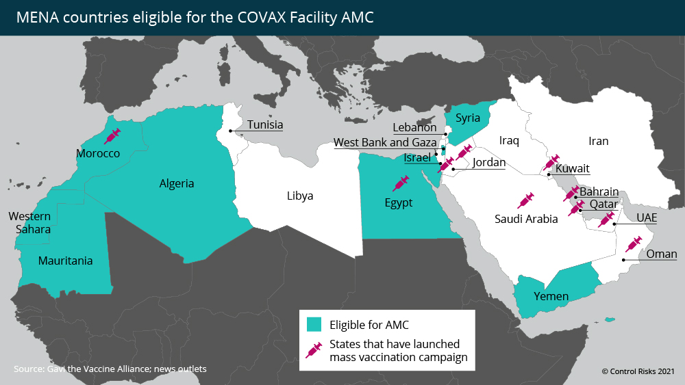
CURRENT POLITICAL CHALLENGES
Change in US foreign policy - gradual abandonment of the Middle East X increase of Russian and Chinese influence in the region (COVID-19 vaccine diplomacy).
Post-conflict reconstruction, high unemployment in post-war states (Iraq, Syria).
High debt and corruption.
Political and religious instability.
Missing and insufficient infrastructure.
Consequences of covid-19 pandemic.

Slide 10
THANK YOU FOR YOUR ATTENTION

