Slide 1
China in the World Economy
China in the World Economy, autumn 2021

Slide 2
Questions from last time
1) Name some reasons why China launched the Belt and Road Initiative.

Slide 3
Questions from last time
1) Name some reasons why China launched the Belt and Road Initiative.
2) Name some more reasons why China launched the Belt and Road Initiative.

Slide 4
Questions from last time
1) Name some reasons why China launched the Belt and Road Initiative.
2) Name some more reasons why China launched the Belt and Road Initiative.
3) What are „memoranda of understanding“ and „cooperation agreements“?

Slide 5
Questions from last time
1) Name some reasons why China launched the Belt and Road Initiative.
2) Name some more reasons why China launched the Belt and Road Initiative.
3) What are „memoranda of understanding“ and „cooperation agreements“?
4) How are Belt and Road projects financed?

Slide 6
Questions from last time
1) Name some reasons why China launched the Belt and Road Initiative.
2) Name some more reasons why China launched the Belt and Road Initiative.
3) What are „memoranda of understanding“ and „cooperation agreements“?
4) How are Belt and Road projects financed?
5) How do financing conditions compare to concessional development lending (World Bank etc.) and commercial loans?

Slide 7
Questions from last time
6) What type of projects are typically financed via BRI?

Slide 8
Questions from last time
6) What type of projects are typically financed via BRI?
7) What leads developing countries to join BRI?

Slide 9
Questions from last time
6) What type of projects are typically financed via BRI?
7) What leads developing countries to join BRI?
8) Name some important partner countries and explain why they may be important for China.

Slide 10
Questions from last time
6) What type of projects are typically financed via BRI?
7) What leads developing countries to join BRI?
8) Name some important partner countries and explain why they may be important for China.
9) Can the Chinese navy use a port leased by Sri Lanka to a Chinese company?

Slide 11
Today
The Belt and Road Initiative in Europe

Slide 12
Today
The Belt and Road Initiative in Europe
Summary and extension of topics we have discussed
> joining together what you already know, adding new angles and details
Main focus – opening to international trade and foreign investment

Slide 13
BRI in European Union member states

Slide 14
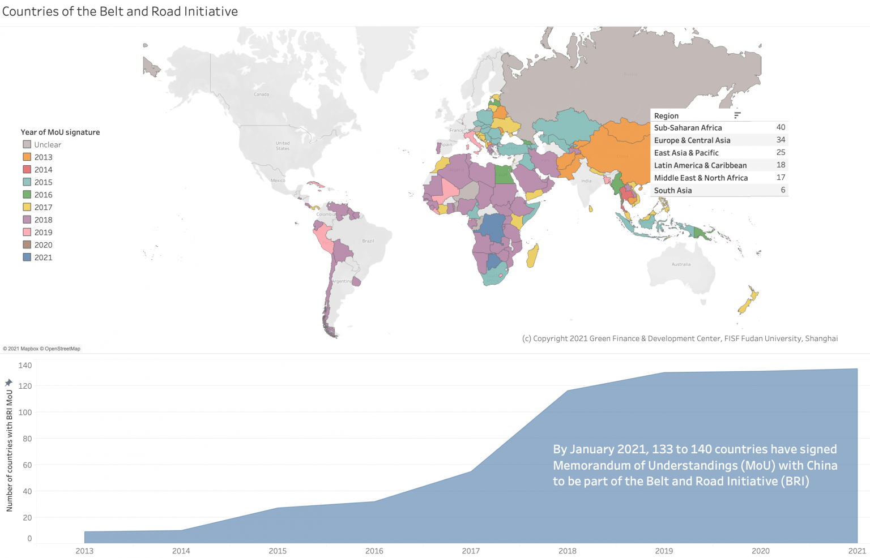

Slide 15
BRI in European Union member states
Hungary, Italy, Greece
Countries frustrated by EU leadership
Facing economic decline, or insufficient convergence with core states
Eastern member states – disappointed by their unequal relationship with Germany

Slide 16
BRI in European Union member states
Main problem for BRI: EU law
Regulates competition and rules for public procurement

Slide 17
BRI in European Union member states
Main problem for BRI: EU law
Regulates competition and rules for public procurement
> need for transparent tenders
> it is not possible to do a backroom deal with a Chinese bank

Slide 18
BRI in European Union member states
Main problem for BRI: EU law
Regulates competition and rules for public procurement
> need for transparent tenders
> it is not possible to do a backroom deal with a Chinese bank
Competition law – state guarantees would be seen as giving Chinese SOEs and banks and unfair advantage over competition > it cannot be done

Slide 19
BRI in European Union member states
Also – EU states are relatively rich

Slide 20
BRI in European Union member states
Also – EU states are relatively rich
+ have access to EU funds + to private lending

Slide 21
BRI in European Union member states
Also – EU states are relatively rich
+ have access to EU funds + to private lending
> they have their own funding and don‘t need China‘s money
> they are higher on Maslow‘s pyramid and care about things like the environment or potential political interference

Slide 22
BRI in European Union member states
Also – better institutions and less corruption

Slide 23
BRI in European Union member states
China underestimated all of this
> their offers are often unacceptable

Slide 24
BRI in European Union member states
China underestimated all of this
> their offers are often unacceptable
> overall, the Belt and Road project is a failure in Europe, without the EU even having to have some strategy against it

Slide 25
BRI in European Union member states
When Chinese companies do successfully win construction contracts, its under European rules:
1) Based on a public tender

Slide 26
BRI in European Union member states
When Chinese companies do successfully win construction contracts, its under European rules:
1) Based on a public tender
2) Financed by European resources
> do debts, no collateral, no ownership of the infrastructure for the Chinese

Slide 27
BRI in European Union member states
When Chinese companies do successfully win construction contracts, its under European rules:
1) Based on a public tender
2) Financed by European resources
> do debts, no collateral, no ownership of the infrastructure for the Chinese
3) No guarantees and obligatory renegotiation of prices
> China‘s companies must behave like any other company without any special regime

Slide 28
The BRI in Europe
China‘s big plan – building a railway from the port of Piraeus through Hungary to Germany

Slide 29
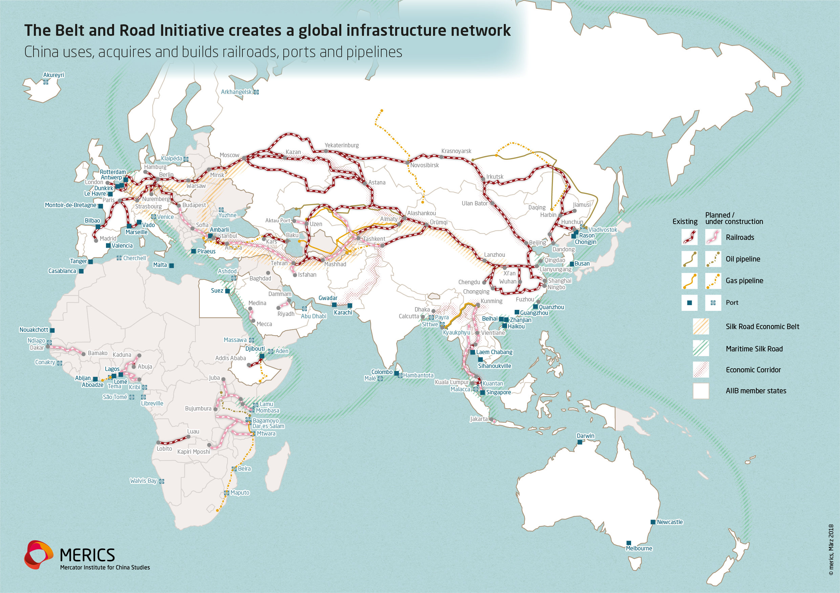
The BRI in Europe

Slide 30
The BRI in Europe
China‘s big plan – building a railway from the port of Piraeus through Hungary to Germany
Only the Hungarians decided to jump on this bandwagon
Like many BRI projects, it is probably too expensive and is never gong to pay for itself > skepticism in most EU states

Slide 31
China‘s opening revisited

Slide 32
China‘s opening revisited
1978 – all trade handled by special FTCs – 12 foreign trade companies = FTCs

Slide 33
China‘s opening revisited
1978 – all trade handled by special FTCs – 12 foreign trade companies = FTCs
Low tariffs and overvalued exchange rate
Why?

Slide 34
China‘s opening revisited
1978 – all trade handled by special FTCs – 12 foreign trade companies = FTCs
Low tariffs and overvalued exchange rate
Why?
Because they were not necessary – the state controlled all the flows of goods without a need for a competitive exchange rate or protective tariff wall

Slide 35
China‘s opening revisited
Two simultaneous processes (dual-track reform):

Slide 36
China‘s opening revisited
Two simultaneous processes (dual-track reform):
1) Reform and gradually open up the statist system > ordinary trade
- inland provinces

Slide 37
China‘s opening revisited
Two simultaneous processes (dual-track reform):
1) Reform and gradually open up the statist system > ordinary trade
- inland provinces
2) Create special rules for foreign companies to process goods in China – completely outside the old system

Slide 38
China‘s opening revisited
Two simultaneous processes (dual-track reform):
1) Reform and gradually open up the statist system > ordinary trade
- inland provinces
2) Create special rules for foreign companies to process goods in China – completely outside the old system > export processing
- coastal provinces

Slide 39
China‘s opening revisited
Two simultaneous processes (dual-track reform):
1) Reform and gradually open up the statist system > ordinary trade
- inland provinces
2) Create special rules for foreign companies to process goods in China – completely outside the old system > export processing
- coastal provinces
These two coexist to this day!

Slide 40
Ordinary trade
Number of monopoly FTCs increased – from 12 to several thousands

Slide 41
Ordinary trade
Number of monopoly FTCs increased – from 12 to several thousands
But all of them were, at least officially, SOEs!

Slide 42
Ordinary trade
Number of monopoly FTCs increased – from 12 to several thousands
But all of them were, at least officially, SOEs!
The FTC system was only completely abolished in 2004, after entering the WTO!

Slide 43
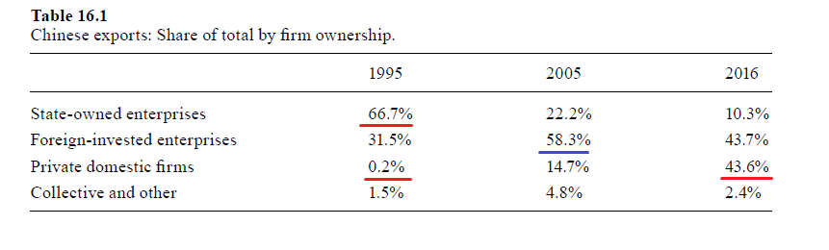

Slide 44
Ordinary trade
Liberalized prices – the foreign trade companies were encouraged to make money instead of fulfilling a plan

Slide 45
Ordinary trade
Liberalized prices – the foreign trade companies were encouraged to make money instead of fulfilling a plan
Before – artificial prices totally detached from the world market, trade guided by state direction
After reform – „export and import whatever is profitable in your business area“

Slide 46
Ordinary trade
Liberalized prices – the foreign trade companies were encouraged to make money instead of fulfilling a plan
Before – artificial prices totally detached from the world market, trade guided by state direction
After reform – „export and import whatever is profitable in your business area“
> give the central government a part of the foreign exchange, keep the rest as use it to do more business

Slide 47
Ordinary trade
„Canalization“ – if you wanted to import something and you did not have the license to do it, you had to persuade one of the monopoly SOEs to do it for you

Slide 48
Ordinary trade
„Canalization“ – if you wanted to import something and you did not have the license to do it, you had to persuade one of the monopoly SOEs to do it for you
> even TVEs and other small companies de facto could take part in trade, but a part of the profit went to the SOEs

Slide 49
Ordinary trade
„Canalization“ – if you wanted to import something and you did not have the license to do it, you had to persuade one of the monopoly SOEs to do it for you
> even TVEs and other small companies de facto could take part in trade, but a part of the profit went to the SOEs
> FTCs as middlemen

Slide 50
Ordinary trade
Gradual establishment of a tariff wall

Slide 51
Ordinary trade
Gradual establishment of a tariff wall
By 1994, the average tariff stood at 43% - similar to protectionist Global South countries such as Brazil

Slide 52
Ordinary trade
Gradual establishment of a tariff wall
By 1994, the average tariff stood at 43% - similar to protectionist Global South countries such as Brazil
Increasing tariffs as a by-product of liberalization!

Slide 53
Ordinary trade
Gradual establishment of a tariff wall
By 1994, the average tariff stood at 43% - similar to protectionist Global South countries such as Brazil
Increasing tariffs as a by-product of liberalization!
After entering the WTO, it was lowered again to circa 10 %

Slide 54
Ordinary trade
Gradual devaluation of the RMB

Slide 55
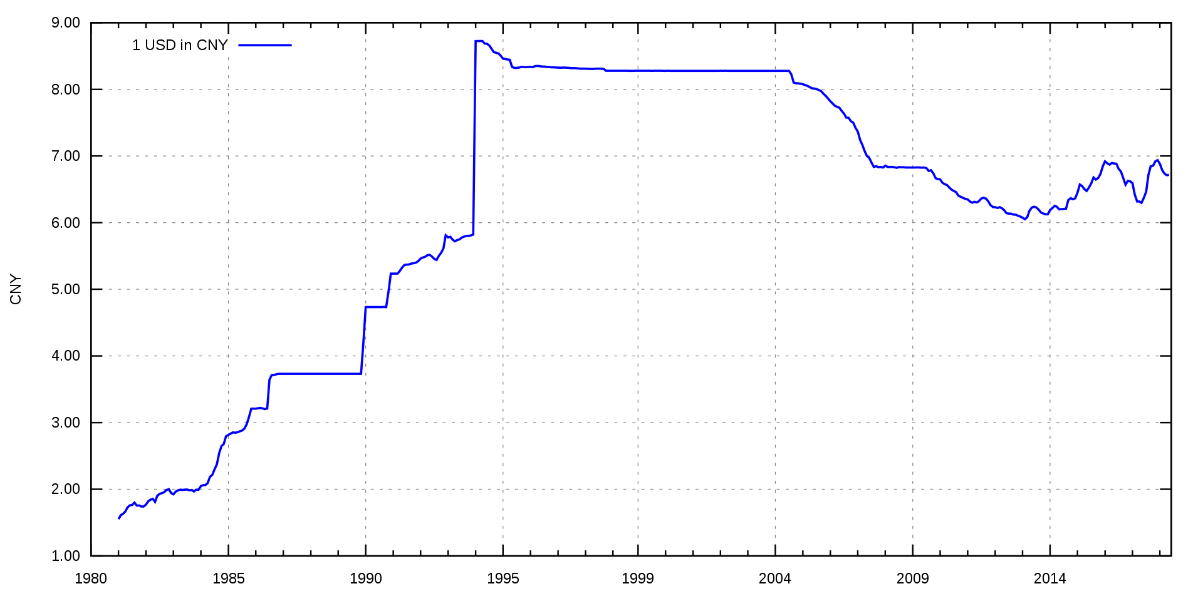
USD to RMB

Slide 56
Ordinary trade
Gradual devaluation of the RMB
Separate foreign exchange market – foreign trade companies could exchange money and ignore the official rate

Slide 57
Ordinary trade
Gradual devaluation of the RMB
Separate foreign exchange market – foreign trade companies could exchange money and ignore the official rate
> two exchange rates – the official one and the one used between the companies
Fix and floating at the same time (kind of)

Slide 58
Ordinary trade
Gradual devaluation of the RMB
Separate foreign exchange market – foreign trade companies could exchange money and ignore the official rate
> two exchange rates – the official one and the one used between the companies
Fix and floating at the same time (kind of)
Which one was lower?

Slide 59
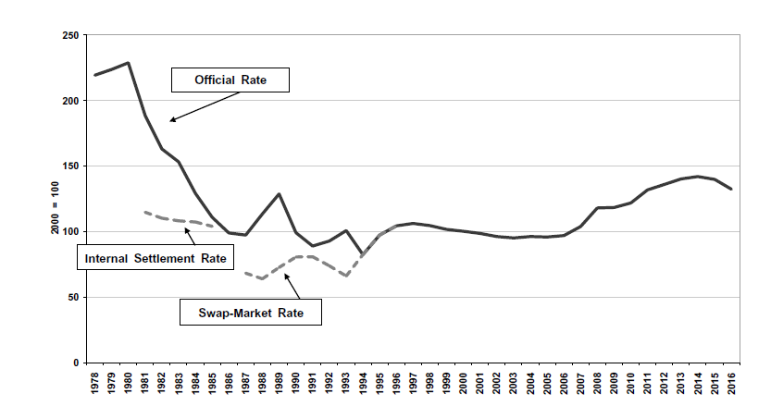
RMB to UDS

Slide 60
Ordinary trade
Main devaluation – 1994 – official rate set and fixed at the previous unofficial rate

Slide 62
USD to RMB

Slide 63
Ordinary trade
Main devaluation – 1994 – official rate set and fixed at the previous unofficial rate
= „Let‘s respect the collective wisdom of the market“

Slide 64
Ordinary trade
Main devaluation – 1994 – official rate set and fixed at the previous unofficial rate
= „Let‘s respect the collective wisdom of the market“
The rate was competitive and led to a more or less balanced trade

Slide 65
Ordinary trade
Main devaluation – 1994 – official rate set and fixed at the previous unofficial rate
= „Let‘s respect the collective wisdom of the market“
The rate was competitive and led to a more or less balanced trade
Under floating, the rate would appreciate because of growing exports
= as China became more competitive, the rate should have gone up

Slide 66
Ordinary trade
But China artificially kept the rate at the 1994 level all the way until 2005

Slide 67
USD to RMB

Slide 68
Ordinary trade
But China artificially kept the rate at the 1994 level all the way until 2005
+ „real depreciation“
The price level in China rose more slowly than in the US and most other capitalist countries

Slide 69
Ordinary trade
But China artificially kept the rate at the 1994 level all the way until 2005
+ „real depreciation“
The price level in China rose more slowly than in the US and most other capitalist countries
> Chinese goods became relatively cheaper

Slide 70
Real appreciation / depreciation
If your exchange rate is stable AND you have lower inflation than a partner country, your currency is undergoing a real depreciation

Slide 71
Real appreciation / depreciation
If your exchange rate is stable AND you have lower inflation than a partner country, your currency is undergoing a real depreciation
> your goods become more competitive > you export more
As if you devalued the currency

Slide 73
USD to RMB

Slide 74
Ordinary trade
But China artificially kept the rate at the 1994 level all the way until 2005
+ real depreciation
> undervaluation, huge trade surpluses!

Slide 75
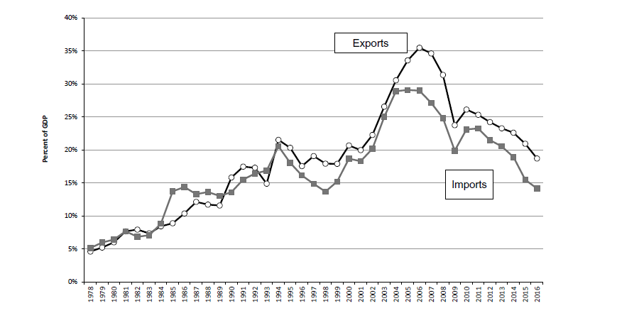

Slide 76
Ordinary trade
The 1994 reform was connected with making the RMB convertible for current account transactions
Yeah, I know, the balance of payments stuff is back! ☹

Slide 77
Ordinary trade
The 1994 reform was connected with making the RMB convertible for current account transactions
> every FTC could access foreign exchange whenever they wished, with no regulation – if it was for trade
= liberalization

Slide 78
Ordinary trade
The 1994 reform was connected with making the RMB convertible for current account transactions
> every FTC could access foreign exchange whenever they wished, with no regulation – if it was for trade
= liberalization
Plans to also abolish capital controls = to make the RMB convertible for financial account transactions

Slide 79
Ordinary trade
The 1994 reform was connected with making the RMB convertible for current account transactions
> every FTC could access foreign exchange whenever they wished, with no regulation – if it was for trade
= liberalization
Plans to also abolish capital controls = to make the RMB convertible for financial account transactions
Abandoned because of the 1997 Asian Financial crisis

Slide 80
Export processing

Slide 81
Export processing
Special economic zones adjacent to HK and TW

Slide 82
Export processing
Special economic zones adjacent to HK and TW
The largest and most important one – Shenzhen – right next to Honk Kong

Slide 83
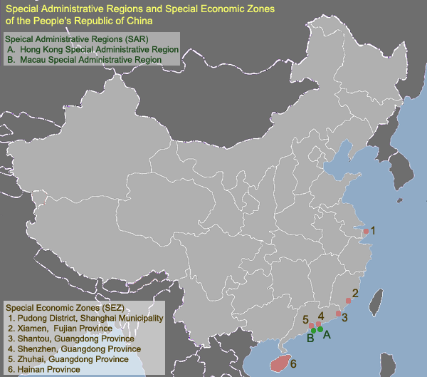

Slide 84
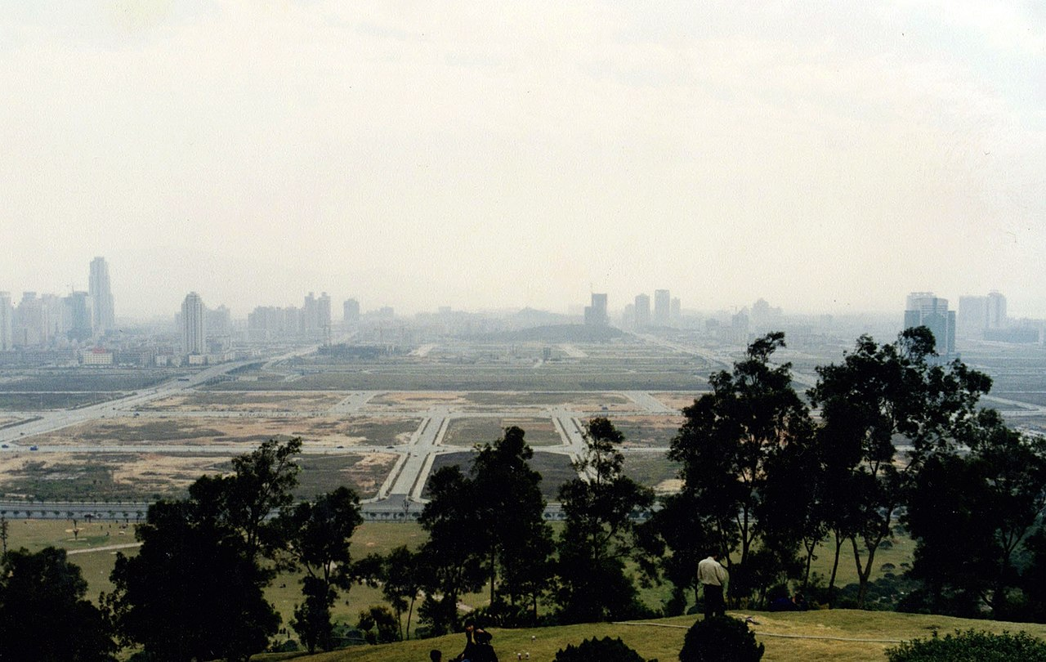

Slide 85
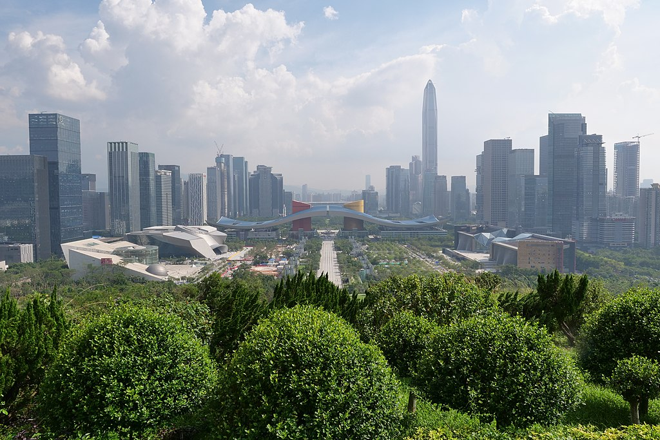

Slide 86
Export processing
Special economic zones adjacent to HK and TW
The largest and most important one – Shenzhen – right next to Honk Kong
FDI was allowed in these zones

Slide 87
Export processing
Special economic zones adjacent to HK and TW
The largest and most important one – Shenzhen – right next to Honk Kong
FDI was allowed in these zones
Most importantly – foreign companies could bring goods in and out duty free, with no tariffs or taxes or FTC middlemen

Slide 88
Export processing
Special economic zones adjacent to HK and TW
The largest and most important one – Shenzhen – right next to Honk Kong
FDI was allowed in these zones
Most importantly – foreign companies could bring goods in and out duty free, with no tariffs or taxes or FTC middlemen
> they could operate outside the confines of the heavily regulated „ordinary trade“

Slide 89
Export processing
Processing of products – Chinese companies, including small TVEs, did simple, labor-intensive tasks for foreign companies
The products were then re-exported

Slide 90
Export processing
Not necessarily connected to investment!
- in principle, the foreign company could just send its inputs to China and than take the final product back

Slide 91
Export processing
Not necessarily connected to investment!
- in principle, the foreign company could just send its inputs to China and than take the final product back
In mid-1980s, this „export processing“ expanded out of the special zones into the entire coastal region of China
= small private companies and TVEs could take part in its

Slide 92
Export processing
Not necessarily connected to investment!
- in principle, the foreign company could just send its inputs to China and than take the final product back
In mid-1980s, this „export processing“ expanded out of the special zones into the entire coastal region of China
= small private companies and TVEs could take part in its
FDI itself was not allowed outside the special zones

Slide 93
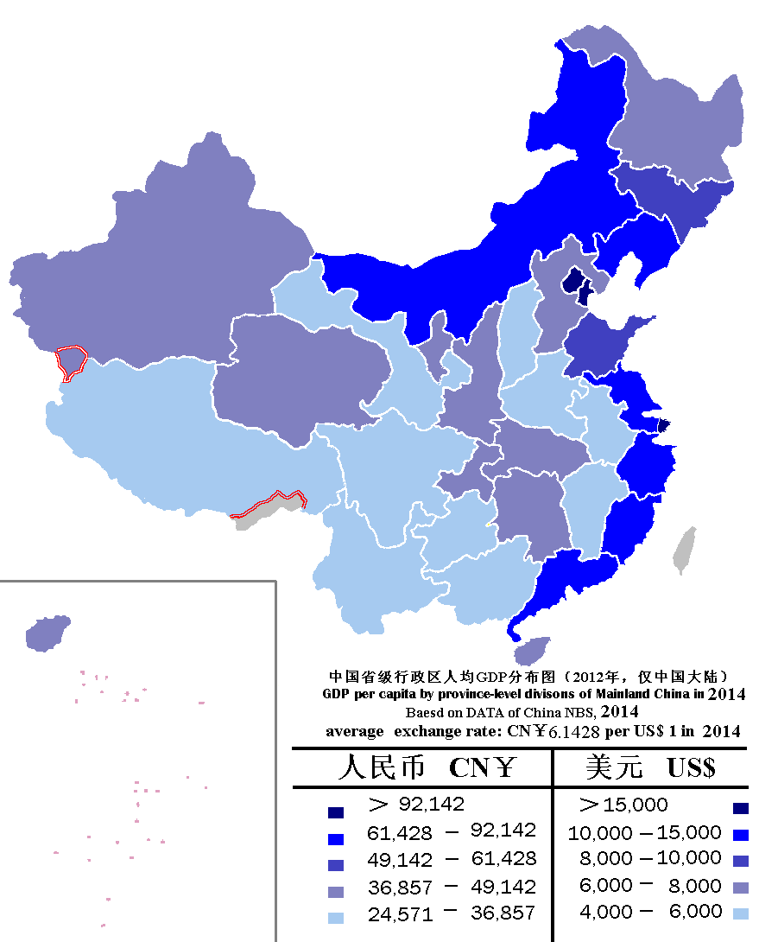

Slide 94
Export processing
What emerged was a triangular pattern of trade

Slide 95
Export processing
What emerged was a triangular pattern of trade
= China imports inputs from HK, Taiwan, South Korea or Japan
These inputs are finished and then exported – to the US or the EU

Slide 96
Export processing
What emerged was a triangular pattern of trade
= China imports inputs from HK, Taiwan, South Korea or Japan
These inputs are finished and then exported – to the US or the EU
Trade surplus with Western countries, trade deficit with small highly developed Asian states!

Slide 97
Export processing
What emerged was a triangular pattern of trade
= China imports inputs from HK, Taiwan, South Korea or Japan
These inputs are finished and then exported – to the US or the EU
Trade surplus with Western countries, trade deficit with small highly developed Asian states!
Survives to this day, even though the specifics have changed!

Slide 98
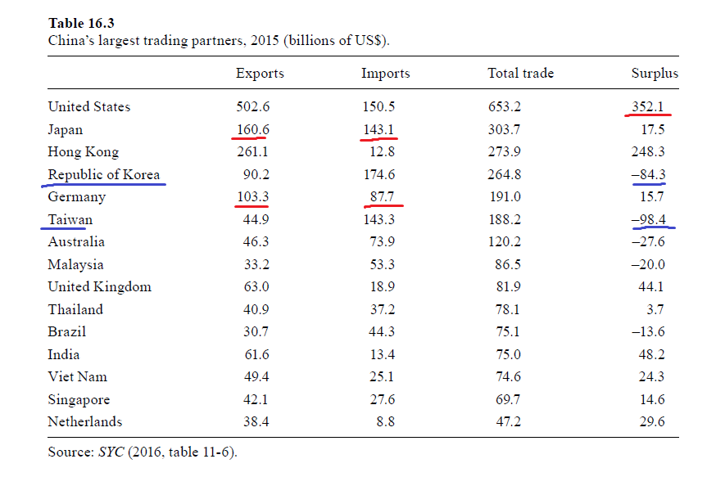
Triangular trade

Slide 99
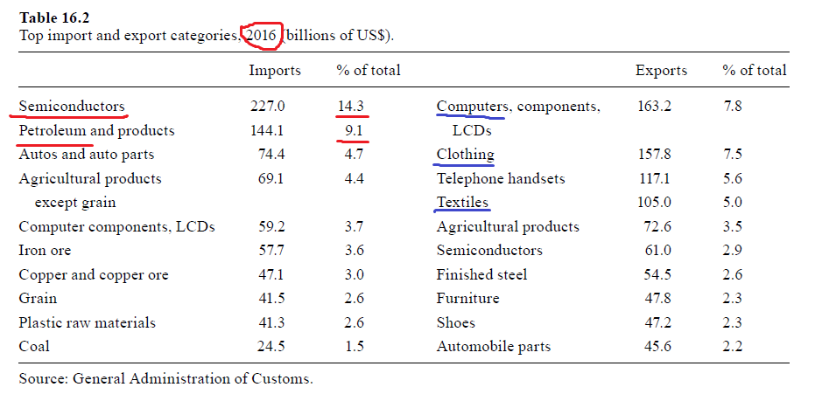
Triangular trade

Slide 100
Imports
1) Raw materials
2) Agricultural products – grain etc.
3) Capital intensive products – steel, chemicals, machinery
4) Technologically advanced products – chips

Slide 101
Imports
1) Raw materials
2) Agricultural products – grain etc.
First two – result of lack of natural resources and fertile land + successful countries often import this > no problem

Slide 102
Imports
1) Raw materials
2) Agricultural products – grain etc.
3) Capital intensive products – steel, chemicals, machinery
4) Technologically advanced products – chips
First two – result of lack of natural resources and fertile land + successful countries often import this > no problem
Second two > result of backwardness

Slide 103
Imports
1) Raw materials
2) Agricultural products – grain etc.
3) Capital intensive products – steel, chemicals, machinery
4) Technologically advanced products – chips
First two – result of lack of natural resources and fertile land + successful countries often import this > no problem
Second two > result of backwardness > China became self-sufficient in 3), now it is chasing self-sufficiency in 4)

Slide 104
Geographical shifts
Industrialization progresses not only in level of sophistication, but also shifts to new locations with lower labor costs

Slide 105
Geographical shifts
Industrialization progresses not only in level of sophistication, but also shifts to new locations with lower labor costs
The frontier keeps moving

Slide 106
Geographical shifts
Industrialization progresses not only in level of sophistication, but also shifts to new locations with lower labor costs
The frontier keeps moving
1980s – Guangdong as a „fifth Asian tiger“
Main focus – textile, shoes, sport gear

Slide 108
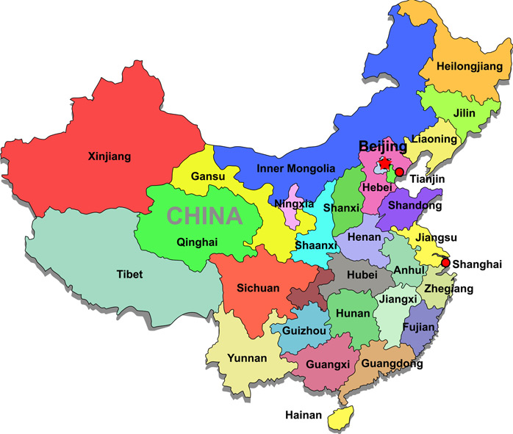

Slide 109
Geographical shifts
1990s – industrialization of Shanghai and the lower Yangtze
= China‘s traditional economic and demographic heart

Slide 111
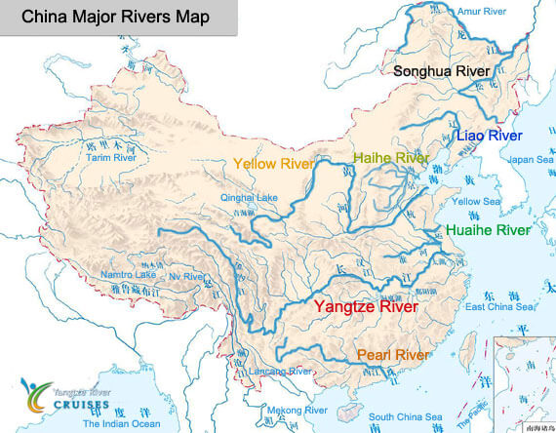

Slide 112
Geographical shifts
1990s – industrialization of Shanghai and the lower Yangtze
= China‘s traditional economic and demographic heart
At first also textile, by 2000 – switch to Electronics!

Slide 113
Geographical shifts
Around 2010 – some industry moves deeper inland, into places like Chongqing or Sichuan

Slide 116
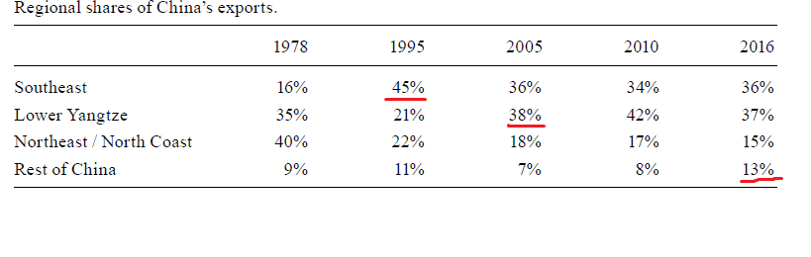

Slide 117
Geographical shifts
Previous frontier retains its wealth, more labor-intensive jobs move on somewhere else

Slide 118
Geographical shifts
Previous frontier retains its wealth, more labor-intensive jobs move on somewhere else
The previously industrialized area moves towards very technologically advanced parts of production
Or towards services – marketing, finance, RaD

Slide 119
Geographical shifts
Same process has happened in Europe over centuries – a previous center of industry never loses its wealth (northern Italy, Netherlands)

Slide 120
Foreign direct investment
By the early 1990s, direct access for foreign investors was expanded

Slide 121
Foreign direct investment
By the early 1990s, direct access for foreign investors was expanded
> growth of FDI, new influx of new FDI from America and Europe

Slide 122
Foreign direct investment
By the early 1990s, direct access for foreign investors was expanded
> growth of FDI, new influx of FDI from America and Europe
Attempts to attract investors – permanently low taxes for „foreign investment enterprises“ – FIEs
Tax holidays, free land….

Slide 123
Foreign direct investment
By the early 1990s, direct access for foreign investors was expanded
> growth of FDI, new influx of FDI from America and Europe
Attempts to attract investors – permanently low taxes for „foreign investment enterprises“ – FIEs
Tax holidays, free land….
> FIEs were treated better than private domestic firms!

Slide 124
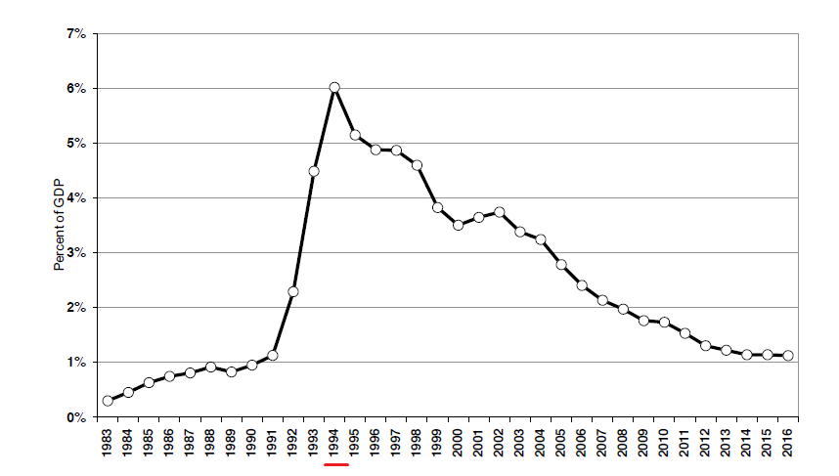
Foreign direct investment

Slide 125
Foreign direct investment
Source countries – most importantly US, Taiwan, Korea, Japan

Slide 126
Foreign direct investment
Source countries – most importantly US, Taiwan, Korea, Japan
Often routed through Honk Kong or tax havens (British Virgin Islands)

Slide 127
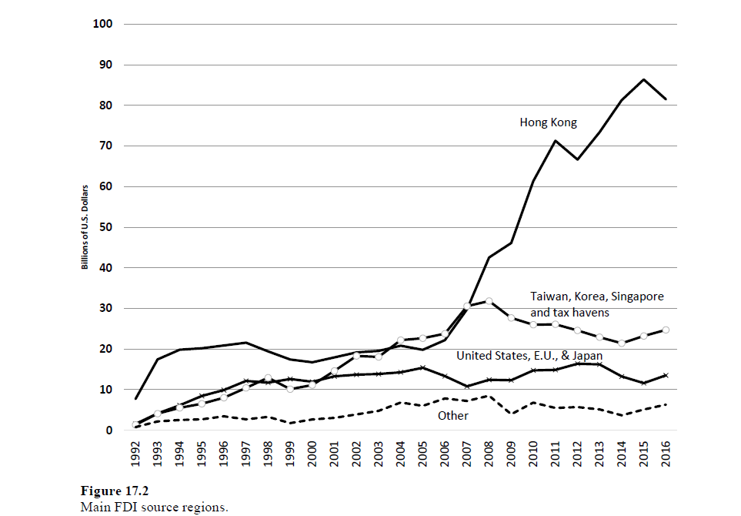

Slide 128
Foreign direct investment
Source countries – most importantly US, Taiwan, Korea, Japan
Often routed through Honk Kong or tax havens (British Virgin Islands)
Largest single investor – Samsung
Typical example of triangular trade – brings in chips from Korea, exports completed phones overseas

Slide 129
Foreign direct investment
What did investors bring in?
Savings, foreign exchange, technology, management and marketing know how

Slide 130
Foreign direct investment
What did investors bring in?
Savings, foreign exchange, technology, management and marketing know how
= they knew how to sell products in rich countries, had contacts and established supply chains overseas

Slide 131
Foreign direct investment
Technology was not decisive at first, it grew in importance as China became more advanced

Slide 132
Foreign direct investment
Technology was not decisive at first, it grew in importance as China became more advanced
Technology transfer – not driven merely by compulsory joint-ventures, but also by strategy of the foreign companies

Slide 133
Foreign direct investment
Technology was not decisive at first, it grew in importance as China became more advanced
Technology transfer – not driven merely by compulsory joint-ventures, but also by strategy of the foreign companies
- they often decided to teach local companies how to make inputs so they did not have to import them

Slide 134
Foreign direct investment
Technology was not decisive at first, it grew in importance as China became more advanced
Technology transfer – not driven merely by compulsory joint-ventures, but also by strategy of the foreign companies
- they often decided to teach local companies how to make inputs so they did not have to import them
Flow of workers between domestic and foreign firms spread knowledge
= typical „spillover effect“

Slide 135
Foreign direct investment
As time went on, FDI became less important as a source of investment and foreign currencies
Because China has a very high rate of savings and also acquired a trade surplus

Slide 136
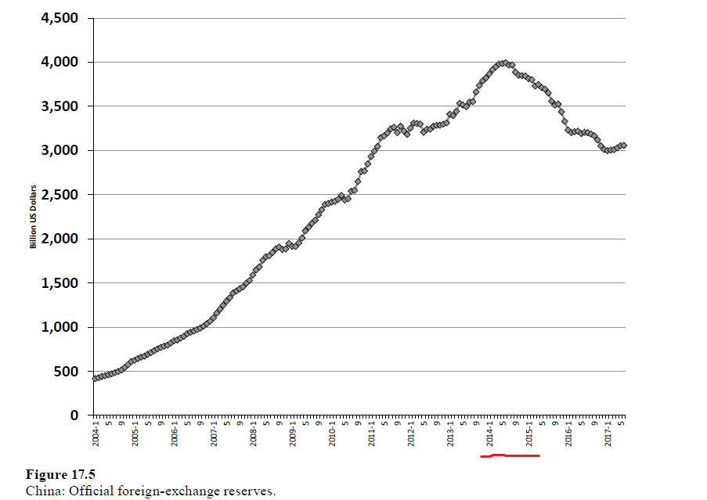
Foreign exchange reserves

Slide 137
Foreign direct investment
As time went on, FDI became less important as a source of investment and foreign currencies
Because China has a very high rate of savings and also acquired a trade surplus
After circa 2000, technology became the main objective for attempting to attract FDI

Slide 138
Foreign direct investment
At the same time – the role of FIEs in the economy decreased

Slide 140
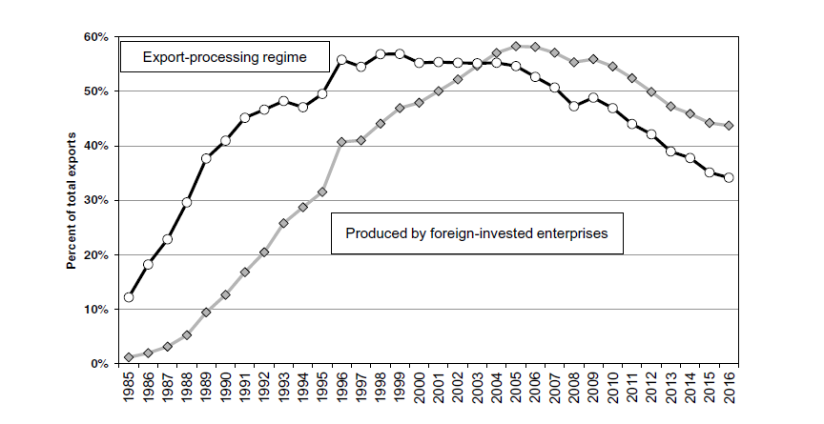

Slide 141
Foreign direct investment
At the same time – the role of FIEs in the economy decreased
China does not need them so much anymore
> fewer advantages, more taxes

Slide 142
Ordinary trade and export processing
In the 1980s, they were completely different

Slide 143
Ordinary trade and export processing
In the 1980s, they were completely different
Overtime, as the hinterland liberalizes, they converge closer together
Special zones are not THAT special anymore

Slide 144
Ordinary trade and export processing
In the 1980s, they were completely different
Overtime, as the hinterland liberalizes, they converge closer together
Special zones are not THAT special anymore
Export processing is in a relative decline as a share of exports

Slide 146
Ordinary trade and export processing
More and more stuff is being produced by Chinese domestic companies
Special rules and privileges for coastal provinces are being eroded - they are not needed anymore

Slide 147
Ordinary trade and export processing
More and more stuff is being produced by Chinese domestic companies
Special rules and privileges for coastal provinces are being eroded - they are not needed anymore
But the division has never been completely abandoned!
In the 2010s, China launched a new special economic zone in Shanghai meant to attract FDI into services

Slide 148
Return to industrial policy
Around 2005, China was the world‘s largest exporter of advanced technology products
But remained confined into low-value added parts of the supply chain

Slide 149
Return to industrial policy
> industrial policies such as Made in China 2015 seek to redress this problem
> desire to put China at the center of global value chains
„We will not play second fiddle to foreign capitalists“

Slide 150
Outgoing Chinese FDI
China has the potential to become the world‘s largest foreign investor

Slide 151
Outgoing Chinese FDI
China has the potential to become the world‘s largest foreign investor
It has an unusually high rate of savings
It also still has quite a large trade surplus

Slide 152
Outgoing Chinese FDI
China has the potential to become the world‘s largest foreign investor
It has an unusually high rate of savings
It also still has quite a large trade surplus
> lots of money that can be converted into dollars and invested abroad

Slide 153
Outgoing Chinese FDI
By 2005, the party-state realized that they have too much foreign exchange on their hands

Slide 154
Outgoing Chinese FDI
By 2005, the party-state realized that they have too much foreign exchange on their hands
Keeping money as exchange means you are not investing them in any productive way

Slide 155
Outgoing Chinese FDI
By 2005, the party-state realized that they have too much foreign exchange on their hands
Keeping money as exchange means you are not investing them in any productive way
They started to create incentives for companies to invest abroad

Slide 156
Outgoing Chinese FDI
By 2005, the party-state realized that they have too much foreign exchange on their hands
Keeping money as exchange means you are not investing them in any productive way
They started to create incentives for companies to invest abroad
Sovereign wealth funds
BRI

Slide 157
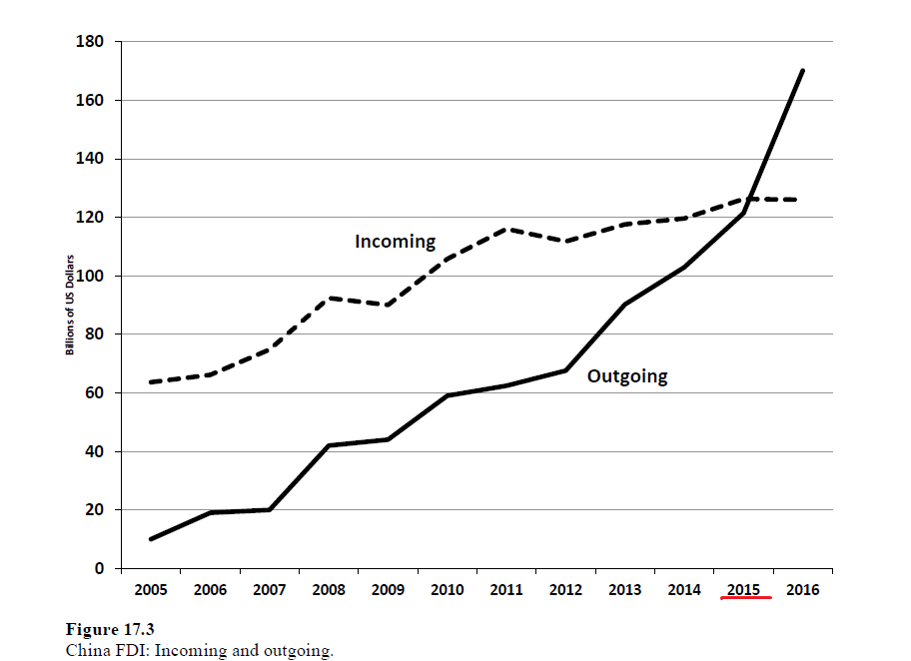
FDI

Slide 158
Portfolio investment
= short term, more speculative than FDI
Officially – tightly regulated by capital controls

Slide 159
Portfolio investment
= short term, more speculative than FDI
Officially – tightly regulated by capital controls
Chinese nationals are avoiding these controls by masquerading these speculative flows as something else
= they say that they want to pay for foreign goods, but actually use this transaction to shift money abroad and invest them

Slide 160
Portfolio investment
= short term, more speculative than FDI
Officially – tightly regulated by capital controls
Chinese nationals are avoiding these controls by masquerading these speculative flows as something else
= they say that they want to pay for foreign goods, but actually use this transaction to shift money abroad and invest them
It seems that are very large and unstable flows of speculative investment in and out of China

Slide 161
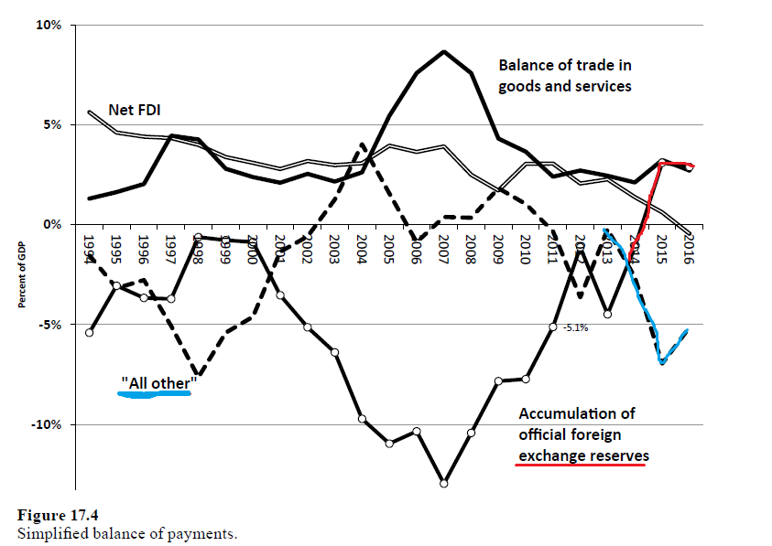
All other = speculative flows

Slide 162
Foreign exchange reserves

Slide 163
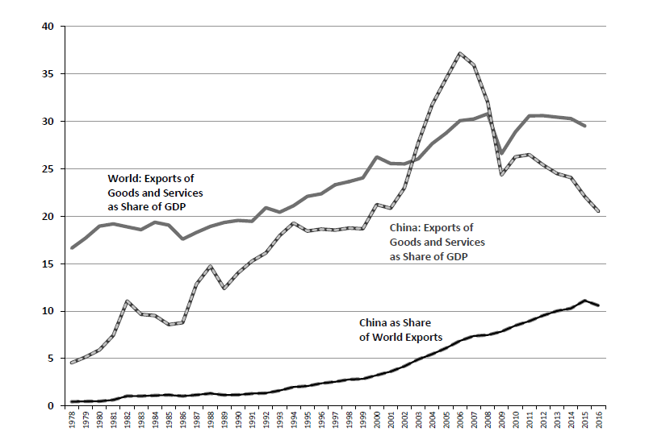
One final graph

Slide 164
Next time - seminar
Each group has 10 minutes to present the findings of their paper
+ 5 minutes for discussion

Slide 165
Final essay
Shorter
Alternative topic

Slide 166
Looking ahead

