Slide 1


Dead ends and mandatory directions in scientific psychology
© Zbyněk Vybíral, Department of Psychology, Masaryk University, Brno, Czech Republic, 2017

Slide 2
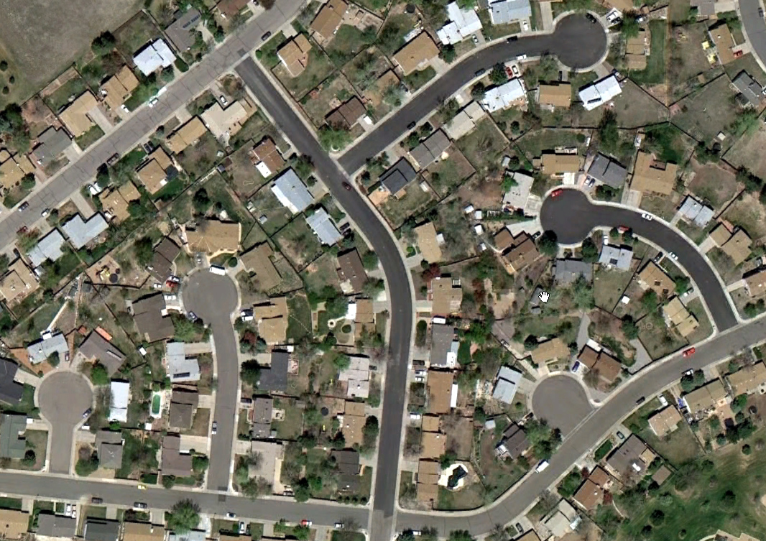
Psychology is not only in replication crisis. Psychologists stepped into many dead ends.

Slide 3
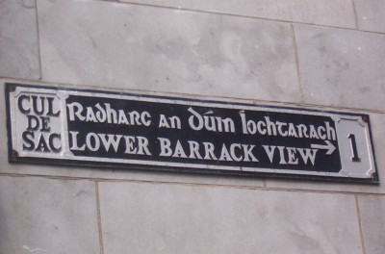

Slide 4
Psychobabble
A form of speech or writing using psychological jargon, buzzwords, or esoteric language to create an impression of truth or plausibility. The term implies that the speaker or writer lacks the experience and understanding necessary for the proper use of psychological terms (wiki)
The term implies that (s)he who talk about XY doesn’t know what XY means.

Slide 5
The problem is that
Psychobabble is not widespread
only by
journalists and nonprofessionals
but also by
psychologists themselves.

Slide 7
One of the famous story in social psychology.

Slide 8
Facial feedback hypothesis:
Facts first, not myths.

Slide 9
The fact is that
Coordinated replications conducted across 17 labs worldwide found no evidence for FFH.
Pushing people to smile or frown can’t trigger inner emotional reactions (evaluated in such a way that funny cartoons seemed more, or less amusing).

Slide 10
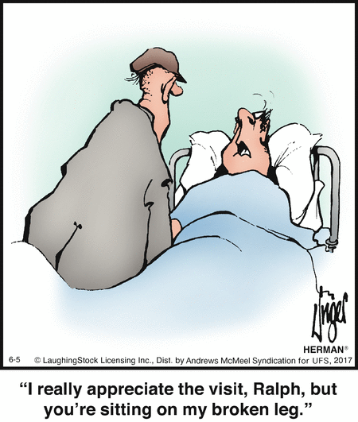

Slide 11
The facts continued
It seems that the facial feedback hypothesis is not valid.
It seems that assumption that smile implies inner emotional state of joy is not reliable.
It seems that we’ll not enhance person’s well being when we use a quasi therapeutic mantras:
Smile and you will feel better!
or
Smile and you will have a look at better world!

Slide 12
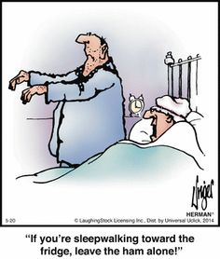

Slide 13
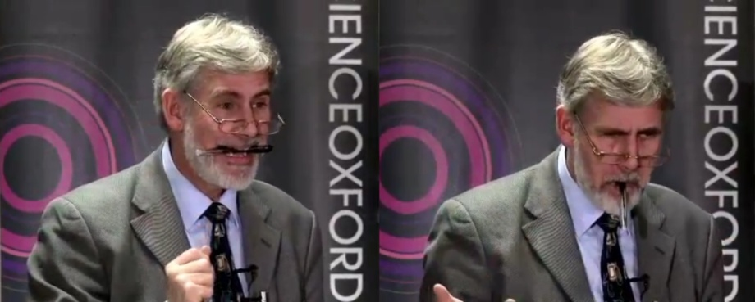
Psychologist demonstrating how easily the physical posture of the body, or parts of the body affects one's interpretation of experience – in this case how a pen is held in one's mouth.

Slide 14
Some cartoons from
Garry Larson’s series The Far Side

Slide 15
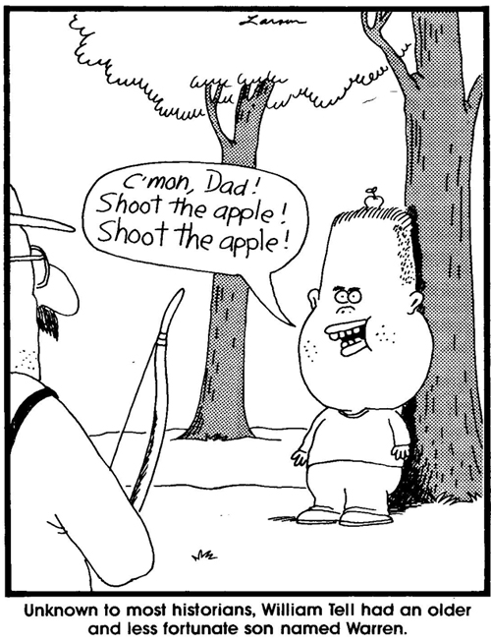

Slide 16
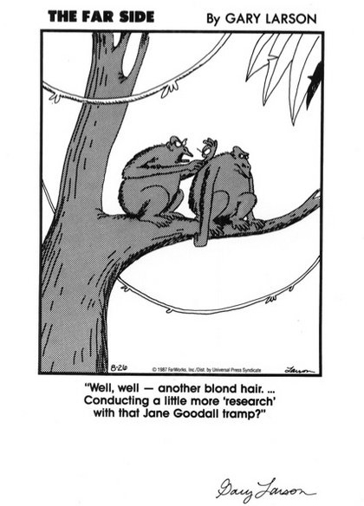

Slide 17
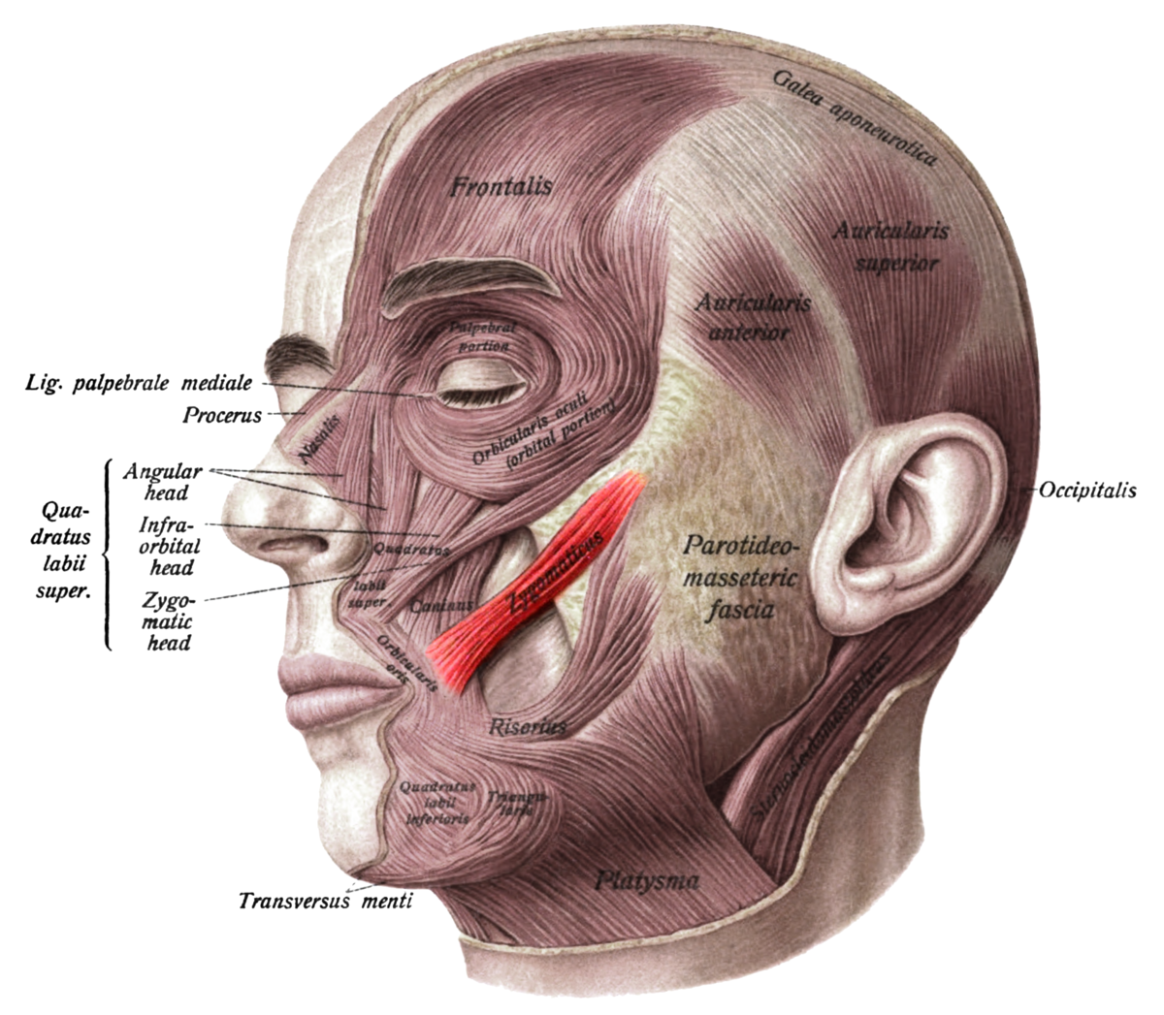
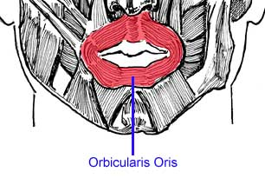
manipulations with zygomaticus major versus orbicularis oris muscles

Slide 18
The result of replication report (2016)
Effect size in meta-analysis of the 17 studies was almost null moving between –0.11 to 0.16 with the biggest difference in one lab –0.58.

Slide 19
Fritz Strack’s objections to debunking, and adherent’s talk about FFH
We are deeply sank in the statistical terminology,
findings should be critically evaluated not only by statisticians but by psychologists who are experts in the field,
there exists no direct route from data to truth.
Science is about arguments and about critical debates that should be based on empirical evidence and subtle epistemology and not be only determined by probabilistic parameters a statistical paths from data to “truth”.

Slide 20
How do look dead ends in scientific psychology?
Oversimplified conclusions dressed up in science (Carol Tavris)
Logical fallacies like one consequence must to have one cause
Confirmation bias and other biases (Scott Lilienfeld)
Overestimation of statisticians views of point (Fritz Strack)
(Often very self-confident) statements without any visible means of empirical support
Manipulations with data
Manipulated and coercive proclamations

Slide 21
Myths, not facts remain, go on and are widespread by pop-psychology
When you are smiling, you feel happier!
The more smiles, the more funny you will feel!
Smile could serve you as a prevention against depression.
☺
☺
☺

Slide 22
Neurorealism
Passages accompanied with fMRI images; anorexia visible with brain scans; Brain Scans Can Diagnose Autism With 97% Accuracy…
Prefix neuro- has been developing its own story
See:
Carol Tavris, Ph.D. - "A Skeptical Look at Pseudoneuroscience" - TAM 2012

Slide 23
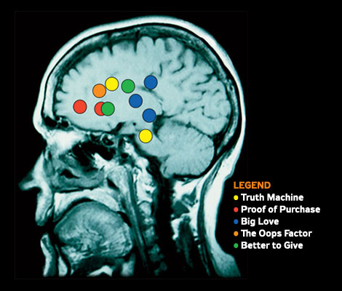

Slide 24
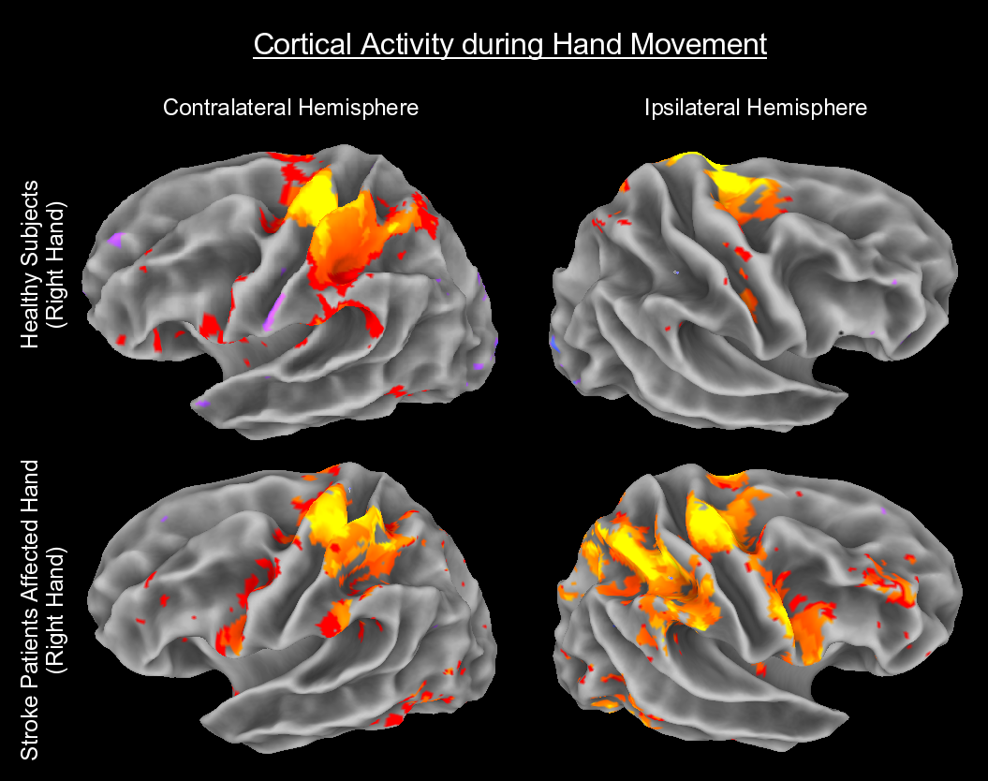

Slide 25
And then we are watching headlines like

Slide 26


Slide 27
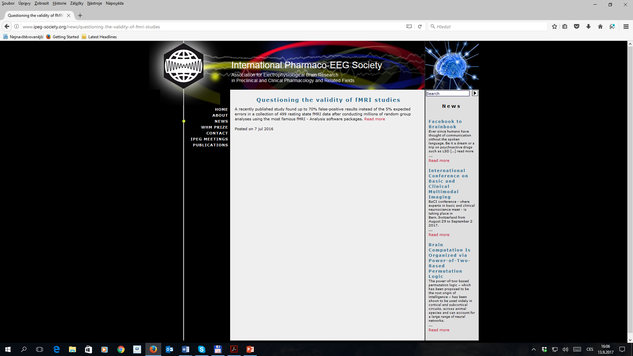

Slide 28
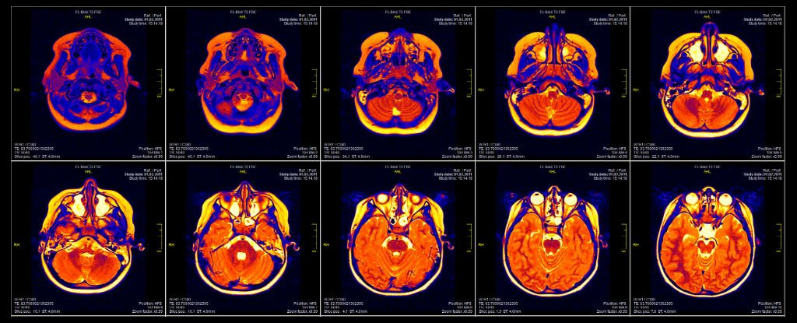
A Bug in FMRI Software Could Invalidate 15 Years of Brain Research (6 JUL 2016)

Slide 29

Does it mean that the new dead end is here?
Or no? Who is right?
Sometimes we don’t know if the alley is cul-de-sac
or
permitted direction remains…

Slide 30

Recommended reading (e.g.)
Eklund, A. et al. (2016)
See:
https://sciencebasedmedicine.org/new-study-questions-fmri-validity/
https://www.sciencealert.com/a-bug-in-fmri-software-could-invalidate-decades-of-brain-research-scientists-discover

Slide 31
Another story

Slide 32
Idea of universal emotion expressions and universal emotion recognition
Presented as scientific discovery, see
  http://www.apa.org/science/about/psa/2011/05/facial-expressions.aspx
Yes, we know, that additional info stress:
The views expressed in Science Briefs are those of the authors and do not reflect the opinions or policies of APA.

Slide 33
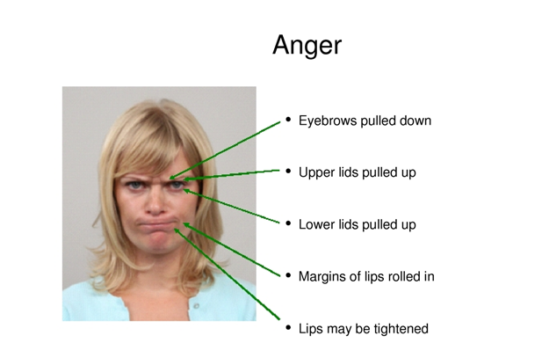
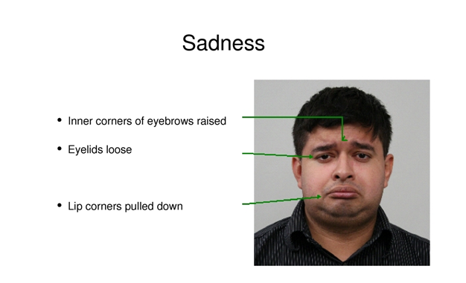
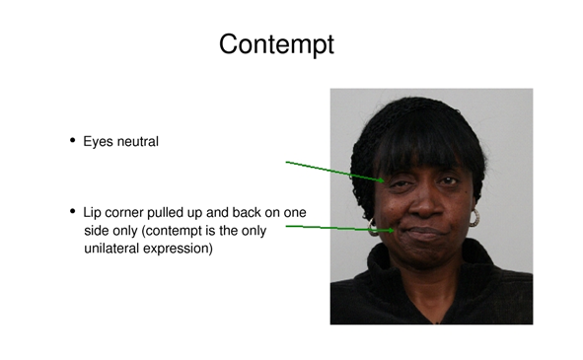
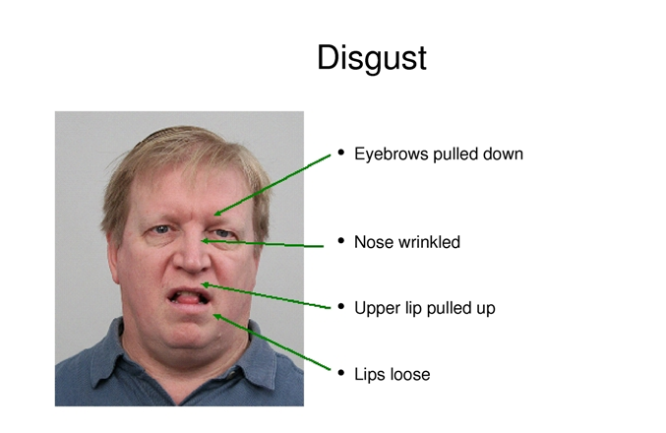

Slide 34
Sometimes it seems easy to recognize a myth

Slide 35
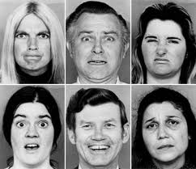
Anger: the same expression all around the world
The basic emotion of “Anger” can be recognized by the picture all around the world, no matter what age, religion or gender you are, or what language you speak.

Slide 36

Read more
Chapter 9:
„Measuring Facial Action by Manual Coding, Facial EMG, and Automatic Facial Image Analysis“
Jeffrey F. Cohn (University of Pittsburgh)
Paul Ekman (University of California San Francisco)
2005

Slide 37
A story of behavioral priming

Slide 38
In 1988 John Bargh concluded that
Behavior can be triggered automatically by features of environment… e.g. via automatic stereotype activation. And that behavior occurs unintentionally and without conscious involvement…
The results of three experiments of his team showed that the e.g. activation of the elderly stereotypes had direct and nonconscious effect on behavior…
New York University graduates primed with the elderly stereotype had a slower walking speed compared to them in a neutral condition.

Slide 39
Why so many questions reveal?
So many questioning…
What happened with the psychology in good condition? What happens with the promising discipline from the past?
Where disappeared our well known psychology?

Slide 40
Three major dead ends in psychology
We promise you (…end of depression)
We give you the best explanation
Psychology offers response to any question to which you don’t know answer
Be compliant to coercive challenges or requirements like : Be unambiguous! Just say: yes, or no!
Of course, there’s a lot of bunks in psychology. And bunks seem more attractive than truth (or scientific findings).

Slide 41
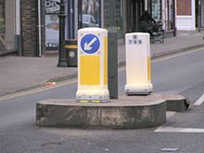
How look mandatory signs and permitted directions in scientific psychology?

Slide 42

Three major scientific developments in psychology
Replications
Fight against generalizations and simplifications
Need to tolerate the uncertainty
Mostly the interaction of the various influences has been so complex that it seems highly problematic generate a prediction.
All these developments aiming to have better (more precise or valid and reliable) and more suitable psychology.

Slide 43
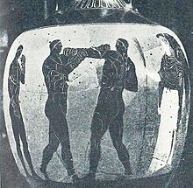
Who is right? John Bargh, or his skeptical replicators?

Slide 44
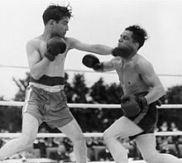
Who is right? Fritz Strack et al., or their skeptical replicators?

Slide 45
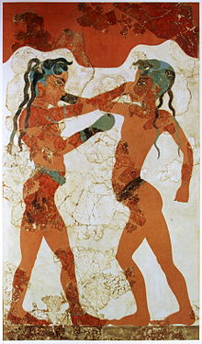
What we should learn from scientific combats between scientists (psychologists)?

Slide 46
What we should learn from epistemological crisis in psychology?

Slide 47
Permitted directions
Study the results and designs of all replications recently done
Study the original results (!)
Read the defense of questioned scientists – published after critique of his, or her original findings
Search the successful replications as well (questioned author always refers that some of replications were successful)
Turn off to step one
Turn off to step two
Think about conceptions and misconceptions
Think about generalization, and limits of each study
Recognize the blind alley
and
Discover the way you have to go (permitted direction)

Slide 48
Psychology is not only in replication crisis, but
also within a debunking crisis,
within credibility crisis,
moreover – not always, but often – in ethical crisis.
But in principle, a crisis is a challenge and give us chance to develop a better psychology.
I am not idealist, but believe that we can do more and really develop attractive and scientific discipline.

Slide 49
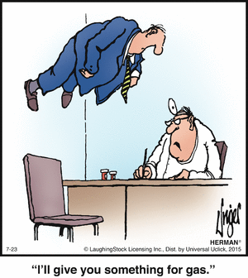

Slide 50
Recommended reading
Tavris, Carol (2014) Thinking Critically about Psychology’s Classic Studies. Skeptic Magazine 19(4), 38–43

Slide 51
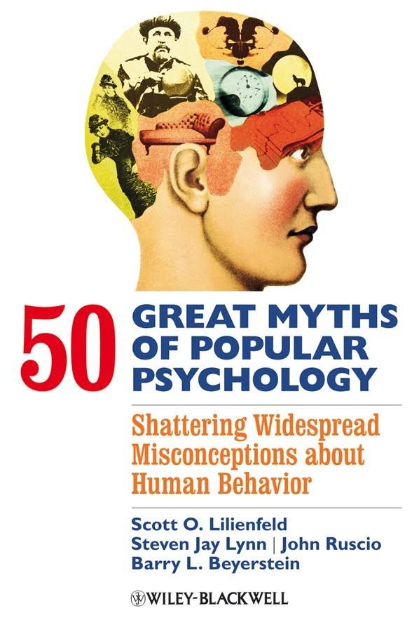
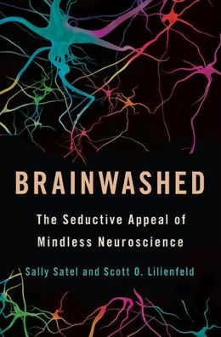

Slide 52
Thank you for your attention.

