Slide 1
The role of information and materials in media and on the internet II
Hana Macháčková

Slide 2
Sources of information
Traditional journalism
  Gatekeeping, tradition, ethical codex
  „Watchdogs of democracy“
New media environment
Huge amont, multiplicity plurality
  Of sources and type
No „gatekeepers“
  disintermediation (Eysenbach, 2008)
  opinion leaders, influencers
User-generated content
Question of author, expertise
  Expert and „experiential“ information

Slide 3
Media information
Quality of information – several dimensions, perspectives
Credibillity – important dimension, especially in relation to socio-political information
Not always primary! Or even important….
  Celebrity news
  intended „Fake news“ – Onion, Daily show
https://www.bbc.com/news/av/world-us-canada-46175024

Slide 4
Fake news
Quandt, T., Frischlich, L., Boberg, S., & Schatto‐Eckrodt, T. (2019). Fake news. The international encyclopedia of Journalism Studies, 1-6.
Alcott and Gentzkow (2017, p. 213): “news articles that are intentionally and verifiably false, and could mislead readers.”
Wardle (2017): satire, misleading headlines, misleading content, false contextual information to imposter content (with faked source information), manipulated content, and fully fabricated content
mis- and disinformation: unintentionally vs deliberately false

Slide 5
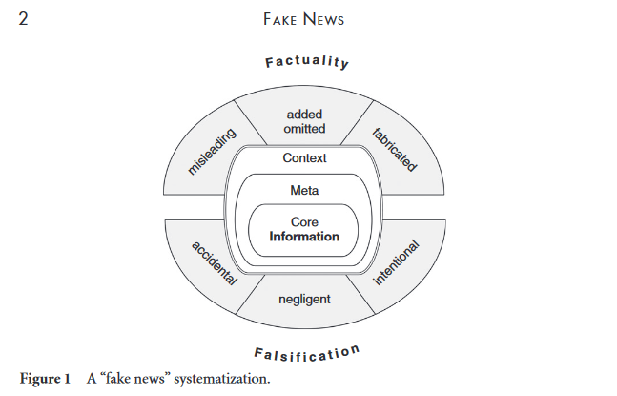
the core content of the information (including textual information, imagery, audio elements, etc.);
accompanying meta-information (headlines/titles, author information, tags, and keywords)
contextual aspects (positioning, references to other articles, framing)
Quandt et al., 2019

Slide 6
discrepancies from factuality: from (a) misleading (but factually correct) information; to (b) additions or deletions of information (e.g., “enrichment of facts by misleading or wrong information, or a change of meaning by omitting or deleting relevant information); to (c) complete fabrications without any factual basis.
Quandt et al., 2019

Slide 7
Problem with news and „fake news“
Polarization and fragmentation in society
Can reinforce existing attitudes, opinions, behavior
  Related to socio-political issues
Division between diverse segments of public
  Barrier for communication and socio-political processes
Highly problematic for functioning democracy

Slide 8
Lets move to individual/group processes
How do we access the information??
Selective exposure - tendency to seek out news information or sources that share own political viewpoints (Lazarsfeld, Berelson, & Gaudet, 1944)
Confirmation bias – believeing in news which correspond with my pre-existing views
  affects also information seeking – trusted sources
Currently, reinforced by personalization processess in online sphere, especially SNS

Slide 9
Echo chambers
  A spaces where „echoes“ only selected views, opinions, information…(Sustein, 2009)
  Those are „known“, others are not known (or false)
  Link with existing social bubbles
  Today – especially on SNS
Spiral of silence
  Dominant views?
  Which beliefs and information are and are not represented (and heard/read)?

Slide 10
What is behind selective exposure?
Metzger, M. J., Hartsell, E. H., & Flanagin, A. J. (2015). Cognitive dissonance or credibility? A comparison of two theoretical explanations for selective exposure to partisan news. Communication Research
Partisan selective exposure
  tendency to seek out news information or sources that share own political viewpoints

Slide 11
Testing two presumptions beyond partisan selective exposure
Cognitive disonance: „Festinger (1957) postulated that people desire consistency among their attitudes as well as between their attitudes and their behaviors. When people are aware of inconsistencies, they experience cognitive dissonance, which causes mental discomfort that they are motivated to avoid and reduce.“
Evaluations of the credibility – „individuals seek information from news sources that share their political attitudes and outlook (i.e., attitude-consistent news sources) because they perceive them as more credible than other sources“

Slide 12
Credibility
Moreover
  people judge unbiased news sources as more credible than biased or one-sided news sources (Allen, 1991; Pechmann, 1992; Zhao & Capella, 2008)
However…
  people may judge biased but attitudinally consistent sources as more credible than unbiased sources (Clark & Maass, 1988; Mackie & Queller, 2000; Vallone, Ross, & Lepper, 1985).

Slide 13
2,146 adults living in the United States (panel)
Experiment: 3 x 3 design
  Source: conservative, liberal, or unbiased
  Story: conservative, liberal, or unbiased
news sources were manipulated to include stories on two issues:
  the legalization of gay marriage in Washington, D.C.
  budget cuts to Planned Parenthood programs
  a) emphasizing liberal views on the issue and presenting those views as superior to conservative views
  b) emphasizing conservative views on the issue and presenting those views as superior to liberal views
  c) presenting both liberal and conservative views on the issue equally and as equally valid

Slide 14
Conservative stories were created by providing quotes from Republican politicians (e.g., Mike Huckabee), emphasizing conservative stances on issues (i.e., pro-life, anti-gay marriage) and criticizing liberal viewpoints. Likewise, liberal stories were created by using quotes from Democrat politicians (e.g., Nancy Pelosi), emphasizing liberal stances on issues and criticizing conser-vative viewpoints. Balanced stories provided quotes about liberal and conserva-tive viewpoints without taking a side.
The news sources were all screenshots of websites and included FoxNews.com (conserva-tively slanted traditional source), NPR.com (liberally slanted traditional source), CNN.com (balanced traditional source), LiberalOasis.com (liberal blog), RedState.com (conservative blog), and TheModerateVoice.com (balanced blog). The news sources were categorized as liberal, conservative, or balanced based on study participants’ own perceptions.

Slide 15
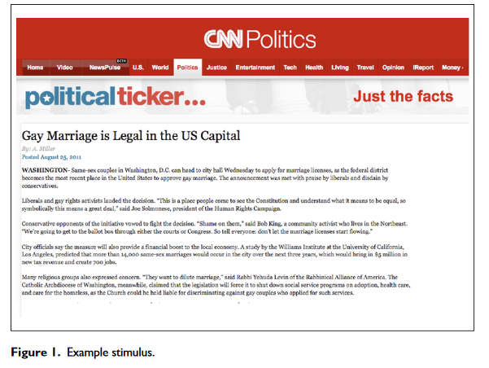

Slide 16
Measures
  Attitudes: if the source/story is attitude-consistent, attitude-challenging, or balanced
  Credibility: of source and message
  Cognitive disonance experienced
    E.g., This news source makes me uncomfortable
  Selective exposure: likelihood to use the source again

Slide 17
Cognitive disonance
Consistent with the predictions:
  Less CD in exposure to attitude-consistent sources vs. both cognitive challenging and balanced
  More likely to return to attitude-consistent sources than to attitude-challenging sources
Not consistent:
  Despite more cognitive dissonance when exposed to unbiased news sources than to attitude-consistent news sources, they are equally likely to select these two source types
  If dissonance avoidance is the true motivator for source selection, participants should have reported being more likely to return to attitude-consistent sources than to unbiased sources

Slide 18
Credibility
attitude-consistent source perceived as significantly more credible than attitude-challenging source
balanced source judged as more credible than an attitude-challenging source, but not more credible that an attitude-consistent source
same pattern for selective exposure: attitude consistent and balanced vs. challenging
Interaction source x message: balanced sources that provide balanced information judged as the most credible

Slide 19
Hostile media effect
Balanced media a solution?
Hostile media effect - partisans on both sides of an issue perceive the same content as biased against their side (Vallone, Ross, & Lepper, 1985)
Partisans – strong preexisting norms, views, attitudes
  which can be contrasted
Why is this happening?
  Eg, selective recall and selective categorization (opposite and neutral as hostile)?

Slide 20
Reid, S. A. (2012). A self-categorization explanation for the hostile media effect. Journal of Communication, 62(3), 381-399.
Understanding via self-categorization theory
  Perception depends on social identities
  Important is the salience of particular social identity
  Prototypes and their relative contrasting

Slide 21
Patisans – salience of group-identity?
Hypothesis 1: If self-categorization theory is correct, the hostile media perception will increase as a function of partisanship when partisans’ identities are salient, but not when an alternative identity is salient
Why are partisans’ judgments more extreme than those of nonpartisans?
Hypothesis 2: The more partisan the social perceiver, the more assimilation of ingroup sourced information (i.e., biased assimilation), and the more contrast from outgroup sourced information (i.e., hostile media perceptions)
The importance of source vs. Message – even imbalanced?
Hypothesis 3: Ingroup sourced attacks will be perceived as less biased than out group sourced attacks, and the extent of this effect will increase with partisanship

Slide 22
Findings
Experiment 1: partisans’ perceptions of media bias were amplified when their political identity was salient, and attenuated when their identity as Americans was salient
Experiment 2: neutral news reports of polling information was perceived as ingroup favoring when attributed to an ingroup source, but as hostile when attributed to an outgroup source
  the extent of both of these perceptions were amplified by partisanship
Experiment 3: the more extreme Democrat participants were the less bias they perceived when an attack on their group was attributed to a Democrat, but the more bias they perceived when the attack was attributed to a Republican

Slide 23
Online information
Emphasis on the role of the receiver
Some negative effects: selective exposure, hostile media bias
What about the assessment of the information?

Slide 24
Credibility
Interdisciplinary term
Connected to trust
What does it mean?
  Accuracy, unbiased, complexity, wholeness,…
Traditionally – two main dimensions
  trustworthiness – subjectively evaluated
  expertise – objective component (certificate, diploma…)
  Other approaches…

Slide 25
Credibility
Long research tradition (half 20th century)
Connected to research on persuasion, mass communication
Traditionaly: credibility of
  Message
  Source
  Later media
Interconencted, mutual influence

Slide 26
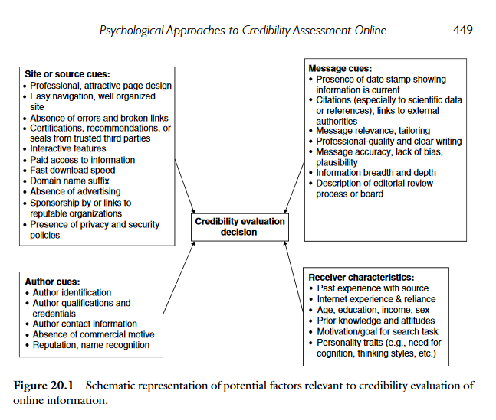
Metzger, M. J., & Flanagin, A. J. (2015). Psychological approaches to credibility assessment online. The handbook of the psychology of communication technology, 32, 445-466.

Slide 27
Credibility assessment
Dual processing models:
  Elaboration Likelihood Model (Petty & Cacioppo, 1981)
  Heuristic-Systematic Model (Chaiken, 1980)
Central and peripheral, analytic and heuristics evaluation
Improtant: Abilities and motivation
Metzger (2007): dual processing model of credibility assessment
  Heuristics: reputation, endorsement, consistency, self-confirmation, expectancy violation, persuasive intent

Slide 28
Social influence and social factors
How do we approach and evaluate information in social media and why?
The importance of source – what makes them expert? And trustworthy?

Slide 29
Tandoc Jr, E. C. (2019). Tell Me Who Your Sources Are: Perceptions of News Credibility on Social Media. Journalism Practice, 13(2), 178-190.
The effect of source – friend vs. traditional news organization (on FB)
The role of perceived homophily – „the degree of perceived similarity a receiver ascribes to a message source“
  Eg., perceived similarity with a journalist predicted news consumers’ evaluation of an author’s level of expertise (Meyer, Marchionni, and Thorson2010)
The role of motivation – affecting systematic evaluation

Slide 30
Tandoc Jr, E. C. (2019). Tell Me Who Your Sources Are: Perceptions of News Credibility on Social Media. Journalism Practice, 13(2), 178-190.
2 (source: news organization - The Straits Times vs. Actual Facebook friend) × 2 (motivation: high vs. Low; un-related to location)
82 Singapure students

Slide 31
Tandoc Jr, E. C. (2019). Tell Me Who Your Sources Are: Perceptions of News Credibility on Social Media. Journalism Practice, 13(2), 178-190.
Source of news: organization vs. friends
  own Facebook friend more credible and more similar to them than a news organization
  news articles rated more credible when they are shared on Facebook by a news organization than when they are shared by their own Facebook friend
Moderating effect of motivation!
  News articles shared by a news organization are rated more credible only when motivation is high
  no significant differences between sources when motivation is low

Slide 32
Turcotte, J., York, C., Irving, J., Scholl, R. M., & Pingree, R. J. (2015). News recommendations from social media opinion leaders: Effects on media trust and information seeking. Journal of Computer-Mediated Communication, 20(5), 520-535.
2-step flow: Lazarsfeld and colleagues (1948): „two-step flow is the process whereby [political] ideas flow from radio and print to the opinion leaders and from them to the less active sections of the population.”
experimental design: social recommendation of news vs. mainstream media
364 US students

Slide 33
Turcotte, J., York, C., Irving, J., Scholl, R. M., & Pingree, R. J. (2015). News recommendations from social media opinion leaders: Effects on media trust and information seeking. Journal of Computer-Mediated Communication, 20(5), 520-535.
social recommendation: fabricated news story about one of two local news contexts and told that it was recommended by one of their real-life Facebook friends (profile picture)
Perception of a Friend’s Opinion Leadership

Slide 34
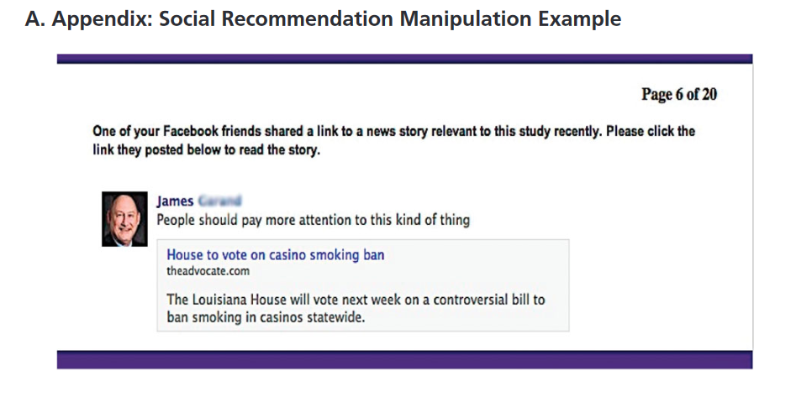
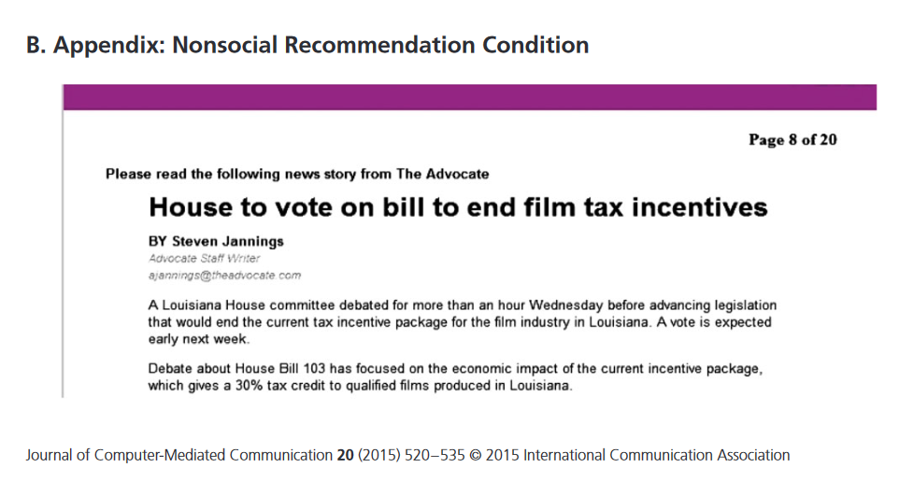

Slide 35
Turcotte, J., York, C., Irving, J., Scholl, R. M., & Pingree, R. J. (2015). News recommendations from social media opinion leaders: Effects on media trust and information seeking. Journal of Computer-Mediated Communication, 20(5), 520-535.
Social media recommendations:
  improve levels of trust in media outlet
  make people want to follow more news from that particular media outlet in the future
Moderation: when the real-life friend sharing the story on social media is perceived as a good opinion leader
  recommendations from friends who are perceived as very poor opinion leaders have a negative effect on respondents’ trust in the news outlet that was recommended
  Excellent opinion leaders have a positive effect on news outlet trust

Slide 36
The social media
And overall internet environment
Media affordances:
  properties that show the possible actions
    e.g., Twitter vs. Facebook vs. TikTok vs. Email etc.
  suggesting what we can and cant do
  depends on perception – which differs interindividually
  can be un/intentional

Slide 37
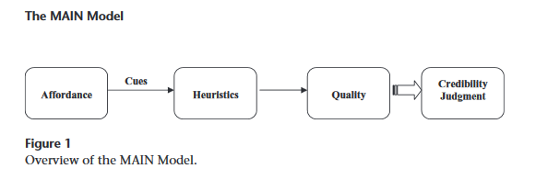
Sundar (2008) – MAIN model
„particular capability possessed by the medium tofacilitate a certain action. It is suggestive and perceived by the use“
Modality (M), Agency (A), Interactivity (I), and Navigability (N)
It is very likely that a given affordance can convey a variety of different cues leading to a number of different heuristic-based judgments, with some being positive and others negative, resulting in a rather complex equation between the presence of an affordance and the nature of credibility assessments that it can trigger (p. 79) .
The MAIN Model: A Heuristic Approach to understanding Technology Effects on Credibility.„ Digital Media, Youth, and Credibility. Edited by Miriam J. Metzger and Andrew J. Flanagin. Cambridge, MA: The MIT Press, 2008.

Slide 38
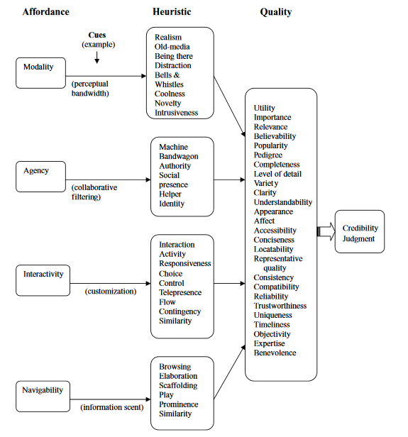
The MAIN Model: A Heuristic Approach to understanding Technology Effects on Credibility.„ Digital Media, Youth, and Credibility. Edited by Miriam J. Metzger and Andrew J. Flanagin. Cambridge, MA: The MIT Press, 2008.

Slide 39
MAIN
Modality
Audio, text, visual..
  realism heuristic would predict that people are more likely to trust audiovisual modality because its content has a higher resemblance to the real world
  Vs. old-media heuristic – text in news
Agency
Agents (sources)
  authority heuristic
  bandwagon heuristic

Slide 40
MAIN
Interactivity
  Interaction and activity
  E.g. choice heuristic
Navigability - interface features that suggest transportation from one location to another, in keeping with the space metaphors such as “site” and “cyberspace” applied to digital media
  prominence heuristic in search engines

Slide 41
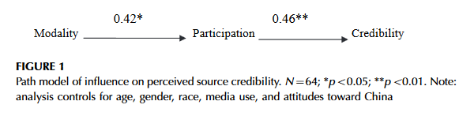
Affordances
Kiousis, S. (2006). Exploring the impact of modality on perceptions of credibility for online news stories. Journalism studies, 7(2), 348-359.
Does modality affect source and message credibility?
M: text, photos, video

Slide 42
Affordances
  Borah, P. (2014). The hyperlinked world: A look at how the interactions of news frames and hyperlinks influence news credibility and willingness to seek information. Journal of Computer-Mediated Communication, 19(3), 576-590.
hyperlinks increase credibility- depending also on the content
value and strategic framed – moral values a political struggle over issue
Moderation - applies in the value-framed condition

Slide 43
Conclusion
Multiplicity of information in traditional nad new media
  And a lot of mis- and dis-information
Important questions – how do we approach, evaluate, judge, and use the information?
Individual, social, and environmental factors all matter
  No single direct effect
Today – experimental studies – limited external validity
  Limitations: older designs; small samples; weaker measures
Mix of approaches – mostly social psychology + communication studies
  Different perspectives and explanations

