Slide 1
Teorie agresivního chování
Hana Macháčková

Slide 2
Agresivní chování
Chování s účelem poškodit či zranit druhého člověka, který je motivován se takovému zacházení vyhnout
Definováno motivací, ne následky
Součást mnoha mezilidských interakcí
Různé podoby a formy

Slide 3
Psychologická vysvětlení agrese
Opakování z bakaláře
Hypotéza frustrace-agrese, teorie transferu excitace, kognitivně-neoasociační model, teorie sociálního učení, social information processing theory…general aggression model (GAM)
Hodně z těchto teorií důraz na socio-kognitivní aspekty agresivního jednání
Social information processing theory – hodně využívaná ale také kritizovaná
Dnes se podíváme na vznik a obohacování této teorie a další směry v rámci socio-kognitivních modelů

Slide 4
Psychologická vysvětlení agrese
Socio-kognitivní modely
Důraz na zpracování sociálních informací
Zapojení socio-kognitivních struktur
Interakci emoce a kognice
Interakce jedince a situace
Vědomostní databáze („knowledge structure“, „database“) – vedou interpretace a odpovědi na okolí
jsou spojeny s afektivními stavy, vzorci chování, a přesvědčeními (o možných důsledcích)

Slide 5
Social Information Processing

Slide 6
Crick, N. R., & Dodge, K. A. (1994). A review and reformulation of social information-processing mechanisms in children's social adjustment. Psychological bulletin, 115(1), 74.
social information-processing models of children's social behavior (e.g., Dodge, 1985, 1986; Dodge & Crick, 1990; Dodge,Pettit, McClaskey, & Brown, 1986; Heusmann, 1988; Ladd &Crick, 1989; Rubin & Krasnor, 1986; Slaby & Guerra, 1988;Yeates & Selman, 1989).
…it is proposed that children come to a social situation with a set of biologically limited capabilities and a database of memories of past experiences
social cognitions are the mechanisms leading to social behaviors that, in turn, are the bases of social adjustment evaluations by others (e.g., Dodge, 1986)

Slide 7
Social database
This database is built from children’s social experiences, which accumulate into memory structures consisting of specific affective, cognitive, and behavioral tendencies, which, in turn, guide children’s SIP in future social contexts (Anderson & Bushman, 2002; Crick & Dodge, 1994)
For instance, children who grow up in harsh environments may develop hostile memory structures that predispose them to process social inter-actions in a hostile manner

Slide 8
Social Information Processing
Rychle probíhající procesy, s více zpětnovazebními mechanismy
Mechanismy specifikující interpretaci a chování v dané situaci
Kódování (encoding) – všímání si vnitřních a vnějších vodítek
Atribuce a interpretace – vysvětlení (motivací)
Volba cíle - který je vhodný a chtěný
Generování reakce – jaká je možná akce?
Hodnocení reakce – je to vhodná akce (vzhledem k situaci a cíli)?
Provedení reakce - volíme reakci, která je nejlépe hodnocena s ohledem na cíle, předpokládané následky, a self-efficacy

Slide 10
Starší – lineárnější - verze

Slide 11
Social Information Processing - aggressive
Specifický způsob zpracování sociálních informací
Biased, defficient….
Zpracování takovým způsobem, který zvyšuje pravděpodobnost agresivního chování v dané situaci
Týká se všech částí modelu (ale ne nutně všech zaráz!)
Interpretace - Hostile attribution bias
Response decision – evaluation - očekávání pozitivního důsledku agrese

Slide 13
Př. 1: Crick, N. R., & Dodge, K. A. (1996). Social information‐processing mechanisms in reactive and proactive aggression. Child development, 67(3), 993-1002.
Studie založená na SIP, zaměření na:
Reaktivní agrese – jako hněvivá defenzivní reakce na frustraci či provokaci
Proaktivní agrese – jako instrumentální, promyšlená, má daný cíl
(1) the first social information-processing pattern (hostile attributional bias) is characteristic of reactive-aggressive children
(2) the second processing pattern (positive evaluations of aggression) is characteristic of proactive-aggressive child

Slide 14
Př. 1: Crick, N. R., & Dodge, K. A. (1996). Social information‐processing mechanisms in reactive and proactive aggression. Child development, 67(3), 993-1002.
Social information-processing patterns were assessed with hypothetical-situation
Intent attribution instrument: six stories, each describes a provocation situation in which the intent of the provocateur is ambiguous (e.g., a peer breaks the subject's new radio while the subject is out of the room).Children were asked to:
- circle one of four presented reasons for the provocation. Two of the presented reasons reflected hostile intent (e.g., The kid was mad at me) and two reflected benign intent (e.g., The radio wasn't made well).
- tell whether the provocateur's behavior was intentional (i.e., hostile intent) or accidental (i.e., benign intent)

Slide 15
Př. 1: Crick, N. R., & Dodge, K. A. (1996). Social information‐processing mechanisms in reactive and proactive aggression. Child development, 67(3), 993-1002.
Response evaluation
4 situations of conflict and group entry
Children evaluated two aggressive strategies (one depicted verbal aggression and the other depicted physical aggression
(1) instrumental (i.e., the strategy will or will not lead to a desired instrumental goal)
(2) relational (i.e., the strategy will or will not result in the peer liking

Slide 17
Př. 2: Dodge, K. A., Lansford, J. E., Burks, V. S., Bates, J. E., Pettit, G. S., Fontaine, R., & Price, J. M. (2003). Peer rejection and social information‐processing factors in the development of aggressive behavior problems in children. Child development, 74(2), 374-393.
The experience of chronic social rejection may prevent a child from acquiring skills of attending to relevant social cues.
This experience might also lead a child to develop hostile attributional biases about peer motives.
A child who has been excluded from peer play might not acquire a response repertoire that includes competent responses, known as solution-generating skill deficits. This child might develop low self-efficacy for the outcomes of his or her own behavior. And this child might not get enough practice to develop skills in enacting competent behaviors.
According to this theory, these processing skill deficits and biases in turn are likely to lead to dysfunctional behavior such as aggression.

Slide 18
We created 12 scripts involving peer rebuff and had actors role-play 3 minute-long scenarios of each script (36 in all) that were videorecorded (see Dodge & Price, 1994).
The intent of the peers in rejecting the child varied as hostile, benign, or ambiguous for each script.
The 36 vignettes were placed into three sets of 12 vignettes each, with four trials of each intent for each set.
We presented these scenarios to each child on videotape and asked the child to imagine being the protagonist who had been rejected by peers.
We then asked questions of the child to assess his or her skills and patterns of processing rejection cues. From these interviews, we derived one internally consistent and reliable score for each of the five aspects of processing.

Slide 19
Peer-rejection stories
Encoding was assessed by asking children to describe what happened in the story. Responses were coded according to how much relevant information the child encoded (0 no attention to relevant information, .5 partial attention, 1 clear attention to appropriate cues). Responses were averaged across vignettes to create a single encoding score (range 0 to 1).
Attributions were coded based on children’s responses to the question: ‘‘Was the other child being mean or not being mean in this story?’’ Hostile bias was the number of times the child interpreted an ambiguous or nonhostile cue as being hostile(range 0 to 8).

Slide 21
Fontaine, R. G., & Dodge, K. A. (2006). Real‐time decision making and aggressive behavior in youth: A heuristic model of response evaluation and decision (RED). Aggressive Behavior: Official Journal of the International Society for Research on Aggression, 32(6), 604-624.
Další rozpracovávání modelu
The present paper focuses on step 5 of SIP, response decision, in order to develop a Framework by which advanced real-time judgments about social behaviors and outcomes may lead to aggressogenic decisions and antisocial behavior
model is intended to explain the incremental contribution of real-time behavioral judgments and decision making in the prediction of behavioral variability, particularly chronic aggressive behavior.

Slide 23
Fontaine, R. G., & Dodge, K. A. (2006). Real‐time decision making and aggressive behavior in youth: A heuristic model of response evaluation and decision (RED). Aggressive Behavior: Official Journal of the International Society for Research on Aggression, 32(6), 604-624.
The degree to which each of these processes is actually utilized varies across social settings.
More typical processing is less thorough and more impulsive
Different situations impose unique demands upon processing resources that compromise these processes. Some situations require rapid (or at least quickened) responding and therefore afford less elaborate (or complete) processing.
Treshold:
the response needs to be generally relevant to the social interaction
responses that are not situationally applicable may be rejected
the response must be of sufficient internal congruence to the responding individual’s self-concept

Slide 24
De Castro, B. O. (2004). The development of social information processing and aggressive behaviour: Current issues. European Journal of Developmental Psychology, 1(1), 87-102. (1)
Důkazy o SIP validitě modelu, aplikace napříč výzkumem
Even though emotion is not specifically included in the SIP model, emotional aspects of information processing have often been indirectly involved in research designs
Emoční stav, regulace emocí, emoce ostatních…
all emotional aspects of SIP that have been studied are related to aggressive behaviour

Slide 25
Crick and Dodge, 1994
„…it is proposed that, in the reformulated model presented here, emotions are an integral part of each social information-processing step (Dodge, 1991)….. Clearly, it will be important for future research to consider carefully the role that emotions play in social information processing and adjustment“
„In the reformulated model, we have attempted to move beyond cognitive variables to consider other factors that may also be important contributors to children's social adjustment. However, although noncognitive factors such as emotion, the relationship between self and other, and social experience have been added to the model, cognitions have still been assigned a primary organizing role. As with any theoretical model, it is important to recognize the limitations of the approach we have taken“

Slide 26
Crick and Dodge, 1994
Jak to konkrétně může vypadat? Autoři navrhují:
At Step 1 (encoding of cues), emotional arousal (e.g., an increase in heart rate) may serve as an internal cue that must be encoded.
At Step 2 (interpretation), emotions may influence the child's interpretation of a particular situation. For example, negative feelings (e.g., anger or anxiety) experienced when meeting a peer for the first time may lead to an immediate dislike of the peer. Likewise, prior-existing arousal states can alter children's accuracy in making social interpretations, such as when fatigue leads to errors. Also, the child's interpretation itself may lead to the experience of affect. For example, an interpretation of a peer's intent as hostile may lead to feelings of fear or anger.

Slide 27
Lemerise, E. A., & Arsenio, W. F. (2000). An integrated model of emotion processes and cognition in social information processing. Child development, 71(1), 107-118.
(1) it is vitally important for develop-mental psychologists to take a broader view of children’s social and cognitive development, and
(2) an essential aspect of this broader view involves considering, both theoretically and empirically, how emotional and cognitive processes can be integrated in models of social competence.

Slide 28
Lemerise, E. A., & Arsenio, W. F. (2000). An integrated model of emotion processes and cognition in social information processing. Child development, 71(1), 107-118.
we define the domain of emotion broadly to include processes that vary in duration from briefly experienced feelings resulting from conscious or unconscious appraisal to more enduring affective styles (see, e.g., Ekman & Davidson, 1994;Oatley & Jenkins, 1996).
Therefore, we deliberately use the term emotion processes.
Children vary in the intensity with which they experience and express emotions and in their skills for regulating emotions. These individual differences in emotionality and regulatory abilities are related to social competence (e.g.,Eisenberg et al., 1997).
We hypothesize that emotioality and regulatory ability will affect both processing of social (and emotional) information and decision making in challenging social situations

Slide 29
Individuální variace
Temperament/emocionalita
Emoční regulace
Nálada

Slide 30
Lemerise, E. A., & Arsenio, W. F. (2000). An integrated model of emotion processes and cognition in social information processing. Child development, 71(1), 107-118.
Database: child’s representations of past experience include affective as well as cognitive components
Children’s social knowledge can be cued by events and/or by emotion cues, and events may cue emotions.
Children enter a social situation with a general level of physiological arousal and/or mood
Children also differ in their skill at regulating arousal or mood

Slide 31
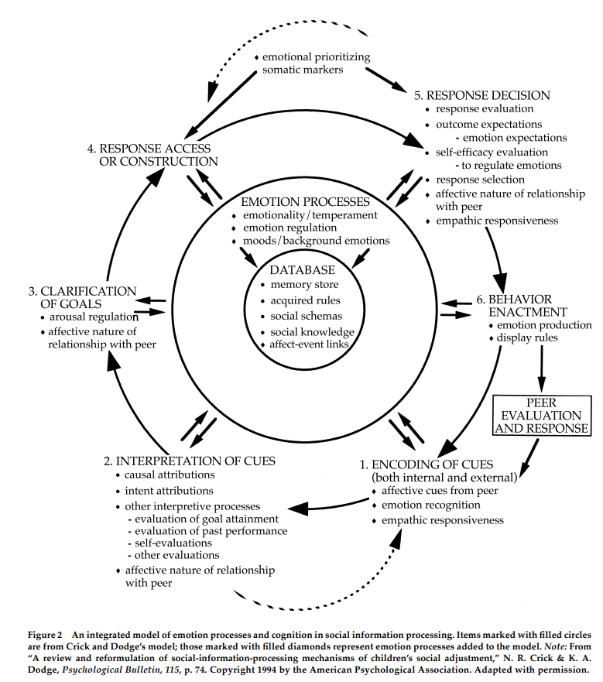

Slide 32
Emoční procesy a stavy - databáze

Slide 33
Afektivní signály, závislost na vztazích

Slide 34
Např. hněv vs pozitivní nálady: instrumentální cíle vs. Udržení nálady
Přehlcení –vyhýbavé nebo hostilní cíle k redukci nabuzení
Nízká empatie – cíle škodlivé pro vztahy
Vztahové cíle – návaznost na vztahy a jejich kvalitu

Slide 35
Hněv, strach, nebo radost podkládají rozdílné odpovědi
Odpověď také závisí na regulaci

Slide 36
Future research
At a general level, we hypothesize that individual differences in emotionality and emotion regulation can influence each step of social information processing.
Specifically, children who are high in emotionality and poor at regulating emotion will show deficits in social information processing

Slide 37
De Castro, B. O. (2004). The development of social information processing and aggressive behaviour: Current issues. European Journal of Developmental Psychology, 1(1), 87-102. (1)
Automatická a reflexivní reakce?
Several authors have remarked that information processing as described by the SIP model is probably more rational, abstract, and reflective than children’s real-life SIP, which is expected to proceed automatically (Crick &Dodge, 1994; Gottman, 1986). In everyday life, carefully assessing and evaluating available information, formulating multiple-response alternatives, and then rationally selecting the response with the best expected outcome is very rare even in trained decision makers, let alone in children with aggressive behaviour problems.

Slide 38
Metodologicky….
the general approach in most of them is to present hypothetical vignettes concerning potentially problematic interactions with peers. Before the situations are presented, participants are asked to imagine that they actually experience the hypothetical situation themselves. The situation is then presented and halted at the moment a problem arises. The participant is then asked questions concerning the SIP model.
Such assessment procedures clearly require reflective processing of social information.
The validity of reflective measures of SIP by aggressive boys has often been questioned (Crick & Dodge, 1994; Vasey, Dalgleish, &Silverman, 2003) and may be problematic for the assessment of emotional information processing

Slide 39
Orobio de Castro et al.,2002

Slide 40
Crick and Dodge, 1994
The seemingly rational nature of the proposed social information-processing model may lead to an inaccurate view of children as consistently reflective, active thinkers who engage consciously in all social information-processing steps before behaving. The extent to which children actually think about social stimuli before enactment of behavior and the extent to which they are aware of their own cognitive processes remain important but unanswered empirical questions.
We doubt that most processing is conscious or reflective. More likely, it is highly automated.

Slide 41
Huesmann, L. R., & Guerra, N. G. (1997). Children's normative beliefs about aggression and aggressive behavior. Journal of personality and social psychology, 72(2), 408.
focus on information-processing operations and skills has provided a useful framework for an initial understanding of how characteristic styles of social behavior are established and maintained, it has only vaguely accounted for the role of organized prior knowledge in regulating such behavior
Importance of cognitive schemata, or abstracted general knowledge, in the regulation of behaviors, particularly automatic behaviors
social schemas reduce an individual's information-processing workload by simplifying reality, enabling individuals to function in a world that would otherwise be of paralyzing complexity

Slide 42
Rowell Huesmann, L. (1988). An information processing model for the development of aggression. Aggressive behavior, 14(1), 13-24.
Zaměření na jeden typ schémat – skripty
Kognitivní skripty – uloženy a používány jako návody pro chování a řešení problémů
Co se v dané situaci asi stane. Jak bychom měli reagovat, jak asi situace dopadne…
se zráním a učením se automatizují
Lidé používají heuristické procesy k vyvolání skriptu relevantního situaci
Předpoklad: Více agresivní lidé mají zakódováno více agresivních skriptů
Agresivní chování je do velké míry kontrolováno skripty které jsou zakodovány, nacvičeny, uloženy, a vyvolány

Slide 43
Huesmann, L. R., & Guerra, N. G. (1997). Children's normative beliefs about aggression and aggressive behavior. Journal of personality and social psychology, 72(2), 408.
Chování navrhnuté skripty je „filtrováno“ sebe-regulačními přesvědčeními (self-regulating beliefs)
Normativní přesvědčení (normative belief)
Vlastní přesvědčení o ne/vhodnosti daného chování
Důležité pro filtrování ne/vhodného chování
Předepisují spektrum dovoleného a zakázaného způsobu reakce
Mohou ovlivňovat emoční reakci na cizí chování

Slide 44
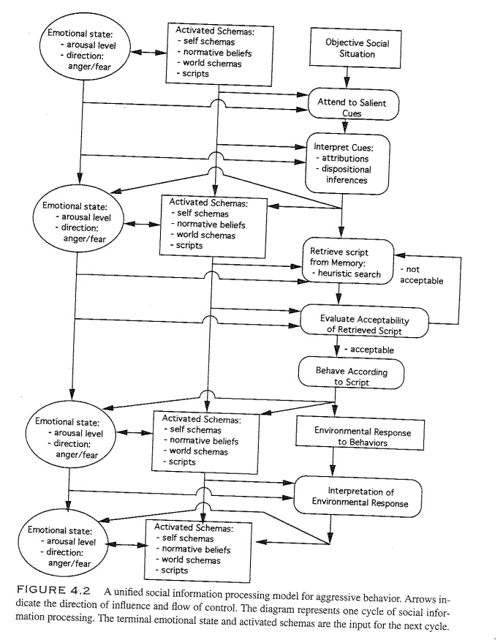

Slide 45
Verhoef, R. E., van Dijk, A., & de Castro, B. O. (2021). A Dual-Mode Social-Information-Processing Model to Explain Individual Differences in Children’s Aggressive Behavior. Clinical Psychological Science, 21677026211016396.
how well children’s SIP explains their aggressive behavior varies considerably between children and studies
relatively few empirical studies on children’s SIP have considered automatic processes (Anderson & Bushman, 2002)
Prior research – methodology - reflect on hypothetical social events
Yet many children may act aggressively without such reflection: When they are in a state of high arousal, an apparently hostile gesture of a peer may trigger a direct automatic aggressive response while children have minimal cognitive control to guide this process reflectively.

Slide 46
Verhoef, R. E., van Dijk, A., & de Castro, B. O. (2021). A Dual-Mode Social-Information-Processing Model to Explain Individual Differences in Children’s Aggressive Behavior. Clinical Psychological Science, 21677026211016396.
distinction is made between a reflective and automatic processing mode in so-called dual-mode processing models (e.g., Chaiken & Trope, 1999; Kahneman, 2011)
Our dual-mode SIP model combines insights from current SIP models (Crick & Dodge, 1994; Lemerise & Arsenio, 2000), the general aggression model (Anderson & Bushman, 2002), and dual-mode processing theory (e.g., Frijda, 1993; Smith & DeCoster, 2000)
although all children may use both processing modes, some children may predominantly engage in aggression that derives from automatic SIP, and other children may engage more frequently in aggression that derives from reflective SIP
Distinguishing between processing modes may have important implications for intervention

Slide 47
Verhoef, R. E., van Dijk, A., & de Castro, B. O. (2021). A Dual-Mode Social-Information-Processing Model to Explain Individual Differences in Children’s Aggressive Behavior. Clinical Psychological Science, 21677026211016396.
we propose an overarching dual-mode SIP model that predicts which processing steps children will take, which children will take them, and under which circumstances, and how this may lead to aggression.
It has been suggested that aggressive behaviors may be a consequence of skipping part of deliberate SIP steps
However, the SIP model does not describe how children who skip parts of these processing steps would actually engage in automatic processing or what would make children skip parts of the deliberate SIP steps.
Our dual-mode SIP model aims to explain what determines whether children process social information automatically or reflectively and how these processes take place.

Slide 49
a direct emotional response to specific situational cues
children in the automatic mode solely use their database of automated contingencies without further consideration of situational cues or decision processes. This allows them to quickly process and respond to situational triggers while saving cognitive resources but occurs at the cost of careful decision-making
depending on learning histories stored in the social database, which is in line with the original SIP model
We propose, however, that, in contrast to the original model, the automatic mode bypasses all SIP steps except the encoding of cues

Slide 50
The reflective mode is characterized by slower explicit processing and consists of several sequential mental steps that result in a deliberate behavioral response.
In contrast to the automatic mode, the reflective mode integrates information from the social database with situational cues
children reconsider their basic appraisal by allocating their attention to the situation and reappraising the encoded cues, which may include attributions of intent or causality etc.

Slide 51
The dual-mode SIP model thus extends current SIP models by explaining not only deliberate, controlled aggression preceded by reflective processing but also fast, emotion-driven aggression preceded by automatic processing.
According to the dual-mode SIP model, children will typically process social information in the automatic mode.
our dual-mode SIP model assumes that children will switch to the reflective mode only in situations that are unfamiliar, potentially threatening, or otherwise personally relevant

Slide 52
The dual-mode SIP model proposes that children’s basic appraisal evokes a certain level of arousal that determines which processing mode they will use. This relation follows an inverted U-shaped function - the reflective mode will be used only when arousal levels are moderate, rather than too low or too high
in situations of low arousal, children will use the automatic mode, which saves cognitive resources.
In situations of moderate arousal, children will use the reflective mode, which allows them to deliberately process and carefully respond to the situation.
In situations of excessive arousal, children are forced to use the automatic mode, which allows them to quickly process and respond to the situation

Slide 53
Whether a situation evokes low, moderate, or excessive arousal will differ between children and situations, depending on their dispositions and dynamic factors (to be discussed later).
These factors together determine children’s basic appraisal
children’s basic appraisal can be seen as an unconscious motivational heuristic that works as the “switch” between the automatic and reflective processing modes by changing children’s level of arousal.

Slide 54
The reflective mode, in contrast, does not solely rely on the social database but explicitly integrates situational input with preexisting memory structures
children’s social database directly determines their automatic SIP
In sum, children’s social database determines whether their SIP is aggressive.

Slide 55
Reactive aggression may result from automatic SIP (e.g., impulsively hitting back) as well as reflective SIP (e.g., deciding to take revenge), just as proactive aggression may result from automatic SIP (e.g., routinely bullying) as well as reflective SIP (e.g., planning to steal).
reactive aggression and proactive aggression can be related to low physiological arousal as well as high physiological arousal

Slide 56
Personální faktory
Emocionální dispozice
Temperament, fyziologická reaktivita
Moderuje arousal
Motivační dispozice
Exekutivní funkce

Slide 57
Vnitřní stav
Whether the arousal, affect, and cognitions that were already activated just before the situation

Slide 58
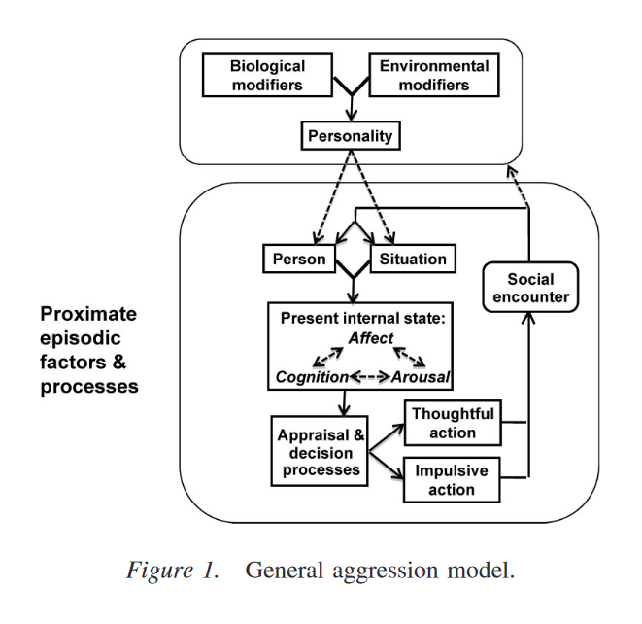
GAM – general aggression model
V současné době dominuje

Slide 59
GAM - origins
comprehensive, integrative framework for understanding human aggression
considers the role of social, cognitive, developmental, and biological factors on aggression
GAM includes elements from many domain-specific theories of aggression, including: cognitive neoassociation theory , social learning theory, script theory, excitation transfer theory, and social interaction theory

Slide 60
Allen, J. J., Anderson, C. A., & Bushman, B. J. (2018). The general aggression model. Current opinion in psychology, 19, 75-80.
human aggression is heavily influenced by knowledge structures, which affect a wide variety of social-cognitive phenomena including perception, interpretation, decision, and behaviors
knowledge structures
beliefs and attitudes (e.g., believing aggression is normal, evaluating it positively) perceptual schemata (e.g., perceiving ambiguous events as hostile)
expectation schemata (e.g., expecting aggression from others)
behavioral scripts (e.g., believing that conflicts should be resolved with aggression)
developed through experience and can influence perception at multiple levels, ranging from simple perception of objects to complex perception of social events
can also become automatized with repeated practice (as is the case with scripts)
can include both cognitive and affective components
For example, anger is strongly linked with hostile attribution biases (the tendency to interpret ambiguous events as hostile)

Slide 61
Allen, J. J., Anderson, C. A., & Bushman, B. J. (2018). The general aggression model. Current opinion in psychology, 19, 75-80.
The proximate processes
explain individual episodes of aggression
three stages: inputs, routes, and outcomes
Inputs influence a person’s present internal state, which in turn affects appraisal and decision processes, which in turn influence aggressive and nonaggressive outcomes.
Each episode of aggression (or non-aggression) serves as a learning trial that can influence the development of aggressive knowledge structures (and thereby personality) over time.

Slide 62
After immediate appraisal, the person decides how to respond to the event. This process depends on available resources and the event itself.
sufficient time and mental resources + the outcome of the immediate appraisal feels both important and unsatisfying = person will engage in a deliberative reappraisal of the event (i.e., considering alternate interpretations).
If not, then the behavioral script that was activated during immediate appraisal is enacted, with little or no awareness of a decision having been made.

Slide 63
Allen, J. J., Anderson, C. A., & Bushman, B. J. (2018). The general aggression model. Current opinion in psychology, 19, 75-80.
The distal processes
how biological and persistent environmental factors work together to influence personality, which in turn change person (and situation) factors
biological modifiers that increase the likelihood of developing an aggressive personality include (but are not limited to): ADHD, impaired executive functioning, hormone imbalances, low serotonin, and low arousal
Environmental modifiers that increase the likelihood of developing an aggressive personality include (but are not limited to): cultural norms supportive of violence, maladaptive families or parenting, difficult life conditions, deprivation, victimization, violent neighborhoods, violent or antisocial peer groups, group conflict, diffusion of responsibility, and chronic exposure to violent media

Slide 64
Kritika GAM
Paradigm change in aggression research: The time has come to retire the General Aggression Model. Aggression and Violent Behavior: Volume 17, Issue 3, May–June 2012, Pages 220-228
Aggression research has entered a period of paradigm change.
The General Aggression Model has received only poor research support.
Diathesis stress models of aggression are a better match to research data.

