Slide 1
Additional Topics
PSYb5440 – Introduction to Factor Analysis
Week 13

Slide 2
Additional Topics
Today’s lesson will be a bit of an amorphic cross-over
We’ll talk about some topics that exceed the basics of FA that we have learned during the semester
If we had more time, the topics presented today would be presented in a more thorough way over the course of multiple days, but…

Slide 3
Model comparison
In many cases, you will have multiple models that are all plausible candidates. Your goal might be to select one of them – the one which is superior to the rest.
You should compare interpretability
You should compare model-data fit
Ideally, you should compare both

Slide 4
Direct model comparison
In order to compare models directly, the compared models
must be nested.
Model A is nested within Model B if Model A is a special case of Model B, or Model B is a general case of Model A.
More specifically, Model A is nested within Model B if Model A can be obtained by imposing additional restrictions on Model B.
The free parameters of Model A are a subset of those of Model B.

Slide 5
Direct model comparison
Sounds arcane?
Some examples of nested models:
Any (usual) restricted model with m factors is nested within an unrestricted model with m factors
An orthogonal model with m factor is nested within an oblique model with m factors (if restricted, they must have the same loading structure)
A model where two parameters are constrained to be equal is nested within the model without this restriction.

Slide 6
Direct model comparison
Nested models:
Will have more degrees of freedom
Will have fewer free parameters (that’s the same thing)
Will have equal or greater value of the same discrepancy function (the model have the same or greater discrepancy from data)

Slide 7
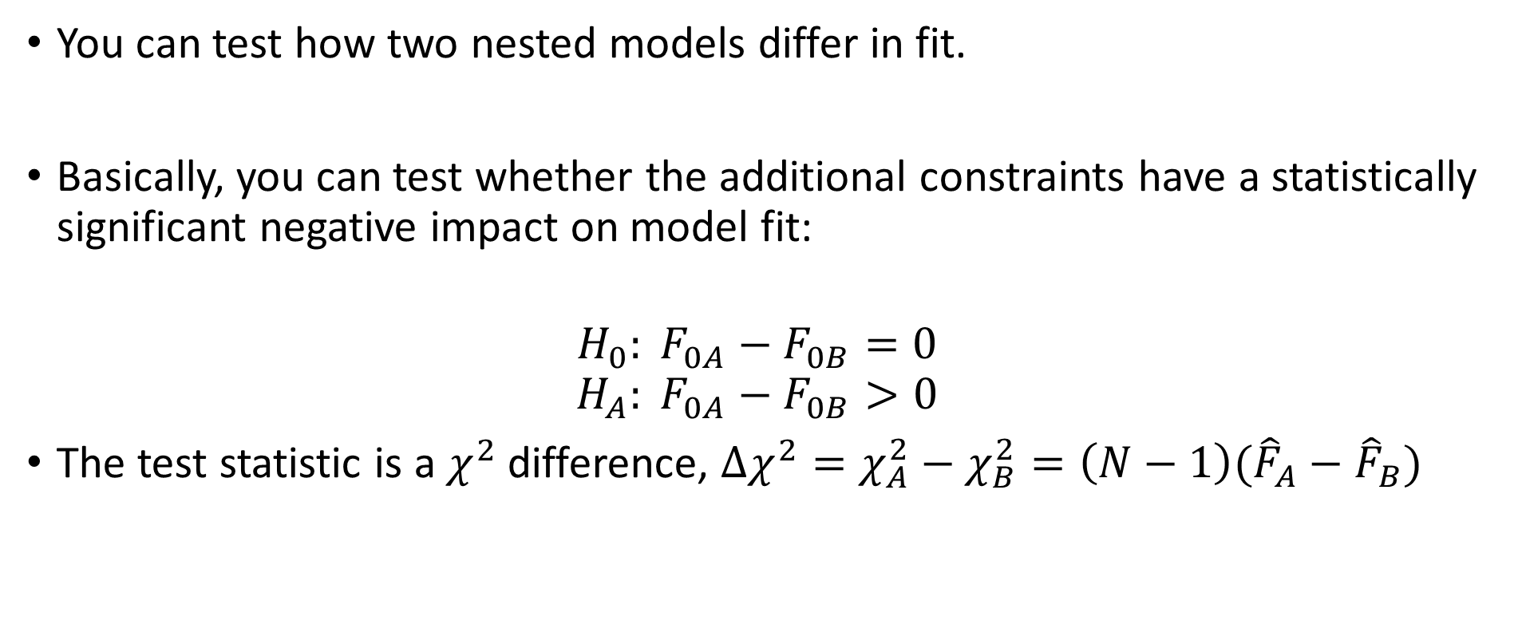
Direct model comparison
You can test how two nested models differ in fit.
Basically, you can test whether the additional constraints have a statistically significant negative impact on model fit:
$$H_{0}: F_{0A}−F_{0B}=0$$
$$H_{A}: F_{0A}−F_{0B}>0$$
The test statistic is a $χ^{2}$ difference, $Δχ^{2}=χ_{A}^{2}−χ_{B}^{2}=\left(N−1\right)({\hat{F}}_{A}−{\hat{F}}_{B})$

Slide 8
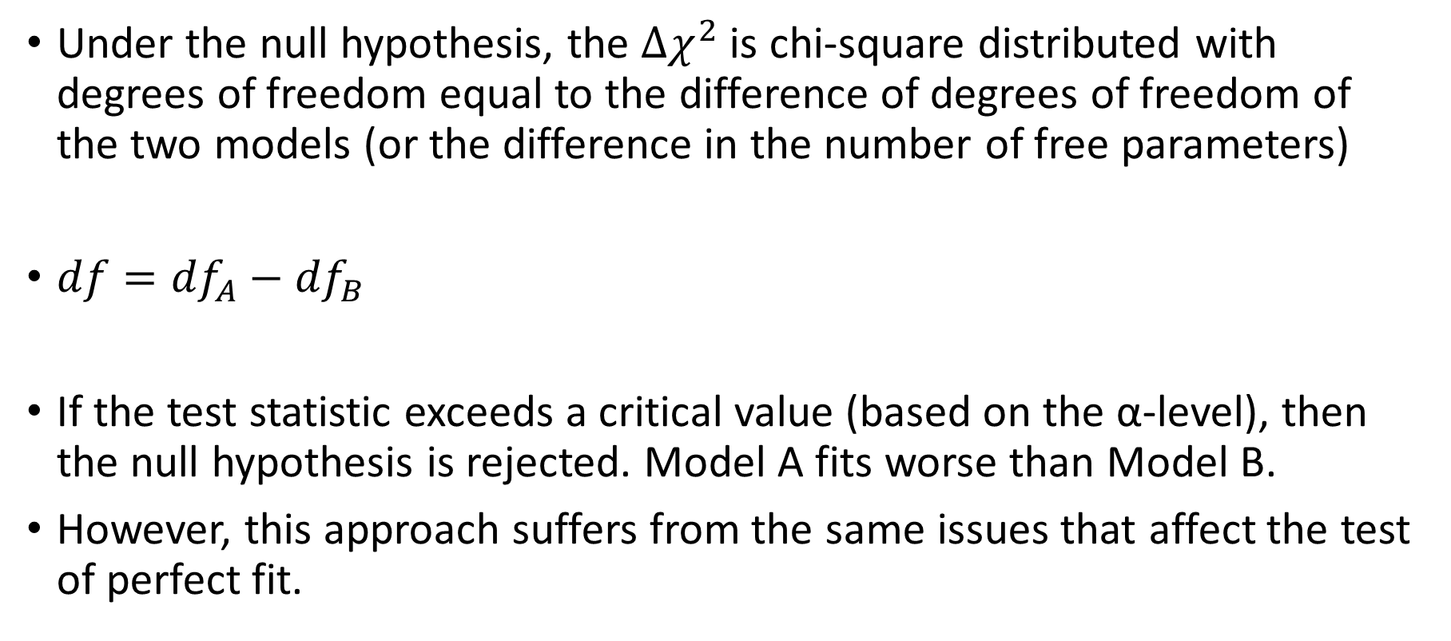
Direct model comparison
Under the null hypothesis, the $Δχ^{2}$ is chi-square distributed with degrees of freedom equal to the difference of degrees of freedom of the two models (or the difference in the number of free parameters)
${df=df}_{A}−{df}_{B}$
If the test statistic exceeds a critical value (based on the α-level), then the null hypothesis is rejected. Model A fits worse than Model B.
However, this approach suffers from the same issues that affect the test of perfect fit.

Slide 9
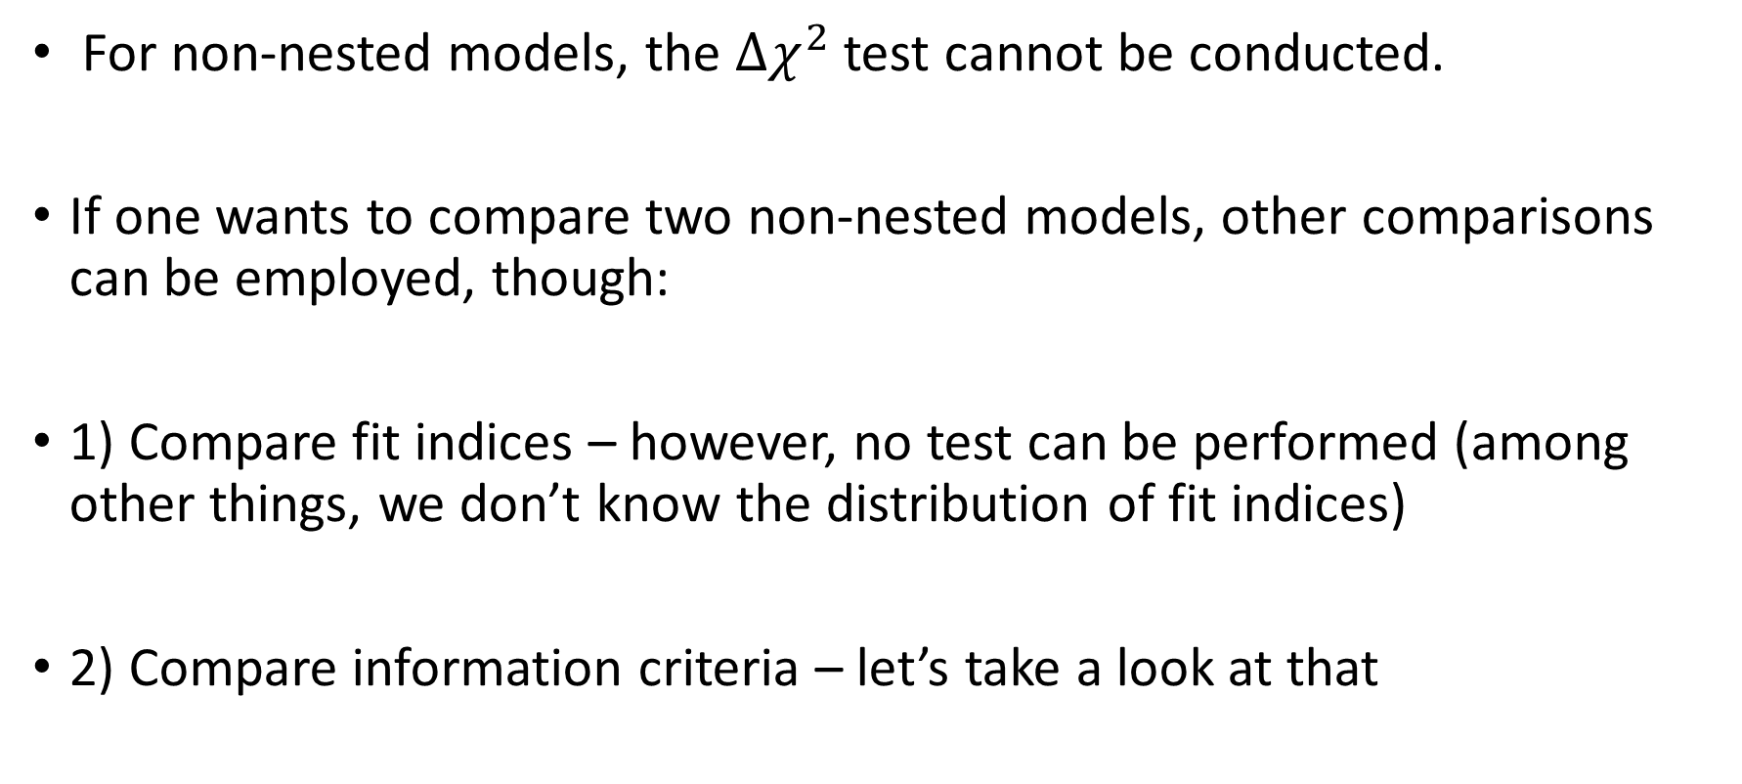
Indirect model comparison
For non-nested models, the $Δχ^{2}$ test cannot be conducted.
If one wants to compare two non-nested models, other comparisons can be employed, though:
1) Compare fit indices – however, no test can be performed (among other things, we don’t know the distribution of fit indices)
2) Compare information criteria – let’s take a look at that

Slide 10
Information criteria
Remember the log-likelihood from way back when we talked about maximum likelihood estimation?
The log-likelihood is usually a relatively large, negative number. The smaller it gets (the more negative it gets), the smaller the likelihood. In case data is the same, worse models will result in smaller likelihood.
Sometimes, a deviance is calculated: -2*log-likelihood (so, a relatively large, positive number). The larger the deviance, the smaller the likelihood (the more the model deviates from data)
Deviance is used to calculate the so-called information criteria.

Slide 11
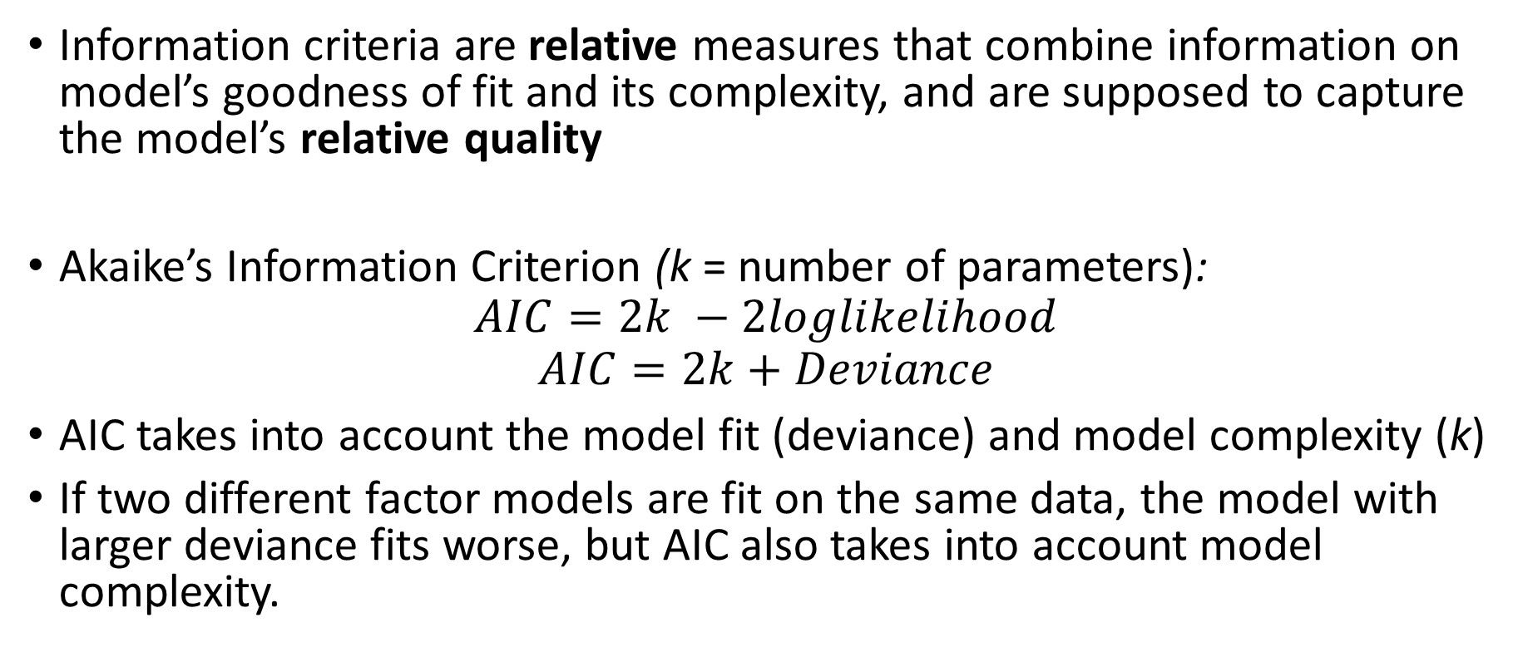
Information criteria
Information criteria are relative measures that combine information on model’s goodness of fit and its complexity, and are supposed to capture the model’s relative quality
Akaike’s Information Criterion (k = number of parameters):
$$AIC=2k −2loglikelihood$$
$$AIC=2k+Deviance$$
AIC takes into account the model fit (deviance) and model complexity (k)
If two different factor models are fit on the same data, the model with larger deviance fits worse, but AIC also takes into account model complexity.

Slide 12
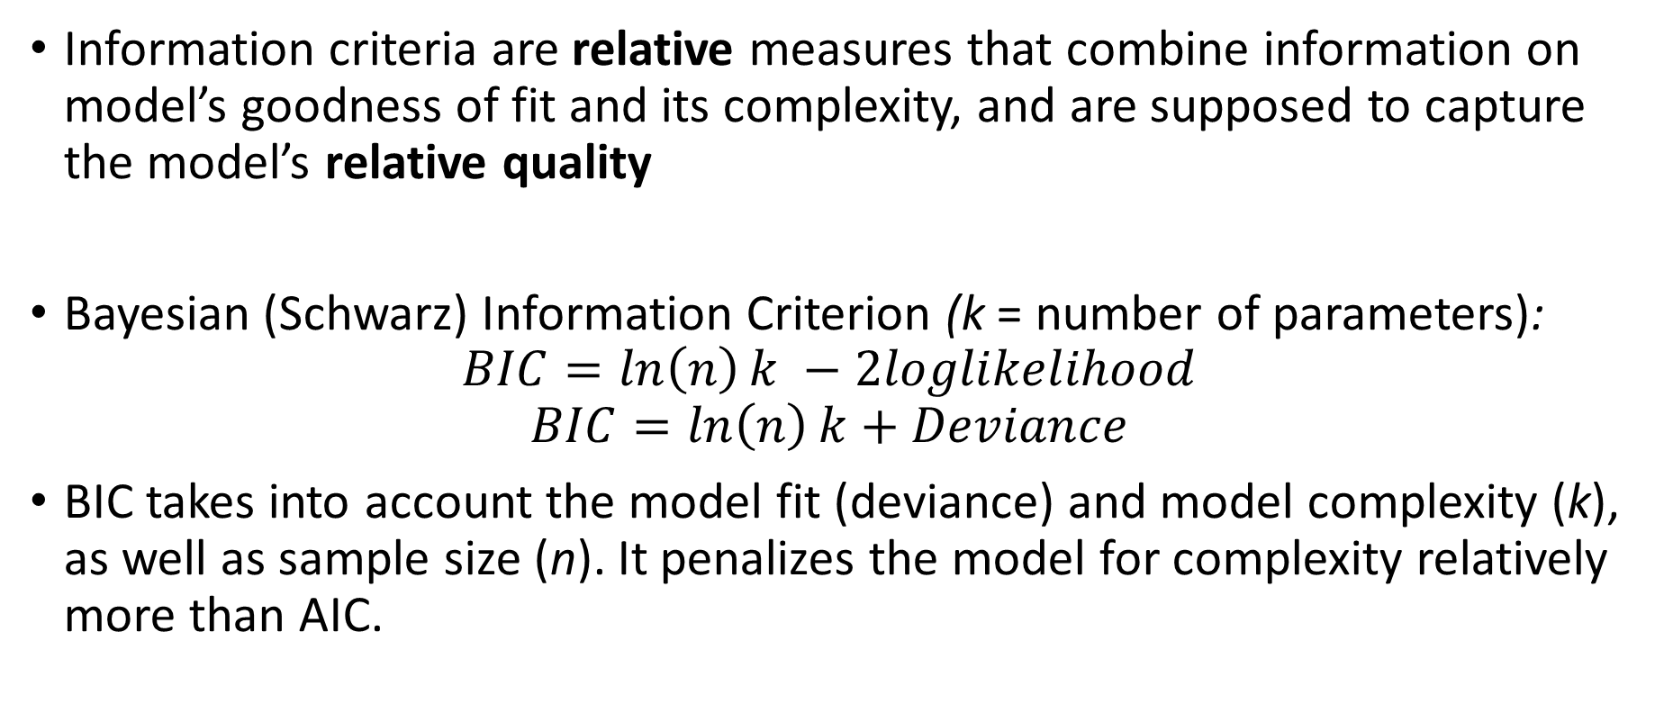
Information criteria
Information criteria are relative measures that combine information on model’s goodness of fit and its complexity, and are supposed to capture the model’s relative quality
Bayesian (Schwarz) Information Criterion (k = number of parameters):
$$BIC=\ln\left(n\right)k −2loglikelihood$$
$$BIC=\ln\left(n\right)k+Deviance$$
BIC takes into account the model fit (deviance) and model complexity (k), as well as sample size (n). It penalizes the model for complexity relatively more than AIC.

Slide 13
Information criteria
You can only compare models on their information criteria if the models were fit to the same data
Moreover, even if the information criteria values differ for two models, we don’t know how much is too much – there is no “effect size” for information criteria.
So treat the AIC and BIC as sources of information, but keep the above in mind.

Slide 14
Bi-factor model
What is the bi-factor model?
1) All items load on a single “general” factor
2) All items also load on one, and only one, additional “specific” factor
3) All factors are uncorrelated
So, the Λ matrix has m columns, where one of these columns is full of free parameters and the remaining m-1 columns contain free parameters each for a set of MVs, these sets do not overlap. The Φ matrix is diagonal.

Slide 15
Bi-factor model
Why can the bi-factor model be useful?
It’s a “multidimensional unidimensional model” ☺
It might have interesting interpretations
It usually fits better than a 1-factor model

