Slide 1
The Nature of Broadcasting - A Theoretical Perspective
Past, Present and Future
Henry Loeser
hloeser@tlu.ee

Slide 2
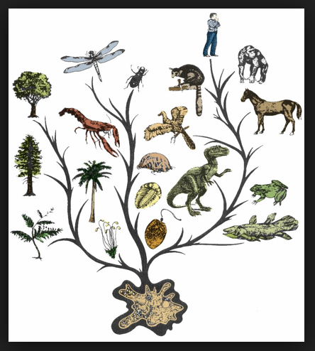
Natural Law
Structure of Nature
All living things seek utility
Nurture (Rationality)
Communication

Slide 3
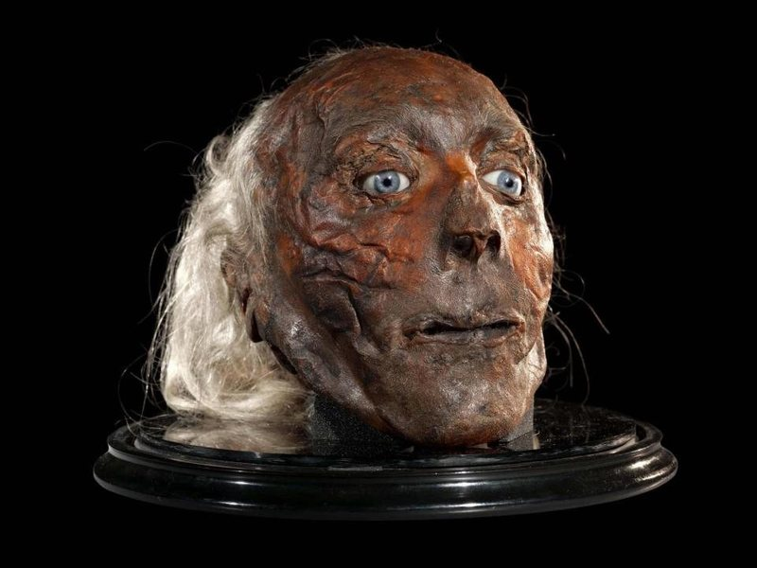
Philosophy
What does it mean to be human?
Jeremy Bentham

Slide 4
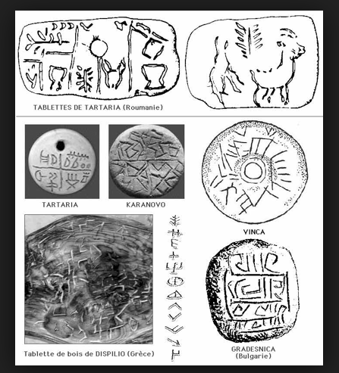
Human Evolution
Groups
Symbolic Interaction
Language
”We shape our tools, and thereafter, our tools shape us.” -Marshall McCluhan

Slide 5
Ontology
- religion: faith
- science: empiricism

Slide 6
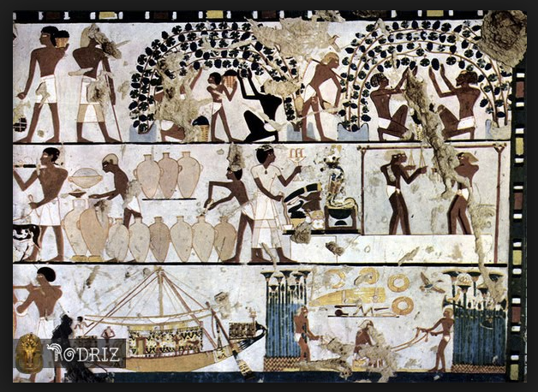
Forming Societies
Specialization
Communication
Greek – Metaphysics (Socrates, Plato)
Eastern – Muslim, India, Chinese

Slide 7
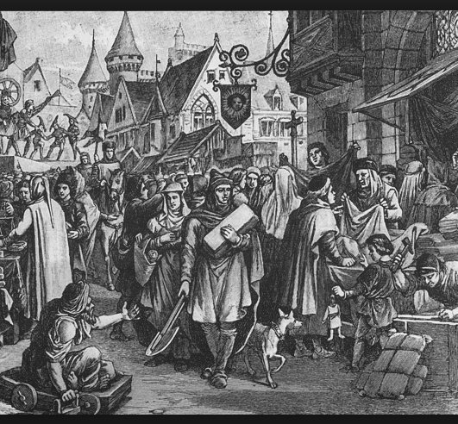
Medieval Europe
Dual authoritarianism of monarchy and church
Religion (Aquinas, Bacon)
Rise of merchant class media

Slide 8
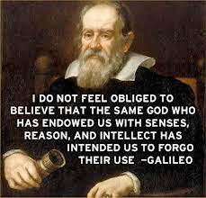
Enlightenment
Science & technology
Secularism
Humanism (Hobbs, Descartes)

Slide 9
Epistemology
- knowledge
- logic /rationalism
- value
- aesthetics

Slide 10
Humanities
Language
Literature
Geography
History

Slide 11
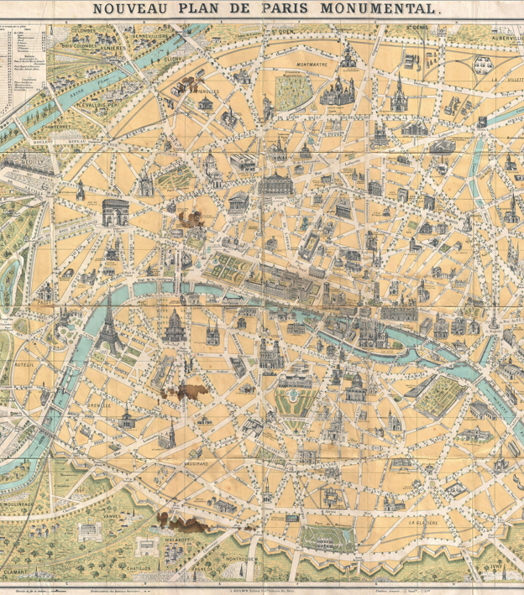
Modernity
Urbanization
Democracy
Mass Media forms
Sociology (Locke, Durkheim, Hegel, Marx)

Slide 12
Social Sciences
Individual - Psychology
Groups - Sociology, Economics, Political Science
Positivist (Natural Sciences, mathematics)
Interpretivist (Symbolic interpretation / critique)

Slide 13
Sociology
Structure
- Spencer: ”each feature, custom, or practice, its effect on the functioning of a supposedly stable, cohesive system”
- Giddens: “the pre-eminence of the social world over its individual parts (i.e. its constituent actors, human subjects)”

Slide 14
Sociology
Agency
- Parsons: “the capacity of individual "agents" to construct and reconstruct their worlds.”
- Bordieau: "externalising the internal", and "internalising the external."
- Berger & Luckman: Society forms the individuals who create society - forming a continuous loop in the “social construction of reality”.

Slide 15
Civil Society
a segment of society apart from commerce and government occupied by individuals and groups in public life outside the home, encompassing their cultural, ethical, political, and/or religious interests
Culture
Politics

Slide 16
Civil Society
Aristotle: “koinōnía politike” (society apart from family & government)
Hegel: “burgerliche gessellschaft” (citizens’ society)
Heller: “mosaic of identities”
Habermas: “communicative action in possibility spaces”
Bordieau, Giddens: “media reproduces culture in civil society”

Slide 17
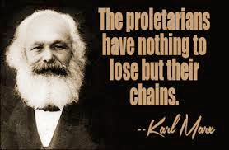
Conflict Theory
Dysfunctional society
Agency vs. Structure
Legal alternativism

Slide 18
Conflict Theory
Horkheimer & Adorno:
In the “culture industries”, the rise of 20th century large cultural industry players had created a structured, supply-driven system that “integrates its consumers from above” and was negating the opportunities for individuals and small groups of producers to comprise “a more diverse and pluralistic platform for societal understanding"
Researching the development of public policy should include not just an examination of the actors' behavior, but also an exploration of the value systems upon which the actions were based

Slide 19
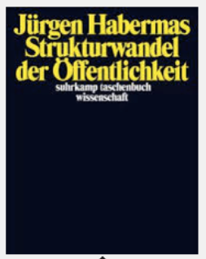
The Public Sphere

Slide 20
The Public Sphere
a participatory bourgeois public sphere of real discourse among equals that transformed into a site of spectator politics manipulated by elites who took control of the medium
the public sphere merged the private concerns of literate individuals regarding family and social integration with the larger public concerns of society
presented in spaces reserved for open discourse among citizens and delineated through argumentative discourse intended to identify and prioritize interests for the common good. Individuals could inform and influence public opinion, even if it was in opposition to the current political status quo.

Slide 21
Alternative Press
Activist media

Slide 22
Public Sphere
The degradation of the public sphere began in the late 19th century concurrent with the societal transition to a system marked by merging economic and political forces, the decline of the individual, and the manipulation of the culture industries

Slide 23
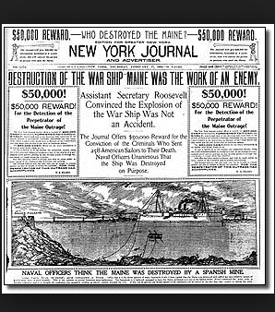
Re-Feudalization
Newspaper conglomerates
Politicization

Slide 24
The Public Sphere
Habermas: “forum for culture and politics co-opted”
Edwards: “multiple public spheres”
Fraser: “issues of class & gender”
Foucalt: “multidirectional power generation from discourse”
Herbst: “mobilize political resources”

Slide 25
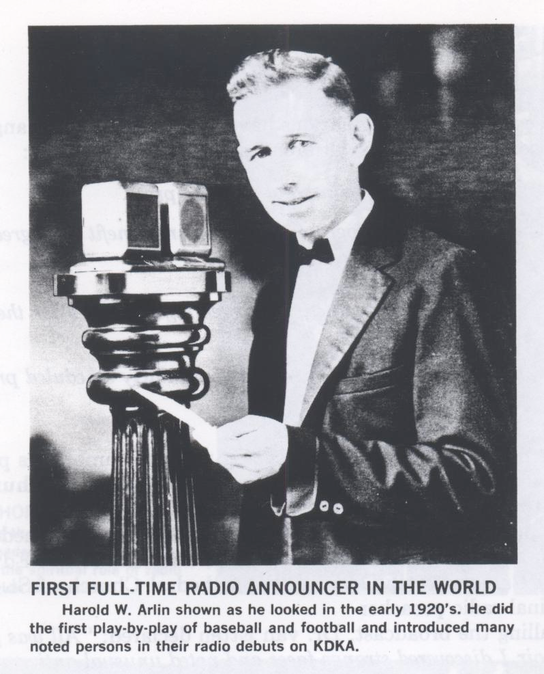
Radio

Slide 26
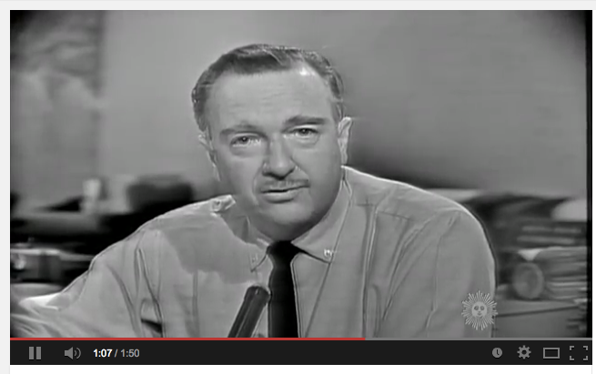
Television
https://www.youtube.com/watch?feature=player_detailpage&v=6PXORQE5-CY

Slide 27
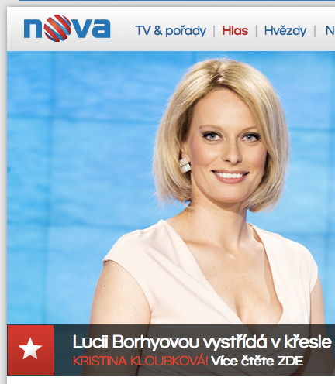
Terrestrial Paradigm
Public Service
Commercial
Alternative

Slide 28
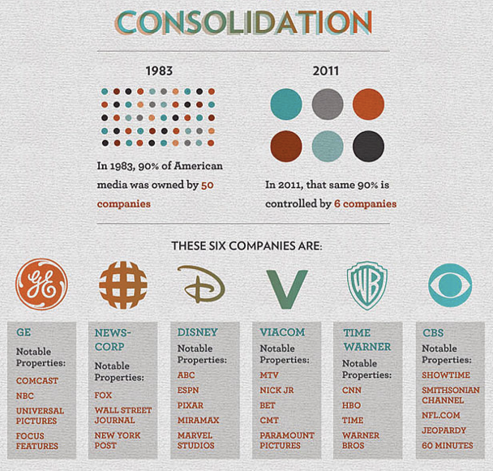
Re-Feudalization II
Policy issues
Commercial conglomerates
Alternatives struggle

Slide 29
IP - The Great Liberator?
One-to-many revolution
low barriers to entry
virtual democracy

Slide 30
The Present: Content
Media Literacy!
Information
Opinion
Entertainment

Slide 31
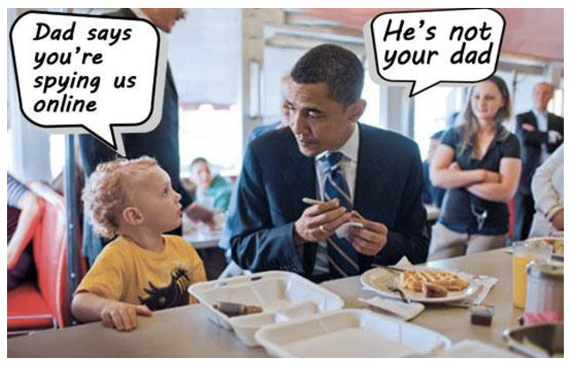
The Present: Your Data

Slide 32
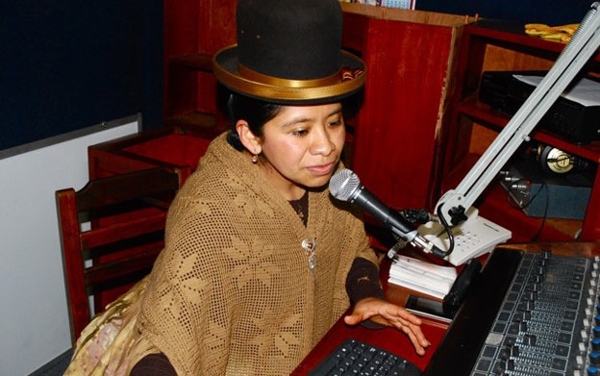
Re-Feudalization III?

Slide 33
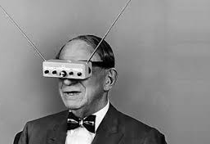
The Future
Beyond RF
Beyond streaming
Neutrality
Creative Commons
Policy reform
Funding solutions

Slide 34
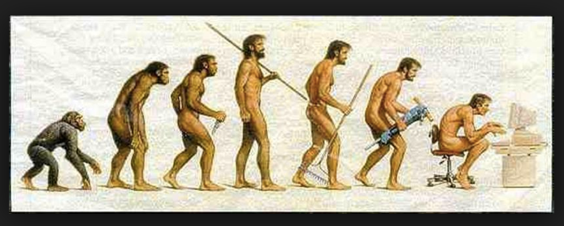
Human Evolution
Structural Functionalism?
The Public Sphere?
Broadcasting plurality?

Slide 35
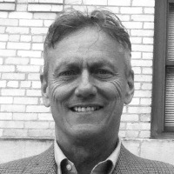
Thank You!
Henry Loeser is a research fellow in MEDIT and teaching member of the
Baltic Film, Media, Arts and Communication School faculty.
Dr. Loeser earned his PhD in 2016 for research into the societal attributes of
Community Media at Masaryk University in the Czech Republic, and holds a
MA in European Politics, BS in Business Administration, and AS in Mechanical Engineering.
He founded the Media Innovation Center at Masaryk University,
establishing the new university broadcast operations of student radio and TV.
He also is an independent media advocate, serving on the board of directors of the Community Media Forum Europe.
Since 2003, he is founder and director of Radioexpert, an NGO that is active in Community Media projects worldwide.

