Slide 1
Body language – your superpower
How to use body language to communicate effectively
Conference skills 23 November 2021

Slide 2
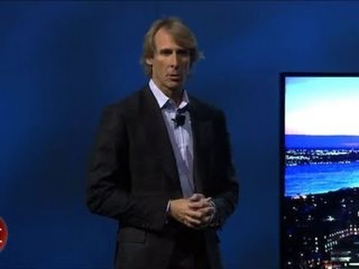
ANALYZE HIS BODY LANGUAGE

Slide 3
THE PRESENTER’S BODY LANGUAGE
NERVOUS, ANXIOUS
CLASPED HANDS, TURNED AWAY FROM THE AUDIENCE
LOOKING DOWN
NOT ACHIEVING COMPOSURE
EXITS THE STAGE

Slide 4

THREE VANTAGE POINTS
POSTURE BREEDS SUCCESS
GESTURES STRENGHTEN OUR MESSAGE
THE AUDIENCE’S BODY MATTERS TOO

Slide 5
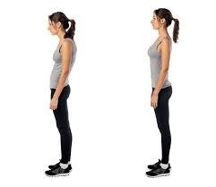
i. POSTURE
COMMUNICATION BEGINS BEFORE YOU OPEN YOUR MOUTH
HOW/WHERE TO STAND
PERFECT POSTURE

Slide 6

II. GESTURES
HELP THE MEMORY
ARMS/HANDS ARE THE MOST VISIBLE
3 TYPES:
- GIVE
- SHOW
- CHOP

Slide 7
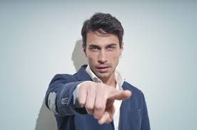
II. GESTURES
PALMS UP
PALMS DOWN
POINTING

Slide 8
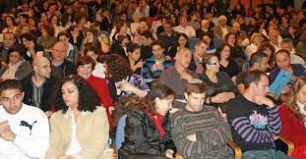
III. THE AUDIENCE’S BODY LANGUAGE
OBSERVATIONAL SKILLS
HOW ARE THEY SITTING?
THE ELEMENT OF SURPRISE

Slide 9

BODY IS YOUR SUPERPOWER
STAND STRONG
GESTURE EFFECTIVELY
MIND YOUR AUDIENCE

