Slide 1
ANDREA HOLESZOVÁ & LISA-SOPHIE MORAVCIK
WRITING & PRESENTATION TIPS
NOVEMBER 23RD 2021

Slide 2
TIPS AND TOOLS FOR ACADEMIC WRITING

Slide 3
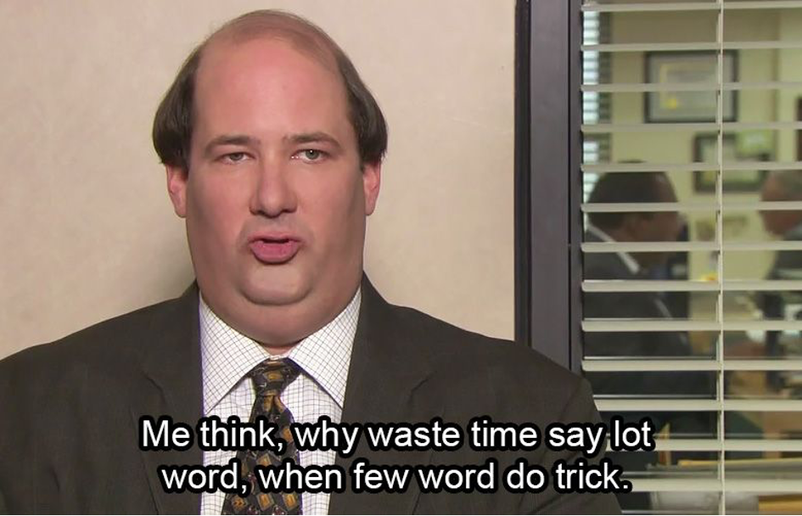
1. Be Concise
CLEAR INFORMATION
ONLY FEW WORDS

Slide 4
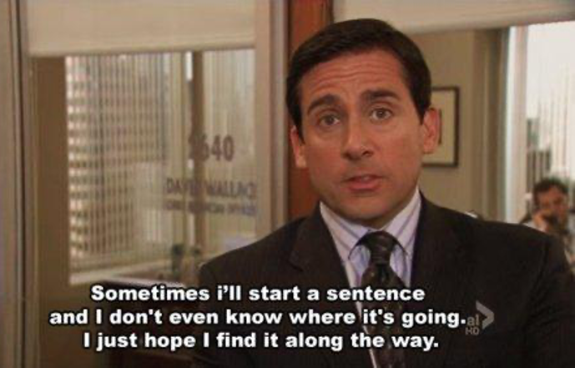
2. Organize Your Paper
WRITE A QUICK OUTLINE
PROVIDE STRUCTURE

Slide 5
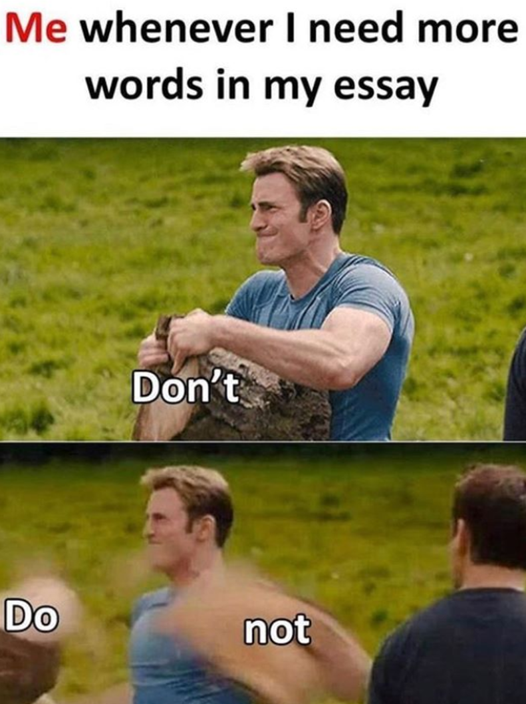
3. Avoid
CONTRACTIONS
IDIOMS
COLLOQUIAL EXPRESSIONS

Slide 6
SIMPLE SENTENCES
I woke up late this morning.
I went to the kitchen.
I made myself a cup of coffee. I finished my coffee.
I got ready for work.
I looked at my watch.
I realized I was running late. I ran out of the door.
I jumped in my car.
4. Vary Your Sentence Structure

Slide 7
COMPOUND-COMPLEX SENTENCES
I woke up late this morning. I went to the kitchen and I made myself a cup of coffee. After I finished my coffee, I got ready for work. When I looked at my watch, I realized I was running late, so I ran out of the door and jumped in my car.
4. Vary Your Sentence Structure

Slide 8
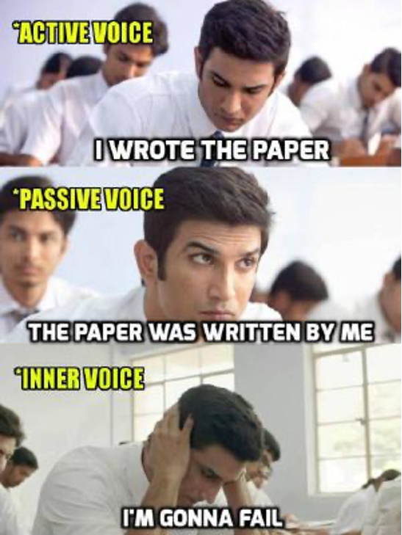
5. Use Active Voice
NOT FOR EVERY SENTENCE
SEE 1. BE CONCISE

Slide 9
VARIETY OF WORDS
6. Avoid repetition
PRECISE LANGUAGE
TRANSITION WORDS

Slide 10
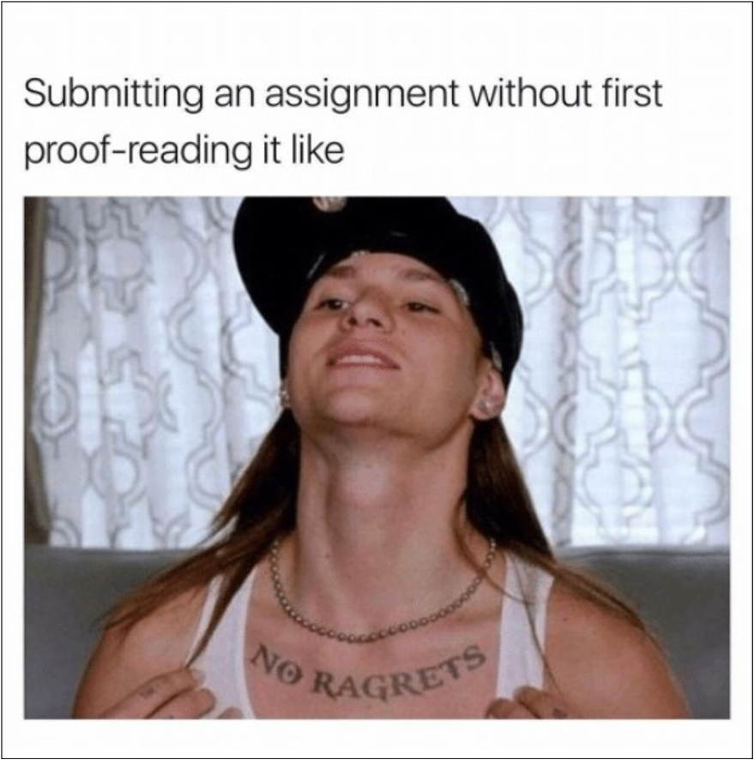
7. Proofread
SENTENCE STRUCTURE
CHECK FOR REPETITION
READ BACKWARDS

Slide 11
PRESENTATION TIPS

Slide 12
Only One Message Per Slide

Slide 13
1
+
1
=
0
John Sweller and Mayer-Theory

Slide 14
Contrast
DARK BACKGROUND
3 COLOURS
TITLE <-> KEY POINTS

Slide 15
Company | Apple | Microsoft | BMW | VW
Revenue | $ 365.82 billion | $ 168.09 billion | € 98.99 billion | € 129.7 billion
Profit | $ 94.7 billion | $ 44.3 billion | € 3.9 billion | € 11.4 billion
Increase | $ 74.52 billion | $ 18 billion | - € 6 billion | 8,8%
Employees | 154.000 | 103.000 | 120.700 | 6662.575

Slide 16
Company | Apple | Microsoft | BMW | VW
Revenue | $ 365.82 billion | $ 168.09 billion | € 98.99 billion | € 129.7 billion
Profit | $ 94.7 billion | $ 44.3 billion | € 3.9 billion | € 11.4 billion
Increase | $ 74.52 billion | $ 18 billion | - € 6 billion | 8,8%
Employees | 154.000 | 103.000 | 120.700 | 6662.575

Slide 17
Disadvantages of a Bright Background
BLINDING
TIRING
LOSS OF FOCUS

Slide 18
Advantages of Dark Background
FOCUS
VISUAL AID
RELAXING

Slide 19
Objects

Slide 20
British Authors
JANE AUSTIN
EMILY BRONTE
H.G. WELLS
J. K. ROWLING
THOMAS HARDY
WILLIAM BLAKE
GEORGE ORWELL
CHARLES DICKENS
VIRGINIA WOLF
WILLIAM SHAKESPEARE
ARTHUR CONAN DOYLE
DAVID WILLIAMS
8/30

Slide 24
S I X

Slide 25
WORK SMARTER NOT HARDER

