Slide 1
ACADEMIC WRITING VS SPEAKING
Viktorija Kudyn, Hindrek Pärg

Slide 2
WHAT‘S THE MOST CHALLENGING ASPECT OF ACADEMIC WRITING FOR YOU?

Slide 3
POV OF STUDENTS
"not using smart words excessively to avoid sounding pretentious"

Slide 4
POV OF STUDENTS
"seeing and understanding context"

Slide 5
POV OF STUDENTS
"pretending that I don't have to google half of the words I use to make sure I know what they mean"

Slide 6
POV OF STUDENTS
"bringing myself to write and making it in time for the deadline"

Slide 7
POV OF PROFESSORS
"being understandable and clear"

Slide 8
POV OF PROFESSORS
"following structure while being original (as opposed to speaking)"

Slide 9
WHAT‘S THE MOST CHALLENGING ASPECT OF ACADEMIC SPEAKING FOR YOU?

Slide 10
POV OF STUDENTS
"not boring my listeners to death"

Slide 11
POV OF STUDENTS
"always finding the right (academic) words"

Slide 12
POV OF STUDENTS
"keeping in mind what I want to say throughout the entire presentation"

Slide 13
POV OF PROFESSORS
"first impression: drawing your listeners in from the first couple seconds"

Slide 14
POV OF PROFESSORS
"making sure you let everyone know that your topic is important and that you‘re a pro in it"

Slide 15
BEST PRACTICES: ACADEMIC WRITING

Slide 16
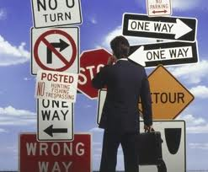
"being clear and concise"

Slide 17

"structure"

Slide 18
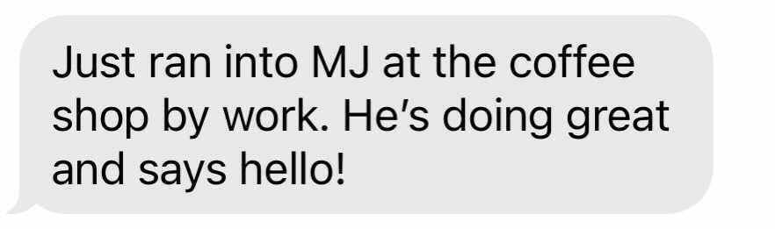
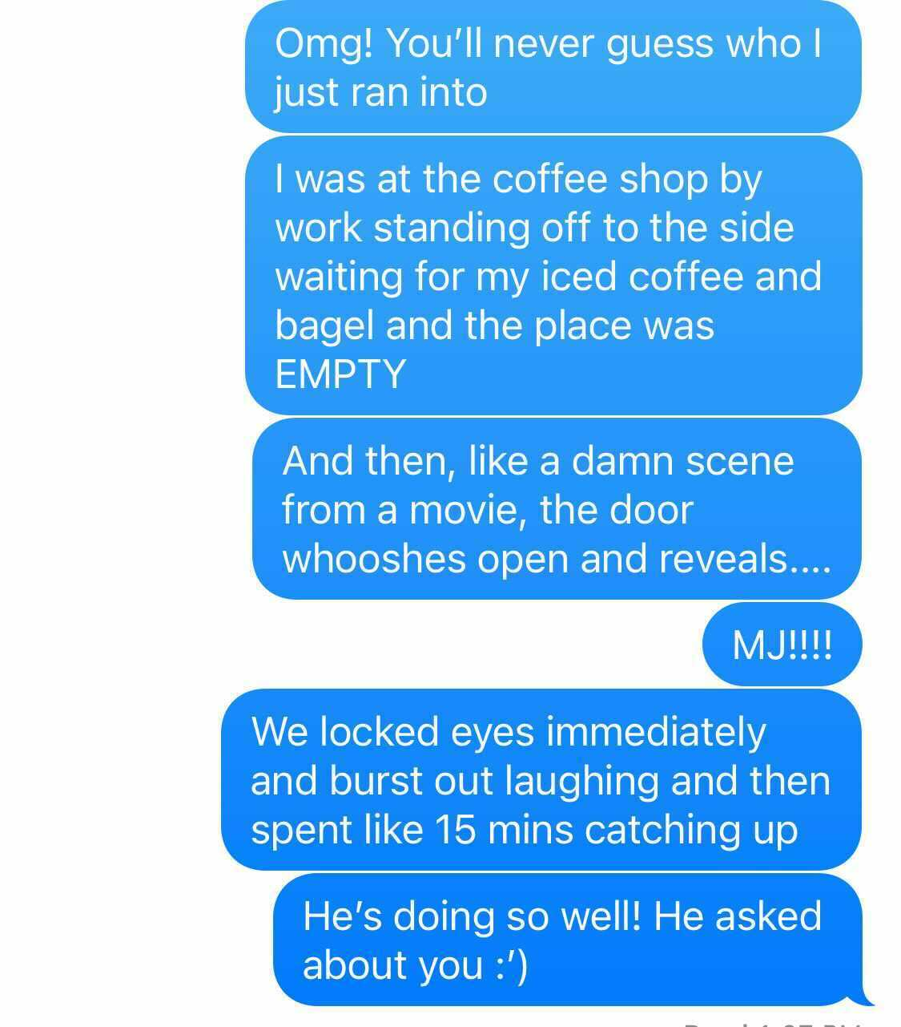
"finding the balance between
simplicity and difficulty"

Slide 19

"trying to maintain originality and personal style"

Slide 20
BEST PRACTICES: ACADEMIC SPEAKING

Slide 21

"drawing and keeping attention"

Slide 22
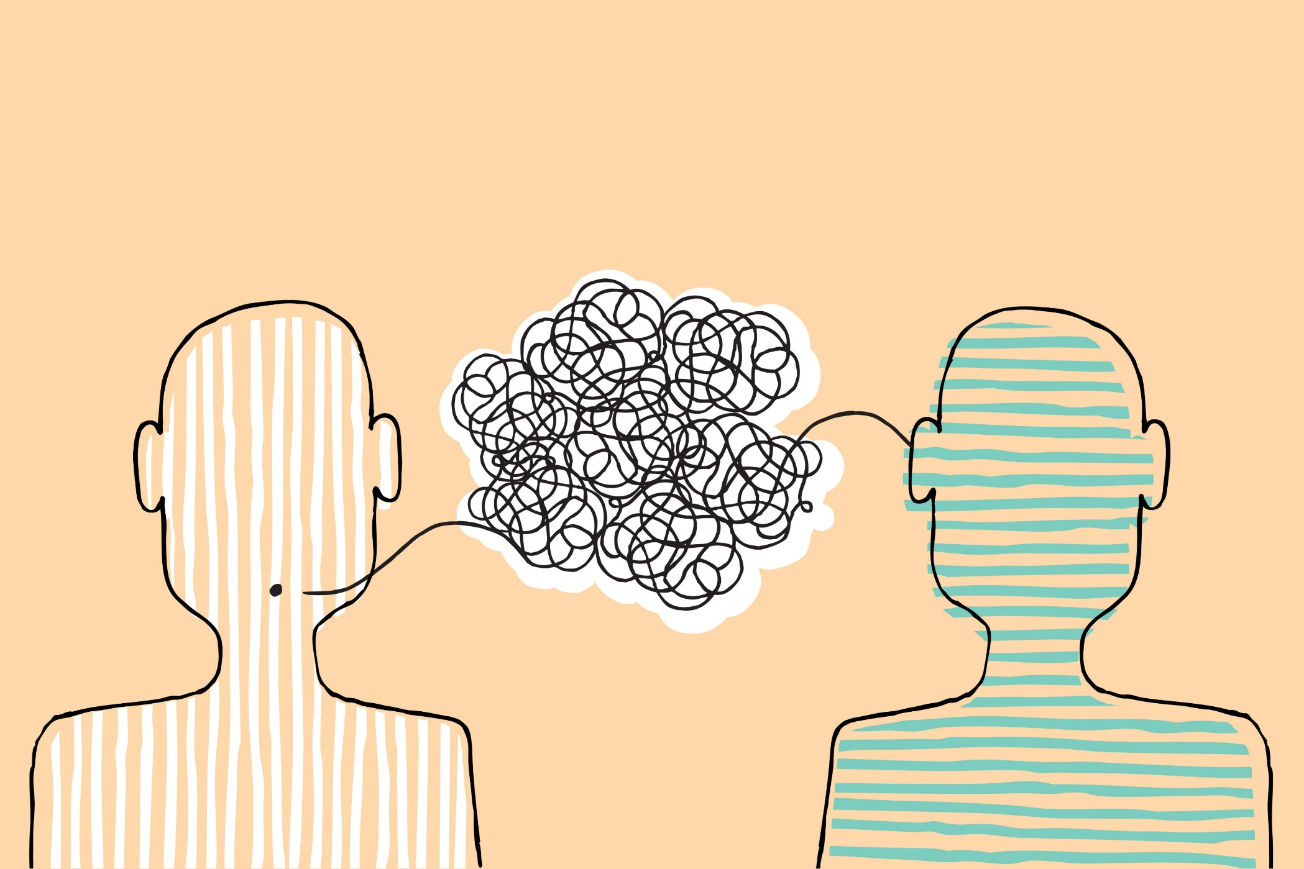
"telling a story"

Slide 23

"professor/researcher/popularizer"

Slide 24
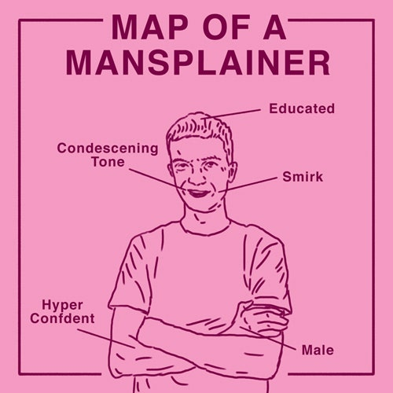
"making your topic interesting to others who are not in the exact same field"

Slide 25
DIFFERENCES: WRITING VS SPEAKING
Academic structure
Reserved
Re-reading
Story
Emotions
One time only
THE TOPIC

Slide 26
SUMMARY

Slide 27
Connect three words in a sentence to summarize what you learned
Boring – words – mind

Slide 28
Connect three words in a sentence to summarize what you learned
Context – google – deadline

Slide 29
Connect three words in a sentence to summarize what you learned
Story – mansplaining – style

Slide 30
Connect three words in a sentence to summarize what you learned
Senpai – popularizer – attention

Slide 31
Connect three words in a sentence to summarize what you learned
Structure – academic – seconds

Slide 32
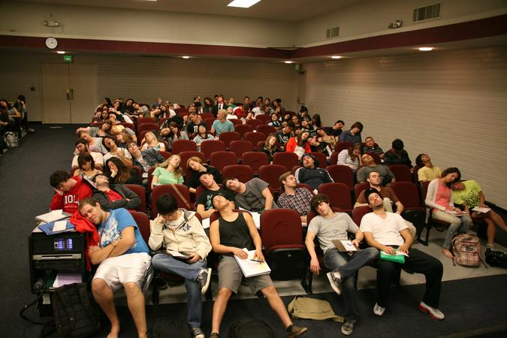
THANK YOU FOR YOUR ATTENTION!

