Slide 1
From 1945 up to the disintegration of Yugoslavia
Balkan Politics
Věra Stojarová
stojarova@fss.muni.cz

Slide 2
After WWII
Main resistence AVNOJ – antifascist council for national liberation of Yugoslavia
Leader Tito
Recognized montenegrin and macedonian nation
1945 elections manipulated, People´s Front 90% of the votes
1946 new constitution drafted after the Soviet one
Post-war Yugoslavia produced as many as four constitutions – in 1946, 1953, 1963 and 1974, The whole system was getting more and more difficult

Slide 3
Regional hegemon
Regional hegemon – integration of Albania into Yugoslavia?
Yugoslav support for Greek communists in Greek Civil War
Yugoslav hoped that Greek threat would lead Albania into Yugoslavia
Federation with Bulgaria? Suggested by Stalin
Tito-Stalin split – Stalin´s letters 1948
At least one failed attempt for military coup supported by Soviets
Lets poison Tito
Titoists!!! – Koci Xoxe, Rudolf Slánský, Laszlo Rajk, Traicho Kostov
Tito cut off support to greek communists 1949
Sharp antagonism with Albania after Tito-Stalin split

Slide 4
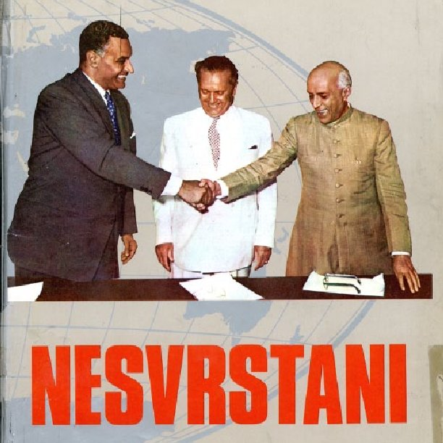
Foreign policy of Tito
East and West
Thirld World countries – Non-Aligned Movement

Slide 5
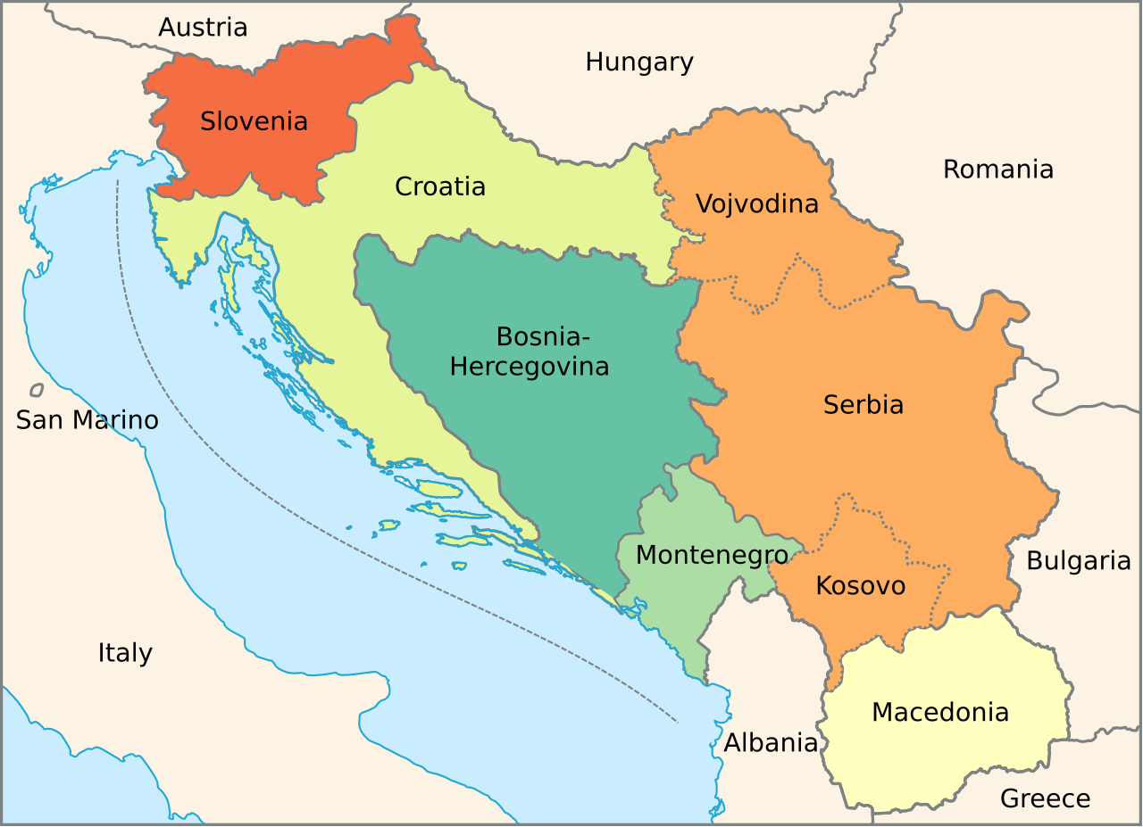
1974 constitution
Right for nationality, use of mother language, yugoslav as well as republican citizenship
Each republic had a right to cesede
The state property was changed into social property

Slide 6
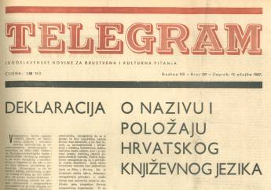
Croatian spring 1967-71 and Croatian silence 1971-1980´s
Croatian language
Demands for increased autonomy
Patriotic songs
Croatian culture
Plans for increased representation of Croatia-related materials in the school curriculum
Calls measures to address the overrepresentation of Serbs in key positions in Croatia
Increased tensions between croats and serb
1968 Student demonstrations in belgrade
1972 oil crisis, IMF debt
1974 constitution
Franjo Tudjman imprisoned for nationalist activities
Vice Vukov (Zvona moga grada https://www.youtube.com/watch?v=mzdp-ZU_kcE) had to emigrate (Tvoja zemlja https://www.youtube.com/watch?v=cE_z8mSZ8qQ)
Significance of catholic church in croatian identity
Cult of Mary as croatian symbol
Suppressed and purges out of Communist Party of Croatia
League of Communists of Slovenia also suppressed

Slide 7
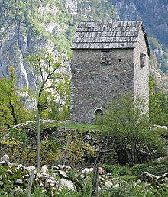
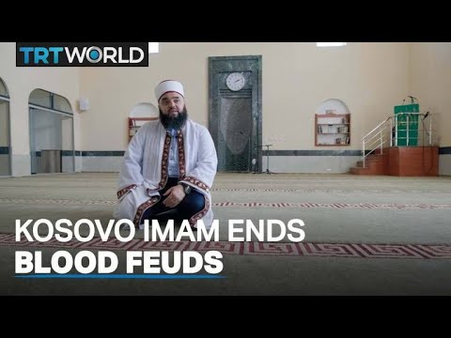
Albanian nationalism
1944-48 – good relations Tirana and Belgrade, pan-balkan federation?
1948 Tito quarrel with Moscow and Hoxha on Russian side
Kosovo republic? Why Montenegro and not Kosovo?
1968 autonomous region, assimilation of Albanians
1968 demonstrations for unification with Albania
1970s albanian language promoted, Albanians in state structures, Albanian university,
1977 autonomous province
Decline of serbs, migration of Serbs vs natality of Albanians
1981 Albanian revolt suppressed
1986 limitations of kosovo autonomy
1990 declaration of independence of Kosovo
Peacefull and armed resistence
Vendettas and kanun
1998-99 escalation of the conflict

Slide 8
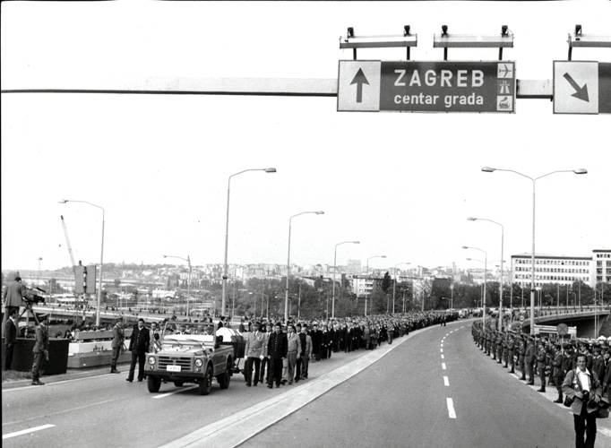
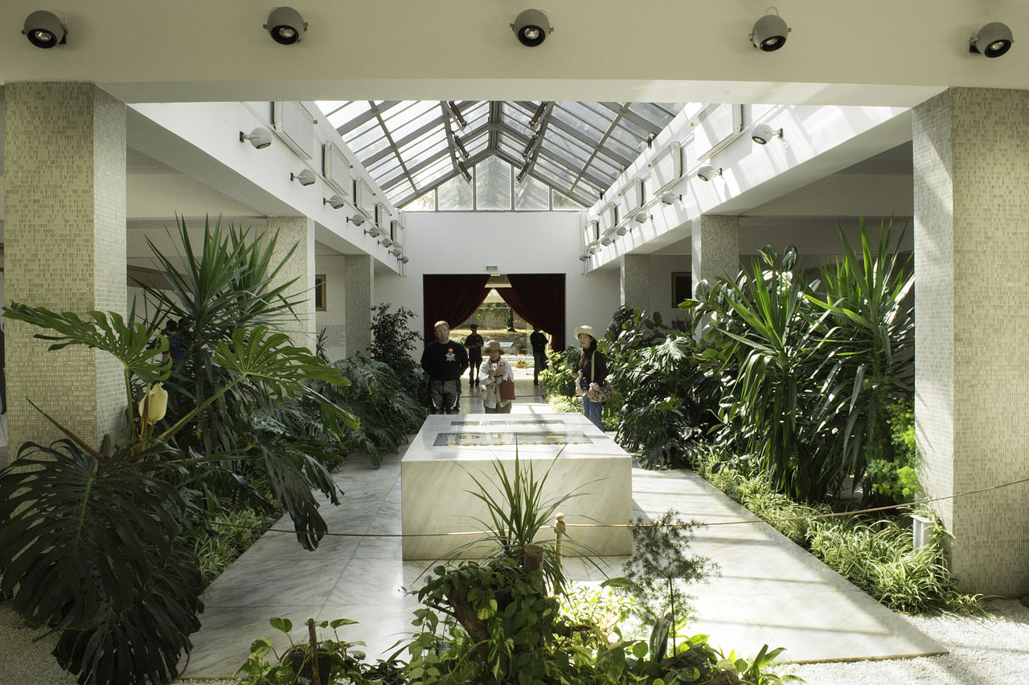
Death of Tito 4.5.1980
State funeral
IMF debt
Tensions
Most attended state funeral in history –128 countries out of the 154 UN members at the time were represented, delegates from seven multilateral organizations, six movements and 40 political parties.
Recession, inflation
Series of wars

Slide 9
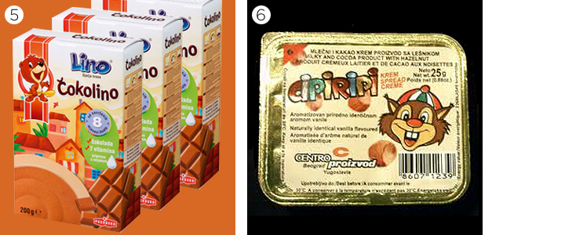
Prior to the collapse
a regional industrial power and an economic success.
1960 to 1980, annual (GDP) growth averaged 6.1 percent, medical care was free, literacy was 91 percent, and life expectancy was 72 years.
Yugoslavia's armed forces were amongst the best-equipped in Europe
East and west
Third World leader
Buffer zone between west and ussr
Struggle between unitarists and federalists
1973 oil crisis, economic growth curbed, heavy IMF debt
1981, Yugoslavia had incurred $19.9 billion in foreign debt.
Another concern was the unemployment rate, at 1 million by 1980.
"unproductiveness of the South"

Slide 10
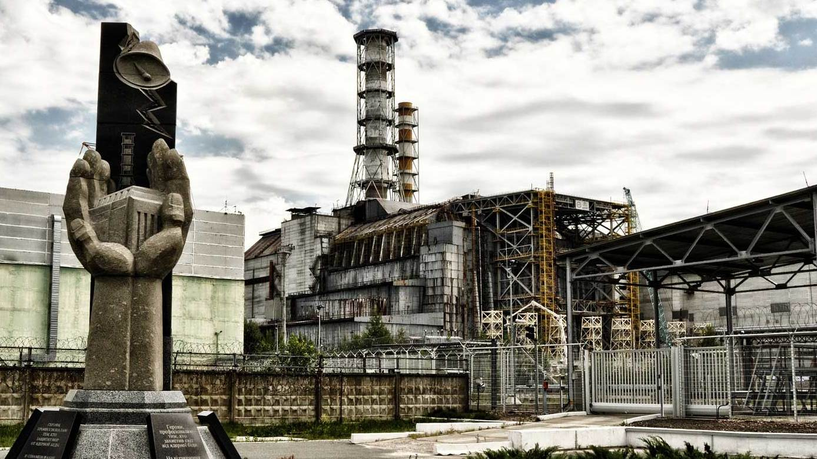
the 1980´s in Europe
Pope Jan Paul II
Mikhail Gorbatshov
Tschernobyl
Round tables in Poland
But Živkov in BGR since 1964, Kadar in Hungary since 1964, Hoxha in Alb since 1944, Ceausescu in Romania since 1964

Slide 11
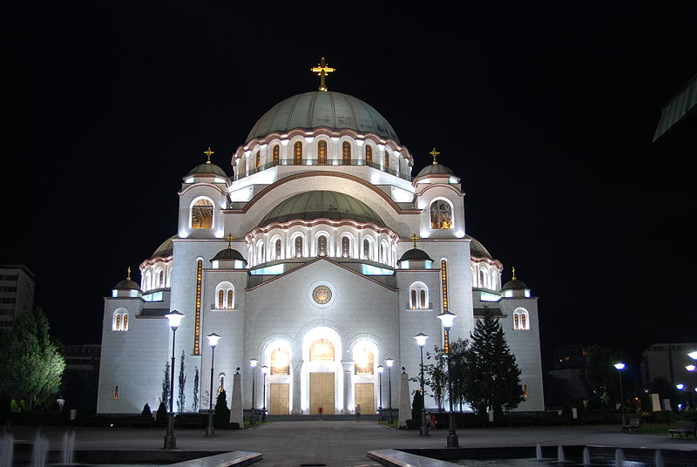
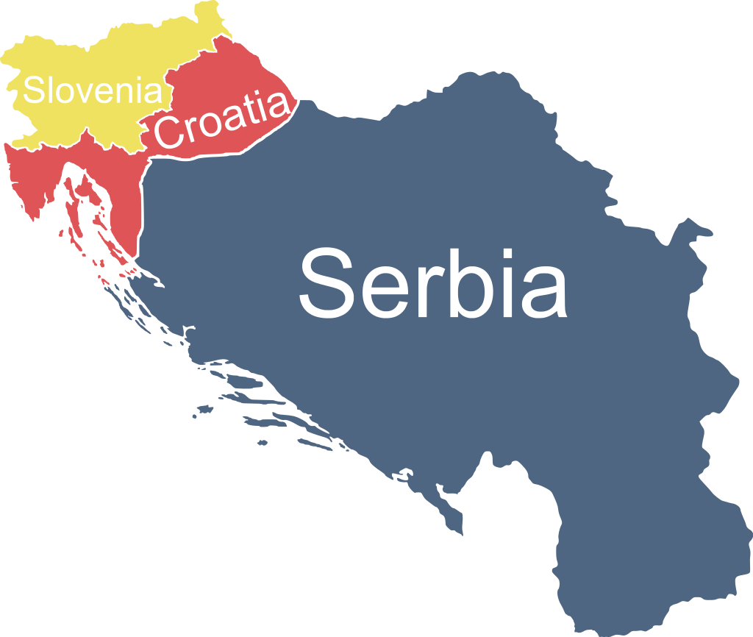
Serbian Nationalism in the 1980´s/1990´s
Memorandum of SANU
Saint Sava
Paračinovo killing
Poisoning of Albanian children
Speech of Slobodan Miloševic at Kosovo polje 1987 "You will not be beaten„
1989 Gazimestan speech (0.5-2 mil. People)- victimisation of Serbs,
Greater Serbia
Vojislav Šesejl
Dobrica Cosic, history of Serbia fulled with suffering

Slide 12
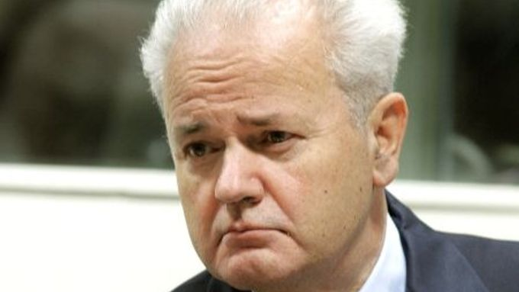
Slobodan Milošević
High ranking communist
Leader of Socialist party of Serbia
President of serbia 1989-1997
President of federal republic of yugoslavia 1997-2000
Communism to nationalism
Authoritarian rule, police brutality
Guilty for the wars
Meetings with Tudjman to divide BiH
ICTY, ICJ, war crimes, crimes against humanity and genocide
called for political change to reduce the autonomy, protect minority Serb rights, and initiate a strong crackdown on separatism in Kosovo.
Extradited to ICTY in 2001
2006 found dead in the cell

Slide 13
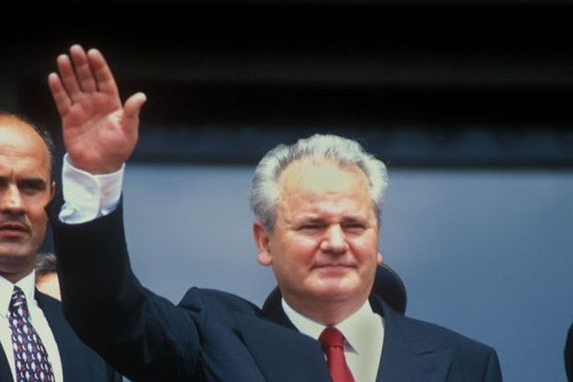
Anti-bureaucratic revolution
1988 and 1989
The protests overthrew the government of the Socialist Republic of Montenegro as well as the governments of the Serbian provinces of Vojvodina and Kosovo, and replaced them with allies of Milošević, thereby creating a dominant voting bloc within the Yugoslav presidency council

Slide 14
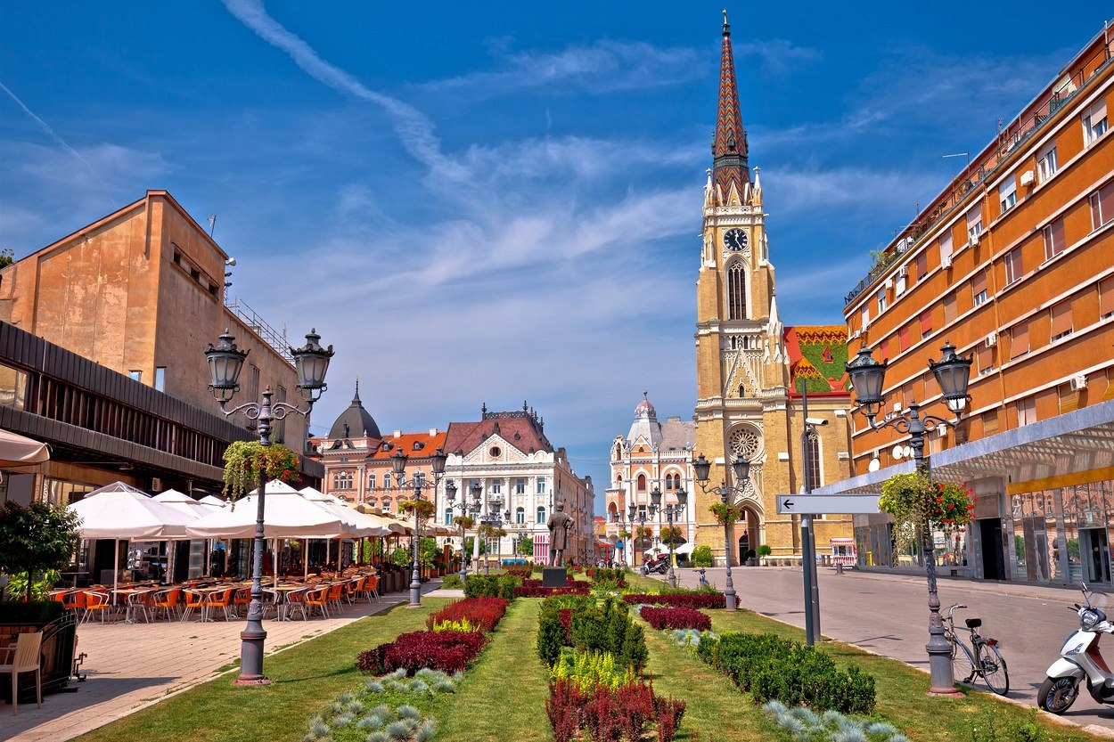
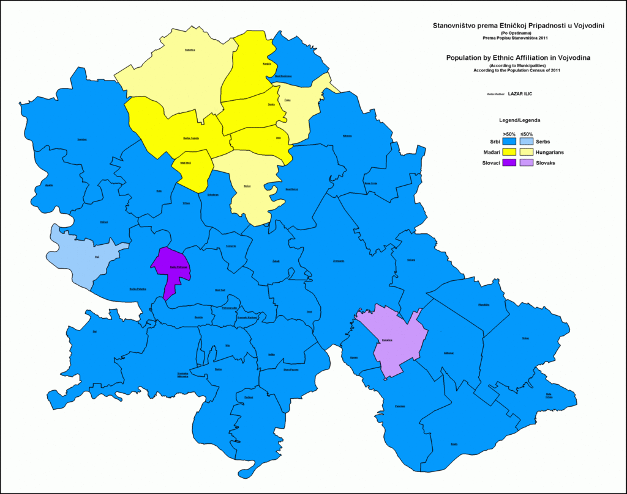
Vojvodina
Wide autonomy
Multi-cultural melting pot
No national tensions (exception flow of Kosovo Serbs)
Serbianisation, ban of hungarian language
1988 Change in leadership from multnational to serbian
War in Croatia and first flow of Hungarians to Hungary
Revision of Trianon Treaty – voices coming from Hungary

Slide 15
Multiparty elections1990
Nationalist platforms
Nationalists won over re-branded communists in Sl, Cr, BiH
Re-branded communists won in Serbia, Montenegro
Accusation of Slovenes and Croats that they support „genocide in Kosovo“

Slide 16
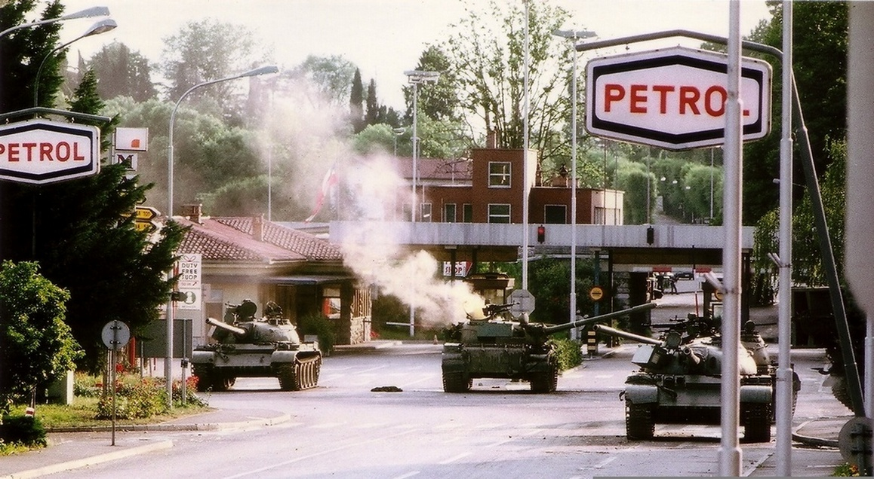
Ten day war
Slovenian war for independence
25 June 1991
Slovenian Territorial defence and JNA
Ethnically homogenous
Propaganda: case of a "David versus Goliath" struggle between an emerging democracy and an authoritarian communist state,
Tanks as in Tiananmen Square protests of 1989 - sympathy

Slide 17
Why so many wars?
Competing projects Greater Croatia, Greater Serbia, Greater Albania….
WWII
Pan-Slavism, Kingdom of Croats, Slovenes and Serbs, domination of Serbs, different concepts
Badinter Arbitration Comittee

Slide 18
Nationalism in the 1990´s in Croatia
Serbs 12.2% but 17.7% of appointed officials in Croatia, including police, were Serbs.
many Serbs employed in the public sector, especially the police, were fired and replaced by Croats.
Franjo Tudjman remarks, i.e. "Thank God my wife is not a Jew or a Serb",
Milošević's media :new "Ustashe state".
Helmut Kohl and Slobodan Milosevic in TV: accusing the two of plotting "a Fourth Reich".[
šahovnica (Croatian checkerboard), kuna
New constitution: define Croatia as "the national state of the Croatian nation and a state of members of other nations and minorities who are its citizens: Serbs ... who are guaranteed equality with citizens of Croatian nationality

Slide 19
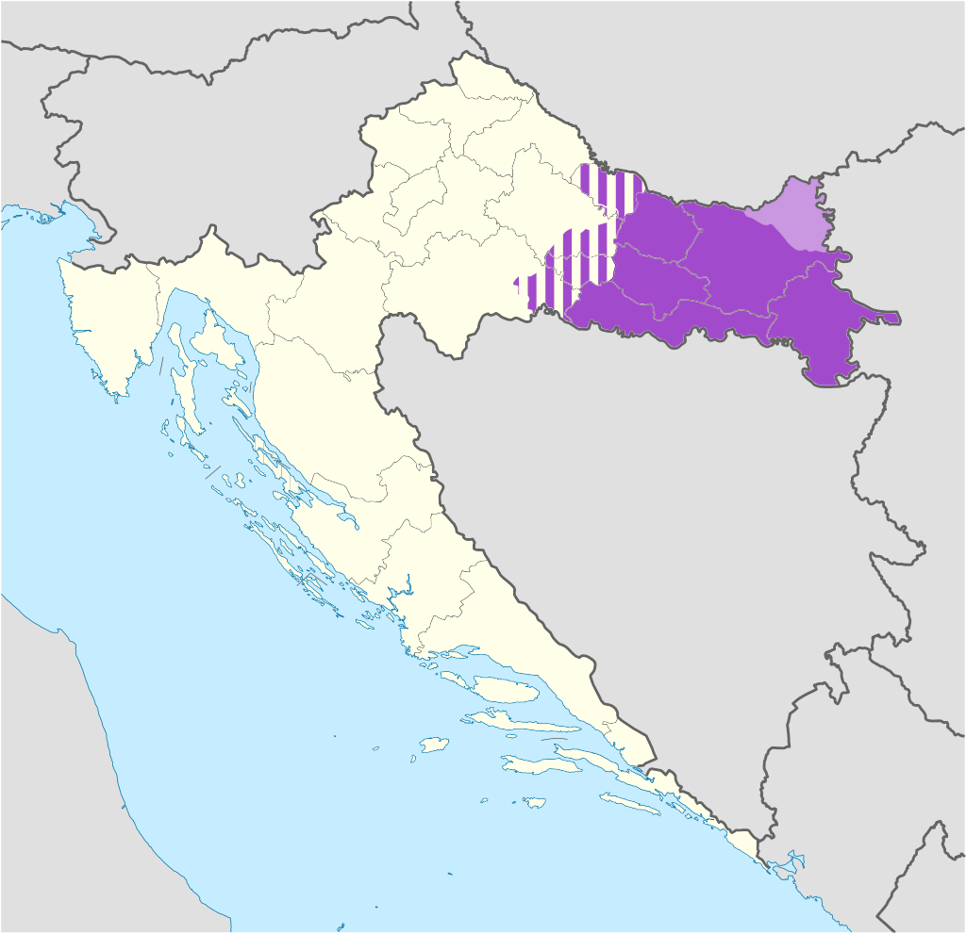
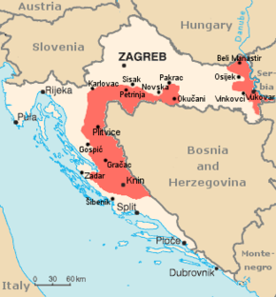
War in Croatia – 1991-1995
War for independence, Homeland War, Greater serbian aggression
Civil war vs war between states
Croats want to leave, Serbs want to stay
25. june 1991 declaration of independence
Republika Srpska Krajina
Operation Storm, Operation Flash 1995
1998 UN transitional authority for Eastern Slavonia integrated into croatia

Slide 20
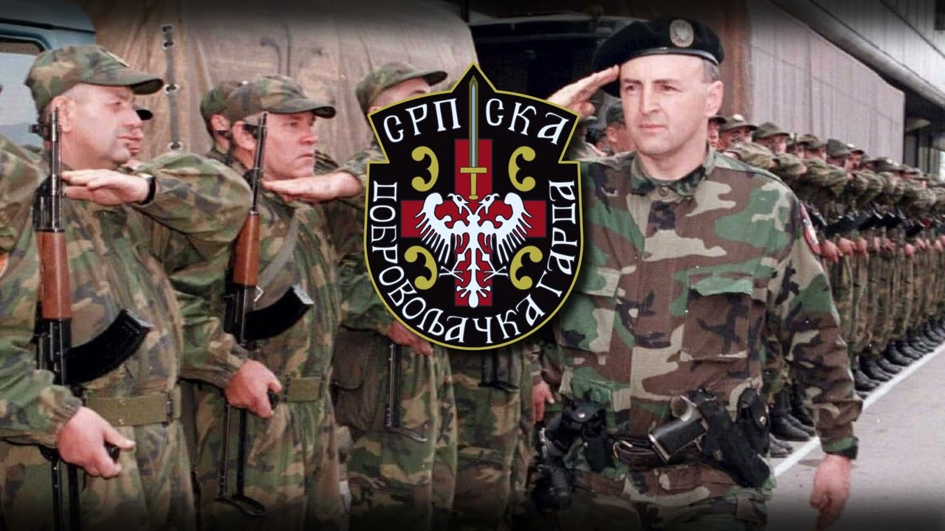
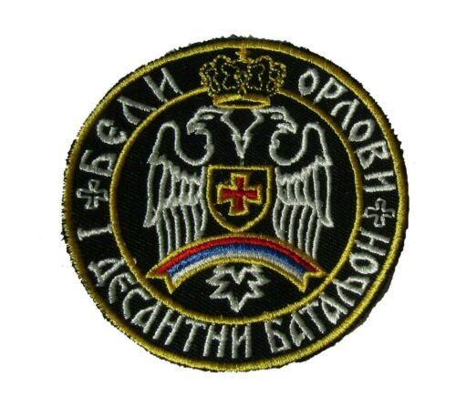
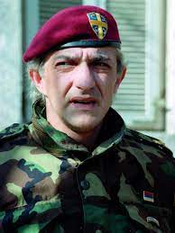
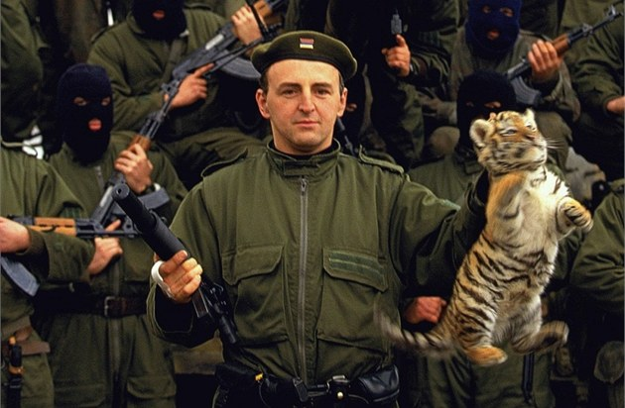
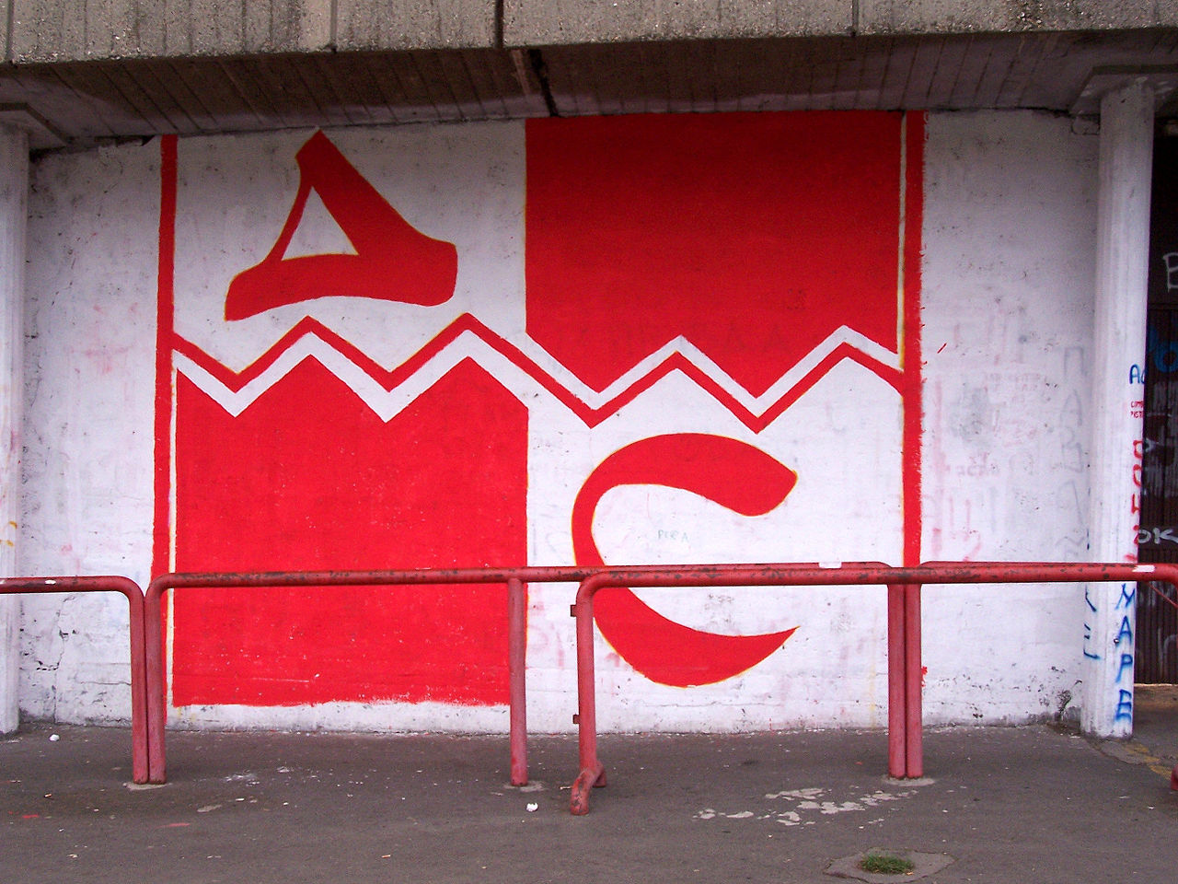
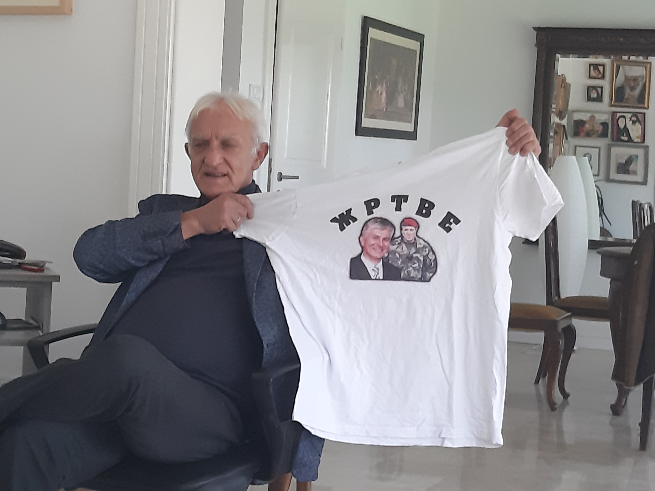
Serbian forces
JNA
Paramilitaries responsible for massacres
White Eagles
Serbian Volunteer Guard
Arkanovi Tigrovi, delije
Volunteers from Russia
By 1991, the JNA officer corps was dominated by Serbs and Montenegrins; they were overrepresented in Yugoslav federal institutions, especially the army. 57.1% of JNA officers were Serbs, while Serbs formed 36.3% of the population of Yugoslavia.
Army of RSK
Arkanove Tigrovi https://www.youtube.com/watch?v=a34IJNQRzWM

Slide 21
War in BiH
3 ethnics: 17%Croatians, 31% Serbs,44 %Bosniaks
Civil war vs. war between the states

Slide 22
 |  | Serbs | Croats | Bosniaks I. | Bosniak II.
Internal actor | Political party | Serbian democratic party (SDS BiH) | Croatian democratic community (HDZ BiH) | Party of democratic action (SDA)
 | Persona | Radovan Karadžić | Davor Perinović, Stjepan Kljuić, Mate Boban | Alija Izetbegović | Fikret Abdić
 | Armed formation | Army of Republika srpska | Croatian council of defence (HVO) | Army of Republic BaH | Army of Fikret Abdić
 | State | 9.1.1992 Republika srpska BaH, 12.8. renamed Republika srpska, Pale | 3.7.1992 Croatian community Herzeg Bosna, 24.8.1993 Croatian republic Herzeg Bosna, Grude | Bosnia and Herzegovina (BiH, Sarajevo) | Athonomous region Western Bosnia, renamed Republic of Western Bosnia, Velka Kladuša
External actor | Political party | Socialistic party of Serbia (SPS) | Croatian democratic community (HDZ) | Support of islamic countries | Cooperation with Croats as well as Serbs
 | Persona | Slobodan Milošević | Franjo Tudjman
 | Armed formation | Yugoslav Peples Army (JNA), Yugoslavian army | Croatian army (HV)
 | State | Federal Republic of Yugoslavia (FRY), Belgrade | Croatia. Zagreb | Support of islamic countries (Iran, Saudi Arabia, Libye)
Paramiliary formations |  | Serbian volunteer guard (Tigers) – Arkan; Chetniks- Šešelj; White Eagles- Jović | Croatian defence forces (HOS) | El-Mudžahid Green Berets

Slide 23
I. Phase of the war (6. 4. 1992 beginning 1993) | II. Phase of the war (1993 -March 1994) | III. Phase of the war (March 1994 -1995) | IV. Local episode (29. 9. 1993 - 7. 8. 1995)
Serbs x Bosniaks + Croats | Serbs x Bosniaks Serbs x Croats Bosniaks x Croats | Serbs x Bosniaks + Croats | Bosniaks x Bosniaks (Army of the Republic BaH x Army of Fikret Abdić)

Slide 24
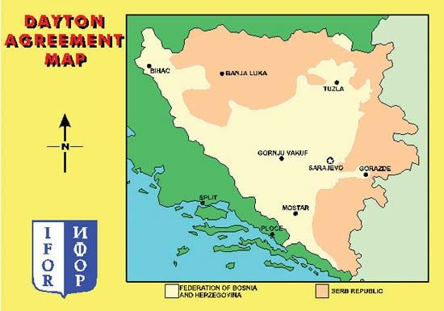
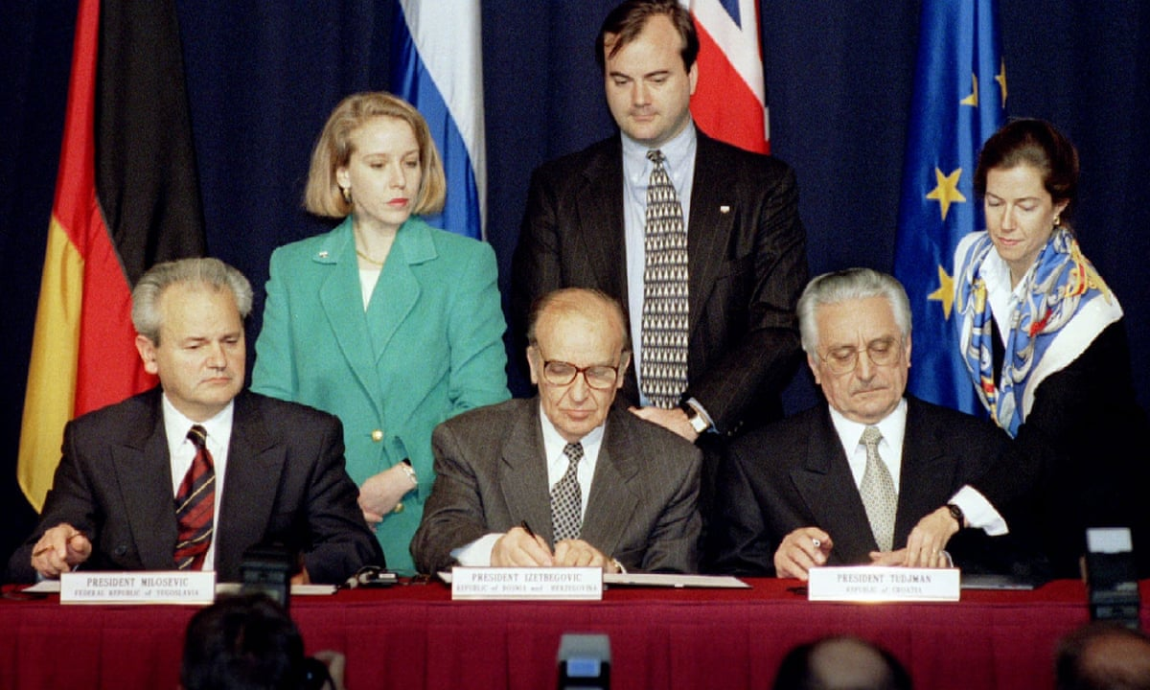
Dayton Peace Agreement
Milosevic, Tudjman, Izetbegovic

Slide 25
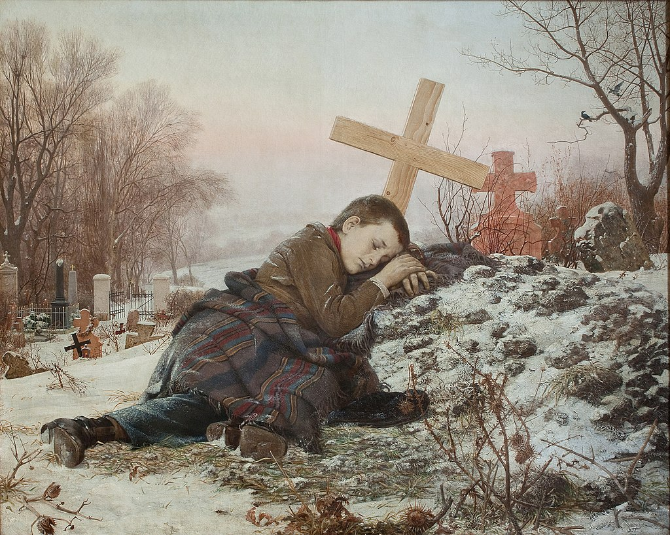
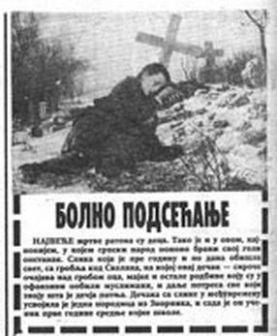
Serbian propaganda
Vukovar baby massacre- Serbian media reported false story that 40 Serb babies (age 5-7) had been killed in Vukovar school which led to retaliation and Ovčara massacre (264 executions of Croats by Serbs)
Fourth Reich
Vatican conspiracy
Franjo Tuđman alleged speech: "There would not have been a war had Croatia not wanted one".
Franjo Tudjman speech: "Some individuals in the world who were not friends of Croatia claimed that we too were responsible for the war. And I replied to them: Yes, there would not have been a war had we given up our goal to create a sovereign and independent Croatia. We suggested that our goal should be achieved without war, and that the Yugoslav crisis should be resolved by transforming the federation, in which nobody was satisfied, particularly not the Croatian nation, into a union of sovereign countries in which Croatia would be sovereign, with its own army, own money, own diplomacy. They did not accept„
Mujahideen terrorist threat for Europe
RTS bombing by NATO in 1999

Slide 26
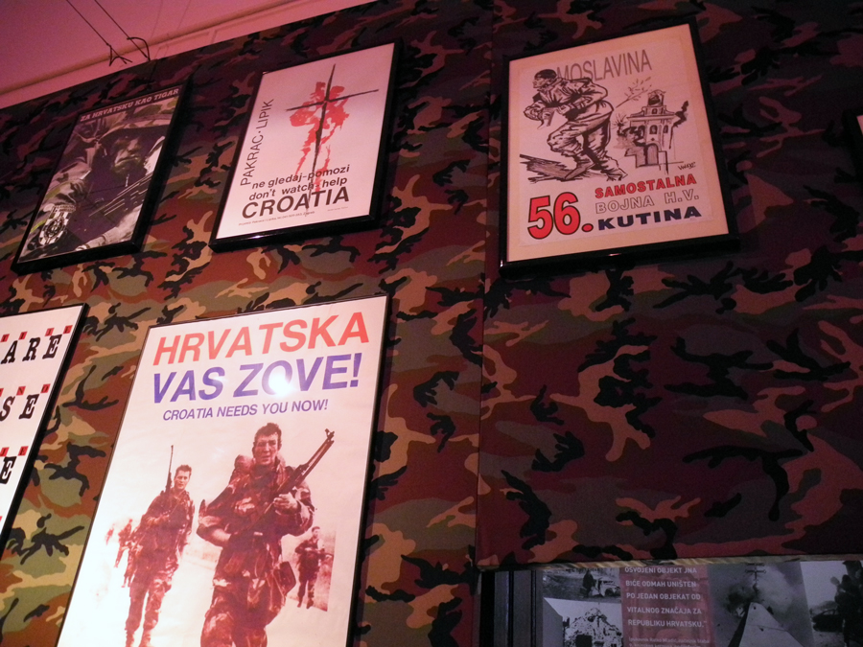
Croatian propaganda
In September 1991, 300 employees at HRT were fired for "security reasons
false stories: 35 Croats were hanged near the Catholic church in Zenica on 9 August 1993
Croatian journalists relativised war crimes committed by Croatian troops against non-Croat civilians
portraying Serbs and Serbia as conquerors, war criminals, robbers and terrorists

Slide 27
Bosnian propaganda
the government of Bosnia and Herzegovina then aimed towards a unitary state
Četnici and ustaše
Bosnian President Alija Izetbegović signed a contract with the Washington-based Ruder Finn to promote a stronger leadership for the United States in the Balkans. The "Bosnian Crisis Communication Centre" set up by the firm put local Bosnian leaders in contact with Western officials and mass media. It also prepared news articles and war narratives for American outlets

Slide 28
Western propaganda
Demonisation of Serbs
simplistic dogma that blames one nation, the Serbs, as the origin of evil in the Balkans
Račak massacre?

Slide 29
ICTY
prosecute the war crimes that had been committed during the Yugoslav Wars
The Hague
1993-2017
grave breaches of the Geneva Conventions, violations of the laws or customs of war, genocide, and crimes against humanity. The maximum sentence that it could impose was life imprisonment. Various countries signed agreements with the UN to carry out custodial sentences.
A total of 161 persons were indicted

