Slide 1
Politics & Security of Croatia
Balkan Politics
Věra Stojarová
stojarova@fss.muni.cz

Slide 2
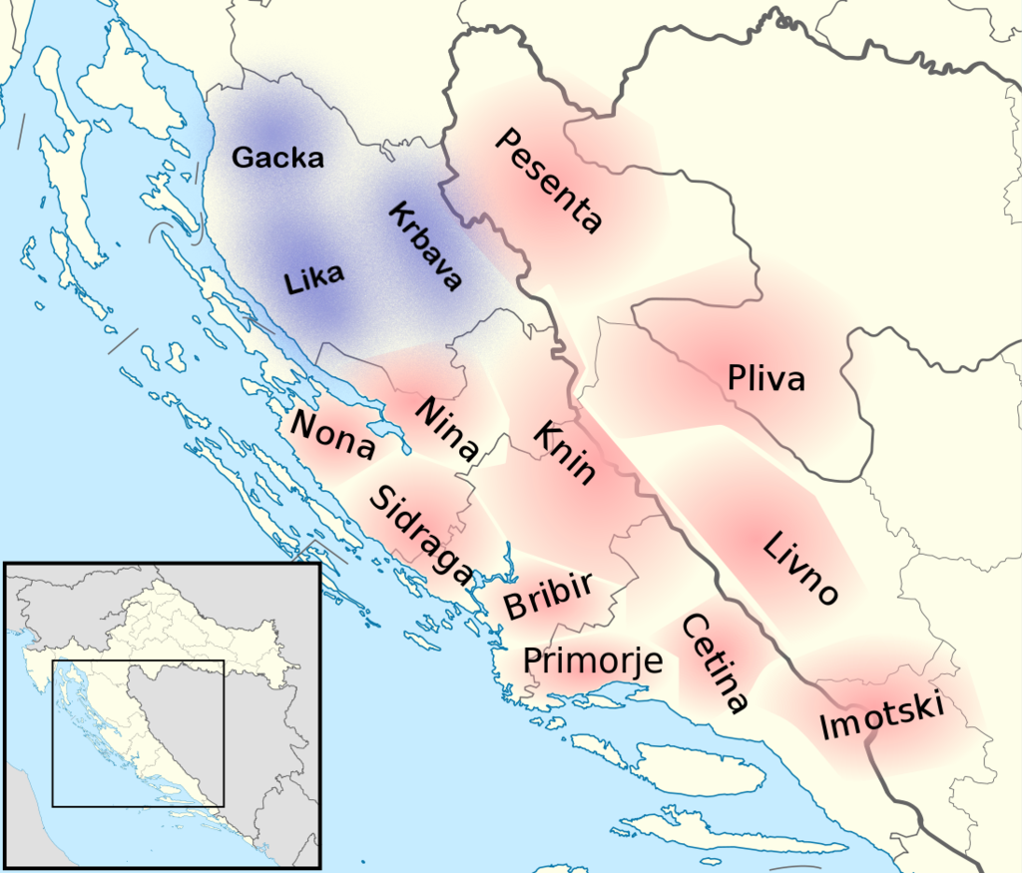
Croatian Kingdom 925-1102
First King Tomislav
After then Personal Union with Hungary, under Habsburg monarchy, within Yugoslavia
Only WWI Independent state of Croatia

Slide 3
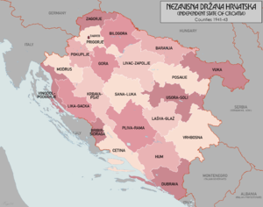
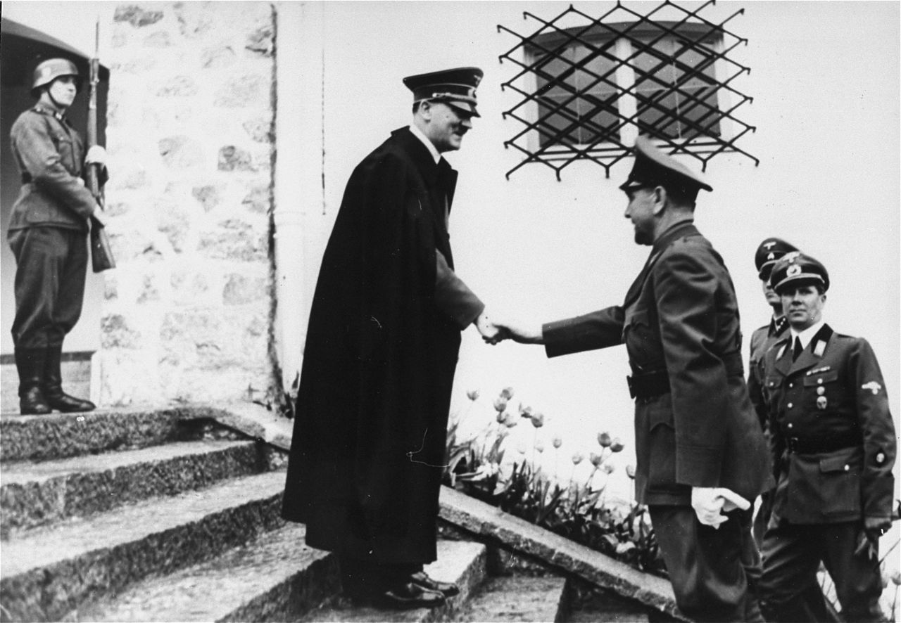
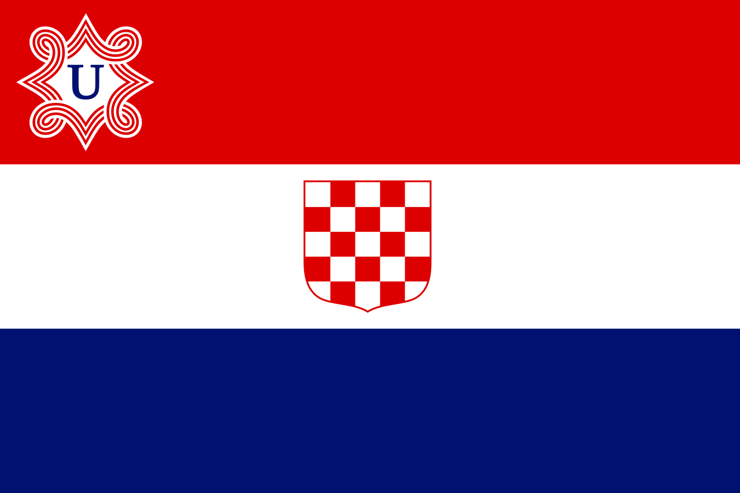
NDH
Regime targeted Serbs, Jews and Romas, anti-fascist Croats and Muslims
Serbs: 1/3 killed, 1/3 expelled, 1/3 converted
all parties but the Ustaše party were banned
An estimated 320,000–340,000 Serbs, 30,000 Croatian Jews and 30,000 Roma were killed
including between 77,000 and 99,000 Serbs, Bosniaks, Croats, Jews and Roma killed in the Jasenovac concentration camp while approximately 300,000 Serbs were forced out of the NDH
the Bleiburg massacre – NDH soldiers and civilians fleeing executed by Partisans, croat. Estimate 30 ths killed
Exodus to Argentina

Slide 4
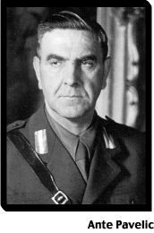
Ante Pavelic
Ante Pavelic
Born in BiH
Ustaša trying to destroy the Kingdom
1934 assasination of King in Marseille
NDH
Vodja vs Poglavnik
Za dom spremni
Fled to Argentina, than hiding, died in Spain 1959 under the protection of Franco regime

Slide 5
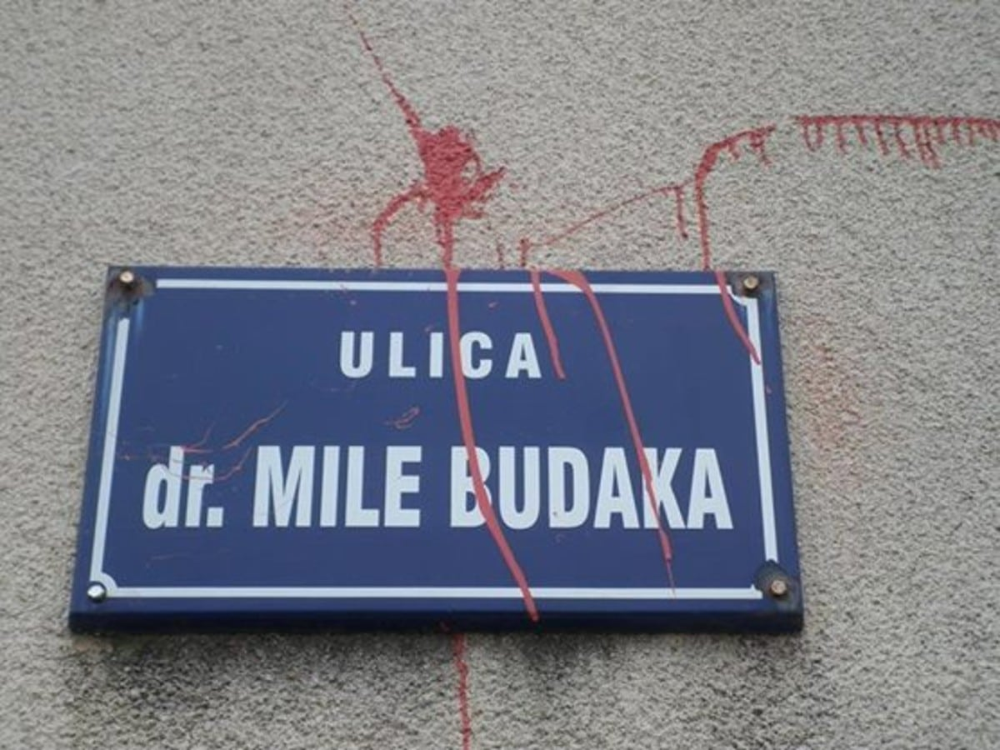
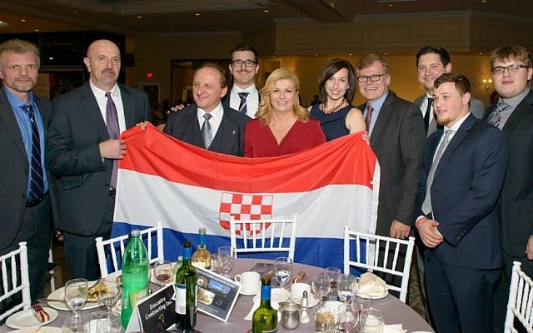
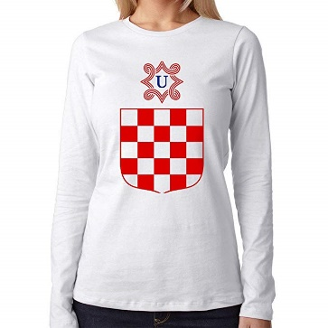
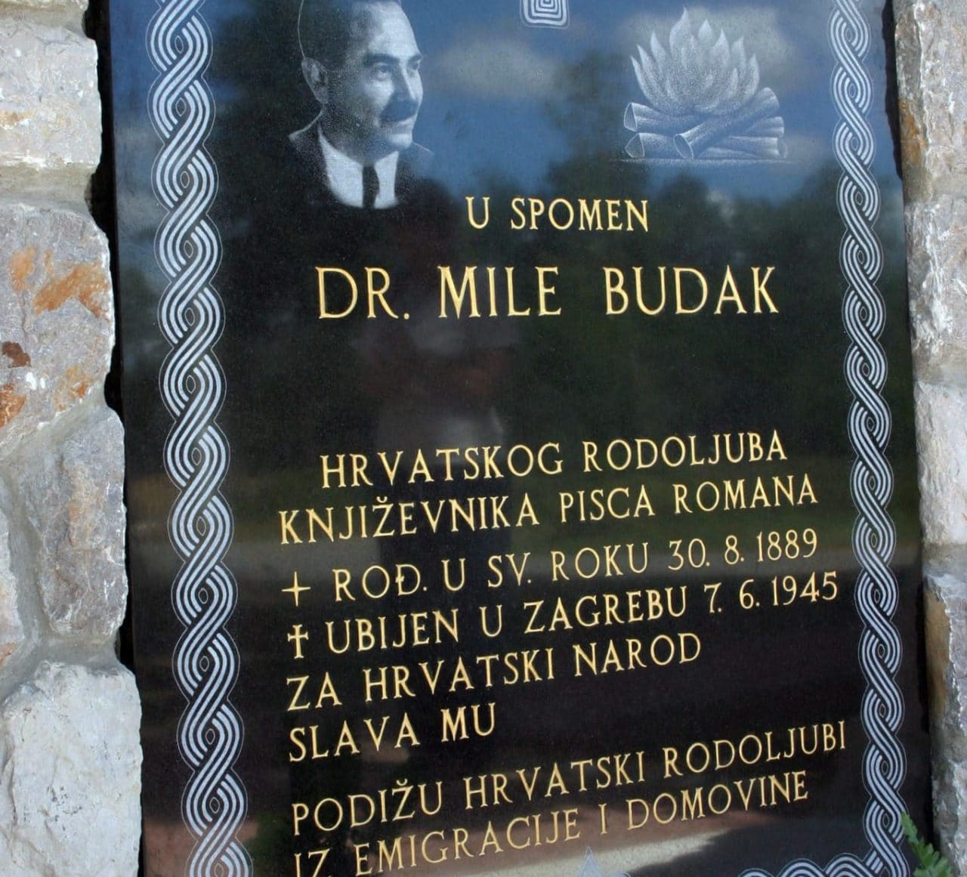
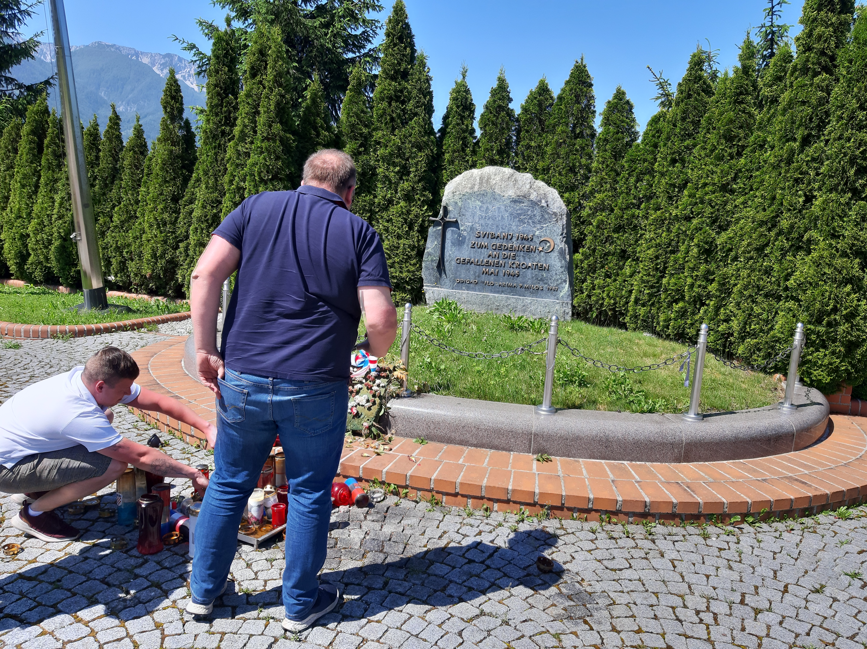
Croatia and NDH
current Constitution of Croatia does not officially recognize the Independent State of Croatia as the historical or legitimate predecessor state of the current Croatian republic.[
Croatia rehabilitated the Croatian Home Guard, whose veterans have since received state pensions.
Za dom spremni
over 30 streets named after some 25 people connected with the NDH (Mile Budak, franjo Nevistic, Ivan Orsanic, Branko Klaric,
Revisionism and patriotism
Annual Bleibourg commemoration
Revisionism Jasenovac: just a labour and punishment camp for enemies of the Croatian state. Death toll only about 1500 compared to 83 ths as stated in Jasenovac (Igor Vukic Labour Camp Jasenovac)
Ustasha symbols widespread visible, crimes downplayed

Slide 6
Article 325 of the Croatian criminal code
people who “call for hatred or violence to be directed against groups… because of their racial, religious, national or ethnic affiliation” can be punished with a three-year prison sentence, while organisers of groups that spread hate can face up to six years in prison.
people who “publicly approve of, deny or significantly belittle criminal acts of genocide, acts of aggression, crimes against humanity or war crimes” can face up to three years in prison.
However, hardly anyone who chants ‘Za dom spremni’ or displays Ustasa insignia is prosecuted according to Article 325. Instead they are usually charged under misdemeanour legislation and fined.
Marko Perkovic (Thompson) - concert 2017, chanted ZDS https://www.youtube.com/watch?v=U1cnaSMtdS4
The court acquitted him, ruling that Perkovic was not inciting hatred by chanting “Ready for the home[land]” and that the slogan was an integral part of the song he was singing at the time.
Croatia’s government-appointed Council for Dealing with Consequences of the Rule of Non-Democratic Regimes said in February this year that the authorities should allow the ‘Za dom spremni’ salute to be used “in exceptional situations” under strict conditions, such as by Croatian Defence Forces veteran
Jasenovac i gradiška stara, Ubij Srbina,
Boj na čavoglave https://www.youtube.com/watch?v=pfUCdsLgr4Y&t=11s

Slide 7
Croatian spring 1967-71
Codification of Croatian language
Demands for increased autonomy
Patriotic songs
Croatian culture
Plans for increased representation of Croatia-related materials in the school curriculum
Calls measures to address the overrepresentation of Serbs in key positions in Croatia
Increased tensions between croats and serb
1968 Student demonstrations in belgrade
1972 oil crisis, IMF debt
1974 constitution

Slide 8
Nationalism in the 1990´s in Croatia
Serbs 12.2% but 17.7% of appointed officials in Croatia, including police, were Serbs.
many Serbs employed in the public sector, especially the police, were fired and replaced by Croats.
remarks, i.e. "Thank God my wife is not a Jew or a Serb",
Milošević's media :new "Ustashe state".
Helmut Kohl and Slobodan Milosevic in TV: accusing the two of plotting "a Fourth Reich".
šahovnica (Croatian checkerboard)
New constitution: define Croatia as "the national state of the Croatian nation and a state of members of other nations and minorities who are its citizens: Serbs ... who are guaranteed equality with citizens of Croatian nationality

Slide 9
Referendum on independence
On May 19, 1991,
Serb local authorities called for a boycott of the vote, which was largely followed by Croatian Serbs
with a turnout of 83.56% and the two referendum questions answered positively by 93.24% and 92.18% (resp.) of the total number of votes
independence of Croatia, on the blue ballot, passed with 93.24% in favor, 4.15% against, and 1.18% of invalid or blank votes.
second referendum question, proposing that Croatia should remain in Yugoslavia, was declined with 5.38% votes in favor, 92.18% against and 2.07% of invalid votes.

Slide 10
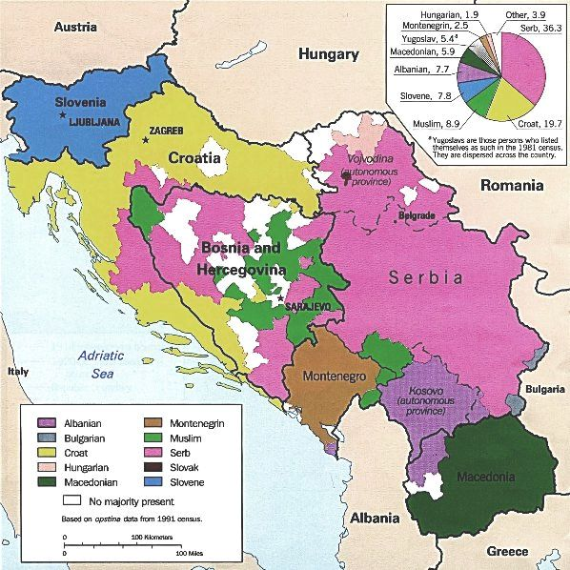

Slide 11
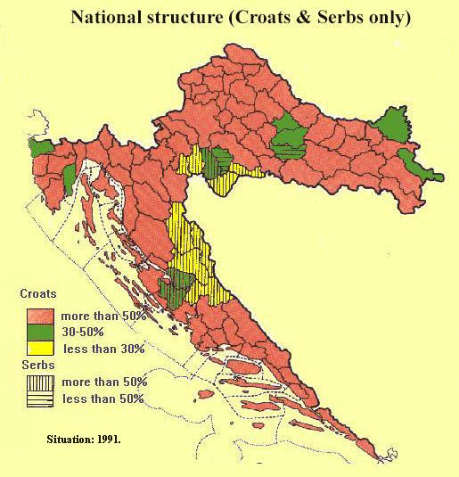
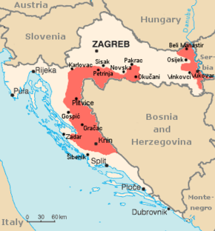
War in Croatia – 1991-1995
War for independence, Homeland War, Greater serbian aggression
Civil war vs war between states
Croats want to leave, Serbs want to stay
25. june 1991 declaration of independence
Republika Srpska Krajina
Operation Storm, Operation Flash 1995
1998 UN transitional authority for Eastern Slavonia integrated into croatia
Around 500 000 IDP s and 20 000 dead people
estimates 1500 – 2500 rapes
On May 29, 2015, the Croatian parliament passed the first law in the country that recognises rape as a war crime

Slide 12
Governments – between SDS (Social democratic party) and HDZ (Croatian democratic community)
1995-1999 Franjo Tudjman HDZ
2000-2003 SDS Ivica Račan SDS
2003-2009 Ivo Sanader HDZ
2009-2011 Jadranka Kosor HDZ first and only female PM
2011- 2016 Milanovic SDP
2016 Oreskovic, Andrej Plenkovic HDZ

Slide 13
Parliament
1990-2001 two chambers: National assembly and the Regional assembly
Since 2001 – 1 chamber – minimum 100 and maximum 160 MPs, 4 years term,
Diaspora

Slide 14
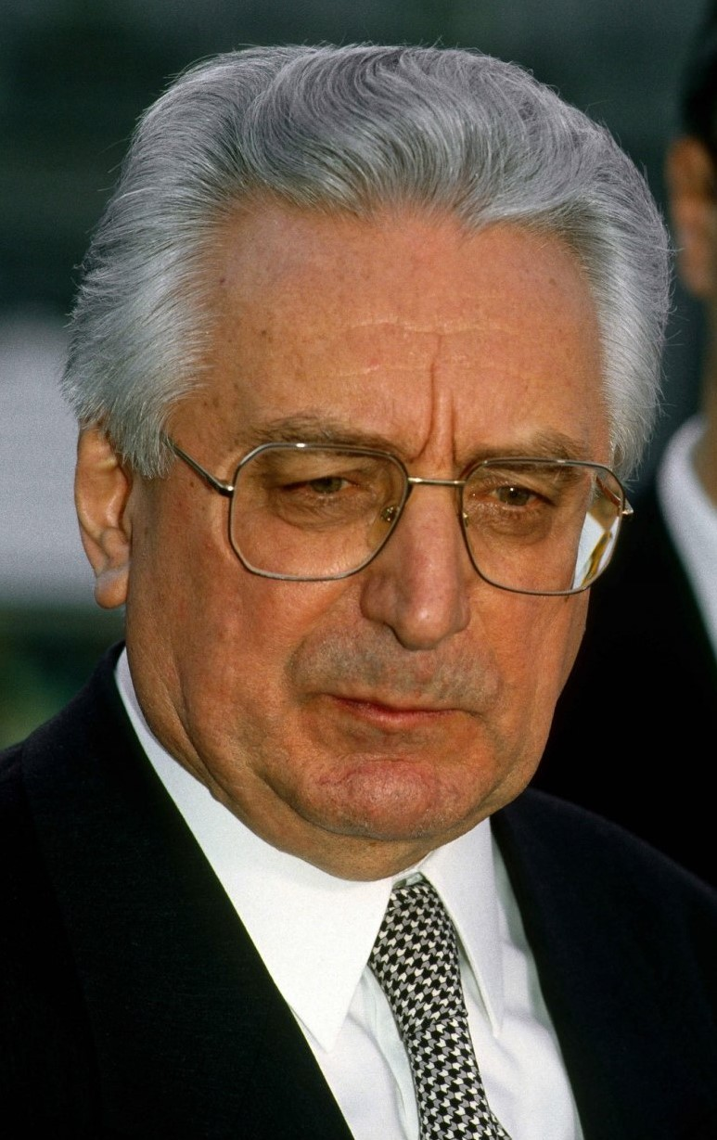
Franjo Tudjman 1995-99
During WWI fought with partisans
Military career
First president of presidency of Croatia 1990
Nationalist
Authoritarian
Anti-Serb
Era of catholic revival
ICTY prosecutor, Carla del Ponte, said in an interview that she would have indicted Tuđman had he not died in 1999
Relativisation of history, historian

Slide 15
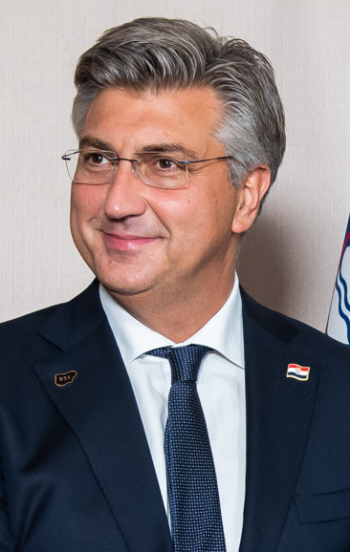
Andrej Plenkovic
Pro-European
Moderate

Slide 16
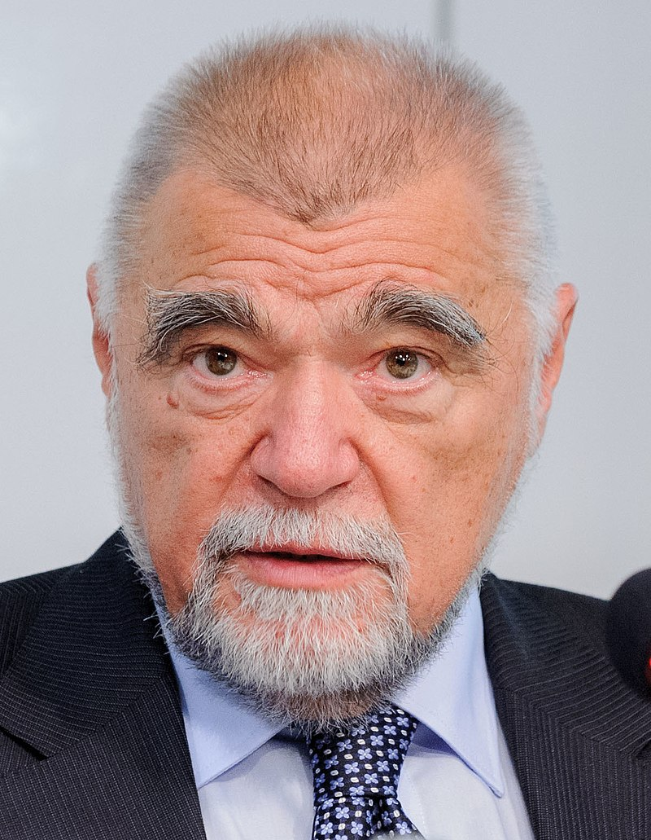
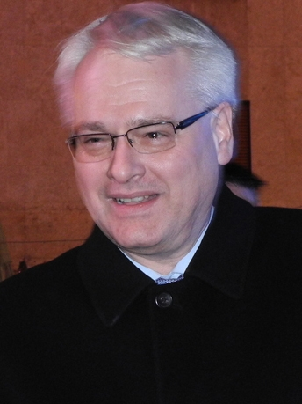
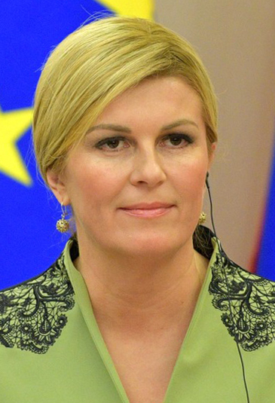
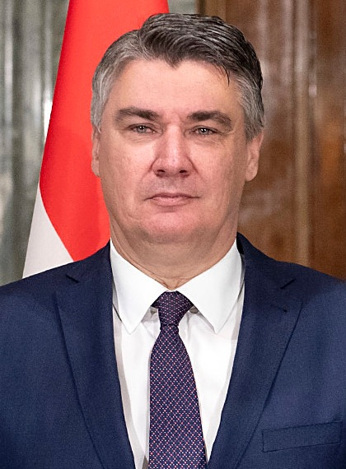
Presidents, 5 years, direct vote, 1 re-election
2000-2010 Stipe Mesic
2010-2015 Ivo Josipovic SDP
2015-2020 Kolinda Grabar Kitarovic HDZ
2020 Zoran Milanovic SDP

Slide 17
Kolinda Kitarovic
First woman president
Thompson - she “never heard” such songs glorifying Ustasha regime nor “seen any evidence that they exist”, was "very fond" of some of his songs and that she did not see any evidence for the controversies associated to him
HDZ – populist, nationalist, modern conservative?
Same sex marriiage yes except of adoption
Not ban for abortion
Suppor for green initiatives

Slide 18
Zoran Milanovic
SDP
First trip to Slovenia
Against curfew and lockdown during pandemic
Milanović compared the lockdown in Austria to the methods employed in the era of Nazism
retransmits Russian propaganda narratives, do not correspond to Croatia's consistent official position in support of Ukraine's sovereignty and territorial integrity
conflict with prime minister Plenković undermine unity within the EU and NATO in the face of current security threats in Europe
suggested blocking Finnish and Swedish accession to NATO, until the electoral law in Bosnia and Herzegovina
did not veto Finnish and Swedish NATO accession

Slide 19
Foreign relations
EU 2013
NATO 2009
Croats in BiH – right to vote
Relations with Serbia – history matters

Slide 20
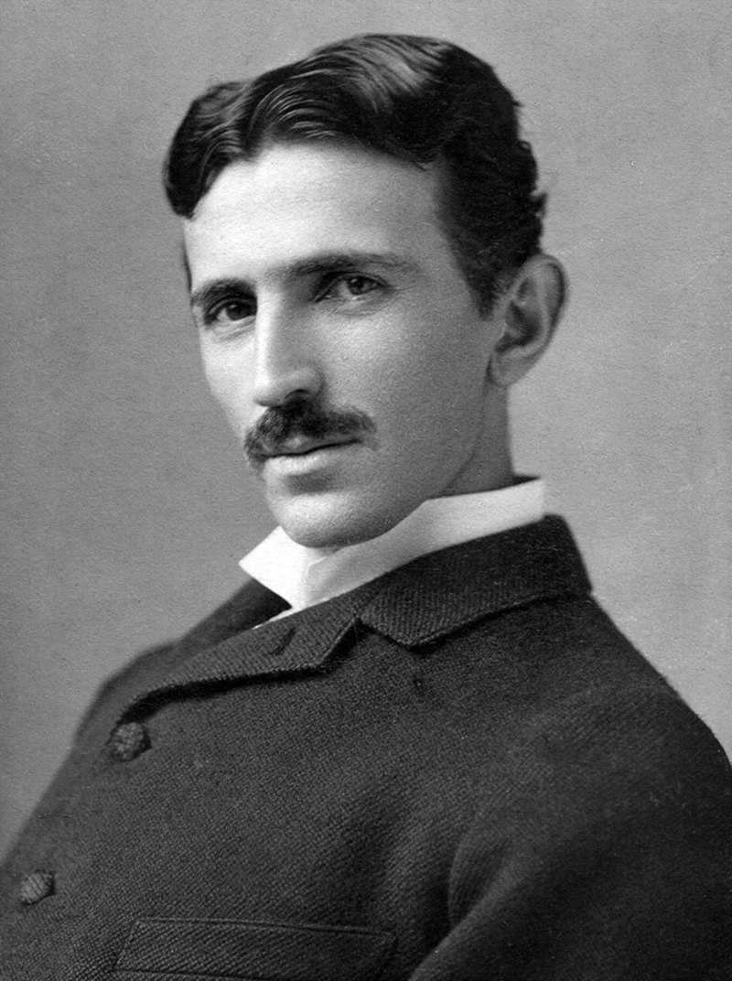
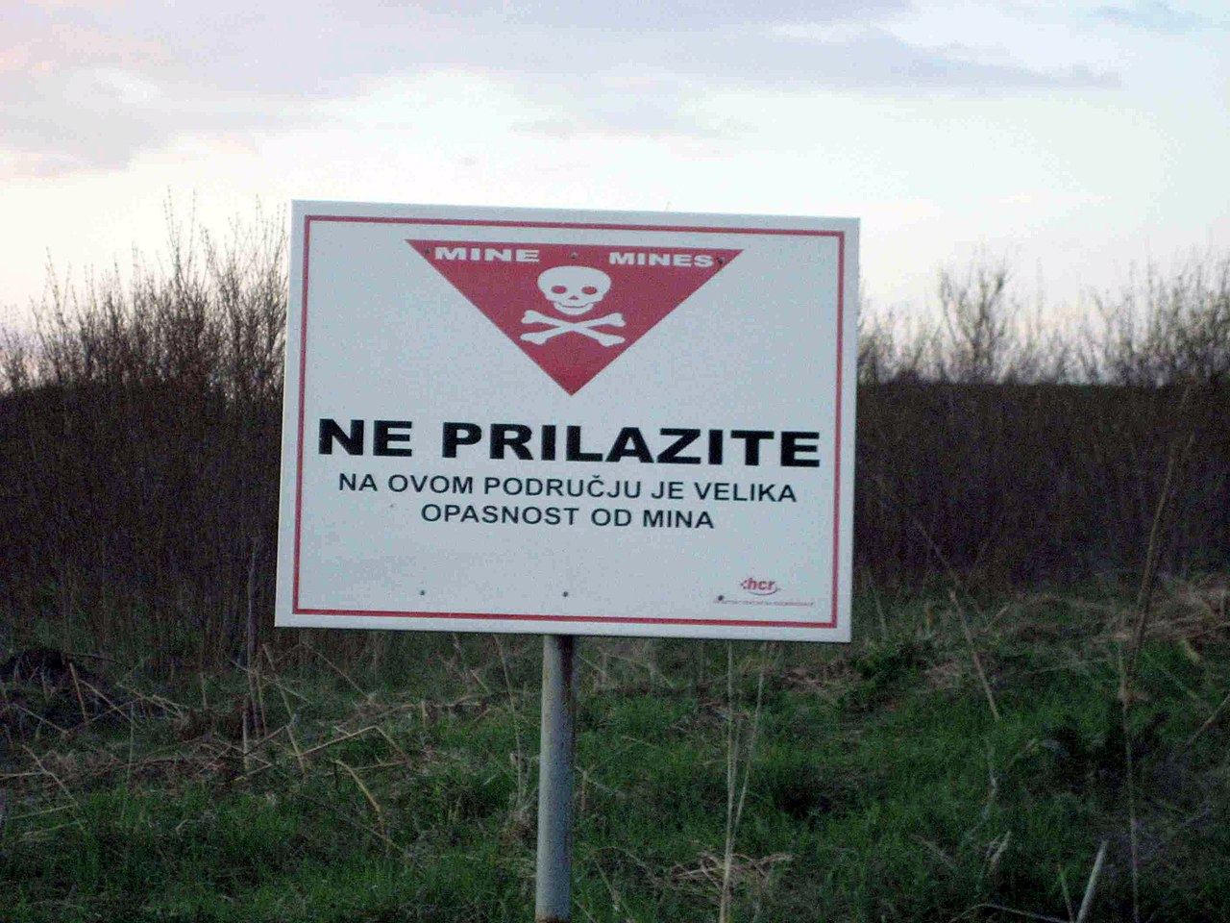
Croatia-Serbia relations
War for independence, Homeland War, Greater serbian aggression
Smaller border disputes
History matters
Croatia filed a genocide lawsuit against Serbia at the International Court of Justice in 1999, and Belgrade filed a countersuit in 2010. Both lawsuits were dismissed 2015, - committed crimes, but they were not committed with genocidal intent
Serbian minister Aleksandar Vulin was proclaimed persona non grata in Croatia
Earthquake 2020 in Croatia : Miloš Stojković, a member of Serb delegation which was supposed to bring the humanitarian aid to areas hit by the earthquake, came to Croatian city of Knin and announced the "return of Republic of Serbian Krajina" and removal of Croatian flag from Knin fortress
Croatia announced in 2021 that Nikola Tesla be on its euro coins

Slide 21
Croats in BiH
Division of bih, greater croatia
All Croatian citizens can vote abroad, in diplomatic missions and consular offices of the Republic of Croatia – unique case
Diaspora voting HDZ, securing so safe votes for HDZ
Protecting, equal positions

Slide 22
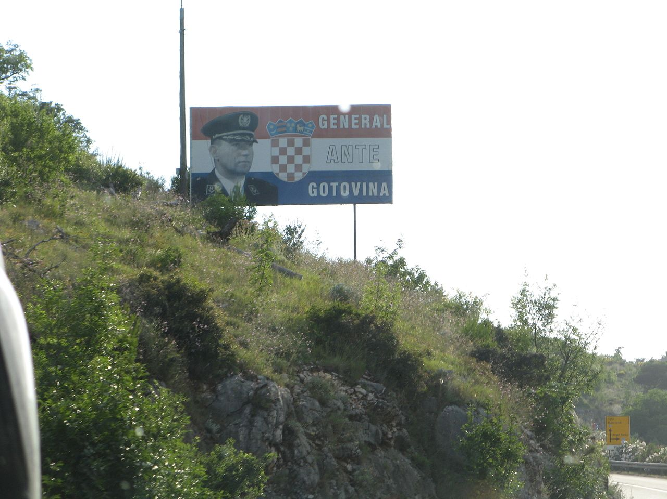
ICTY and Ante Gotovina
Ante Gotovina – primary role in Storm, 2001 indicted by ICTY, hiding, 2005 found in canary Islands, 2012 convictions overturned, released from custody, regarded as a hero
After the generals' release, the Croatian government dispatched the governmental Bombardier Challenger 600 plane along with the Minister of Defence, Ante Kotromanović, and the Minister of Veterans' Affairs, Predrag Matić, to bring Gotovina and Markač to Croatia.
https://www.youtube.com/watch?v=ZxNLxHibSgs
https://www.youtube.com/watch?v=L6TGE8WuVjE

Slide 23
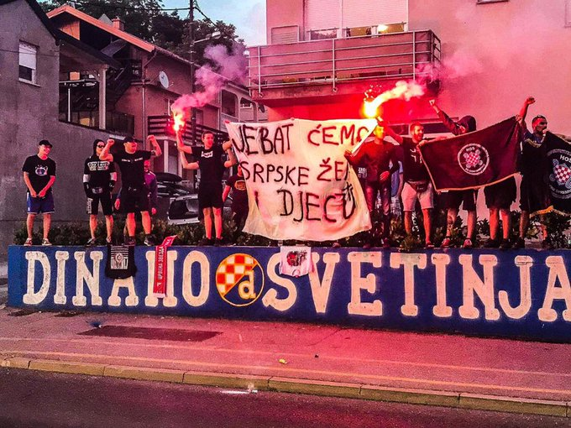
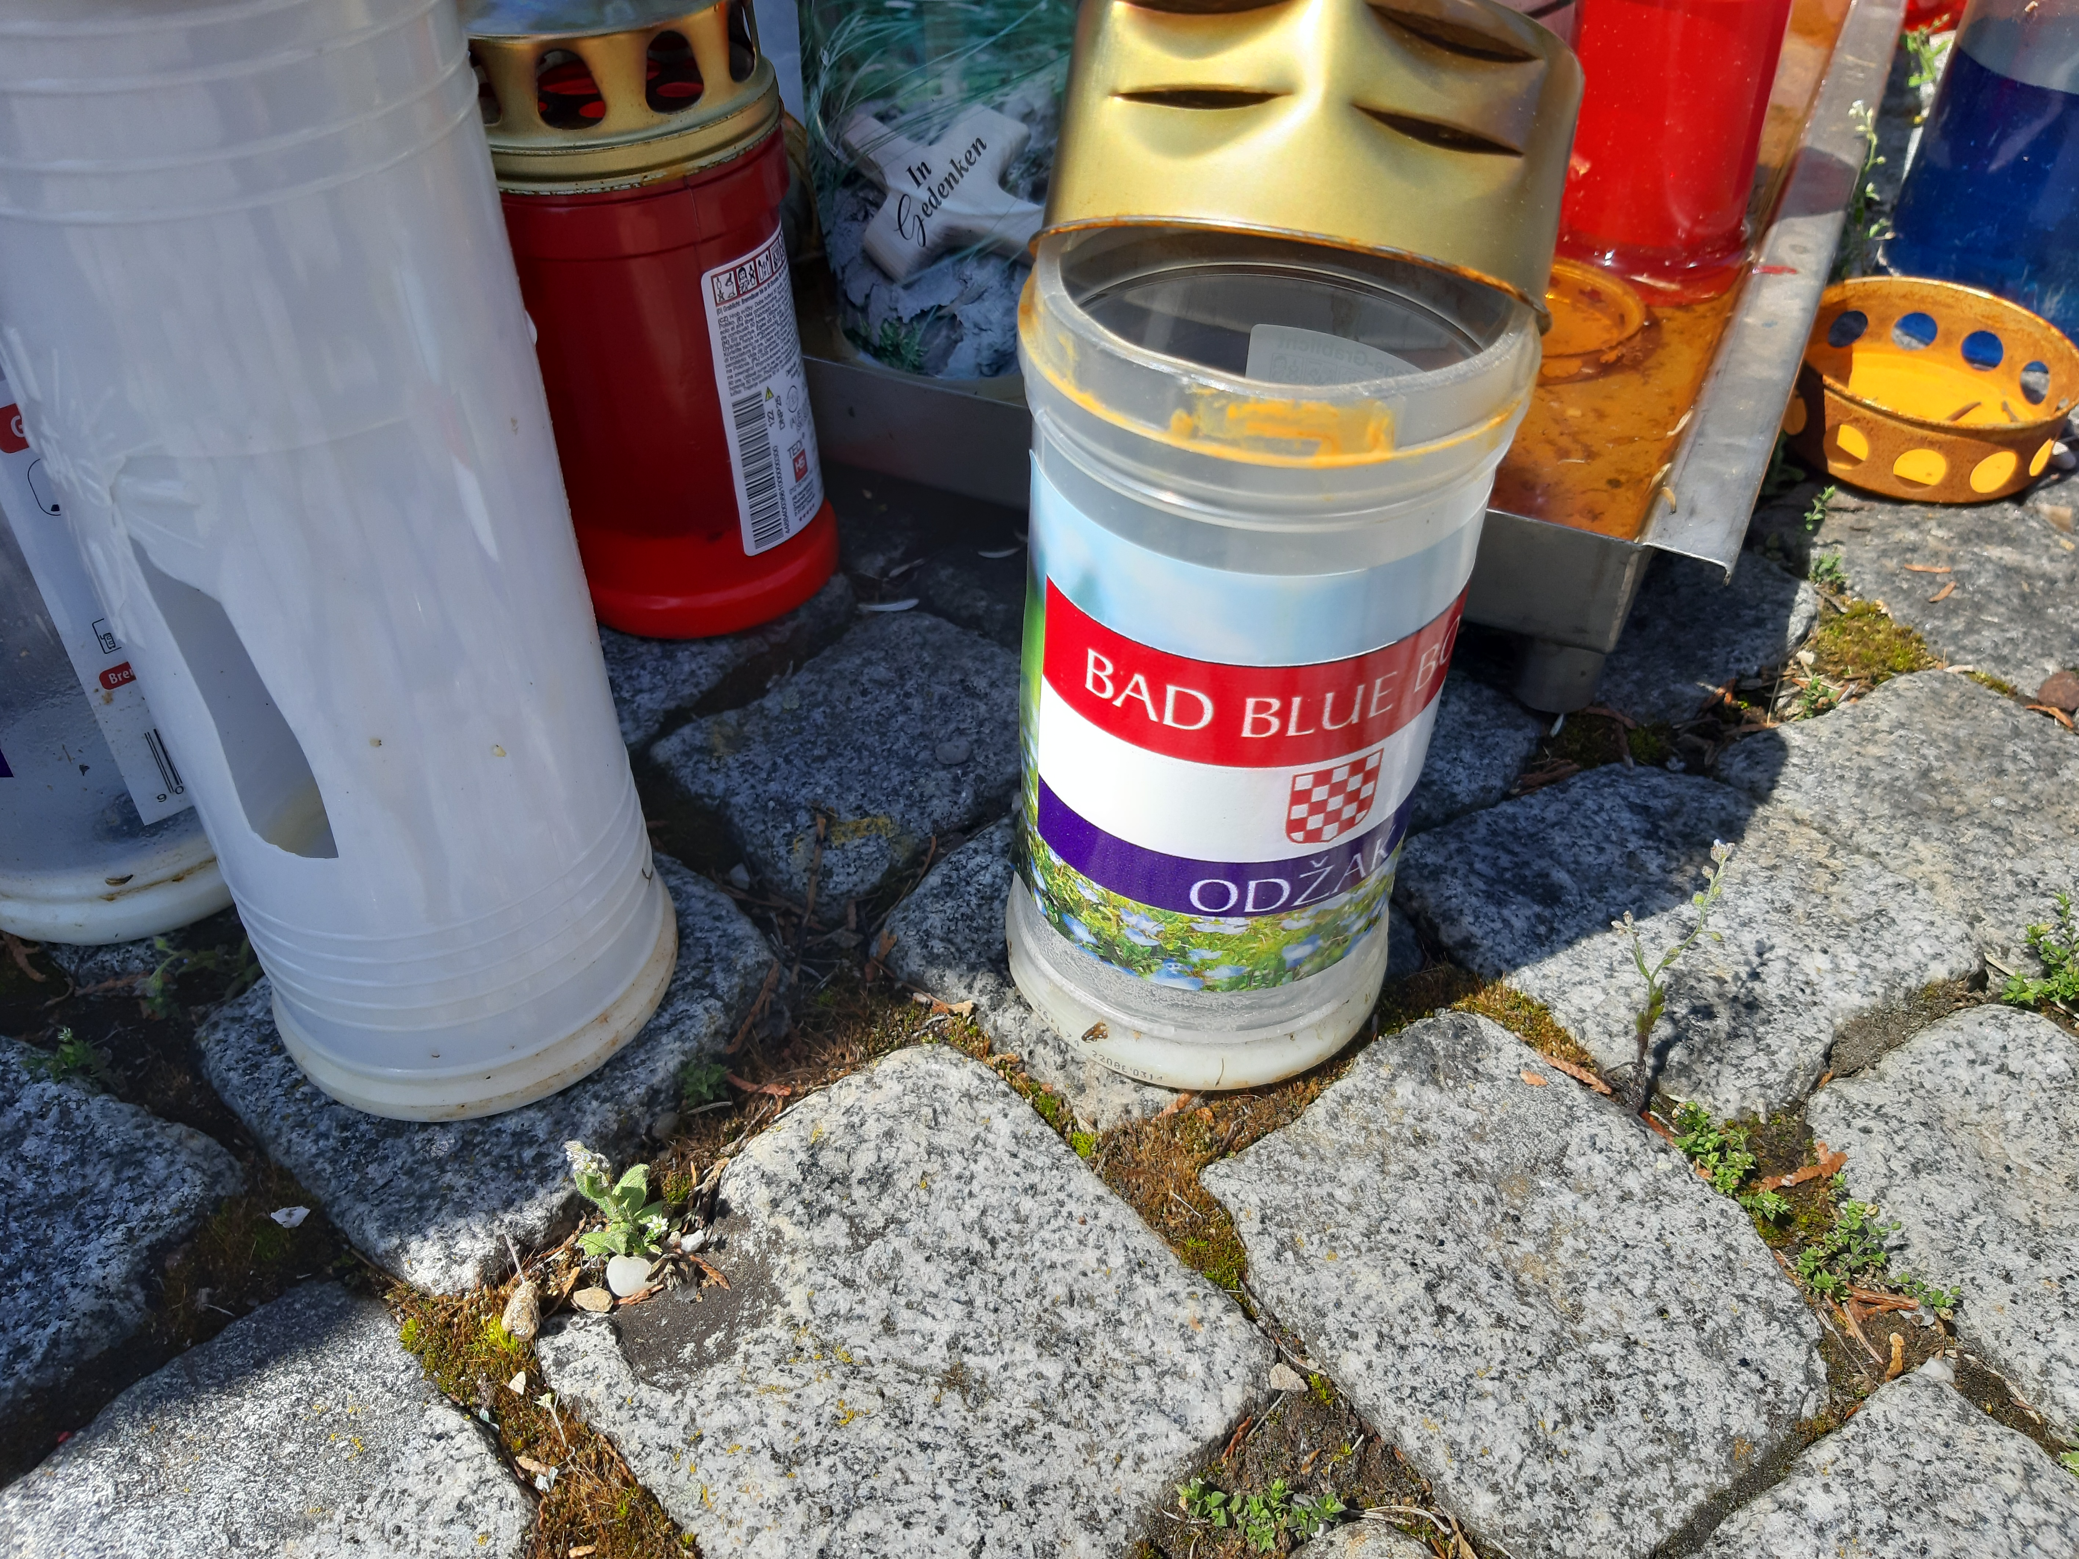
Football hooligans
13 May 1990 Crvena zvezda vs. Dinamo Zagreb at Maksimir stadium
Delije vs. bad blue boys
Is widely beleived to spark the war
https://www.youtube.com/watch?v=zxD2PXJXsZQ
https://www.youtube.com/watch?v=TV4boyQUvJE
Hajduk Split glorifying ustasha - Maks butchers
Josip simunic – fotbal player ZDS, disciplinary proceedings
Notes:
Hajduk Split fans glorifying Ustasa killers. In February last year, during a match against HNK Gorica at the Poljud stadium in Split, some members of Hajduk Split ‘ultras’ group Torcida raised a banner bearing the slogan “Maks’ Butchers”.
It was a reference to Ustasa fighters who committed crimes against Serbs under the command of Vjekoslav ‘Maks’ Luburic, who was nicknamed ‘The Butcher’. Luburic was the general commander of the Ustasa movement’s Jasenovac concentration camp during World War II.
The term was popularised in a song by Croatian nationalist rock star Marko Perkovic, alias Thompson, in which he sings that WWII concentration camps Jasenovac and Gradiska Stara are “the house of Maks’ butchers”

Slide 24
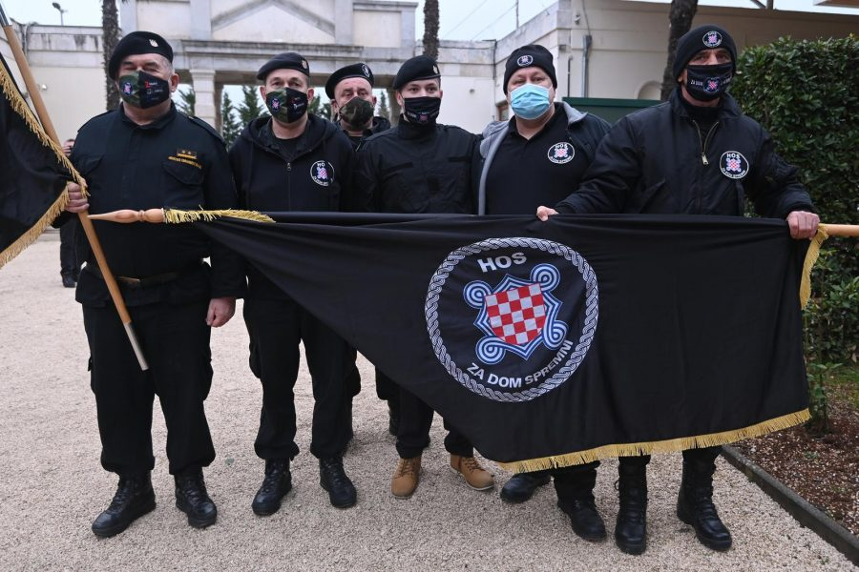
Austria and NDH
Bleiburg massacre - "the largest fascist gathering in Europe„, motion to ban the event
Ban symbols that are tied to NDH – U, chessboard coat of arms 2019
Flag, coat of arms of Croatian defence Forces (HOS) - 2021
The maximum fine for using the proscribed insignia is 4,000 euro, and those who repeat the offence can be fined up to 10,000 euro.

