Slide 1
Politics & Security of Northern Macedonia
Balkan Politics
Věra Stojarová
stojarova@fss.muni.cz

Slide 2
Problems of the newly emerged state:
Recognition of the Macedonian nation by Bulgarians
Recognition of the Republic of Macedonia by Greece
Recognition of the Macedonian orthodox church by Serbia
Albanian minority

Slide 3
Nation building, state building of the Macedonian/Bulgarian nation at the end of the 19th century
The original "Macedonian Revolutionary Organization" (MRO) was established in Sofia.
The distinction between being a Macedonian and being a Macedonian-Bulgarian was not sharp,
The Bulgarians "proper" regarded the Macedonians as second class, primitive and uncultured Bulgarian relatives who inhabit a part of Bulgaria to the east.
The Macedonians themselves were divided. Some wished to be incorporated in Bulgaria, Others wanted an independent state –
A third group (and Goce Delcev was, for a time, among them) wanted a federation of all states Balkan with an equal standing for a Macedonian polity (autonomy).

Slide 4
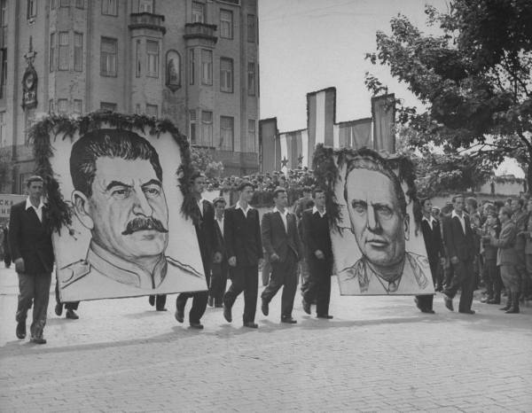
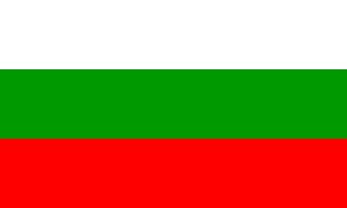
Recognition of the Macedonian nation by Bulgarians influenced by the Yugoslav-Soviet swinging politics: It became axiomatic that whenever relations between Moscow and Belgrade cooled, then the heat rose in the Macedonian problem as far as Sofia was concerned.
Warming up in the relations of USSR and Yugoslavia:
1945-1948
1953- 1968
Recognition of the Macedonian nation by Bulgaria:
1953: tendention towards recognition
1961: Bulgaria recognises, that since the WWII we could observe the formation of the macedonian nation
Since 1971: improving of the situation, Bulgaria signs the documents in bulgarian as well as macedonian language

Slide 5
Bulgaria
Bulgaria recognized the Republic of Macedonia, 15th of January 1992,
the Badinter commission recommended Macedonia for the recognition
However, Bulgaria refused to recognise the macedonian nation and the macedonian language
Current EU debate

Slide 6
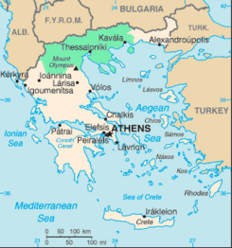
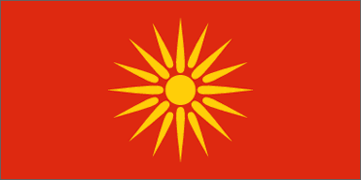
Greece
name of the nothern Greek province
Alexander Great MacedoniaN
The flag: the sixteen-ray VERGINA SUN star - symbol of the ancient state of MACEDONIA
The constitution: a reference in Article 49 to the Republic caring "for the status and rights of those persons belonging to the Macedonian people in neighboring countries, as well as Macedonian expatriates, assist[ing] their cultural development and promot[ing] links with them," which Greece interpreted as encouraging separatism among its own Macedonian slav minority.

Slide 7
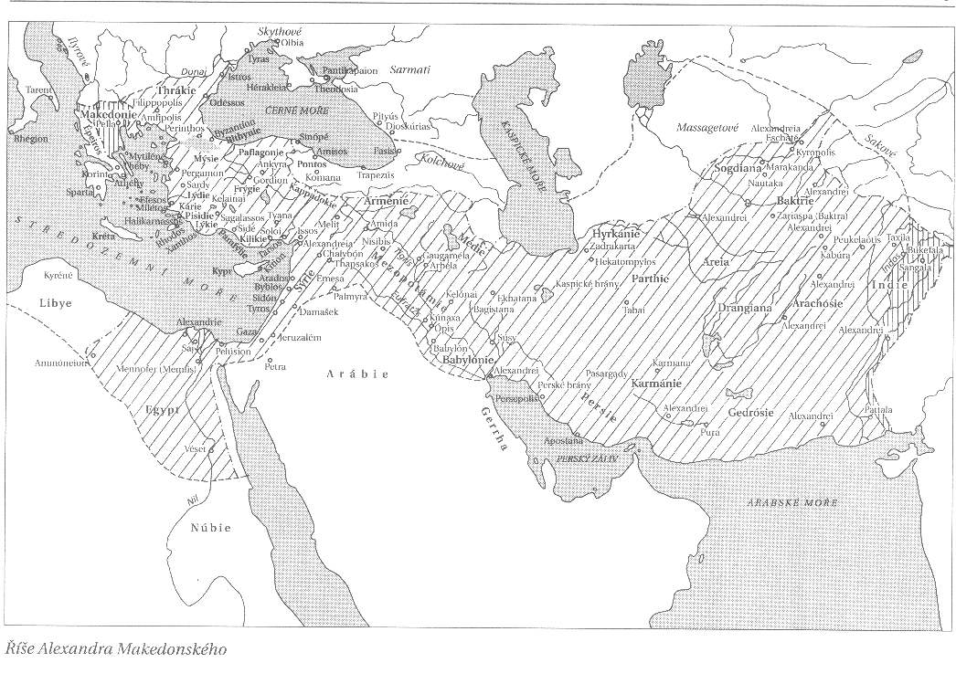
The empire of the Alexander the Great

Slide 8
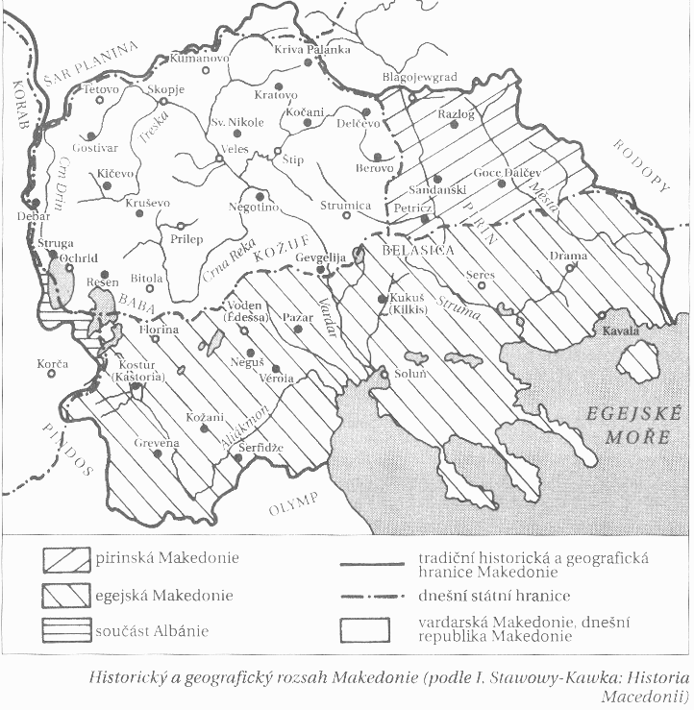
The map of the United (Great) Macedonia

Slide 9
New name??
Vardar republic
Republic of Skopje
Former republic Macedonia of Former Yugoslavia☺

Slide 10
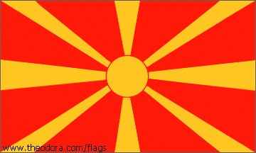
Greek reactions:
Closing of the consulate in Skopje
Total embargo on the trade with Macedonia including transit
The normalisation of the bilateral relations: temporary agreement: The Greece recognises Macedonia under the name FYROM, recognises the borders and revokes the embargo. Macedonia promised not to have any land demands, not to engage in the protection of the macedonian minority in Greece and promised to change the state symbols.
2018 Prespa agreement

Slide 11
Bilateral relations with Serbia
The withdrawal of the Serbian forces was smooth and quick (Serbian engagement in Croatia, Bosnia, Kosovo, no serbian minority in Macedonia)
Case of Macedonian orthodox church – Serbian orthodox church does not recognise the Macedonian orthodox church and claims the property (churches, monasteries etc.) on the Macedonian territory

Slide 12
Albanian minority
Demand for the cultural, school and administrative authonomy
Proclamation of the Republic of Ilyrida (2.4.1992 recognized by nobody)
1992 riots, UN sent small stabilisational contingent
Albanian university
After 1999 extremists from kosovo flew to macedonia
2001 escalation of the conflict
Ohrid agreement

Slide 13
Ohrid agreement
Inviolability of borders and integrity of the Republic of Macedonia
Demilitarisation of the UÇK
Macedonian government is obliged to pass the new decentralisation law, held a new census, assure the equality of all citizens in the governmental agencies
The change of the Constitution and the decentralisation law is possible only under the consent of the 2/3 in the parliament and simultaneously under the 2/3 within the minority in the parliament.
The laws dealing with the culture, language, education, ID´s, use of symbols, local finances, local elections, status of Skopkje only under the consent of the 2/3 MP´s of the minority nation.
The chance of having parallel albanian faculties under the umbrella of current universities
Affirmative action in the education system
Macedonian language as the offical language, where the minority is more than 20 % then their language official as well.
The IDs in the language of the minority, symbols only with simoultaneous use with the macedonian ones.

Slide 14
Presidents, directly elected, 5 years, 1 re-election, symbolic
Kiro Gligorov 1991-1999
Boris Trajkovski 1999-2004
Branko Crvenkovski 2004-2009
Gjorgje ivanov 2009-2019
Stevo pendarovski 2019

Slide 15
Bipolar party system
Macedonian and Albanian
Macedonian: SDSM (successor of the communistparty) on the left and VMRO-DPMNE (national conservative) on the right
Albanian

Slide 16
Albanians
The Democratic Union for Integration BDI/DUI
Democratic party of Albanians PDSH/DPA
Alliance for the albanians, besa movement
Integrated, coalition governments

Slide 17
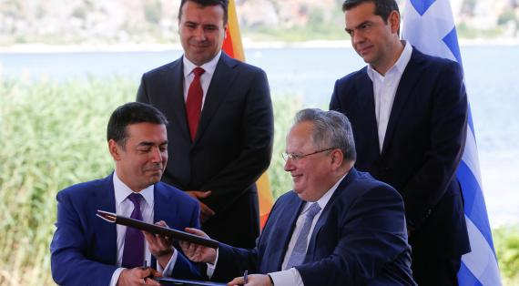
Prespa agreement
2018
Greece and Macedonia – name issue
North Macedonia

Slide 18
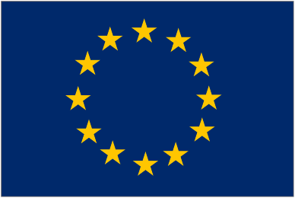
Macedonia on the way towards EU and NATO
2020 NATO member
Was granted candidate status in 2005
Bulgaria

