Slide 1
Modern Technologies and Conflicts
History, overview and ethics
Jakub Drmola

Slide 2
“We've arranged a global civilization in which most crucial elements profoundly depend on science and technology. We have also arranged things so that almost no one understands science and technology. This is a prescription for disaster. We might get away with it for a while, but sooner or later this combustible mixture of ignorance and power is going to blow up in our faces.”
― Carl Sagan, 1995

Slide 3
Longterm Trends
technology frees up people from doing previously necessary work and enables them to do something new instead
new professions and sectors are created, influencing the rest of society
all kinds of conflict (military and social) drive new science
it is never possible to predict all outcomes of research

Slide 4
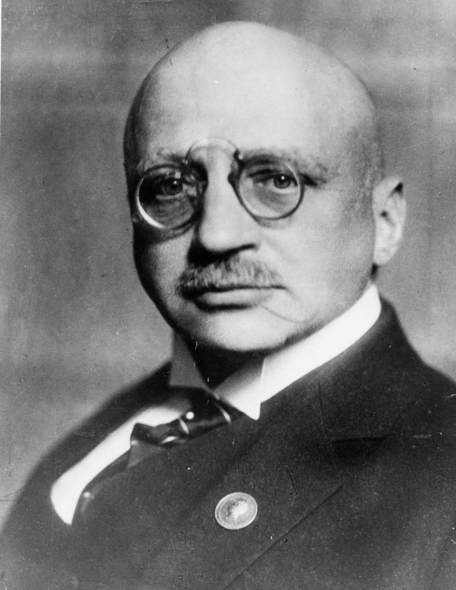
Fritz Haber
1918 Nobel price for the “Haber-Bosch process”
fixation of atmospheric nitrogen into ammonia (NH₃)
currently uses about 1-2% of global energy budget
we produce about 400 million tons of it
pillar of agriculture (fertilizer)
quadruples effectivity
⅔ of produced food
it was a prerequisite of the population boom

Slide 5
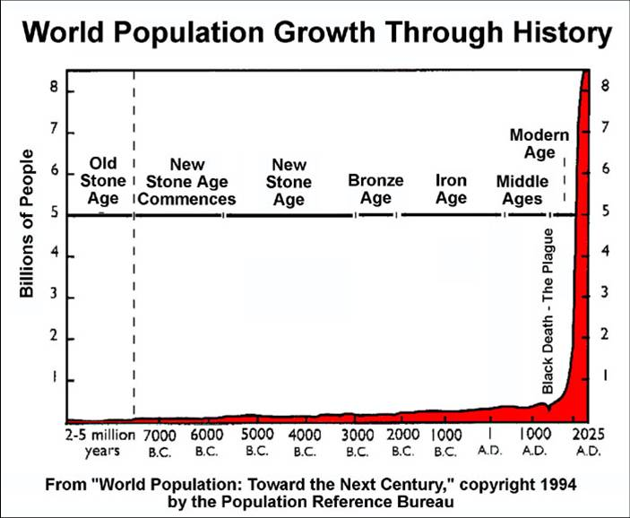

Slide 6
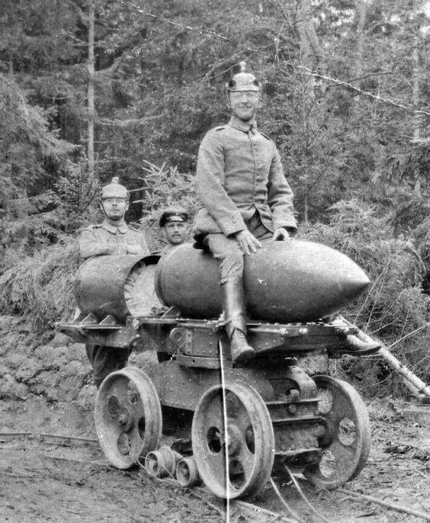
Fritz Haber and the War
but nitrogen is also used in explosives
and he worked on chemical weapons:
chlorine gas
yperite (mustard gas)
and his work was basis for future development of Zyklon A
(originally used as insecticide)

Slide 7
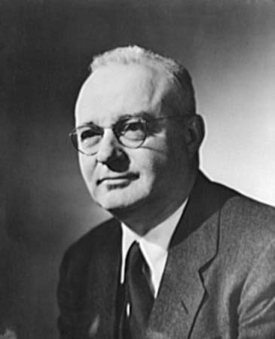
Thomas Midgley
famous and decorated chemist
1921 invented leaded gasoline (TEL)
1928 invented freons (CFCs)

Slide 8
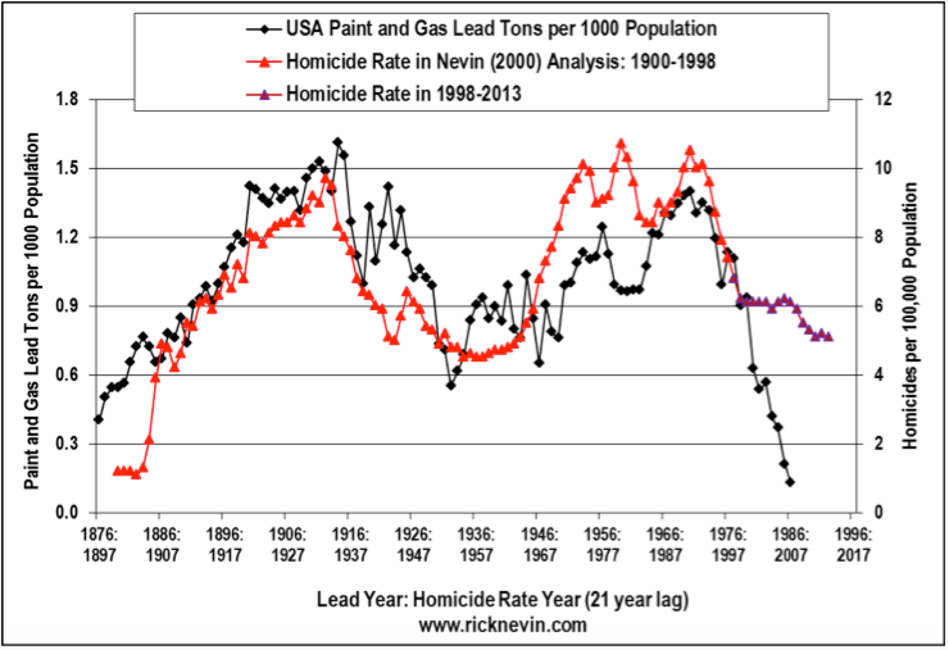

Slide 9
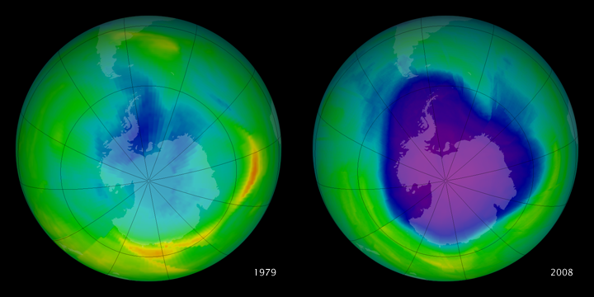

Slide 10
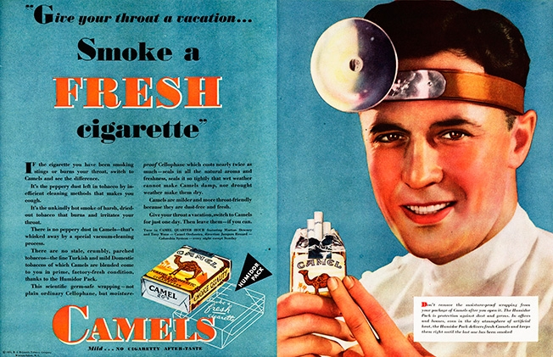

Slide 11
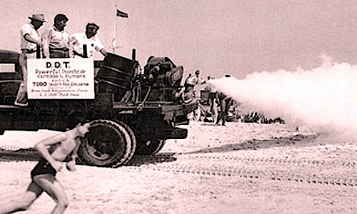
Notes:
DDT

Slide 12
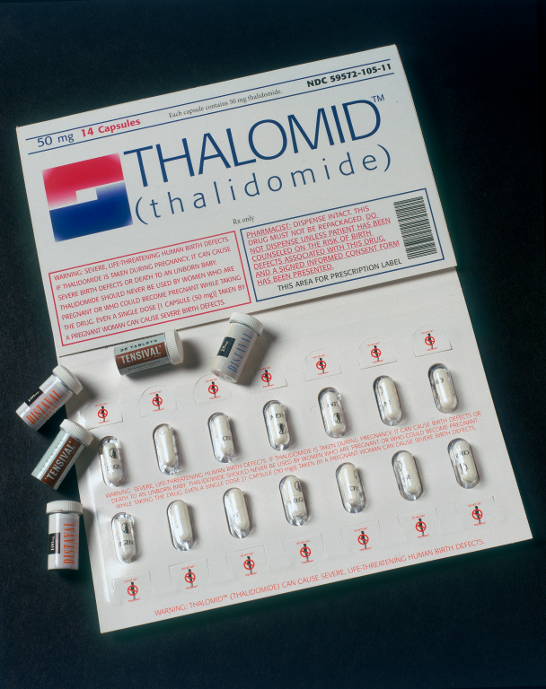
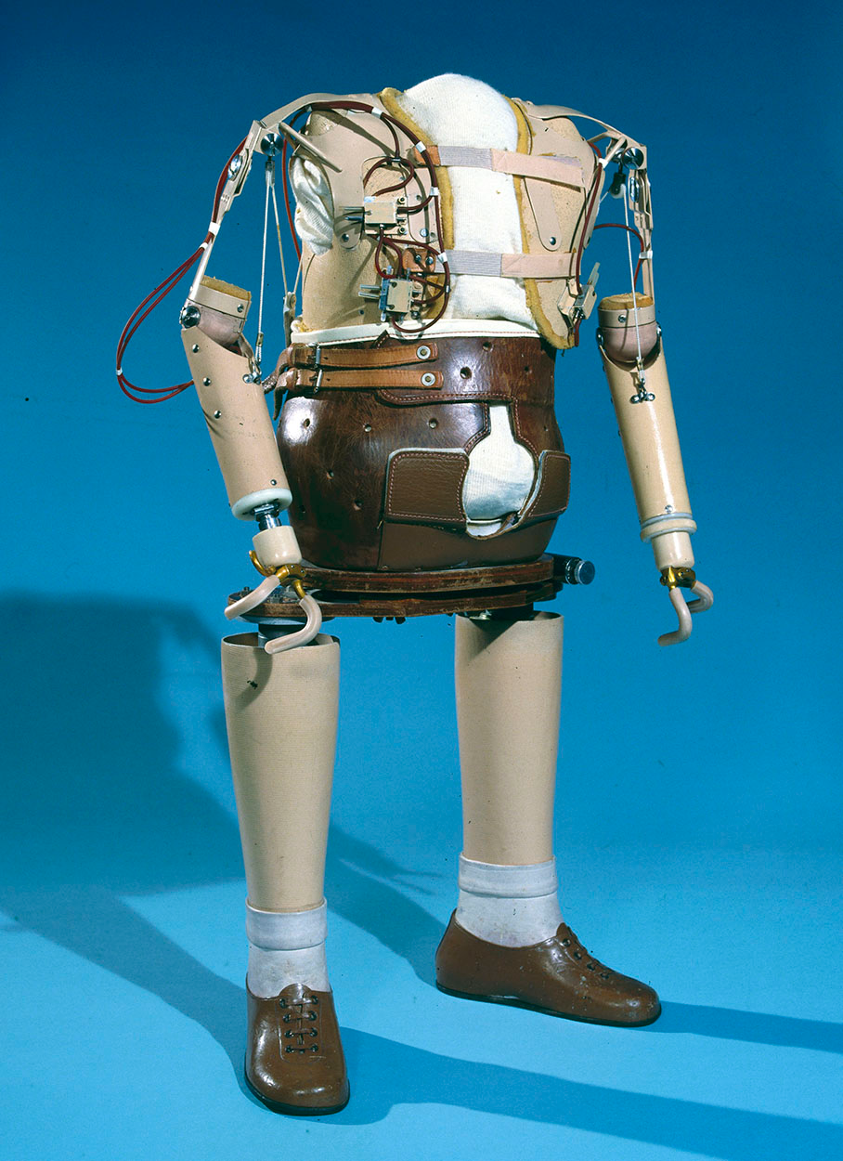
Notes:
Thalidomid

Slide 13
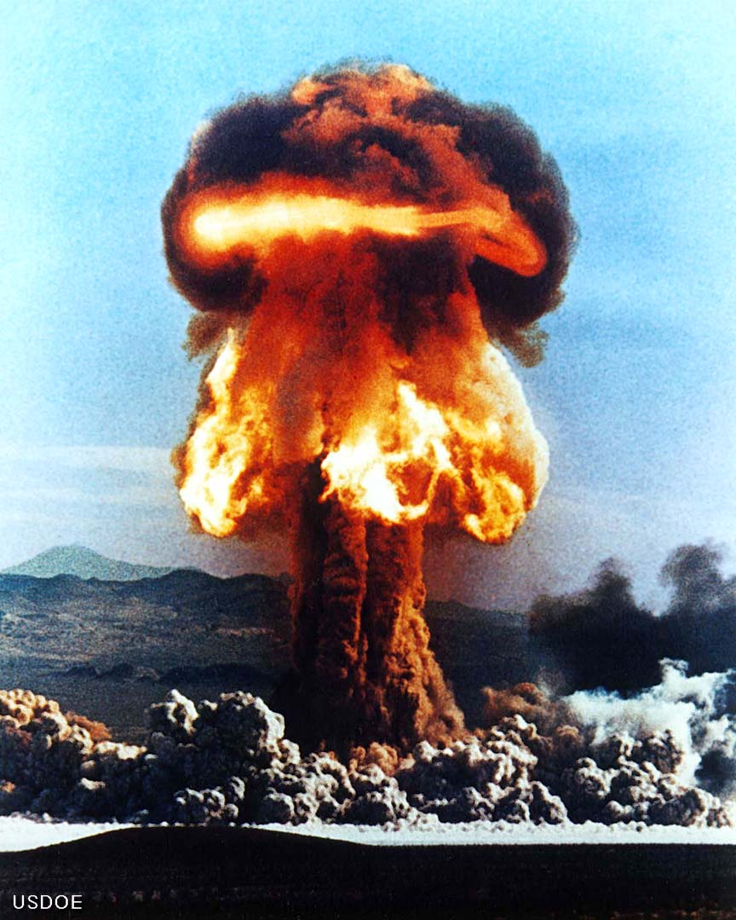
Nuclear weapons
Ernest Rutherford discovered atomic nucleus (1911)
Germany vs. USA
https://dai.ly/x6ptg1x?start=913
- 15:13-20:13 (Feynman)
https://vimeo.com/128088968 - 15:06-21:21 (Bagge + Weizsacker)
various rationalizations
impact on future?
Hiroshima, Nagasaki
Cold War
energy generation
Notes:
http://dai.ly/x24gwgc?start=913 - 15:13-20:13
https://vimeo.com/128088968 - 15:06-21:21 (Weizsacker + Bagge)

Slide 14
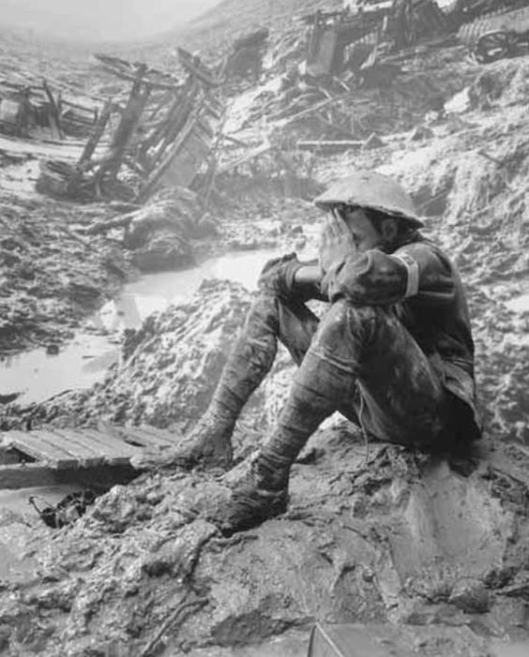
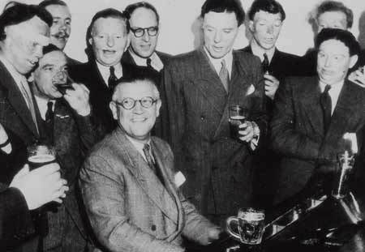
Medicine
intimately connected with wars and human experimentation
Archibald McIndoe (plastic surgery)
Dwight Harken (heart surgery)
PTSD/Gulf War Syndrome/Shell Shock

Slide 15
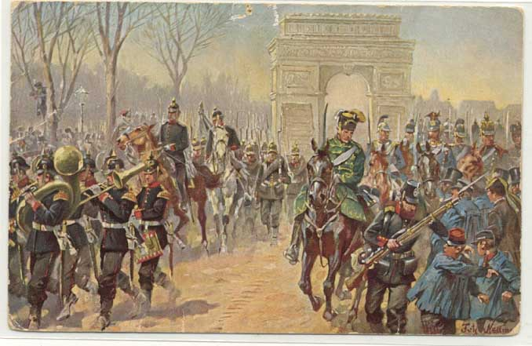

Slide 16
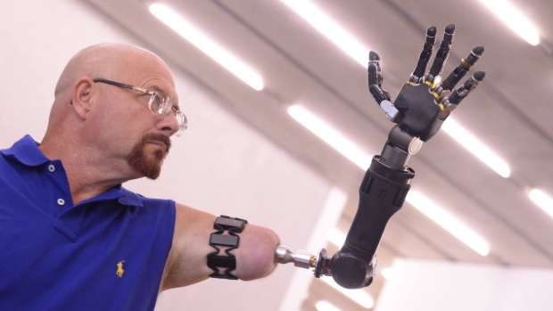
Artificial Limbs
https://www.youtube.com/watch?v=F_brnKz_2tI

Slide 17
Ethics and regulation of science
are wars good for science?
can science be separated from politics and should it?
who should decide what to research?
who is or should be responsible for the results?

