Slide 1
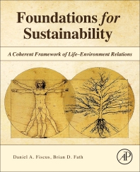
Foundations for Sustainability
Brian D. Fath & Dan Fiscus
Professor, Towson University, Maryland, USA
Senior Research Scholar, International Institute for Applied Systems Analysis, Austria
Visiting Professor, Masaryk University, Brno, Czech Republic

Slide 2
Chapter 1: To solve a difficult problem, enlarge it
Your reaction:
What is, in your opinion, the main message of Chapter 1?
What part was most confusing or most difficult to understand?

Slide 3
Evidence of crisis
Unprecedented land use change and conversion of natural habitat to human dominated landscapes
Rates of species extinctions on par with the five mass extinctions of all time
Soil loss and degradation
Plateau of food production and increasing vulnerability of the food supply
Disruption of the global nitrogen cycle
Pressure related to fossil-fuel dependency (including conflicts over pipelines, fracking, and more)
Global climate disruption
Sea level rise and impacts on coastal areas with dense human population
Ocean acidification and related disruption to coral reefs and ecosystems
Water pollution and shortages in many areas
Persistent and bioaccumulating toxins and solid waste such as plastic and microplastics

Slide 4
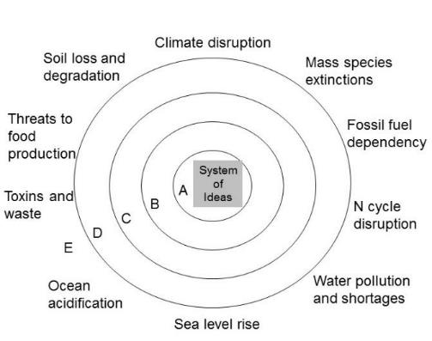
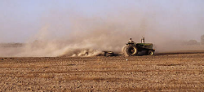
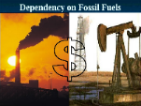
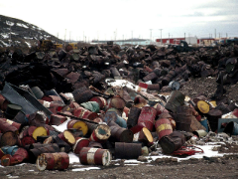
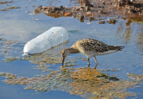
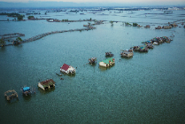
Environmental Challenges
Soil erosion
emerge from our core way of knowing
Toxins and waste
Water pollution
a new paradigm
Sea level rise

Slide 5
Reality of win-win
Switch from a paradigm that see a fragmented and antagonistic relation between life and environment, and humans and environment
To one that recognizes that ecosystem interdependencies promote mutualism and synergism
The fundamental, net human-environment relationship is mutualism or win-win

Slide 6
Applied-theory science
Balances and synergizes holism with reductionism;
Equally emphasizes internalist and self-referential as well as objectivist perspectives;
Is anticipatory and accelerates the pace and process of paradigm shifts; and
Is consciously, intentionally, and transparently value-based centered on the value of life.

Slide 7
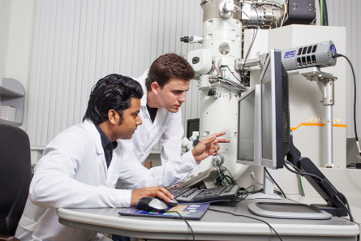
All education is environmental education
By what is included or excluded students are taught that they are part of or apart from ecological systems – disciplines separate people from nature

Slide 8
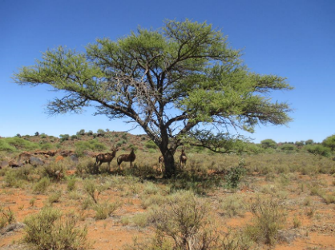
Getting the metaphor right
Switching from a machine view
To ecosystem/web/network view
More on this later

Slide 9
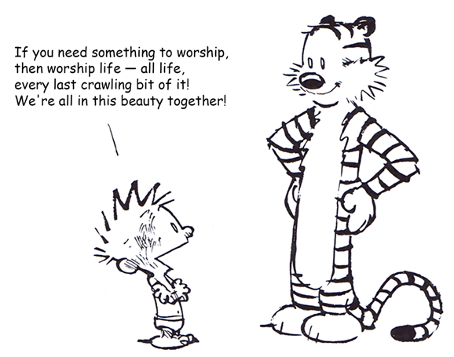
Reverence for life
Schweitzer
Leopold
Ulanowicz
Chapter 2

Slide 10
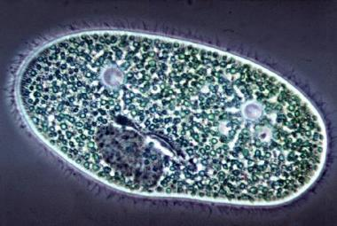
What is life?
A single cell possesses all the necessary aspects to be alive

Slide 11
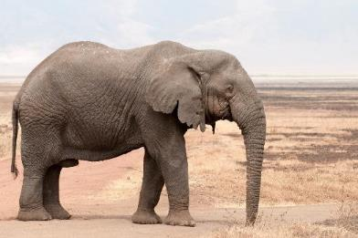
What is life?
Discrete Life
A single organism possesses all the necessary aspects to be alive

Slide 12
Mental models and outcomes Real impacts of choice of system boundaries
Tragedy of the Commons
Humans win, environment degrades
Inherent in this paradigm, life is separate from environment in mind and action
Once fragmented, it is possible and likely that the value of environment is seen and treated as less than the value of life
Environment is consumed and degraded as manifest in many symptoms of ecological crisis
Life
Environment
Figures by Dan Fiscus

Slide 13
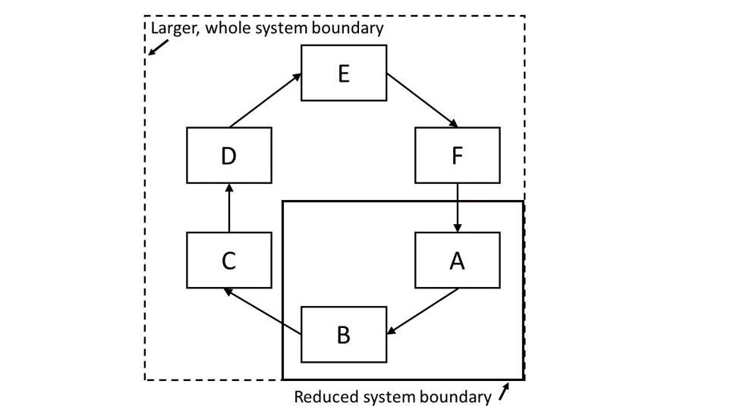
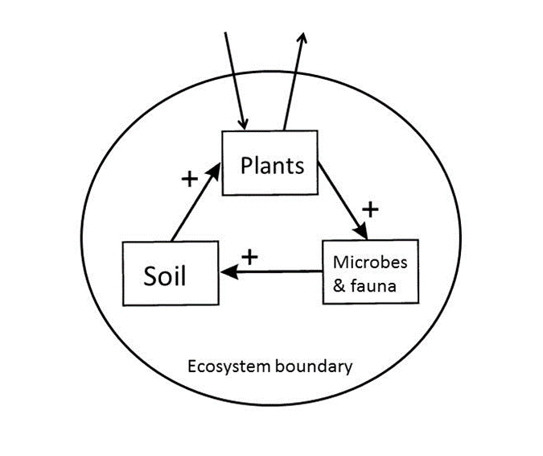

Slide 14
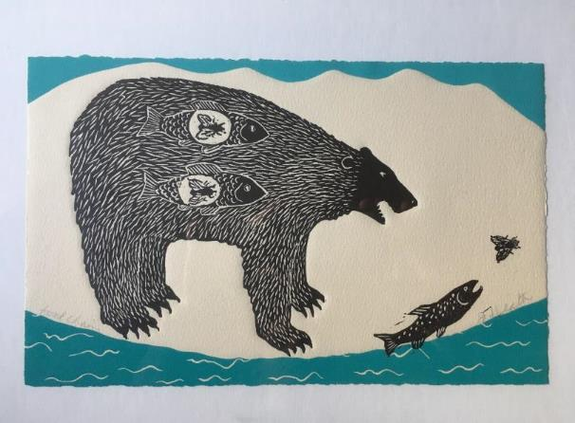
Ecosystem is full of
Interconnections and Interdependencies
Art work of Jan Heath, entitled “food chain”

Slide 15
A bottom up re-visioning is vital: A new holistic paradigm for life
Contrary to the dominant mainstream view, the basis of all current biology and life science education, it now is becoming clear that life is not only (or even primarily) an organismal property.
In the view actively emerging, life is not centered on or emanating from organisms, nor is it primarily a localized, objectified or material phenomenon.
Life is inherently relational, distributed, and non-localized

Slide 16
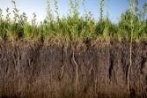
Environmental and ecological interactions
Discrete Life
A single organism possesses all the necessary aspects to be alive

Slide 17
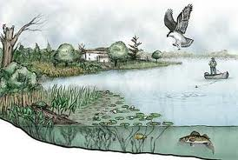
Interacting ecological community and its environment is an ecosystem
Sustained Life
An ecosystem possesses all the necessary aspects to sustain life

Slide 18
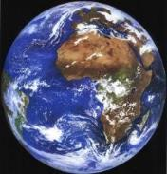
Recursive nature of nature
Bounty of the Commons
Humans win, environment improves
Life and environment are best understood and modeled as unified as a single “Life–Environment” system.
Fiscus D, Fath BD, Goerner S. 2012. E:CO 14(3), 44–88.

Slide 19
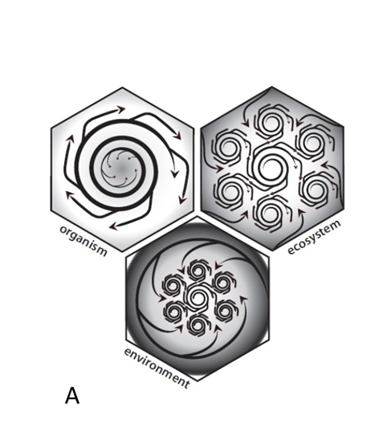
Three unit models of Life:
Organism
Ecosystem
Environment
Artwork by McManus

Slide 20
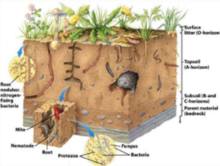
Sustained life depends on death
In an energy economy appropriate to the use of biological energy, all bodies, plant and animal and human, are joined in a kind of energy community. . . .
They are indissolubly linked in complex patterns of energy exchange. They die into each other’s life, live into each other’s death. (Berry 1977, p. 90)

Slide 21
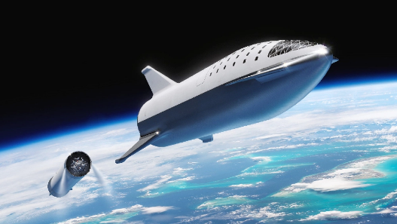
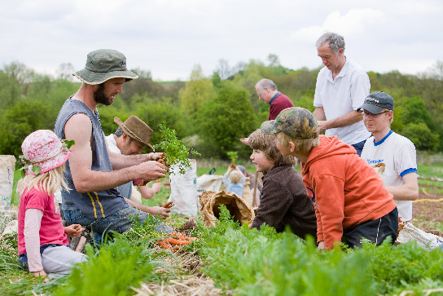
Sustainers and Transcenders
Change themselves/lifestyle
Work with nature
Break barriers
Innovate
Are there environmental limits?
Are both sides aware of them?

Slide 22
Cultural Theory Solidarities (Thompson 1997)
Fatalist/Capricious
Hierarchist/Reasonable within limits
Hermit
group
Individualist/Durable
Egalitarian/Fragile
grid
transcenders
sustainers

Slide 23
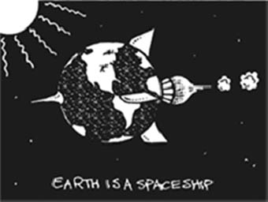
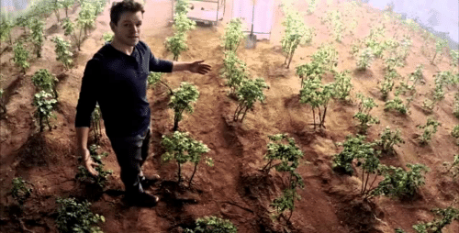
Why sustainers and transcenders need to work together
We need to know how to take the life support with us
NASA has programs to recycle biological and other wastes of astronauts
But not yet to recycle astronauts themselves…

Slide 24
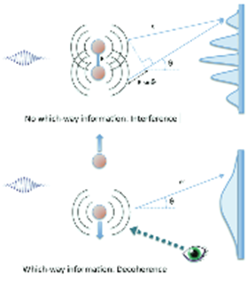
Deep truths
Are statements in which the opposite also contains a deep truth
Complementarity of discrete life and sustained life
Meadow’s leverage points
Power to transcend paradigms

Slide 25
What if we are wrong? What if this is all wrong?

Slide 26
Key message: Avoid fragmentation
This is wrong!
object
Environment
Input Environment
H
Output Environment
Object is inseparably part of its environment

Slide 27
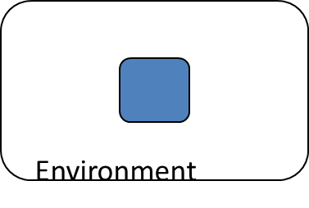
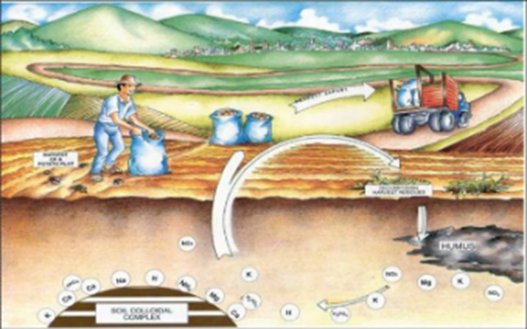
Avoid fragmentation
The concept of country, homeland, dwelling place becomes simplified as ‘the environment’—that is, what surrounds us. Once we see our place, our part of the world, as surrounding us, we have already made a profound division between it and ourselves.
We have given up the understanding—dropped it out of our language and so out of our thought—that we and our country create one another, depend on one another, are literally part of one another;
that our land passes in and out of our bodies just as our bodies pass in and out of our land; that as we and our land are part of one another, so all who are living as neighbors here, human and plant and animal, are part of one another, and so cannot possibly flourish alone;
our culture must be our response to our place, our culture and our place are images of each other and inseparably from each other, and so neither can be better than the other. Berry (1977, p. 24).

Slide 28
Avoiding the word “solutions”, we look for New patterns and processes that..
Build and aggrade soils and increase fertility;
A compromise similar to E.O. Wilson’s “Saving Half the Earth” is reached;
Rates of species extinctions in line with historical rates between mass extinctions;
Improved food production and resilience, sustainability, affordability, and health of the food supply and its beneficiaries;
Stable global nitrogen cycle including an end to dead zones in estuaries and gulfs;
Broken addiction with fossil fuels with most energy from renewable sources;
Stable global climate similar to the Holocene; no net increase in GHG concentrations or temperature;
Sea levels follow natural patterns and more secure coastal areas with human populations;
An end to increased ocean acidification and regeneration of coral reefs and ecosystems;
Abundant, affordable clean water sufficient for human needs and for wild nature; and
Great reduction in environmental toxins/waste; emissions within rates of recycling or decontamination.
Naïve or possible?

Slide 29
Discussion questions
https://vimeo.com/212281432
What does the title of the chapter have to do with the content?
Why don’t biology textbooks teach about two kinds of life (discrete and sustained)?
Can this be changed? How?
How to tap into the existing forces of the system to create change? i.e., work alongside transcenders not against them.

Slide 30
Discussion questions
A lot of the discussion comes back to scale – short term versus long term or global versus local. How to instill more long term, holistic approaches in a “present-oriented” society?
We propose that when you avoid fragmentation that: The fundamental, net human-environment relationship is mutualism or win-win
Is there evidence for this?
Other questions?

