Slide 1
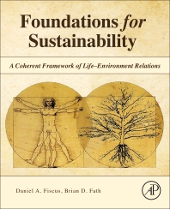
Foundations for Sustainability
Brian D. Fath & Dan Fiscus
Fulbright Distinguished Chair, Masaryk University, Brno, Czech Republic
Professor, Towson University, Maryland, USA
Senior Research Scholar, International Institute for Applied Systems Analysis, Austria

Slide 2
Chapter 2: Life as the basis of value
Your reaction
What is, in your opinion, the main message of Chapter 2?
What part was most confusing or most difficult to understand?

Slide 3
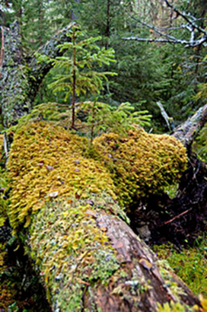
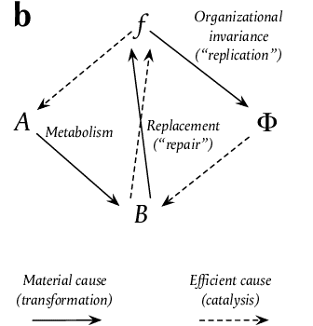
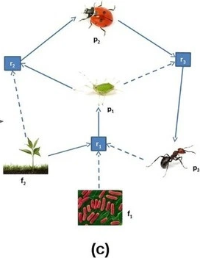
Life has a dual role of means and ends
Closure of activity
An individual’s actions make a life and is a life
Rosen (1991)
Cazzolla Gatti et al. 2019. J. Theoretical Biology

Slide 4
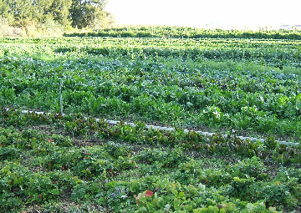
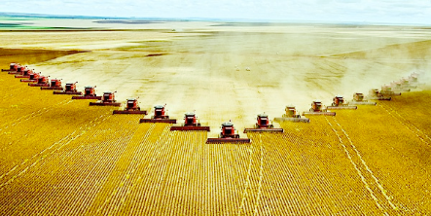
Organic farming
How does the paradigm differ from conventional agriculture?
How does this influence the practices that are used?
Feed the soil, and the soil will feed the plants

Slide 5
Barriers and proposals
Short term rewards
Common enemy is systemic death
Extend instincts beyond the boundary of the individual to include Life-support organically in our decision making

Slide 6
Values
“social norms and the closely related value system highlights the interdependence of the individual sense of self and the societal system of values and norms.” p. 30
Connective tissue of society
Capital “Life” is used throughout the book to represent this.

Slide 7
Great transformations
How else does change come about?

Slide 8
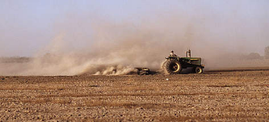
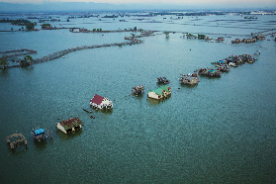
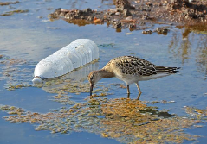
Avoiding unintended consequences
Climate change
Acid rain
Geoengineering
Soil erosion
Water pollution

Slide 9
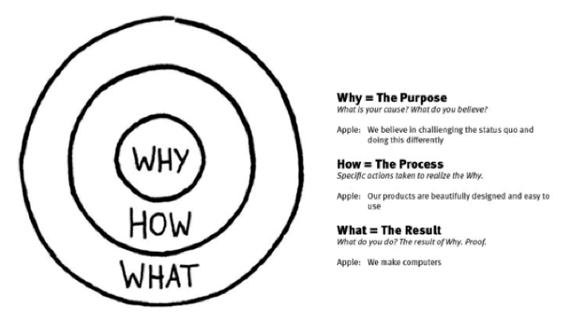
1. Start with the end in mind

Slide 10
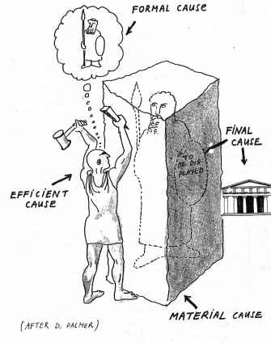
Causation
Aristotle proposed four levels of causation:
  Material cause - the material of which it consists
  Formal cause - arrangement of matter
  Efficient cause - "the primary source of the change or rest"
  Final cause - its aim or purpose

Slide 11
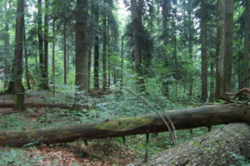
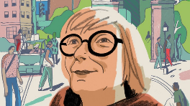
2. Depict the goal and outcomes
Crises solved
Self-regulating, regenerated and regenerative
“An ensemble grows rich on an environment that the ensemble itself made rich.” (Jacobs, 2000, p. 60)
What if degradation is the abnormality and clean environment are achieved by basic natural Life systems
  A tree in the forest makes the forest better
  Why can’t a human in a city make the city better?

Slide 12
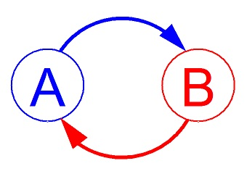
3. Work backwards to realize the ideal outcome – the how that leads to it
Take advantage of positive feedbacks
  Change comes from moving to a new configuration

Slide 13
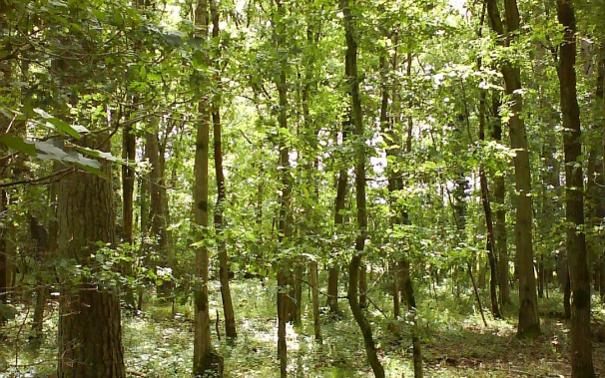

4. The why that motivates the how
Shared value of life as the center of ethics
A science to serve Life

Slide 14
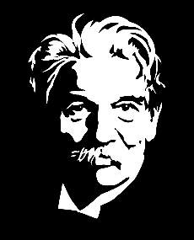
Life as the basis of value
True values are carried out in everyday life
  no wasted effort,
  no cross purpose,
  no conflict of interest
“Once a man has experienced [reverence for life] ... He carries his morality within him and can never lose it, for it continues to develop within him. He who has never experienced this has only a set of superficial principles.” (Schweitzer 1969, pp. 115–116)
Albert Schweitzer

Slide 15
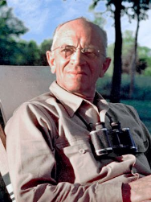
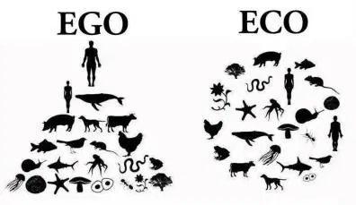
Land Ethic
“A thing is right when it tends to preserve the integrity, stability, and beauty of the biotic community. It is wrong when it tends otherwise.” (Leopold 1949, pp. 224–225)
Aldo Leopold

Slide 16
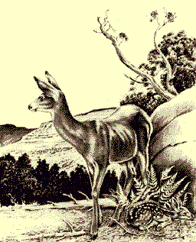
Ecological Cascades
Thinking like a mountain
Recycling – Indians
    … and Astronauts

Slide 17
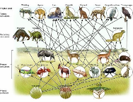
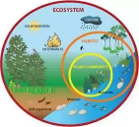
Historical Ecological Landmarks
Ecology—Haeckel (1866)
Ecosystem—Tansley (1935)
Trophic-dynamic aspect of ecology—Lindeman (1942)
Diversity and stability relationships—Elton (1958) & MacArthur (1955)
Strategy of ecosystem development—EP Odum (1969)
“Though the organisms may claim our prime interest, when we are trying to think fundamentally, we cannot separate them from their special environments, with which they form one physical system.” (Tansley 1935, p. 299)

Slide 18
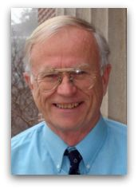
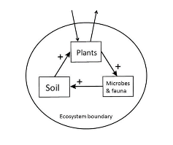
Ecological metaphysic
Learning from nature
Causal understanding – configuration of processes
Application to socio-economic systems
“It seems not unreasonable to assume that many of the same dynamics are at work in economics as structure ecosystems, and that, over ‘‘deep time,’’ nature has solved many of the developmental problems for ecosystems that still beset human economies.” (Ulanowicz 2009)
Robert Ulanowicz

Slide 19
Holism and cycles of life
Schweitzer (1969): “How fantastic that in other existences something comes into being, passes away again, comes into being once more, and so forth from eternity to eternity!”
Leopold (1993): “In the soil grows an oak, which bears an acorn, which feeds a squirrel, which feeds an Indian, who ultimately lays him down to his last sleep in the great tomb of man to grow another oak. . .”
Ulanowicz (2009b): “The action of autocatalytic feedback tends to import the environment into the system or, alternatively, embeds the system into its environment.”
Input Environment
H
Output Environment

Slide 20
Implications and next steps
This universal life–environment cycle also brings a unifying quality to all humans across all races, nations, and ethnicities, and between all life forms.
Ecosystems must be treated as fundamental units of study, and units of Life, and cannot be treated as epiphenomena explainable by dynamics of interacting subset parts (p. 46)

Slide 21
Discussion questions
https://vimeo.com/212281432
Deep ecology – the rights of nature
A bug’s life – Gregor Samsa
Is it realistic/possible to set life as the basis of value
Can you give an example where a problem was solved at the root cause?

Slide 22
Discussion questions
A goal is not happiness but wholeness: to have “no wasted effort, no cross purpose, no conflict of interest”
Why do we not see the cycles of life?
How can we engage in “ecosystem” studies?
Other questions?

