Slide 1
Inequality and environmental justice
Introduction to Global Challenges
Mikuláš Černík

Slide 2
State of the art inequality
https://wid.world/
Income inequality – richest 10% take 52% of income, poorest half less than 9% - average income is app. 16k €/year
Wealth inequality – richest 10% own 76%!, poorest half just around 2%
Just for fun – scroll here to grasp the scale of inequality
https://mkorostoff.github.io/1-pixel-wealth/

Slide 4
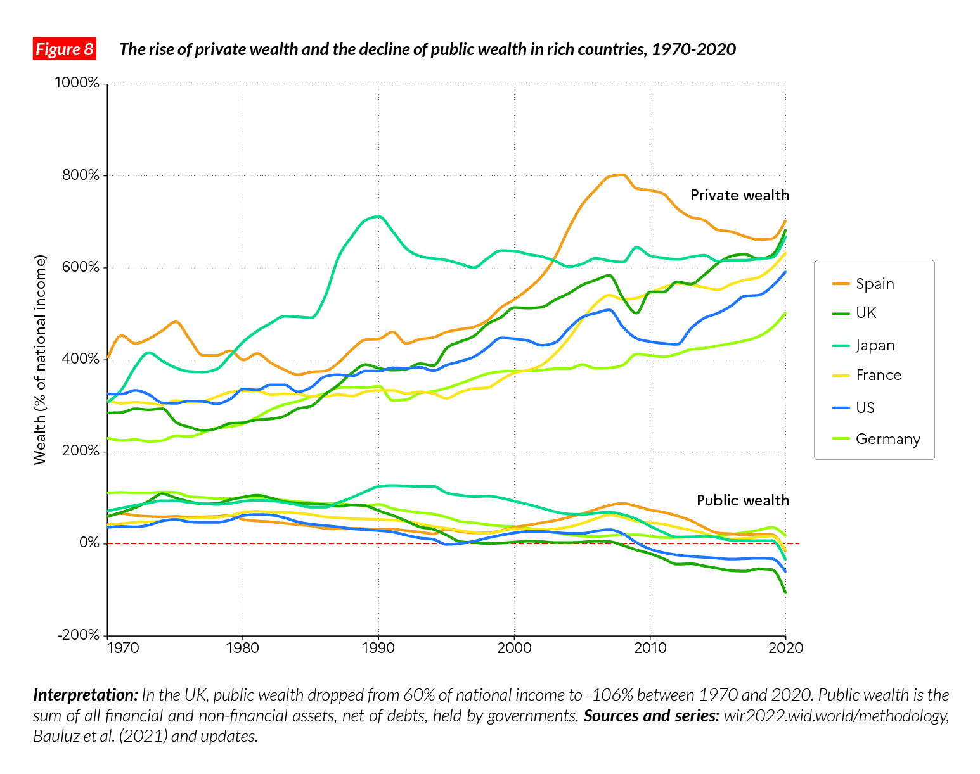

Slide 5
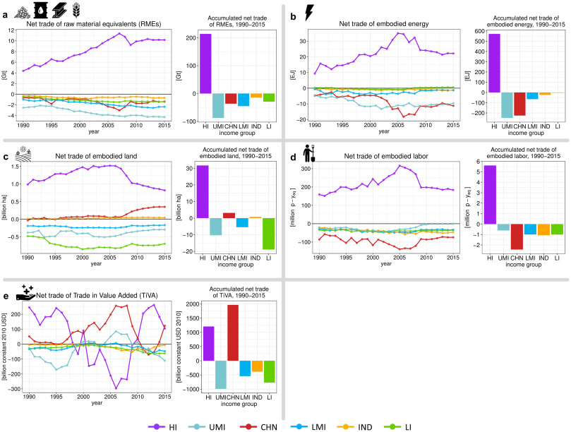
Ecologically Unequal Exchange
„Asymetric resource flows are a necessary condition for accumulation of wealth and economic growth in economic centres“ (Dorninger et al., 2021)

Slide 6
Global Resource Use
International Resource Panel
since 1970
extraction of materials trippled
biomass 9bn tonnes (1970) –> 24 bn tonnes (2017)
metals 2,6 bn tonnes –> 9,1 bn tonnes
fossil fuels 6bn tonnes -> 15 bn tonnes
non-metallis minerals 9bn tonnes -> 44 bn tonnes
„The extraction and processing of natural resources has accelerated over the last two decades, and accounts for more than 90 per cent of our biodiversity loss and water stress and approximately half of our climate change impacts.“
“On a per capita basis, the high-income countries are reliant on 9.8 tonnes of primary materials mobilized elsewhere in the world.”

Slide 7
Ecological debt
Narrow definition: The sum of all monetized ecological damages accumulated over a time in the geographically defined surroundings of a certain extraction or production unit, where the cause-effect relationship between the unit and the damages is sufficiently unique and confirmed.
Paredis & Ghent School define ecological debt broadly as:
(1) the ecological damage caused over time by a country in other countries or to ecosystems beyond national jurisdiction through its production and consumption patterns
(2) the exploitation or use of ecosystems (and its goods and services) over time by a country at the expense of the equitable rights to these ecosystems by other countries

Slide 8
Imperial mode of living
Wissen & Brand (2021)
„prevailing patterns of production and consumption that disproportionately rely on global labour power, resources and sinks. The deep-rootedness of these patterns is reflected in societal relationships between forces and in everyday practices, particularly in the countries of the global North, and explains both the continuity and the crisis of prevailing society-nature relationships.“

Slide 9
Case study - aviation
Gössling & Humpe (2020):
11% of global population flew in 2018
most frequent flyers (max 1%) contributes by more than 50% to all emissions from passenger air travel
„average world citizen flew every 22 months“
Use of private jet can contribute as much as 7,500 CO2/year!
Aviation produces app. 2% of CO2 emissions

Slide 10
Environmental racism
Environmental racism and class inequalities impact population unevenly – access to clean and healthy working and/or living environment is often restricted and denied to marginalised groups.
The start of environmental justice movement was at Warren County, North Carolina – Opposing a Toxic Landfil
More recent example is a study on impact of Hurricane Katrina in New Orleans (Bullard & Wright, 2009)
The phenomenon is not restricted to the US, for example in CEE contries Harper, Steger & Filčák (2009) focus on Roma settlements and environmental exclusion

Slide 11
Commodity frontier
Concept brought by geographer Jason W. Moore
„processes and sites of the incorporation of resources (land, energy, raw materials, knowledge and labour) move at ever-accelerating speed across vast areas of the globe, incorporating ever more land, labour and natural resources.“
Green Sacrifice Zones Robbins & Zografos 2020
„Shifting the costs of green transitions permits the sourcing of certain materials (minerals) that are indispensable for those (green and just) transitions…But at the same time, these cost shifts and salvation logics are precisely just transition’s conditions of impossibility. They undermine its own universalist ambitions (such as equal inclusion in benefit sharing or equal participation in decision making) and expose links to colonialism, a project replete with exclusions.“

Slide 12
Main approaches to environmental justice
Distributive
Procedural
Recognition
Capabilities
And than critical environmental justice – intersectional, decolonial, abolicionist

Slide 13
Environmental Justice Atlas
more than 3700 documented & categorized cases of environmental conflicts globally
collaborative effort, example of citizen science

Slide 14
Resources
World Inequality Database - https://wid.world/
Global Material Flows Database - https://www.resourcepanel.org/global-material-flows-database
Environmental Justice Atlas - https://ejatlas.org/

Slide 15
References
Dorninger, Christian, Alf Hornborg, David J. Abson, Henrik Von Wehrden, Anke Schaffartzik, Stefan Giljum, John-Oliver Engler, Robert L. Feller, Klaus Hubacek, and Hanspeter Wieland. "Global patterns of ecologically unequal exchange: Implications for sustainability in the 21st century." Ecological Economics 179 (2021): 106824.
Schandl, Heinz, Marina Fischer‐Kowalski, James West, Stefan Giljum, Monika Dittrich, Nina Eisenmenger, Arne Geschke et al. "Global material flows and resource productivity: forty years of evidence." Journal of Industrial Ecology 22, no. 4 (2018): 827-838.
Menton, M., Larrea, C., Latorre, S. et al. Environmental justice and the SDGs: from synergies to gaps and contradictions. Sustain Sci 15, 1621–1636 (2020).
Zografos, Christos, and Paul Robbins. "Green sacrifice zones, or why a green new deal cannot ignore the cost shifts of just transitions." One Earth 3, no. 5 (2020): 543-546.
Brand, Ulrich, and Markus Wissen. The imperial mode of living: Everyday life and the ecological crisis of capitalism. Verso Books, 2021.
Harper, Krista, Tamara Steger, and Richard Filčák. "Environmental justice and Roma communities in Central and Eastern Europe." Environmental Policy and Governance 19, no. 4 (2009): 251-268.
Bullard, Robert D., and Beverly Wright, eds. Race, place, and environmental justice after Hurricane Katrina: Struggles to reclaim, rebuild, and revitalize New Orleans and the Gulf Coast. Westview Press, 2009
Warlenius, Rikard, Gregory Pierce, and Vasna Ramasar. "Reversing the arrow of arrears: The concept of “ecological debt” and its value for environmental justice." Global Environmental Change 30 (2015): 21-30.
Gössling, Stefan, and Andreas Humpe. "The global scale, distribution and growth of aviation: Implications for climate change." Global Environmental Change 65 (2020): 102194

