Slide 1
War
What are the issues of IR

Slide 2
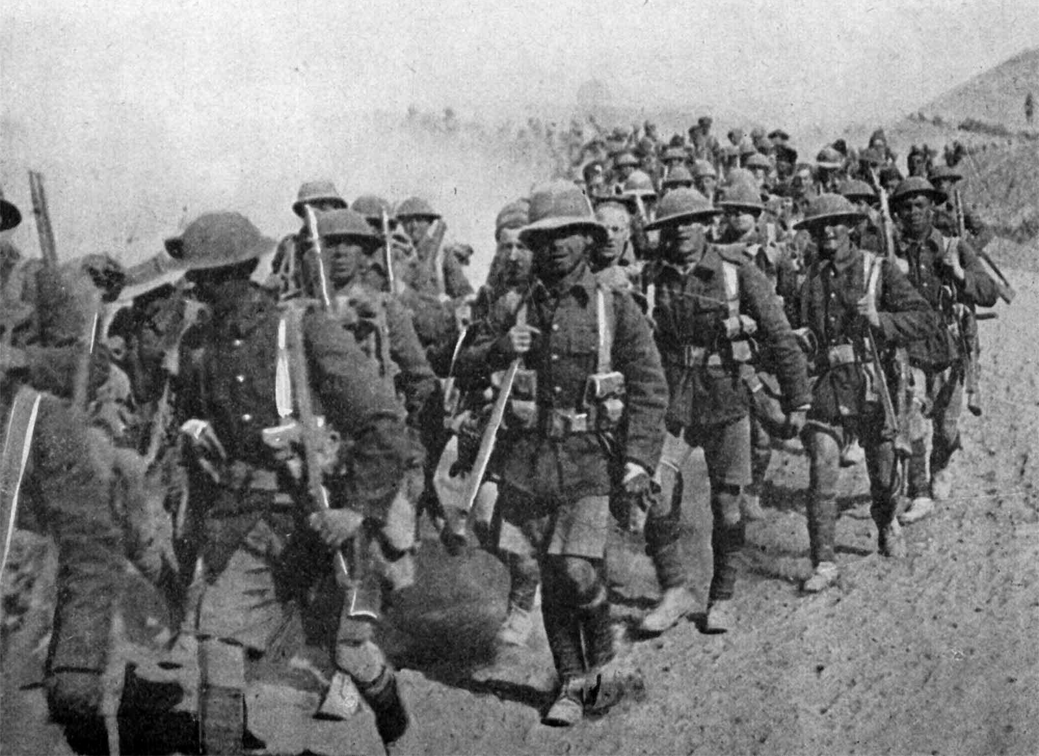
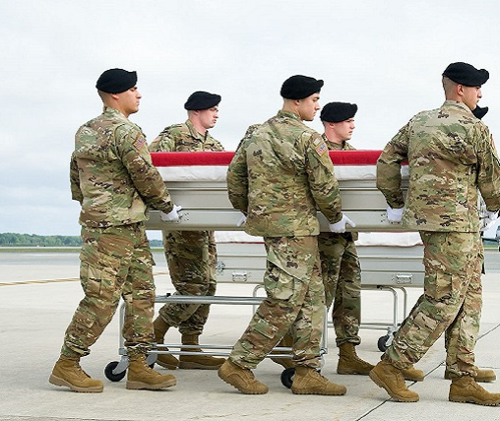
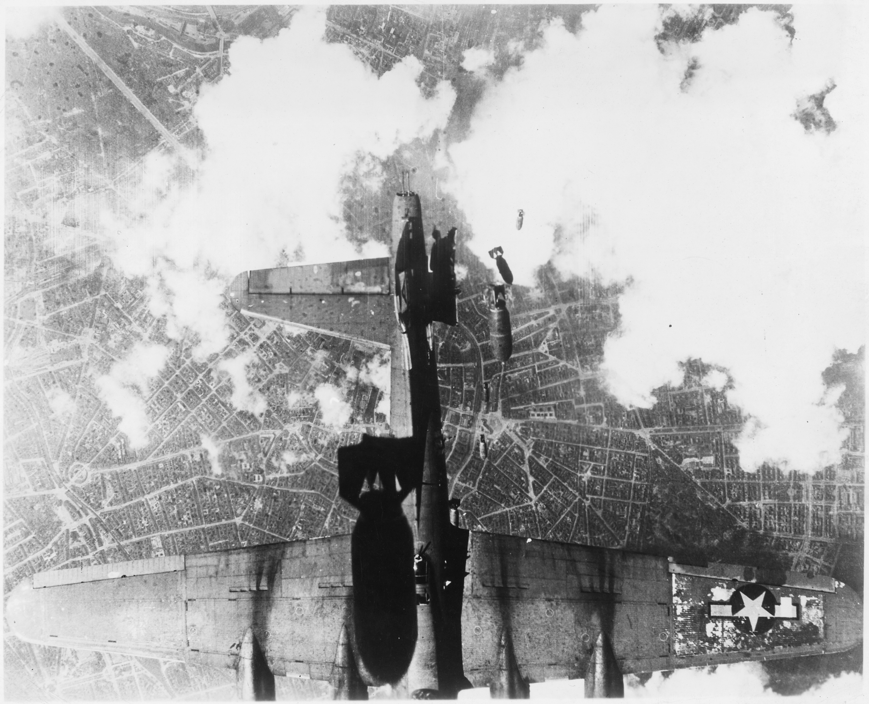
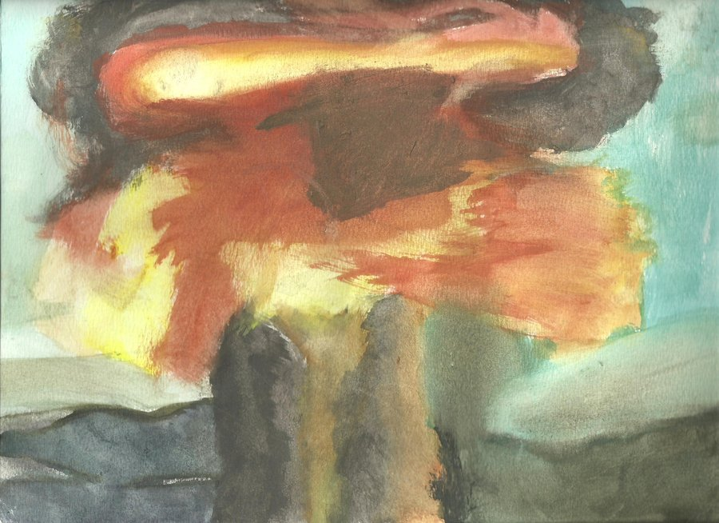
War
Changing nature of the phenomenon

Slide 3

Are there more or less wars today than in the past? Why? Or why not?

Slide 4
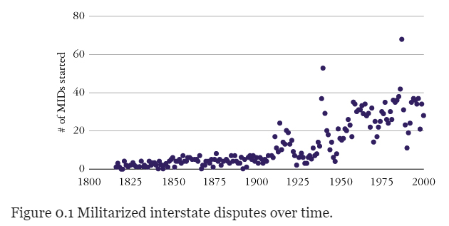

Slide 5
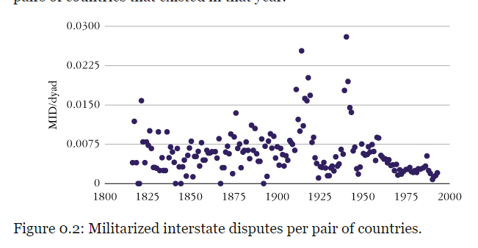

Slide 6
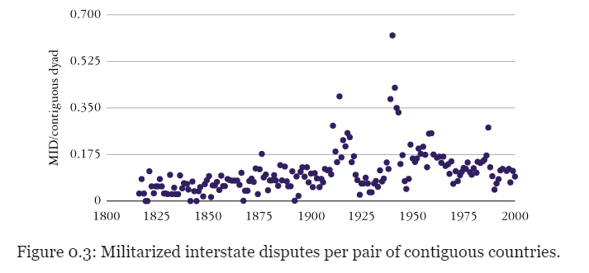

Slide 7
The decline of war thesis
Steven Pinker: Better Angels of our Nature (measure: decline of war deaths per capita)
Joshua L. Goldstein: Winning the War on War: the decline of Armed Conflict

Slide 8
What is war?
Adda Bozeman in War and the Clash of Ideas: "organized violence" tied back into cultural and civilizational
Alexander Moseley: war is a cultural phenomenon, it doesn't just happen, it is actively started and maintained
Cicero: While there are two ways of contending, one by discussion, the other by force, the former belonging properly to man, the latter to beasts, recourse must be had to the latter if there be no opportunity for employing the former.
Clausewitz: War is a continuation of politics by other means

Slide 9
What is war
“War is organized violence carried on by political units against each other.”

Slide 10
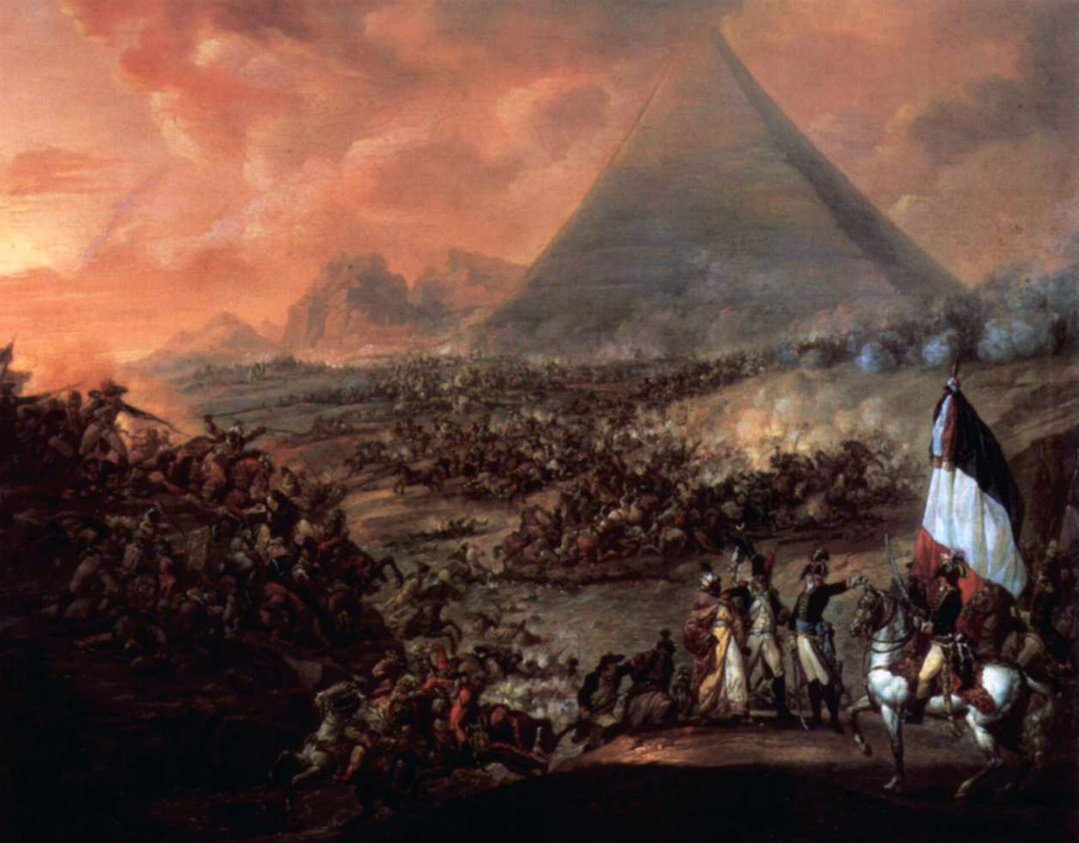
Causes of war – Kenneth Waltz and his three images
1st image
2nd image
3rd image

Slide 11
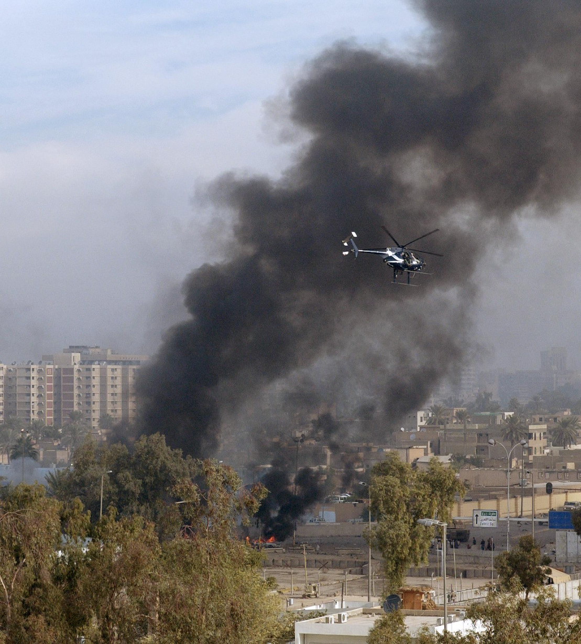
War has been constantly changing form and aims, because the societies it is tied to change.
Pre-modern warfare
  Seasonal (not during harvest and not during planting time)
Modern warfare
  Tied with the nation state
  Evolved from early-modern hired mercenary to mass-conscripted
  Total war
Post-modern warfare ("new wars")
  Going back to some extent (outsourcing war: Executive Outcomes, Blackwater, Wagner group)
  Non-state actors, not governed by elaborate schemes of interantional law, often directed at women and children
  Asymetric, on the sub-state level (civil wars, insurgencies)

