Slide 1
International security - ireb1007
Fall 2022
Security terms and theories
dr. Martin Chovančík

Slide 2
Starting discussion
Is security survival?
Is security absolute or relational?
Is state/national security paramount?
How do we know we’re (not) secure? Who decides?
(think individual but also collective)
Who improves or damages security (which actors)?

Slide 3
Short Group work
Make a group of 4
Pick exactly ONE country – any country (if more of you or some of you are from that country all the better)
Come up with a list of top 5 security issues to that country
This is a priority list
What is lower on the list might not be addressed – enjoy the same resources
Think of this a writing a National Security Strategy
So what makes us most insecure? (WMD, or climate, or terrorism, or conflict?)

Slide 4
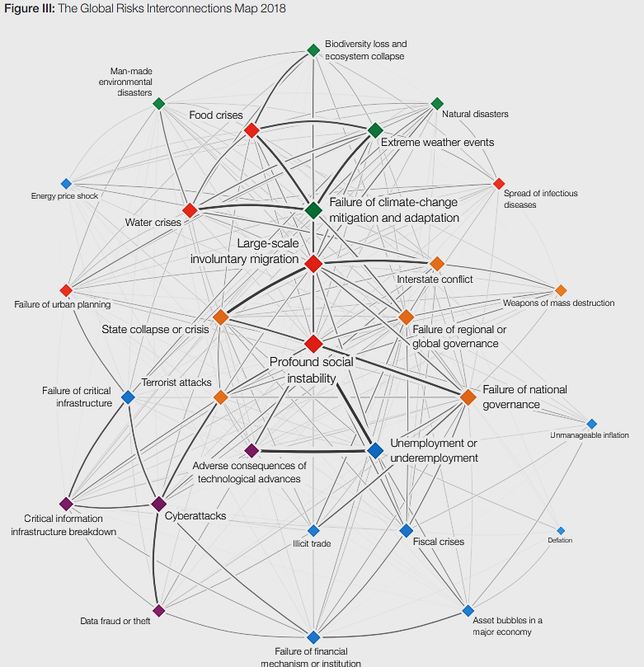
Global risks
Now let’s compare to global challenges
World Economic Forum
The Global Risks Report 2022
https://www3.weforum.org/docs/WEF_The_Global_Risks_Report_2022.pdf

Slide 5
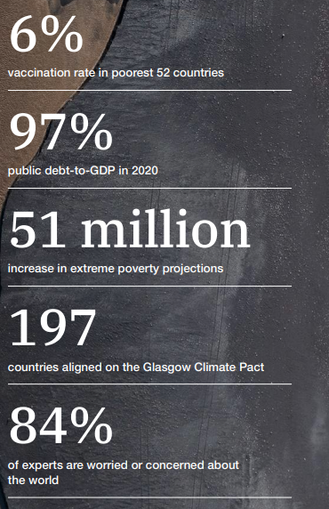
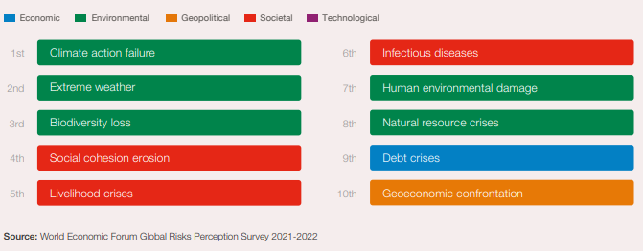
Developed and developing world
The 2017 NSS of the USA removed climate change as a security threat

Slide 6
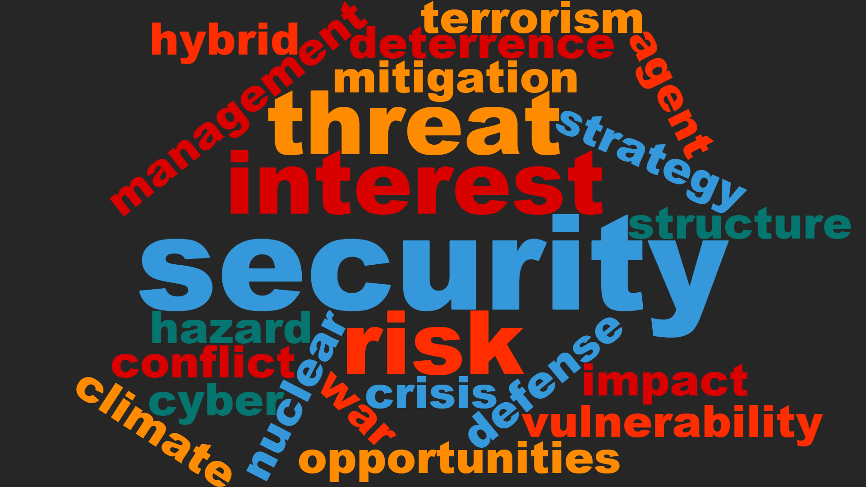

Slide 7
security
security is survival plus
while survival is easier to define the plus is not
depending on the level of analysis (read Singer) survival will consist of:
  a degree of sovereignty, independence, and territorial integrity
the prevention/mitigation of threats to values
freedom from (persecution)
and freedom to (pursue happiness)
Global
International
National
Individual

Slide 8
threat
Cold War
  dual threat to state security – physical and ideological
  dual as source – internal and external
  oriented at military
  Collective defense
Expanded
  societal and environmental threats
  previous are present, but expanded
  Collective security
primary phenomenon endangering values
severity corresponds to how core the value is
national security threat as an action or sequence of events that (Ullman 1983):
  1) threatens drastically and over a relatively brief span of time to degrade the quality of life for the inhabitants of a state; or
  2) threatens significantly to narrow the range of policy choices available to the government of a state or to private non-governmental entities (persons, groups, corporations) within the state
ever broadening list with varying weights of impact

Slide 9

Security challenge
In Collective Security, threat is not known in advance
In Collective Defence, threat is known in advance
In Collective Security enemy is not known in advance
In Collective Defence enemy is known in advance
Collective Security is global in nature
Collective Defence is regional and continental
Is it just a threat?
technically a synonym, but used to underline collective security and increase the standing of remote but shared threats
often “soft security”:
  i.e.: contagions, environmental degradation, migration, antibiotic resistance, drought, ageing populations, and many others growing in importance due to globalization
does not have to name an adversary

Slide 10
vulnerability
the level AND area-specific weakness/exposure to threats
susceptibility to threat, being exposed, or sensitive to STRESSORS in a particular area and at a particular level
follows the logic of security challenges and discourse is guided away from military and national security vulnerabilities, to more societal and environmental definitions
  How would you conduct a structural vulnerability assessment?
  What is resilience?
from physical exposure: presence and density of the people, habitat, networks, goods and services in risk zones, physical military or civilian infrastructure
to concepts of resilience: societal capacity to retain values and recover from attacks negative influence

Slide 11
Risk
Is a risk negative or positive?
likelihood of occurrence
  “Uncertainty arises when the future is unknown but no actual probabilities (objective or subjective) are attached to alternative outcomes. Risk arises when specific numerical probabilities are attached to alternative outcomes”(Llewllyn 1996:744)
probability of a loss coupled with our evaluation of its size and significance
What is a risk appetite?
Risk management
  just weigh the risk of climate change against the risk of economic downturn if policies are applied
    How aggressively?
    How “risky” is it to stall?
  Broadest equation:
Impact
Threat
Vulnerability
RISK

Slide 12
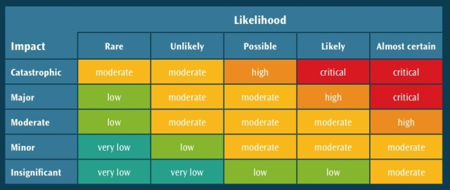
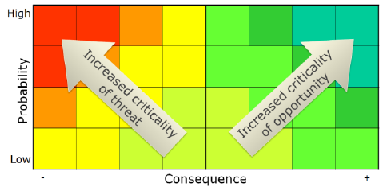
Risk assessment matrix

Slide 13
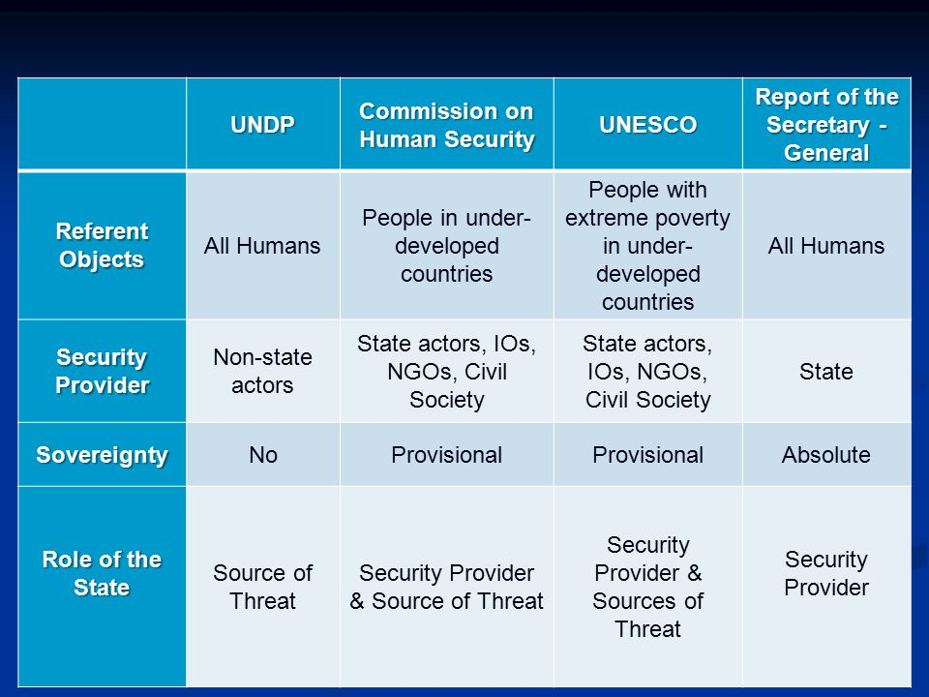
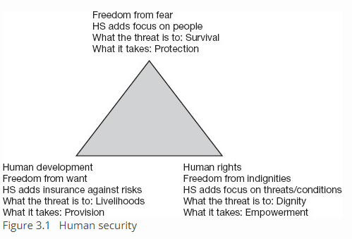
referent
referent or referent object
entity whose security is to be assured
national security – state
human security – individual

Slide 14
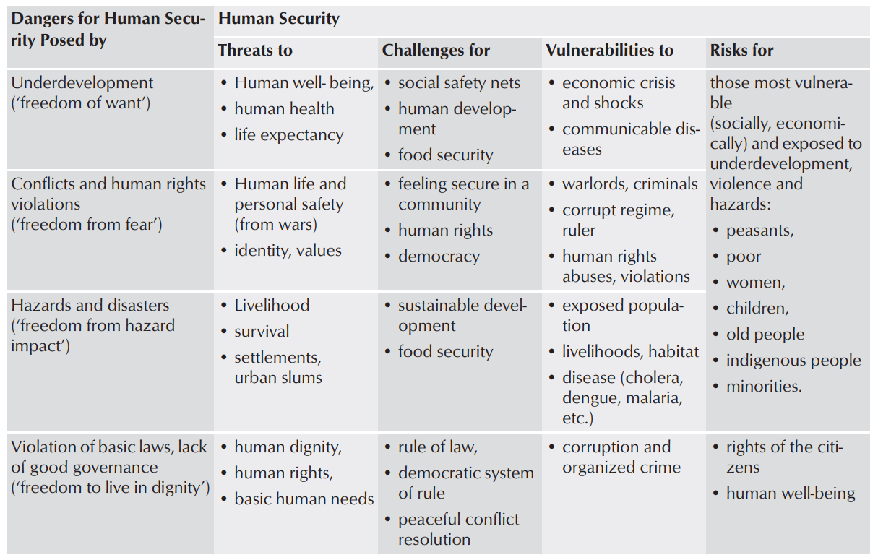
threat
Brauch 2011: 101
Concepts of Security Threats, Challenges, Vulnerabilities and Risks

Slide 15
structure
the context which allows for and limits the actions of actors
our context is international
the structure of the system is perceived differently, depending on the paradigm:
  realism, neorealism, liberalism, neoliberalism, Marxism, constructivism
the departing assumption dictates that since global governance is lacking: the international system is subject to varying degrees of anarchy
Unipolarity
Bipolarity
Multipolarity
Market structure
Interdependence
Dialectical materialism
World-systems core-periphery
World society
….

Slide 16
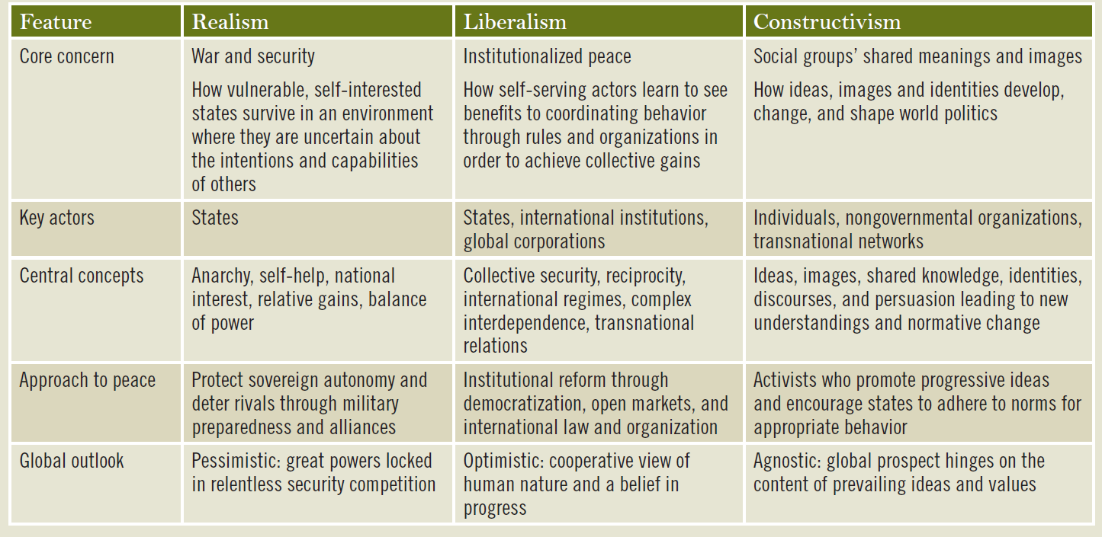
Paradigms (Kegley – Shannon 2011:47)

Slide 17
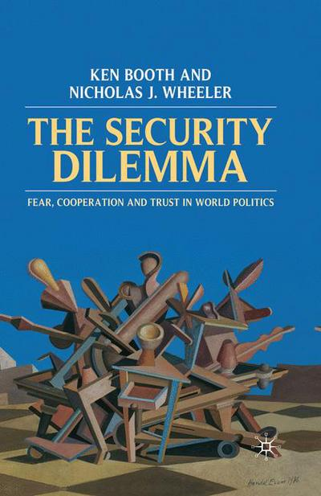
Uncertainty and the Security dilemma
2 level dilemma
not to be confused with security spiral (although often used in its lieu)
1st level dilemma – a dilemma of interpretation intentions, capabilities, and signals of others
  occurs under the inescapable and unresolvable uncertainty between defensive and offensive acts
  How can we know our adversary’s steps are aiming to change the status quo rather than safeguarding it?
2nd level dilemma – a dilemma of choosing the appropriate response to not reinforce the 1st level dilemma
  if 1st dilemma is evaluated incorrectly may send a strong signal to the opposite effect
  misplaced trust may lead to ruin, while deterring a benign act may result in escalation (security paradox)

Slide 18
Dealing with uncertainty
Fatalist logic (realism and neorealism)
  is the idea that security competition can never be escaped in international politics. Human nature and the condition of international anarchy determine that humans will live in an essentially conflictual world.
Mitigator logic (liberalism and neoliberalism)
  is the idea that security competition can be ameliorated or dampened down for a time, but never eliminated. Here, notions of regimes and societies are key, blunting the worst features of anarchy
Transcender logic (constructivism)
  is the idea that human society is self-constitutive, not determined. Humans have agency, as individuals and groups, and so human society can seek to become what it chooses to be, though inherited structural constraints will always be powerful. A global community of peace and trust is in principle possible if in practice it currently looks improbable.
  Booth and Wheeler 2008:143.

Slide 19
The broadening of security
Hard security
Soft security
primarily external existential threats
response military deterrence, threat, or use
response capacity is delimited geographically
realist-based and measured in terms of power
predominantly zero-sum
response requires other than military force, collaboration cooperation, prevention
response capacity and action is delimited by issue rather than geography
more liberal and measured in terms of coverage and progress
primarily internal, or transborder, or global threats
predominantly non-zero sum
Current mainstream approach COMBINES and EVOLVES
Constituting broadly out of 2 domains which overlap

Slide 20
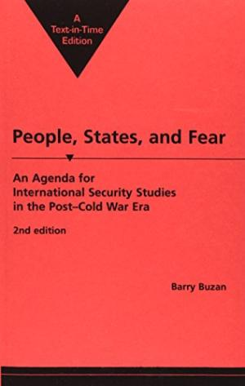
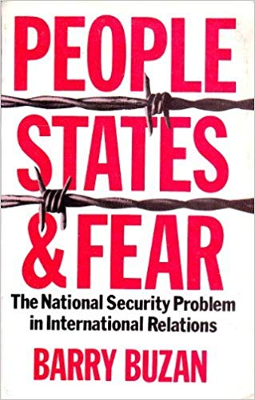
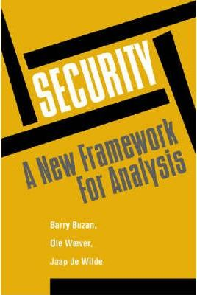
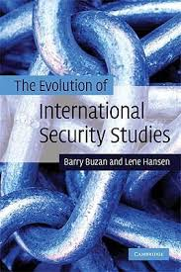
Evolution of security – through the eyes of barry buzan
1983 1991 1997 2009

Slide 21
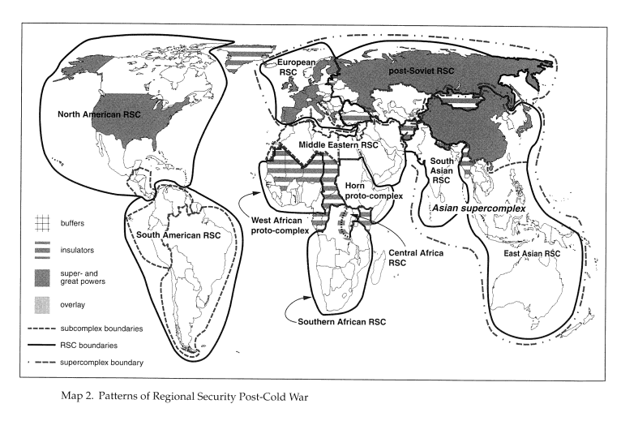
Mainstream security
Regional security complexes as ecosystems of security
Currently defined in 5 sectors:
Military
  state-centric; involve use of force; existential
Political
  regime orientated, ideological in nature
Economic
  acceptable level of stability
Societal
  coping with differences in identity and culture
Environmental
  climate and ecology orientated issues
at 3 different levels: individuals, states, and international system

Slide 22
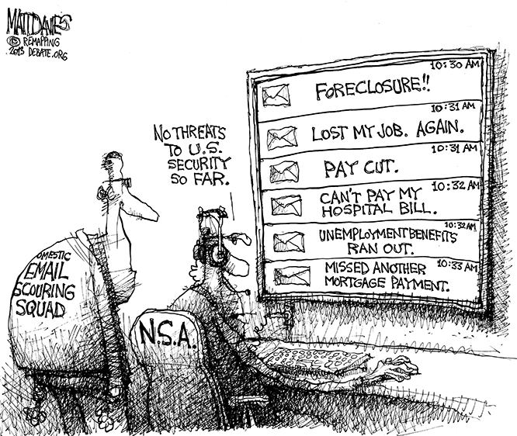
Securitization in ir
Making something more secure?
rather making something that was not a threat before (although existed) into a threat in the political arena
  by introducing an issue in the security discourse it becomes a threat
  step up from politicization – the act of making something a political issue
  once an issue is securitized it is subject to special treatment and security responses may apply
constant process broadening our definition of security
no “essence”, no universal feature of security
a self-referential practice

Slide 23
Securitization
Securitization act:
(1) claims that a referent object is existentially threatened
(2) demands the right to take extraordinary countermeasures to deal with that the threat
(3) convinces an audience that rule-breaking behavior to counter the threat is justified
Ole Weaver and Barry Buzan
followed by many iterations, revisions, and critiques

