Slide 1
International security - ireb1007
Fall 2022
Conflict resolution approaches
dr. Martin Chovančík

Slide 2
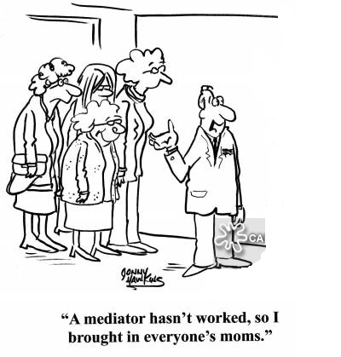
Starting discussion
Is a negotiated peace better than a peace won in battle?
Should we negotiate with terrorists? What about armed groups who have attacked civilians?
Do arms embargoes work?

Slide 3
Collective security
or why we should care about managing and resolving conflicts (addressing conflict to be more precise)
the necessary assumption of collective security is simply that wars are likely occur and that they ought to be prevented due to their destructive impact and spillover
collective security is not a design for organizing coalition warfare in the twentieth-century sense, but a plan for organizing international police action in an unprecedented sense over the pacific settlement of disputes:
the conflicts may be the fruit of unreflective passion or of deliberate planning; they may represent efforts to settle disputes. effects of undefinably broad situations of hostility, or calculated means to realize ambitious designs of conquest. They may be launched by the irresponsible dictate of cynical autocrats or the democratic will of a chauvinistic people-although the champions of collective security have frequently evinced the conviction that most wars are likely to stem from the former type of initiative. The point is that the theory of collective security is not invalidated by the discovery that the causes, functional purposes and initiatory mechanisms of war are varied. (Claude 1984)

Slide 4
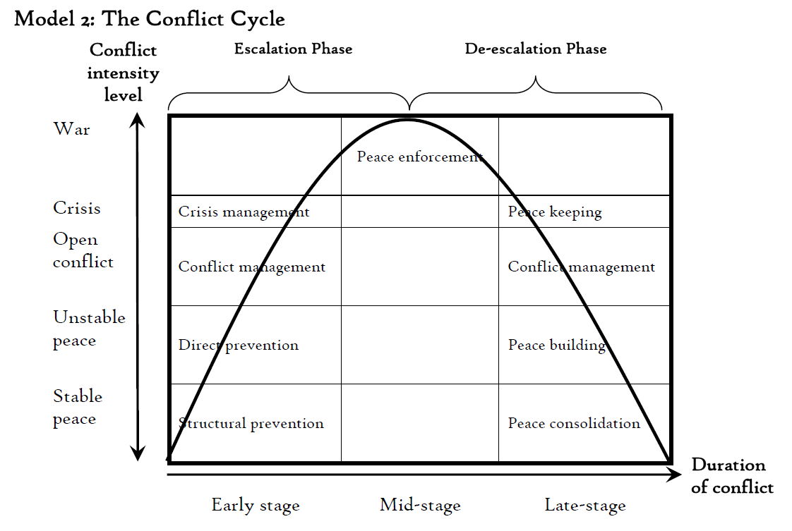
Conflict cycle + conflict trends

Slide 5
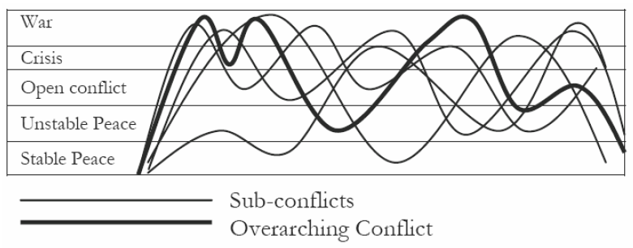
Actual conflict cycles

Slide 6
The spectrum of tasks
conflict prevention:
Activities aimed at preventing the occurrence and escalation of conflicts into their armed stage.
conflict management:
Activities aimed at the armed aspects of crises with the objective of stopping active combat, containing crisis spillover and minimizing destructive impacts.
conflict resolution:
Activities aimed at achieving a voluntary mutual peaceful solution to common incompatibilities and a cessation of hostilities.
post-conflict reconstruction:
Activities aimed at rebuilding the socioeconomic structure and conditions for stable peace.

Slide 7
resolution
(mediation, negotiated settlement)
post-conflict reconstruction
(DDR, SSR)
structural prevention
(stabilization projects, HR support)
direct prevention
(crisis diplomacy)
management
(peacekeeping, arms embargo)
ceasefire
peace
develop
instability
violence
escalation

Slide 8
Conflict prevention
Structural prevention
Long-term efforts on political, economic, developmental, cultural, civil society level
Emphasis on the indivisibility of security
IO membership, association agreements, cooperation, development programmes
Direct prevention
Immediate efforts during initial crisis phases
Early warning, mediation and shuttle diplomacy
Lackluster in practice
Early warning systems
Global and regional initiatives to identify crises prior to potential escalation
UN – 1998 primary initiative, 2000 Prevention team
IGAD – 2002 – CEWARN in the Horn of Africa
AU – 2009 – CEWS Continental EWS
Indicators to watch (WB):
past conflict, low income, high export dependence, political instability, human rights, militarization, ethnic dominance, regional conflict, unemployment rate among young adults, distribution of access to natural resources

Slide 9
Conflict prevention - Preventive diplomacy
Problem with precise definition
Could possibly encompass all of diplomacy (in the structural segment) by way of “building stable societies/states” argument
Pre-emptive diplomacy might suit as a better term, but is disused
Definition:
Action taken in vulnerable places and times to avoid the threat or use of armed force and related forms of coercion by states or groups to settle the political disputes that can arise from the destabilizing effects of economic, social, political, and international change. (Lund 1996)
Instruments:
International appeals – suasion, Fact-finding missions, on-site monitoring, Good offices, Early warning systems, Official diplomacy, Two-track diplomacy, Conciliatory gestures, Mediation, Incentive offerings, Negotiation forums
Note that they do not contain coercive measures

Slide 10
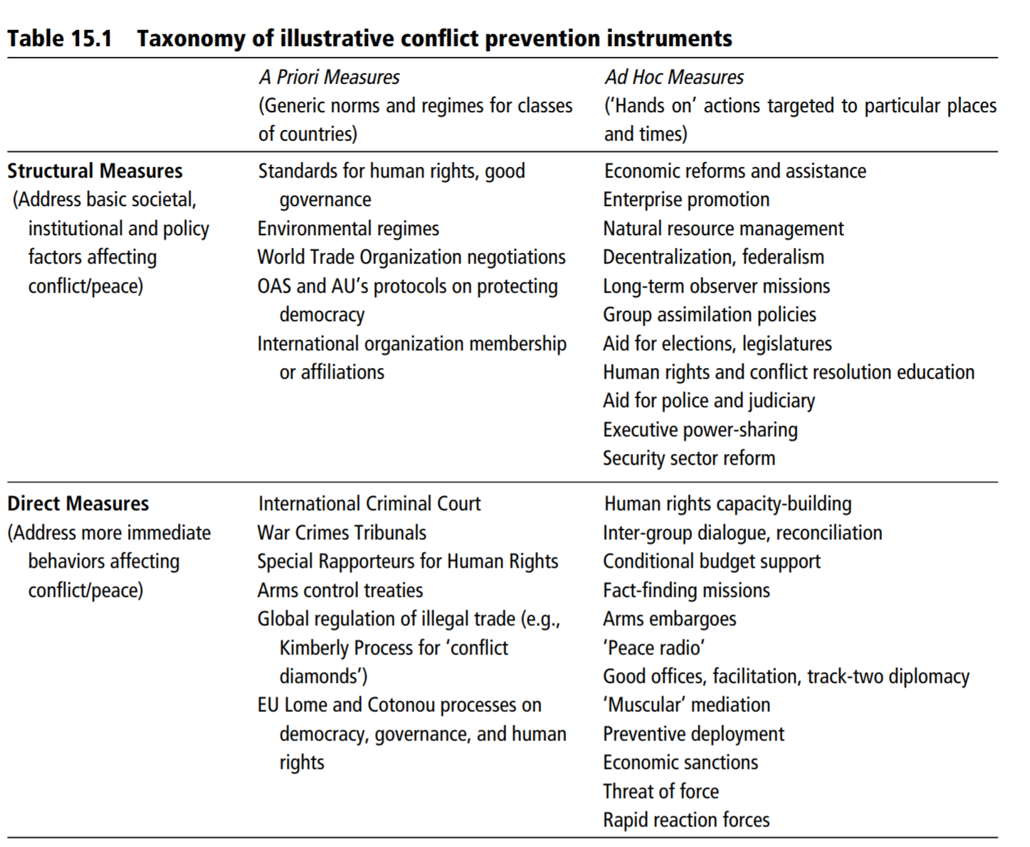
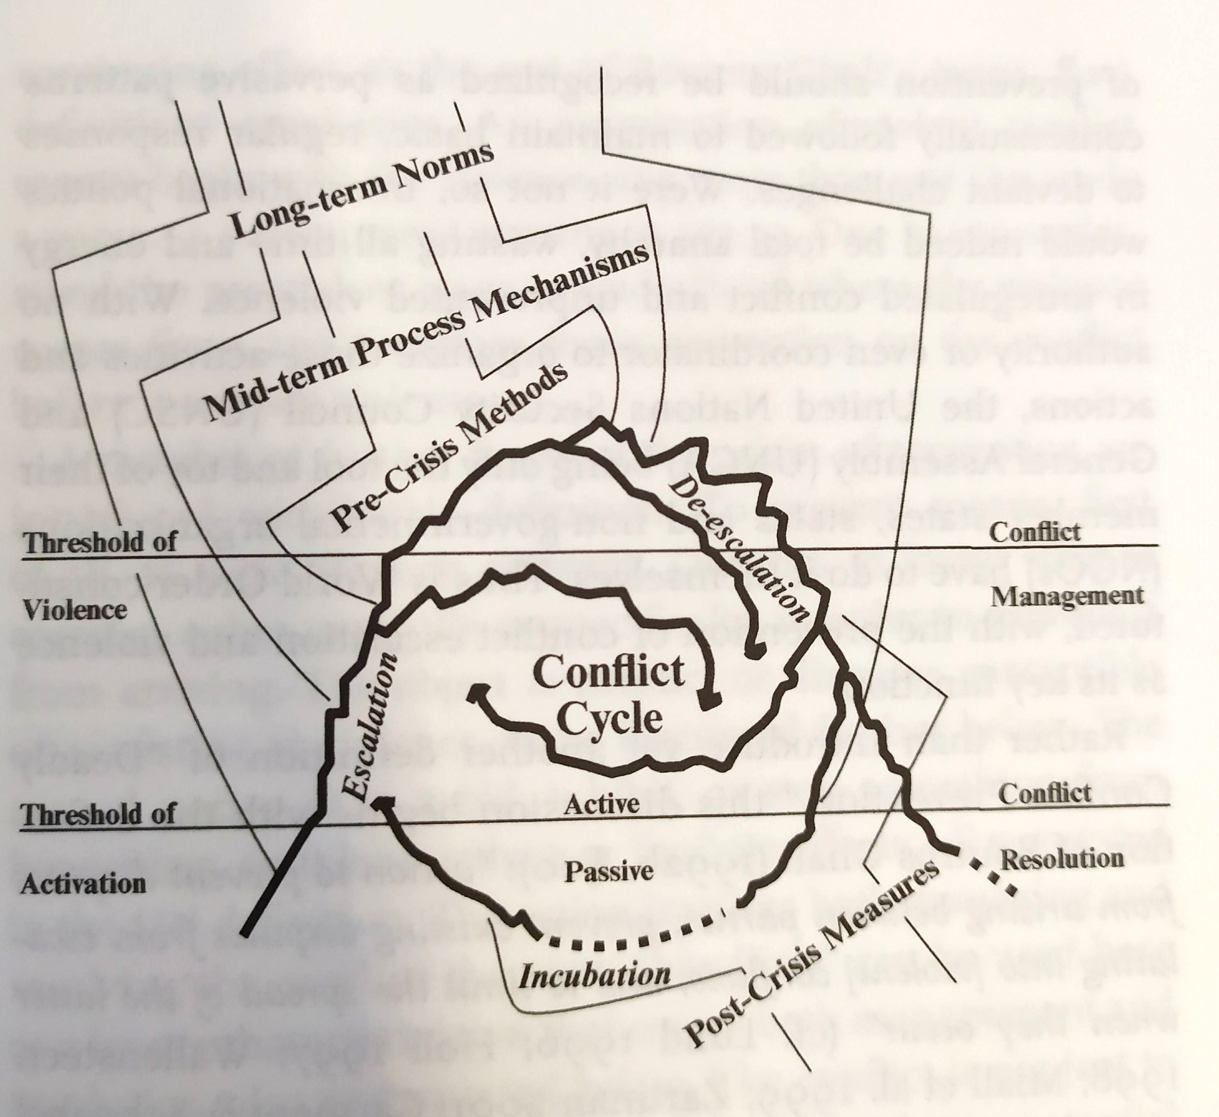
Structural vs. operational prevention
A comparison of “Old” prevention and “New” prevention
Consider a priori to contain norm-building (oft untargeted) measures
Zartman 2016
Lund 2009

Slide 11
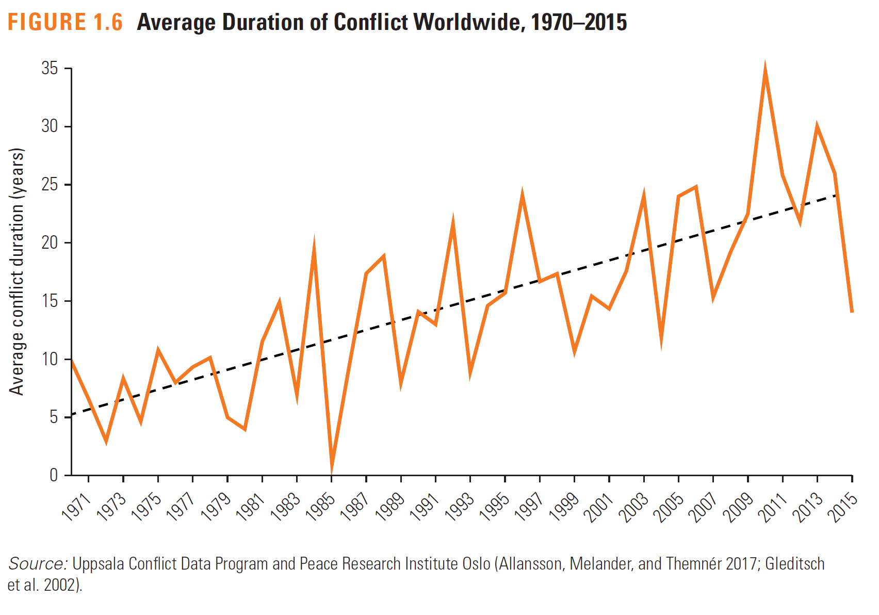
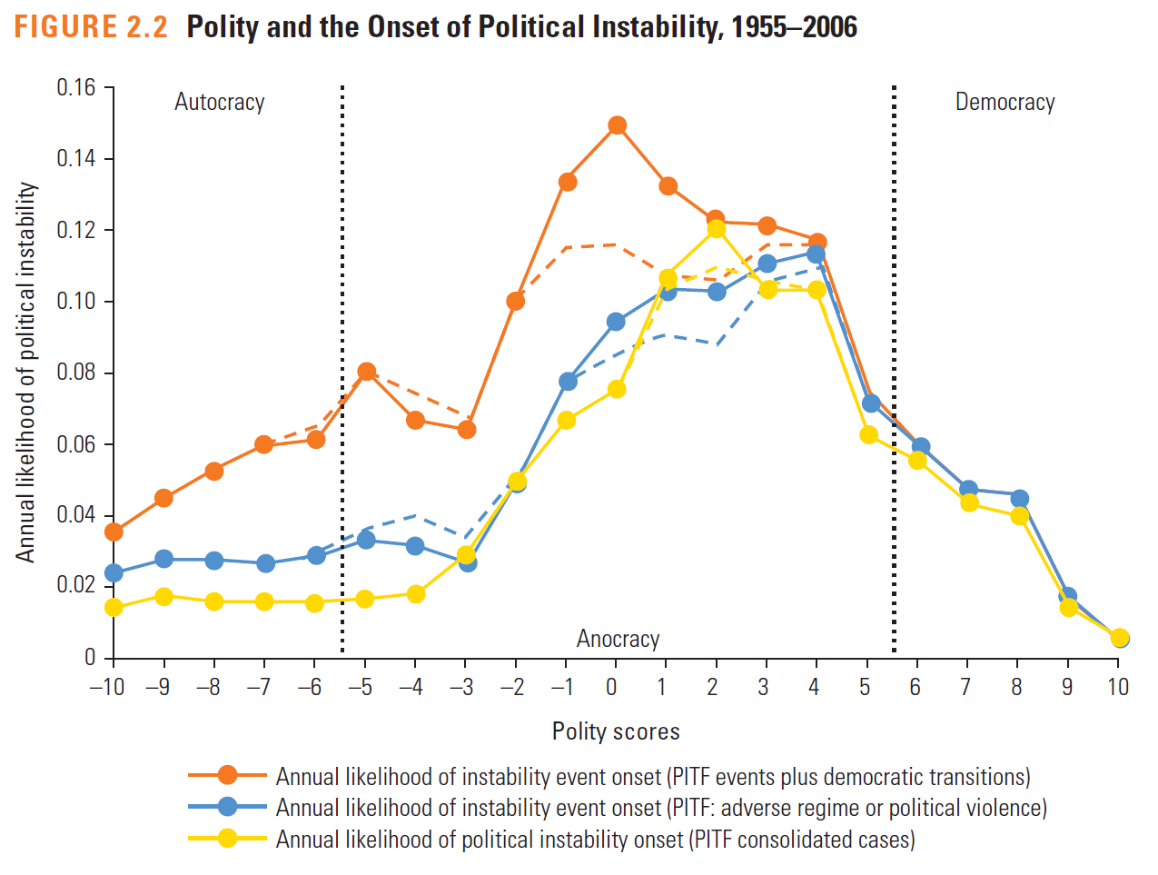
Consider the environment
Contexts is far more volatile
Risk-laden
Insurgency use of terror
Fractionalization and ease of access to shock-violence
Long consolidation processes
WB 2018

Slide 12
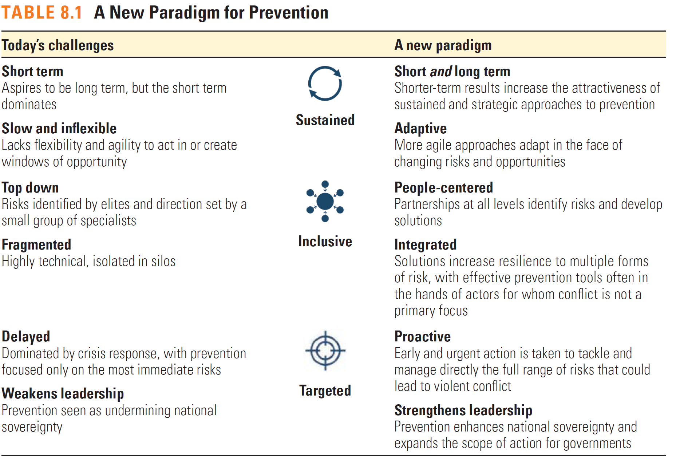
Paradigm shift in current prevention
Standing operational prevention (Nathan)
But standing cannot be coercive (as it would be opposed), yet coercion is oft required
Does bottom up/multitrack also mean powerless?
WB 2018

Slide 13
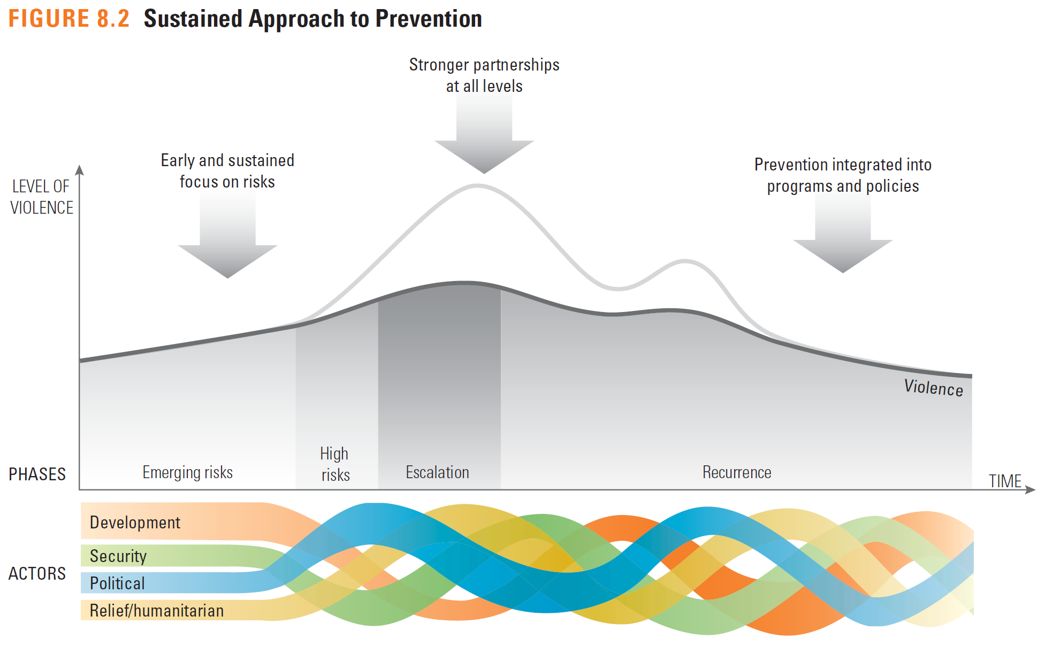
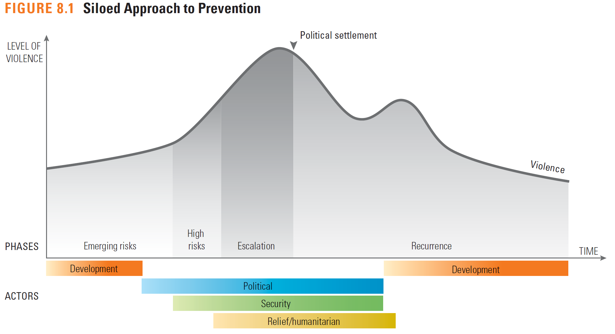
Sequencing and investment
Main paradigm shift in separating structural and operational prevention (targeted and untargeted)
Long-term engagement at a higher intensity
Institutionalization of capacities (2008 UN MSU)
Aided by structure of SDGs
WB 2018

Slide 14
Prevention Success factors in the last decade
Absence of large-scale violence
Consent to preventive action
Unity of effort from community
International leverage and the will to use it
Use of incentives for pull factor
Absence of major power interest
Multi-hatted envoys
Pre-existing multitrack relations
Engaged civil society and inclusivity
UN 2015, 2018; Huan 2017; Nathan 2018,2019; Emmanuel 2016; Karreth 2018;

Slide 15
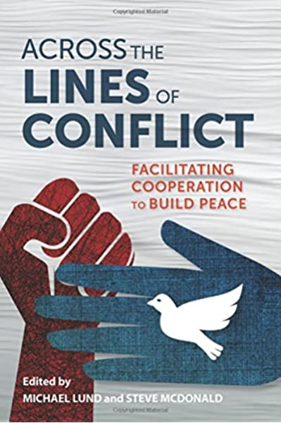
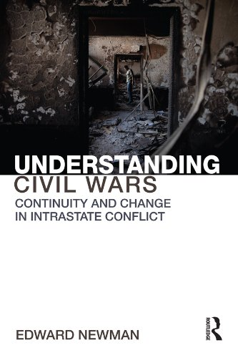
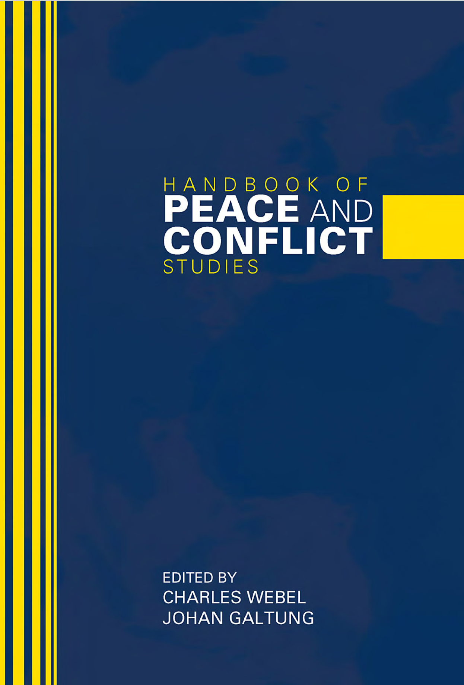

Slide 16
Conflict management
Conflict management de-escalation strategies
GRIT graduated reciprocation in tension-reduction
One-sided announcement of conciliatory measures, which continues even without immediate reciprocity
TFT Tit for Tat
Simulation and game theory based
Initiate cooperative stance, and then reciprocate consistently depending adversary’s response (positive or negative)
Mutually enticing opportunity
Third party creation of conditions with pull-factor from current deadlock or Mutually Hurting Stalemate

Slide 17
Conflict management - mediation
Mediation
Defined as negotiation facilitated by third, presumably impartial, parties, to help seek a solution the direct parties cannot find themselves
Voluntary
in selecting mediation, mediator, presence, progress, and most of all propositions and results
Dynamic process
concession, compensation, and construction OR positive-sum negotiations and bargaining negotiations
Cheap
cheaper than any other form of third party involvement
Absence of coercion
Although possibility of “mediation with muscle”
the process of combining conflicting positions into a joint agreement… and is the most common (although not the only) way of preventing, managing, resolving, and transforming conflicts
(Zartman 2009: 322).

Slide 18
Conflict management - coercion
Deterrence – discourage, seek inaction in target’s sought and intended steps
Compellence – force to take initiative, take unplanned action desired by the sender (including cessation) (the slippery slope of compliance)
Compellence easier than deterrence (expected utility)? Give examples of both. Which is more prevalent?
Or is it? (prospect theory) – different risk aversion
Prospect theory leads us to conclude that the adversary is more likely to opt for the sure bet of compliance in deterrence situations and will tend to choose the risky gamble of defiance in compellence situations (Schaub 2004)

Slide 19
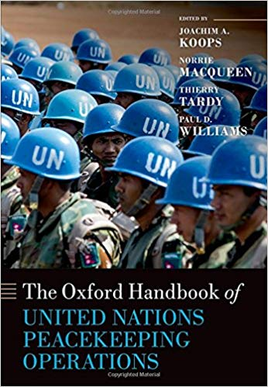
Military Conflict management
intervention by mainly military, usually multinational force
activities aimed at creating/maintaining a secure environment in order to end a crisis and/or enable peace to be established/maintained
MCM now coupled with CCM (Civilian CM) includes:
peacekeeping missions
conflict prevention missions
stabilization and reconstruction missions
humanitarian missions

Slide 20
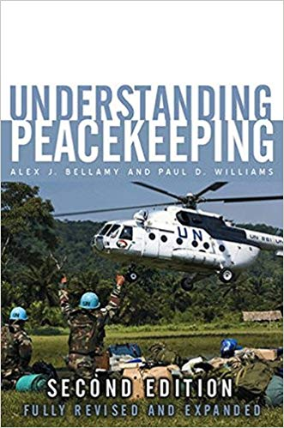
Military Conflict management
first, the spectrum of tasks has expanded
from traditional peacekeeping (containment and reduction of military escalation) to social, political, and economic transformation (conflict resolution)
from consenting states to hostile environments
from buffer zones to active engagement
from single actors to multinational coalitions and IOs in cooperation to cover the spectrum
“Comprehensive Approach” to complex political emergencies

Slide 21
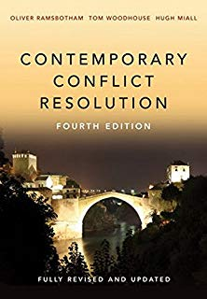
Conflict resolution
peacemaking in the narrow definition
unless victory is achieved stems from negotiation
resolution options revolve around
Priority change
Division of subject of contention (part in the executive)
Barter exchange
Joint control (coalition)
Delegated control
Arbitrage
Deferral
employed instruments involve ALL deployed instruments - MULTITRACK

Slide 22
Conflict resolution - negotiation
1. pre-negotiation
a dominant field today, where mediation comes into play the most often
aims to frame a possible acceptance of a negotiated settlement or even meeting for negotiations
2. agreement formula
within the negotiation or mediation processes this phase entails the establishment of major agreement framework such as recognition, need for concessions, shared rule, or third party assistance
3. agreement details
perhaps the longest phase delivers the specifics
actors readjust their strategies ‘phase by phase’ according to their subjective consideration of three factors:
the contents of the peace proposal,
the resources under their control
the strength of the incentives and pressures from external interveners.

Slide 23
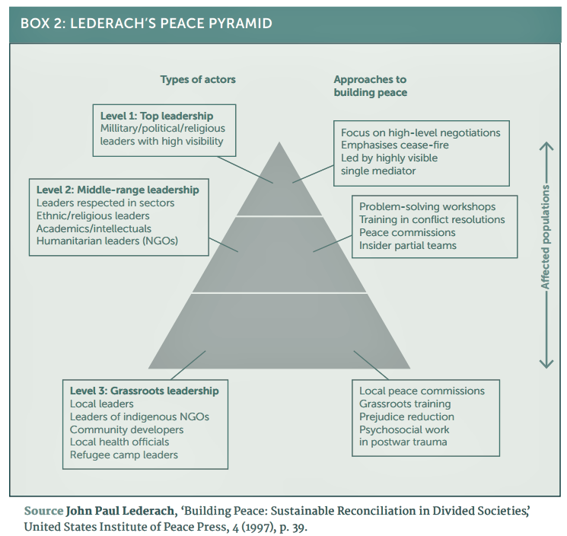
Conflict resolution
Dilemmas include:
Negotiated settlement vs. Victory
strenuous debate over more stable and lasting peace
Inclusivity vs. Spoilers
negotiation dilemma of including relevant stakeholders
Guarantees vs. Non-intervention
peace agreement guarantor and guarantees

Slide 24
Post-conflict reconstruction
Activities aimed at renewing the socio-economic structure of the society and the establishment of adequate conditions for the secure and peaceful development of society
Key concepts:
System inclusion
External assistance
Sustainability after self reliance
Reconstruction serves as structural prevention
Nation building – synonym for post-conflict reconstruction? Or for democratization and westernization? – only a part of post-conflict reconstruction

Slide 25
Post-conflict reconstruction
4 pillars
Security – crucial to any success
Civilian security, DDR, buffer zones, civilian control over armed forces, training
Justice and Reconcilliation – establishment of rule of law
Preventing reprisals, interim justice, human right legislation, police training
Social and economic well-being – aid and resources distribution
Elementary food and water security, repatriations, infrastructure reconstruction, requalification training, subsidies and investments
Governance and participation – transitive authority support
NGO cooperation, interim government support, election preparations, legislation expertise transfer, civil society support
2002 Post-Conflict Reconstruction (CSIS/AUSA)

