Slide 1
Nuclear Arms Race in the First Nuclear Age

Slide 2
Nuclear Weapons Proliferation
1st Nuclear Age – 1945 – 1989
Vertical proliferation
2nd Nuclear Age – 1990 – present
Horizontal proliferation

Slide 3
Motives for NW Proliferation
USA 1945
USSR 1949
Belarus
Ukraine
Kazakhstan
Great Britain 1952
France 1960
China 1964
Israel 1966
India 1974
South Africa 1979
Pakistan 1998
North Korea 2006

Slide 4
Nuclear RMA
„The historical trajectory of the (US) nuclear RMA was as follows:
the scientists told the politicians and bureaucrats what might be achieved with patience, a great deal of money, and a huge industrial effort (1939–41);
the politicians and officials, after much delay and notwithstanding some initial skepticism, decided that the scientists’ story had to be tested (1941–45);
the military sought to fashion a nuclear-armed long-range striking force which actually could express a radical change in the character and conduct of war (1948–54/55);
and finally a body of scholar-commentators appeared which tried to make strategic sense of the nuclear RMA that already was a well established fact (1954–57).
Each of these four clusters of people shared parentage of the nuclear RMA. When we refer to the nuclear revolution we mean not just the military-technical epiphanies exploded in 1945, 1949, 1952, and 1955. In addition, we mean the military instrument(s) and the political, moral, strategic, and other contexts shaped by the radical change in warfare.“
Gray, C. S.: Strategy for Chaos, p. 204.

Slide 5
Nuclear Stockpiles of the USA and USSR 1945-1989
 | USA | USSR
1945 | 6 | 0
1950 | 369 | 5
1955 | 3057 | 200
1960 | 20 434 | 1605
1965 | 31 642 | 6129
1970 | 26 119 | 11 643
1975 | 27 052 | 19 055
1980 | 23 764 | 30 062
1985 | 23 135 | 39 197
1989 | 22 174 | 35 805

Slide 6
U.S. Strategic Concepts
Massive Retaliation
Flexible Response

Slide 7
Soviet Thinking on NW
Stalin
Khrushchev
Brezhnev
Gorbachev

Slide 8
Strategic Weapons

Slide 9
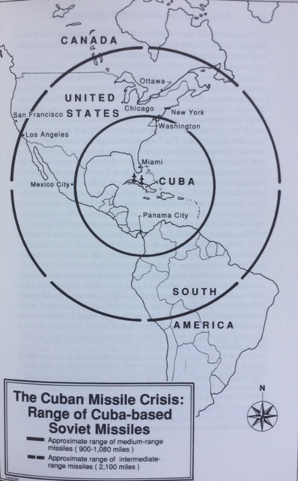

Slide 10
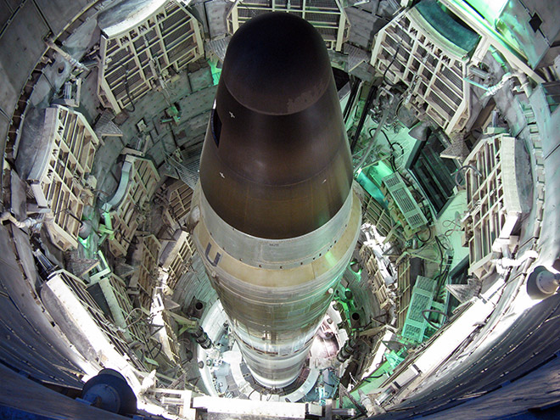
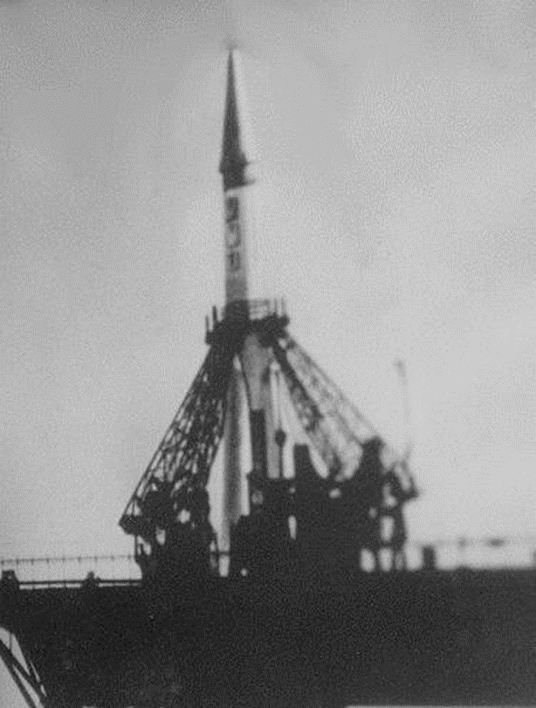
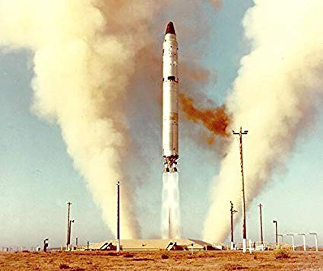
MAD
Declaratory doctrine

Slide 11
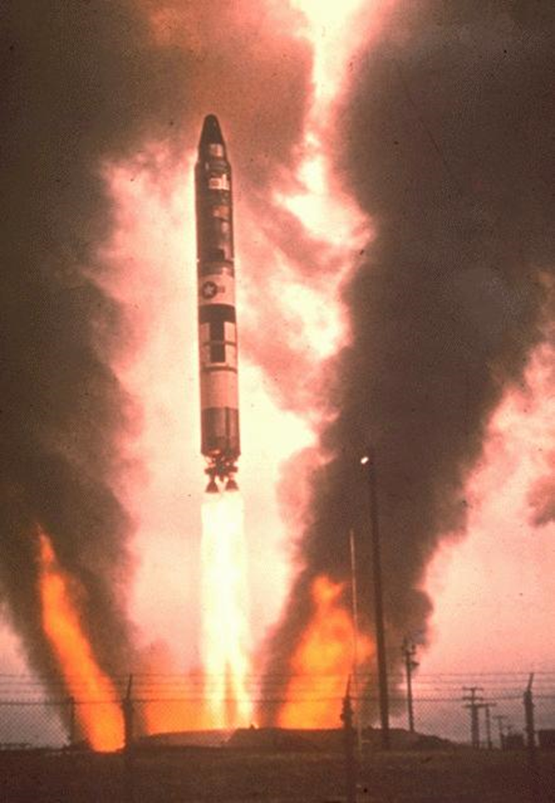
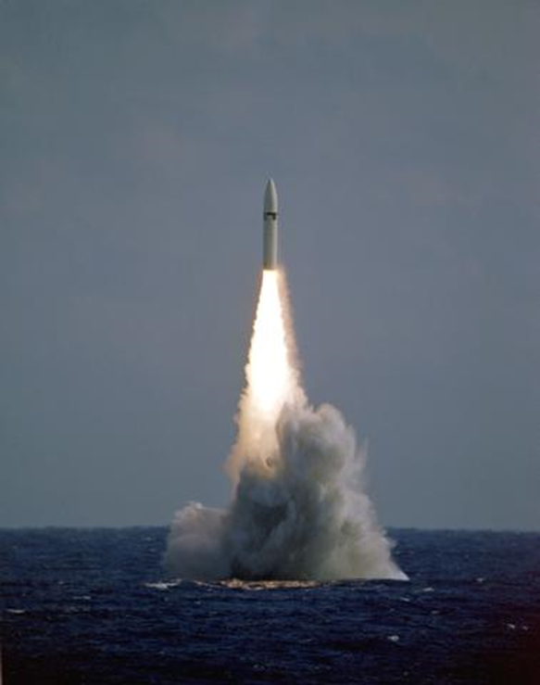
Strategic Triad

Slide 12
SS-11 Sego
990 missiles deployed between 1966-1972

Slide 13
Strategic Weapons

Slide 14
Strategic Weapons

Slide 15
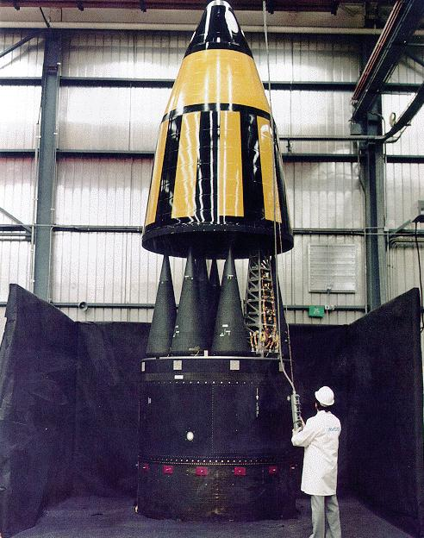
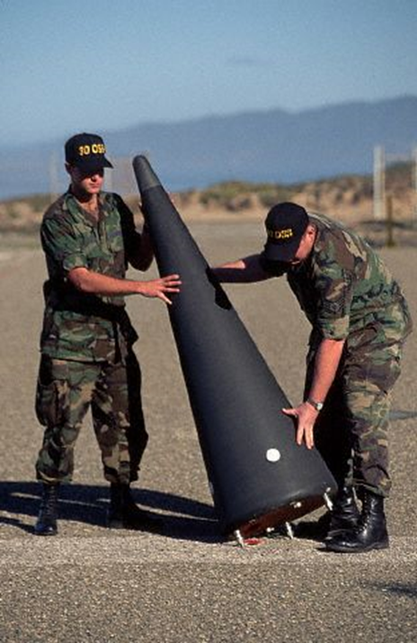
MIRVs

Slide 16
Strategic Weapons

Slide 17
Strategic Weapons

