Slide 1
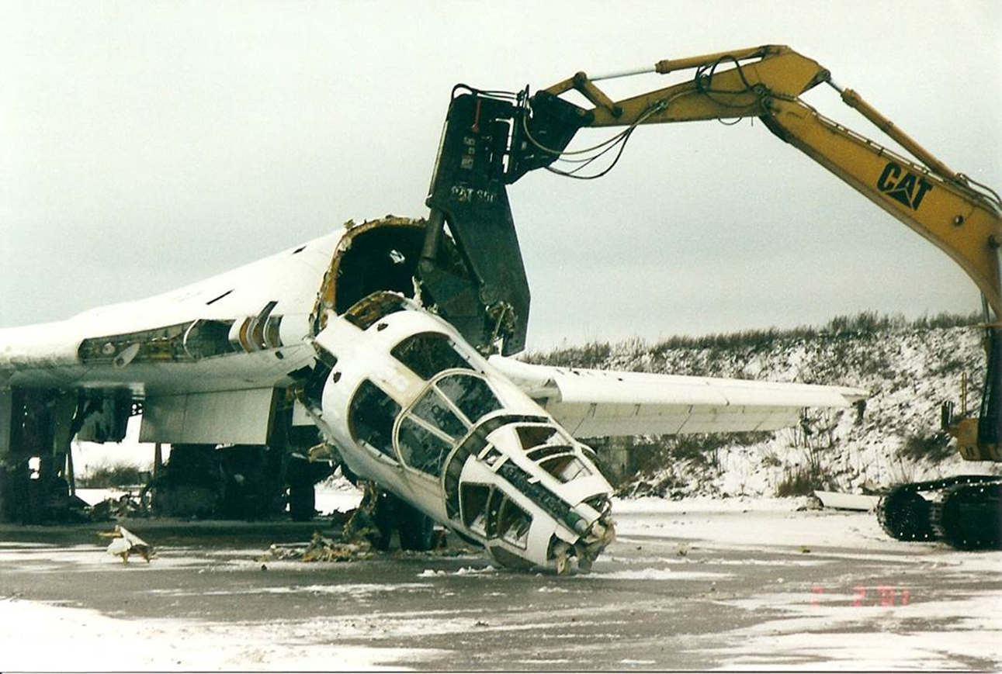
Nuclear Arms Proliferation and Control

Slide 2
Nuclear Weapons Proliferation
1st Nuclear Age – 1945 – 1989
    Vertical proliferation
2nd Nuclear Age – 1990 – present
    Horizontal proliferation

Slide 3
Motives for NW Proliferation
USA 1945
USSR 1949
    Belarus
    Ukraine
    Kazakhstan
Great Britain 1952
France 1960
China 1964
Israel 1966
India 1974
South Africa 1979
Pakistan 1998
North Korea 2006

Slide 4
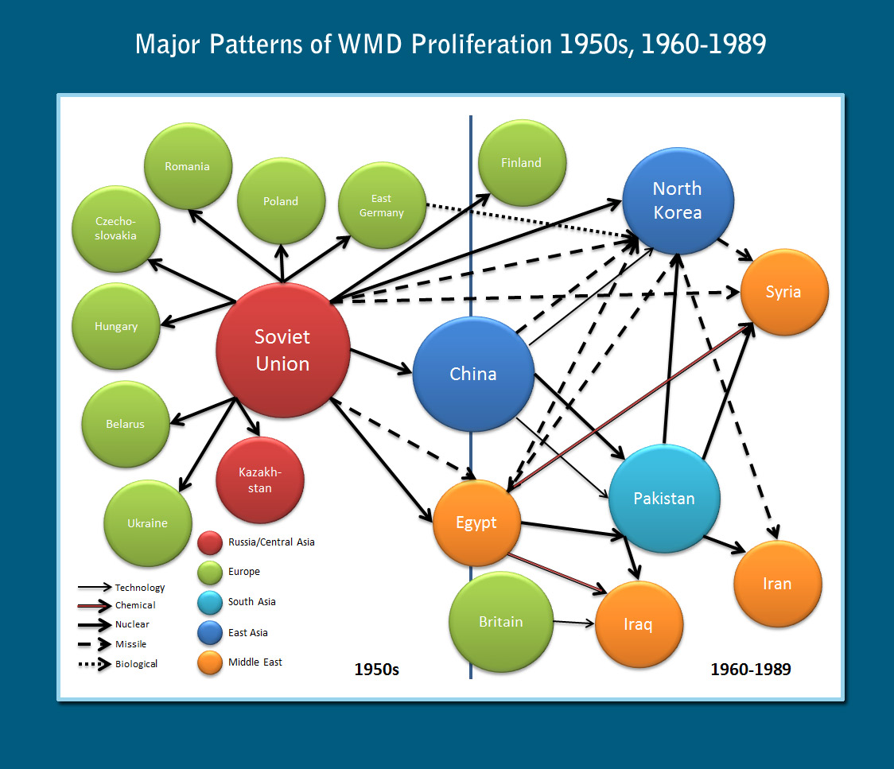

Slide 5
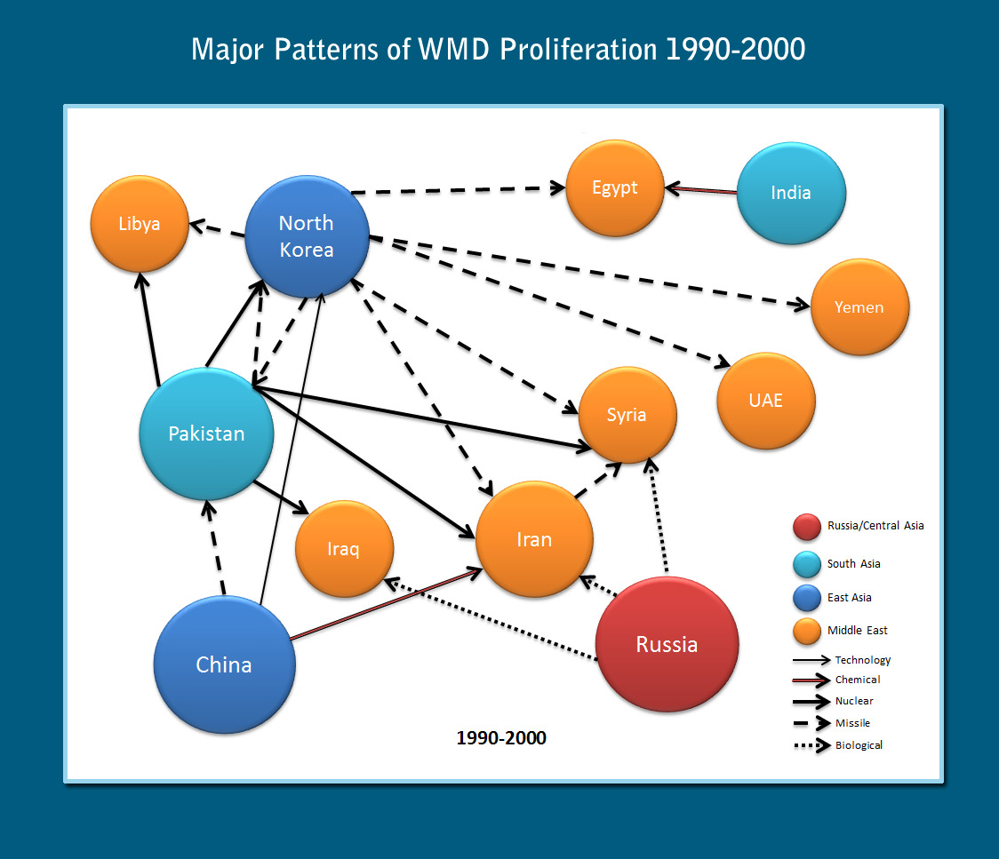

Slide 6
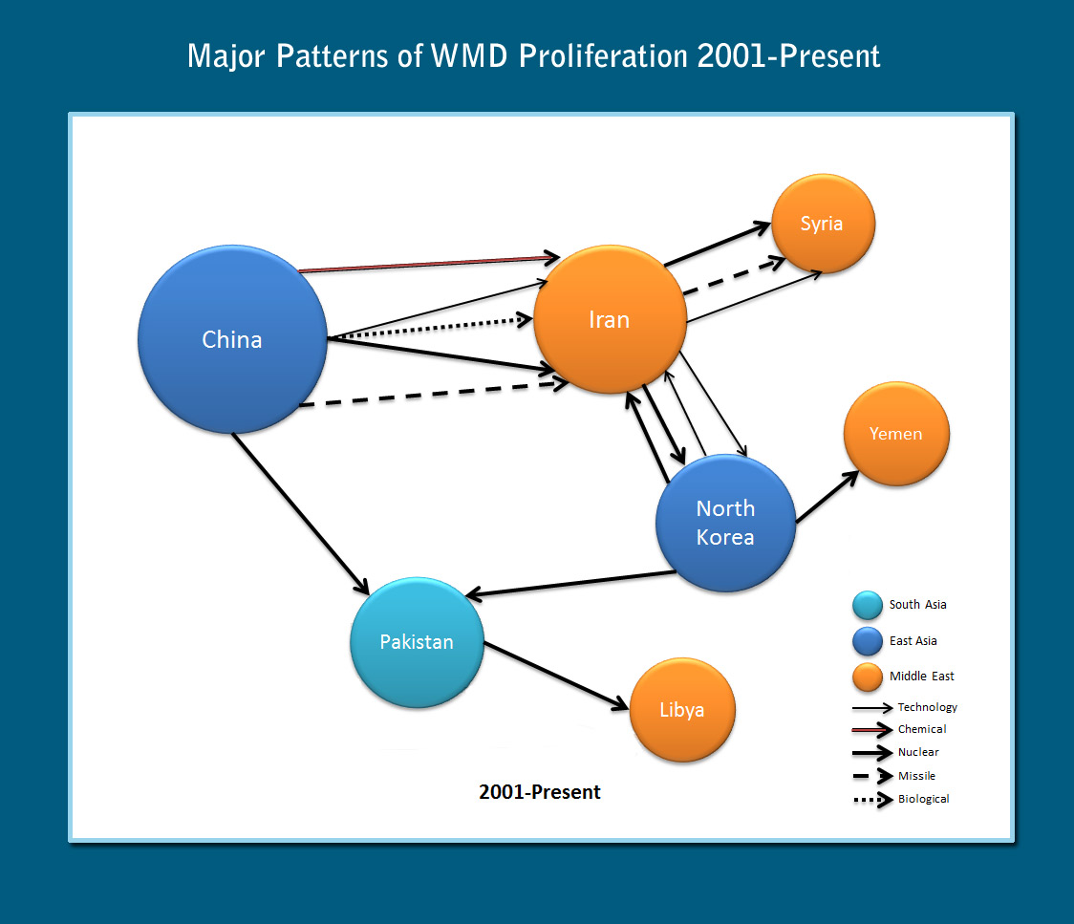
Choksy, C. B. E. and Choksy, J. K. (2013). WMD Proliferation Threatens the World. (http://yaleglobal.yale.edu/content/wmd-proliferation-threatens-world)

Slide 7
Nuclear Stockpiles of the USA and USSR 1945-1989
 | USA | USSR
1945 | 6 | 0
1950 | 369 | 5
1955 | 3057 | 200
1960 | 20 434 | 1605
1965 | 31 642 | 6129
1970 | 26 119 | 11 643
1975 | 27 052 | 19 055
1980 | 23 764 | 30 062
1985 | 23 135 | 39 197
1989 | 22 174 | 35 805

Slide 8
Arms Control
„The excercise of restraint in the acquisition, deployment and use of military capabilities“
„Measures that enable actors to conduct themselves in a more restrained way (through developing techniques of crisis management)“ (Evans, Nenham 1998:33)
„All the forms of military cooperation between potential enemies in the interest of reducing the likelihood of war, its scope and violence if it occurs, and the political and economic costs of being prepared for it.“ (Schellin & Halperin 1985: 2)

Slide 9
Disarmament
A process – reduction, removal, elimination of identified weapon systems
A state – establishment of a disarmed world and the prevention of a rearmament thereafter

Slide 10
Structural & Operational Arms Control
Structural – qualitative and quantitative aspects of weapons of a given class. The goal is to achieve or keep arsenals in balance and thus establish or keep parity and stability
Operational – attempts to keep adversaries as restrained as possible when resort to arms is concerned. The aim is to prevent an outbreak or further escalation of a conflict

Slide 11
Croft’s Typology
Arms control at the conclusion of major conflicts
Arms control to strengthen strategic stability
Arms control to create norms of behavior
Arms control managing proliferation of weapons
Arms control by international organization

Slide 12
Arms Control & Disarmament
What arms control and disarmament treaties do you know?

Slide 13
Operational Arms Control
The U.S. – the USSR Hot Line Agreement (1963)
Limited Test Ban Treaty (LTBT – 1963)
Nuclear Non-Proliferation Treaty (NPT – 1968)
Threshold Test Ban Treaty (TTBT – 1974)
Comprehensive test Ban Treaty (CTBT – 1996)
Outer Space Treaty (1967)
Seabed Treaty (1971)
CSBMs

Slide 14
Structural Arms Control
SALT I and ABM Treaty (1972)
SALT II (1979)
INF (1987)
START I (1991)
START II (1993)
SORT (Moscow Treaty)
New START (2010)

Slide 15
SALT I
 | ICBMs | SLBMs | SSBNs with SLBMs
USA May 1972 | 1054 | 656 | 41
SALT I Limit | 1054 | 710 | 44
SSSR May 1972 | 1618 | 740 | 56
SALT I Limit | 1618 | 950 | 62

Slide 16
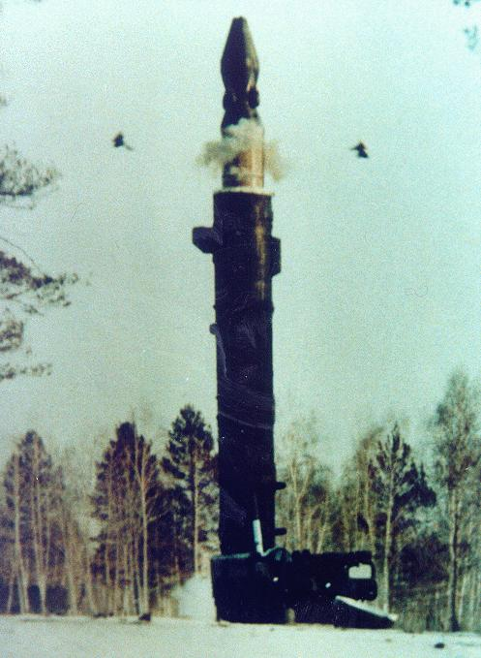
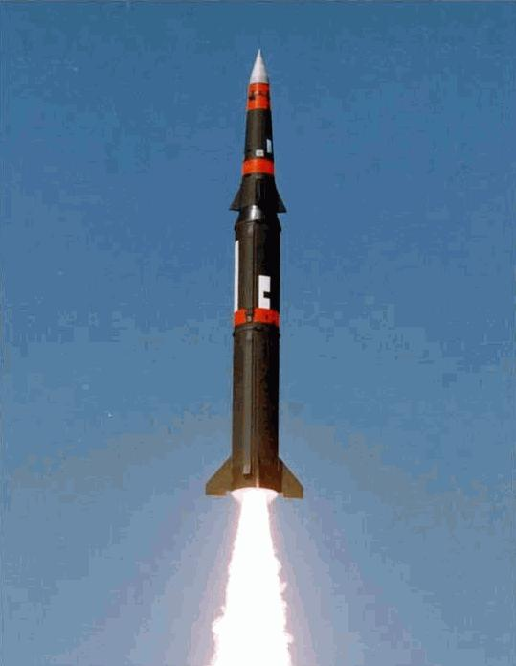
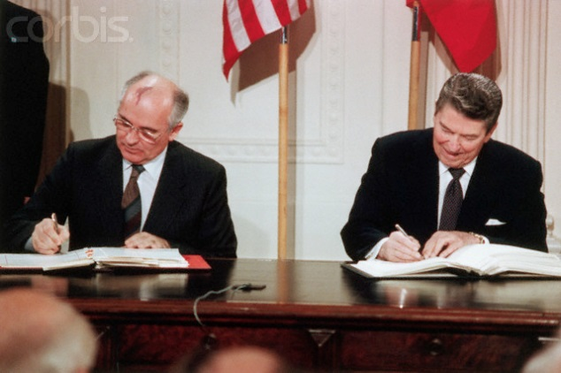
The INF Treaty
Intermediate-Range Forces Treaty
1987 U.S.-Soviet Treaty
Global withdrawal and elimination of U.S. and Soviet land based MRBMs (500-1000 km) and IRBMs (1,000-5,500 km)
Very robust on-site inspection and verification measures for production and deployment

Slide 17
INF Treaty
USSR
SS-20 - 654
SS-23 - 239
SS-4 – 149
SS-5 – 6
SS-12 – 718
SSC-X-4 - 80
Aggregate n. - 1846
USA
Pershing 2 - 234
GLCM – 443
Pershing IA - 169
Aggregate n. - 846

Slide 18
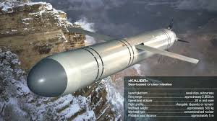
Central Problem: Russian Violation
  Russian test 2 Sept. 2015 was first launch of GLCM with potential INF range, 500-5,500km, and is a Treaty violation
Test of a ground-launched cruise missile, the R-500, or SSC-X-8, this is a version of Kalibr used to attack targets in Syria

Slide 19
Multilateralization of the Treaty
It saves the INF Regime, Aids U.S., Russian, and Global Security
Who Should Join? China is the key actor due to Russian concerns
  China’s accession to the Treaty would have a substantial stabilizing effect in the light of the proliferation of Chinese IRBMs and growing Russian concerns.
  Alexei Arbatov and Vladimir Dvorkin, Russian Arms Control Experts: “China must be taken into consideration when discussing subsequent U.S.-Russian initiatives on arms limitations and reductions.”
Were China to join, Russia would still have an incentive to remain within the Treaty, as IRBMs would remain banned

Slide 20
This is a Complex Problem
One of the most challenging arms control negotiations
Dangerous security situation in Asia
  Particularly tension between China and Japan, and China and India
To move forward, it is necessary for Russia and the United States to approach and engage China directly on this issue
  This step would recognize Beijing’s special status and importance as a growing force in international politics.
Likely strong resistance such a proposal would meet from other regional players, such as India and Pakistan
China has the diplomatic, economic, and military means to further its goals and ambitions without its land based IRBMs

Slide 21
Why China should join the INF Treaty (2 of 3)
Benefits for Asia (reduces security dilemma)
  Given present tensions in Asia. New Delhi, Hanoi, Manila, and Tokyo are suspicious of China’s possible territorial ambitions in the East and South China Seas, and along the Sino-Indian border
  There is a strong legacy of mistrust, and the possibility of arms races, crises, and intense security competition is significant
Benefits for China: It is a Status Quo Power Interested in Strategic Stability
  Beijing shows it accepts the value of arms control and seeks confidence-building measures
  Demonstrates that China is a status quo power in the Asia-Pacific
  Strengthens the ballistic missile non-proliferation regime

Slide 22
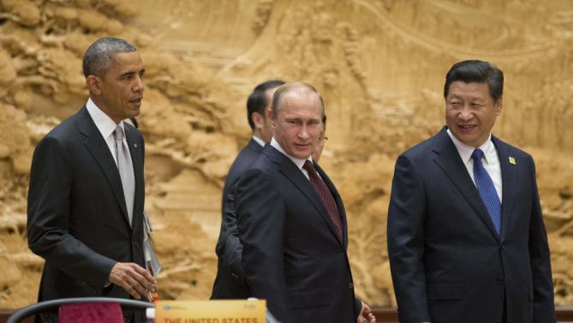
What China Will Gain
Russia is prevented from reintroduction of their land based INF systems in Asia
The U.S. is prevented from potential deployment in East Asia and Pacific
As Moscow and Washington operate under the New START Treaty, China could have confidence that their strategic force will not increase
Other states might be inspired to join the treaty

Slide 23
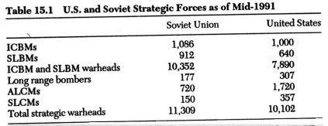
Strategic Weapons

Slide 24
START Treaties
START I - Limit 1600 strategic carriers (ICBMs, SLBMs, strategic bombers)
6000 nuclear warheads
START II - Limit 3500 warheads
Ban on MIRVed ICBMs
Ban on „heavy“ missiles

Slide 25
START Treaties
SORT (2002)
1700-2200 warheads
New START (2010)
1550 warheads
700 operational launchers

Slide 26
Current Nuclear Arsenals
USA 2080 (7100)
Russia 4500 (7500)
France 300
China (260)
Great Britain (215)
Pakistan (130)
India (120)
Israel (80)
North Korea (15+)

