Slide 1
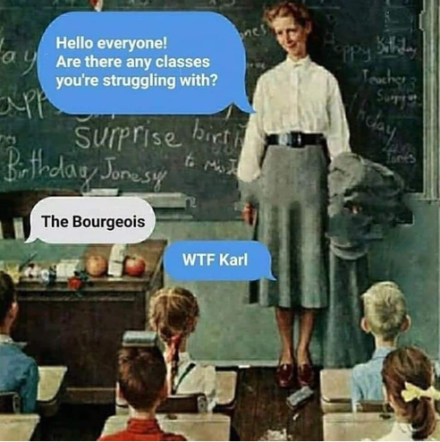
Marxism

Slide 6
Marxism in international relations
Marx does not deal with international affairs much
International outcomes are results of the economic base
Various attempts to apply:
Lenin's imperialism
Trotsky's uneven and combined development
Robert Cox's application of Gramscian thought
Wallerstein's world-systems theory

Slide 8
Gramscianism
The role of base and superstructure is changed
Hegemonic culture to misinterpret the interests of the controled class and pacify it
They live/Jsou mezi námi

Slide 9
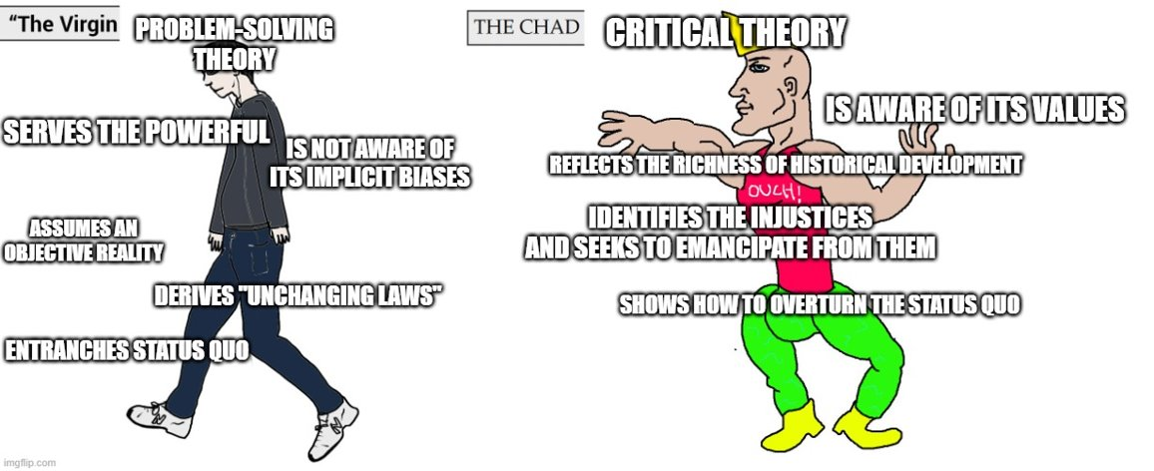
Robert Cox – Gramscian in international relations
"a theory is always for someone and some purpose"
Critical vs. Problem-solving theory

Slide 10
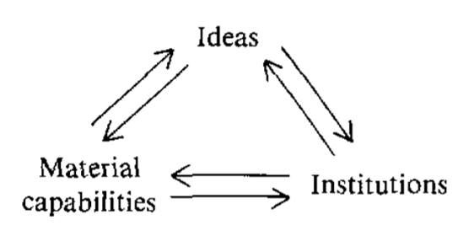
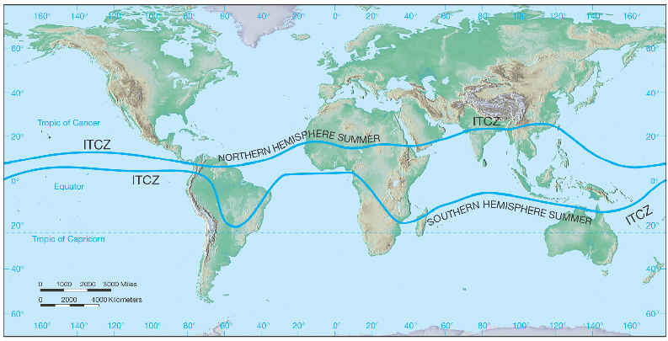
Cox: Critical vs. Problem-solving Theory
Holistic, interaction of the base and (reformed) superstructure, historical
Three main components that are interrelated which define a system like IR
The case of origin of states

Slide 11
Cox
Critical theory is deriving the definition of a particular structure, not from an abstract model but from a study of the historical situation
If we look at international system from the point of critical theory...
How did it develop? Why is it this way? How could it be changed? We look at historical process that made it this way and possibility of change

Slide 12
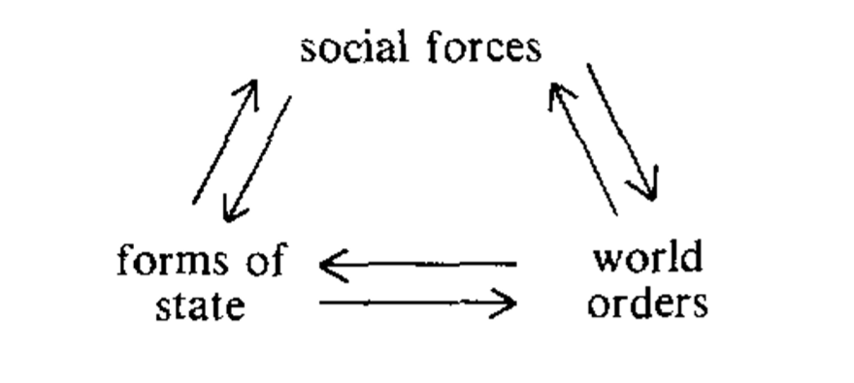
Cox: Three main levels of historical structures
Modes of production (social forces)
Forms of states
World orders
Are Interrelated: changes in modes of production affect forms of states which in turn alter world orders etc.
Example: The process of transformation from feudalism to capitalism

Slide 13
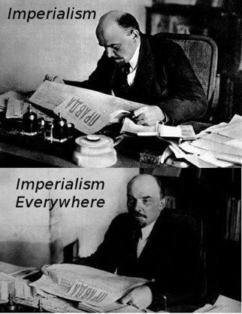
Imperialism the final stage of capitalism
Monopolization
Spreading of capitalist exploitation -> colonies
Core vs. Periphery
Maximization of profits leads to struggle over periphery
Exploitation of periphery enables improved living standards in the core

Slide 16
Uneven and combined development
Marxism assumes linear development forward
International interaction does change that
Combining developed and backward aspects in various ways
Creates unique characteristics in societies combining local and global influences

