Slide 1
Why are we talking about realism?

Slide 2
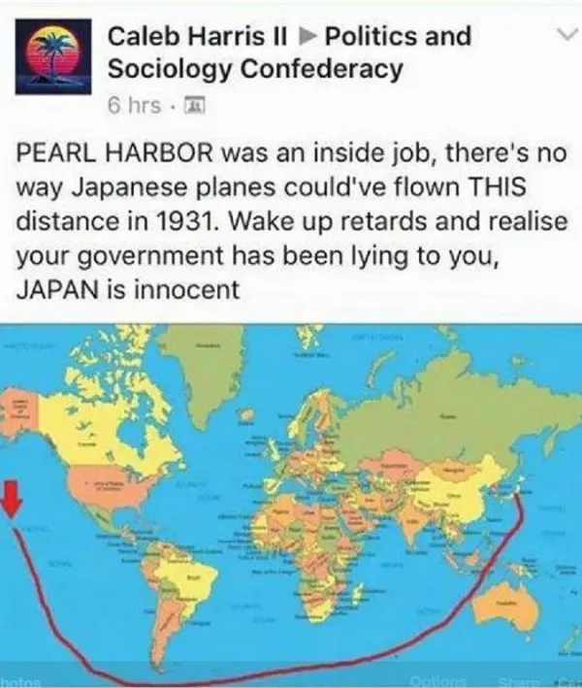
What is realism?

Slide 3
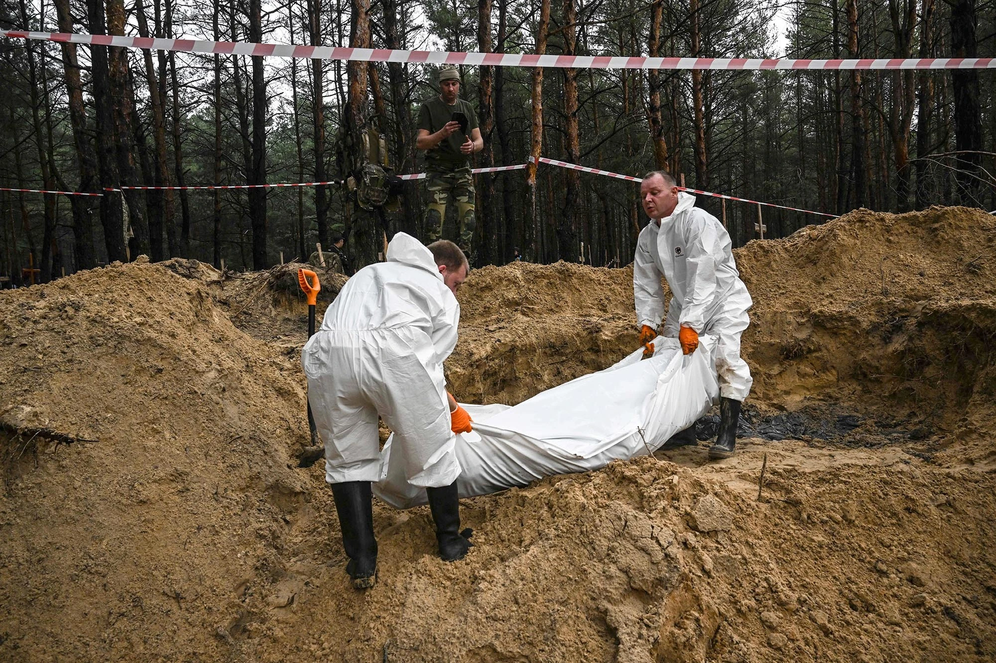
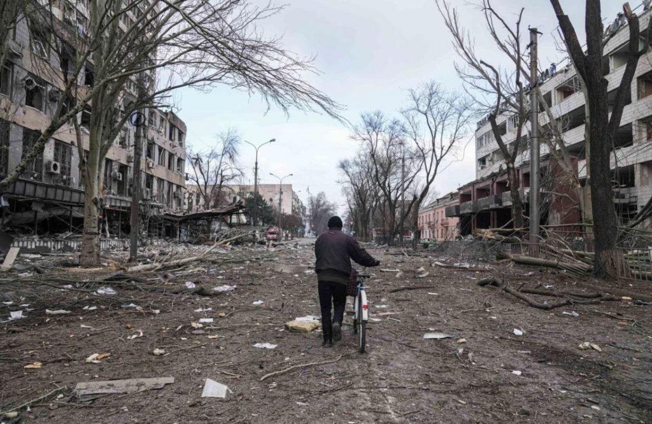
What is realism?

Slide 4
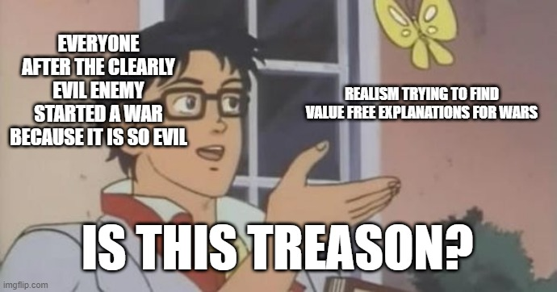
Thucydides the OG realist

Slide 5
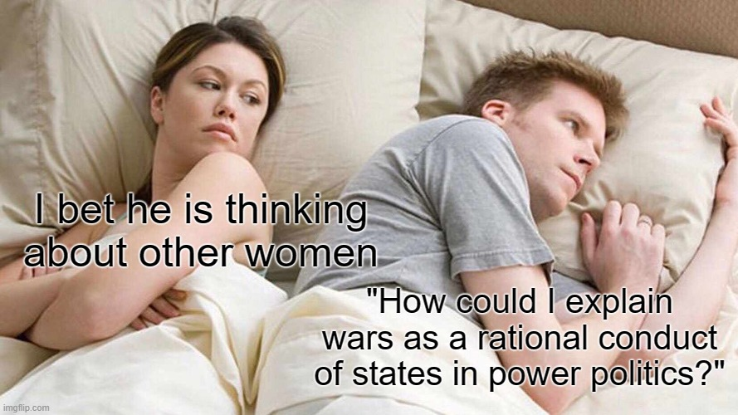
Thucydides

Slide 6
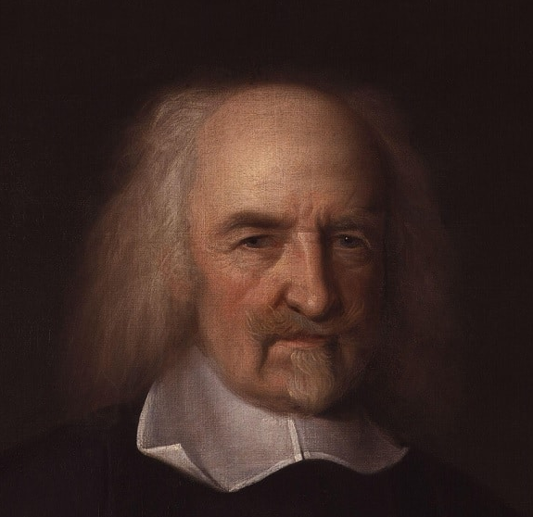
Thomas Hobbes

Slide 7
Realism (as a modern school of thought) begins in the wake of World War 2

Slide 9
State as the key actor of international politics

Slide 10
Crisis of classical realism

Slide 11
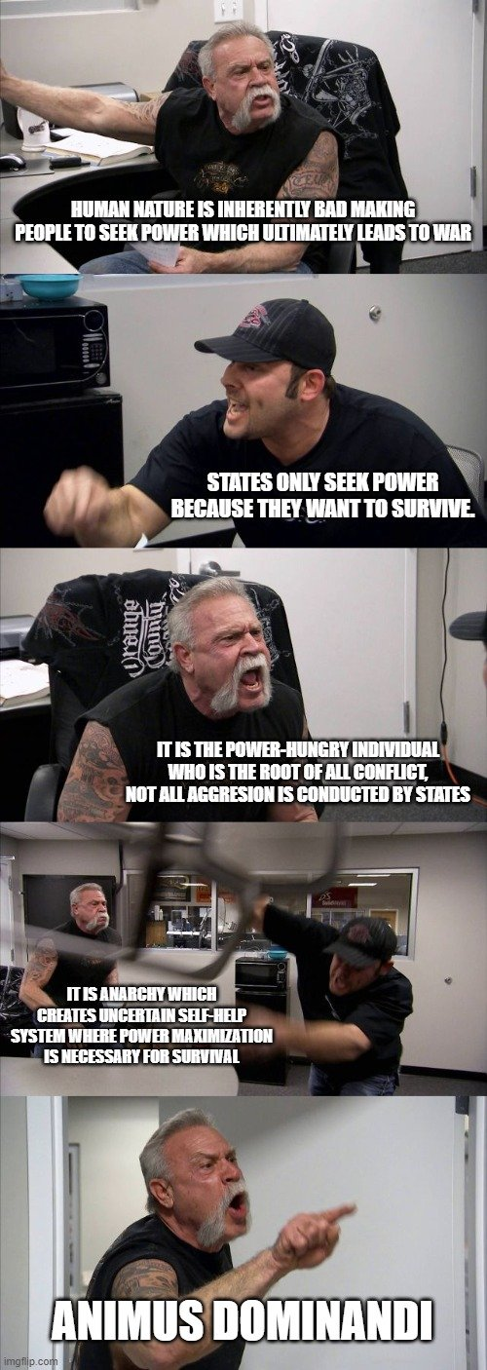
Structural realism

Slide 12
Balance of power

Slide 14
The effects of polarity

Slide 15
Neoclassical realism

Slide 16
The two realist traditions

Slide 18
Different strategies in realist theories

Slide 19
Realist views of energy security

