Slide 1
The US-Chinese technological rivalry
China in the World Economy, 2022

Slide 2
Questions from last time
In which ways were Chinese economic reforms in in the 1990s distinct from the 1980s?

Slide 3
Questions from last time
Which era could be seen as China‘s most free market phase?

Slide 4
Questions from last time
Which era could be seen as China‘s most free market phase?
When did China‘s current account surplus reach its peak?

Slide 5
Questions from last time
Which era could be seen as China‘s most free market phase?
When did China‘s current account surplus reach its peak?
How were Chinese exports distinct from developing country exports in the 2000s?

Slide 6
Questions from last time
Which era could be seen as China‘s most free market phase?
When did China‘s current account surplus reach its peak?
How were Chinese exports distinct from developing country exports in the 2000s?
When did FDI as a share of GDP reach its peak?

Slide 7
Questions from last time
Which era could be seen as China‘s most free market phase?
When did China‘s current account surplus reach its peak?
How were Chinese exports distinct from developing country exports in the 2000s?
When did FDI as a share of GDP reach its peak?
What happened with the renminbi‘s exchange rate in 1994?

Slide 8
Questions from last time
Which era could be seen as China‘s most free market phase?
When did China‘s current account surplus reach its peak?
How were Chinese exports distinct from developing country exports in the 2000s?
When did FDI as a share of GDP reach its peak?
What happened with the renminbi‘s exchange rate in 1994?
What does the phrase „triangular trade“ mean?

Slide 9
Today
The return of industrial policy
The rise of Xi Jinping
Western backlash

Slide 10
Today
The return of industrial policy
The rise of Xi Jinping
Western backlash
End of neoliberal / Fukuyamist era of globalization?

Slide 11
Picking up the story
Circa 2005 – apex of export-driven growth, everything seems fine…

Slide 12
Averting a middle-income trap
Despite all the success, the CCP fears that China will fall into a „middle income trap“

Slide 13
Averting a middle-income trap
Despite all the success, the CCP fears that China will fall into a „middle income trap“
China continues to specialize on low-value added activities within global value chains

Slide 14
Averting a middle-income trap
Despite all the success, the CCP fears that China will fall into a „middle income trap“
China continues to specialize on low-value added activities within global value chains
= it takes part in the production of sophisticated products organized by multinational companies, who keep the most lucrative work elsewhere

Slide 15
Averting a middle-income trap
Despite all the success, the CCP fears that China will fall into a „middle income trap“
China continues to specialize on low-value added activities within global value chains
= it takes part in the production of sophisticated products organized by multinational companies, who keep the most lucrative work elsewhere
For example, China makes electronics, but cannot produce top notch semiconductors

Slide 16
Averting a middle-income trap
Warning story – Japanese stagnation after 1990 – after wages grew, export moved to cheaper locations like China

Slide 17
Averting a middle-income trap
Theory – the most value added processes are at the start of production (research and development, design) and at the end (marketing, retailing)
The physical work in between can be done by anyone (= China)
Smiley curve

Slide 18
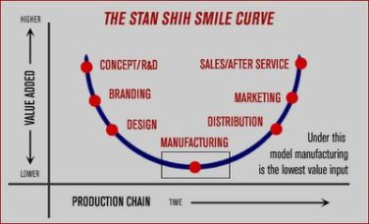
Averting a middle-income trap

Slide 19
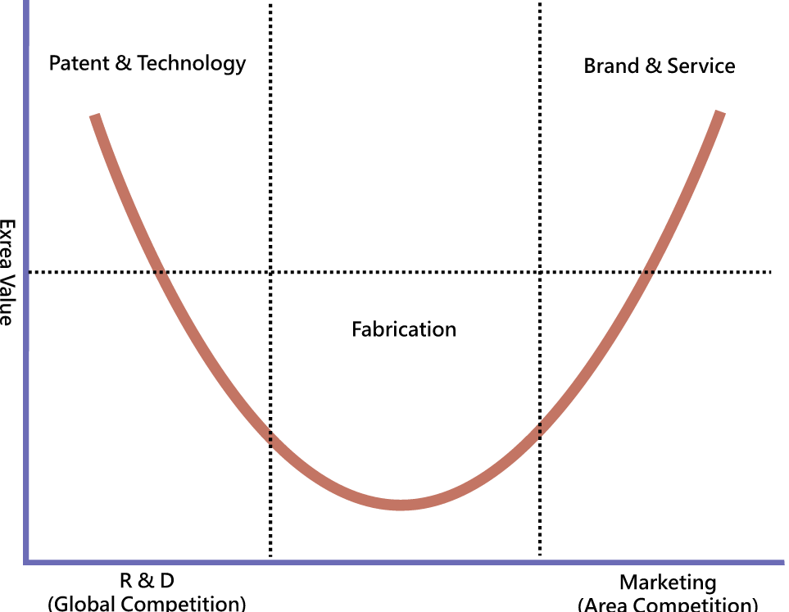
Averting a middle-income trap

Slide 20
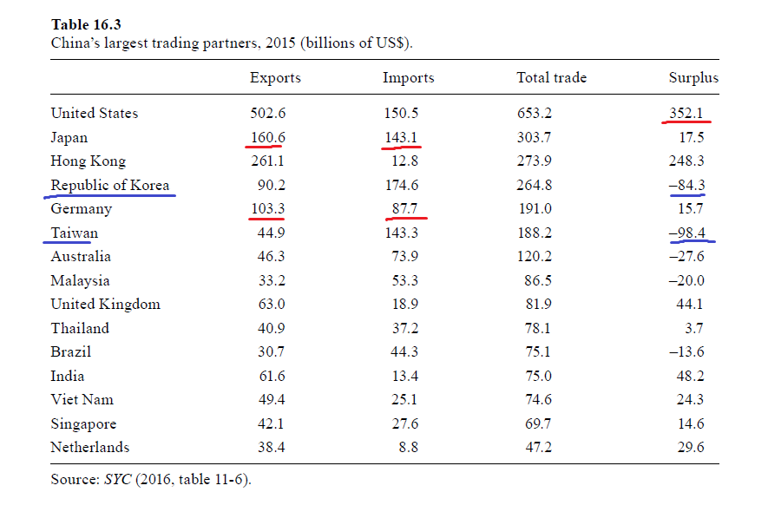
Triangular trade

Slide 21
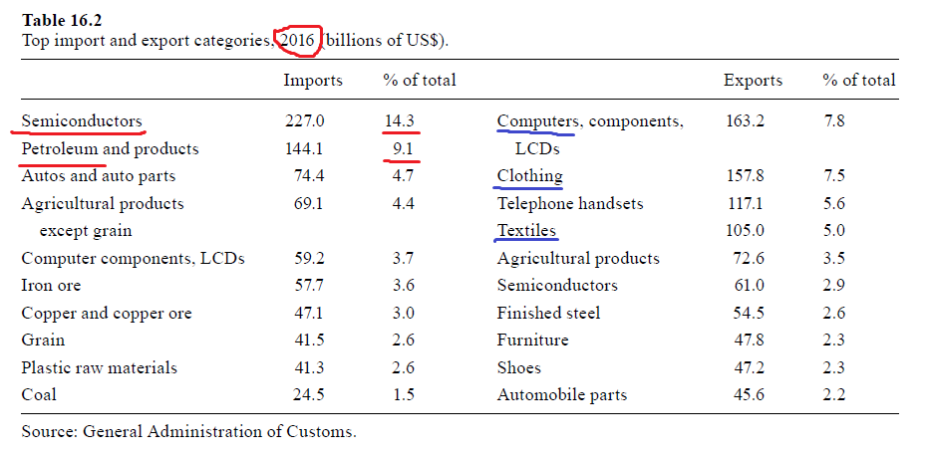
Triangular trade

Slide 22
Averting a middle-income trap
China needs to move up the value chains

Slide 23
Averting a middle-income trap
China needs to move up the value chains
Ideally to create its own brands which keep the best jobs in China

Slide 24
Averting a middle-income trap
China needs to move up the value chains
Ideally to create its own brands which keep the best jobs in China
Outsource cheap labor to poorer countries – Southeast Asia

Slide 25
Averting a middle-income trap
Technology will compensate for growing wages – China will remain a competitive exporter

Slide 26
Averting a middle-income trap
Kennedy and Lim – the innovation imperative
If a country wants to escape the middle-income trap, it must start to innovate (RaD)

Slide 27
Averting a middle-income trap
Kennedy and Lim – the innovation imperative
If a country wants to escape the middle-income trap, it must start to innovate (RaD)
Three types of possible actions:
1) Domestic innovation and research
2) Purchase of foreign technologies
3) Theft of foreign technologies

Slide 28
Averting a middle-income trap
Kennedy and Lim – the innovation imperative
If a country wants to escape the middle-income trap, it must start to innovate (RaD)
Three types of possible actions:
1) Domestic innovation and research
2) Purchase of foreign technologies
3) Theft of foreign technologies
> China practices all three at a large scale

Slide 29
Averting a middle-income trap
Kennedy and Lim – the innovation imperative
If a country wants to escape the middle-income trap, it must start to innovate (RaD)
Three types of possible actions:
1) Domestic innovation and research > industrial policy
2) Purchase of foreign technologies
3) Theft of foreign technologies
> China practices all three at a large scale

Slide 30
Return of industrial policy
Around 2000, China‘s central government did not directly attempt to develop specific sectors of the economy

Slide 31
Return of industrial policy
Around 2000, China‘s central government did not directly attempt to develop specific sectors of the economy
There were provincial programs + support for some SOEs and large corporations, but no central coordinated plan

Slide 32
MLP
2006 – Medium-Long Range Plan For Science and Technology (MLP) – 16 megaprojects

Slide 33
MLP
2006 – Medium-Long Range Plan For Science and Technology (MLP) – 16 megaprojects
- aircraft, semiconductors, intelligent computers, GMOs, novel drugs

Slide 34
MLP
Ambition to invest 2,5% of GDP into research and development by 2020
Almost achieved, RaD expenditures continue to grow quickly

Slide 35
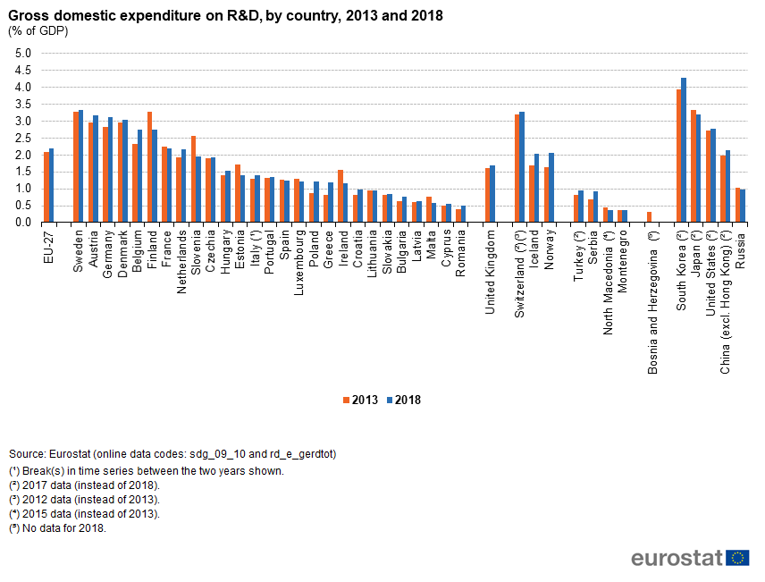

Slide 36
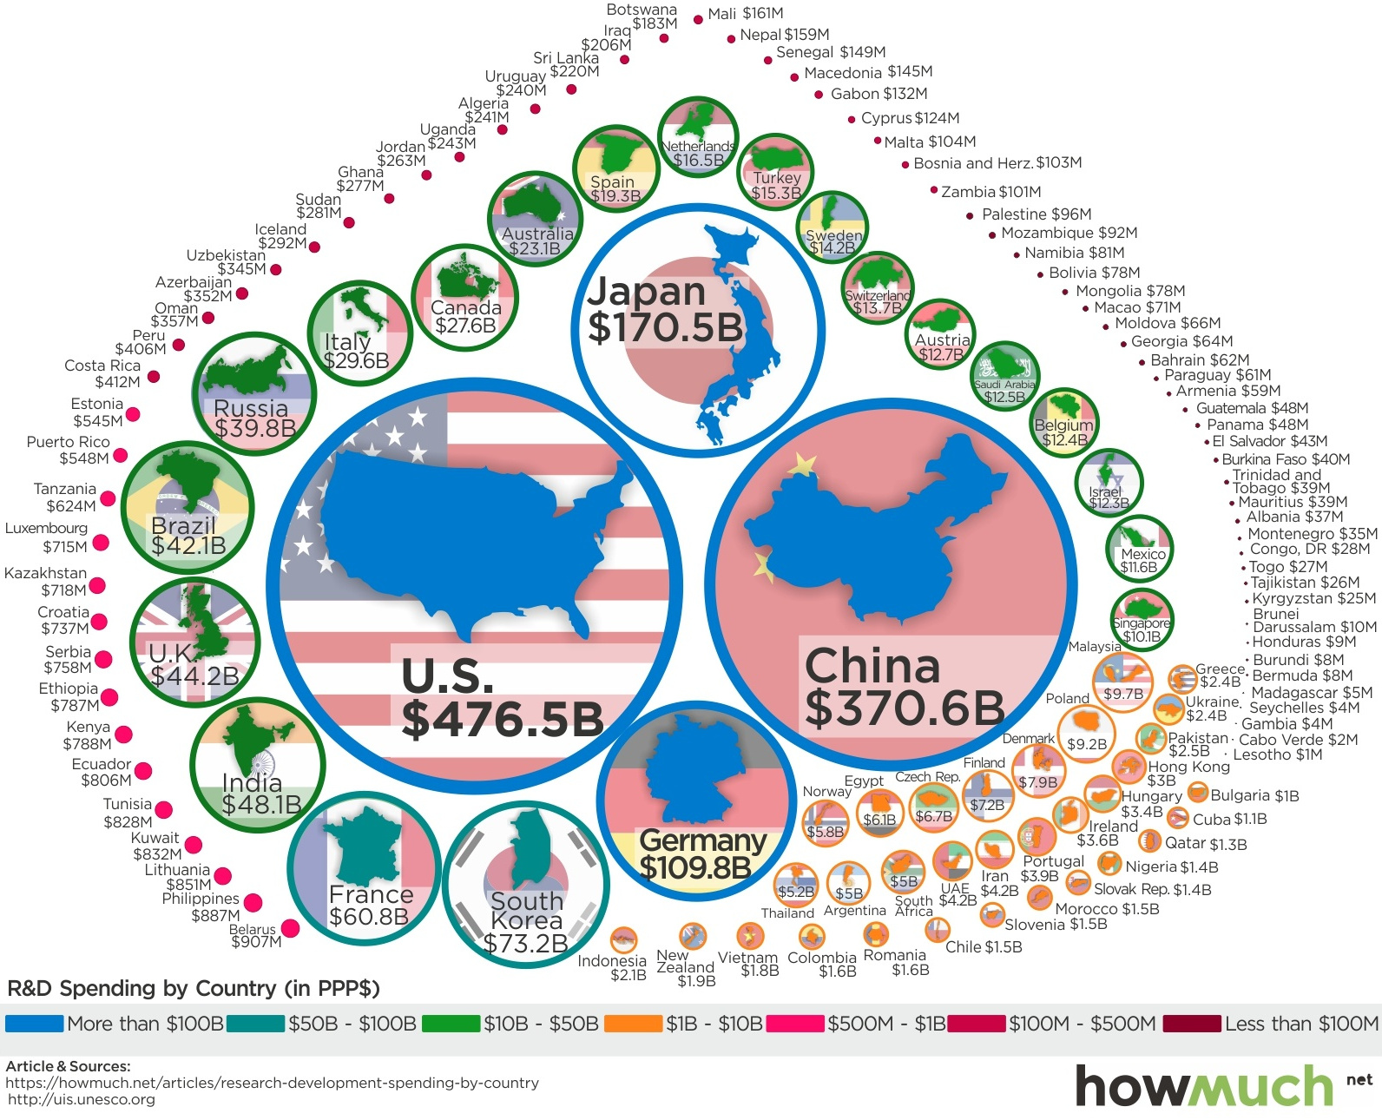

Slide 37
MLP
MLP – investments into science and research, not support for specifically chosen companies

Slide 38
MLP
Goal – to catch up with industry leaders

Slide 39
MLP
Goal – to catch up with industry leaders
= typical goal of industrial policy – use governmental incentives to learn and adopt foreign technologies
= similar to policies of other countries

Slide 40
2008 Financial crisis
> huge injections of state capital into the economy
Use of state banks and SOEs!

Slide 41
2008 Financial crisis
> huge injections of state capital into the economy
Use of state banks and SOEs!
Successful – return to growth as early as 2010
= positive experience with a large state intervention

Slide 42
2008 Financial crisis
> perception that the Western model of capitalism has failed

Slide 43
2008 Financial crisis
> perception that the Western model of capitalism has failed
> China should use the advantages of its state capitalist model more often and more forcefully

Slide 44
Strategic emerging industry (SEI)
Prime minister Wen – it is during periods of crisis when great technological revolutions take place

Slide 45
Strategic emerging industry (SEI)
Prime minister Wen – it is during periods of crisis when great technological revolutions take place
> this time, China is not going to miss it!

Slide 46
Strategic emerging industry (SEI)
Prime minister Wen – it is during periods of crisis when great technological revolutions take place
> this time, China is not going to miss it!
“Seize the commanding heights of the new technological revolution”

Slide 47
Strategic emerging industry (SEI)
2010 – new and more ambitious policy
Ambition to not just catch up with but to overtake leading countries and firms (=5G etc.)
= qualitative new goal, distinct from „normal“ industrial policy

Slide 48
Strategic emerging industry (SEI)
2010 – new and more ambitious policy
Ambition to not just catch up with but to overtake leading countries and firms (=5G etc.)
= qualitative new goal, distinct from „normal“ industrial policy
More direct – cooperation with specific firms

Slide 49
The Xi Jinping era
2012 – new leadership of the Party
Conservative, authoritarian turn

Slide 50
The Xi Jinping era
2012 – new leadership of the Party
Conservative, authoritarian turn
Limiting the autonomy of regional governments and collective bodies, cult of personality – president for life

Slide 51
The Xi Jinping era
2012 – new leadership of the Party
Conservative, authoritarian turn
Limiting the autonomy of regional governments and collective bodies, cult of personality – president for life
Ethnic nationalism, clampdown on minorities, upholding of traditional gender norms (ban on sissy boys etc.)

Slide 52
The Xi Jinping era
Economically – strengthening the role of the state/Party

Slide 53
The Xi Jinping era
Economically – strengthening the role of the state/Party
In the preceding era – the private sector grew faster than the public sector (in spite of policy!) and gradually overshadowed it

Slide 54
The Xi Jinping era
Private corporations:
1) May pose a threat to the Party

Slide 55
The Xi Jinping era
Private corporations:
1) May pose a threat to the Party
2) Behave according to their selfish motives = invest money according to what is most immediately profitable, not what is most beneficial for China in the long rung

Slide 56
The Xi Jinping era
Private corporations:
1) May pose a threat to the Party
2) Behave according to their selfish motives = invest money according to what is most immediately profitable, not what is most beneficial for China in the long rung
= they don‘t see the „big picture“= divert resources from more important causes

Slide 57
The Xi Jinping era
Private corporations:
1) May pose a threat to the Party
2) Behave according to their selfish motives = invest money according to what is most immediately profitable, not what is most beneficial for China in the long rung
= they don‘t see the „big picture“= divert resources from more important causes
> the Party must lead to overcome this coordination problem

Slide 58
The Xi Jinping era
Creeping nationalization > private companies are being forced to accept a role for the Party in decision making

Slide 59
The Xi Jinping era
Creeping nationalization > private companies are being forced to accept a role for the Party in decision making
Veto right, founding of new party cells inside of businesses

Slide 60
The Xi Jinping era
Creeping nationalization > private companies are being forced to accept a role for the Party in decision making
Veto right, founding of new party cells inside of businesses
Similar rules were often created in the 1990 for privatized SOEs, here this régime is extended to formally purely private companies

Slide 61
The Xi Jinping era
Creeping nationalization > private companies are being forced to accept a role for the Party in decision making
Veto right, founding of new party cells inside of businesses
Similar rules were often created in the 1990 for privatized SOEs, here this régime is extended to formally purely private companies
> even greater obfuscation of the already blurry line between the public and private sector!

Slide 62
„New Era“
1949-1976 – Maoism – correct principles, but insufficient capacity to implement them

Slide 63
„New Era“
1949-1976 – Maoism – correct principles, but insufficient capacity to implement them
1978-2012 – Reform and Opening – attempt to build up wealth and strength at the cost of diverting from preferred values

Slide 64
„New Era“
1949-1976 – Maoism – correct principles, but insufficient capacity to implement them
1978-2012 – Reform and Opening – attempt to build up wealth and strength at the cost of diverting from preferred values
2012 -? – New Era – dialectical synthesis – now China has the means to go back to a much more statist economy and to do so efficiently = correct principles with capacity to implement them

Slide 65
Artificial intelligence

Slide 66
Artificial intelligence
2016 – AlphaGo (Google) defeated professional Go players

Slide 67
Artificial intelligence
2016 – AlphaGo (Google) defeated professional Go players
- a traditional Asian game which is far more complex than chess
> „Sputnik moment“

Slide 68
Artificial intelligence
2016 – AlphaGo (Google) defeated professional Go players
- a traditional Asian game which is far more complex than chess
> „Sputnik moment“
„AI gap“ – like the missile gap during the Cold War

Slide 69
Prime minister Wen – it is during periods of crisis when great technological revolutions take place
> this time, China is not going to miss it!
“Seize the commanding heights of the new technological revolution”

Slide 70
Artificial intelligence
2016 – AlphaGo (Google) defeated professional Go players
- a traditional Asian game which is far more complex than chess
> „Sputnik moment“
„AI gap“ – like the missile gap during the Cold War
> „AI is the new groundbreaking technology we are looking for!“
A new economic era is beginning, China must take the lead

Slide 71
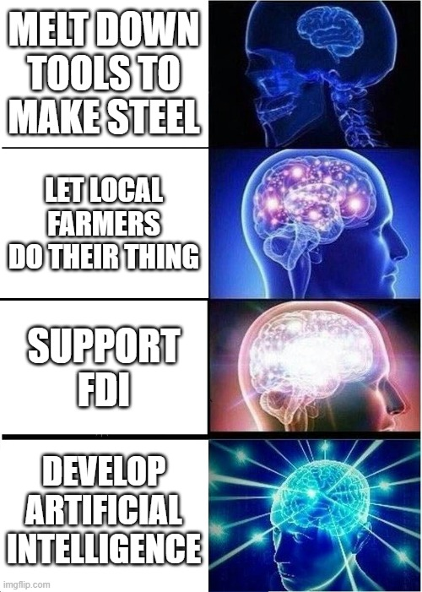

Slide 72
The AI triad
1) Collection of data – sensors, cameras with facial recognition etc.
2) Quick transfer of data – next generation Internet
3) Processing od data – algorithms, advanced hardware

Slide 73
The AI triad
1) Collection of data – sensors, cameras with facial recognition etc.
2) Quick transfer of data – next generation Internet
3) Processing od data – algorithms, advanced hardware
> a car driven by computer stops at a red light, which reacts to sensors observing transport, which automatically reacts to traffic jam

Slide 74
The AI triad
1) Collection of data – sensors, cameras with facial recognition etc.
2) Quick transfer of data – next generation Internet
3) Processing od data – algorithms, advanced hardware
> a car driven by computer stops at a red light, which reacts to sensors observing transport, which automatically reacts to traffic jam
> automatically operated factories or systems of transport

Slide 75
The AI triad
1) Collection of data – sensors, cameras with facial recognition etc.
2) Quick transfer of data – next generation Internet
3) Processing od data – algorithms, advanced hardware
> a car driven by computer stops at a red light, which reacts to sensors observing transport, which automatically reacts to traffic jam
> automatically operated factories or systems of transport
„Digital central planning“?

Slide 76
Industrial revolutions

Slide 77
Industrial revolutions
1st – steam engine > textile industry, ships, trains

Slide 78
Industrial revolutions
1st – steam engine > textile industry, ships, trains
2nd – electricity and combustion engines > cars, planes; lightbulbs and domestic appliances

Slide 79
Industrial revolutions
1st – steam engine > textile industry, ships, trains
2nd – electricity and combustion engines > cars, planes; lightbulbs and domestic appliances
3rd – information technologies and electronics – computers, phones, GPS – human oversight!

Slide 80
Industrial revolutions
1st – steam engine > textile industry, ships, trains
2nd – electricity and combustion engines > cars, planes; lightbulbs and domestic appliances
3rd – information technologies and electronics – computers, phones, GPS – human oversight!
4th – AI – autonomous robots and machines, smart manufacturing etc.

Slide 81
China should seize the opportunity and become the leader in the 4th industrial revolution
> take a shortcut, bypass some stages of development and go to the top
> leapfrog advanced countries

Slide 82
At the same time – Brexit, Trump, terrorist attacks in France > even greater perception of Western decline

Slide 83
At the same time – Brexit, Trump, terrorist attacks in France > even greater perception of Western decline
> the West is weak and decadent, and cannot possibly withstand China‘s ability to mobilize resources and make sacrifices for its common future

Slide 84
China rediscovered its confidence after 40 years of basically uninterrupted growth and success

Slide 85
traditional anti-liberal worldview:
„Americans let their best minds focus on creating addictive social media; advertisement; financial services…“

Slide 86
traditional anti-liberal worldview:
„Americans let their best minds focus on creating addictive social media; advertisement; financial services…“
> „We will focus on things that are actually valuable and useful“ = high tech

Slide 87
„techno-nationalism“

Slide 88
Noah Smith – Why Is China Smashing Its Tech Industry?

Slide 89
Noah Smith – Why Is China Smashing Its Tech Industry?
What is called „tech“ in the West are mostly consumer-oriented services such as social media and financial apps

Slide 90
Noah Smith – Why Is China Smashing Its Tech Industry?
What is called „tech“ in the West are mostly consumer-oriented services such as social media and financial apps
China thinks this type of stuff is soft – true tech is advanced manufacturing, material science, AI…

Slide 91
Noah Smith – Why Is China Smashing Its Tech Industry?
What is called „tech“ in the West are mostly consumer-oriented services such as social media and financial apps
China thinks this type of stuff is soft – true tech is advanced manufacturing, material science, AI…
= things that have a high and measurable performance

Slide 92
Noah Smith – Why Is China Smashing Its Tech Industry?
What is called „tech“ in the West are mostly consumer-oriented services such as social media and financial apps
China thinks this type of stuff is soft – true tech is advanced manufacturing, material science, AI…
= things that have a high and measurable performance
Smith - would be useful in a war???

Slide 93
Liberal critique - Naughton, Huang – value does not necessarily come from technological prowess
Many things we value are quite rudimentary

Slide 94
Liberal critique - Naughton, Huang – value does not necessarily come from technological prowess
Many things we value are quite rudimentary
Krpec – a kilogram of integrated circuits vs. a kilogram of Parma ham

Slide 95
Made in China 2025
Announced in 2015
A truly large program of industrial policy – bigger, more concrete and more ambitious than SEI

Slide 96
Made in China 2025
Announced in 2015
A truly large program of industrial policy – bigger, more concrete and more ambitious than SEI
Supported sectors – advanced technology fields – AI, machine learning, internet of things, new materials, aerospace, biotechnology…

Slide 97
Innovation Driven Development Strategy
2016, meant as a more general framework for existing programs (MiC25, SEI, Internet Plus)

Slide 98
Innovation Driven Development Strategy
2016, meant as a more general framework for existing programs (MiC25, SEI, Internet Plus)
Main idea – AI is a general-purpose technology

Slide 99
Innovation Driven Development Strategy
2016, meant as a more general framework for existing programs (MiC25, SEI, Internet Plus)
Main idea – AI is a general-purpose technology
The goal is to 1) develop it and then 2) implement it in all sectors of the Chinese economy

Slide 100
Innovation Driven Development Strategy
2016, meant as a more general framework for existing programs (MiC25, SEI, Internet Plus)
Main idea – AI is a general-purpose technology
The goal is to 1) develop it and then 2) implement it in all sectors of the Chinese economy
> digitalization, smart cities, intelligent manufacturing

Slide 101
Innovation Driven Development Strategy
China now has a whole system of programs to develop new technologies and support their adoption

Slide 102
Biggest target of support – semiconductors
= chips
= brain of electronics, „DNA of technology“

Slide 103
Biggest target of support – semiconductors
= chips
= brain of electronics, „DNA of technology“
Necessary for China‘s technological goals

Slide 104
Biggest target of support – semiconductors
= chips
= brain of electronics, „DNA of technology“
Necessary for China‘s technological goals
China continues to be surprisingly weak and aims to improve its position

Slide 105
Return of industrial policy
Bigger (even relatively) than policies of Japan, Taiwan, South Korea etc. in the post-war period
A qualitatively different goal – leadership

Slide 106
Return of industrial policy
Bigger (even relatively) than policies of Japan, Taiwan, South Korea etc. in the post-war period
A qualitatively different goal – leadership
Highly provocative – Naughton – breaking of unwritten international rules

Slide 107
Return of industrial policy
Bigger (even relatively) than policies of Japan, Taiwan, South Korea etc. in the post-war period
A qualitatively different goal – leadership
Highly provocative – Naughton – breaking of unwritten international rules
> backlash - end of Western complacency about China – US-China trade war

Slide 108
„…in the IDDS, the opportunity to move directly to the technological frontier and surpass other economies is no longer a wished-for feature of a few random sectors, but rather a fundamental feature of the current global moment.“

Slide 109
„Increasingly, Chinese industrial policy is based on the idea that China has a once-in-a-lifetime opportunity to get in on the ground floor of a technological revolution and vault into the leading ranks of economic and technological powers.“

Slide 110
China‘s industrial policy programs
2006 – MLP – „let‘s development these X sectors“

Slide 111
China‘s industrial policy programs
2006 – MLP – „let‘s development these X sectors“
2010 – SEI - „let‘s development these X sectors AND become the global leader in them“

Slide 112
China‘s industrial policy programs
2006 – MLP – „let‘s development these X sectors“
2010 – SEI - „let‘s development these X sectors AND become the global leader in them“
2015 – MiC, IDDS - „let‘s development these X sectors AND become the global leader in them AND implement these technologies in the entire economy“

Slide 113
How does China do this?

Slide 114
Industrial Guidance Funds
Key tool of industrial policy
The previous (MiC25 etc.) were programs laying out goals; this is about the means

Slide 115
Industrial Guidance Funds
Inspired by US venture capital firms
But funded by SOEs and banks – indirect state capital

Slide 116
Industrial Guidance Funds
Inspired by US venture capital firms
But funded by SOEs and banks – indirect state capital
„You have savings and profits? Give them to a designated fund!“

Slide 117
Industrial Guidance Funds
Inspired by US venture capital firms
But funded by SOEs and banks – indirect state capital
„You have savings and profits? Give them to a designated fund!“
Investment – both new startups and established firms

Slide 118
Industrial Guidance Funds
Inspired by US venture capital firms
But funded by SOEs and banks – indirect state capital
„You have savings and profits? Give them to a designated fund!“
Investment – both new startups and established firms
2019 – total commitment 1,6 trillion USD – 11 % of Chinese GDP

Slide 119
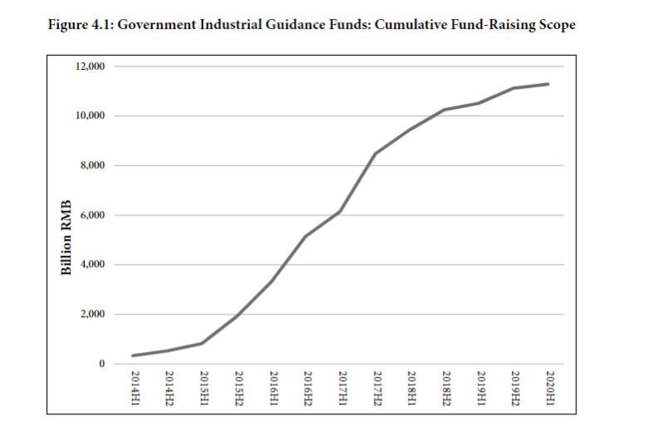

Slide 120
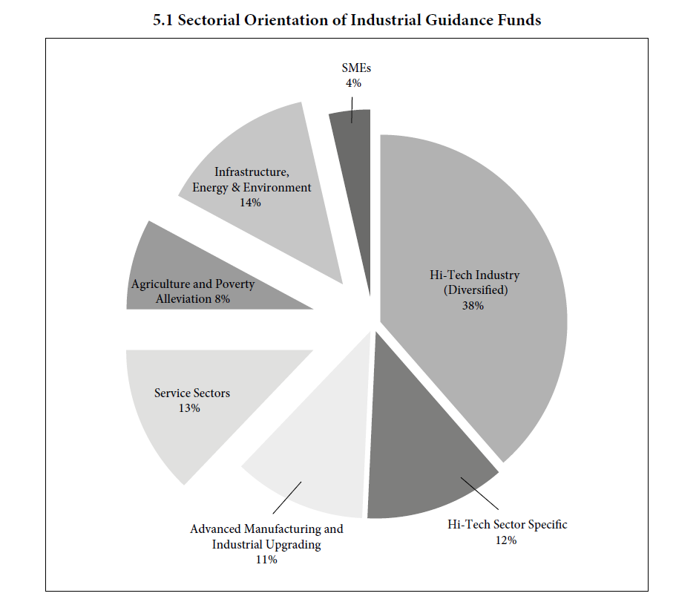

Slide 121
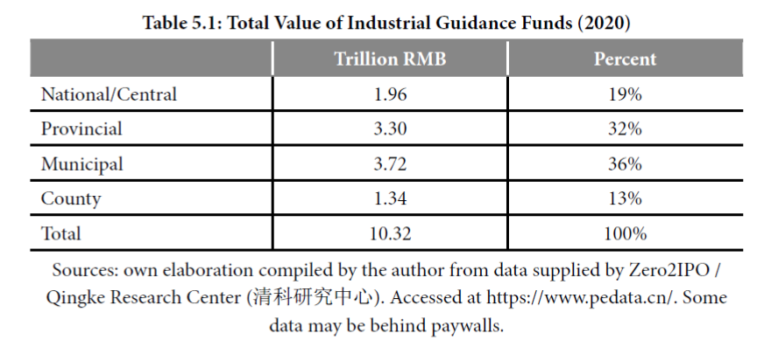

Slide 122
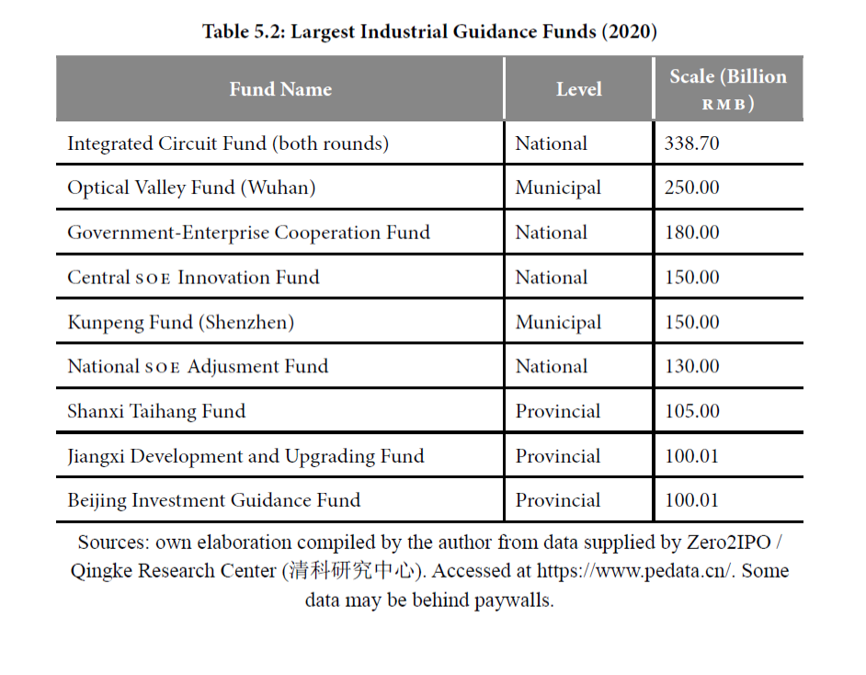

Slide 123
Social credit system(s)
In the West – interpreted merely as a tool of social control

Slide 124
Social credit system(s)
In the West – interpreted merely as a tool of social control
Additional purpose – another layer of regulation for businesses

Slide 125
Social credit system(s)
In the West – interpreted merely as a tool of social control
Additional purpose – another layer of regulation for businesses
If you follow laws, reduce your emissions, are fair to costumers, contribute to national industrial and technological goals, etc., you will be rewarded

Slide 126
Social credit system(s)
In the West – interpreted merely as a tool of social control
Additional purpose – another layer of regulation for businesses
If you follow laws, reduce your emissions, are fair to costumers, contribute to national industrial and technological goals, etc., you will be rewarded
- by cheaper loans, access to public procurement contracts

Slide 127
„Wish list approach“
Matt Sheehan: How China’s Massive AI Plan Actually Works
Next Generation Artificial Intelligence Plan – 2017

Slide 128
„Wish list approach“
Matt Sheehan: How China’s Massive AI Plan Actually Works
Next Generation Artificial Intelligence Plan – 2017
A brimful of goals and targets – but no plan of how to acquire them

Slide 129
„Wish list approach“
Matt Sheehan: How China’s Massive AI Plan Actually Works
Next Generation Artificial Intelligence Plan – 2017
A brimful of goals and targets – but no plan of how to acquire them
> „let the local Party leaders figure this out, we will reward the successful ones“

Slide 130
„Wish list approach“
Matt Sheehan: How China’s Massive AI Plan Actually Works
Next Generation Artificial Intelligence Plan – 2017
A brimful of goals and targets – but no plan of how to acquire them
> „let the local Party leaders figure this out, we will reward the successful ones“
= combination of central plans with local initiative – typical for China since the Great Leap Forward

Slide 131
„Wish list approach“
„The central government isn’t issuing detailed marching orders to local officials for carrying out a master plan. Instead, it’s giving them hundreds of ideas for “gifts” that it would like to receive, and saying, “surprise me.”“

Slide 132
Examples from Sheehan‘s article
Are you in charge of transportation for the new megacity of Xiong’an? Partner with Baidu’s self-driving project, Apollo, to demonstrate autonomous vehicles in the city.
Head of the Changping branch of Beijing’s Public Security Bureau? Spend 2.75 million yuan ($437,000) procuring AI person-tracking software for security cameras.
President of a mid-tier engineering university in Shandong? Open the province’s first AI research center focusing on medical and marine AI.
Party chief of a Nanjing economic development zone? Pour 8 billion yuan ($1.3 billion) into an AI-focused venture capital fund and dole out 5 million yuan ($794,000) in R&D subsidies to each firm that sets up shop there.

Slide 133
„Wish list approach“
“government-steered market economy”

Slide 134
Chips

Slide 135
Chips
Basic unit – a transistor – either allows electric current to pass through, or it does not

Slide 136
Chips
Basic unit – a transistor – either allows electric current to pass through, or it does not
> coding of 0s and 1s

Slide 137
Chips
Basic unit – a transistor – either allows electric current to pass through, or it does not
> coding of 0s and 1s
Semiconductor materials must be used to do this - silicon

Slide 138
Chips
Basic unit – a transistor – either allows electric current to pass through, or it does not
> coding of 0s and 1s
Semiconductor materials must be used to do this - silicon
Chip – lots of transistors on a silicon wafer

Slide 139
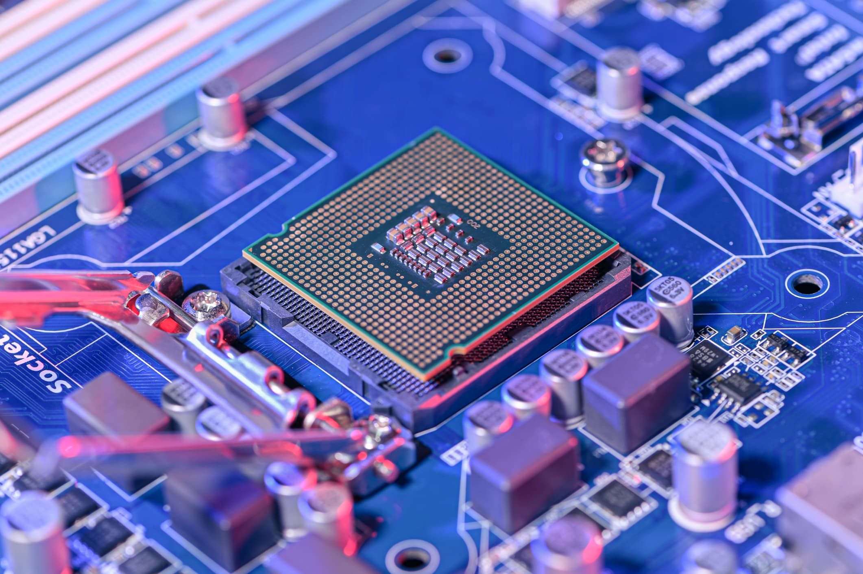

Slide 140
Chips
Basic unit – a transistor – either allows electric current to pass through, or it does not
> coding of 0s and 1s
Semiconductor materials must be used to do this - silicon
Chip – lots of transistors on a silicon wafer
Invented – Bell labs, late 1950s

Slide 141
Chips
Since 1970s – Moore‘s Law

Slide 142
Chips
Since 1970s – Moore‘s Law
Every two years, the number of transistors in a chip of equal size doubles

Slide 143
Chips
Since 1970s – Moore‘s Law
Every two years, the number of transistors in a chip of equal size doubles
> double brute computing force

Slide 144
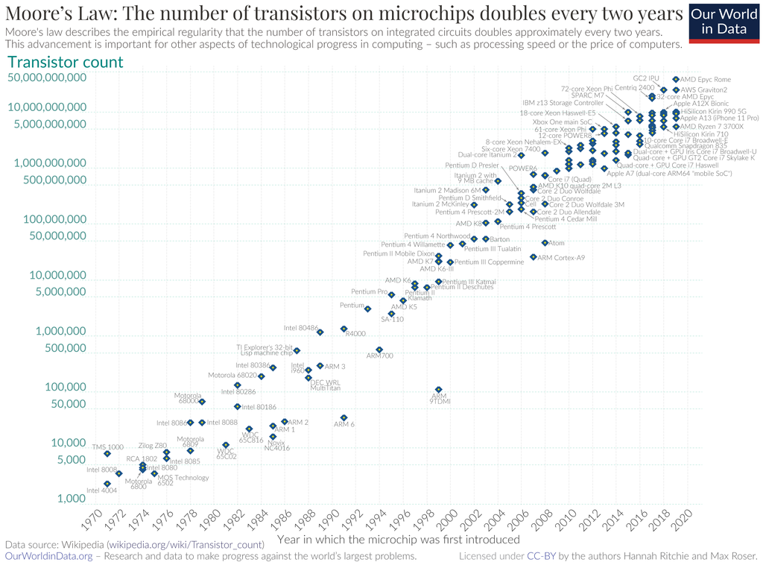

Slide 145
Chips
Since 1970s – Moore‘s Law
Every two years, the number of transistors in a chip of equal size doubles
> double brute computing force
Self-fulfilling prophecy – if you want to stay in business, you must keep up with the Law

Slide 146
Chips
Since 1970s – Moore‘s Law
Every two years, the number of transistors in a chip of equal size doubles
> double brute computing force
Self-fulfilling prophecy – if you want to stay in business, you must keep up with the Law
Or focus on specific types of rudimentary, trailing edge chips – Europe!

Slide 147
Chips
China imports the vast majority of its chips

Slide 148
Chips
China imports the vast majority of its chips
Its national chip maker- SMIC – Semiconductor Manufacturing International Corporation

Slide 149
Chips
China imports the vast majority of its chips
Its national chip maker- SMIC – Semiconductor Manufacturing International Corporation
Quintessential national champion on part with Huawei!

Slide 150
Chips
China imports the vast majority of its chips
Its national chip maker- SMIC – Semiconductor Manufacturing International Corporation
Quintessential national champion on part with Huawei!
Extremely high support - 50% of its revenue comes from state subsidies

Slide 151
Chips
China imports the vast majority of its chips
Its national chip maker- SMIC – Semiconductor Manufacturing International Corporation
Quintessential national champion on part with Huawei!
Extremely high support - 50% of its revenue comes from state subsidies
But it is still far behind industry leaders and only has a small global market share

Slide 152
Chips
SMIC‘s smallest transistors are 14 nm in size
The smallest produced on a large scale globally are 7nm, the cutting edge is moving to 5nm

Slide 153
Chips
SMIC‘s smallest transistors are 14 nm in size
The smallest produced on a large scale globally are 7nm, the cutting edge is moving to 5nm
Most of their production is even further from the frontier!

Slide 154
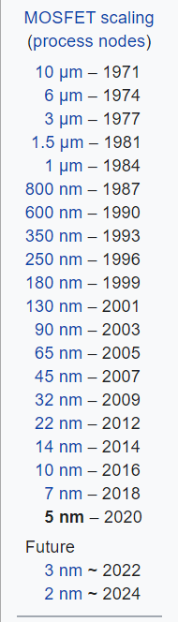

Slide 155
Chips
China imports some 70 % of chips produced worldwide, half is then re-exported
It only produces 16 % of world production, only 6 % comes from domestically owned firms

Slide 156
The semiconductor value chain
Perhaps the most sophisticated value chain in the world

Slide 157
The semiconductor value chain
No country or company in the world is able to produce cutting edge chips on its own

Slide 158
The semiconductor value chain
Dominated by USA + Taiwan, Korea, Japan; Netherlands

Slide 159
The semiconductor value chain
EDA – software (US firms)

Slide 160
The semiconductor value chain
EDA – software (US firms)
Design – smartphone manufacturers etc.

Slide 161
The semiconductor value chain
EDA – software (US firms)
Design – smartphone manufacturers etc.
SME – equipment – US + Japan + Netherlands (ASML)

Slide 162
The semiconductor value chain
EDA – software (US firms)
Design – smartphone manufacturers etc.
SME – equipment – US + Japan + Netherlands (ASML)
- extreme-ultraviolet lithography

Slide 163
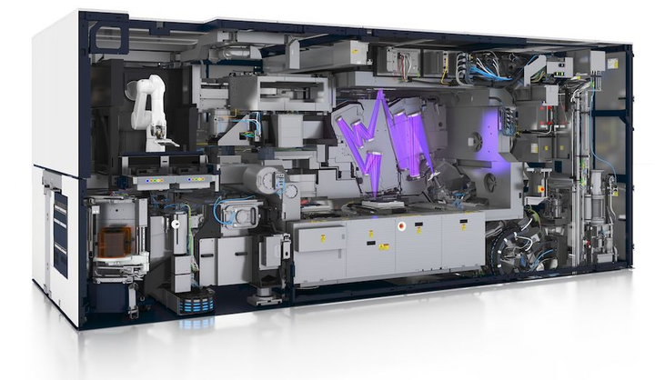

Slide 164
The semiconductor value chain
EDA – software (US firms)
Design – smartphone manufacturers etc.
SME – equipment – US + Japan + Netherlands (ASML)
- extreme-ultraviolet lithography – largest bumps on their mirrors are smaller than one atom!

Slide 165


Slide 166
The semiconductor value chain
Together – „fabs“ – most expensive factories in the world – circa 20 billion dollars to create a production link

Slide 167
The semiconductor value chain
Together – „fabs“ – most expensive factories in the world – circa 20 billion dollars to create a production link
Non-monetary inputs – need for engineers with experience, which is extremely rare

Slide 168
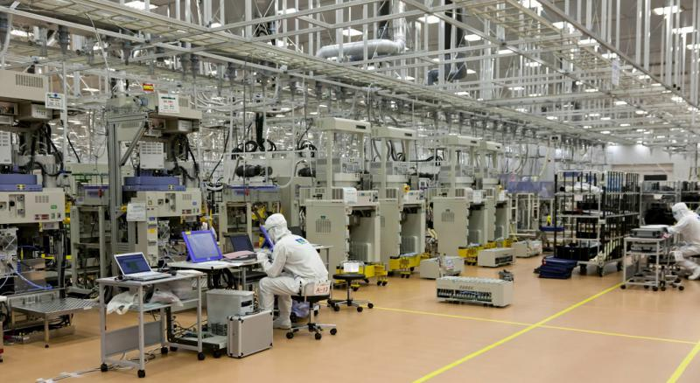

Slide 169
The semiconductor value chain
Most important producer of chips in the world – TSMC – Taiwan Semiconductor Manufacturing Company

Slide 170
The semiconductor value chain
Most important producer of chips in the world – TSMC – Taiwan Semiconductor Manufacturing Company
- 50% of global production or so, even stronger on the cutting edge

Slide 171
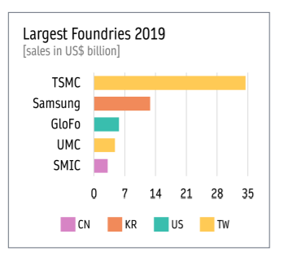

Slide 172
The semiconductor value chain
China – no EDA or SME, few experiences engineers

Slide 173
The semiconductor value chain
China‘s Achilles‘ heel!

Slide 174
The semiconductor value chain
China‘s Achilles‘ heel!
> huge resources are being invested into redressing it

Slide 175
The semiconductor value chain
China‘s Achilles‘ heel!
> huge resources are being invested into redressing it
> US pressure is concentrated in this area

Slide 176
US – Chinese technological rivalry
Khan and Flynn: Maintaining China s Dependence on Democracies for Advanced Computer Chips

Slide 177
US – Chinese technological rivalry
Khan and Flynn: Maintaining China s Dependence on Democracies for Advanced Computer Chips
The goal should be to prevent China from gaining a capacity to produce cutting edge chips

Slide 178
US – Chinese technological rivalry
Khan and Flynn: Maintaining China s Dependence on Democracies for Advanced Computer Chips
The goal should be to prevent China from gaining a capacity to produce cutting edge chips
> China must be prevented from importing SME (equipment) or licensing EDA software

Slide 179
US – Chinese technological rivalry
Khan and Flynn: Maintaining China s Dependence on Democracies for Advanced Computer Chips
The goal should be to prevent China from gaining a capacity to produce cutting edge chips
> China must be prevented from importing SME (equipment) or licensing EDA software
This embargo must include US allies (Korea, Japan, Taiwan, Netherlands)

Slide 180
US – Chinese technological rivalry
The goal is not to prevent China from importing chips!

Slide 181
US – Chinese technological rivalry
The goal is not to prevent China from importing chips! > that would give them an even greater motivation to develop an indigenous production capacity!

Slide 182
US – Chinese technological rivalry
The goal is not to prevent China from importing chips! > that would give them an even greater motivation to develop an indigenous production capacity!
When China is dependent, the US and its allies can impose conditions for usage – so that chips are not used for military purposes, surveillance of Uighurs, etc.

Slide 183
US – Chinese technological rivalry
The goal is not to prevent China from importing chips! > that would give them an even greater motivation to develop an indigenous production capacity!
When China is dependent, the US and its allies can impose conditions for usage – so that chips are not used for military purposes, surveillance of Uighurs, etc.
Biden‘s strategy - in line with this approach – last week‘s restrictions!

Slide 184
Biden‘s sanctions on China
Wide ban on SME exports to China – mostly ASML – achieved because ASML uses US technologies
Ban on US engineers working for Chinese semiconductor companies
Ban on exporting specific advanced chips to China – AI chips
Deeper bans on specific companies

Slide 185
Trump only targeted Huawei and SMIC

Slide 186
Export controls
Cold War-era legislation – it is possible for the US government to ban the export of products which can be used for military purposes

Slide 187
Export controls
Cold War-era legislation – it is possible for the US government to ban the export of products which can be used for military purposes
Much harsher than tariffs – outright ban of sale

Slide 188
Export controls
Cold War-era legislation – it is possible for the US government to ban the export of products which can be used for military purposes
Much harsher than tariffs – outright ban of sale
Exterritorial – falls on foreign companies using US inputs or IP

Slide 189
Investment screenings
Since circa 2014, China ramped up strategic purchases of foreign technological companies

Slide 190
Investment screenings
Since circa 2014, China ramped up strategic purchases of foreign technological companies
> a screening mechanism, which allows US authorities to stop the sale

Slide 191
Investment screenings
Since circa 2014, China ramped up strategic purchases of foreign technological companies
> a screening mechanism, which allows US authorities to stop the sale
If the owner still wants to sell, he must find a different buyer, if he can‘t one, the government will temporarily purchase it

Slide 192
A tighter regime of export controls and investment screenings is being created in the EU as well!
– two new EU regulations in 2021!

Slide 193
The US-China trade war

Slide 194
The US-China trade war
„China shock“ – contrary to expectations of economists, the post-2000 surge of imports had negative impacts on many parts of US society

Slide 195
The US-China trade war
„China shock“ – contrary to expectations of economists, the post-2000 surge of imports had negative impacts on many parts of US society
> de-industrialization, followed by permanently decreased wages and employment

Slide 196
The US-China trade war
Political conflict – winners vs. losers of globalization

Slide 197
The US-China trade war
Political conflict – winners vs. losers of globalization
Branko Milanovic - paradoxically – rich urban American are on the same side as the poor from the Global South – in favor of (US) free trade

Slide 198
The US-China trade war
Political conflict – winners vs. losers of globalization
Branko Milanovic - paradoxically – rich urban American are on the same side as the poor from the Global South – in favor of (US) free trade
> Donald Trump

Slide 199
The US-China trade war
2018-2019 – 4 waves of tariffs on Chinese goods

Slide 200
The US-China trade war
2018-2019 – 4 waves of tariffs on Chinese goods
Tariffs on Chinese products increased from circa 3 % to circa 20 %

Slide 201
The US-China trade war
2018-2019 – 4 waves of tariffs on Chinese goods
Tariffs on Chinese products increased from circa 3 % to circa 20 %
Usually, tariffs were increased by 25 percentage points, some goods were given exceptions

Slide 202
The US-China trade war
2018-2019 – 4 waves of tariffs on Chinese goods
Tariffs on Chinese products increased from circa 3 % to circa 20 %
Usually, tariffs were increased by 25 percentage points, some goods were given exceptions
Chinese retaliation

Slide 203
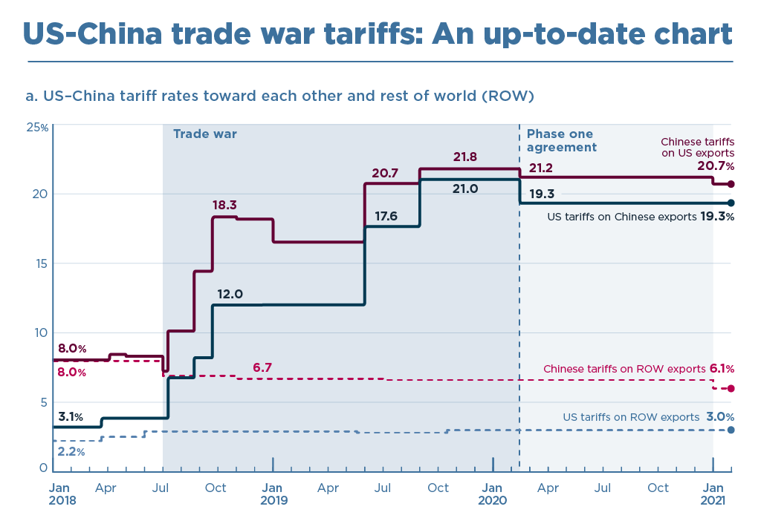

Slide 204
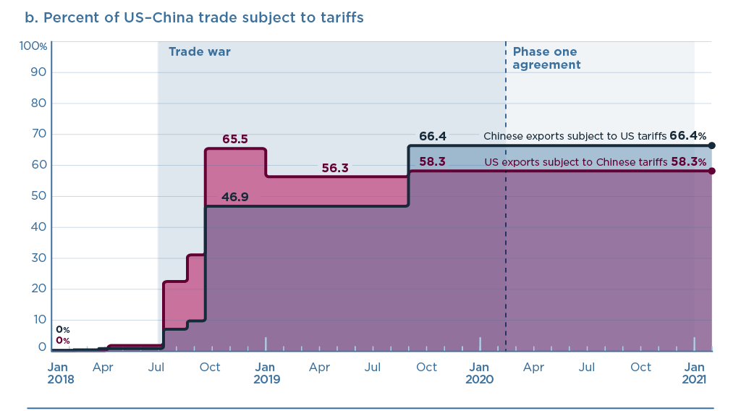

Slide 205
The US-China trade war
Much worse for China – far more dependent on exports, has more to loose

Slide 206
The US-China trade war
Much worse for China – far more dependent on exports, has more to loose
Also not great for US customers

Slide 207
The US-China trade war
Much worse for China – far more dependent on exports, has more to loose
Also not great for US customers
Winners – US workers in import-competing industries; third countries – EU!

Slide 208
The US-China trade war
Much worse for China – far more dependent on exports, has more to loose
Also not great for US customers
Winners – US workers in import-competing industries; third countries – EU!
Popular in the US – Biden continues the same policy

Slide 209
The US-China trade war
By the beginning of Covid, US imports from China returned to 2011 levels

Slide 210
The US-China trade war
By the beginning of Covid, US imports from China returned to 2011 levels
China‘s share of US imports dropped to 2008 levels

Slide 211
The US-China trade war
By the beginning of Covid, US imports from China returned to 2011 levels
China‘s share of US imports dropped to 2008 levels
= decoupling?

Slide 212
The US-China trade war
Goal – „onshoring“ – forcing companies to return home, or at least to relocate from China into another country

Slide 213
The US-China trade war
Goal – „onshoring“ – forcing companies to return home, or at least to relocate from China into another country
Far less successful – China remains paramount for large multinational companies

Slide 214
The US-China trade war
Goal – „onshoring“ – forcing companies to return home, or at least to relocate from China into another country
Far less successful – China remains paramount for large multinational companies
- a giant market
Returns on investment in China are higher than anywhere else in the world

Slide 215
The US-China trade war
Goal – „onshoring“ – forcing companies to return home, or at least to relocate from China into another country
Far less successful – China remains paramount for large multinational companies
- a giant market
Returns on investment in China are higher than anywhere else in the world
Sometimes – feigned moves abroad – products are completed in another country, so they avoid US tariffs etc.

Slide 216
The US-China trade war
How has China‘s role changed from the perspective of a multinational corporation between 2000 to 2020?

Slide 217
The US-China trade war
How has China‘s role changed from the perspective of a multinational corporation between 2000 to 2020?
From a source of cheap labor to a market – the Chinese are rich enough to consume

Slide 218
The US-China trade war
How has China‘s role changed from the perspective of a multinational corporation between 2000 to 2020?
From a source of cheap labor to a market – the Chinese are rich enough to consume
This goes hand in hand with China‘s drive to decrease its dependence on exports – promotion of domestic consumption

Slide 219
The US-China trade war
How has China‘s role changed from the perspective of a multinational corporation between 2000 to 2020?
From a source of cheap labor to a market – the Chinese are rich enough to consume
This goes hand in hand with China‘s drive to decrease its dependence on exports – promotion of domestic consumption
Trade war = another incentive to make China less dependent on exports

Slide 220
Threats to China‘s success story

Slide 221
Threats to China‘s success story
1) Backlash from industrialized countries
Even EU, CANZ, Japan etc. are starting to turn against China

Slide 222
Threats to China‘s success story
2) An uncertain wager on digital technologies

Slide 223
Threats to China‘s success story
2) An uncertain wager on digital technologies
Normally, industrial policy is about catching-up

Slide 224
Threats to China‘s success story
2) An uncertain wager on digital technologies
Normally, industrial policy is about catching-up
There are existing technologies to be copied – it is faster to copy something than to develop it

Slide 225
Threats to China‘s success story
2) An uncertain wager on digital technologies
Normally, industrial policy is about catching-up
There are existing technologies to be copied – it is faster to copy something than to develop it
Even if you decide for domestic innovations, it is still clear that the technology is viable and can work

Slide 226
Threats to China‘s success story
2) An uncertain wager on digital technologies
As you get near the frontier, it is more and more hard to say which way to go

Slide 227
Threats to China‘s success story
2) An uncertain wager on digital technologies
As you get near the frontier, it is more and more hard to say which way to go
Most countries (J, K, T) liberalize at this point > so that markets can experiment and find the way

Slide 228
Threats to China‘s success story
2) An uncertain wager on digital technologies
As you get near the frontier, it is more and more hard to say which way to go
Most countries (J, K, T) liberalize at this point > so that markets can experiment and find the way
China has decided to bet huge resources on a technological revolution that is yet to emerge

Slide 229
Threats to China‘s success story
2) An uncertain wager on digital technologies
As you get near the frontier, it is more and more hard to say which way to go
Most countries (J, K, T) liberalize at this point > so that markets can experiment and find the way
China has decided to bet huge resources on a technological revolution that is yet to emerge
> What if the future doesn‘t work the way Beijing imagines?

Slide 230
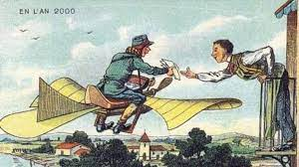

Slide 231
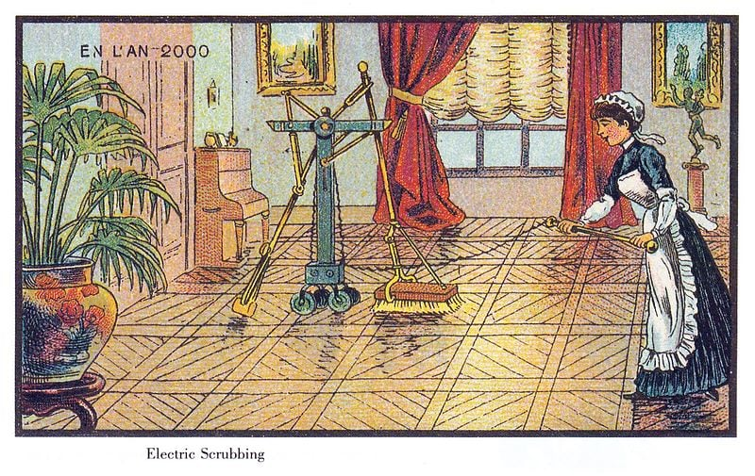

Slide 232
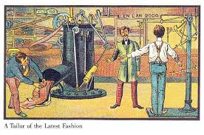

Slide 233
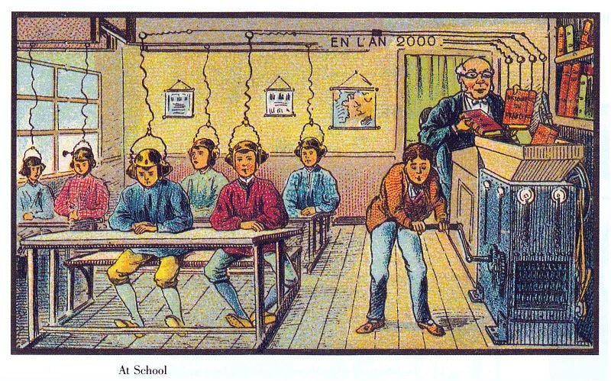

Slide 234
„The future will be just like the present, only more so“

Slide 235
Threats to China‘s success story
2) An uncertain wager on digital technologies
Huge resources might be wasted creating unproductive industries
At the expense of the actually promising sectors

Slide 236
Threats to China‘s success story
2) An uncertain wager on digital technologies
Huge resources might be wasted creating unproductive industries
At the expense of the actually promising sectors
Bursting of a bubble x permanent support for an entrenched interest

Slide 237
Threats to China‘s success story
3) Ageing population

Slide 238
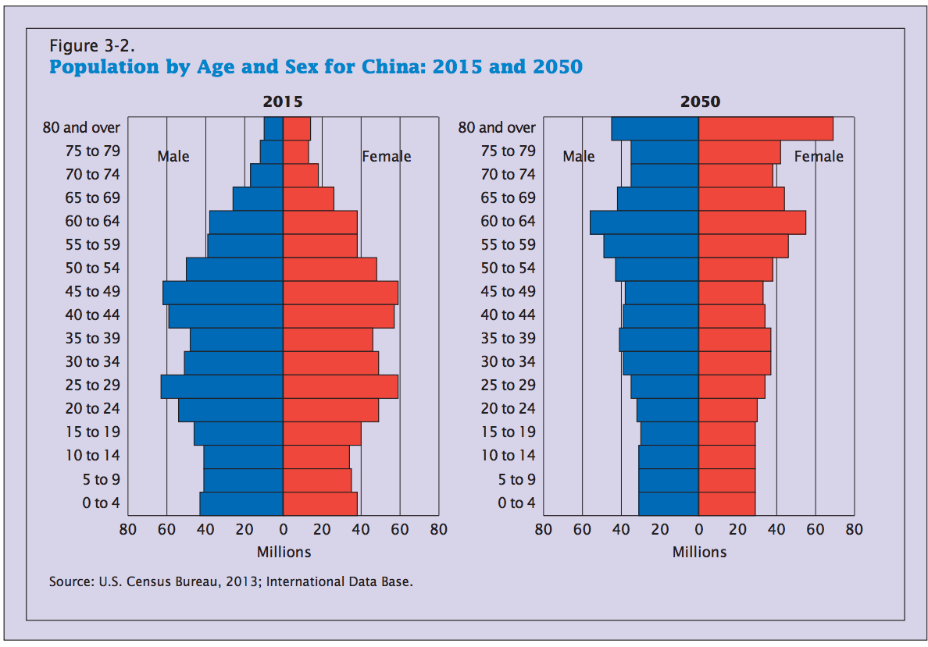

Slide 239
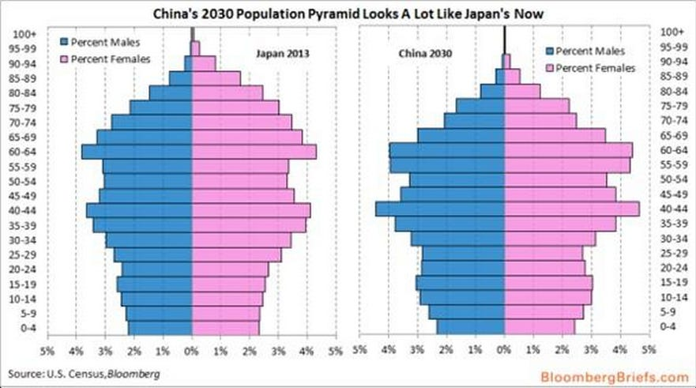

Slide 240
Threats to China‘s success story
3) Ageing population
> need for far greater spending on pensions, healthcare spending

Slide 241
Threats to China‘s success story
3) Ageing population
> need for far greater spending on pensions, healthcare spending
China currently only has a tiny welfare state
Because „it promotes laziness“

Slide 242
Poll
Is China right-wing or left-wing?

Slide 243
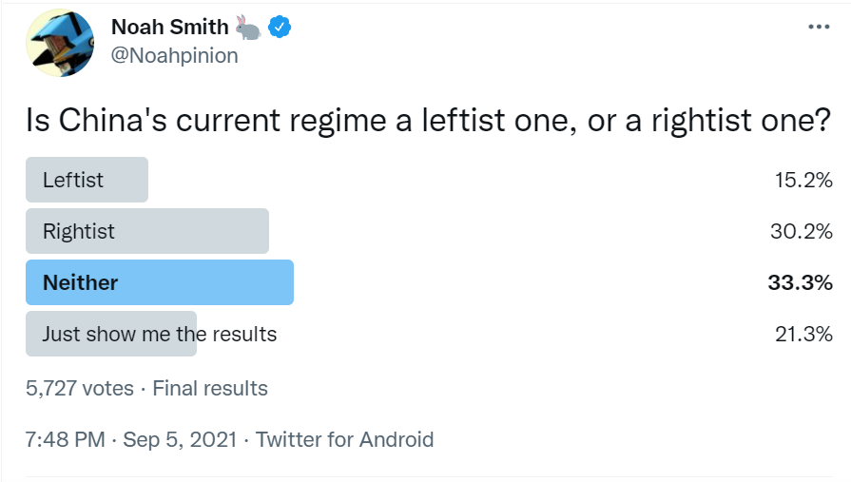
Poll

Slide 244
Threats to China‘s success story
4) A real-estate bubble

Slide 245
Threats to China‘s success story
4) A real-estate bubble
Huge build up of real estate since 1990

Slide 246
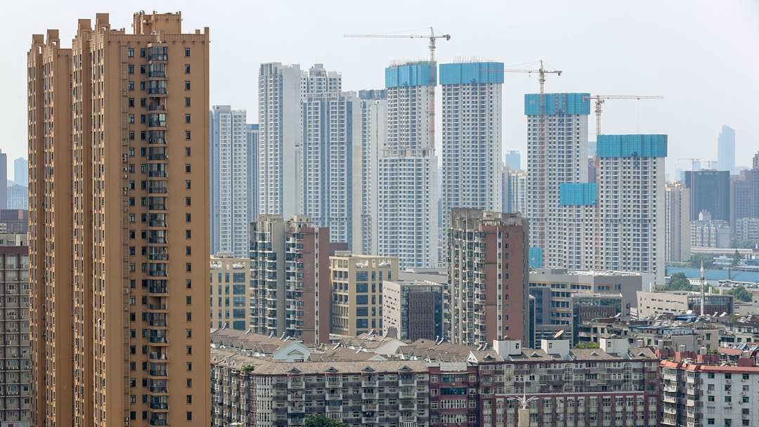

Slide 247
Threats to China‘s success story
4) A real-estate bubble
Huge build up of real estate since 1990
Also infrastructure

Slide 248
Threats to China‘s success story
4) A real-estate bubble
Huge build up of real estate since 1990
Also infrastructure
Financed by state banks, built by SOEs

Slide 249
Threats to China‘s success story
4) A real-estate bubble
During every crisis > financial injection > even more build up

Slide 250
Threats to China‘s success story
4) A real-estate bubble
During every crisis > financial injection > even more build up
„Keynesianism with Chinese characteristics“ was based around real-estate

Slide 251
Threats to China‘s success story
4) A real-estate bubble
During every crisis > financial injection > even more build up
„Keynesianism with Chinese characteristics“ was based around real-estate
> near miraculous ability to escape recessions

Slide 252
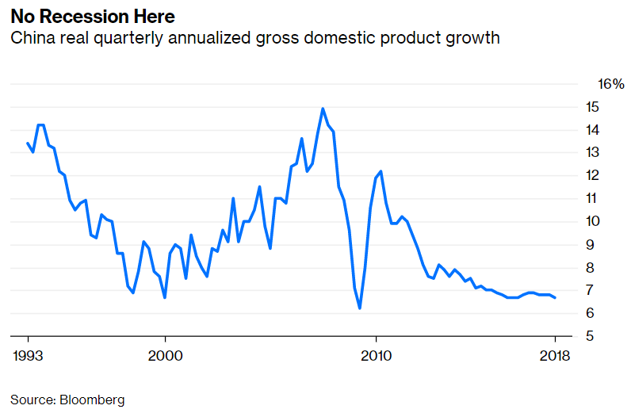

Slide 253
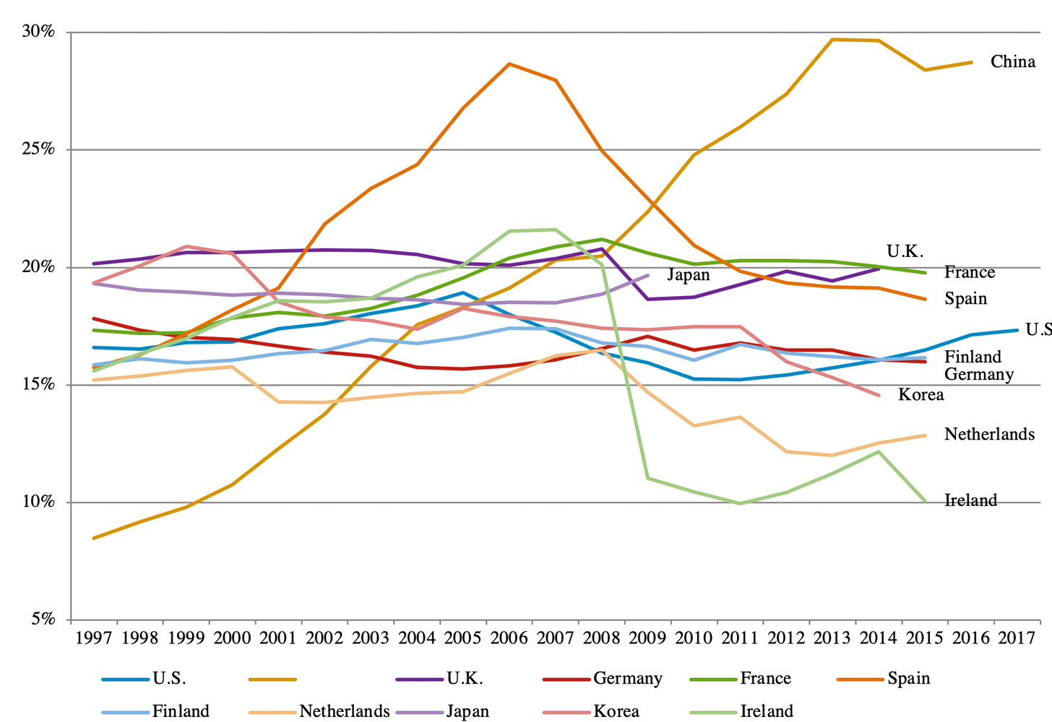

Slide 254
Threats to China‘s success story
4) A real-estate bubble
2008 – the biggest injection of them all > overproduction, redundant capacity

Slide 255
Threats to China‘s success story
4) A real-estate bubble
2008 – the biggest injection of them all > overproduction, redundant capacity
Also – since finance is controlled by the party-state, real estate is the one asset into which households can invest

Slide 256
Threats to China‘s success story
4) A real-estate bubble
2008 – the biggest injection of them all > overproduction, redundant capacity
Also – since finance is controlled by the party-state, real estate is the one asset into which households can invest
Empty suburbs of investment flats

Slide 257
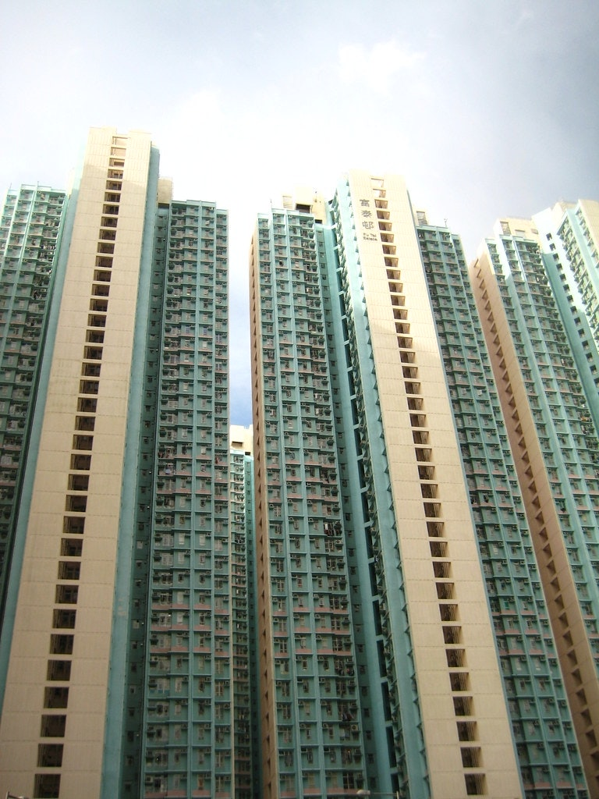

Slide 258
Threats to China‘s success story
4) A real-estate bubble
The Xi leadership – lets switch resources to manufacturing!

Slide 259
Threats to China‘s success story
4) A real-estate bubble
But:
What if the manufacturing strategy fails?

Slide 260
Threats to China‘s success story
4) A real-estate bubble
But:
What if the manufacturing strategy fails?
If the move is permanent and the construction industry becomes obsolete, how will China react to a future crisis?

Slide 261
Threats to China‘s success story
4) A real-estate bubble
But:
What if the manufacturing strategy fails?
If the move is permanent and the construction industry becomes obsolete, how will China react to a future crisis?
Local governments get income from selling land > will they have to switch to higher taxes?

Slide 262
Threats to China‘s success story
4) A real-estate bubble
But:
What if the manufacturing strategy fails?
If the move is permanent and the construction industry becomes obsolete, how will China react to a future crisis?
Local governments get income from selling land > will they have to switch to higher taxes?
What about the middle class and their savings?

Slide 263
Do we still have time?

Slide 264
Do we still have time?
Probably not…

Slide 265
Next time
China in the World Trade Organization

