Slide 1
Populism and the media
Populist political communication

Slide 2
What is the relationship between populism and the media?

Slide 3
Outline
Populism in the media
Populism against the media
Media populism

Slide 4
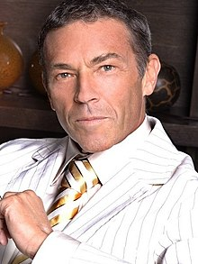
Populism in the media
Usually flamboyant personalities attracting media attention – „media complicity“
Reporting about anything that „breaks the routine“ in the very core of the media (populists as „newsmakers“)
Tabloid vs traditional media – traditional media defending the status quo vs focus on eccentric/negative aspects of the social reality
Populist communication style including language and appearance („‘journalists liked to comment on Haider’s various dress styles and labelled him a male model’“)

Slide 5
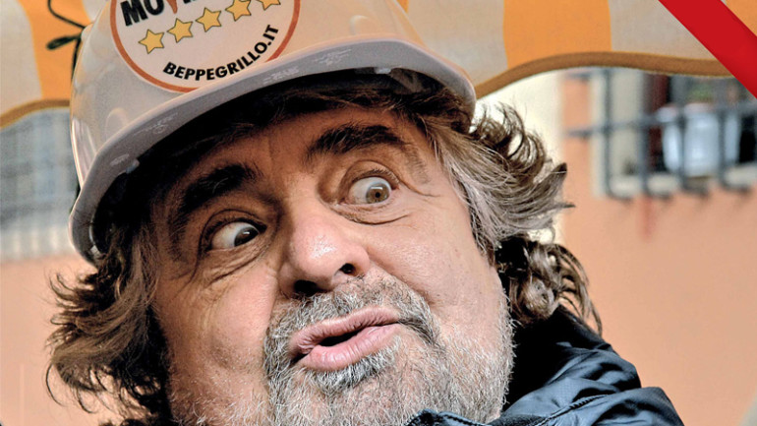
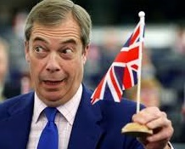
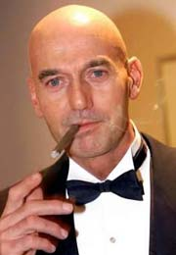
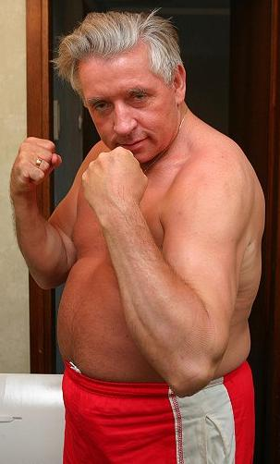
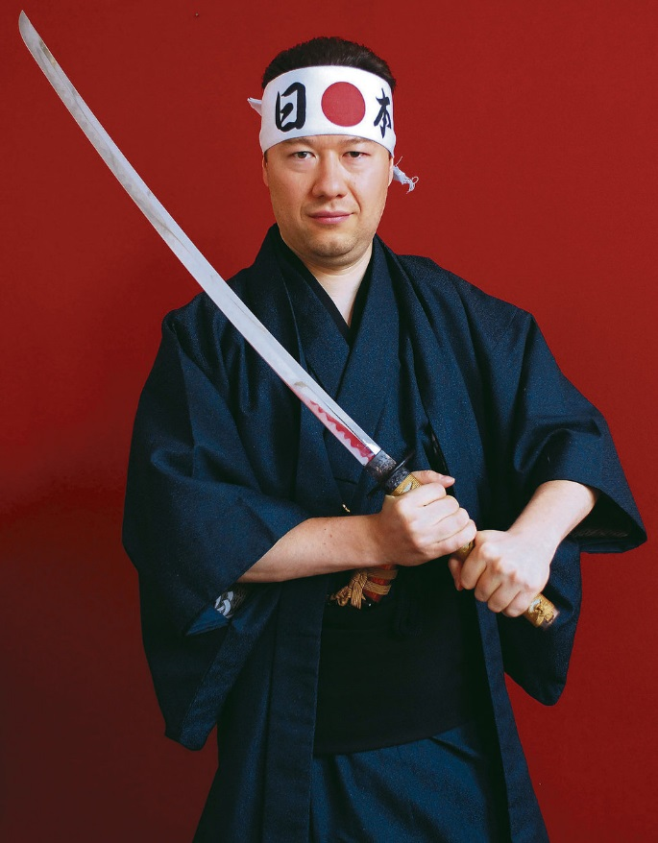
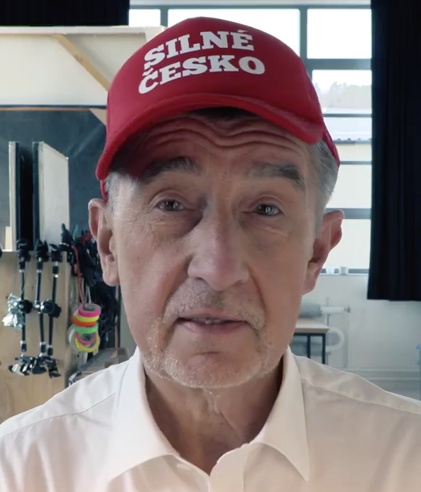
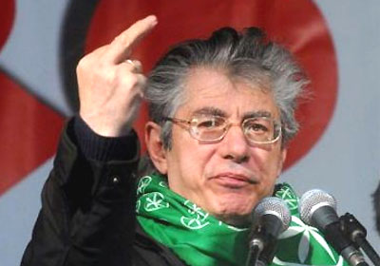
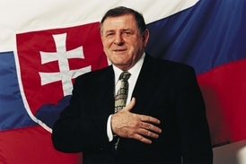
Flamboyant populism

Slide 6
Populism in the media
Four structural positions of the media that affect the presence of populism (Kramer 2014):
They can speak directly to the people, therefore circumvening the political system (traditional communication channels)
Media as „powerful movement that only consists of public sentiment, shared moral concerns, and collective mobilization“
2. Symbolic power via the representation of society – depiction of the reality based on the life of the common people, the real life X elites alienated from the everyday word
3. Media as the fourth estate outside the structures of political power – BUT impartiality and neutrality. Depends on the level of the bias of the coverage.
4. Specific style and rhetoric – media may use the style and language different from the one used by political elites: being more martial, radical, polemical

Slide 7
Populism against the media
Anti-elitist appeal as a defining feature of populist political communication
Chameleonic nature of populism – receptive towards other ideologies
Media often presented as part of the elitist conspiracy against the elites
Specific framing depends on the content of populism („liberal media“, „welcoming media“, „“The monopolistic media hide the true values for the people” /Csurka/,…)
Media stealing the sovereignty of the people
= anti-media populism

Slide 8
Not just anti-media populism
Havlík, Kluknavská (in progress): Beyond anti-media populism: Legitimate and untruthful media in the communication of PRR on Facebook
Friend and foe relationship with the media: legitimate and untruthful media
Information and communication functions X reference to untruthfulness
Analysis of communication of Czech populist radical right on Facebook – claims analysis about the media(various outlets, context of the crises)
Conclusion: more than half of claims about the legitimate role, cca 1/3 post-truth accusations
Post-truth accusations linked to media in general and PSM, far less disinformation media
SPD more truth accusations than Dawn, immigration issue linke to information and communication function
Not just anti-media communication – more complex relationship

Slide 9
Media populism
„‘populist media’ or ‘media populism’ – highly commercialized media production and/or news coverage that yield to general popular tastes (Mazzoleni 2008)
The process of mediatization (also „video democracy“ – Sartori)
The transformation of political language into spectacle
Mastering of TV broadcasting – „telepopulism“ (Blocher and ARENA - https://www.youtube.com/watch?v=njTtf1nRX1w&ab_channel=BlocherTV )
Greater focus on personalization – emotions, dramatization (more suitable for populists or populist communication) + populist parties usually more strongly identified with the leader (x policies)
Strengthened by the competition between private and public media since the 1990s (in Europe)

Slide 10
+ populist media ownership
Is media ownership more likely for populist politicians?
Not necessarily a strong theoretical linkage between populism and the media ownership
BUT populism has little patience with checks and balances including the watchdog role of the media
Any examples?
Berlusconi in Italy
Babiš in the Czech Republic

Slide 11
Populist voters and media consumption
Hameleers et al. (2017): The Appeal of Media Populism: The Media
Preferences of Citizens with Populist Attitudes
Theoretical assumption about attitudinal congruence between voters and the media content (echo chambers, confirmation bias)
citizens with populist attitudes are expected to self-select media content that articulates a societal divide between “us” and “them”
Three types of populism in the media: people centrality, anti-elitism, monocultural populism
Expectations: tabloid media, entertainment media diet
Exclusionism related to tabloid consumption (preferences for media stronger with preferences for populist content)

Slide 12
Conclusion
Different layers of the relationship between the media and populism
Populism in the media – populist content or opportunities for the populist content shared by the media
Media populism – populism and populist political communication in the age of mediatization
Populism against the media – media as part of the anti-media populist discourse
Media ownership
Media consumption

