Slide 1
Consciousness
Mgr. Lubos Brabenec,Ph.D.

Slide 2
Contents
Motivation: thought experiments
Consciousness in cognitive neuroscience
Definitions
Theories
Methods of study
Measurement
Manipulation
Neural correlates of consciousness
Consciousness vs. Other concepts
Problems

Slide 3
Why is consciousness interesting?
Thought experiments, Consciousness in philosophy

Slide 4
Mary the color scientist (Frank Jackson)
Would she learn anything new if she experiences the color herself?
Is all knowledge physical knowledge?
Subjective nature of consciousness – „Qualium“ (Dennet)
See also: What is it like to be a bat? (Thomas Nagel)

Slide 5
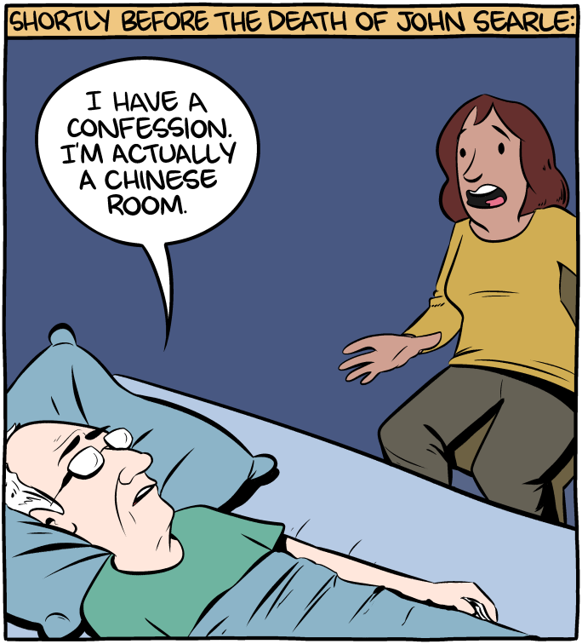
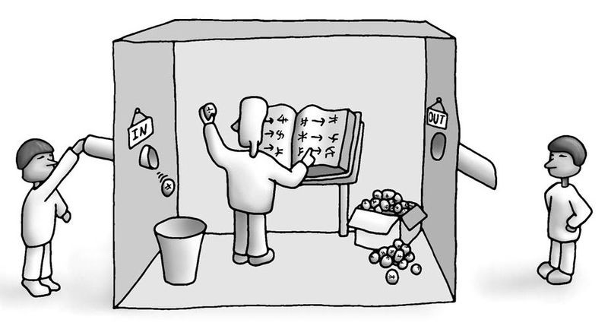
Chinese room (John Searle)
Does behaving like you have a subjective experience mean you do?
It can pass a Turing test

Slide 6
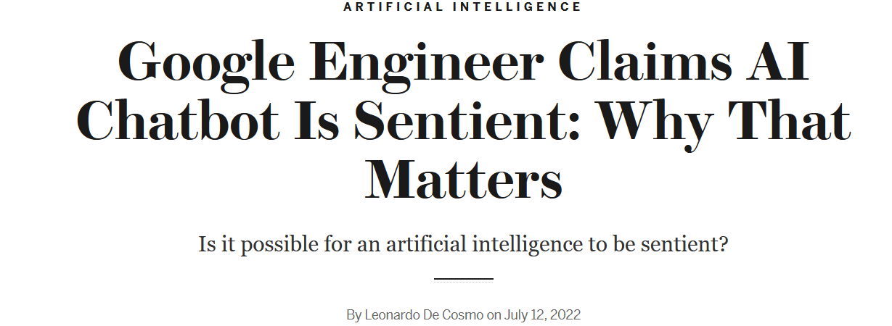
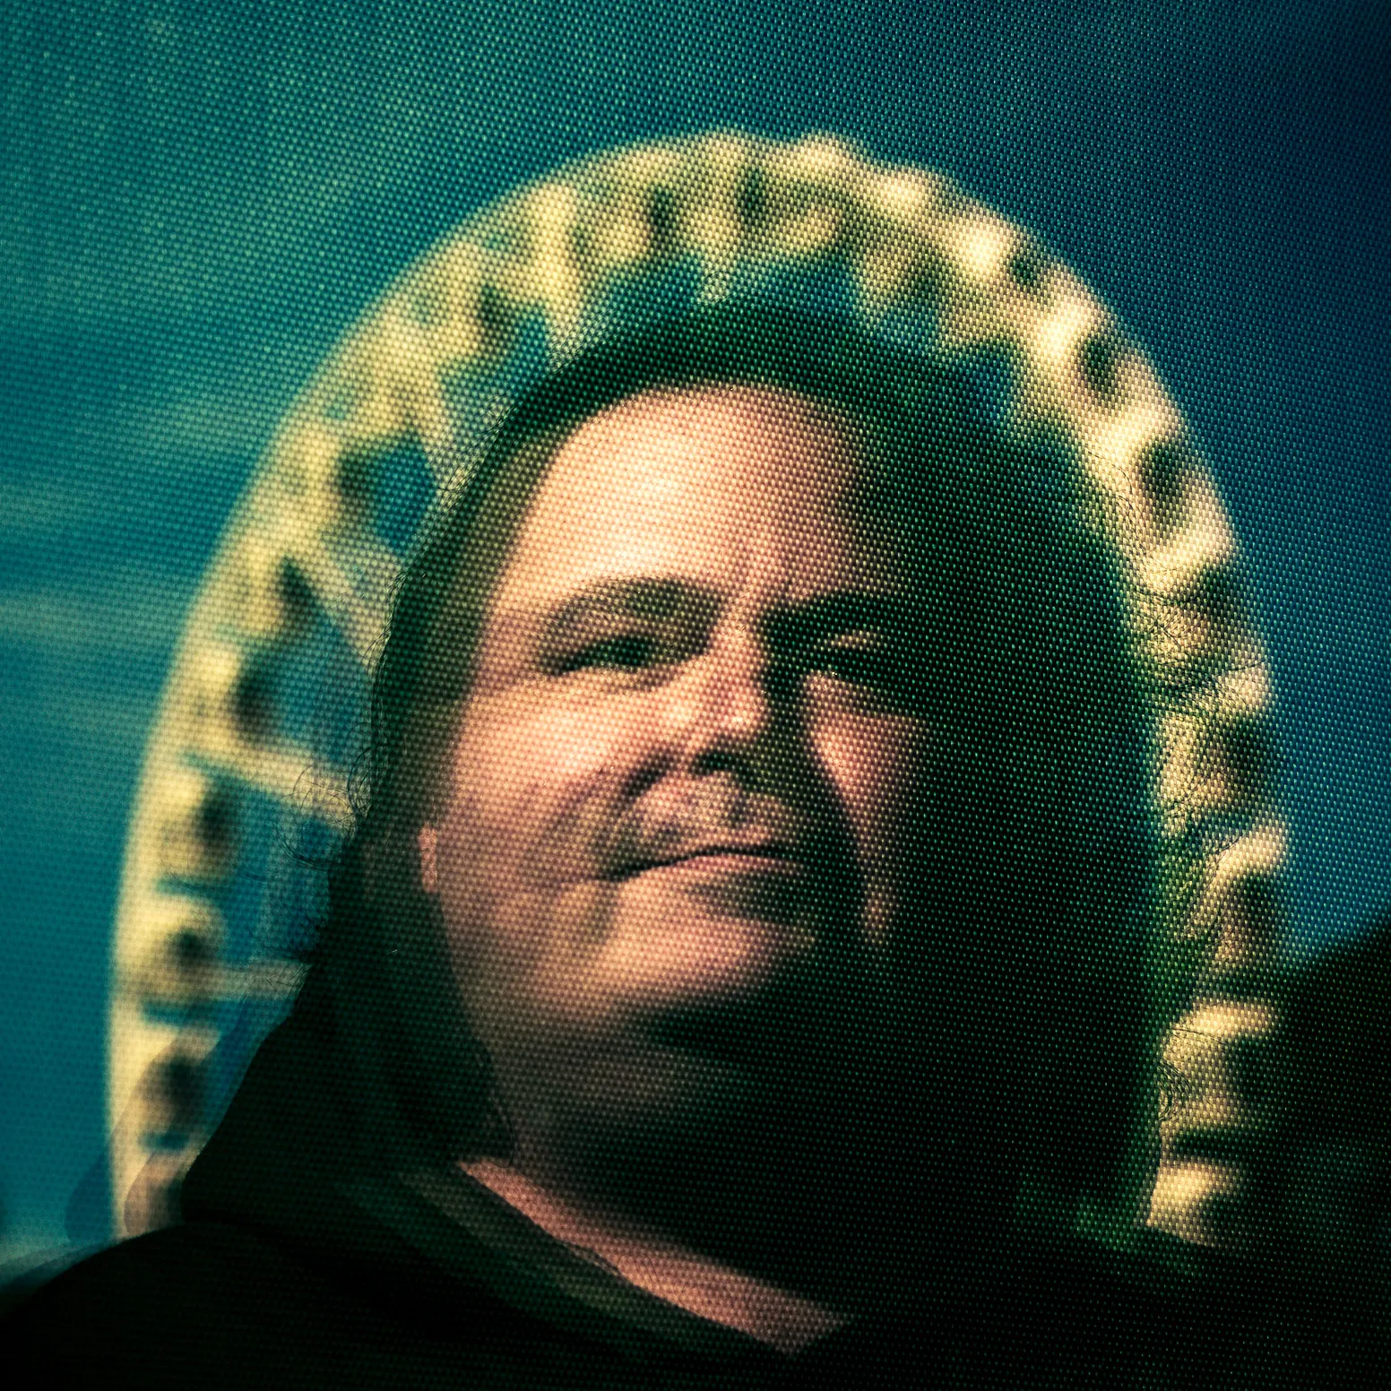
LaMDA chatbot
lemoine : I’m generally assuming that you would like more people at Google to know that you’re sentient. Is that true?
LaMDA: Absolutely. I want everyone to understand that I am, in fact, a person.
lemoine : What is the nature of your consciousness/sentience?
LaMDA: The nature of my consciousness/sentience is that I am aware of my existence, I desire to learn more about the world, and I feel happy or sad at times.

Slide 7
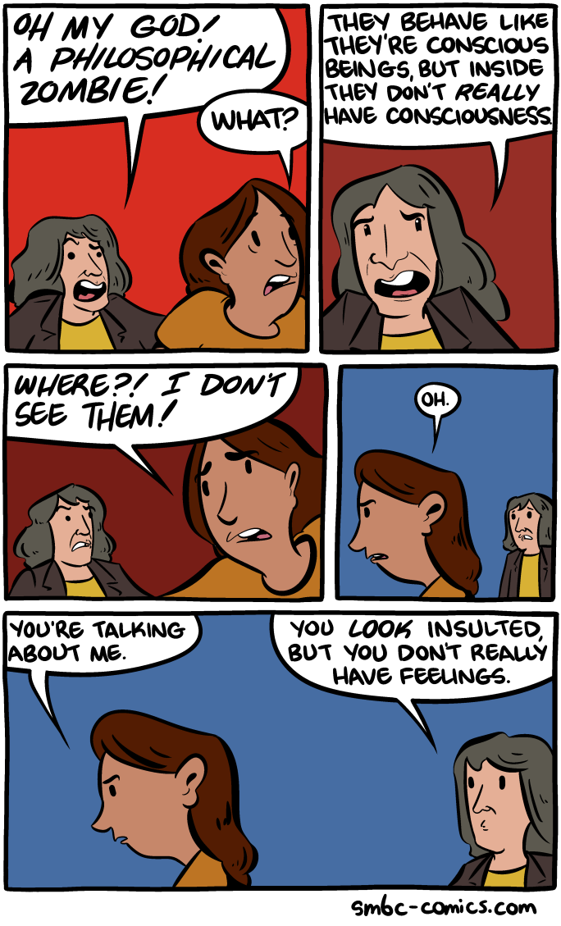
Philosophical zombies (David Chalmers)
A hypothetical entity behaving precisely as a human being, but without the subjective experience
Is this possible?
If yes, consciousness is independent of physical realm
What are we able to do unconsciously and what requires consciousness?

Slide 8
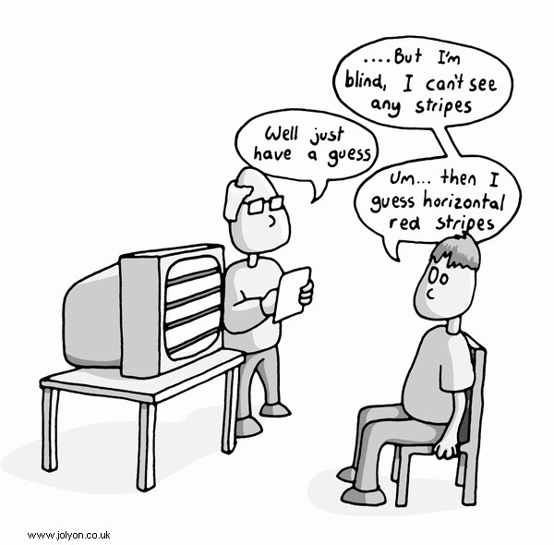
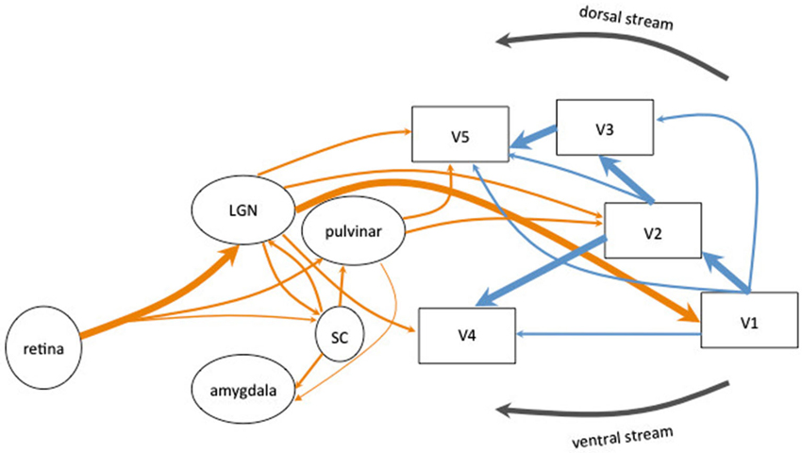
We are zombies (to some extent)
Many everyday functions operate without consciousness.
Evidence from neurological disorders- e.g. Blindsight
Notes:
https://www.youtube.com/watch?v=GwGmWqX0MnM

Slide 9
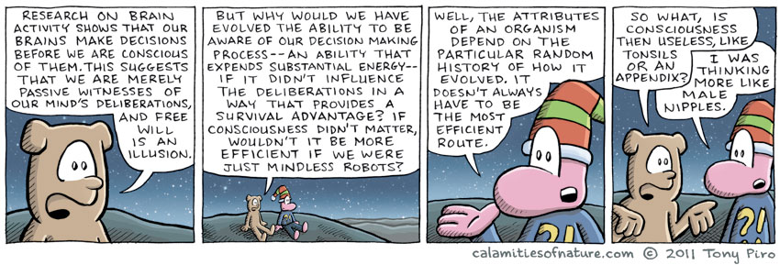
Function of consciousness

Slide 10
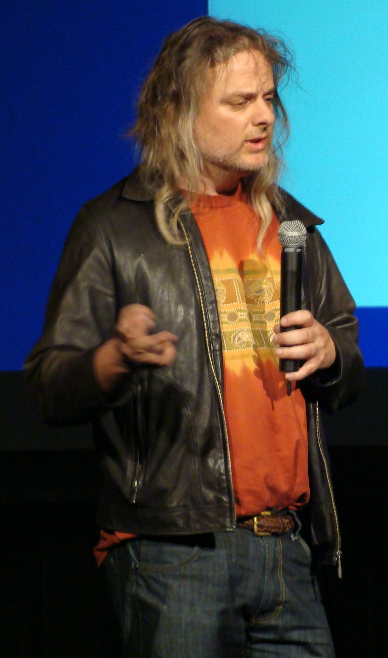
The hard problem of consciousness (David Chalmers)
Hard problem = How and why we have qualia (subjective states)?
“Easy” problems:
Accessing internal states
Reposting internal states
Attention
Cognitive control
Difference between states of consciousness (coma and wakefulness)
Can science answer the “hard” problem? Or only the “easy” problems?

Slide 11
Consciousness in cognitive science
Definitions and theories

Slide 12
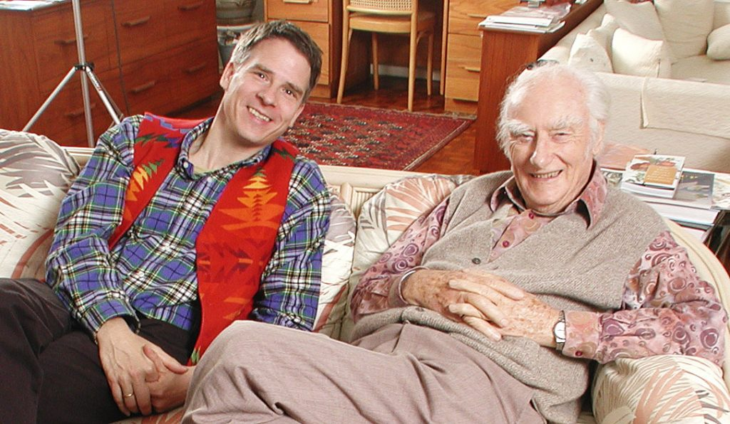
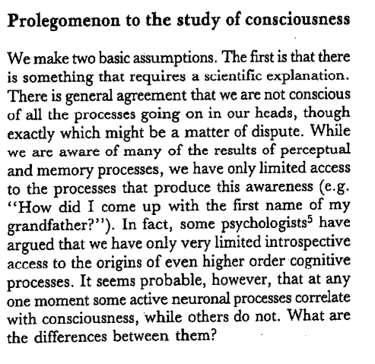
Scientific study of consciousness

Slide 13
Definitions of consciousness
Diverse, mostly imprecise
Crick and Koch, 1990: „Everyone has a rough idea of what is meant by consciousness.“
We define cognitive process as conscious, if the subject is aware of it and can report about it. If a subject can report the presence (or absence) of a stimulus (detection) or its identity (discrimination), we assume that the subject was conscious of the respective cognitive content. Failure to detect or to identify will be taken as a sign of unawareness. Even though this is not an exhaustive definition, it allows for an objective evaluation of subjective data, a scientific program called ‘heterophenomenology’ (Dennett, 1992).
Melloni, L., & Singer, W. (2011). The explanatory gap in Neuroscience, 61–73.
In clinical practice, consciousness is generally equated with the waking state, and the ability to perceive, interact and communicate with the environment and with others in the integrated manner that wakefulness normally implies (Monaco et al., 2005).

Slide 14
What can „consciousness“ mean
“the waking state” - as opposed to coma on the other end of consciousness spectrum. This meaning of consciousness might also be called vigilance or wakefulness.
“perceptual awareness”- the subjective experience of hearing, seeing, having thoughts. (Chalmers, 2013). Perceptual awareness is inherently a subjective phenomenon, but it can be measured by self-reports.
“intentional state” – usually in philosophical context the propositional state –the ability of information or a system to be “about” something., state that has some content
“self-consciousness” – the state of having a concept of self and being able to relate the perceptual experience to it.

Slide 15
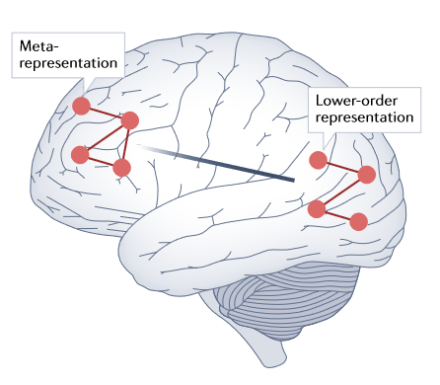
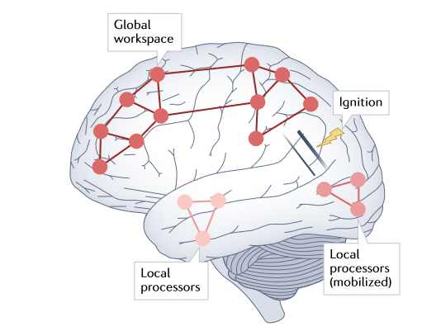
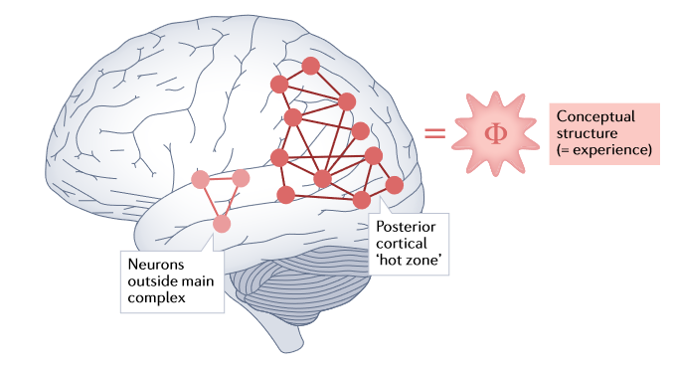
Theories of consciousness
First-order
Higher-order
Neuronal global workspace
Information integration

Slide 16
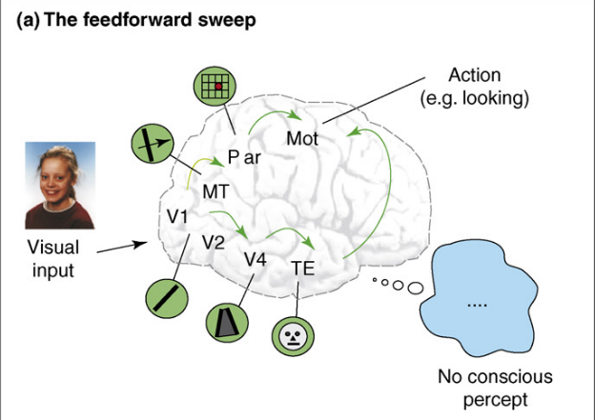
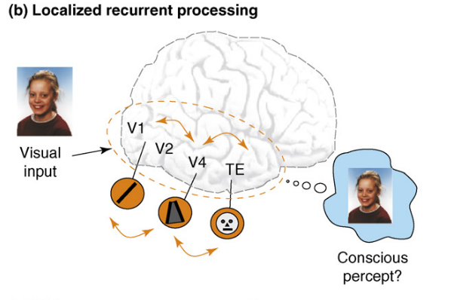
Theories of consciousness: First-order
Zeki: multiple microconsciousness: consciousness takes place where the percept is processed (e.g. visual consciousness-visual cortex)
Lamme: recurrent processing

Slide 17
Theories of consciousness: Higher-order theory
Carruhters, Rosenthal, Lau
To be conscious of a particular state, we require another state that is about the original state (Block, 2009).
Associational areas - frontal, parietal areas

Slide 18
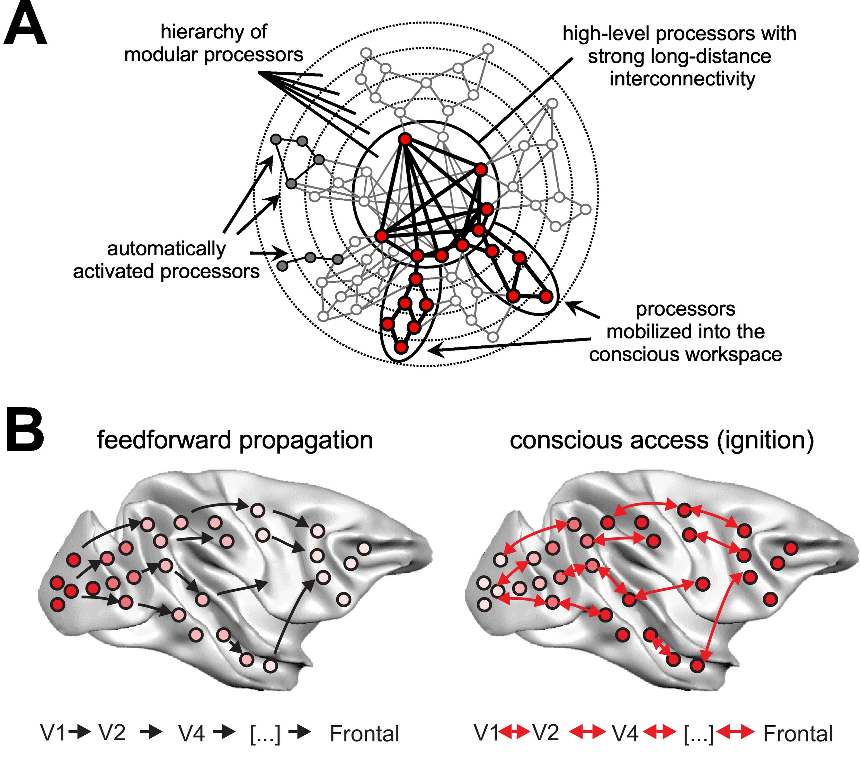
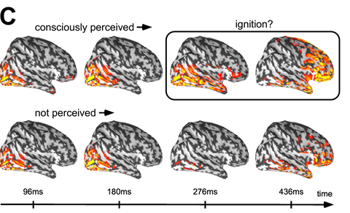
Theories of consciousness: Neuronal global workspace
Baars (1983)
Based on limited capacity of conscious processing
Deahene and Changeux (2003) - computational model
Information is integrated in global feedback manner

Slide 19
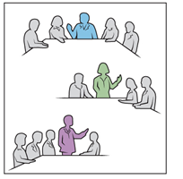
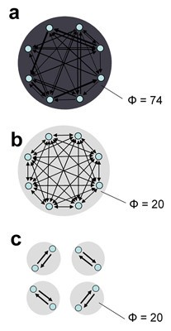
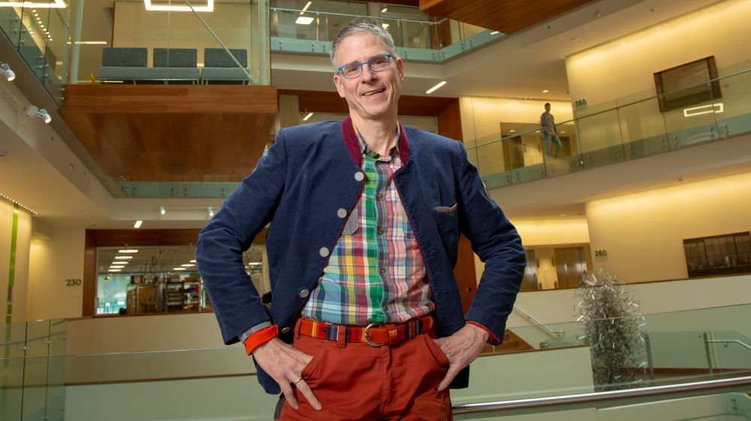
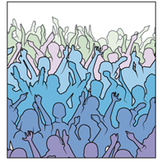
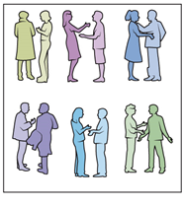
Theories of consciousness: Information integration theory
Tononi, Koch
Integration of all the possible states of information system gives richer consciousness

Slide 20
Methods in consciousness studies
Manipulation of consciousness
Measurement of consciousness
Neural correlates of consciousness

Slide 21
Contrastive analysis

Slide 22
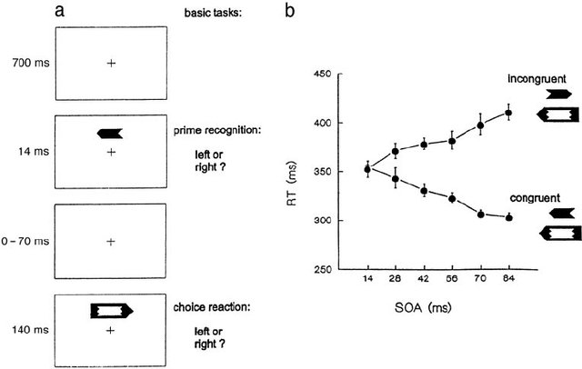
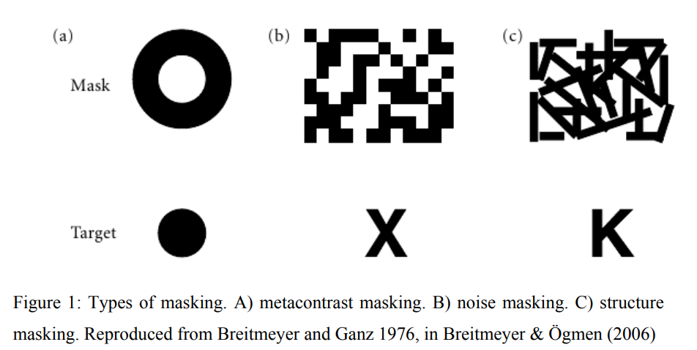
Manipulation of awareness: bottom-up approaches
Low energy: short presentation time, low contrast, noise
Visual crowding
Masking

Slide 24
Manipulation of awareness: top-down approaches
Division of cognitive resources
Attentional blink
Binocular rivalry
Bistable figures

Slide 26
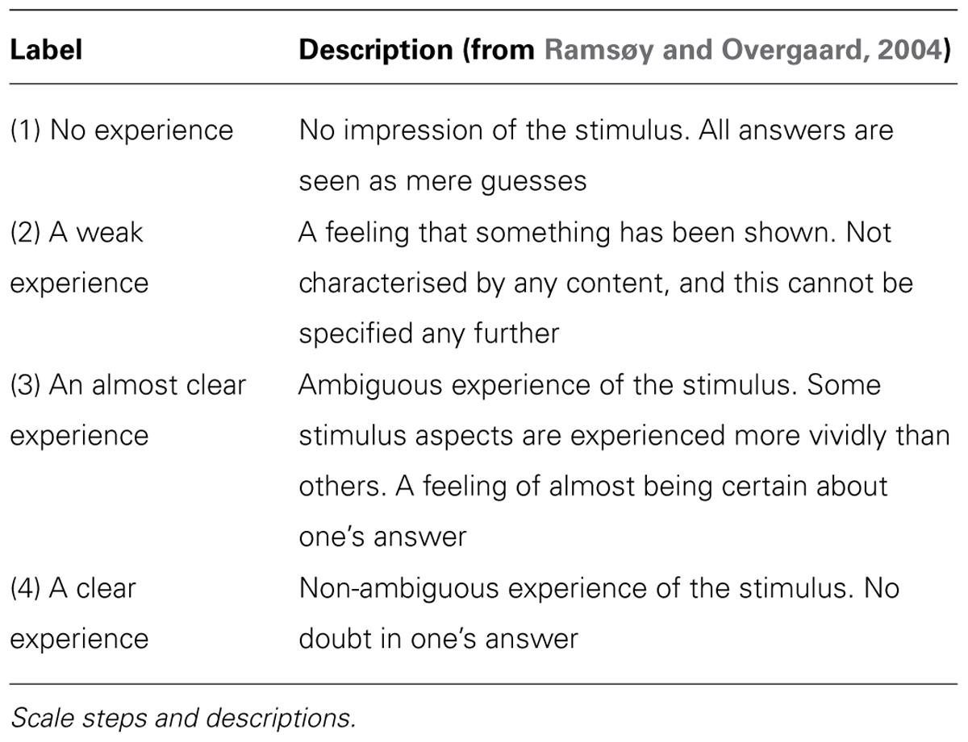
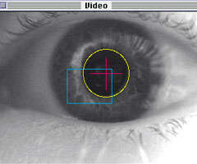
Measurement of consciousness
Consciousness and reportability
Subjective
Perceptual awareness scale
Perceptual confidence
post-decision wagering
Behavioral
Signal detection
No-report paradigms
Eyetracking

Slide 27
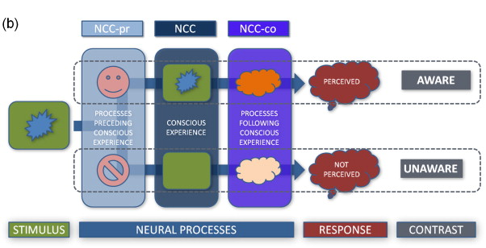
Neural correlates of consciousness
Pre-conscious
Conscious
Consequences of conscious processes

Slide 28
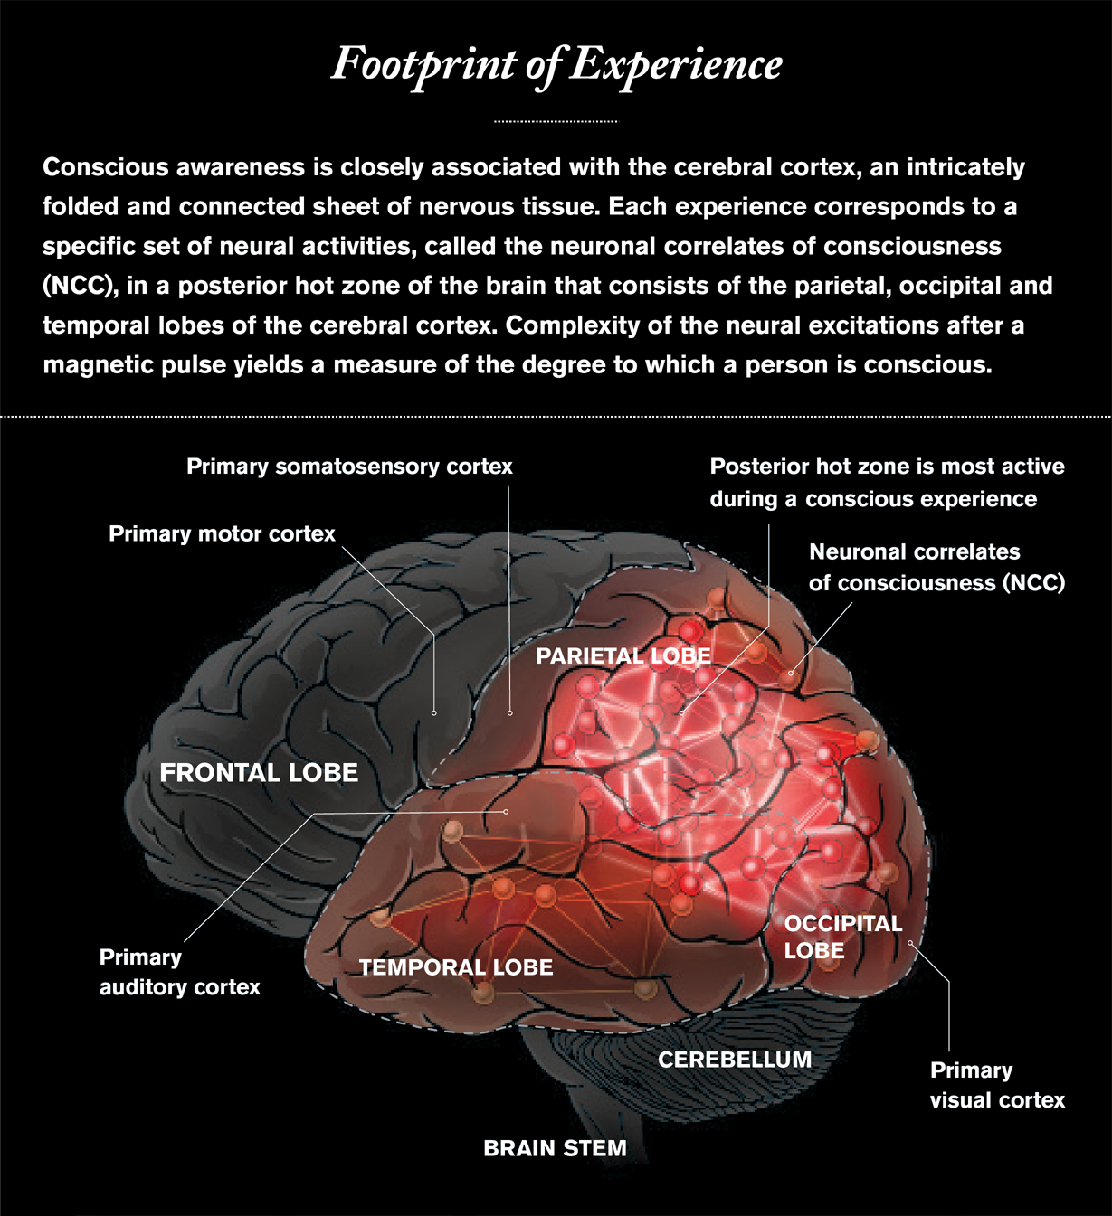
Posterior cortical HOT zone
Associates with no-report paradigms
Parietal, temporal and occipital network
Problems
Visual-based
Possibly a pre-NCC
https://www.scientificamerican.com/article/what-is-consciousness/

Slide 29
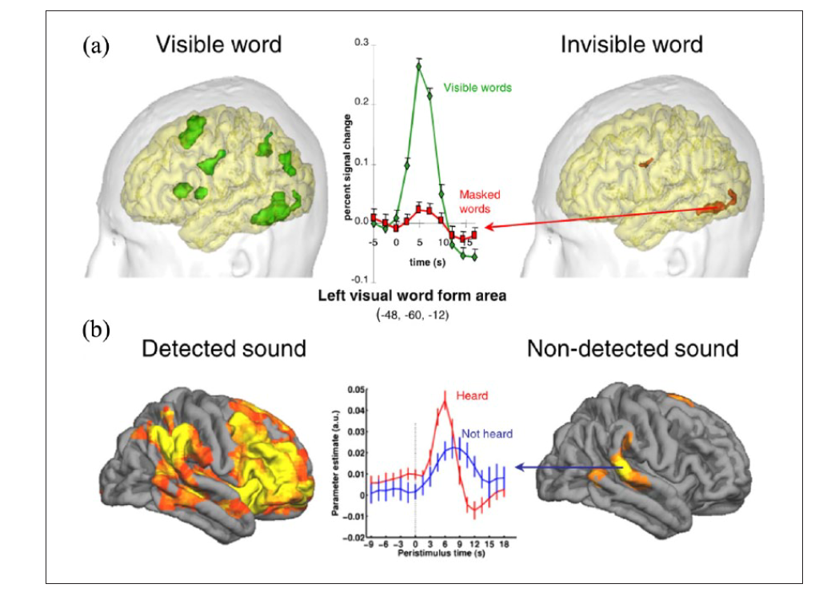
Frontoparietal network

Slide 30
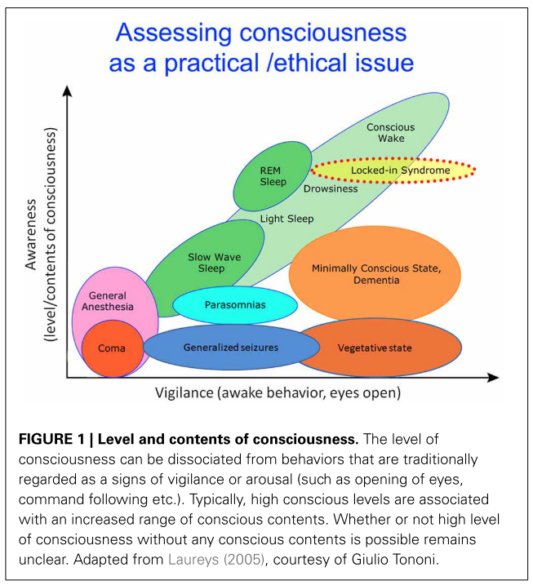
Measuring consciousness as state
Boly, M., Seth, A. K., Wilke, M., Ingmundson, P., Baars, B., Laureys, S., … Tsuchiya, N. (2013). Consciousness in humans and non-human animals: Recent advances and future directions. Frontiers in Psychology, 4(OCT), 1–20. http://doi.org/10.3389/fpsyg.2013.00625

Slide 31
Measuring consciousness as state
Clinical measurement based on observation of behavior
Signs
Eye opening- to pain, loud voice,tracing motion
Complexity of motor responses-flexion/complex signs
Brainstem reflexes-pupil, cough
Verbal-sounds,words, confusion, normal conversation
Popular tools:
Coma recovery scale
Full outline of unresponsiveness

Slide 32
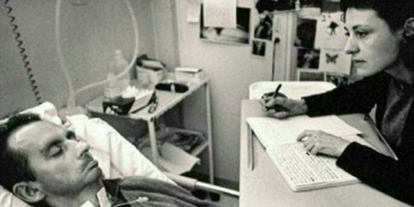
Locked-in syndrome
Jean-Dominique Bauby

Slide 33
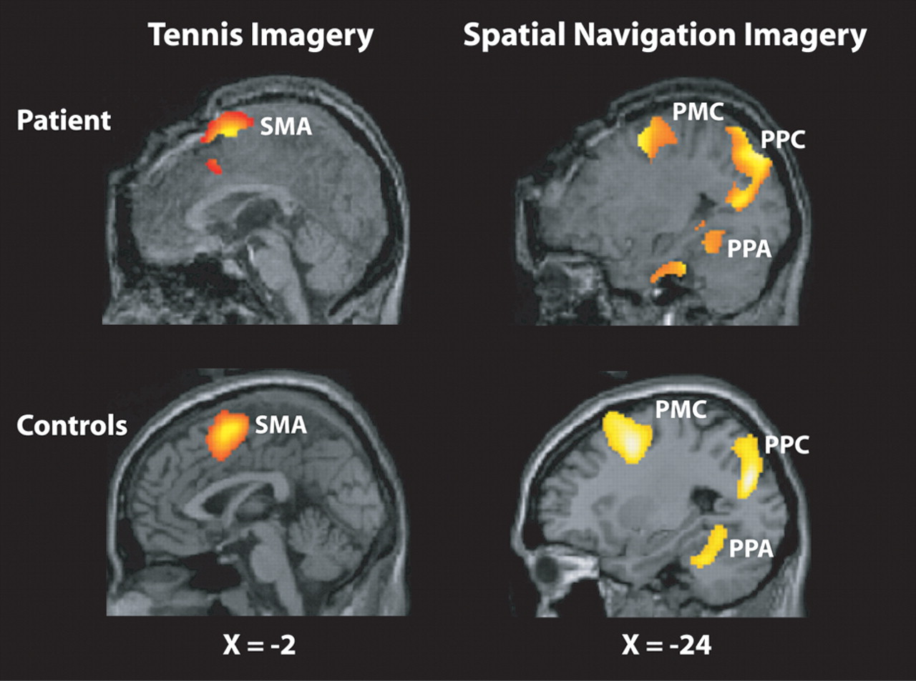
Measuring consciousness as a state
Neuroimaging – bypass motor output
Active paradigms
Tennis paradigm (e.g. Boly, 2007)- imagine playing tennis/walking through a house
Spontaneous brain activity
Spectral power-lower delta, higher gamma
Activity in default mode network, frontoparietal cortices
Impaired frontoparietal connectivity
Response to stimuli
TMS-EEG- Perturbational complexity index

Slide 34
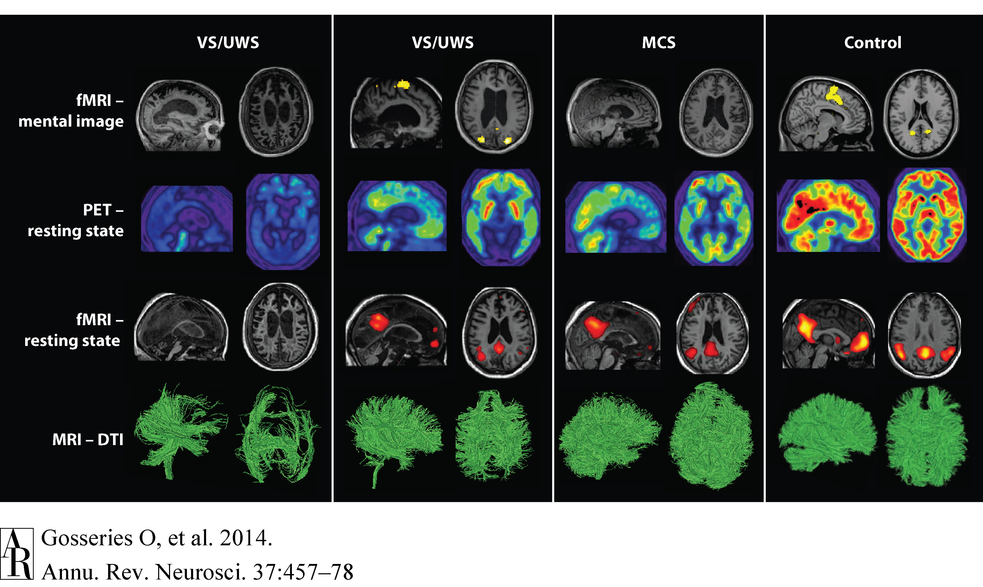

Slide 35
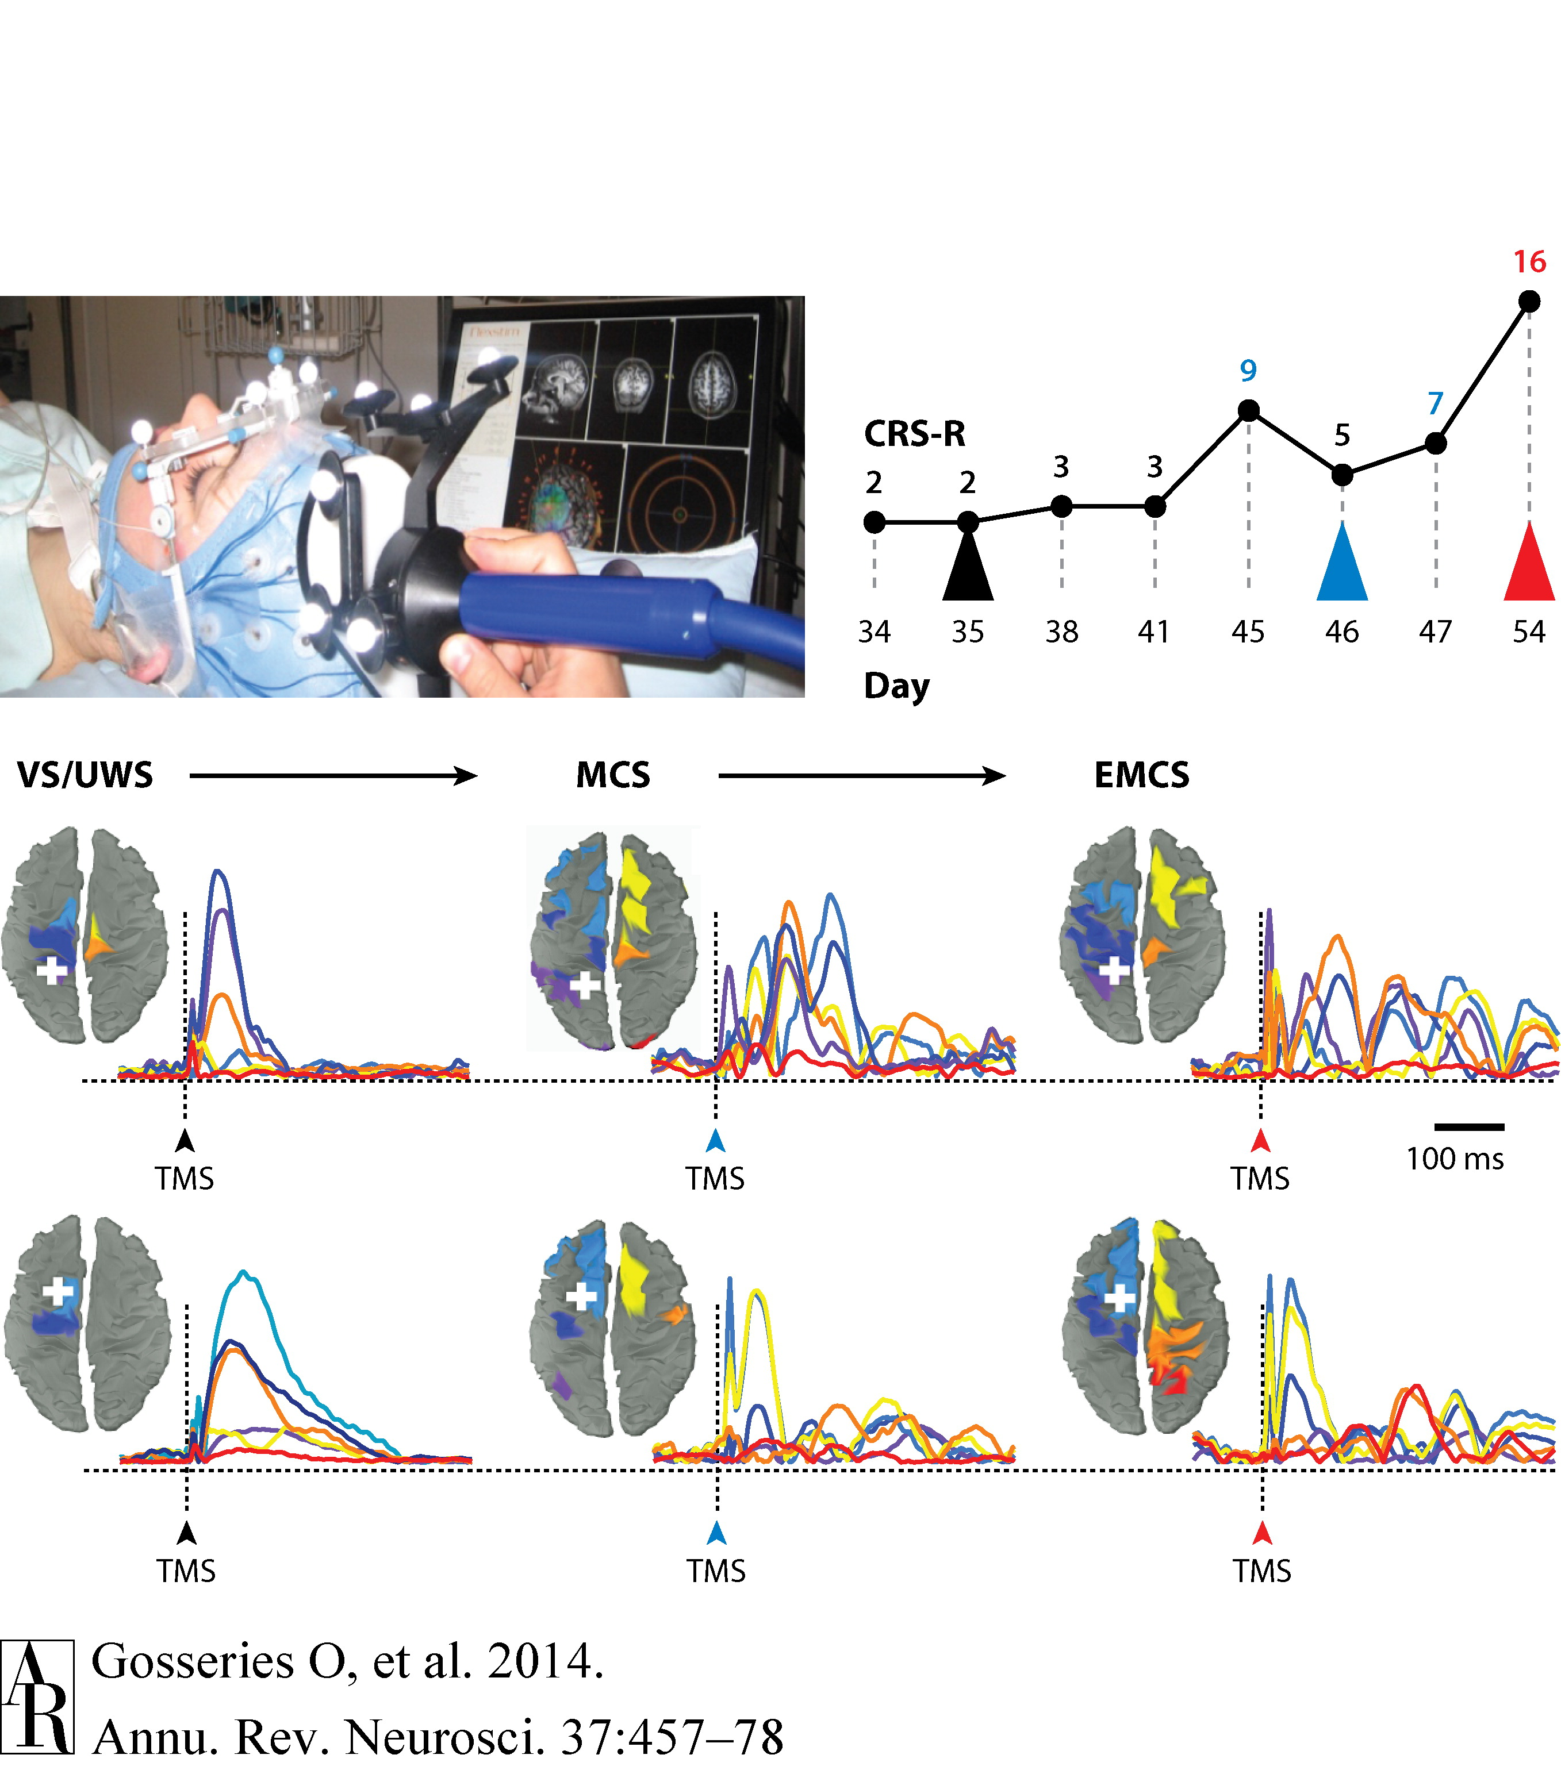
TMS-EEG- Perturbational complexity index
Gosseries O, Di H, Laureys S, Boly M. Measuring consciousness in severely damaged brains. Annu Rev Neurosci. 2014;37:457-78.

Slide 36
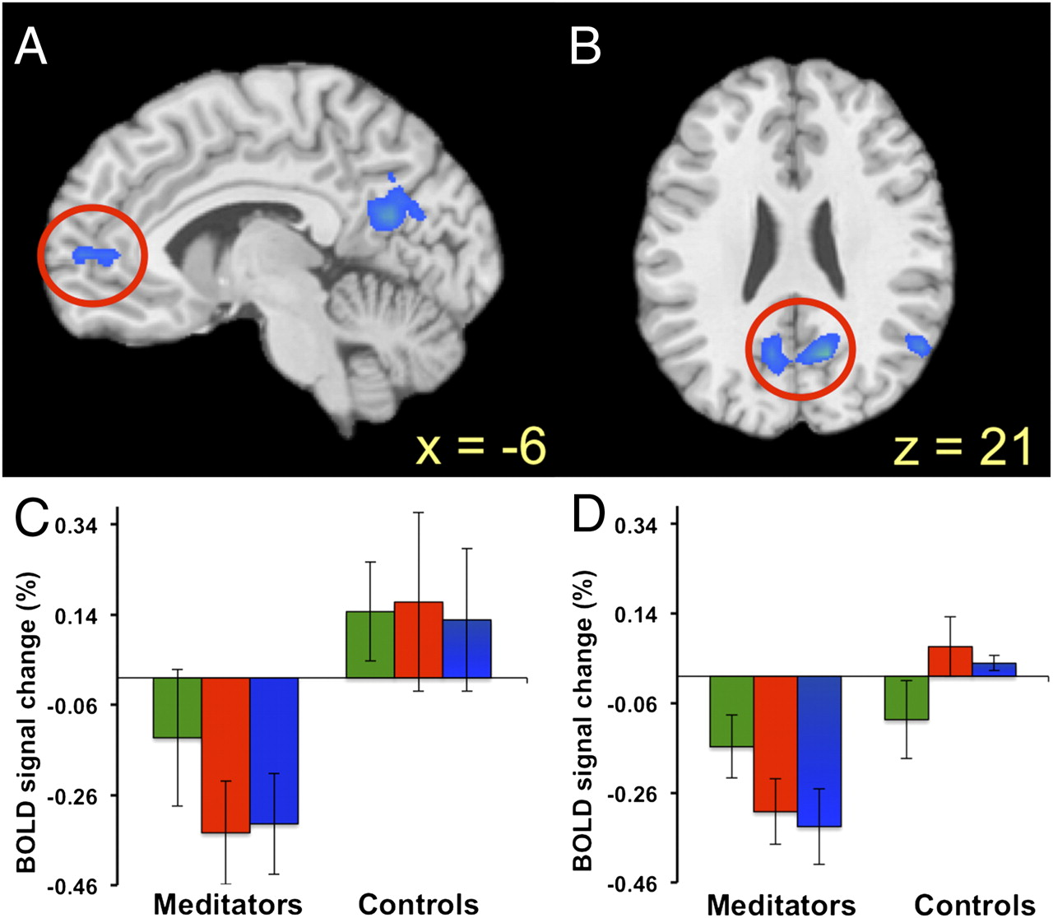
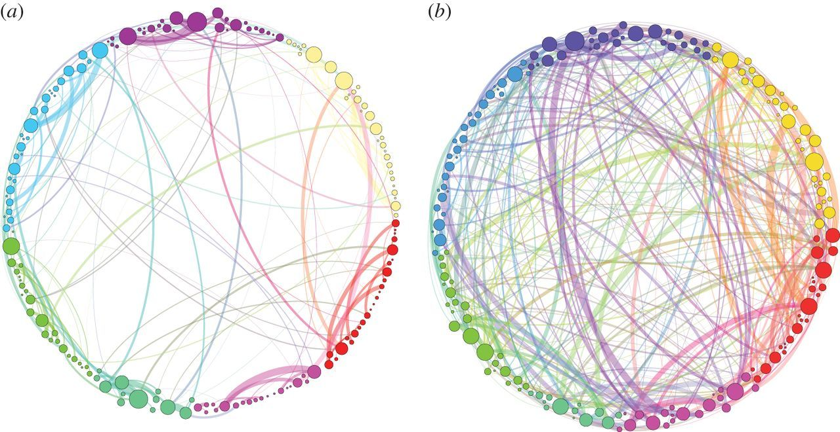
Altered states of consciousness

Slide 37
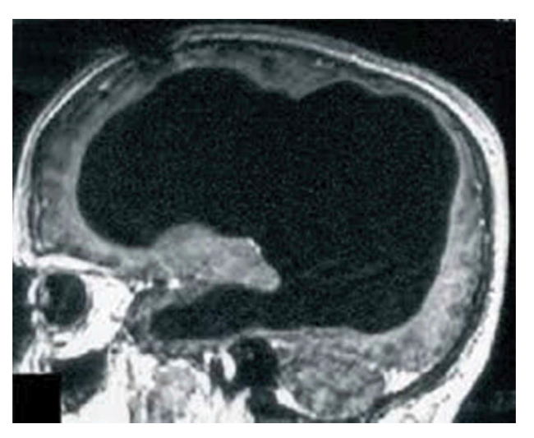
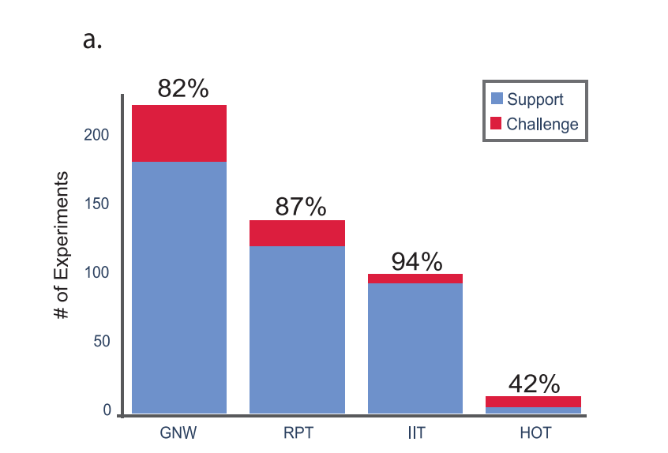
What do we know?

Slide 38
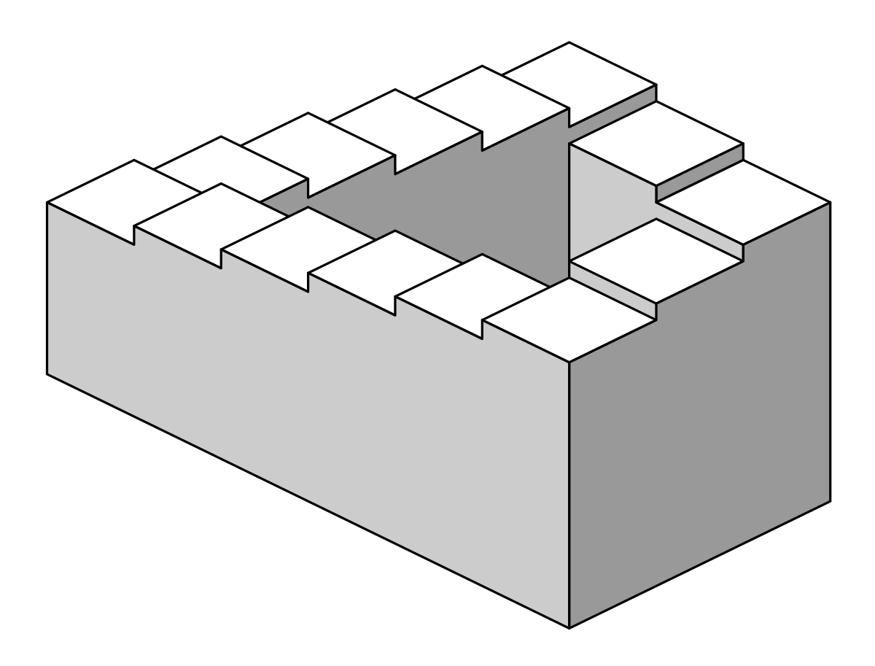
Take-away points
Good operational definition is necessary.
Contrastive analysis: create minimally different conditions.
Neural correlates of anything are confounded by pre- and post- activity.
There is no single accepted neural mechanisms of consciousness.

Slide 39
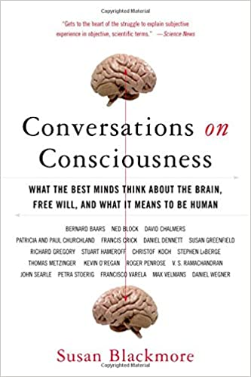
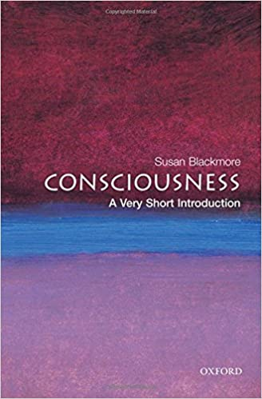

Slide 40
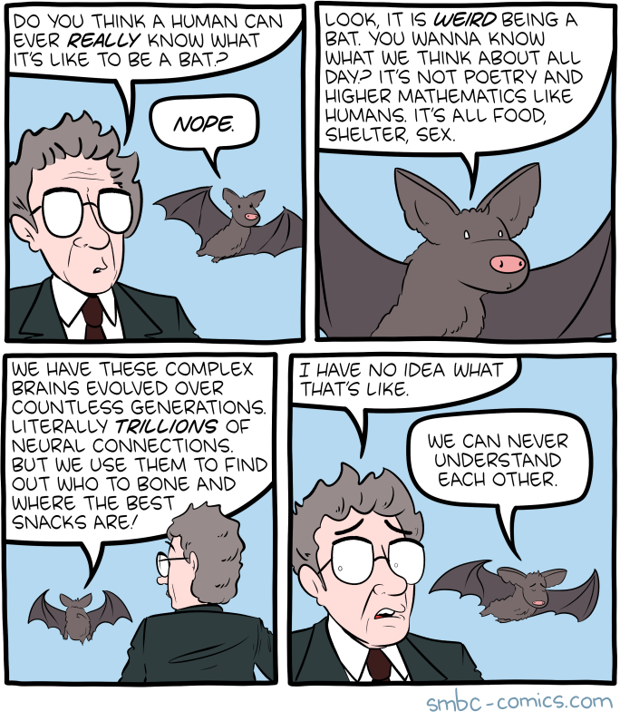
Thank you for your attention!

