Slide 1
History of Social Anthropology (Course Code: SANb 2032)
FSS, Masaryk Univ. Brno
When: Winter/Spring 2022, Thurs from 16:00 to 17:40 (CET). Where: U43
Course convenor: Dr Patirck LAVIOLETTE
246133@mail.muni.cz / patrick.laviolette@fss.muni.cz
Office Hours: Tuesdays 14:00 16:00 (or Zoom appointment)
Office: Room 3.48, Joštova 218/10. 602 00 Brno
Phone: +420 549 49 49 04
Or by Zoom appointment:
Notes:
1

Slide 2

WHO ARE YOU ??
What are some of the main ways in which we go about doing Science??

Slide 3
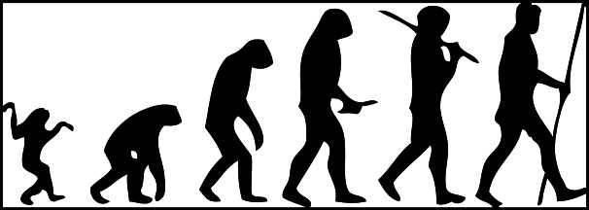
The Scientific Method, yes, but what does this involve??

Slide 4
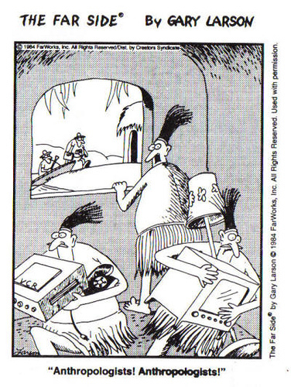
We ask the basic inquisitive questions,
Then we go about finding the best possible
answers, in as many ways as we can.
In thinking through the academic discipline of social anthropology, we will ask such questions as: how is it practiced? How long has it existed? How is it disseminated? When did it start? When will it end? When was it most and least important? Where are the centres of its production and consumption? Where will it grow and/or shrink? Where do anthropologists do their research? What do they examine? What methods and theories do they use? What disciplines influence it most and are the disciplines that it most resembles? Who are the main figures in establishing its international importance? Who’s been left out of such narratives.

Slide 5
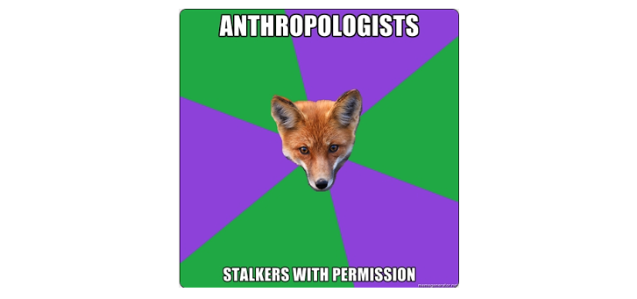
And how do we verify the findings?

Slide 6
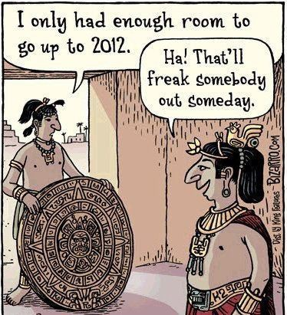
Through a system of Peer Review,
i.e., assessments by experts in
the discipline.
This is meant to question the results,
challenge, the methods and theoretical
Framework – often questioning the
Initial questions themselves.

Slide 7
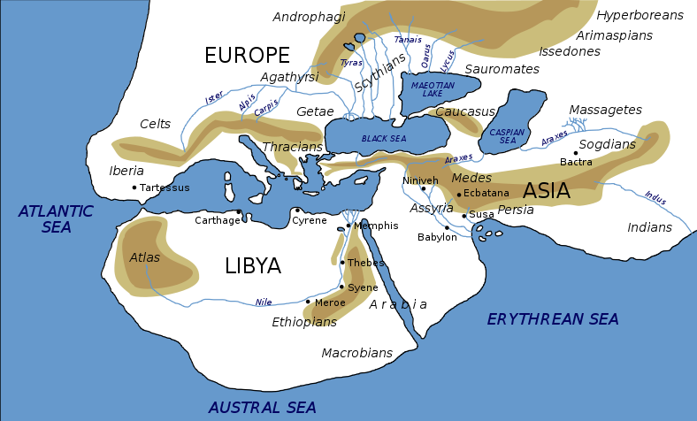
Reconstruction of a map of world by Herodotus (circa 450 BC)

Slide 8
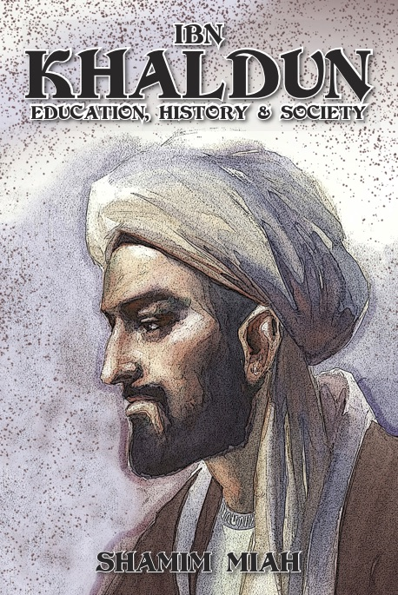
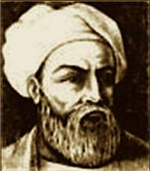
Ibn Battuta (1304–1369)
Tangier
(1332–1406)
Arab scholar in what is now
Tunisia.

Slide 9
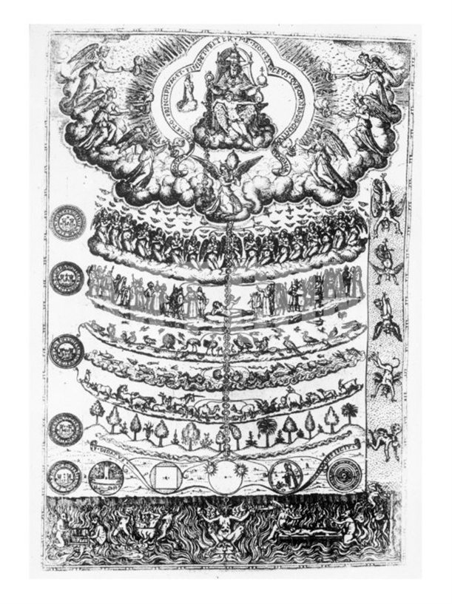
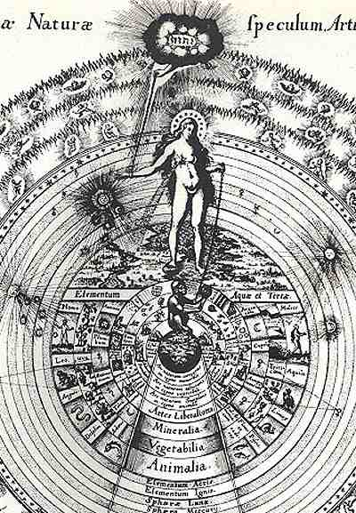
Robert Fludd, Chain of Being, 1617
1579, Great Chain of Being ‘Scala Natura’
from Didacus Valades, Rhetorica Christiana.
Notes:
9

Slide 10
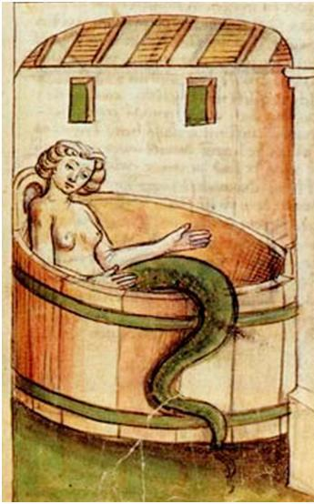
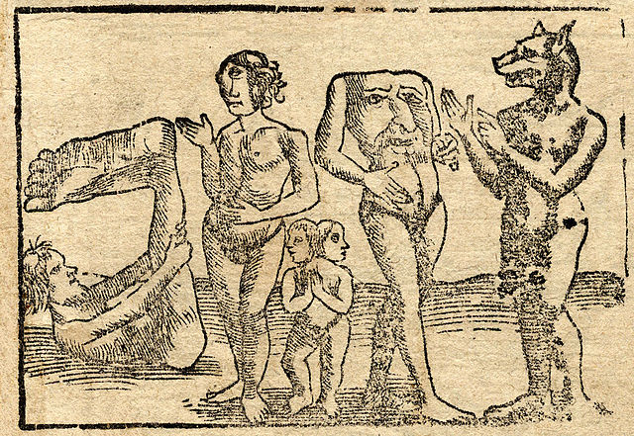

Slide 11
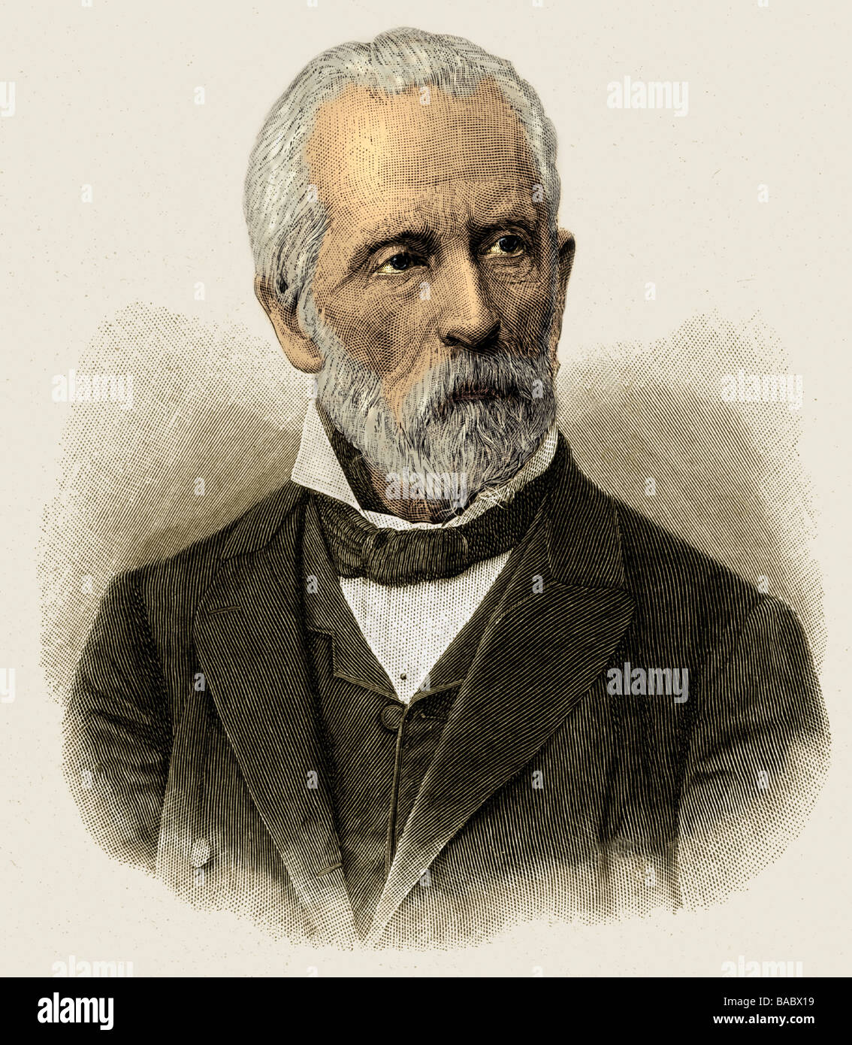
Adolf Bastian
[1826 -1905]
Bremen, DE
Der Mensch in der
Geschichte (1860)
Professor of Ethnology
Berlin.
Director of the Imperial
Museum
Main contributor to a new
Museum für Völkerkunde, est. in 1868

Slide 12
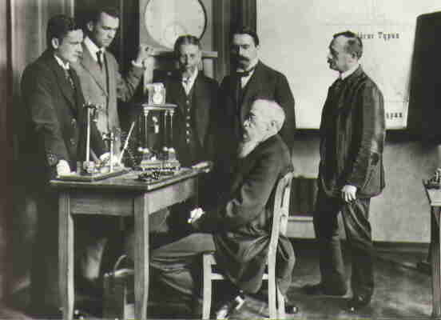
Wilhelm Wundt (1832–1920), Völkerpsychologie
Cultural psychology, Leipzig.

Slide 13
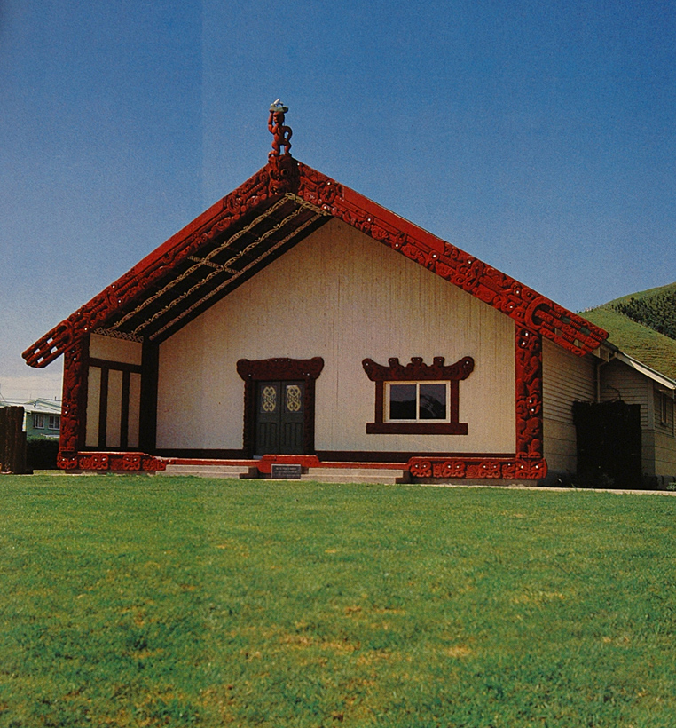
Te Poho-o-Rawiri, Gisborne, Rotorua School of Māori Arts and Crafts carvers (including John Taiapa, Pine Taiapa and Wihau), opened 1925

Slide 14
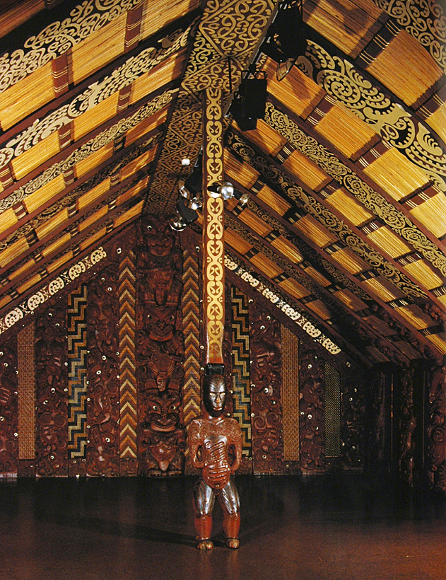
Raharuhi Rukupo (of Rongowhakaata) Te Hau-Ki-Turanga, 1840-42

Slide 15
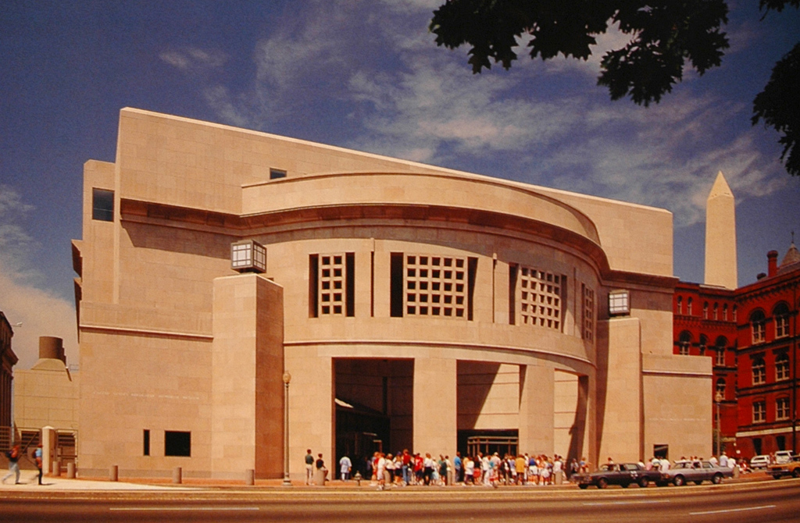
United States Holocaust Memorial Museum, Entrance, Washington, D.C. James Ingo Freed (1930-2005)

Slide 16
